Slide 1
Lecture 5:
Conventional Input Models for Window Managers and Toolkits
Brad Myers
05-830
Advanced User Interface Software

Slide 2
Homework 2
lineThickness of outlineRects and lines
Review of required algorithm

Slide 3

Objects defined by properties
50
50
100
100
200
200
200
200
Object title: | Square
Shape: | square
Corner location: | (100, 50)
Height: | 200
Width: | 200
Color: | red
Object title: | Square
Shape: | square
Corner location: | (100, 50)
Height: | 200
Width: | 200
Color: | red
blue

Slide 4
Displaying Multiple Objects
Object title: | Square 1
Shape: | square
Corner location: | (100, 50)
Height: | 300
Width: | 300
Color: | blue
Object title: | Rectangle 1
Shape: | rectangle
Corner location: | (250, 300)
Height: | 100
Width: | 250
Color: | green
Object title: | Circle 1
Shape: | circle
Center: | (400, 300)
Radius: | 100
Color: | red
Object title: | Circle 2
Shape: | circle
Center: | (600, 400)
Radius: | 100
Color: | orange

Slide 5
Redrawing When Objects Are Moved
Changing attributes of one object may require redraw of others.
Area must be redrawn
1st Boundary Box
Object title: | Square 1
Shape: | square
Corner location: | (100, 50)
Height: | 300
Width: | 300
Color: | blue
Object title: | Rectangle 1
Shape: | rectangle
Corner location: | (250, 300)
Height: | 100
Width: | 250
Color: | green
Object title: | Circle 1
Shape: | circle
Center: | (400, 300)
Radius: | 100
Color: | red
Object title: | Circle 2
Shape: | circle
Center: | (600, 400)
Radius: | 100
Color: | orange
(400, 75)

Slide 6
Redrawing From Back To Front
Redraw operations are required for all affected objects.
Objects redrawn from back
to front to repair “damage”
2nd Boundary Box
This object not redrawn
1st Boundary Box
Object title: | Square 1
Shape: | square
Corner location: | (100, 50)
Height: | 300
Width: | 300
Color: | blue
Object title: | Rectangle 1
Shape: | rectangle
Corner location: | (250, 300)
Height: | 100
Width: | 250
Color: | green
Object title: | Circle 1
Shape: | circle
Center: | (400, 75)
Radius: | 100
Color: | red
Object title: | Circle 2
Shape: | circle
Center: | (600, 400)
Radius: | 100
Color: | orange

Slide 7
Operations Requiring No Redrawing
Some operations may require that no objects be redrawn.
No redraw necessary
Boundary Box
Delete object
DELETE
Object title: | Square 1
Shape: | square
Corner location: | (100, 50)
Height: | 300
Width: | 300
Color: | blue
Object title: | Rectangle 1
Shape: | rectangle
Corner location: | (250, 300)
Height: | 100
Width: | 250
Color: | green
Object title: | Circle 1
Shape: | circle
Center: | (400, 75)
Radius: | 100
Color: | red
Object title: | Circle 2
Shape: | circle
Center: | (600, 400)
Radius: | 100
Color: | orange

Slide 8
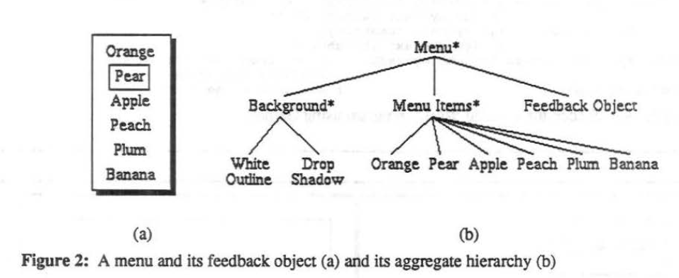
Redraw algorithm
Reference: David S. Kosbie, Brad Vander Zanden, Brad A. Myers, Dario Giuse. "Automatic Graphical Output Management", in Brad A. Myers, editor. The Garnet Compendium: Collected Papers, 1989-1990. Carnegie Mellon University School of Computer Science Technical Report, no. CMU-CS-90-154, August, 1990. pp. 30-43. pdf.
Group Hierarchy
Note coordinate
systems

Slide 9
Multi-pass Refresh algorithm
Keep track of objects whose slots have changed
  Can have “group” keep track by having each graphical object call “damage” on its container group passing in the
  object‘s bounding box
  Groups propagate damage rectangles up to the top
    Careful about coordinates
    Combine damage rectangles
Call “redraw” on top-level
group
  Intersect each component with
  composite damage rectangle
  If intersect, then redraw all
  children, back to front

Slide 10
Input

Slide 11
Quotes
“One of the most complex aspects of Xlib programming is designing the event loop, which must take into account all of the possible events that can occur in a window.”
-- Nye & O'Reilly X Toolkit Intrinsics Programming Manual, vol. 4, 1990, p. 241.
“The dispatching and handling of events is rather complicated.”
-- Galaxy Reference Manual, v1.2, p. 20-5.

Slide 12
How Keyboard and Mouse Events are Handled
Most window manager and toolkits use the same model
Quite old and has problems

Slide 13
First issue: Which Window?
Called “focus”
  Old name: “active” window
Click to Type
Move to Type
Affects what kinds of interactions are possible
  Mac single menubar not possible with move-to-type

Slide 14
Event Records
Structures (records) composed of all information about events
Created by window manager, sent to a queue for each window
X defines 33 different types of events
  Except for selectionRequest, the X/11 “*request” events are only for window managers

Slide 15
X Event Types
visibilityNotify (become covered)
resizeRequest
circulateNotify (stacking order)
configureNotify (resize or move)
destroyNotify (was destroyed)
gravityNotify (moved due to gravity)
mapNotify (became visible)
createNotify
reparentNotify (in diff. window)
unmapNotify (invisible)
circulateRequest
configureRequest
mapRequest
mappingNotify (keyboard mapping)
clientMessage
selectionClear (for cut and paste)
selectionNotify
selectionRequest
buttonPress
keyPress
keyRelease
buttonRelease
motionNotify
enterNotify
leaveNotify
focusIn
focusOut
keymapNotify (change keymap)
Expose
graphicsExpose (source of copy not available)
noExpose (source of copy is available)
colormapNotify
propertyNotify (some property changed)

Slide 16
Windows .Net Events
AutoSizeChanged
BackColorChanged
BackgroundImageChanged
BackgroundImageLayoutChanged
BindingContextChanged
CausesValidationChanged
ChangeUICues
Click
ClientSizeChanged
ContextMenuChanged
ContextMenuStripChanged
ControlAdded
ControlRemoved
CursorChanged
Disposed
DockChanged
DoubleClick
DragDrop
DragEnter
DragLeave
DragOver
EnabledChanged
Enter
FontChanged
ForeColorChanged
GiveFeedback
GotFocus
HandleCreated
HandleDestroyed
HelpRequested
ImeModeChanged
Invalidated
KeyDown
KeyPress
KeyUp
Layout
Leave
LocationChanged
LostFocus
MarginChanged
MouseCaptureChanged
MouseClick
MouseDoubleClick
MouseDown
MouseEnter
MouseHover
MouseLeave
MouseMove
MouseUp
MouseWheel
Move
PaddingChanged
Paint
ParentChanged
PreviewKeyDown
QueryAccessibilityHelp
QueryContinueDrag
RegionChanged
Resize
RightToLeftChanged
SizeChanged
StyleChanged
SystemColorsChanged
TabIndexChanged
TabStopChanged
TextChanged
Validated
Validating
VisibleChanged
Source: http://msdn.microsoft.com/en-us/library/1dk48x94.aspx

Slide 17
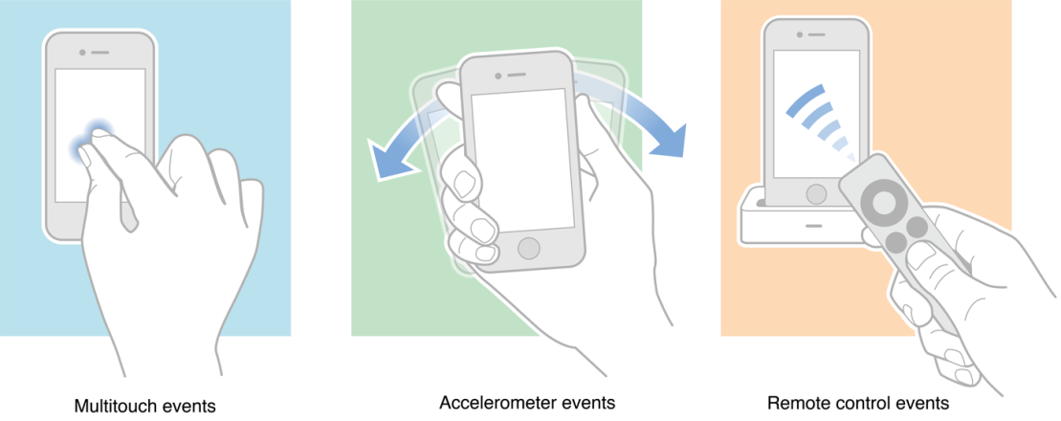
Other events
Java has events for:
  MouseMove vs.
  MouseDrag
  Java event hierarchy starts from java.awt.AWTEvent
    Many special events: PaintEvent, WindowEvent, HierarchyEvent, etc.
  Java event tutorial
Visual Basic has events for:
  Drag
  Drop
  Timer
  MouseWheel
iOS (iPhone): accelerometer; remote controls
HTML/CSS supports Hover
In X, a window specifically declares which events they want to receive using event masks
  Reduces network traffic and unnecessary processing
  Event masks also used for other things in X
    “pointerGrab”
Source: http://developer.apple.com/library/ios/#documentation/EventHandling/Conceptual/EventHandlingiPhoneOS/Introduction/Introduction.html

Slide 18
Event Modifiers
Which “modifier” keys
  Shift, Control, Alt, Function, Command (Mac), Num-Lock
  Various combinations
Can get events when Shift, etc. goes down, but usually ignored
Single click, double-click, triple-click, etc.
  Click vs. Down vs. Drag
Amulet supports string parsing of names:
  “SHIFT_CONTROL_DOUBLE_LEFT_DOWN”

Slide 19
Gestural “Events”
Gestures might come in as if they were regular events
So lower-level code doesn’t need to distinguish
Android has separate “gesture” classes
iOS: Gesture Recognizers
Amulet: added at higher level, as “commands” (see next lecture)

Slide 20
Event Handling
Toolkits (e.g., Visual Basic) automatically handle expose and some other events for the widgets.
Structured graphics systems (e.g., Amulet) automatically handle many of the events.
Events (in X) are C-language union type of many event structures that are all the same size but with different field names.
Key and mouse events contain (at least):
  x position of the mouse
  y position of the mouse
  window of the mouse
  event type
  event code
  event modifiers
  timestamp

Slide 21
Examples
Amulet lowest levels:
  Big switch statement
    gemW_draw.cc (see MainWndProc)
    gemX_input.cc (see Am_Handle_Event_Received)
Issue: new types of events
  E.g, tablet eraser on stylus, proximity
  Gesture, mouse wheel events, like scroll
  New types of devices: e.g., hardware widgets

Slide 22
Waiting for Events
Low-level routine that waits for event wants to be blocking rather than polling for efficiency
  Calls specified routines when events arrive
  Macintosh (used to?) use polling for mouse location
Toolkits provide this internally, e.g.:
  XtAppMainLoop(...)
  Am_Main_Event_Loop() in Amulet
Can specify timeouts so notified after certain time if no events
Can ask X to flush multiple motion events
  If not handled fast enough, get weird lag
  Garnet tries to do extra flushing to avoid this
  Not an issue if polling for motion events
  Problem for polylines, gestures, etc.
Java listeners for events

Slide 23
Architectures
Old: giant switch statement per window
  Branch for each event
  But not dependent on mode, which object, etc.
  “MainEventLoop” in Amulet’s implementation
Global event handlers for each type of event
  No matter where that event happens in the window
  E.g., per Activity in Android
Specific event handlers per object
    Java Swing: button1.addActionListener(this);
    Android: View event listeners (since widgets are views)
    But only works if knows where the objects are
Lots of issues with multiple threading

Slide 24
Propagation
Events sent to the lowest level window containing the pointer.
If event not selected with event-mask, then sent to the container window, etc.
Can't specify individual keys (get all keys and may have to explicitly resend events)
Handlers often will get to say whether they handled the event or not
  Android: onXXXX() handlers return booleans

Slide 25

Issue: Covering
Which objects get an event when overlapping
  “Z” order vs. containment
  What about when top object
  doesn’t want event?
  Can’t necessarily use
  obj.contains(eventX, eventY)
Input mechanism must know
about graphical objects
Bounding box vs. on object
Complexities: http://developer.apple.com/library/ios/#documentation/EventHandling/Conceptual/EventHandlingiPhoneOS/event_delivery_responder_chain/event_delivery_responder_chain.html#//apple_ref/doc/uid/TP40009541-CH4-SW2

Slide 26
Issue: Event Priorities
When already interacting, need to give priority to current interaction
  While dragging, who gets mouse move events?
    Issue: if mouse is moved too fast &
    gets outside of the object
  While text editing
    Current field gets all text events, no
    matter where mouse is
What if leave the window?
  Interacts with Click vs. move to type
  Cross-window drag & drop

Slide 27
Translation Tables
So particular mouse key or keyboard key not hard-wired into application.
  Allows user customization and easier changes
Supported in Motif by the resources mechanism
  e.g. Shift<Btn1Down>: doit()
  can be put in .Xdefaults, and then application deals with doit, and user can change bindings.
Keyboard translation is 2 step process in X:
  Hardware "keycodes" numbers mapped to "keysyms"
  "Keysyms" translated to events
For double-clicking, Motif does translation, but not Xlib
  For non-widgets, have to do it yourself
  Always also get the single click events
  Java – no built-in double click support
    Does have click vs. drag

Slide 28
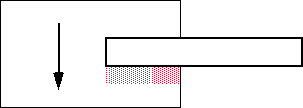
Issue: Scrolling Refresh
Race condition when copy from an area that might be covered
X/11 provides graphicsExpose and noExpose events

