Slide 1
Lecture 4:
Why are User Interfaces Hard to Design and Implement? and
Types of User Interfaces
Brad Myers
05-830
Advanced User Interface Software
Spring, 2017

Slide 2
Who are “Users”?
People who will use a product or web site.
As opposed to the “Designers”
  People who create the system or web site
Designers ≠ Users
You are the designer
Have to make an effort to Know The User

Slide 3
What is the “User Interface”?
Everything the user encounters
  Functionality & Usefulness
  Content
  Labels
  Presentation
  Layout
  Navigation
  Speed of response
  Emotional Impact
  Documentation & Help
Book calls it “User Experience”

Slide 4
What is “Usability”?
= Quality!
Learnability
Efficiency
  Productivity
Memorability
  Little “re-learning” required
Errors
Satisfaction
  Pleasurable

Slide 5
User “Experience” (UX)
Even more than “usability”
  Usability focuses on performance
User Experience
  Emotion, Heritage
  Fun, Style, Art
  Branding, Reputation
  Political, social personal connections
  Beyond just the device itself – “Service Design”
Blends: usability engineering, software engineering, ergonomics, hardware engineering, marketing, graphic design

Slide 6
Why Hard to Design UIs?
“It is easy to make things hard. It is hard to make things easy.”
No silver bullet
Seems easy, common sense, but seldom done right
  Once done right, however, seems “obvious”
User Interface design is a creative process
Designers have difficulty thinking like users
  Often need to understand task domain
  Can’t “unlearn” something

Slide 7
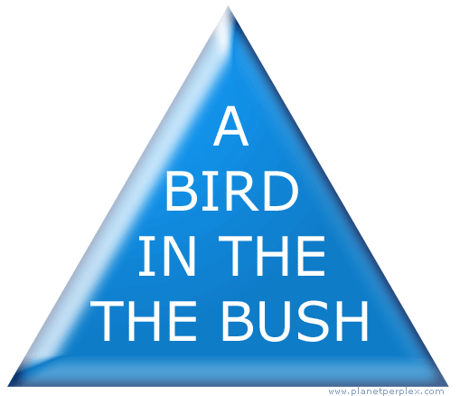
Can’t Unlearn Something

Slide 8
Why Difficult, 2
Specifications are always wrong:
  "Only slightly more than 30% of the code developed in application software development ever gets used as intended by end-users. The reason for this statistic may be a result of developers not understanding what their users need."
    -- Hugh Beyer and Karen Holtzblatt, "Contextual Design: A Customer-Centric Approach to Systems Design,“
    ACM Interactions, Sep+Oct, 1997, iv.5, p. 62.
  Need for prototyping and iteration

Slide 9
Why Difficult, 3
Tasks and domains are complex
  Word 1 (100 commands) vs. Word 2013 (>2000)
  MacDraw 1 vs. Illustrator
  BMW iDrive adjusts over 700 functions
Adding graphics can make worse
  Pretty ≠ Easy to use
Can’t necessarily just copy other designs
  Legal issues
All design/development involves tradeoffs
  Add Features
  Test/Fix Bugs
  Test/Fix usability
  Time-to-market

Slide 10
Why are User Interfaces Difficult to Implement?

Slide 11
What are the most difficult kinds of programs, in general?
What properties make a task difficult to program?

Slide 12
Why Are User Interfaces Hard to Implement?
They are hard to design, requiring iterative implementation
  Not the waterfall model: specify, design, implement, test, deliver
They are reactive and are programmed from the "inside-out"
  Event based programming
  More difficult to modularize
They generally require multi-processing
  To deal with user typing; aborts
  Window refresh
  Window system as a different process
  Multiple input devices

Slide 13
Why Hard to Implement? cont.
There are real-time requirements for handling input events
  Output 60 times a second
  Keep up with mouse tracking
  Video, sound, multi-media
Need for robustness
  No crashing, on any input
  Helpful error messages and recover gracefully
  Aborts
  Undo

Slide 14
Why Hard to Implement? cont.
Lower testability
  Few tools for regression testing
Little language support
  Primitives in computer languages make bad user interfaces
  Enormous, complex libraries
  Features like object-oriented, constraints, multi-processing
Complexity of the tools
  Full bookshelf for documentation of user interface frameworks
  MFC, Java Swing, VB .Net, etc.
Difficulty of Modularization

Slide 15
Examples
Difference between displaying “hello” in console and displaying a blue rectangle in a window
Difficulty to read a file name
  Readln() in Pascal, Java, C++, etc.
  Vs. tool in modern toolkits
    Complexity of the file dialog itself
    You must deal with aborting, undo, etc.

Slide 16
Why Tools?
The quality of the interfaces will be higher. This is because:
  Designs can be rapidly prototyped and implemented, possibly even before the application code is written.
  It is easier to incorporate changes discovered through user testing.
  More effort can be expended on the tool than may be practical on any single user interface since the tool will be used with many different applications.
  Different applications are more likely to have consistent user interfaces if they are created using the same user interface tool.
  A UI tool will make it easier for a variety of specialists to be involved in designing the user interface.

Slide 17
Why Tools, cont.
The user interface code will be easier and more economical to create and maintain. This is because:
  There will be less code to write, because much is supplied by the tools.
  There will be better modularization due to the separation of the user interface component from the application.
  The level of expertise of the interface designers and implementers might be able to be lower, because the tools hide much of the complexities of the underlying system.
  The reliability of the user interface may be higher, since the code for the user interface is created automatically from a higher level specification.
  It may be easier to port an application to different hardware and software environments since the device dependencies are isolated in the user interface tool.

Slide 18
Success of Tools
Today’s tools are highly successful
  Window Managers, Toolkits, Interface Builders ubiquitous
  Most software built using them
  Are based on many years of HCI research
  Brad A. Myers. “A Brief History of Human Computer Interaction Technology.”
  ACM interactions. Vol. 5, no. 2, March, 1998. pp. 44-54.

Slide 19
What should tools do?
Help design the interface given a specification of the tasks.
Help implement the interface given a design.
Help evaluate the interface after it is designed and propose improvements, or at least provide information to allow the designer to evaluate the interface.
Create easy-to-use interfaces.
Allow the designer to rapidly investigate different designs.
Allow non-programmers to design and implement user interfaces.
Provide portability across different machines and devices.
Be easy to use themselves.

Slide 20
Tools might do:
Provide sets of standard UI components
Guide the implementation
Help with screen layout and graphic design.
Validate user inputs
Handle user errors
Handle aborting and undoing of operations
Provide help and prompts
Deal with field scrolling and editing
Insulate the application from all device dependencies and the underlying software and hardware systems.
Support features in the interface that allow the end user to customize the interface.

Slide 21
Types of User Interfaces
User Interface Styles

Slide 22
Input Devices
QUERTY keyboard (other types)
Mouse (1, 2 or 3 buttons)
  Stylus or fingers
    Single touch
    Multi-touch
Other pointing devices:
  Stylus or pucks on tablets or PDAs
    Issue: buttons, stability, etc.
  "Light pens" on screens
  DataGloves, eye tracking, etc.
  “Bat" 3-D input device
Speech input
Other sensors
  Tilt, accelerometer, compass, etc.
Computer-connected camera
  presence
  free-space gestures
  eye-tracking

Slide 23
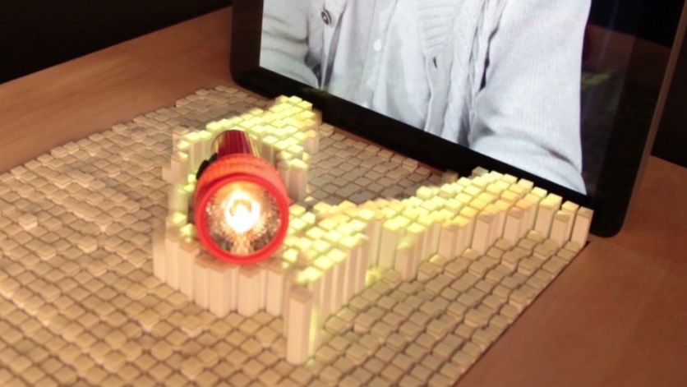
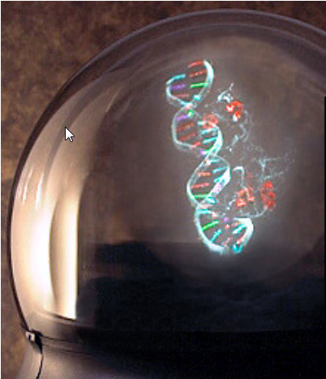
Output Devices
Older:
  TTY on paper
  24x80 terminals: "glass-TTY"
  Vector screens
Raster-scan screens
  Color, monochrome
LCD panels
Tiny (watch), phone-size, tablet-size, "normal size" Wall-size
3-D devices
  Head-mounted displays (VR systems)
  Stereo
  "Real" 3-D
Speech output
Non-speech audio

Slide 24
Application Types
Each has own unique UI style, and implementation challenges
Word processors
Drawing programs
  CAD/CAM
Painting programs
Hierarchy displays, like file browsers
Mail readers
Spreadsheets
Forms processing
WWW
Interactive games
Visualizations
Automated-teller machines (ATM)
Virtual Reality
Multi-media
  Video
  Animation
Controlling machinery

Slide 25
Metaphors
Content metaphors
  desktop
  paper document
  notebook with tabs
  score sheet , stage with actors (Director)
  accounting ledger (spreadsheet)
  stereo (for all media players)
  phone keypad
  calculator
  Web: "Shopping Carts"
  Quicken: "CheckBook"
Interaction metaphors = tools, agents: "electronic secretary“

Slide 26
User Interface Styles
(from Nielsen text, 1993)
A method for getting information from the user or interfacing with a user.
Usually, interfaces provide more than one style:
  Command language for experts with menus for novices
  Menus plus single characters (Macintosh & Windows)
Appropriate style depends on type of user and task.
Important issues:
  Who has control?
  Ease of use for novices.
  Learning time to become proficient
  Speed of use (efficiency) once become proficient.
  Generality/Flexibility/Power (how much of user interface with this technique cover?)
  Ability to show defaults, current values, etc.
  Skill requirements required (e.g., typing)

Slide 27
1) Question and Answer
(Nielsen describes 1, 2 & 3 as "line-oriented”)
Computer asks questions, user answers.
Used by some simple programs, and also expert systems.
"Wizards" in Microsoft products
Telephone interfaces ("press 1 for sales, 2 for support, ...")
Pros and cons:
  + Easy to implement (writeln, readln)
  + Easy for novices
  - Can't correct previous errors, or to change your mind.
    Except in Wizards, often have a "Previous" button
  - Can be slower for experts

Slide 28
2) Single character commands and/or function keys:
Function keys can be labeled.
Pros and cons:
  + Fastest method for experts.
  + Easy to learn how.
    + so easier to provide telephone support ("just hit the F1 key now")
  + Usually very simple to implement.
  - Hardest to remember which key does what.
  - Easy to hit wrong key by mistake

Slide 29
3) Command Language:
User types instructions to computer in a formal language.
  Unix, DOS shell
  Google input field
Pros and cons:
  + Most flexible.
  + Supports user initiative.
  + Fast for experts.
  + Possible to provide programming language capabilities for macros, customization, etc.
  + Takes less space on screen
  - Hardest for novices.
  - Requires substantial training and memorization.
  - Error rates usually high.
  - Syntax is usually very strict.
  - Poor error handling.
  - Hard for user to tell what can do.
Implementation difficulty depends on availability of tools like LEX & YACC, and the complexity of the language.
Related form is programming language extensions, such as in Lisp.

Slide 30
4) Menus:
Pros and cons:
  + Very little training needed
  + Shows available options
  + Allows use of recognition memory (easier than generation)
  + Hierarchy can expand selection
  + Default or current selection can be shown.
  + Ability to show when parts are not relevant (e.g., greyed out)
  + Can be used for commands and arguments
  + Reduces keystrokes (compared to command languages)
  + Clear structure to decision making.
  - Usable only if there are few choices
  - Slow for experienced users (need accelerators)
  - If big hierarchy, commands can be hard to find
  - Uses screen space
Most effective with pointing device.

Slide 31
5) Form Filling
Like menus except have text/number fields that can be filled in.
Often used on character terminals (e.g., for data entry).
Macintosh and Windows Dialog Boxes are another example.
Pros and cons: (Similar to menus)
  + Simplifies data entry.
  + Very little training needed
  + Shows available options
  + Allows use of recognition memory (easier than generation)
  + Ability to show defaults and current values.
  + Ability to show when parts are not relevant (e.g., greyed out)
  - Consumes screen space.
  - Expensive to internationalize.
Most effective with pointing device.
Apparently, most user interfaces are of this form
Specialty of Visual Basic

Slide 32
6) Direct Manipulation
WIMP (Windows, Icons, Menus, Pointing Device) Interfaces include 6 and 7
  Graphical user interface – GUI
Definition:
  Visual Model of the world
  Visual objects that can be operated on
  Results of actions are reflected in the objects immediately.
  Objects, once operated on, can be further operated on.
Term coined by Ben Shneiderman
Original system: Sketchpad from 1962
"Object-oriented" from user's point of view
  As opposed to "function-oriented"
  Usually select object, then give command
  Hollan argues this user feel more important to DM than Shneiderman's methods

Slide 33
Direct Manipulation, cont.
Pros and cons:
  + User initiated
  + Easy to learn, intuitive, analogical
  + Fast to use for object that are on the display
  + Easily augmented with menus and forms
  + Provides closure of actions and gesture.
  + Errors can be avoided.
  + High subjective satisfaction (fun).
  - Can be inconvenient and slow if user knows the name of an undisplayed object, but must find it anyway.
  - Limited power; not all desired actions have a DM analog.
  - Difficult to provide macros, other user extensible/customizable features.
  - Difficult to implement

Slide 34
7) WYSIWYG:
"What you see is what you get".
Like direct manipulation, but more so.
Pros and cons: (Similar to direct manipulation)
  + Can always tell what final result will be.
  - Screen image may be hard to read/interpret, especially if screen resolution is too low.
  - Cannot show hidden structure (how the picture was made).
  - May be very slow at run-time (e.g., page breaks)
  - Extremely difficult to implement.
  - WYSIATI: What You See Is All There Is - lack of structure; no ability to show structure

Slide 35
Next generation
"Non-Command" or "Next-generation" or “Post-WIMP” Interfaces
“Recognition-Based” interfaces
Microsoft: “Natural User Interfaces” (NUI)
  (Mainly Kinect, speech input)
"Natural" actions invoke computer response.
Issues: mis-interpretation, feedback

Slide 36
8) Gestures:
Like user would mark on paper.
Pros and cons:
  + Can be very natural to learn.
  + Often faster to execute than other techniques.
  + Give command and parameters together
  - Many gestures are hard to do with a mouse.
  - Users must memorize gestures.
  - No "affordances“

Slide 37
9) Natural Language
E.g., a subset of normal English.
Includes speech
Pros and cons:
  + Theoretically easiest for learning.
  + Speaking is the fastest output technique.
  - Rather slow for typing
  - Requires clarification dialog.
  - Unpredictable.
  - General systems are impossible with today's technology.
Research with Bernhard Suhn showing that if factor in correction times, speech input may be slower and less natural than typing, etc.

