Slide 1
05-830
Advanced User Interface Software
Brad Myers
Human Computer Interaction Institute
Spring, 2017

Slide 2
Course:
Course web page:
  http://www.cs.cmu.edu/~bam/uicourse/830spring17
Schedule:
http://www.cs.cmu.edu/~bam/uicourse/830spring17/schedule.html
Tuesdays and Thursdays
1:30pm to 2:50pm
Room: GHC 4301
Last offered 2013
  See previous schedule, homeworks, etc.
  http://www.cs.cmu.edu/~bam/uicourse/830spring13

Slide 3

Instructor
Brad Myers
  Human Computer Interaction Institute
  Office: Newell-Simon Hall (NSH) 3517
  Phone: x8-5150
  E-mail: bam@cs.cmu.edu
  http://www.cs.cmu.edu/~bam
  Office hours: By appointment or drop by
Secretary: Ebony Dickey
  NSH 3526
  412-268-8204
No TA

Slide 4
Readings and Homeworks
Schedule of readings:
http://www.cs.cmu.edu/~bam/uicourse/830spring17/schedule.html
  Course schedule is tentative
  Note required readings
  Student-presented material at end
  CMU-only, use CMU network or VPN
Homeworks
http://www.cs.cmu.edu/~bam/uicourse/830spring17/homeworks.html
  No midterm or final
  Create a framework for UI software in Java for Swing
  Like Amulet / Garnet / SubArctic / Flash / Flex
  No project
  Harder in the middle

Slide 5
What is this class about?
“User Interface Software”
  All the software that implements the user interface
  “User Interface” = The part of an application that a person (user) can see or interact with (look + feel)
  Often distinguished from the “functionality” (back-end) implementation
  “Implements” – course will cover how to code a design once you already have the design
    Not covering the design process or UI evaluations
      (Except that we will cover design & prototyping tools, & eval. of tools)
User Interface Software Tools
  Ways to help programmers create user interface software

Slide 6
Examples of UI Software Tools
Names
  Toolkits, Development Kits, SDKs, APIs, Libraries, Interface Builders, Prototypers, Frameworks, UIMS, UIDE, …
See a list: http://goo.gl/bv3JK -- we will update this list!
APIs for UI development:
  Microsoft Foundation Classes, .Net, wx-Python
  Java AWT, Swing, Android UI classes
  Apple Cocoa, Carbon
  Eclipse SWT
Interactive tools
  Visual Basic .Net
  Adobe Flash Professional, Adobe Catalyst, Prototypes like Axure, Balsamiq
Programming Languages focused on UI development
  JavaScript, php language, html, …
  Adobe’s ActionScript (for Flash)
2-D and 3-D graphics models for UIs
Research systems:
  Garnet
  Amulet
  subArctic
  ConstraintJS
Web UI frameworks
Service-Oriented Architecture (SOA) and other component frameworks

Slide 7
What Will We Cover?
History of User Interface Software Tools
  What has been tried
  What worked and didn’t
  Where the currently-popular techniques came from
Future of UI Software Tools
  What is being investigated?
  What are the current approaches
  What are the challenges
How to evaluate tools
  Good or bad

Slide 8
Homework 1
http://www.cs.cmu.edu/~bam/uicourse/830spring17/homework_1.html
Assign tools to students
  Spreadsheet with random order
Evaluate using HE, Cognitive Dimensions, or user testing
Short presentations in class
  Submit slides as PDFs in advance, so I can put them together on my machine

Slide 9
Important Schedule Note
Change date of class on Tuesday, Jan. 31, 2017 ?
    2nd day for presentations of homework 1
  Thursday, Jan 26, 3-4:30 (double length class?)
  Friday, Jan 27 at 9-10:30 or 9:30-11?
  Wednesday, Feb. 1 anytime except 12-1?

Slide 10
Lecture 1:
Evaluating Tools
Brad Myers

Slide 11
How Can UI Tools be Evaluated?
Same as any other software
Software Engineering Quality Metrics
  Power (expressiveness, extensibility and evolvability), Performance (speed, memory), Robustness, Complexity, Defects (bugginess), …
Same as other GUIs
  Tool users (programmers) are people too
    Effectiveness
    Errors
    Satisfaction
    Learnability
    Memorability
    …

Slide 12
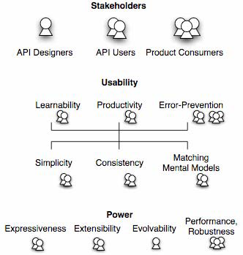
Stakeholders
Who cares about UI Tools’
quality?
Tool Designers
Tool Users (programmers)
Users of Products create
with the tools = consumers
Source: Jeffrey Stylos and Brad Myers, "Mapping the Space of API Design Decisions," 2007 IEEE Symposium on Visual Languages and Human-Centric Computing, VL/HCC'07. Sept 23-27, 2007, Coeur d'Alene, Idaho. pp. 50-57. pdf

Slide 13
API Design Decisions
(Stylos, 2007)

Slide 14
API Design Decisions, cont.

Slide 15
Who Are Developers?
Programming tools are not just used by highly-trained professional programmers
End-User Programmers = People whose primary job is not programming
In 2012 in USA at work: — [Scaffidi, Shaw and Myers 2005]
  3 million professional programmers
  6 million scientists & engineers
  13 million will describe themselves as programmers
  55 million will use spreadsheets or databases at work
  90 million computer users at work in US

Slide 16
UI Evaluation of UI Software Tools:
Some Usability Methods
Heuristic Evaluation
Cognitive Dimensions
Think-aloud user studies
Personas
Contextual Inquiry
Contextual Design
Paper prototypes
Cognitive Walkthrough
KLM and GOMS
Task analysis
Questionnaires
Surveys
Interaction Relabeling
Focus groups
Video prototyping
Wizard of Oz
Body storming
Affinity diagrams
Expert interviews
Card sorting
Diary studies
Improvisation
Use cases
Scenarios
Log analysis
…

Slide 17
Dangers of Not Applying Human Centered Approaches
Tools may prove to be not useful
  Useful = solves an important problem
    Happens frequently
    Difficult to solve otherwise
    Developers believe academic tools solve unimportant problems [How do practitioners perceive Software Engineering Research? http://catenary.wordpress.com/2011/05/19/how-dopractitioners-perceive-software-engineering-research/]
  Tools may not actually solve the problem
    Example: a study suggested that Tarantula tool identifying potentially faulty statements for debugging was not helpful
      Changed the task, but telling if the identified statement was actually faulty not easier than finding the bug
      Parnin, C. and Orso, A. 2011. Are Automated Debugging Techniques Actually Helping Developers International Symposium on Software Testing and Analyisis (2011), 199–209.
}
HCI questions

Slide 18
Dangers of Not Applying
Human Centered Approaches
Tools may show no measurable impact
  Desired advantage overwhelmed by problems with other parts
  Example: Emerson Murphy-Hill found that refactoring tools are under-utilized and programmers do not configure them due to usability issues
    Emerson Murphy-Hill, Chris Parnin, Andrew P. Black. How we refactor, and how we know it. In ICSE '09: Proceedings of the 2009 IEEE 31st International Conference on Software Engineering (2009), pp. 287-297.

Slide 19
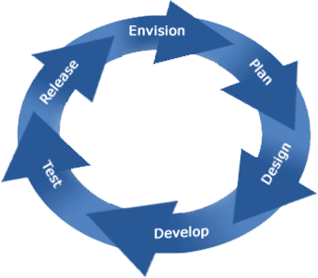
Product Lifecycle
Exploratory Studies
  Contextual Inquiries
  Surveys
  Lab Studies
  Corpus data mining
Field Studies
  Logs & error reports
Evaluative Studies
  Expert analyses
  Usability Evaluation
  Formal Lab studies
Design Practices
  “Natural programming”
  Graphic & Interaction Design
  Prototyping

Slide 20
Design and Development
Use CIs, other field studies and surveys to find problems to solve
  Ko, A.J., Myers, B.A., and Aung, H.H. “Six Learning Barriers in End-User Programming Systems,” in IEEE VL/HCC’2004. pp. 199-206.
  Ko, A.J. and DeLine, R. “A Field Study of Information Needs in Collocated Software Development Teams,” in ICSE'2007.
  Thomas D. LaToza and Brad Myers. "Developers Ask Reachability Questions", ICSE'2010: 32nd International Conference on Software Engineering, Cape Town, South Africa, 2-8 May 2010. pp. 185-194. pdf
  Also surveys, etc.: Myers, B., Park, S.Y., Nakano, Y., Mueller, G., and Ko, A. “How Designers Design and Program Interactive Behaviors,” in IEEE VL/HCC‘2008. pp. 185-188.
Iterative design and usability testing of versions
  E.g., in the development of Alice
  E.g., paper prototypes for LaToza’s Reacher
Summative testing at end

Slide 21


Evaluation Methods
Does my tool work?
Does it solve the developer’s problems?
“If the user can’t use it, it doesn’t work!”
  ̶̶ Susan Dray

Slide 22
Expert Analyses
Usability experts evaluating designs to look for problems
  Heuristic Analysis – [Nielsen] set of guidelines
  Cognitive Dimensions – [Green] another set
  Cognitive Walkthroughs – evaluate a task
Can be inexpensive and quick
However, experienced evaluators are better
  22% vs. 41% vs. 60% of errors found [Nielsen]
Disadvantage: “just” opinions, open to arguments

Slide 23
Heuristic Evaluation Method
Named by Jakob Nielsen
Expert evaluates the user interface using guidelines
“Discount” usability engineering method
  One case study found factor of 48 in cost/benefit:
    Cost of inspection: $10,500. Benefit: $500,000 (Nielsen, 1994)

Slide 24
10 Basic Principles
From Nielsen’s web page: http://www.useit.com/papers/heuristic/heuristic_list.html
Visibility of system status
Match between system and the real world
User control and freedom
Consistency and standards
Error prevention
Recognition rather than recall
Flexibility and efficiency of use
Aesthetic and minimalist design
Help users recognize, diagnose, and recover from errors
Help and Documentation
Slightly different from list in Nielsen’s text

Slide 25
Cognitive Dimensions
12 different dimensions (or factors) that individually and collectively have an impact on the way that developers work with an API and on the way that developers expect the API to work. (from Clarke’04)
  Abstraction level. The minimum and maximum levels of abstraction exposed by the API
  Learning style. The learning requirements posed by the API, and the learning styles available to a targeted developer.
  Working framework. The size of the conceptual chunk (developer working set) needed to work effectively.
  Work-step unit. How much of a programming task must/can be completed in a single step.
  Progressive evaluation. To what extent partially completed code can be executed to obtain feedback on code behavior.
  Premature commitment. The amount of decisions that developers have to make when writing code for a given scenario and the consequences of those decisions.
  Penetrability. How the API facilitates exploration, analysis, and understanding of its components, and how targeted developers go about retrieving what is needed.
  Elaboration. The extent to which the API must be adapted to meet the needs of targeted developers.
  Viscosity. The barriers to change inherent in the API, and how much effort a targeted developer needs to expend to make a change.
  Consistency. How much of the rest of an API can be inferred once part of it is learned.
  Role expressiveness. How apparent the relationship is between each component exposed by an API and the program as a whole.
  Domain correspondence. How clearly the API components map to the domain and any special tricks that the developer needs to be aware of to accomplish some functionality.

Slide 26

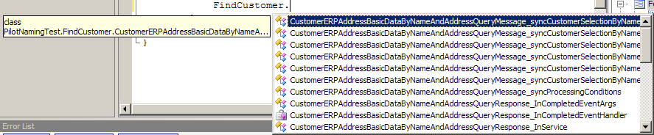
Our Use of Expert
Analyses
Study APIs for Enterprise Service-Oriented Architectures - eSOA (“Web Services”)
  Cite: Jack Beaton, Sae Young Jeong, Yingyu Xie, Jeffrey Stylos, Brad A. Myers. "Usability Challenges for Enterprise Service-Oriented Architecture APIs,“ VL/HCC'08. Sept 15-18, 2008, Herrsching am Ammersee, Germany. pp. 193-196.
HEs and Usability Evaluations
Naming problems:
  Too long
  Not understandable
  Differences in middle are frequently missed
CustomerAddressBasicDataByNameAndAddressRequestMessageCustomerSelectionCommonName
CustomerAddressBasicDataByNameAndAddressResponseMessageCustomerSelectionCommonName

Slide 27
SAP’s NetWeaver®
Gateway Developer Tools
Plug-in to Visual Studio 2010 for developing SAP applications
We used the HCI methods of heuristic evaluation and cognitive walkthroughs to evaluate early prototypes
Our recommendations were quickly incorporated due to agile software development process
Andrew Faulring, Brad A. Myers,Yaad Oren, Keren Rotenberg. "A Case Study of Using HCI Methods to Improve Tools for Programmers," Cooperative and Human Aspects of Software Engineering (CHASE), An ICSE 2012 Workshop. Zurich, Switzerland, June 2, 2012. pp. 37-39. pdf

Slide 28
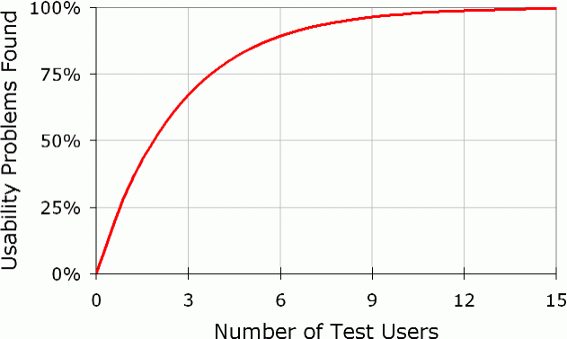
Usability Evaluations with users
Different from formal A vs. B “user studies”
  Understand usability issues
  Should be done early and often
    Doesn’t have to be “finished” to let people try it
“Think aloud” protocols
  “Single most valuable usability engineering method”
  -- [Nielsen]
  Users verbalize what they
  are thinking
    Motivations, why doing things,
    what confused about
  Don’t need many users
Notes:
More on WHY
Especially when doesn’t go the direction you want.

Slide 29
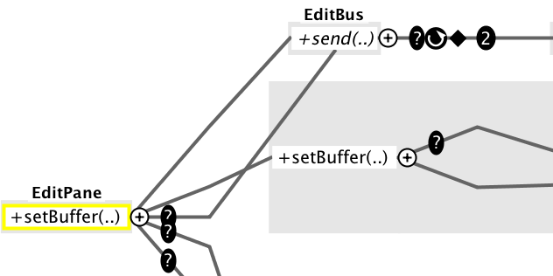
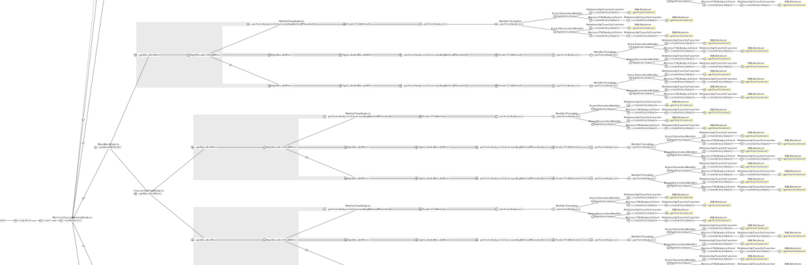
Example of Our Use
Thomas LaToza’s Reacher tool for Reachability Questions went through multiple iterations
  Revised based on paper prototype (discussed already)
  Revised based on 1st evaluation of full system
    E.g., replaced duplicates of calls to methods with pointers
    Changed to preserve order of outgoing edges
    Redesign of icons, interactions
→

Slide 30
Why Usability Analysis
Improve the user interface prior to:
  Deployment
  A vs. B testing (as a “pilot” test)
Demonstrate that users can use the system
  Show that novel features of the UI are understandable

Slide 31
Formal A vs. B “User Studies”
Formal A vs. B lab user studies are “gold standard” for academic papers – to show something is better
But many issues in the study design
Issues:
  Vast differences in programmer productivity
    10X often cited (cites: Sackman, 1968, Curtis 1981, Mills 1983, DeMarco and Lister 1985, Curtis et al. 1986, Card 1987, Boehm and Papaccio 1988, Valett and McGarry 1989, Boehm et al 2000)
  Difficulty of controlling for prior knowledge
  Usually really care about expert performance, which is difficult to measure in a user test
  “Confounding” factors which were not controlled and are not relevant to study, but affect results
  Tasks or instructions are mis-understood
    Use prototypes & pilot studies to find these
Statistical significance doesn’t mean real savings
Be sure to collect qualitative data too
  Strategies people are using
  Why users did it that way
  Especially when unexpected results

Slide 32
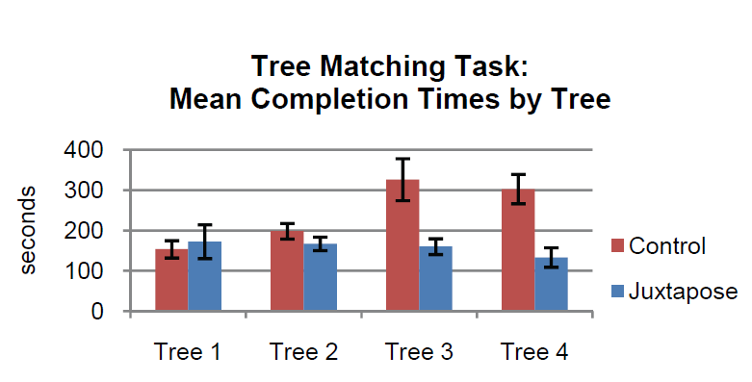
Examples of UI Tests
Many tool papers have user tests
  Especially at CHI conference
    E.g.: Ellis, J. B., Wahid, S., Danis, C., and Kellogg, W. A. 2007. Task and social visualization in software development: evaluation of a prototype. CHI '07. http://doi.acm.org/10.1145/1240624.1240716
      8 participants, 3 tasks, within subjects: Bugzilla vs. SHO, observational
  Backlash? at UIST conference
    Olsen, 2007: “Evaluating user interface systems research”
    But: Hartmann, Björn,Loren Yu, Abel Allison, Yeonsoo Yang, and Scott Klemmer. "Design As Exploration: Creating Interface Alternatives through Parallel Authoring and Runtime Tuning“, UIST 2008 Full Paper –
    Best Student Paper Award
      18 participants, within subjects,
      full interface vs. features removed,
      “(one-tailed, paired Student’s
      t-test; p < 0.01)”

Slide 33
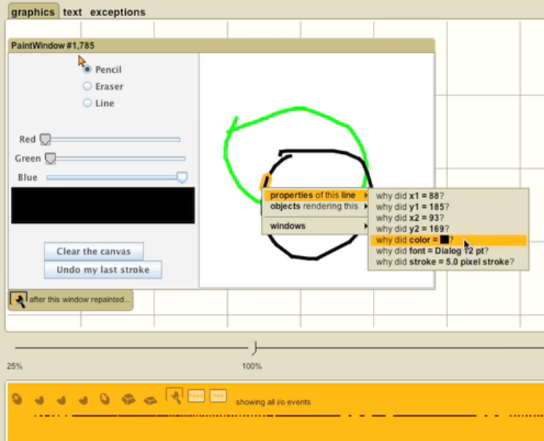
Our use of A vs. B Study: Whyline
PhD work of Andy Ko
Allow users to directly ask “Why” and “Why not”

Slide 34
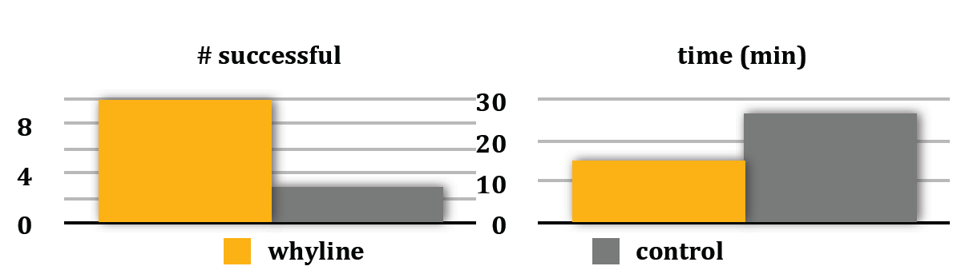
Whyline User Studies
Initial study:
  Whyline with novices outperformed experts with Eclipse
  Factor of 2.5 times faster
Formal study:
  Compared to Whyline with key features removed (rather than Eclipse)
  Tasks: 2 real bug reports from real open source system (ArgoUML)
  Whyline was over 3 times as successful, in ½ of the time

Slide 35
Steven Clarke’s “Personas”
Classified types of programmers he felt were relevant to UI tests of Microsoft products (Clarke, 2004) (Stylos & Clarke 2007)
Capture different work styles, not experience or proficiency
Systematic - work from the top down, attempting to understand the system as a whole before focusing on an individual component. Program defensively, making few assumptions about code or APIs and mistrusting even the guarantees an API makes, preferring to do additional testing in their own environment. Prefer full control, as in C, C++
Opportunistic - work from the bottom up on their current task and do not want to worry about the low-level details. Want to get their code working and quickly as possible without having to understand any more of the underlying APIs than they have to. They are the most common persona and prefer simple and easy to use languages that offer high levels of productivity at the expense of control, such as Visual Basic.
Pragmatic - less defensive and learn as they go, starting working from the bottom up with a specific task. However when this approach fails they revert to the top-down approach used by systematic programmers. Willing to trade off control for simplicity but prefer to be aware of and in control of this trade off. Prefer Java and C#.

Slide 36
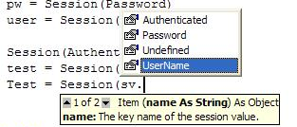
Usability Evaluations of APIs
PhD work of Jeff Stylos (extending Steven Clarke’s work)
Which programming patterns are most usable?
  Default constructors
  Factory pattern
  Object design
  E-SOA APIs
Measures: learnability, errors, preferences
Expert and novice programmers
Fix by:
  Changing APIs
  Changing documentation
  Better tools in IDEs
    E.g., use of Code completion
    (“IntelliSence”) for exploration

Slide 37
“Factory” Pattern
(Ellis, Stylos, Myers 2007)
Instead of “normal” creation: Widget w = new Widget();
Objects must be created by another class:
AbstractFactory f = AbstractFactory.getDefault();
Widget w = f.createWidget();
Used frequently in Java (>61) and .Net (>13) and SAP
Lab study with expert Java programmers
  Five programming and debugging tasks
  Within subject and between subject measures
Results:
  When asked to design on “blank paper”, no one designed a factory
  Time to develop using factories took 2.1 to 5.3 times longer compared to regular constructors (20:05 v 9:31, 7:10 v 1:20)
  All subjects had difficulties getting using factories in APIs
Implications: avoid the factory pattern!

Slide 38
Object Method Placement
(Stylos & Myers, 2008)
Where to put functions when doing object-oriented design of APIs
  mail_Server.send( mail_Message )
  vs.
  mail_Message.send( mail_Server )
When desired method is on the class that they start with, users were between 2.4 and 11.2 times faster (p < 0.05)
Starting class can be predicted based on user’s tasks

Slide 39
Examples from HASD
05-899D: Human Aspects of Software Development (HASD), Spring 2011
  http://www.cs.cmu.edu/~bam/uicourse/2011hasd/
CI, then tool, then usability evaluations
Comprehensive reading list:
https://docs.google.com/document/pub?id=1jHrF42YuL7Vy8YArJ48NU8bLCN1jJqXSWvHWTQwoAfg
  See especially:
    2.1.2 Conducting HCI studies
    2.2 Research Methods for Studies of Developers

Slide 40
Summary
CIs and Iterative Design to help design and develop better tools
User testing is still the “gold standard” for user interface tools
HE and CD are useful for evaluations

