Slide 1
Lecture 8:
Overview of UI Software and Tools
Brad Myers
05-830
Advanced User Interface Software

Slide 2

Happy Valentine’s Day

Slide 3
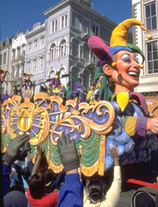
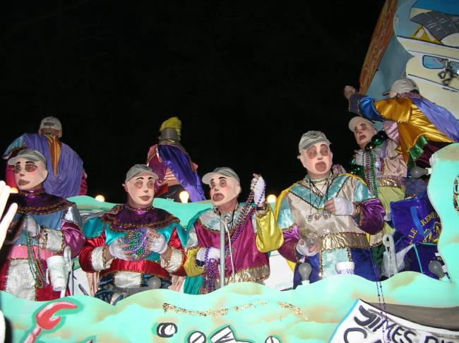
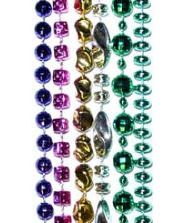
Happy Mardi Gras!
(last Tuesday!)

Slide 4
Layers of UI Software
Application
Higher Level Tools
Toolkit
Windowing System
Operating System

Slide 5
Highly Successful
Today’s tools are highly successful
  Window Managers, Toolkits, Interface Builders ubiquitous
  Most software built using them
  Are based on HCI research

Slide 6
Historical Perspective
Themes
  Address the useful & important aspects of UIs
    Tools that succeeded helped (just) where needed
  Threshold / Ceiling
    Threshold = How hard to get started
    Ceiling = how much can be achieved
  Path of Least Resistance
    Tools influence user interfaces created
  Predictability
    If not predictable, then not accepted by programmers
  Moving Targets
    Changing user interface styles makes tools obsolete

Slide 7
What Worked
Window Managers and Toolkits
Event Languages
Graphical, Interactive Tools
Component Architectures
Scripting Languages
Hypertext
Object Oriented Programming
Constraints

Slide 8
Windows
Manages and controls multiple contexts by separating them into different physical parts of the screen.
Can be part of a program (Smalltalk), part of operating system (Windows), or a separate program (X)
"Window System" – old X/11 terminology
  Programming interface
  Provides output graphics operations to draw clipped to a window = Output Model
  Channels input from mouse and keyboard to appropriate window = Input Model

Slide 9
Windows, cont.
"Window Manager"
  User interface to windows themselves
  Decorations on windows
  Mouse and keyboard commands to control windows.

Slide 10
Windows, cont.
Many systems combine WS+WM
  Macintosh, Windows, iPhone
Others allow different WM on same WS
  X, NeWS
  Allows diversity and user preference
Different WS on same hardware
  SunTools, X, NeWS on Suns
  Windows, MacOS on Macs
  Hack Linux onto many platforms (iPod)

Slide 11
Window &
Graphics
Structure

Slide 12
Windows System: Output Model
Graphics commands that the programs can use
All usually go through window manager so clipped
  Usually can only draw what WS provides
Examples: Win32 API, Mac “Quickdraw”
Older systems (SunTools, etc.) simple primitives
  Draw Rectangles, text
  "BitBlt" or "RasterOp":
    Move a rectangle of the screen (memory)
  + Easier to implement
Newer (Macintosh, X, etc.) more sophisticated
  Filled polygons, splines, colors, clipping
  + Prettier images and easier for application

Slide 13
Postscript
Language invented by Adobe for sending pages to printers
Is a complete, textual programming language
Provides:
  arbitrary rotation and scaling (even fonts)
  Complete hardware independence (coordinates are floats)
Used as an output model for some Window systems
  NeWS, Display Postscript: NeXT, DEC, etc.
Java 2D model based on this, with similar features

Slide 14
Other old graphics standards
CORE (~1977), GKS (1985)
PHIGS (1988) -- PEX (1991): PHIGS + 3-D for X
Don't support "modern" graphical interfaces

Slide 15
Window System: Input Model
How input from user is handled.
  Most only support keyboard and mouse
All systems use same model:
  Events generated and passed to applications
Record (struct) containing type, (x,y) of mouse, time, etc.
Asynchronously sent
  For key down/up, mouse button down/up, cursor enter/leave window, window refresh.
Problems:
  Application must be almost always willing to accept events.
  Race conditions, since asynchronous
  Not device independent
  No abort

Slide 16
Window System: Communication
Window system often protected process
  So bad application won't kill whole machine
  (Isn't on MacOS to 9, PalmOS, and regular MS Windows 95,98,ME)
  Is on Unix, MacOS since 10 …, Windows since NT
How do applications communicate with window system?
  Special system calls
  Kernel, OS calls
    SunTools, Macintosh, PalmOS
  Network protocol
    Send messages to the process
    X, NeWS
    + Processes can display on remote machines.
    + Different programming languages
    - Less efficient

Slide 17
Window Manager: Window Layouts
How the windows are arranged
Tiled vs. Overlapping
  Whether windows can be on top of each other
  Don't see tiled much any more:
  Cedar, MS Windows 1.
  Overlapping was first, current
    Smalltalk (1976)
    X
Multiple (tiled) windows in research systems of 1960’s: NLS, etc.
Overlapping introduced in Alan Kay’s thesis (1969)
Smalltalk, 1974 at Xerox PARC

Slide 18
Window Manager: Window Decorations
Decorations:
  Window borders, titles
  Icons
  Screen background

Slide 19
Window Manager: Commands
How the user can control the windows.
Mouse and keyboard commands
Menus, buttons, etc.
  Sometimes use a toolkit
Listener or Focus ( “active” window)
  Only one keyboard and mouse
  How decide which window (process) to give it to?

Slide 20
Window Managers
Successful because multiple windows help users manage scarce resources:
  Screen space and input devices
  Attention of users
  Affordances for reminding and finding other work

Slide 21
Toolkits
A library of interaction techniques that can be called by application programs.
An interaction technique is a graphical object which can be manipulated using a physical input device to input a certain type of value.
  Also called “widget” or “control”
Toolkits contain procedures to do menus, scroll bars, buttons, dialog boxes.
Used only by programmers, only procedural interface
Examples:
  Macintosh Toolbox
  Windows Toolkit
  xtk for X (Motif and OpenLook)
  Interviews for C++ and X
  NeXTStep for NeXT
  tk part of tcl/tk
  Amulet
  Java Swing and awt and swt

Slide 22
Toolkits, cont.
Important
  Consistent Look and Feel
  Re-use of code
Can be hard to use:
  Very large libraries
  Very large manuals
  No help with when and how to call what
Two layers:
  Intrinsics:
    How the widgets are implemented
  Widget set:
    Particular "look and feel“

Slide 23
Toolkits, Intrinsics
Procedure-oriented:
  Library of procedures that can be called
  Macintosh Toolbox, SunTools library
  + Simple to implement
Object-oriented
  Library defines standard classes
  Programmer can make sub-classes
  Need an OO language
  Xtk, Interviews, Garnet, Java AWT and Swing
  + Natural way to think about organization: widgets on screen "seem" like objects
  + Easier to make customizations
  - Requires special (single) programming language

Slide 24
Toolkits, Widget Sets
Collections of interaction techniques with a particular look-and-feel
Can be copyrighted, patented

Slide 25
Toolkits, Widget Sets, cont.
Different look-and-feels on same intrinsics
The same look-and-feel can be implemented on different intrinsics
awt | Swing | swt
Java graphics 2D
Windows L&F
Windows
Windows L&F
Java Swing

Slide 26
Toolkits, Widgets Sets, cont.
Interface to applications: usually “call-back procedures”
  Application supplied
  Widget calls
  Listeners used in Swing are similar
  Problems
    - can be hundreds or thousands,
    - hard to deal with Undo, etc.
    - modularization compromised
Amulet uses command objects instead

Slide 27
Virtual Toolkits
Other name: Cross-Platform Development Tools
Thin layer above existing toolkits that hides the toolkit dependencies.
Allows applications to be more easily ported to different toolkits
As opposed to a toolkit that runs on different environments
Problems:
  Toolkit-specific style features
  Drawing routines must also be provided
Examples:
  XVT (eXtensible Virtual Toolkit), supported Motif, OpenLook, Windows, PM, Macintosh, and character displays
  Galaxy (from Visix Corp). Re-implemented the widgets
Today: Java:
  AWT, SWT: use native widgets
  Swing: re-implements the widgets
Qt, PhoneGap

Slide 28
Toolkits Success
Help maintain consistency among UIs
  Key insight of Macintosh toolbox
Path of least resistance translates into getting programmers to do the right thing
Successful partially because address common, low-level features for all UIs
  Address the useful & important aspects of UIs

Slide 29
Event Languages
Create programs by writing event handlers
Many old tools used this style
  Univ. of Alberta (1985), Sassafras (1986), HyperCard, etc.
Used by Visual Basic, Lingo, Java, etc.
  Toolkits with call-backs or action methods
Advantages:
  Natural for GUIs since generate discrete events
  Flow of control in user’s hands rather than programmer’s
    Discourages moded UIs

Slide 30
Constraints
Declare a relationship and system maintains it
Sketchpad (1963), ThingLab (1979), Higgens (85), Garnet (1990), Amulet (1997), SubArctic (1996)
1999: hadn’t caught on
  We thought would be mostly used for graphics
Now: Flash data bindings
  Connect data to graphics
  Address the useful & important aspects of UIs
Predictability
  Constraint networks can be hard to debug
  Especially in multi-way constraints
High threshold
    Programmer must specify (or deduce) solving order
  Constraints require thinking differently

Slide 31
Higher-Level Tools
Since toolkits are hard to use, need higher-level support.
User Interface Development Environments
  Comprehensive support for UI Software
Tradeoffs:
  Range of interfaces vs. amount of help (if narrow, can provide more support)
  Ease of use vs. power
2 Levels:
  “Foundation Classes”
  Interactive Tools

Slide 32
Foundation Classes
Object-oriented framework that helps you structure all the code
Issue: how separate from “Toolkit” part?
MacApp, MFC
Parts of Swing, Amulet, etc.

Slide 33
Component Architectures
Create applications out of components which are separately developed and compiled
  In UI software, each component controls an area of the screen
  Example: drawing component handles picture inside a document
Invented by Andrew research project at CMU (1988)
1999: OLE, OpenDoc, ActiveX, Java Beans
Now: SOA
Address the useful & important aspects of UIs
  Just the “glue” to hold together components

Slide 34
Interactive Tools
Prototyping tools
  Quickly see how UI is going to look and act
Interface Builders
  Lay out widgets
  Create menus, dialog boxes
  Other names: Resource Editors, Interactive Development Tools (IDTs)
Evidence that interactive tools 10 to 50 times faster than coding with toolkits

Slide 35
Graphical Interactive Tools
Create parts of user interface by laying out widgets with a mouse
  Examples: Menulay (1983), Trillium (1986), Jean-Marie Hullot from INRIA to NeXT
  Now: Interface Builders, Visual Basic’s layout editor, resource editors, “constructors”
Advantages:
  Graphical parts done in an appropriate, graphical way
    Address the useful & important aspects of UIs
  Accessible to non-programmers
    Low threshold

