Slide 1
Lecture 6:
Garnet & Amulet input models:
“Interactor” Objects
Brad Myers
05-830
Advanced User Interface Software

Slide 2
Overview
Try to provide more support so input handling isn't so difficult
Make easy things simple and complex things possible
Based on the "Model-View-Controller" architecture from Smalltalk
True separation of graphics (view) and input handling (controller)
Also uses idea from Foley&Wallace of identifying types of input handlers:
  move
  grow
  rotate
  text edit
  gesture
  select (pick)
Notes:
Stopped here

Slide 3
Innovations
Identifying primitive "Interactor" objects and correct parameterizations so most direct manipulation UIs can be constructed by re-using built-in objects.
  Better name might be “Behavior” objects
Only a few kinds of behaviors, and standard parameters
Real separation between input and output handling
Handles all input
  insides of widgets
  and for application programs
+ First successful separation of View from Controller in Smalltalk MVC
+ Integration of gestures with conventional interaction.
+ Easier to code because substantial re-use
+ Built-in support for multi-window dragging

Slide 4
General idea
Attach interactor objects to a set of graphical objects to handle their input.
Graphical objects don't handle input
  No "event methods" in objects
Instead, define invisible "Interactor" objects and attach them to graphics
Interactors can operate on multiple objects
Strategy: pick the right type of Interactor, attach to the objects to be moved, fill in necessary slots of interactor
Widgets use interactors internally
Can have multiple interactors on an object (e.g., different mouse buttons)
Interactors directly set slots of objects using a standard protocol
  constraints can be used to map those slots into behaviors:
Details of input events and event processing is hidden
Used first in Garnet, refined in Amulet.

Slide 5
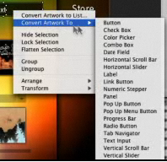
Flash Catalyst
Current (discontinued) product from Adobe
Also has behaviors
that can be attached
to graphics and
parameterized

Slide 6
Full Documentation
Full Amulet Manual:
  http://www.cs.cmu.edu/afs/cs/project/amulet/amulet3/manual/Amulet_ManualTOC.doc.html
  Tutorial
  Interactors and Command Objects

Slide 7
Types of Interactors
Am_Choice_Interactor : select one or more of a set of objects
Am_One_Shot_Interactor - single action, like Choice
Am_Move_Grow_Interactor : move or grow objects with the mouse
Am_New_Points_Interactor: to create new objects by entering points while getting feedback "rubber band" objects
Am_Text_Edit_Interactor : mouse and keyboard edit of text
Am_Gesture_Interactor: interpret freehand gestures

Slide 8
Parameters for all Interactors
Set of objects to operate on:
  To be active, Interactor must be attached to an object which is (recursively) attached to the screen
  Equivalent to visibility of graphical objects
  Unlike graphical objects which can only be added as parts of windows or groups, interactors can be added as parts of any object:
  rect.Add_Part(my_inter);
  Default: operates on the object attached to
  But also common to operate on any member of a group.
  Controlled by the Am_Start_Where_Test slot, which should contain a method

Slide 9
Example Start_Where_Test
SP_Ship_Mover =
Am_Move_Grow_Interactor.Create("SP_Ship_Mover")
.Set (Am_START_WHEN, "LEFT_DOWN")
.Set (Am_START_WHERE_TEST, Am_Inter_In_Part);
ship_group.Add_Part(SP_Ship_Mover);

Slide 10
More standard parameters
Multiple groups
  interactor can span multiple windows
start, stop and abort events
  single key, mousebutton, "any" mousebutton, modifiers, (shift, meta...), double click, click vs. drag, etc.
active?
priority levels

Slide 11
Parameters for specific types of Interactors
For buttons (Choice Interactors)
  how many objects to select: set, toggle, list-toggle
For move-grow:
  interim feedback object (while the mouse moves)
    if missing then object itself is modified
  gridding
  move or grow
  where-attach
    center, n, ne, nw, w ... , where-hit
flip if change sides
minimum size

Slide 12
Example
Am_Object feedback_circle = moving_circle.Create()
.Set (Am_LINE_STYLE, Am_Dashed_Line)
.Set (Am_VISIBLE, false);
my_win.Add_Part (feedback_circle);
// The definition of the interactor
Am_Object objs_grower = Am_Move_Grow_Interactor.Create()
.Set (Am_START_WHERE_TEST, Am_Inter_In_Part)
.Set (Am_GROWING, true) // grow instead of move
.Set (Am_FEEDBACK_OBJECT, feedback_circle);
objs_group.Add_Part (objs_grower);

Slide 13
Parameters for New_Point
interim feedback object (while the mouse moves)
gridding
minimum size
abort if too small

Slide 14
Parameters for Text_Interactor
editing translation table (to map keystrokes and mouse into editing functions)

Slide 15
Parameters for Gesture_Interactor
gesture recognizer table
If missing, can use this to get freehand drawings

Slide 16
Simple Example
To make an object movable with the mouse:
Am_Object rect = Am_Rectangle.Create() .Set(Am_LEFT, 40) .Set(Am_TOP, 50) .Set(Am_FILL_STYLE, Am_Red) .Add_Part(Am_Move_Grow_Interactor.Create());

Slide 17
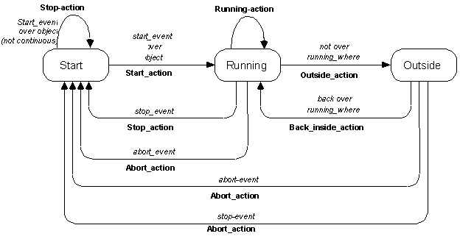
Standard Behavior

Slide 18
Operation
Interactors do 3 things
  modify objects directly
  set Am_VALUE slot of their command
  call the command's Am_DO_METHOD
Can just have a constraint from an object or widget to the Am_VALUE of the widget
Method to override for application-specific operations
Fill in the UNDO_METHOD to support undo

Slide 19
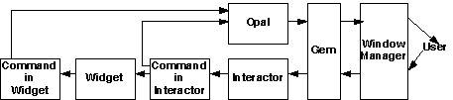
Operation Picture

Slide 20
Choice Interactor
Three ways to get the result:
  Access the Am_INTERIM_SELECTED and Am_SELECTED slot of the object itself
    By default, sets the Am_INTERIM_SELECTED and Am_SELECTED slots of the affected objects
    Constraints that depend on these slots
  Access the Am_VALUE slot of the interactor
  Write a Am_DO_METHOD for the command object, and access the command object's Am_VALUE slot

Slide 21
Example
Am_Define_Style_Formula (line_from_selected) {
if ((bool)self.Get(Am_INTERIM_SELECTED))
return Am_Red;
else if ((bool)self.Get(Am_SELECTED))
return Am_Black;
else return Am_Blue;
}
Am_Object my_prototype = Am_Line.Create()
.Set(Am_LINE_STYLE, line_from_selected);
my_group = Am_Group.Create()
.Add_Part(Am_Choice_Interactor.Create());
Now add instances of my_prototype to my_group
Also collects a list of the selected objects in the Am_VALUE slot of the command object in the interactor

Slide 22
Values
Value of Command in Choice Interactor set to object selected
Value of Command in button-type widgets set to Label of command, or Am_ID field of the command
Remember, label can be a string or a graphical object

Slide 23
Debugging: Tracing
Can turn on tracing and get print out of which Interactors run and what they do
Options: trace all, trace only setting of slots, trace a particular interactor, short trace (only which interactors run), etc.
Inspector just toggles inspecting all or none
Printout to console window

Slide 24
Example
<><><><><> LEFT_DOWN x=180 y=289 time=3114329169
Enter GO for <grow_inter_in_handle_185>, state=0...
Checking start event against wanted = LEFT_DOWN * SUCCESS
Checking start where.. ~~SUCCESS=<Am_Rectangle_650>
Move_Grow starting over <Am_Rectangle_650> translated coordinates 169,268
Calculated attach point for non-line is Am_ATTACH_S
++Object <grow_inter_in_handle_185> setting Am_VISIBLE of <Sel_Rect_Feedback_197> to true
++Object <grow_inter_in_handle_185> setting obj=<Sel_Rect_Feedback_197> setting obj=<Sel_Rect_Feedback_197> LEFT=90 TOP=142 WIDTH=182 HEIGHT=148
<><><><><> LEFT_UP x=179 y=326 time=3114329838 drawonable=Amulet Test Selection Widget(0x4015b848)
Enter GO for <grow_inter_in_handle_185>, state=1...
Checking abort event against wanted = CONTROL_g * FAILED
Checking running where.. ~~SUCCESS=<window>
Checking stop event against wanted = ANY_MOUSE_UP * SUCCESS
Move_Grow stopping over <Am_Rectangle_650>
++Object <grow_inter_in_handle_185> setting Am_VISIBLE of <Sel_Rect_Feedback_197> to false
++Object <grow_inter_in_handle_185> setting obj=<Am_Rectangle_650> setting obj=<Am_Rectangle_650> LEFT=79 TOP=121 WIDTH=182 HEIGHT=185

Slide 25
Advanced Feature: Priorities
If two interactors want to run, priorities used to determine which
Am_PRIORITY slot contains a number. Default = 1
When running, 100 added to it
Inspector interactors use 300.0
If multiple with same priority, runs the one attached closer to the leaf

Slide 26
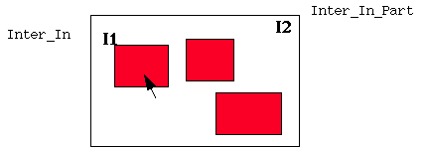
Example

Slide 27
Advanced Feature: Using Slots of Interactors
In addition to value set into Command, a number of slots are set into the Interactor itself, which might be useful.
Can get the interactor as the Owner of the command passed to the DO_METHOD
Am_START_OBJECT, Am_START_CHAR, Am_FIRST_X, Am_FIRST_Y, Am_WINDOW, Am_CURRENT_OBJECT

Slide 28
Doing something with results: Command Objects
Each Interactor and Widget has a Command object as a part in the Am_COMMAND slot
Instead of executing a callback function, interactors and widgets create a "Command Object" and execute its "Do" method
Slots of command object:
  DO_METHOD
  UNDO_METHOD
  REDO_METHOD (undo the undo)
  SELECTIVE_UNDO
  SELECTIVE_REPEAT and SELECTIVE_REPEAT_On_NEW
  HELP: for "balloon" or status line
  LONG_HELP
  ACTIVE (enabled) -- usually contains a constraint
  VALUE, OLD_VALUE
  etc.
Like Command Objects in MacApp, but hierarchical
Customize by overriding default methods

Slide 29
Handling Undo
Add an undo-handler to the window
Each command will be registered with the undo handler
Built-in types of undo handlers
  One undo then redo, like Mac
  Infinite undo, one redo
  Selective undo mechanism
Each DO method saves necessary information for undo in command object

Slide 30
Selective Undo
Implementing selective undo not much harder than regular undo:
  Allocates a new command object and adds to top to history list
  Semantics is based on what the user would want
  Undo the operation in a new context means to set the object back to its previous value
  Enabled if object is still available
  Undo of create is delete
Redo the operation means to set the value of the object again; create a new object
Also, redo on new object

Slide 31
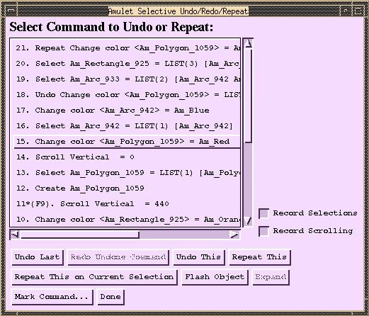
Original Interface

Slide 32
Commands in Widgets
Various kinds of button panels:
  Take list of items in the Am_ITEMS slot as an Am_Value_List
  Contents of list can be strings, graphical objects, or instances of Am_Command
  If commands, then the Am_LABEL field is used, and the DO_METHOD of that command is called
  If not commands, then DO_METHOD of the top-level widget is called
  For menu_bar, Am_ITEMS slot of each top-level command contains Am_Value_List of the sub-commands

Slide 33
Innovations
+ Better reuse
  Many commands are in the library and are usually used without change
  Cut, Copy, Paste, Create-Object, Delete-object, To-Top, etc.
  Usually can be used without change
  Easier to customize when necessary
+ Better modularization
  Hierarchical means each level only has to deal with its own actions
+ New form of selective undo, repeat
  Includes undo/repeat of selections and scrolling
+ Single place for enabling, help, label, etc.
  Can be computed by constraints
+ Makes scripting easier
  End-User programming by demonstration
  Parameterization possible without help from application
+ May help with CSCW
  Executing the command on multiple machines

Slide 34
Scripting
Added for CHI'98
Not in standard release
Select set of commands and specify that in a program
Can parameterize actions
Moving selection handles
  Forwards, backwards, left, right, up, down, in, out
  Search for object of a particular type or value
Little or no change to application if it supports Selective Repeat

Slide 35
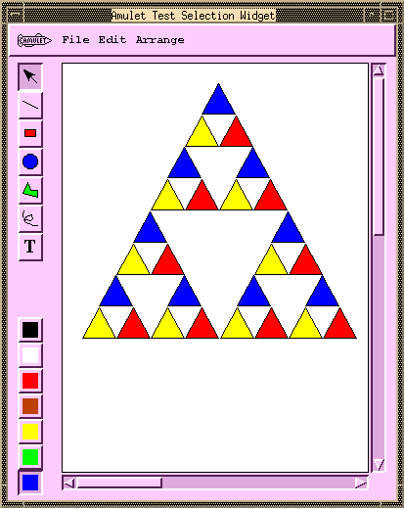
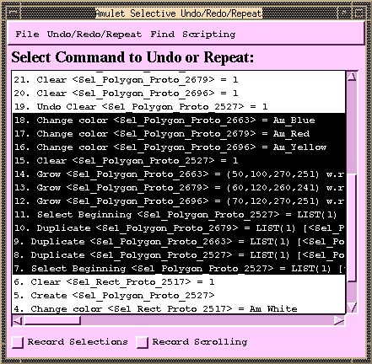
Pictures for Scripting, 1

Slide 36
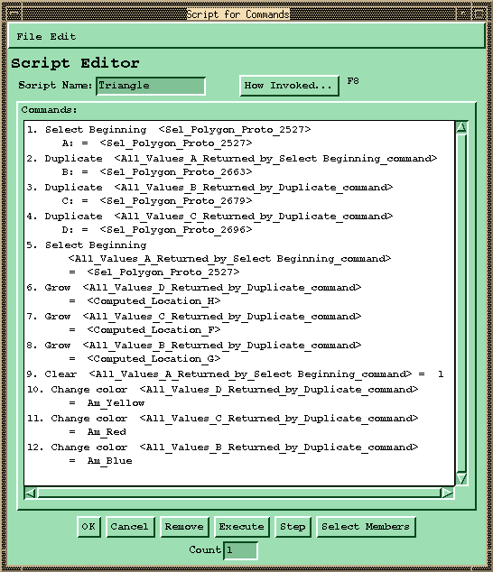
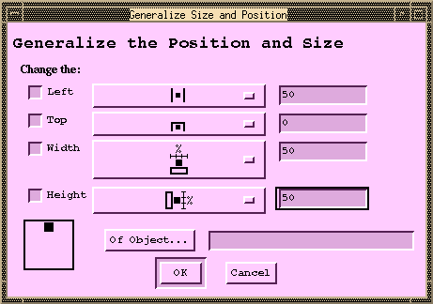
Pictures for Scripting, 2

Slide 37
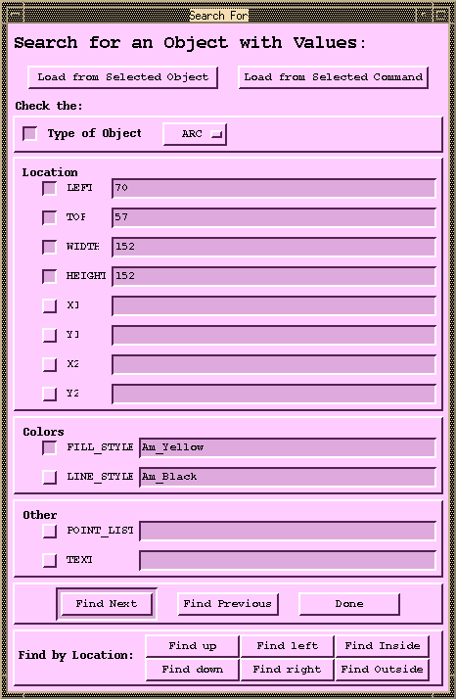
Pictures for Scripting, 3

Slide 38
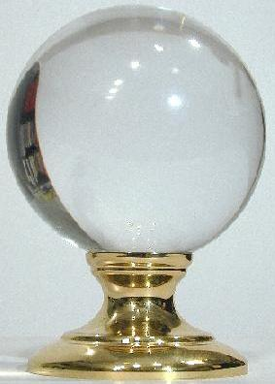
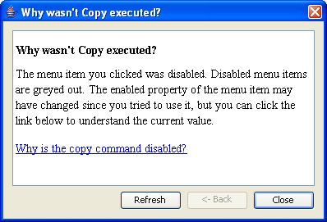
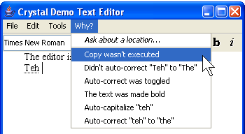
Using Undo History for “Why” Help
Crystal: Clarifications Regarding Your
Software using a Toolkit, Architecture and
Language
Brad Myers, David A. Weitzman, Andrew J. Ko, and
Duen Horng Chau, "Answering Why and Why Not Questions
in User Interfaces," CHI'2006. April, 2006.397-406
Help answer why things happen in regular
desktop applications
Lots of complexity in powerful features that people generally like
Ask “Why” about what
recently happened

Slide 39
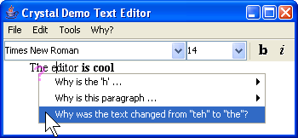
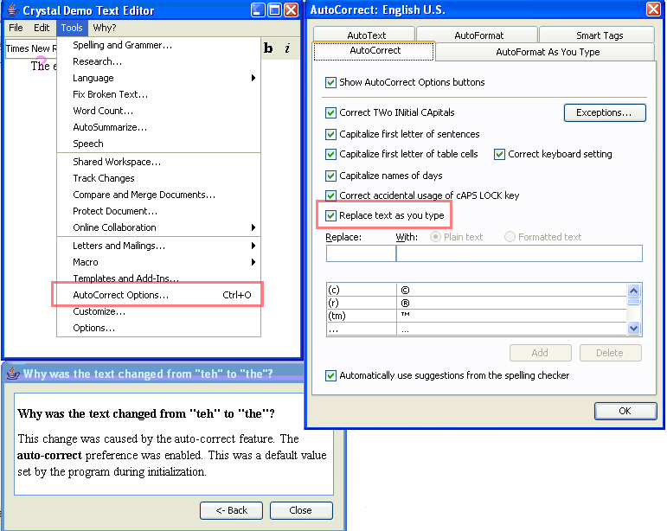
Crystal
Or, ask Why about a location by clicking on objects, or whitespace
Also can explain
complexities like
style inheritance,
etc.

Slide 40
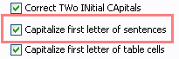
Crystal Implementation Overview
(Full details in the paper)
Only a little more work than supporting Undo
“Command object” architecture for actions
  Command objects stored on a list for undo
Programmer adds back pointers from objects to the commands that changed them
Add dependency
information for mode
variables
Add special commands for actions not executed
Add extra invisible objects for whitespace and deletions

Slide 41
Crystal Implementation, cont.
Crystal framework then builds Why menus and answers automatically
Crystal finds:
  Objects under the mouse
  Commands that affected those objects
  User interface controls involved in those commands
Programmer can annotate some commands to not include in menus
  E.g., regular typing
  Similar to heuristics for granularity of Undo

