Slide 1
Lecture 3:
Other Output Models:
Structured Graphics;
Object-Oriented Techniques
Brad Myers
05-830
Advanced User Interface Software

Slide 2
Homework 1
OK to post the PDFs of evaluations on-line?
  With your names on it?
Do you want to feedback from classmates?
  With names?
Not easy – 3 week assignment on purpose
How TestOutlineRect should look
Redraw vs. main event loop
Reminder: no copying or collaborating
  Will be checking
Homework 2

Slide 3
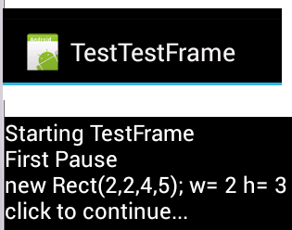
Interesting issue
java.awt.Rectangle – (x, y, width, height)
  My BoundaryRectangle class based on this
android.graphics.Rect – (left, top, right, bottom)
  Doesn’t say whether inclusive or exclusive!!
  Rect r = new Rect(2,2,4,5);
    What is r.width() and r.height()?

Slide 4
Structured Graphics
Saves a list of all the graphical objects
  Edit the screen by editing the saved list
Also called "display list" or "retained object model"
Provided by many toolkits and graphics packages early vector displays
  CORE (~1977), GKS (1985), PHIGS (1988)
  Optional in InterViews, CLIM, etc.
  Required in Amulet, Garnet, Rendezvous, etc.
HTML document object model (DOM)
  Display tree

Slide 5
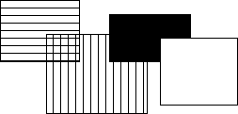
Structured Graphics, cont.
Advantages:
  Simpler to program with: don't call "draw" and "erase"
  Automatic refresh of windows when uncovered, etc.
  Automatic redisplay of objects when change and also of other overlapping objects
Before
After

Slide 6
Structured Graphics Can Support
Ability to support:
  high-level behaviors like move, grow, cut/copy/paste, etc.
  high-level widgets like selection handles
  constraints among objects
  automatic layout
  grouping: "Groups" in Garnet
  automatic printing
  tutors and monitors
  external scripting, ...
  accessibility

Slide 7
Structured Graphics Disadvantages
Disadvantages:
  Significant space penalties
    objects take up to 1000 bytes each
    imagine a scene with 40,000 dots (200x200 fat bits)
  Time penalties
    Redisplay doesn't take advantage of special properties of data:
      regularity
      non-overlapping

Slide 8
Redisplay Algorithms
Redisplay everything each time
  Most appropriate for small numbers of objects, and if drawing is really quick compared to computation
  Used on the Macintosh and many others
  Used by Amulet
  Used by homework 2
  May add clipping region and/or double-buffering

Slide 9
Redisplay only the affected areas of the screen
Requires computing what areas are affected
Garnet:
  keep track of objects that change any "interesting" slot
  compute the bounding box of all these changed objects in their old and new locations
  assert this as the clipping region (must not self-intersect; Garnet uses 2 regions)
  erase the area
  go through objects from top-to-bottom, back to front draw those which overlap the bounding box
  for step 4: goes through all top level aggregates, and any children of the aggregates that intersect (recursively)
Other techniques: quad trees

Slide 10
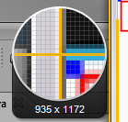
Issue: Anti-Aliasing and special effects
Drop shadows, highlights, other special effects
Can’t assume clipping regions will work
Can draw outside of the bounding boxes
Mac OS X uses anti-aliasing and seems to redraw lots of windows

Slide 11
Optimizing Redraw
Special additions in Garnet; not in Amulet
  "Fast-redraws"
    declared by the programmer
    objects drawn with XOR on top of other objects
    those that have a solid color behind them (nothing in front) so can be erased with a rectangle or by redrawing with the background color
    When change, have to be erased using old values
    No bounding boxes, no intersections, etc.
  "Virtual aggregates"
    only pretend to allocate storage for elements
    provide table and arbitrary layouts

Slide 12
Optimizing Redraw
“Glyphs” in InterViews
  Calder, P.R. and Linton, M.A. “Glyphs: Flyweight Objects for User Interfaces,” in Proceedings UIST'90: ACM SIGGRAPH Symposium on User Interface Software and Technology. 1990. Snowbird, Utah: pp. 92-101.
  Don't include position information, etc. so very small
  Much of the layout retained by the aggregate (computed as needed)
  Object can be reused in many places: e.g.: the letter "a"
  Used for a text editor
  Issue: why is location special? What about red vs. blue "a"s?

Slide 13
Object-Oriented Techniques
Motivation
  Became popular along with GUIs, Direct Manipulation
  Icons, graphics seem like objects:
    have internal state, persistance
  OO was originally developed (SmallTalk) and became popular (C++) mostly due to GUIs.

Slide 14
Object Oriented
As a UI technique:
  Same as GUI, Direct Manipulation = icons, graphical objects, widgets
Here, as a programming paradigm (often in a language)
A form of "data abstraction"
"Classes" describe the basic structure of the data
Also, the methods that can be called
Usually no direct access to the data, only the methods

Slide 15
OO
Create "instances" of the classes
  local copy of data
  may also be class data -- all instances share the same value
  shares all methods
"Inheritance": create a new class "like" the superclass
  by default has all the same methods and data
  can add new data and methods and re-program inherited methods
Example: graphical_object.draw ... circle.draw

Slide 16
OO
New style of programming; thinking about the problem
  Many books about how to do it right.
  OO design; getting the classes and protocols right
    So subclasses don't have extra, wasted data space
    Methods make sense to all sub-classes
    So external classes don't need to know inside description.
  Also OO databases, etc.
Implementation:
  object in memory, starts with pointer to table of methods, etc.
  lots of tricks and extra declarations in C++, Java etc. to avoid overhead of lookups at run-time ("virtual", "pure virtual")

Slide 17
Multiple inheritance
Class has multiple parent classes
Combine all the methods and data of all
Special rules for when conflict (same method, same name of data with different types, etc.)
Example: circle inherits from graphical-object and moveable-object
Complex so often not used even when available
Amulet uses constraints to provide flexible copying of values instead
Java, etc. use “interfaces”
  No inheritance of implementations, but ability to have arbitrary “mix-ins”
  No confusion about which superclass to inherit from

Slide 18
Prototype-Instance model
Instead of the class-instance model
All objects are instances
Can use any object as a prototype for other objects
  Inherits all slots it doesn't override (= instance variables, member variables, fields, attributes).
  Methods are just a value in a slot
  Dynamic changing of methods
Easy to implement using structures.
Usually, changing prototype data also changes all instances that do not override it.
Now used by JavaScript, ActionScript (Flash)
  Older uses: SELF, NewtonScript,

Slide 19
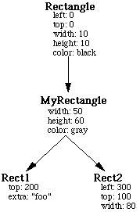
Prototype-Instance model

Slide 20
Prototype-Instance model
May provide adding and removing of slots dynamically to any instance
Simpler model, easy to implement
More dynamic
But much less efficient
  Can't usually compile slot accesses into structure access; may need a search
  Type checking on slots
  Methods looked up at run-time
  Space for names of slots, extra pointers, etc.

Slide 21
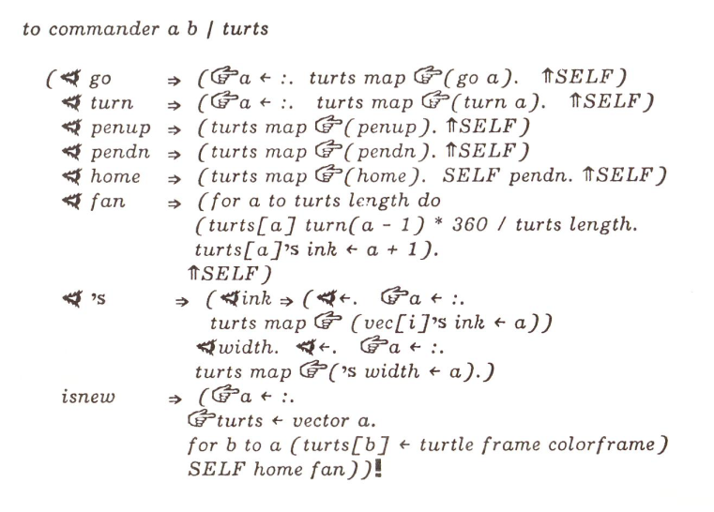
Examples of OO Systems
OO in SmallTalk
  First "pure" example
  Everything is an object
  (numbers, strings, etc.)
  Single inheritance
  Methods dispatched on a single parameter
    3 + "4.5" different from "4.5" + 3
  Dynamic method lookup at run-time
    => "Message not understood"
  Smalltalk 72 had strange syntax with special characters
  Whole environment (windows, browsers, MVC, etc.)
Notes:
Stopped here

Slide 22
Examples of OO Systems
OO in C++
  Numbers, strings, etc. not objects
  Lots of mess to make it fit with C
  Statically (compile-time) determine types, methods
  Originally a pre-processor (new syntax)
  Multiple-inheritance

Slide 23
Examples of OO Systems
OO in CLOS (Common-Lisp Object System)
  Add-on to language
  Special feature: method dispatch on all parameters
  +(int int) +(int str) +(str int) +(str str)
  Methods not as tightly coupled with objects

Slide 24
Examples of OO Systems
OO in MacApp (approx. 1985 – 1994)
  Because OO so natural for UIs, invented their own language: Object Pascal with help from Niklaus Werth (inventor of Pascal)
  Used in MacApp
  SmallTalk model, but more compile-time checkable
  Eventually abandoned in favor of Objective C (NeXT)
    Third-party company by Brad Cox
    Now supported directly by Apple

Slide 25
Examples of OO Systems
OO in Andrew and Motif
  GUI systems for X Window System on Unix in the late 1980’s
  Invented their own object systems in C
    Similar to GTK+ and Qt from homework 1 presentations
  Before C++ was popular, available
  "Intrinsics"
  Mainly is a method and inheritance protocol
  Andrew: (ATK) pre-processor for header files
    single inheritance
    "_" = new syntax: class_method(xxx)
    dynamic loading of object implementations
    querying an object's class at run-time
    Andrew converted to C++
    Now defunct
  Motif
    just a set of conventions; no preprocessor
    not "real" inheritance, overriding

Slide 26
Examples of OO Systems
Amulet provides a prototype-instance object system embedded in C++
Java
C#
Objective C
Javascript & ActionScript

Slide 27
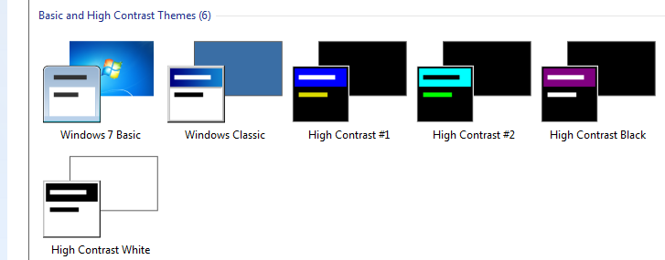
Design Issues: Hierarchies
& Inheritance
How many hierarchies for OO graphics systems?
  Inheritance (class-instance or prototype-instance)
  Components / Groups
  Display tree
Where do properties come from?
  Color, size, shape
  Issue: changing type of object – rectangle → polygon
  Windows widget
  properties
    Size, color scheme,
    transparency, …

Slide 28

Amulet and Garnet Videos
Brad A. Myers, Dario Giuse, Andrew Mickish, Brad Vander Zanden, David Kosbie, Richard McDaniel, James Landay, Matthew Goldberg, and Rajan Parthasarathy. “The Garnet User Interface Development Environment.” Technical Video Program of the CHI'94 conference. SIGGRAPH Video Review, Issue 97, no. 13. ACM, ISBN 0-89791-940-8.
Brad A. Myers, Richard G. McDaniel, Robert C. Miller, Alan Ferrency, Ellen Borison, Andrew Faulring, Andy Mickish, Patrick Doane, and Alex Klimovitski, “The Amulet User Interface Development Environment”. 8 minute video. Technical Video Program of the CHI'97 conference. ACM, 0-89791-876-2.
  OpenVideo version
1996, 8:45 min

