Slide 1

Flash Interactive Environment
05-830 Advanced User Interface Software
Applying Cognitive Dimensions on the
Kyungmin Kim | Human Computer Interaction

Slide 2
About Flash
Multimedia authoring tool for creating interactive graphics and movies
Can create interactive animations without any programming skill
Activity type: exploratory design

Slide 3
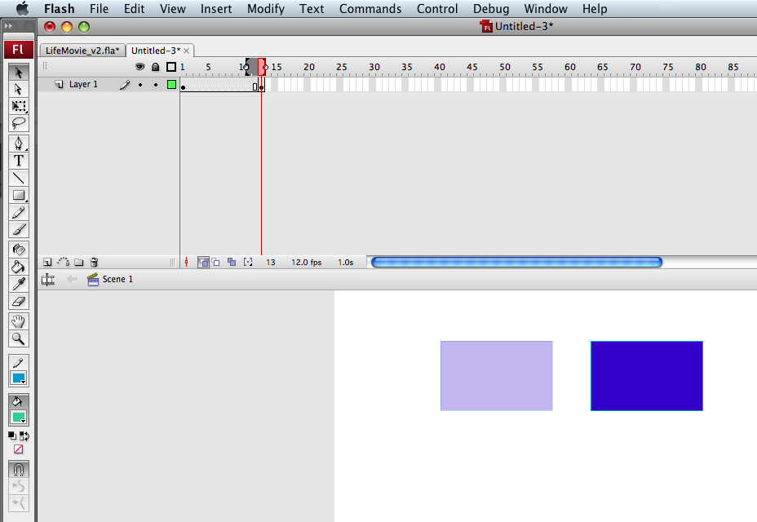
Direct manipulation
High closeness of mapping
Notes:
Evidence:
Dimensions: Closeness of mapping
The user can directly create objects on the main panel using the drawing toolbar on the left side. When an object is created, the circle in the corresponding frame becomes black. On the other hand, clicking on any frame in the timeline shows the corresponding objects on the main panel.
Explanation
This is a good example of the closeness of mapping as the user can create objects and animations in an intuitive manner by clicking buttons or dragging/dropping components. The timeline and the main panel is closely mapped by various symbols, such as circles and arrows.

Slide 4
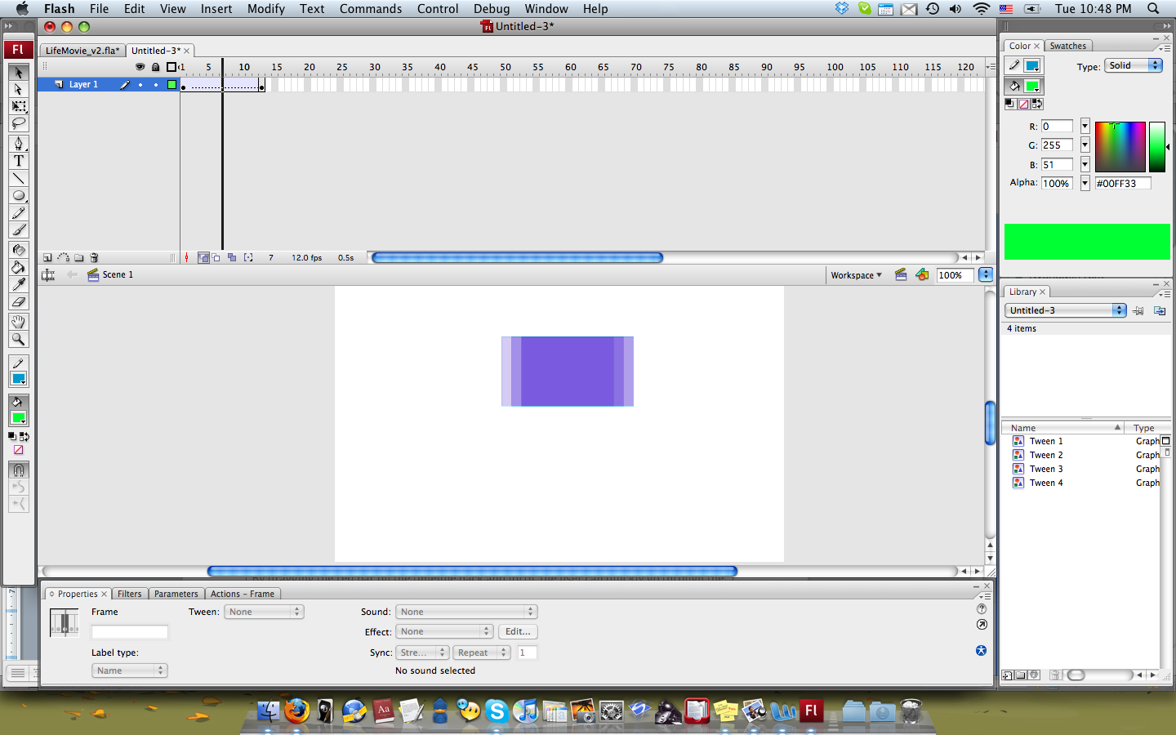
Quick playback
Good progressive evaluation
Notes:
Evidence:
Dimensions: Progressive evaluation
By dragging the red bar on the timeline back and forth, the user can quickly go through the animation. Alternatively, the user can select Control>Play to preview the whole animation.
Explanation
Moving the timeline back and forth frame by frame allows the users to make sure everything is working well as intended.

Slide 5
Error indication
Good progressive evaluation
Notes:
Evidence:
Dimensions: Progressive evaluation
When there is any problem in the motion, the arrow in the timeline becomes a dotted line to indicate the problem.
Explanation
It constantly checks for an error and provides an immediate feedback to the user.

Slide 6
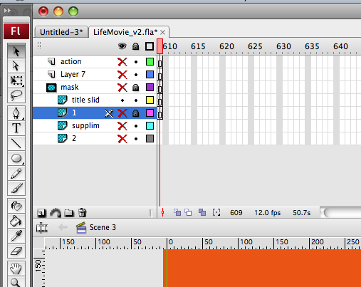
Layer visibility
High visibility
Notes:
Evidence:
Dimensions: Visibility
The user can show or hide each layer to see specific components.
Explanation
Turning on and off the visibility of each layer enables the user to see components that are hidden by other layers.

Slide 7
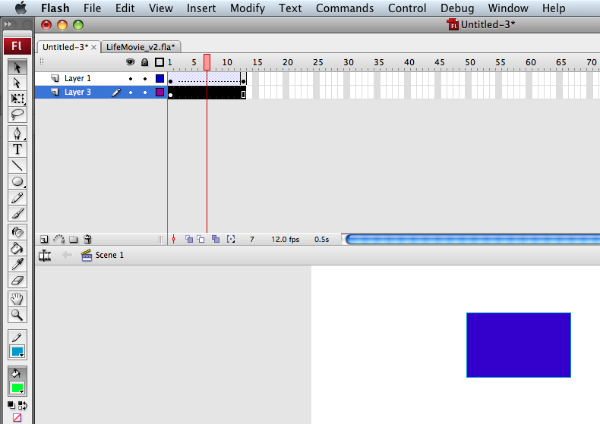
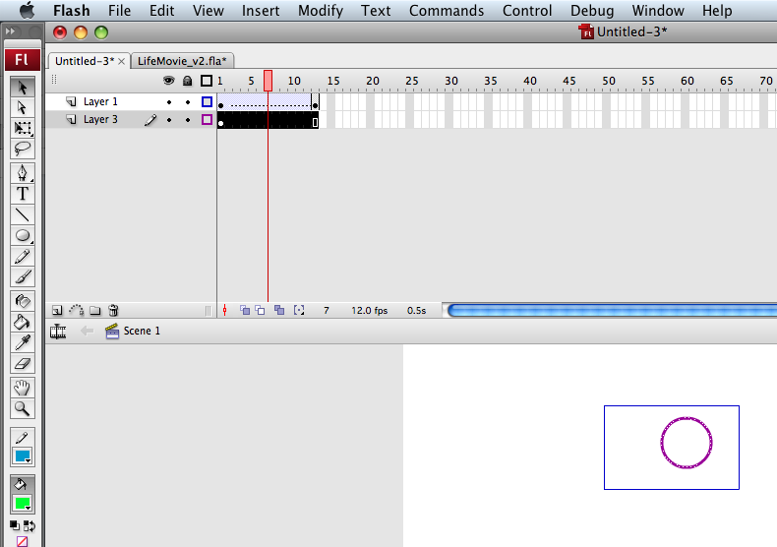
Outline view
High visibility
Notes:
Evidence:
Dimensions: Visibility
The user can show or hide each layer to see specific components from an outline view.
Explanation
When more than two objects overlap, it is hard to see which and how many objects are on the layer. The outline view allows the user to see overlapping components.

Slide 8
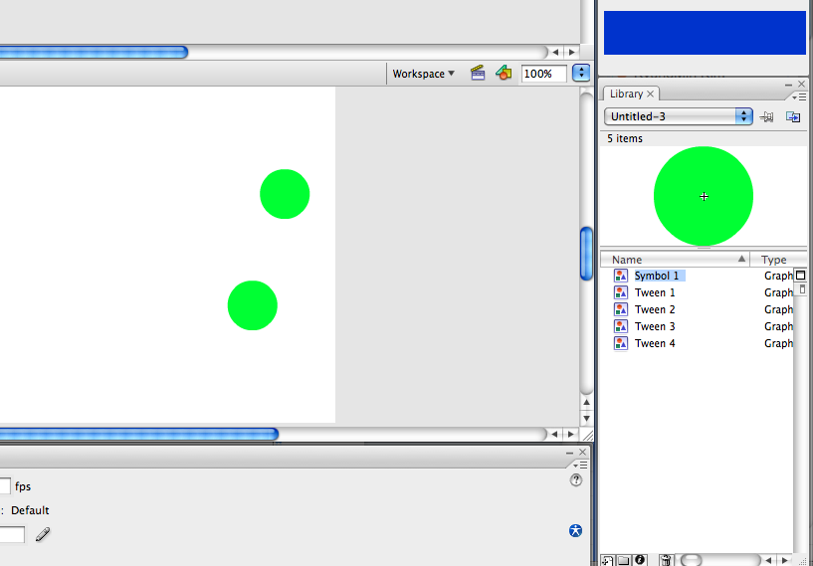
Generating instances from Library
High viscosity
Notes:
Evidence:
Dimensions: Viscosity
The user can set a graphic as a symbol to store in Library. Once put in Library, the user can drag and drop an instance of the object at any time and change values for each object.
Explanation
Symbols in Library make it easy to create instances and change values for specific objects without affecting other instances.

Slide 9
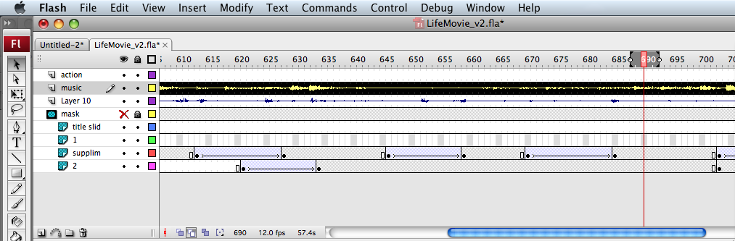
Decoding the timeline
Hard mental operation
Notes:
Evidence:
Dimensions: Hard mental operations
Timeline represents the whole sequence of objects and motions. They are indicated as small circles (key frames), arrows (motions), and background colors, etc.
Explanation
The symbols are not intuitive and become confusing as the number of layers and frames increase. A solution could be to provide several abstraction levels to users to allow them to see both the details and the high-level overview in the timeline. The detail level would show a thumbnail of each frame.

Slide 10
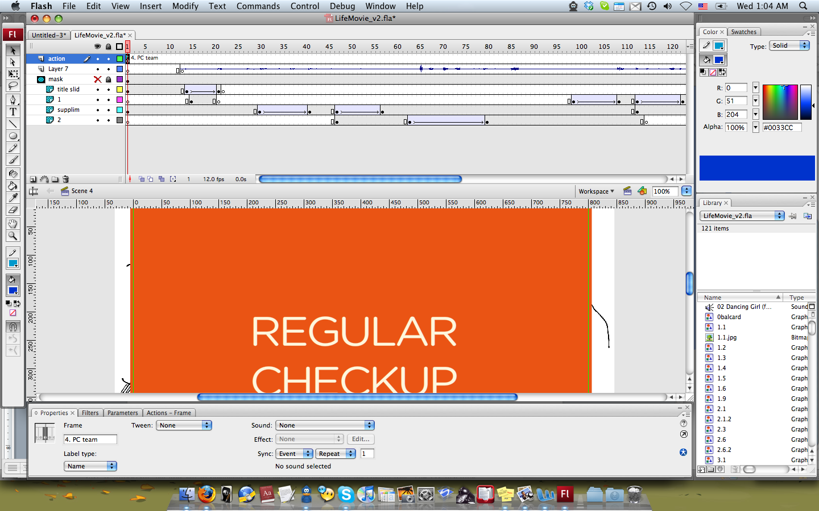
Frame labels
Good secondary notation
Notes:
Evidence:
Dimensions: Secondary notation
Frame Label is marked as a flag with the label on the timeline.
Explanation
Frame Label not only is useful for ActionScript but it also helps the user to identify a specific section of frames.

Slide 11
Extending frame segments
Low viscosity
Notes:
Evidence:
Dimensions: Viscosity
In order to increase the length of the sound (indicated by a flag with intro) later, the user has to first move the right-most frame segment, then the left ones.
Explanation
Dragging the leftmost segment to the right side might end up overlapping the existing frames. In order to extend the segment correctly, the user needs to go through several steps. Giving the user to insert or override frame segments could solve the problem.

Slide 12
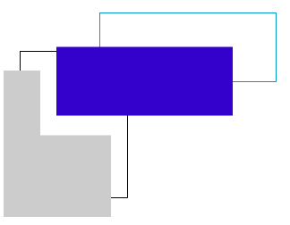
Moving objects
Low viscosity
Notes:
Evidence:
Dimensions: Viscosity
When the user clicks on an object and moves it around, it only selects the fill part (separating it from borders) and erases other objects when it overlaps.
Explanation
As moving around an object affects other objects, the user needs to be cautious about it. Otherwise, they might need to start over. A solution could be to provide several different modes of handling objects.

Slide 13
Conclusion
CD is somewhat system-oriented and does not evaluate usability aspects.
Flash shows high visibility, which is important for exploratory activities
Users need caution on some aspects with low viscosity

