Slide 1
ActionScript under Flash 9
Study with Cognitive Dimensions

Slide 2
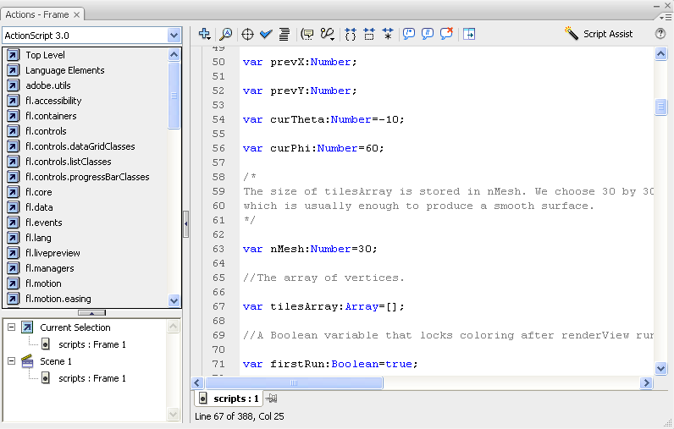
The tool
Library
Toolbar
Editing area
Elements

Slide 3
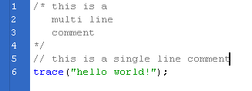
Secondary notation

Slide 4
Visibility

Slide 5
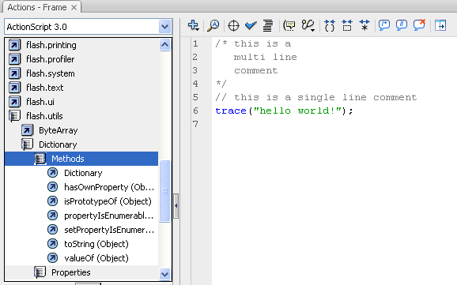
Visibility

Slide 6
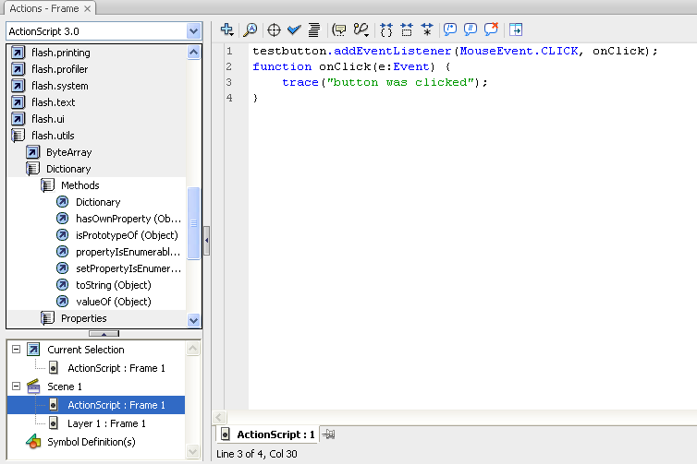
Closeness of mapping / Visibility

Slide 7
Error-proneness

Slide 8

Provisionality

Slide 9
Viscosity

Slide 10
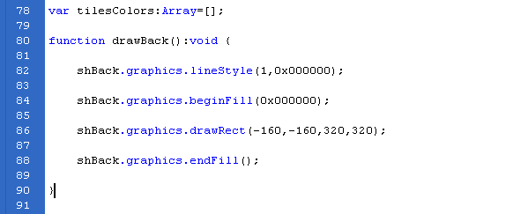
Role-expressiveness

Slide 11
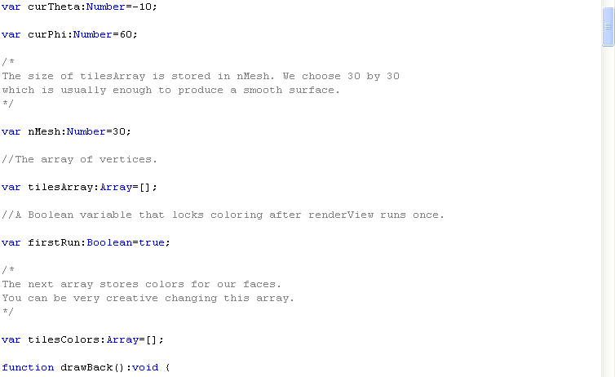
Role-expressiveness

Slide 12
Some thoughts on CD
Some dimensions are specific for an environment
Difficult: some seem to be specific, some more general
  Error-proneness vs. hard mental effort
Some dimensions apply to more than just the evaluated API
  e.g. OOP

