Slide 1
Adobe Flex
Framework and Tool
Stephen Oney
Notes:
Open browser to: http://examples.adobe.com/flex3/componentexplorer/explorer.html
Open Flash
Open Flex

Slide 2
Brief History

Slide 3
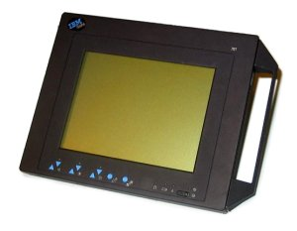
PenPoint OS (1991)
GO Corporation
Tablets & PDAs
PenPoint OS
Notes:
Starts with PenPoint OS
Created by GO Corp., one of the best funded startups at the time (1987) eventually burned through $75 million. Attracted high profile developers
Main developer: Robert Carr, who had a long history of developing software for the Xerox Alto, the first computer to use the desktop metaphor
PenPoint: OS developed especially for tablets and PDAs (picture is of IBM 700T – tablet from )
Features included gestures, dynamic layout toolkit for portrait & landscape modes, many other features present in Windows Tablet Edition
(2 lawsuits from GO Corp. for Windows)

Slide 4
SmartSketch (1993)
FutureWave Software
For PenPoint OS
Vectors
For tablets
SmartSketch
PenPoint OS
Notes:
FutureWave software was small company that made SmartSketch, a vector-based drawing program

Slide 5
SmartSketch (1994)
GO (now under AT&T) abandoned
No Platform for SmartSketch
SmartSketch
PenPoint OS

Slide 6
What next for SmartSketch?
?
?
Windows / Mac?
  Macromedia Freehand
  Adobe Illustrator
SIGGRAPH ’95 Feedback
  Animation
  Browser Playback
?
SmartSketch
?
?
?
?
Macromedia
Freehand
Adobe
Illustrator
Windows / Mac OS
Notes:
Could port to Windows and/or Mac but would be competing against tech giants Adobe & Macromedia and Freehand & Illustrator respectively
SIGGRAPH 95 in LA

Slide 7
FutureSplash Animator (1995)
Netscape
Prototype used Java
  (slow)
Plugin-in API
  See Tobias’ presentation
Ships 1996
FSA
Java
FS Animator
Netscape
Windows / Mac OS
Notes:
FutureWave software was small company that made SmartSketch, a vector-based drawing program
Wanted to add animation to product

Slide 8
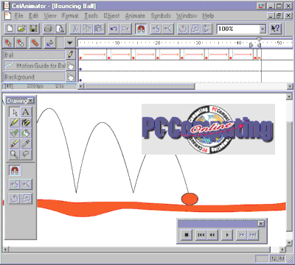
FutureSplash Animator

Slide 9

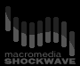



FutureSplash Animator
Rejected by Adobe
MSN
  TV over Internet
Disney
  Also Shockwave
Bought by Macromedia
FS Animator
Netscape
Windows / Mac OS
Notes:
1996 – FutureWave proposes to adobe, tries to sell FutureSplash to them. Rejected
FutureWave software was small company that made SmartSketch, a vector-based drawing program
Wanted to add animation to product

Slide 10
Rich Internet Applications (90s)
Applications on web
Proprietary extensions
Later, AJAX
See Phil’s presentation
Notes:
Original idea from 90s
Flash:
Free plugin

Slide 11
Macromedia Flash
FS Animator Flash
  “Future Splash”
Plugin: Flash Player
IDE: Flash
FS Animator
Flash
Mozilla
IE
Windows / Mac OS

Slide 12
Flash 1 (1996)
Same as FutureSplash Animator
IE & Netscape plugins
Vector animations

Slide 13
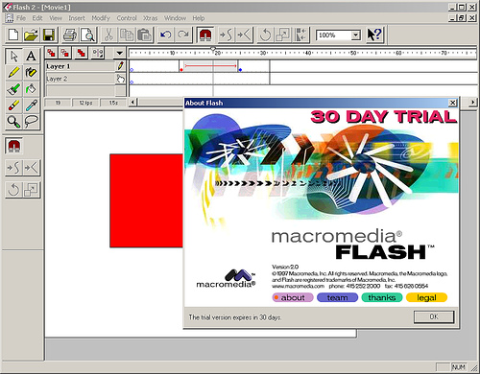
Flash 2 (1997)
Reusable objects (buttons)
Basic scripting

Slide 14
Flash 5 (2000)
ActionScript 1.0

Slide 15
Flash 6, MX (2000)
Video playback support

Slide 16
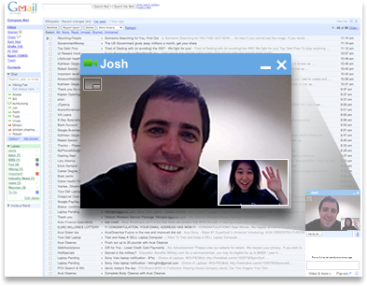
Flash 8 (2005)
Video authoring
Actionscript video processing

Slide 17

Adobe buys Macromedia (2005)
Adobe Flash CS3 (2006)
Integrated with CS
Notes:
Vector & Raster
Back & Forth A/V Streaming

Slide 18
Flash Demo

Slide 19
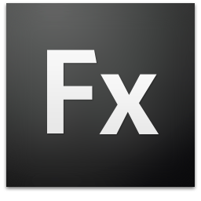
Adobe Flex
For developers
IDE (Eclipse)
Extendable classes
Backend wizards
  ColdFusion
  PHP

Slide 20
Drawing Editor
(creates objects)
Actionscript
(manipulates objects)

Slide 21
Widgets
(reusable)
MXML &Actionscript
(program)

Slide 22
Flex Demo

Slide 23

File Format
SWF (Shockwave-Flash)
Partially open

Slide 24

Flash Player
Desktop
  Windows
  OS X
  GNU/Linux
  Solaris
Mobile (Lite)
Notes:
Flash lite 1.1 : Flash 4.0
Flash lite 2.0: Flash 7.0
Flash lite 3.0: Flash 8.0, video streaming

Slide 25

Adobe AIR
Adobe Integrated Runtime
Offline
Store data

Slide 26
DEVELOPMENT
RUNTIME
Flash
Designers
Flash Player
Browser
Flex
Programmers
AIR
Desktop

Slide 27
MXML

Slide 28
Flex 3 Component Explorer
http://examples.adobe.com/flex3/componentexplorer/explorer.html

Slide 29
Actionscript

Slide 30
Future

Slide 31
Flash 10 (CS4) (2008)
Basic 3D support
  See Joon’s talk
Joints, bones, inverse kinematics

Slide 32

Flash Catalyst
Formerly Thermo
Visual Flex
Steps:
  Import from CS
  Attach behaviors
  Export to Flex

Slide 33
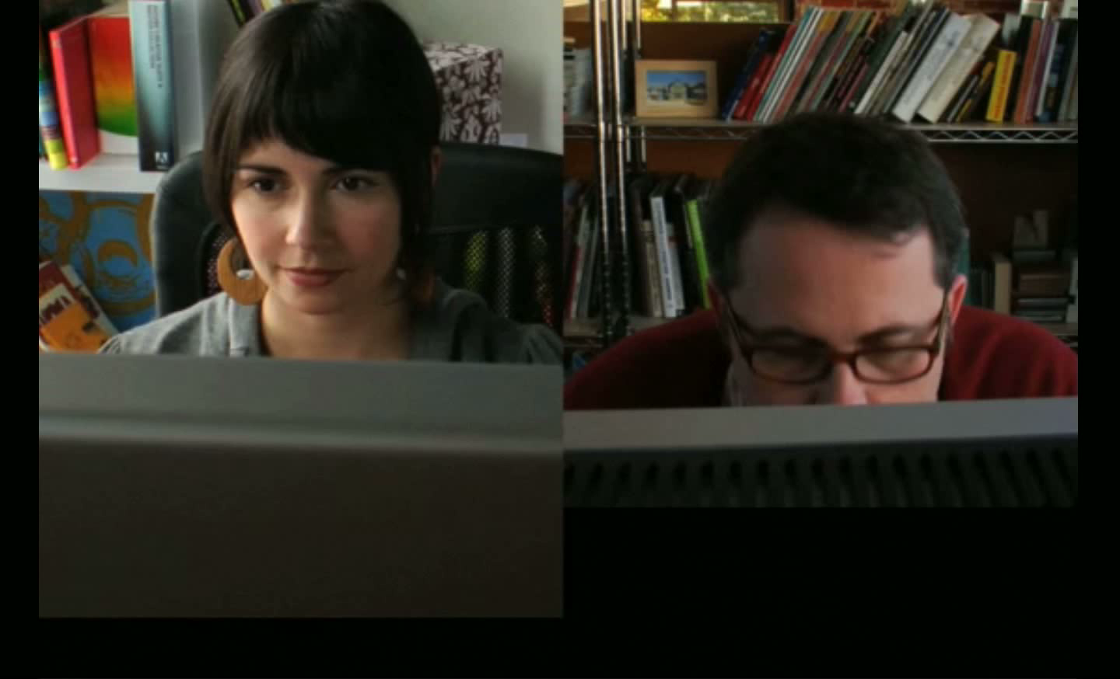

Slide 34
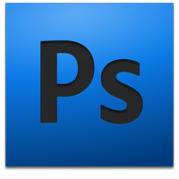


Graphics
Catalyst
Player
Flex
Notes:
Photoshop: Raster graphics (photos), retouch
Illustrator: Create vector graphics
Fireworks: Can create, but more for web optimization, leftover from Macromedia acquisiation

Slide 35
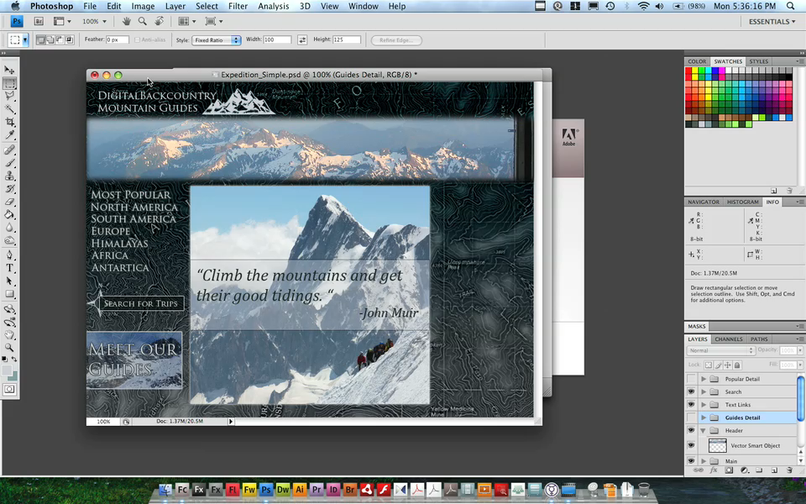

Slide 36
Questions

Slide 37

Have a great summer!

Slide 38
What’s the Difference?
Flash
Shockwave
Built for Internet
  Loads quickly
Interpreted
90% install base
CD-ROM Dynamic Content
  More versatile
“Compiled”
58% install base
Growing closer with each release
http://www.howstuffworks.com/web-animation6.htm

