Slide 1
JavaFX Evaluation using Cognitive Dimensions
Stephen Oney

Slide 2
JavaFX
Made by Sun
NetBeans integration
Misnomer
Notes:
Like JavaScript, JavaFX is not actually Java. Most likely, Sun is trying to capitalize off of the popularity of the name “Java” for the JavaFX platform
In fact, JavaFX is built on top of Java

Slide 3
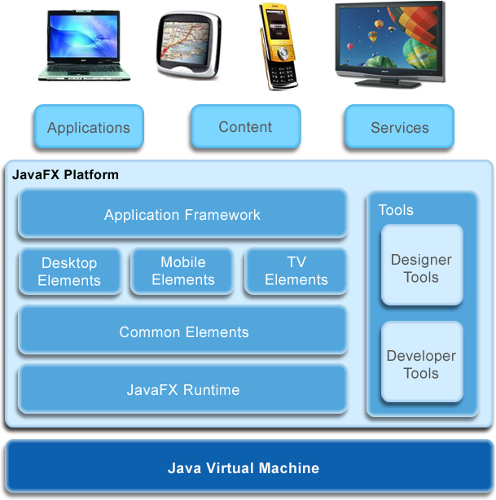
JavaFX
Notes:
Built on top of Java

Slide 4
JavaFX Targets
Designers with little programming experience
  Flash tool
  Illustrator
Developers
  ActionScript
  JavaScript

Slide 5
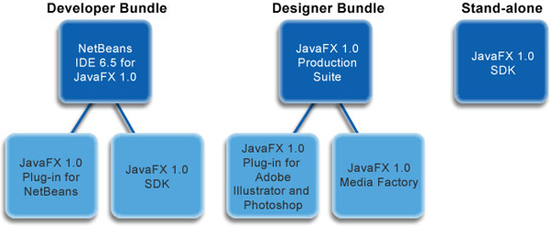
JavaFX Bundles

Slide 6
Evaluation
Wrote 4 programs
  Followed 3 tutorials
  Wrote one game

Slide 7
Learning Styles (+)
Can learn JavaFX
  More visually (Illustrator/Photoshop)
  Like another programming language (NetBeans)
Notes:
Probably why Flash is a huge success

Slide 8
JavaFX Syntax
Stage {
title: "My First JavaFX Sphere"
width: 250
height: 250
scene: Scene {
content: [
Text {
font: Font { size: 24 }
x: 20, y: 90
textAlignment: TextAlignment.CENTER
content:"Welcome to \nJavaFX World"
} //Text
] // content
} // Scene
} // Stage
Notes:
Declarative syntax. Also has imperative syntaxes
Easy to read
Fairly confusing for developers

Slide 9
Consistency (-)
Not consistent with other languages’ syntax
Not consistent with own syntax
  Three different styles of named variables
    Key/Value
      x: 30,
    Variables
      var x = 20;
    Attributes
      x: Number = 10;
  Confusing semicolon requirements
    Sometimes required, sometimes can be substituted with \n or ,

Slide 10
Consistency
For JavaScript coders: why does the following produce an error?
function( e: MouseEvent ):Void {
var a = "ABC";
a = 123
}
Notes:
JavaFX is actually weakly typed!

Slide 11
Penetration (+)
NetBeans allows developers to drag components in
  Reduces memorization requirements
  Allows for more exploration

Slide 12
Abstraction Level (+/-)
Great primitives for 2D drawings
  Shapes
  Gradients
  WIMP widgets
Still allows all Java operations
Weak support for other application types
  3-D
  Character animations (joints)

Slide 13
Domain Correspondence (+)
Many easy to use tools correspond strongly with animation domain
  Timelines
  Tweens
  Binding

Slide 14
Work-Step Unit (+)
Mix between declarative and imperative eliminates much of overhead
  Difficulty of task more proportionate to amount of code compared to Swing, JavaScript

Slide 15
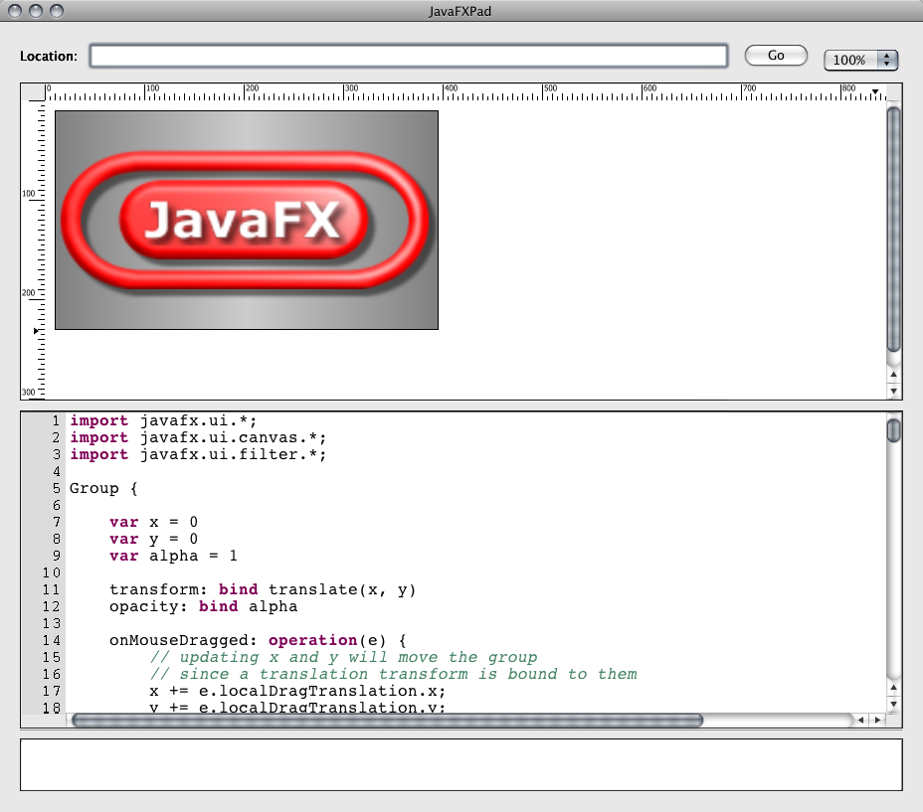
Progressive Evaluation (+)
JavaFXPad allows quick interaction/evaluation

Slide 16
Role Expressiveness (+)
Declarative syntax makes roles clearer:
Stage {
title: "Application title"
width: 800
height: 800
scene: Scene {
content: Circle {
onMouseDragged: function( e: MouseEvent ):Void {
println('dragged');
}
centerX: 100
centerY: 100
radius: 40
fill: Color.RED
}
}
}

Slide 17
Sample application
http://stephenoney.com/howtos/AvoidBalls/dist/AvoidBalls.php

Slide 18
Conclusion
Great primitives, language design
Confusing syntax
Overall positive experience

