Slide 1
Lecture 12:
Model-based tools:
Creating the UI Automatically
Brad Myers
05-830
Advanced User Interface Software

Slide 2
Model-Based Tools
Overview
  Programmer describes the operation of the system or the user interface in a specification language = the "model".
    model is a high-level description
    usually declarative (listing parts and relationships)
  System automatically creates the interface
    Uses a low-level toolkit for the widgets

Slide 3
Goals:
High-level description of an interface is easier to write than low-level toolkit code
Automatic generation may produce better UIs than programmers
Allow separation of UI design (embodied in rules) from UI contents (supplied by the programmer)
Support dynamic creation of objects
  define templates or prototypes
Increase re-use since design rules shared by multiple applications
Tools can reason over the specification to produce extra stuff:
  Automatic generation of help, undo, etc.
  Transform interface into different but functionally equivalent interface
  Enabling and disabling of widgets
  Enforcement or checking of design guidelines- consistency, completeness
    Enforces consistency since rules will pick similar objects for similar situations
  Automatic adjustment to different screen sizes, etc., since rules can take this into account
  Automatic analysis for quality
    NGOMSL analysis : GLEAN (Kieras, UIST'95)

Slide 4
Overview, cont.
Related to the "Declarative" approach discussed in previous lecture
  but here system has some intelligence or knowledge so less has to be specified by the programmer.
Different types:
  Dialog box creators: Mickey, DON, Jade (lots of others)
  Representations of the full UI: ITS, UIDE, Humanoid, MasterMind
  New: Create from XML, using more sophisticated algorithms
    Covered in next lecture

Slide 5
Dialog Box Creators
Easiest part of the UI to create
Given a list of the contents, automatically:
  choose widgets:
    specify type of desired input:
    string = text input field
    number = slider
    one-of-many = radio buttons or pop-up options
    many-of-many = check boxes or checks in a menu
    commands = menu

Slide 6
Dialog Box Creators, cont.
  arrange widgets
    based on look-and-feel guidelines
      where OK goes
      which commands go in which menus
    based on good graphic design principles.
  set variables
    to reduce the number of callbacks necessary

Slide 7
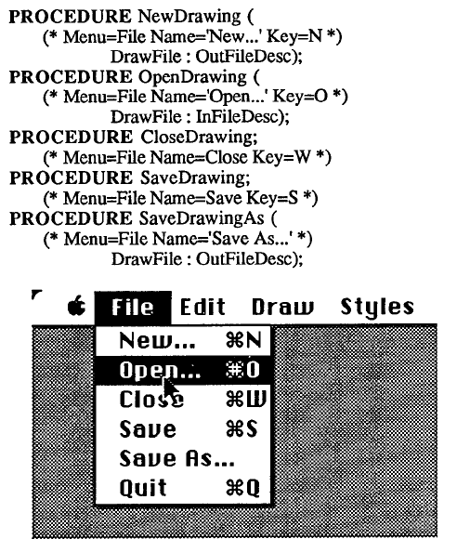
Example: Mickey
Programmer specifies UI by
putting special comments in a
Pascal file.
Uses the Apple Macintosh
guidelines
Pre-processor to parse the
Pascal code and generate the
Macintosh resources.
Maps Procedures into Menu
items.
  If parameter is one of a standard
  set, pops up appropriate dialog
  box or waits for input
    File to be read, file to be written
    New point, line or rectangle

Slide 8
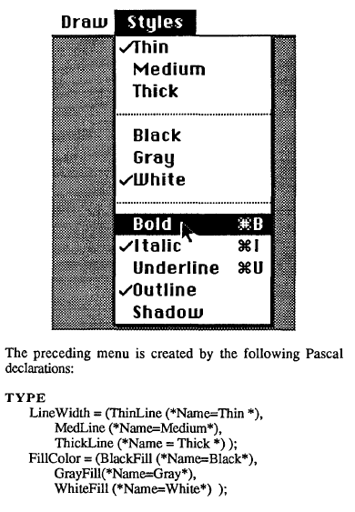
Mickey, cont.
Variables:
  Enumerated types mapped to
  check lists separated by lines. Sets the variables when changed.
  Enumerated types with 2 choices mapped to name changes
  Booleans: single checked items

Slide 9
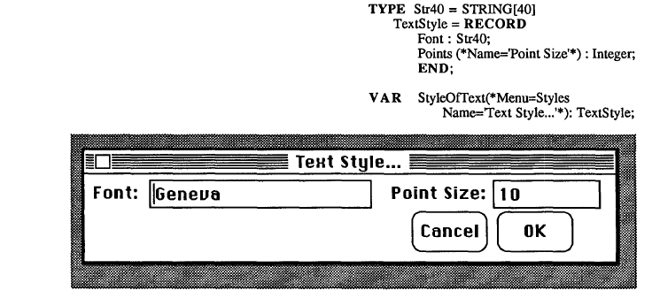
Mickey, cont.
  Records generate dialog boxes
    will pop up if a parameter to an invoked procedure, or if explicitly requested
  "Guard" routines allow setting variable to bold to also set property of the selected item.
    are "Demon" procedures

Slide 10
Mickey, cont.
Graying out items using a built-in procedural service routine
Evaluation
  + Don't have to worry about resources, etc.
  + Easy to keep code and resources in sync.
  - Very limited range
  - Generation Rules hardwired, so if UI not good enough, have to edit the generated code or resources.
  - Settings are right in the code, so can't be changed by user or internationalized.
  - Have to learn special comment forms and commands.
  - Long pre-process, compile, link, test loop.

Slide 11
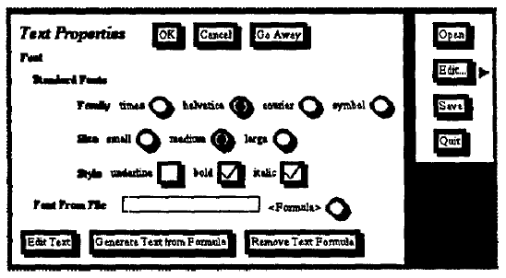
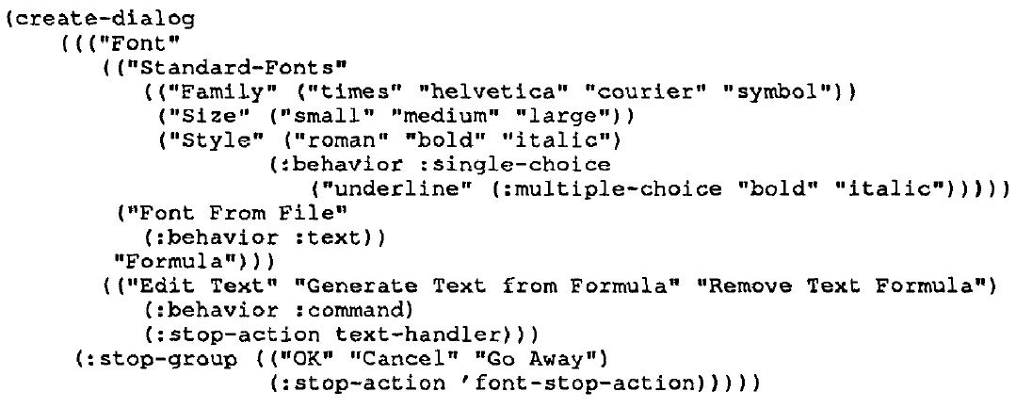
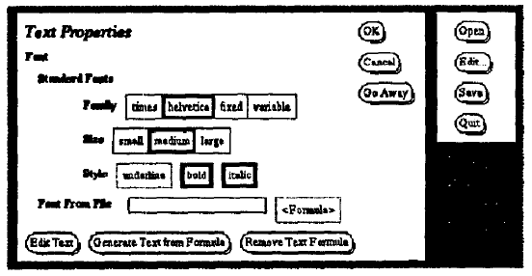
Jade
Brad Vander Zanden and Brad A. Myers, "Automatic, Look-and-Feel Independent Dialog Creation for Graphical User Interfaces," Proceedings SIGCHI'90: Human Factors in Computing Systems. Seattle, WA, April 1-5, 1990. pp. 27-34. ACM DL Reference
"Judgment-based Automatic Dialog Editor"
Given a textual specification of just the
contents and their types, creates a dialog box
  Separately specify which look-and-feel
  (not part of the specification)
  Defines mapping from types to widget
  selection
  Graphic design rules for "nice" layout

Slide 12
Jade, cont.
Graphical editor can be used afterwards to add decorations
Retained if the specification is edited since refer to higher-level abstractions of specification
  Also designed to support dynamic creation of dialog boxes when a program generates the contents list.
Can specify constraints to compute "enabled" based on values of other widgets
"Stop-action" for call-backs
Evaluation
  + Don't have to worry about layout, etc.
  - Have to use rigid syntax for specification

Slide 13
DON
(Won Chul Kim & Foley, InterCHI'93, pp. 430-437)
  ACM DL Reference
Ultimate in dialog box layout
Kim's PhD thesis
Works with OpenLook and devGuide
Allows interactive designer guidance (preferences) on sizes, layout, widget choice, etc.
  Can also choose among proposed layouts
Sophisticated 2-D layout
  Tries to balance dialog box
  Groupings of related items
  Effective use of white space (even margins, minimize wasted space)
  Generates multiple designs and uses an evaluation metric to choose.

Slide 14
Don, pictures
PDF, with other pictures

Slide 15
Generating Full UI
These next tools require a specification of the full UI
Usually have rule-based components
Specifications are in a special language

Slide 16
Interactive Transaction System (ITS)
Bennett, et.al., UIST'89 pp. 67-75
Wiecha, et.al. CHI'89, pp. 277-282
Wiecha, et.al., ACM TOIS, 8(3), Jul'90, pp. 204-236
Goal: capture designers knowledge as style rules
  So unlike other systems, designer is required to edit the rules, not just the specification
  All of UI must be created by editing the rules
    no interactive editing of generated interface (since then the knowledge about why the generated interface wasn't good enough would be lost)
Like dialog-box systems, separate specification of content and style
  Style-independent tags associated with content
  "Style expert" programs the style for each tag
  Styles include both output (display) and input (interaction techniques) specifications

Slide 17
ITS, cont.
Can handle dialog boxes, forms, node-link diagrams, kiosk frames, etc.
Used for a number of internal IBM applications
Used for all the information services at Expo'90 in Spain
  Information, maps, restaurant reservations, etc.
  IBM researchers and content experts were in Spain for months
Evaluation
  + Full representation of design may increase re-use
  - Design specification ends up containing many specific "hacks" used to achieve specific effects in single interfaces
  - Complex formal language for specification and rules
Pictures from ITS, TOIS, 8(3), pp. 213, 215, 217

Slide 18
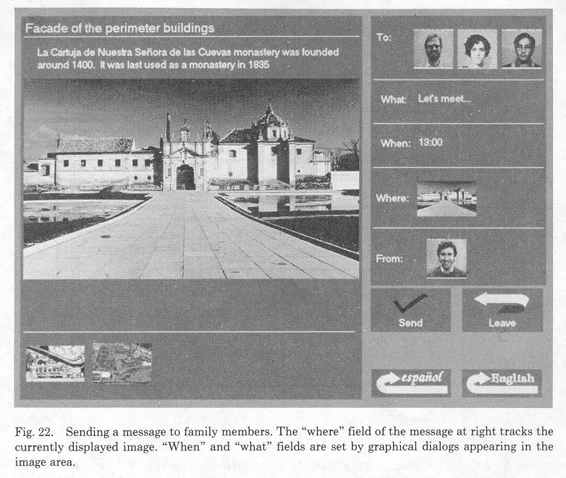
ITS, pictures
PDF

Slide 19
The User Interface Design Environment (UIDE)
Foley, et. al. CHI'88, pp. 67-72
Foley, et. al. IEEE Software, Jan'89, 25-32;
Sukaviriya, et. al. InterCHI'93, pp. 375-382
Long-term project of Foley's at George Washington and Georgia Tech
  Ended about 1994 when Foley left
A loose collection of separate implementations:
  IDL's transformations
  DON dialog boxes (described above)
  Sukaviriya's animated help
  Martin Frank's work (EET in Event-Based lecture)
  - etc.

Slide 20
UIDE
Programmer defines Knowledge-base "schemas" describing parts of the interface:
  Objects: in a class, sub-class inheritance hierarchy
    (e.g. shapes that can be drawn in an editor)
    Name
    Description (for help)
    Actions available
    Attributes that are settable

Slide 21
UIDE, Schemas, cont.
  Actions: what can be done in the interface
    Name
    Description
    Kind (explicit = ask user, implicit = global vble)
    Objects applied to
    Actions mutually exclusive with
    Inverse action (for Undo)
    Parameters
    Pre-conditions - enables action (e.g. obj selected)
    Post-conditions - assertions after action
    Attributes (colors, etc.)
    Attribute types (integer, real, boolean, etc.)

Slide 22
UIDE, cont.
Pre-conditions and post-conditions are in a very limited language
  counting, booleans, simple tests
  used for testing enabled and explaining why
Transformations change among equivalent UIs:
  e.g. Currently-selected obj <=> currently-selected cmd
  performed based on pre-, post-conditions
  example pictures: IEEE Software, Jan'89, p. 27-28

Slide 23
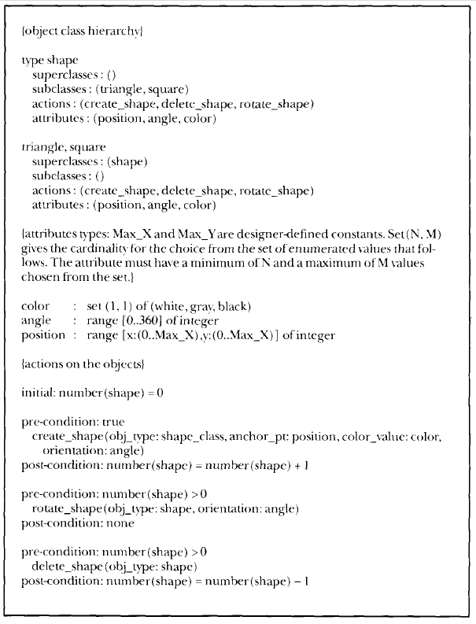
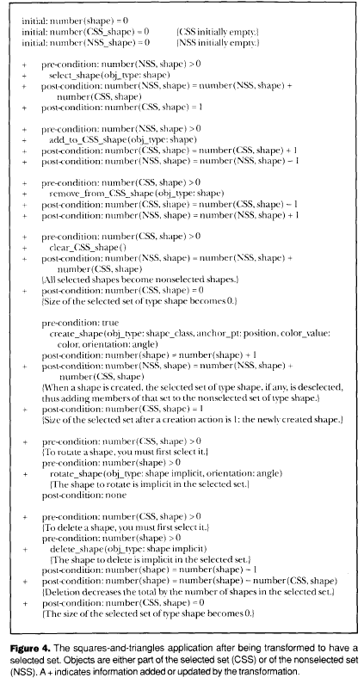
Pictures from UIDE

Slide 24
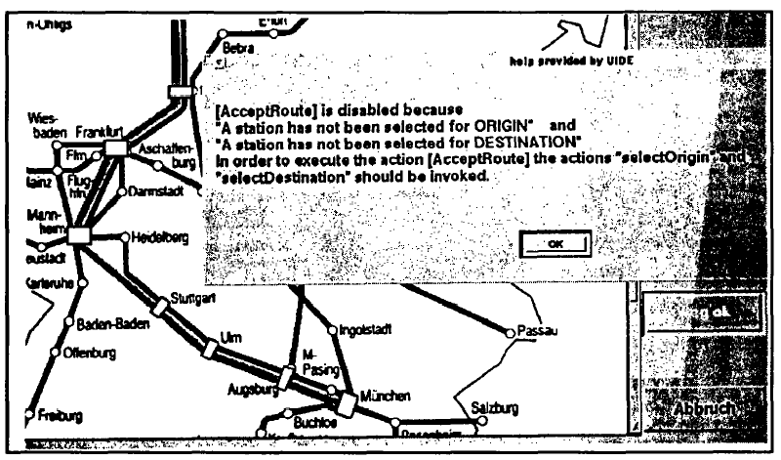
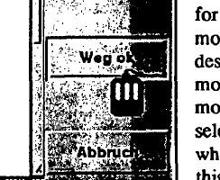
UIDE, cont.
Automatic generate help for why commands are not available
  Sukaviriya, et. al. AVI’94, Pages: 44 - 52
  Animated help provides animations as a tutorial
    Determines what needs to be done to demonstrate action
    Sequence of actions
    E.g. bring windows to the front, create an object, etc.

Slide 25
UIDE
Evaluation
  + Support for more than dialog boxes
  - Pre and post condition language is weak
    can't express the test "if the selected object is a polygon..."
  - Model language is a new, difficult language to learn

Slide 26
Humanoid
Szekely, et. al. UIST'90, pp. 1-9
Szekely, et. al. CHI'92, pp. 507-514
Szekely, et. al. InterCHI'93, pp. 383-390
High-level UIMS for Manufacturing Applications Needing Organized Iterative Development
Model application data and interaction similar to UIDE
Model whole application: semantics + interface

Slide 27
Humanoid, cont.
Four main components of model:
  Presentation
  Manipulation: what user can do, and what affects are
  Sequencing: order in which manipulations are enabled
    some constraints inferred, others specified
  Action side effects: what happens
System picks generic interaction techniques immediately using "templates"
Designer can refine interface iteratively by creating more specific sub-classes:
  Single-Command-Input-With-Alternatives
  Single-Command-Input-With-Few-Alternatives
  Allows exploration with incomplete designs

Slide 28
Humanoid, cont.
Interactive structure-editor to help with building the models
Was used for a number of large-scale (in-house) applications (unlike UIDE)
Evaluation
  + Much richer specification language than UIDE
  - More complex to define interfaces (more to learn)
    but interactive tools help
Pictures from Humanoid, CHI'93 pp. 384

Slide 29
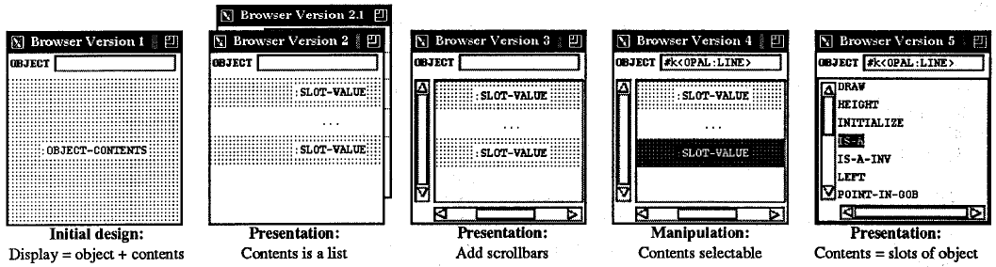
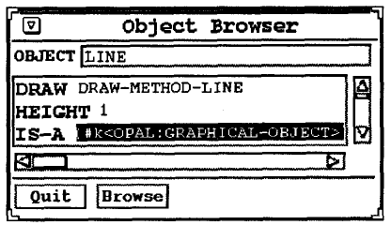
Humanoid Pictures

Slide 30
MasterMind
Neches, et. al. ACM 1993 Intelligent User Interfaces Workshop, pp. 63-70
Models Allowing Shared Tools and Explicit Representations to Make Interfaces Natural to Develop
Idea: combine UIDE and Humanoid
Support entire life-cycle: early conceptual design through maintenance
  Knowledge base is shared among all tools
Knowledge base serves as an integrating framework for various tools at design time and run time.
Spent a lot of time negotiating on how to combine models
Lots of different parts to the model
Personelle and coordination problems in doing the research
Used Amulet!

Slide 31
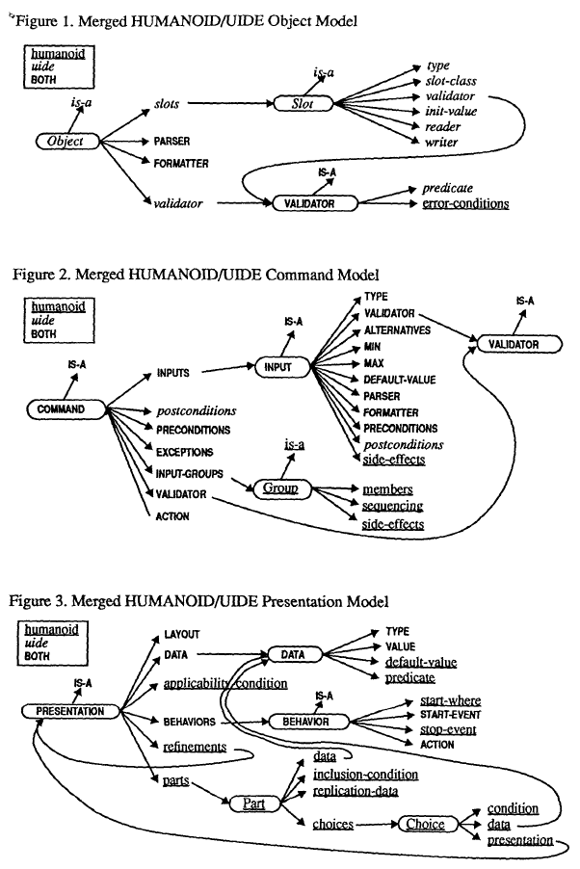
Mastermind
Pictures

Slide 32
Others
To some extent, web browsers to "model-based" layout from HTML
  Takes size of window into account a little
  Some user preferences (link color, etc.)
Could do a lot more
XML is a "model" of the data
Provide semantics to the content:
  uPnP, Salutation
  Jini kind-of, but includes UI?
More widely varying screens and interaction types may increase need for model-based design
E.g., WAP for cell-phones
Also for widely varying I/O devices:
  wall-size to cell-phone
  even different Windows CE sizes
Current PhD work of Jeff Nichols: "Personal Universal Controller"
These will be covered in next lecture

Slide 33
Model-based systems advantages/disadvantages
+ Separate specification of UI from content
+ Automatic reformatting, retargeting for different platforms, customization to users
+ May allow programmers (non-experts) to write specification and have a good UI automatically created
  But this didn’t really work out
– Result is often unpredictable
– Often UI can be worse UI than hand-drawn
– Sometimes model is larger than the code it would replace
– Model often in a different language that must be learned

