Slide 1
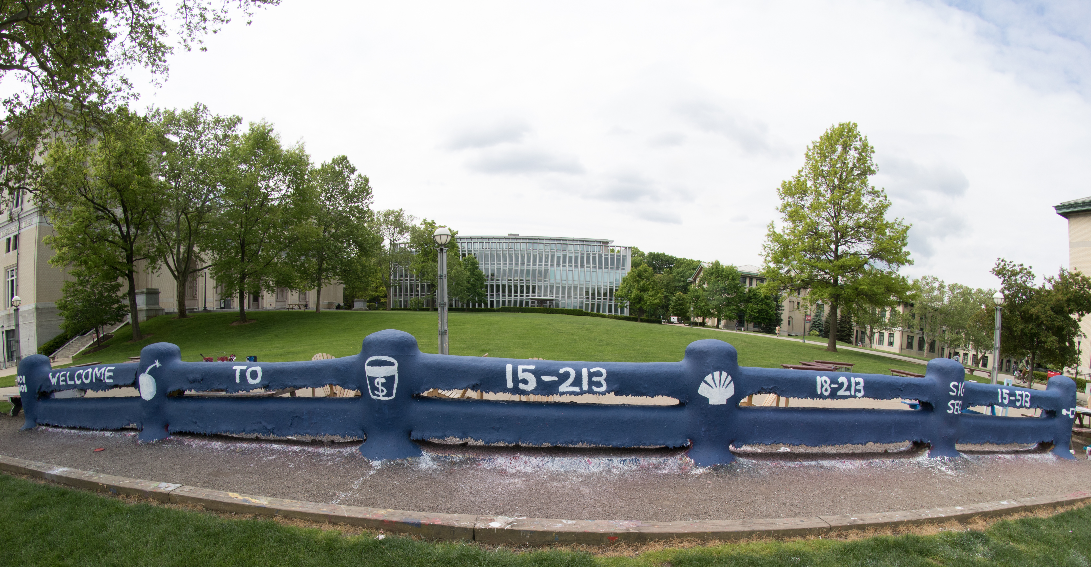
14-513
18-613

Slide 2
Machine-Level Programming I
15-213/14-513/15-513:
Introduction to Computer Systems, Fall 2026
3rd Lecture, September 1, 2026

Slide 3
Today: Machine Programming I: Basics
Assembly Basics: Registers, operands, move
Arithmetic & logical operations
Condition codes and jumps
C, assembly, machine code

Slide 4
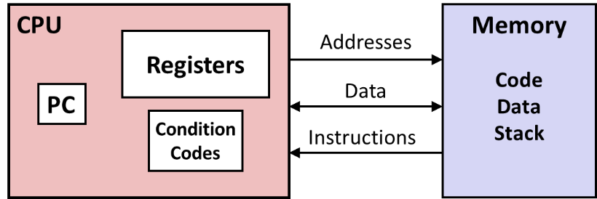
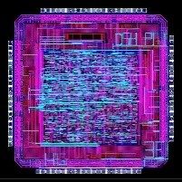
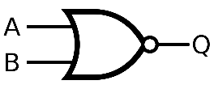
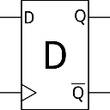
Context: Levels of Abstraction
#include <stdio.h>
int main(){
int i, n = 10, t1 = 0, t2 = 1, nxt;
for (i = 1; i <= n; ++i){
printf("%d, ", t1);
nxt = t1 + t2;
t1 = t2;
t2 = nxt; }
return 0; }
C programmer
Assembly programmer
Computer Designer
Gates, clocks, circuit layout, …

Slide 5
CPUs store data in Registers and Memory
Registers: Super-fast memory right on the CPU core itself.
  About 16 named registers on x86
Many instructions operate on registers
Registers are fixed-width, often 32 or 64 bits
“int x = 5; x *= y; x++” – x is probably stored in a register while being operated on frequently.
Registers are accessed by their name
“Memory” means DRAM, typically off-chip storage, bigger and cheaper and slower. When you call “malloc”, you usually get this.
Memory is accessed by (byte) address

Slide 6
Introduction to Assembly
Assembly is a programming language
  It has “types” (sort of)
  It has control flow shape
  It is an intermediate language, has very limited verbs, and
  operations are need to be explicit
Assembly is defined by the ISA
(instruction set architecture)
  x86, ARM, RISC-V, etc
Implemented by the microarchitecture
- e.g., a “core i7” x86 processor

Slide 7
Beginning Grammar
Say something in assembly:
Operation (op)
Register names
add %rbx, %rax
add %rbx, %rax
is
rax += rbx

Slide 8
Nouns
Registers
  Special parts of the CPU to hold small amounts of data, like local variables
  Names are limited and very specific:
  %r?x (a,b,c,d)
  %r?i (d,s)
  %r?p (b,i,s) // Special meanings
  %r? (8-15)
Memory
  Everything else; accessed by address.

Slide 9
X86 registers – some history
Intel created x86 in the 16-bit microprocessor 8086.
Its registers held 16 bits. So:
“ax”, the “accumulator”, stored 16 bits of data.
Initially the registers had a defined purpose. (They mostly don’t now.)
In 1985, Intel introduced the 32-bit 80386, and “e”xtended the registers to 32 bits, creating “eax”
In 2003, AMD introduced x86-64, growing registers to 64 bits and creating “rax”

Slide 10
x86-64 Integer Registers (reference)
%rax
%r8
%eax
%r8d
%rbx
%r9
%ebx
%r9d
%rcx
%r10
%ecx
%r10d
%rdx
%r11
%edx
%r11d
%rsi
%r12
%esi
%r12d
%rdi
%r13
%edi
%r13d
%rsp
%r14
%esp
%r14d
%rbp
%r15
%ebp
%r15d
  Can reference low-order 4 bytes (also low-order 1 & 2 bytes)
  Not part of memory (or cache)

Slide 11
Verbs (i.e., operations)
Transfer data between memory and register
  Load data from memory into register
  Store register data into memory
Perform arithmetic function on register or memory data
Transfer control
  Unconditional jumps to/from procedures
  Conditional branches
  Indirect branches

Slide 12
Verbs have optional suffix
Operation suffix specifies the size(s) involved
  There are also different register names for the different sizes
  Suffix Register Name Size (bytes)
  q r.. 8
  l e.. (usually) 4
  w see reference 2
  b see reference 1

Slide 13
Moving Data
x = 5
mov $5, %rax
x = y
mov %rcx, %rdx
x = *p
mov (%rsi), %r8

Slide 14
Memory
Parentheses always denote a memory address computation
  (%rdi) → *ptr
Most operations will then access memory

Slide 15
movq Operand Combinations (reference)
Source
Dest
Src,Dest
C Analog
Reg
movq $0x4,%rax
temp = 0x4;
Imm
Mem
movq $-147,(%rax)
*p = -147;
Reg
movq %rax,%rdx
temp2 = temp1;
movq
Reg
Mem
movq %rax,(%rdx)
*p = temp;
Mem
Reg
movq (%rax),%rdx
temp = *p;
Cannot do memory-memory transfer with a single instruction

Slide 16
Reading Assembly Example
void
whatAmI(<type> a, <type> b)
{
????
}
whatAmI:
movq (%rdi), %rax
movq (%rsi), %rdx
movq %rdx, (%rdi)
movq %rax, (%rsi)
ret
%rsi
%rdi
What is <type>?
Find %rdi in the assembly.
How is it used?

Slide 17
Reading Assembly Example
void swap
(long *xp, long *yp)
{
long t0 = *xp;
long t1 = *yp;
*xp = t1;
*yp = t0;
}
swap:
movq (%rdi), %rax
movq (%rsi), %rdx
movq %rdx, (%rdi)
movq %rax, (%rsi)
ret
We have now written the “pseudo-C” for the assembly, using the types and replacing each register with a “variable name”.

Slide 18
Understanding Swap()
Memory
void swap
(long *xp, long *yp)
{
long t0 = *xp;
long t1 = *yp;
*xp = t1;
*yp = t0;
}
Registers
%rdi
%rsi
%rax
%rdx
Register Value
%rdi xp
%rsi yp
%rax t0
%rdx t1
swap:
movq (%rdi), %rax # t0 = *xp
movq (%rsi), %rdx # t1 = *yp
movq %rdx, (%rdi) # *xp = t1
movq %rax, (%rsi) # *yp = t0
ret

Slide 19
Understanding Swap()
Memory
Registers
Address
123
0x120
%rdi
0x120
0x118
%rsi
0x100
0x110
%rax
0x108
%rdx
456
0x100
swap:
movq (%rdi), %rax # t0 = *xp
movq (%rsi), %rdx # t1 = *yp
movq %rdx, (%rdi) # *xp = t1
movq %rax, (%rsi) # *yp = t0
ret

Slide 20
Understanding Swap()
Memory
Registers
Address
123
0x120
%rdi
0x120
0x118
%rsi
0x100
0x110
%rax
123
0x108
%rdx
456
0x100
swap:
movq (%rdi), %rax # t0 = *xp
movq (%rsi), %rdx # t1 = *yp
movq %rdx, (%rdi) # *xp = t1
movq %rax, (%rsi) # *yp = t0
ret

Slide 21
Understanding Swap()
Memory
Registers
Address
123
0x120
%rdi
0x120
0x118
%rsi
0x100
0x110
%rax
123
0x108
%rdx
456
456
0x100
swap:
movq (%rdi), %rax # t0 = *xp
movq (%rsi), %rdx # t1 = *yp
movq %rdx, (%rdi) # *xp = t1
movq %rax, (%rsi) # *yp = t0
ret

Slide 22
Understanding Swap()
Memory
Registers
Address
456
0x120
%rdi
0x120
0x118
%rsi
0x100
0x110
%rax
123
0x108
%rdx
456
456
0x100
swap:
movq (%rdi), %rax # t0 = *xp
movq (%rsi), %rdx # t1 = *yp
movq %rdx, (%rdi) # *xp = t1
movq %rax, (%rsi) # *yp = t0
ret

Slide 23
Understanding Swap()
Memory
Registers
Address
456
0x120
%rdi
0x120
0x118
%rsi
0x100
0x110
%rax
123
0x108
%rdx
456
123
0x100
swap:
movq (%rdi), %rax # t0 = *xp
movq (%rsi), %rdx # t1 = *yp
movq %rdx, (%rdi) # *xp = t1
movq %rax, (%rsi) # *yp = t0
ret

Slide 24
More memory grammar
movq (%rdi), %rax
x = *rdi
movq (%rdi, %rsi), %rax
x = *(rdi + rsi)
movq (%rdi, %rsi, 4), %rax
x = *(rdi + 4 * rsi)
movq 0x80(%rdi, %rsi, 4), %rax
x = *(rdi + 4 * rsi + 0x80)

Slide 25
The memory ops make arrays easy
char *d;
int y;
char a = ‘\0’;
d[y] = a;
movb %ral, (%rdi, %rsi)

Slide 26
When array type is larger than a byte
int *d;
int s;
char a = 67;
d[y] = a;
movl %eax, (%rdi, %rsi, 4)
sizeof(int) == 4

Slide 27
Generalized memory grammar
D(Rb,Ri,S) Mem[Reg[Rb]+S*Reg[Ri]+ D]
  D Constant “displacement” 1, 2, or 4 bytes
  Rb Base register: Any of 16 integer registers
  Ri Index register: Any, except for %rsp
  S Scale: 1, 2, 4, or 8
If a value is “missing”, it is the identity element
  +0 or *1

Slide 28
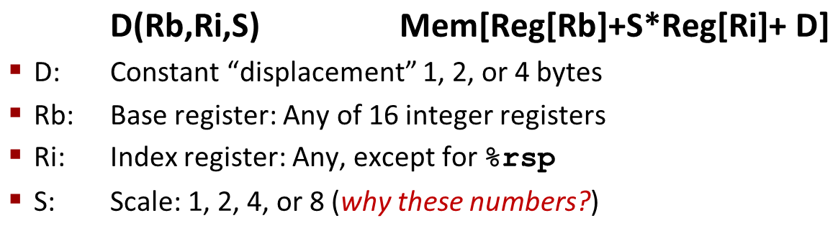
Address Computation Examples
%rdx | 0xf000
%rcx | 0x0100
Expression | Address Computation | Address
0x8(%rdx)
(%rdx,%rcx)
(%rdx,%rcx,4)
0x80(,%rdx,2)
Expression | Address Computation | Address
0x8(%rdx) | 0xf000 + 0x8 | 0xf008
(%rdx,%rcx) | 0xf000 + 0x100 | 0xf100
(%rdx,%rcx,4) | 0xf000 + 4*0x100 | 0xf400
0x80(,%rdx,2) | 2*0xf000 + 0x80 | 0x1e080
Notes:
0xf000 + 0x8 = 0xf008
0xf000 + 0x0100 = 0xf100
0xf000 + 4*0x0100 = 0xf400
2*0xf000 + 0x80 = 0x1d080

Slide 29
More Verbs
Two operands (think datalab)
  Format Computation
    addq Src,Dest Dest = Dest + Src
    salq Src,Dest Dest = Dest << Src Also called shlq
    sarq Src,Dest Dest = Dest >> Src Arithmetic
    shrq Src,Dest Dest = Dest >> Src Logical
    …
One operand (also datalab)
    incq Dest Dest = Dest + 1
    decq Dest Dest = Dest − 1
    negq Dest Dest = − Dest
    notq Dest Dest = ~Dest

Slide 30
Address Computation Instruction
leaq Src, Dst
  Src is address mode expression
  Set Dst to address denoted by expression
Uses
  Computing addresses without a memory reference
    E.g., translation of p = &x[i];
  Computing arithmetic expressions of the form x + k*y
    k = 1, 2, 4, or 8
Example
long m12(long x)
{
return x*12;
}
Converted to ASM by compiler:
leaq (%rdi,%rdi,2), %rax # t = x+2*x
salq $2, %rax # return t<<2
Notes:
The irregular verb

Slide 31
Registers have conventions
Architectural requirements:
  %rip – program counter / instruction pointer
    Only points to the next instruction to execute
  %rsp – stack pointer
    %rbp – sometimes also stack related
“Calling Convention” (must be agreed upon for interop!)
  %rax – return value
  %rdi – first argument
  %rsi – second argument
  %rdx – third argument
  …

Slide 32
Putting it Together
arith:
leaq (%rdi,%rsi), %rax
addq %rdx, %rax
leaq (%rsi,%rsi,2), %rdx
salq $4, %rdx
leaq 4(%rdi,%rdx), %rcx
imulq %rcx, %rax
ret
Arguments?
  How many?
  What type(s)?
Return value?
Local variables?
Interesting Instructions
  leaq: address computation
  salq: shift
  imulq: multiplication
    But, only used once
Notes:
Draw on slide or board

Slide 33
Arithmetic Expression Example
arith:
leaq (%rdi,%rsi), %rax
addq %rdx, %rax
leaq (%rsi,%rsi,2), %rdx
salq $4, %rdx
leaq 4(%rdi,%rdx), %rcx
imulq %rcx, %rax
ret
long arith
(long x, long y, long z)
{
long t1 = x+y;
long t2 = z+t1;
long t3 = x+4;
long t4 = y * 48;
long t5 = t3 + t4;
long rval = t2 * t5;
return rval;
}
Interesting Instructions
  leaq: address computation
  salq: shift
  imulq: multiplication
    But, only used once

Slide 34
Understanding Arithmetic Expression Example
arith:
leaq (%rdi,%rsi), %rax # t1
addq %rdx, %rax # t2
leaq (%rsi,%rsi,2), %rdx
salq $4, %rdx # t4
leaq 4(%rdi,%rdx), %rcx # t5
imulq %rcx, %rax # rval
ret
long arith
(long x, long y, long z)
{
long t1 = x+y;
long t2 = z+t1;
long t3 = x+4;
long t4 = y * 48;
long t5 = t3 + t4;
long rval = t2 * t5;
return rval;
}
Register | Use(s)
%rdi | Argument x
%rsi | Argument y
%rdx | Argument z, t4
%rax | t1, t2, rval
%rcx | t5

Slide 35
Quiz Time!
Check out:
https://canvas.cmu.edu/courses/55964/quizzes/169245

Slide 36
Expressing Inequality
We want to express numeric relations in assembly
  Equals, not equals
  Greater, less than

Slide 37
Control Flow
We also need assembly to make decisions based on these (in)equalities
  We call the sequence of instructions executed, the control flow

Slide 38
Control flow
extern void op1(void);
extern void op2(void);
void decision(int x) {
if (x) {
op1();
} else {
op2();
}
}
decision
x != 0
op2
op1
return

Slide 39
Control flow in assembly language
extern void op1(void);
extern void op2(void);
void decision(int x) {
if (x) {
op1();
} else {
op2();
}
}
decision:
testl %edi, %edi
je .L2
call op1
jmp .L1
.L2:
call op2
.L1:
ret
It’s all done with GOTO!
Notes:
The ret should probably be rep ; ret for historic reasons. The assembly is simplified to avoid any excess complexity.

Slide 40
Conditional “Goto”
How did the example work?
The first jump instruction is conditional
  It uses processor state set by the test instruction
  Processor has special registers to hold specific state
We call this specific state, “condition codes”
Notes:
Aside: On some architectures, there are predicate registers and we can explicitly see the condition codes in registers / the dependencies. X86 is implicitly using eflags.

Slide 41
Expressing Inequality
x86 has two instructions to set the specific state
  cmp
  test
Instructions other than lea also implicitly set the state on x86

Slide 42
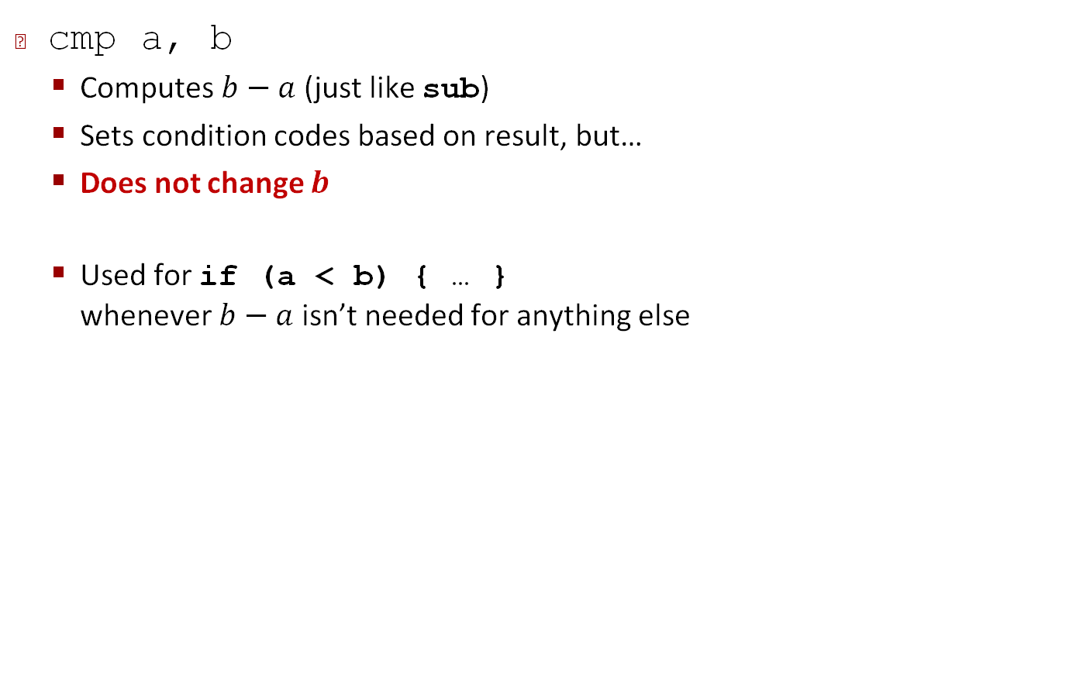
Compare Instruction
cmp a, b
  Computes $b−a$ (just like sub)
  Sets condition codes based on result, but…
  Does not change $b$
  Used for if (a < b) { … }
  whenever $b−a$ isn’t needed for anything else

Slide 43
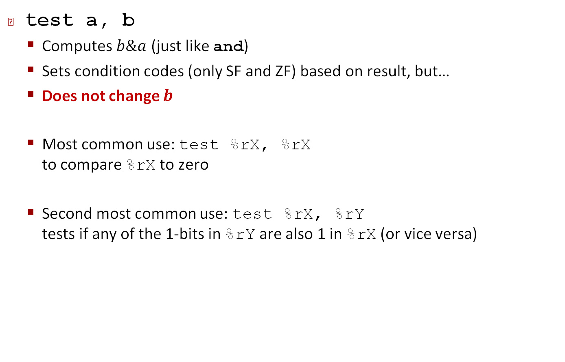
Test Instruction
test a, b
  Computes $b\&a$ (just like and)
  Sets condition codes (only SF and ZF) based on result, but…
  Does not change $b$
  Most common use: test %rX, %rX
  to compare %rX to zero
  Second most common use: test %rX, %rY
  tests if any of the 1-bits in %rY are also 1 in %rX (or vice versa)

Slide 44
Jumping
jX Instructions
  Jump to different part of code depending on condition codes
  jmp – unconditional
  Z
    ZERO
  GE
    Greater than or equal

Slide 45
Jumping (reference)
jX Instructions
  Jump to different part of code depending on condition codes
jX | Condition | Description
jmp | 1 | Unconditional
je | ZF | Equal / Zero
jne | ~ZF | Not Equal / Not Zero
js | SF | Negative
jns | ~SF | Nonnegative
jg | ~(SF^OF)&~ZF | Greater (Signed)
jge | ~(SF^OF) | Greater or Equal (Signed)
jl | (SF^OF) | Less (Signed)
jle | (SF^OF)|ZF | Less or Equal (Signed)
ja | ~CF&~ZF | Above (unsigned)
jb | CF | Below (unsigned)

Slide 46
Returning Condition Codes
setX will
  Set low-order byte of destination to 0 or 1 based on combinations of condition codes
  Does not alter remaining 7 bytes
int gt (long x, long y)
{
return x > y;
}
cmpq %rsi, %rdi # Compare x:y
  setg %al # Set when >
  movzbl %al, %eax # Zero rest of %rax
ret

Slide 47
movXYZ – Moving to larger bit widths
mov with three suffixes will move to larger bit widths
  X – {s,z}
    Sign extend
    Zero extend
  Y – source bit width
  Z – destination bit width
movzbl %al, %eax
  z – zero
  b – source is 1 byte
  l – destination is 4 bytes

Slide 48
Summary
Nouns
  Registers
Verbs
  Instructions or operations
Suffixes and Annotations
  Specify the size (usually optional)
  Memory addressing mode
Relations
  Relies on condition codes and conditional jump (i.e., goto)

Slide 49
Definitions
Architecture: (also ISA: instruction set architecture) The parts of a processor design that one needs to understand for writing assembly/machine code.
  Examples: instruction set specification, registers
Microarchitecture: Implementation of the architecture
  Examples: cache sizes and core frequency
Code Forms:
  Machine Code: The byte-level programs that a processor executes
  Assembly Code: A text representation of machine code
Example ISAs:
  Intel: x86, IA32, Itanium, x86-64
  ARM: Used in almost all mobile phones
  RISC V: New open-source ISA

Slide 50
Assembly/Machine Code View
CPU
Memory
Registers
Addresses
Data
Code
Data
Stack
PC
Condition
Codes
Instructions
Programmer-Visible State
  PC: Program counter
    Address of next instruction
    Called “RIP” (x86-64)
  Register file
    Heavily used program data
  Condition codes
    Store status information about most recent arithmetic or logical operation
    Used for conditional branching
  Memory
    Byte addressable array
    Code and user data
    Stack to support procedures

Slide 51
Where does it come from?
Assembly is usually generated by the compiler
  We can ask the compiler to show us the assembly
  We can also generate assembly from machine code
The compiler runs a separate tool that generates machine code
  Machine code is just bytes in memory
Execution gives bytes their “types”

Slide 52
Turning C into Object Code
  Code in files p1.c p2.c
  Compile with command: gcc –Og p1.c p2.c -o p
    Use debugging-friendly optimizations (-Og)
    Put resulting binary in file p
text
C program (p1.c p2.c)
Compiler (gcc –Og -S)
text
Asm program (p1.s p2.s)
Assembler (gcc –c or as)
binary
Object program (p1.o p2.o)
Static libraries (.a)
Linker (gcc or ld)
binary
Executable program (p)

Slide 53
Compiling Into Assembly
C Code (sum.c)
Generated x86-64 Assembly
long plus(long x, long y);
void sumstore(long x, long y,
long *dest)
{
long t = plus(x, y);
*dest = t;
}
sumstore:
pushq %rbx
movq %rdx, %rbx
call plus
movq %rax, (%rbx)
popq %rbx
ret
Obtain (on shark machine) with command
  gcc –Og –S sum.c
Produces file sum.s
Warning: Will get very different results on non-Shark machines (Andrew Linux, Mac OS-X, …) due to different versions of gcc and different compiler settings.

Slide 54
What it really looks like
.globl sumstore
.type sumstore, @function
sumstore:
.LFB35:
.cfi_startproc
pushq %rbx
.cfi_def_cfa_offset 16
.cfi_offset 3, -16
movq %rdx, %rbx
call plus
movq %rax, (%rbx)
popq %rbx
.cfi_def_cfa_offset 8
ret
.cfi_endproc
.LFE35:
.size sumstore, .-sumstore

Slide 55
What it really looks like
Things that look weird and are preceded by a ‘.’ are generally directives
.globl sumstore
.type sumstore, @function
sumstore:
.LFB35:
.cfi_startproc
pushq %rbx
.cfi_def_cfa_offset 16
.cfi_offset 3, -16
movq %rdx, %rbx
call plus
movq %rax, (%rbx)
popq %rbx
.cfi_def_cfa_offset 8
ret
.cfi_endproc
.LFE35:
.size sumstore, .-sumstore
sumstore:
pushq %rbx
movq %rdx, %rbx
call plus
movq %rax, (%rbx)
popq %rbx
ret

Slide 56
Object Code
Code for sumstore
Assembler
  Translates .s into .o
  Binary encoding of each instruction
  Nearly-complete image of executable code
  Missing linkages between code in different files
Linker
  Resolves references between files
  Combines with static run-time libraries
    E.g., code for malloc, printf
  Some libraries are dynamically linked
    Linking occurs when program begins execution
0x0400595:
0x53
0x48
0x89
0xd3
0xe8
0xf2
0xff
0xff
0xff
0x48
0x89
0x03
0x5b
0xc3
  Total of 14 bytes
  Each instruction 1, 3, or 5 bytes
  Starts at address 0x0400595

Slide 57
Machine Instruction Example
C Code
  Store value t where designated by dest
Assembly
  Move 8-byte value to memory
    Quad words in x86-64 parlance
  Operands:
    t: Register %rax
    dest: Register %rbx
    *dest: Memory M[%rbx]
Object Code
  3-byte instruction
  Stored at address 0x40059e
*dest = t;
movq %rax, (%rbx)
0x40059e: 48 89 03

Slide 58
Disassembling Object Code
Disassembled
0000000000400595 <sumstore>:
400595: 53 push %rbx
400596: 48 89 d3 mov %rdx,%rbx
400599: e8 f2 ff ff ff callq 400590 <plus>
40059e: 48 89 03 mov %rax,(%rbx)
4005a1: 5b pop %rbx
4005a2: c3 retq
Disassembler
  objdump –d sum
  Useful tool for examining object code
  Analyzes bit pattern of series of instructions
  Produces approximate rendition of assembly code
  Can be run on either a.out (complete executable) or .o file

Slide 59
Alternate Disassembly
Disassembled
Dump of assembler code for function sumstore:
0x0000000000400595 <+0>: push %rbx
0x0000000000400596 <+1>: mov %rdx,%rbx
0x0000000000400599 <+4>: callq 0x400590 <plus>
0x000000000040059e <+9>: mov %rax,(%rbx)
0x00000000004005a1 <+12>:pop %rbx
0x00000000004005a2 <+13>:retq
Within gdb Debugger
  Disassemble procedure
  gdb sum
  disassemble sumstore

Slide 60
Alternate Disassembly
Disassembled
Object
Code
Dump of assembler code for function sumstore:
0x0000000000400595 <+0>: push %rbx
0x0000000000400596 <+1>: mov %rdx,%rbx
0x0000000000400599 <+4>: callq 0x400590 <plus>
0x000000000040059e <+9>: mov %rax,(%rbx)
0x00000000004005a1 <+12>:pop %rbx
0x00000000004005a2 <+13>:retq
0x0400595:
0x53
0x48
0x89
0xd3
0xe8
0xf2
0xff
0xff
0xff
0x48
0x89
0x03
0x5b
0xc3
Within gdb Debugger
  Disassemble procedure
  gdb sum
  disassemble sumstore
  Examine the 14 bytes starting at sumstore
  x/14xb sumstore

Slide 61
What Can be Disassembled?
% objdump -d WINWORD.EXE
WINWORD.EXE: file format pei-i386
No symbols in "WINWORD.EXE".
Disassembly of section .text:
30001000 <.text>:
30001000: 55 push %ebp
30001001: 8b ec mov %esp,%ebp
30001003: 6a ff push $0xffffffff
30001005: 68 90 10 00 30 push $0x30001090
3000100a: 68 91 dc 4c 30 push $0x304cdc91
Reverse engineering forbidden by
Microsoft End User License Agreement
Anything that can be interpreted as executable code
Disassembler examines bytes and reconstructs assembly source

Slide 62
Additional Slides

Slide 63
Some History: IA32 Registers
Origin
(mostly obsolete)
%eax
%ax
%ah
%al
accumulate
%ecx
%cx
%ch
%cl
counter
%edx
%dx
%dh
%dl
data
general purpose
%ebx
%bx
%bh
%bl
base
%esi
source
index
%si
%edi
destination
index
%di
%esp
stack
pointer
%sp
%ebp
base
pointer
%bp
16-bit virtual registers
(backwards compatibility)

Slide 64
Machine Programming I: Summary
History of Intel processors and architectures
  Evolutionary design leads to many quirks and artifacts
C, assembly, machine code
  New forms of visible state: program counter, registers, ...
  Compiler must transform statements, expressions, procedures into low-level instruction sequences
Assembly Basics: Registers, operands, move
  The x86-64 move instructions cover wide range of data movement forms
Arithmetic
  C compiler will figure out different instruction combinations to carry out computation

Slide 65
History: Machine Programming I: Basics
History of Intel processors and architectures
Assembly Basics: Registers, operands, move
Arithmetic & logical operations
C, assembly, machine code

Slide 66
Intel x86 Processors
Dominate laptop/desktop/server market
Evolutionary design
  Backwards compatible up until 8086, introduced in 1978
  Added more features as time goes on
    Now 3 volumes, about 5,000 pages of documentation
Complex instruction set computer (CISC)
  Many different instructions with many different formats
    But, only small subset encountered with Linux programs
  Hard to match performance of Reduced Instruction Set Computers (RISC)
  But, Intel has done just that!
    In terms of speed. Less so for low power.

Slide 67
Intel x86 Evolution: Milestones
Name Date Transistors MHz
8086 1978 29K 5-10
  First 16-bit Intel processor. Basis for IBM PC & DOS
  1MB address space
386 1985 275K 16-33
  First 32 bit Intel processor , referred to as IA32
  Added “flat addressing”, capable of running Unix
Pentium 4E 2004 125M 2800-3800
  First 64-bit Intel x86 processor, referred to as x86-64
Core 2 2006 291M 1060-3333
  First multi-core Intel processor
Core i7 2008 731M 1600-4400
  Four cores (our shark machines)

Slide 68
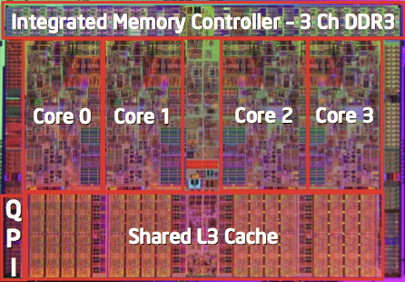
Intel x86 Processors, cont.
Machine Evolution
  386 1985 0.3M
  Pentium 1993 3.1M
  Pentium/MMX 1997 4.5M
  PentiumPro 1995 6.5M
  Pentium III 1999 8.2M
  Pentium 4 2000 42M
  Core 2 Duo 2006 291M
  Core i7 2008 731M
  Core i7 Skylake 2015 1.9B
Added Features
  Instructions to support multimedia operations
  Instructions to enable more efficient conditional operations
  Transition from 32 bits to 64 bits
  More cores

Slide 69
Intel x86 Processors, cont.
Past Generations
  1st Pentium Pro 1995 600 nm
  1st Pentium III 1999 250 nm
  1st Pentium 4 2000 180 nm
  1st Core 2 Duo 2006 65 nm
Recent & Upcoming Generations
  Nehalem 2008 45 nm
  Sandy Bridge 2011 32 nm
  Ivy Bridge 2012 22 nm
  Haswell 2013 22 nm
  Broadwell 2014 14 nm
  Skylake 2015 14 nm
  Kaby Lake 2016 14 nm
  Coffee Lake 2017 14 nm
  Cannon Lake 2018 10 nm
  Ice Lake 2019 10 nm
  Tiger Lake 2020 10 nm
  Alder Lake 2022 “intel 7” (10nm+++)
Process technology
Process technology dimension
= width of narrowest wires
(10 nm ≈ 100 atoms wide)
(But this is changing now.)

Slide 70
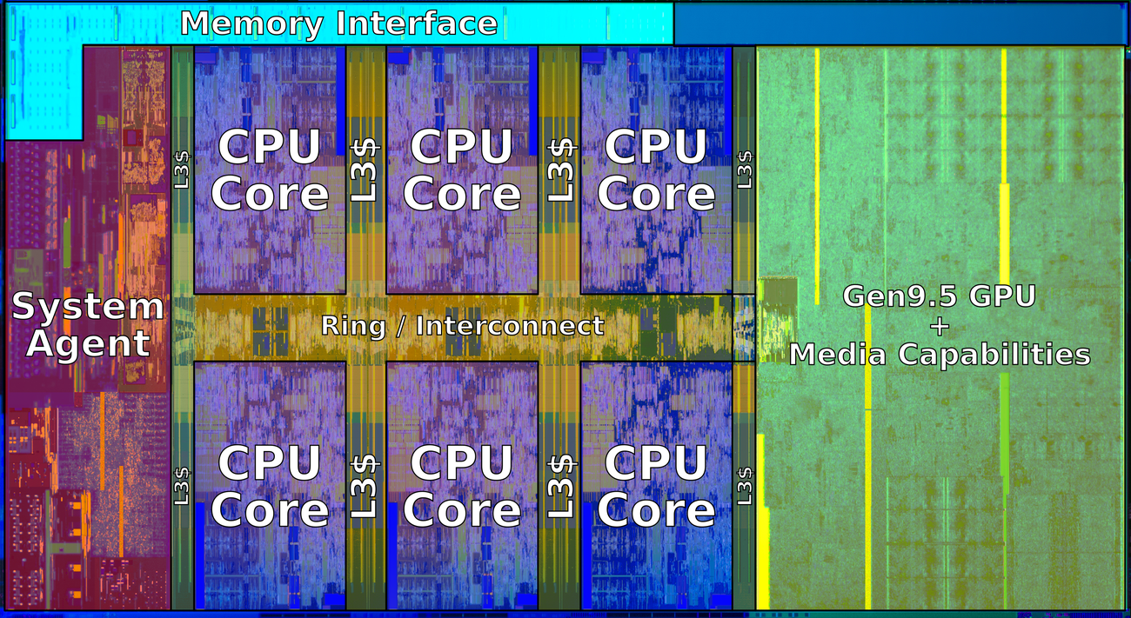
2018 State of the Art: Coffee Lake
Mobile Model: Core i7
  2.2-3.2 GHz
  45 W
Server Model: Xeon E
  Integrated graphics
  Multi-socket enabled
  3.3-3.8 GHz
  80-95 W
Desktop Model: Core i7
  Integrated graphics
  2.4-4.0 GHz
  35-95 W

Slide 71
x86 Clones: Advanced Micro Devices (AMD)
Historically
  AMD has followed just behind Intel
  A little bit slower, a lot cheaper
Then
  Recruited top circuit designers from Digital Equipment Corp. and other downward trending companies
  Built Opteron: tough competitor to Pentium 4
  Developed x86-64, their own extension to 64 bits
Recent Years
  Intel got its act together
    1995-2011: Lead semiconductor “fab” in world
    2018: #2 largest by $$ (#1 is Samsung)
    2019: reclaimed #1
  AMD fell behind: Spun off GlobalFoundaries
  2019-20: Pulled ahead! Used TSMC for part of fab
  2022: Intel re-took the lead

Slide 72
Intel’s 64-Bit History
2001: Intel Attempts Radical Shift from IA32 to IA64
  Totally different architecture (Itanium)
  Executes IA32 code only as legacy
  Performance disappointing
2003: AMD Steps in with Evolutionary Solution
  x86-64 (now called “AMD64”)
Intel Felt Obligated to Focus on IA64
  Hard to admit mistake or that AMD is better
2004: Intel Announces EM64T extension to IA32
  Extended Memory 64-bit Technology
  Almost identical to x86-64!
All but low-end x86 processors support x86-64
  But, lots of code still runs in 32-bit mode

Slide 73
Our Coverage
IA32
  The traditional x86
  For 15/18-213: RIP, Summer 2015
x86-64
  The standard
  shark> gcc hello.c
  shark> gcc –m64 hello.c
Presentation
  Book covers x86-64
  Web aside on IA32
  We will only cover x86-64

