Slide 1
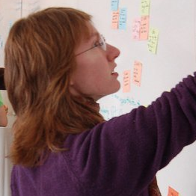
Scalable Statistical Relational Learning for NLP: Part 3/3
William Y. Wang
William W. Cohen Machine Learning Dept and Language Technologies Inst.
joint work with:
Kathryn Rivard Mazaitis

Slide 2
Logic
Scalability
Machine Learning
Probabilistic
First-order
Methods
Abstract Machines, Binarization
Scalable Probabilistic
Logic
Scalable ML

Slide 3
Outline
Motivation
Background
Logic
Probability
Combining logic and probabilities: MLNs
ProPPR
Key ideas
Learning method
Results for parameter learning
Structure learning for ProPPR for KB completion
Comparison to neural KBC models
Joint IE and KB completion
Beyond ProPPR
….

Slide 4
Relational Learning Systems
MLNs
ProPPR
Task |  | Task |  | Task
2. First order program |  | Clausal 1st-order logic |  | Function-free Prolog (Datalog)
3. “Compiled” representation |  | Undirected graphical model |  | Graph with feature-vector labeled edges
Inference | Learning | approx | approx | PPR (RWR) | pSGD
formalization
easy
harder?
+DB
“compilation”
sublinear in DB size
expensive
fast
can parallelize
linear
fast, but
not convex

Slide 5
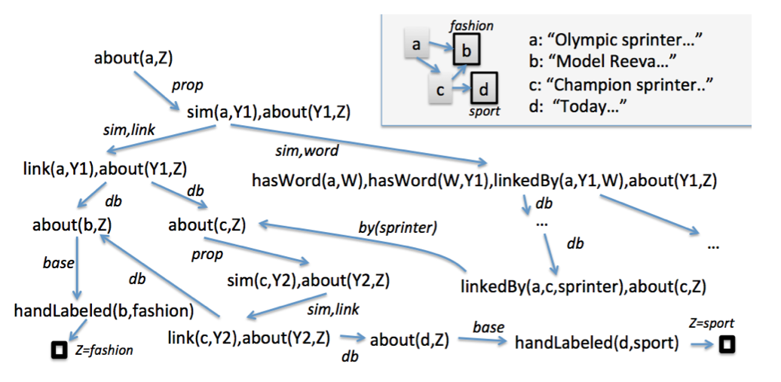
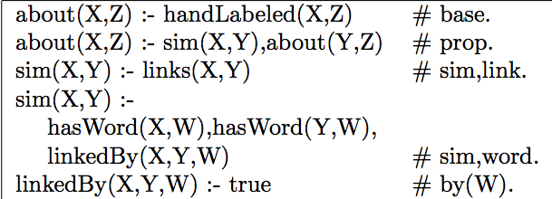
Query: about (a,Z)
DB
Program + DB + Query define a proof graph, where nodes are conjunctions of goals and edges are labeled with sets of features.
Program (label propagation)
LHS ➔ features

Slide 6
Every node has an implicit reset link
Low probability
High probability
Short, direct paths from root
Longer, indirect paths from root
Transition probabilities, Pr(child|parent), plus Personalized PageRank (aka Random-Walk-With-Reset) define a distribution over nodes.
Very fast approximate methods for PPR
Transition probabilities, Pr(child|parent), are defined by weighted sum of edge features, followed by normalization.
Learning via pSGD

Slide 7
Results – parameter learning for large mutually recursive theories
[Wang et al, MLJ, in press]
Theories/programs learned by PRA (Lao et al) over six subsets of NELL, rewritten to be mutullyy recursive
100k facts in KB
1M facts in KB
 | #rules | AUC | sec | #rules | AUC | sec
PRA 1 | ~ 430-540 | 88.4 – 95.2 | 5-10s with 16 threads | ~ 550 | 95.5 | 15-18s with 16 threads
PRA 2 | ~ 620-770 | 91.6 – 95.4 |  | ~ 800 | 96.0
PRA 3 | ~800-1000 | 95.2 – 95.9 |  | ~1000 | 96.4
Alchemy MLNs: 960 – 8600s for a DB with 1k facts

Slide 8
Outline
Motivation
Background
Logic
Probability
Combining logic and probabilities: MLNs
ProPPR
Key ideas
Learning method
Results for parameter learning
Structure learning for ProPPR for KB completion
Comparison to neural KBC models
Joint IE and KB completion
Beyond ProPPR
….

Slide 9
Query: about (a,Z)
DB
Where does the program come from?
First version: humans or external learner (PRA)
Program (label propagation)
LHS ➔ features

Slide 10
Features generated from using the interpreter correspond to specific rules in the sublanguage
Logic program is an interpreter for a program containing all possible rules from a sublanguage
interpreter
#f(…)
Where does the program come from?
Use parameter learning to suggest structure
Program (label propagation)
LHS ➔ features

Slide 11
Logic program is an interpreter for a program containing all possible rules from a sublanguage
Query₀: sibling(malia,Z)
DB₀: sister(malia,sasha), mother(malia,michelle), …
Query: interp(sibling,malia,Z)
DB: rel(sister,malia,sasha), rel(mother,malia,michelle), …
Interpreter for all clauses of the form P(X,Y) :- Q(X,Y):
interp(P,X,Y) :- rel(P,X,Y).
interp(P,X,Y) :- interp(Q,X,Y), assumeRule(P,Q).
assumeRule(P,Q) :- true # f(P,Q). // P(X,Y):-Q(X,Y)
interp(sibling,malia,Z)
rel(Q,malia,Z), assumeRule(sibling,Q),…
Features correspond to specific rules
assumeRule(sibling,sister),…
assumeRule(sibling,mother),…
f(sibling,sister)
f(sibling,mother)
…
…
Z=sasha
Z=michelle

Slide 12
Logic program is an interpreter for a program containing all possible rules from a sublanguage
Features ~ rules. For example:
f(sibling,sister) ~ sibling(X,Y):-sister(X,Y).
Gradient of parameters (feature weights) informs you about what rules could be added to the theory…
Query: interp(sibling,malia,Z)
DB: rel(sister,malia,sasha), rel(mother,malia,michelle), …
Interpreter for all clauses of the form P(X,Y) :- Q(X,Y):
interp(P,X,Y) :- rel(P,X,Y).
interp(P,X,Y) :- interp(Q,X,Y), assumeRule(P,Q).
assumeRule(P,Q) :- true # f(P,Q). // P(X,Y):-Q(X,Y)
interp(sibling,malia,Z)
rel(Q,malia,Z), assumeRule(sibling,Q),…
Added rule:
Interp(sibling,X,Y) :- interp(sister,X,Y).
assumeRule(sibling,sister),…
assumeRule(sibling,mother),…
f(sibling,sister)
f(sibling,mother)
…
…
Z=sasha
Z=michelle

Slide 13
Structure Learning in ProPPR
[Wang et al, CIKM 2014]
Iterative Structural Gradient (ISG):
Construct interpretive theory for sublanguage
Until structure doesn’t change:
Compute gradient of parameters wrt data
For each parameter with a useful gradient:
Add the corresponding rule to the theory
Train the parameters of the learned theory
templates
P(X,Y) :- R(X,Y)
P(X,Y) :- R(Y,X)
P(X,Y) :- R1(X,Z),R2(Z,Y)

Slide 14
Logic
Scalability
Machine Learning
Probabilistic
First-order
Methods
Abstract Machines, Binarization
Scalable Probabilistic
Logic
hometown?
?
Scalable ML
?

Slide 15
Structure Learning for KB Completion
Input: an KB
Facts about many relations that are mutually informative about each other
There may be noise
There will be missing facts
Output:
New facts for the KB that “fill in the blanks”
Possible evaluations:
Reconstruct some heldout facts from a complete KB
Use MTurk or similar to assess new facts

Slide 17
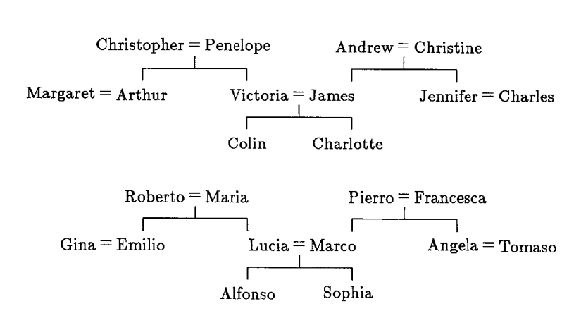
Structure Learning For Expressive Languages From Incomplete DBs is Hard
two families and 12 relations: brother, sister, aunt, uncle, …
corresponds to 112 “beliefs”: wife(christopher,penelope), daughter(penelope,victoria), brother(arthur,victoria), …
and 104 “queries”: uncle(charlotte,Y) with positive and negative “answers”: [Y=arthur]+, [Y=james]-, …
experiment:
repeat n times
hold out four test queries
for each relation R:
learn rules predicting R from the other relations
test

Slide 18
Structure Learning: Example
two families and 12 relations: brother, sister, aunt, uncle, …
Result:
7/8 tests correct (Hinton 1986)
78/80 tests correct (Quinlan 1990, FOIL)
Result, leave-one-relation out:
FOIL: perfect on 12/12 relations; Alchemy perfect on 11/12
:
repeat n times
hold out four test queries
for each relation R:
learn rules predicting R from the other relations
test

Slide 19
Structure Learning: Example
two families and 12 relations: brother, sister, aunt, uncle, …
Result:
7/8 tests correct (Hinton 1986)
78/80 tests correct (Quinlan 1990, FOIL)
Result, leave-one-relation out:
FOIL: perfect on 12/12 relations; Alchemy perfect on 11/12
Result, leave-two-relations out:
FOIL: 0% on every trial
Alchemy: 27% MAP
Why?
In learning R1, FOIL approximates meaning of R2 using the examples not the partially learned program
Typical FOIL result:
uncle(A,B) ⬅ husband(A,C),aunt(C,B)
aunt(A,B) ⬅ wife(A,C),uncle(C,B)
“Pseudo-likelihood trap”

Slide 20
Structure Learning: Example
two families and 12 relations: brother, sister, aunt, uncle, …
New experiment (3):
One family is train, one is test
Use 95% of the beliefs as KB
Use 100% of the training-family beliefs as training
Use 100% of the test-family beliefs as test
I.e.: learning to complete a KB that has 5% missing data
Repeat for 5%, 10%, ….

Slide 21
KB Completion

Slide 22
KB Completion
ISG
Why?
We can afford to actually test the program, using the combination of the interpreter and approximate PPR
This means we can learn AI/KR&R based probabilistic logical forms to fill in a noisy, incomplete KB

Slide 23
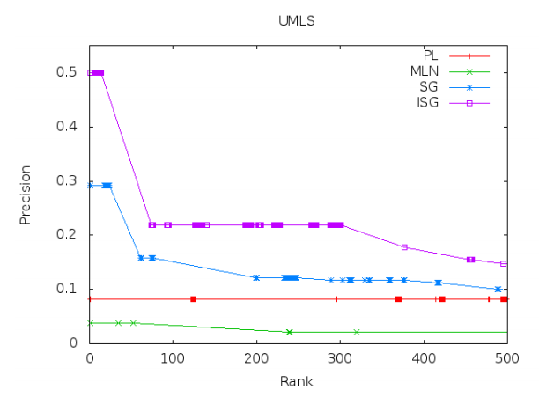
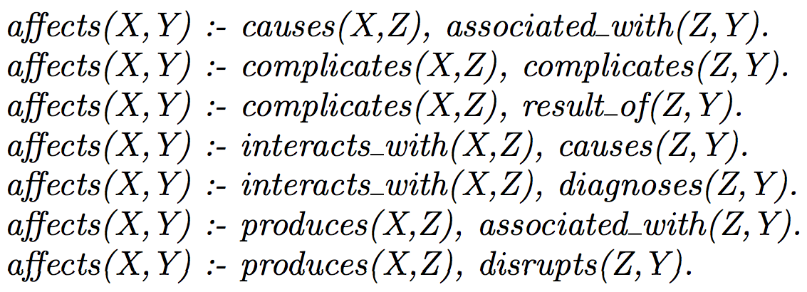
Results on UMLS

Slide 24
Scaling Up Structure Learning
Experiment
2000+ Wikipedia pages on “European royal families”
15 Infobox relations: birthPlace, child, spouse, commander, …
Randomly delete some relation instances, run ISG to find a theory that models the rest, and compute MAP of predictions.
 | 10% deleted | 50% deleted
MLNs/Alchemy | 60.8 | 38.8
ProPPR/ISG | 79.5 | 61.9
MAP - Similar results on two other InfoBox datasets, NELL

Slide 25
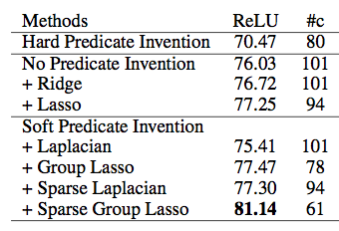
Experiments: Royal Families using structured regularization and L1-regularization
Regularization
MAP Results with structural gradient learner.

Slide 26
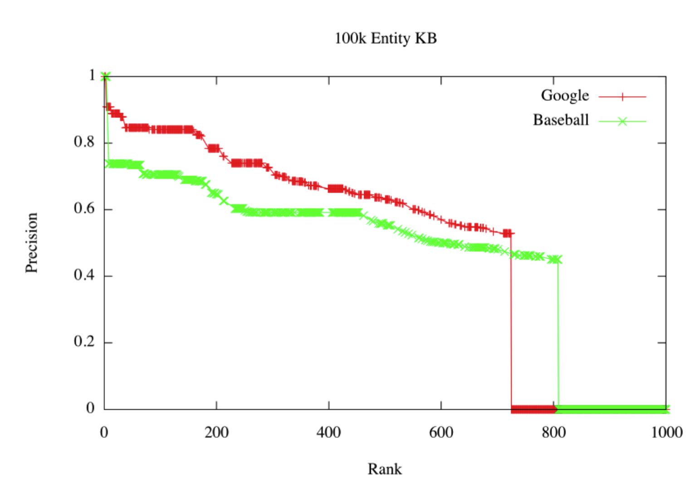
Completing the NELL KB

Slide 27
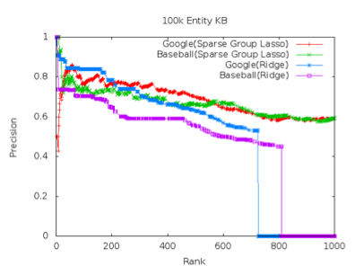
Completing the NELL KB

Slide 28
Outline
Motivation
Background
Logic
Probability
Combining logic and probabilities: MLNs
ProPPR
Key ideas
Learning method
Results for parameter learning
Structure learning for ProPPR for KB completion
Comparison to neural KBC models
Joint IE and KB completion
Beyond ProPPR
….

Slide 29
Neural KB Completion Methods
Lots of work on KBC using neural models broadly similar to word2vec
word2vec learns a low-dimensional embedding e(w) of a word w that makes it easy to predict the “context features” of a w
i.e., the words that tend to cooccur with w
Often these embeddings can be used to derive relations
E(london) ~= E(paris) + [E(france) – E(england)]
TransE: can we use similar methods to learn relations?
E(london) ~= E(england) + E(capitalCityOfCountry)

Slide 30
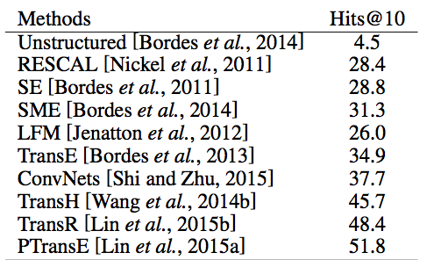
Neural KB Completion Methods
Freebase 15k

Slide 31
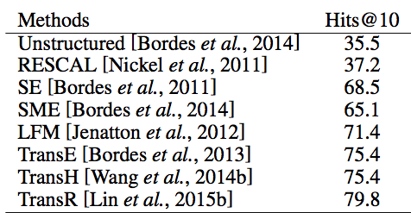
Neural KB Completion Methods
Wordnet

Slide 32
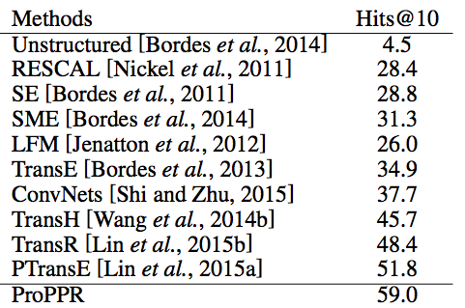
Neural KB Completion Methods
Freebase 15k

Slide 33
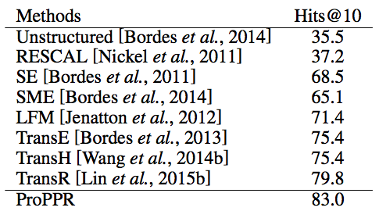
Neural KB Completion Methods
Wordnet

Slide 34
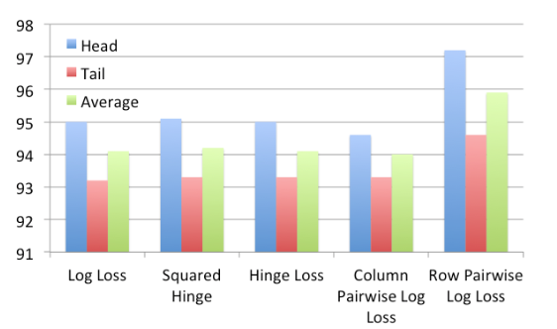
Under submission, 2016
Based on Bayesian Personalized Ranking: all formulas in a positive proof should be ranked above all unused formulas
New parameter-learning method similar to universal schema algorithm (Wordnet dev)

Slide 35
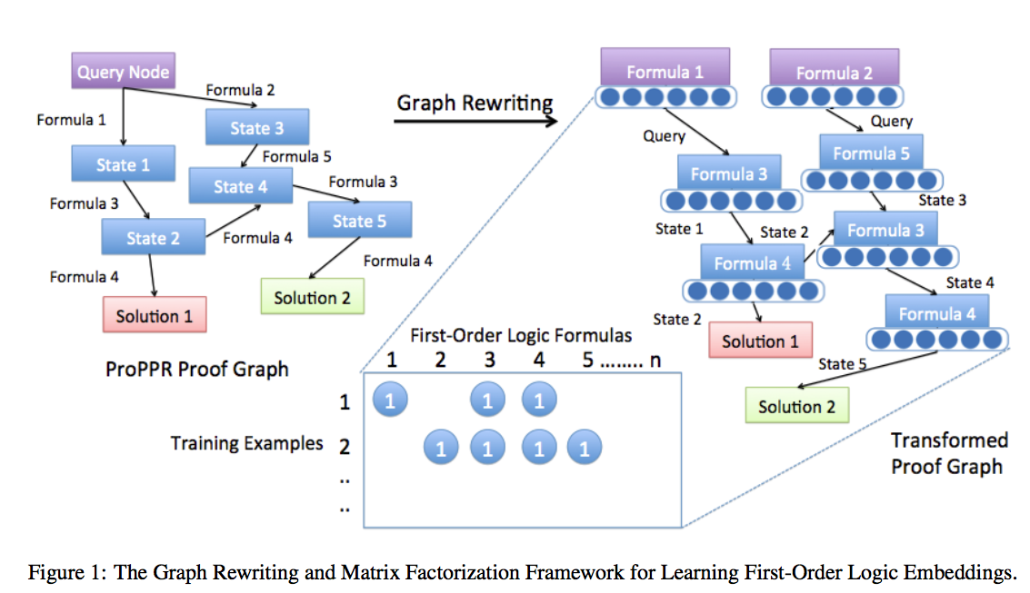

Slide 36
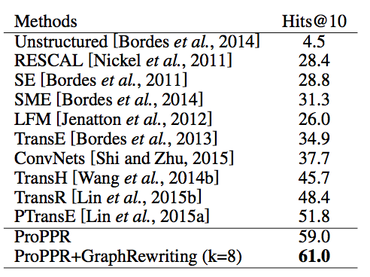
Neural KB Completion Methods
Freebase 15k

Slide 37
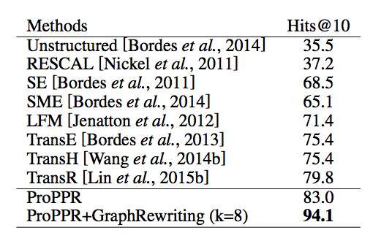
Neural KB Completion Methods
Wordnet

Slide 38
Outline
Motivation
Background
Logic
Probability
Combining logic and probabilities: MLNs
ProPPR
Key ideas
Learning method
Results for parameter learning
Structure learning for ProPPR for KB completion
Joint IE and KB completion
Comparison to neural KBC models
Beyond ProPPR
….

Slide 39
Recap: Structure Learning in ProPPR
[Wang et al, CIKM 2014]
Iterative Structural Gradient (ISG):
Construct interpretive theory for sublanguage
Until structure doesn’t change:
Compute gradient of parameters wrt data
For each parameter with a useful gradient:
Add the corresponding rule to the theory
Train the parameters of the learned theory
templates
P(X,Y) :- R(X,Y)
P(X,Y) :- R(Y,X)
P(X,Y) :- R1(X,Z),R2(Z,Y)

Slide 40
Recap: Structure Learning Dataset
Experiment
2000+ Wikipedia pages on “European royal families”
15 Infobox relations: birthPlace, child, spouse, commander, …
Randomly delete some relation instances, run ISG to find a theory that models the rest, and compute MAP of predictions.
 | 10% deleted | 50% deleted
MLNs/Alchemy | 60.8 | 38.8
ProPPR/ISG | 79.5 | 61.9
MAP - Similar results on two other InfoBox datasets, NELL

Slide 41
IE in ProPPR
In March 1849 her father-in-law <a href=“Charles_Albert_of_Sardinia”> Charles Albert</a> abdicated …
Experiment
Same data and protocol
Add facts: nearHyperlink(Word,Src,Dst) for Src,Dst in data
Add rules like:
interp(Rel,Src,Dst) :-
nearHyperlink(Word,Src,Dst), indicates(Word,Rel).
indicates(Word,Rel) :- true # f(Word,Rel)
~= 67.5k links
This is distant supervision:
we know the tuple (rel,src,dst), but not a label for this hyperlink
hyperlink label is latent, and marginalized out by the PPR inference

Slide 42
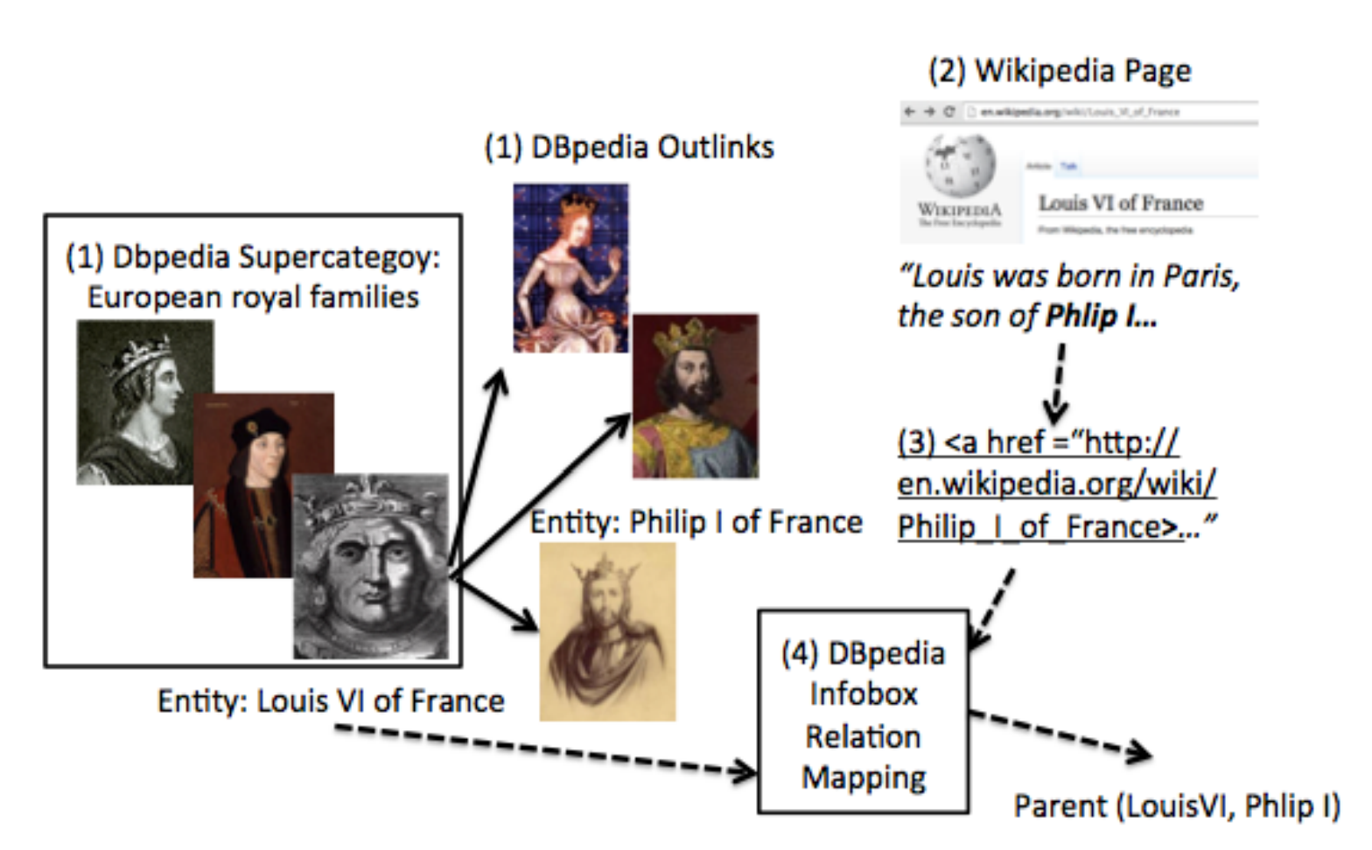
ACL 2015
Data: groups of related Wikipedia pages
knowledge base: infobox facts
IE task: classify links from page X to page Y
features: nearby words
label to predict: possible relationships between X and Y (distant supervision)
Train/test split: temporal
To simulate filling in an incomplete KB: randomly delete X% of the facts in train

Slide 43
Experiments
ACL 2015
Task: KB Completion
Three Wikipedia Datasets: royal, geo, american
67K, 12K, and 43K links
MAP Results for predicted facts on Royal, similar results on two other InfoBox datasets
Notes:
royal: 2258 pages, 15 relations,
american: 679 pages, 12k links, 30 relations
geo: 500 pages, 43k mentions/links, 10 relations

Slide 44
Joint IE and relation learning
ACL 2015
Baselines: MLNs (Richardson and Domingos, 2006), Universal Schema (Riedel et al., 2013), IE- and structure-learning-only models

Slide 45
IE in ProPPR
Experiment
Same data and protocol
Add facts: nearHyperlink(Word,Src,Dst) for Src,Dst in data
Add rules like:
interp(Rel,Src,Dst) :-
nearHyperlink(Word,Src,Dst), indicates(Word,Rel).
indicates(Word,Rel) :- true #f(Word,Rel)
 | 10% deleted | 50% deleted
ProPPR/ISG | 79.5 | 61.9
ProPPR/IE | 81.1 | 70.6
Similar results on two other InfoBox datasets

Slide 46
Joint Relation Learning IE in ProPPR
Experiment
Combine IE rules using nearHyperlink and interpretive rules
 | 10% deleted | 50% deleted
ProPPR/ISG | 79.5 | 61.9
ProPPR/IE | 81.1 | 70.6
ProPPR/Joint IE,ISG | 82.8 | 78.6
Similar results on two other InfoBox datasets

Slide 47
Joint IE and Relation Learning
Task: Knowledge Base Completion.
Baselines: MLNs (Richardson and Domingos, 2006), Universal Schema (Riedel et al., 2013), IE- and structure-learning-only models.

Slide 48
Joint IE and relation learning
ACL 2015
Baselines: MLNs (Richardson and Domingos, 2006), Universal Schema (Riedel et al., 2013), IE- and structure-learning-only models

Slide 49
Latent context invention
ACL 2015
Making the classifier deeper: introduce latent classes (analogous to invented predicates) which can be combined with the context words in the features used by the classifier
R(X,Y) :- latent(L),link(X,Y,W),indicates(W,L,R).
R(X,Y) :- latent(L1),latent(L2),link(X,Y,W),
indicates(W,L1,L2,R).

Slide 50
Effect of latent context invention

Slide 51
Joint IE and Relation Learning
Task: Knowledge Base Completion.
Baselines: MLNs (Richardson and Domingos, 2006), Universal Schema (Riedel et al., 2013), IE- and structure-learning-only models.

Slide 52
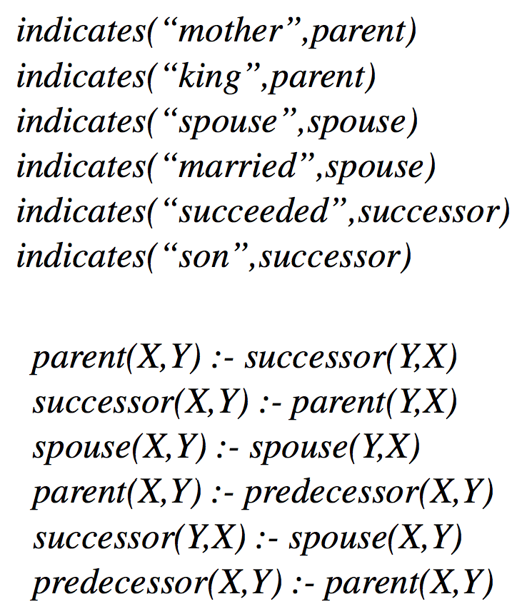
Joint IE and relation learning
ACL 2015
Universal schema: learns a joint embedding of IE features and relations
ProPPR: learns
weights on features indicates(word,relation) for link-classification task
Horn rules relating the relations
Highest-weight of each type

Slide 53
Outline
Motivation
Background
Logic
Probability
Combining logic and probabilities: MLNs
ProPPR
Key ideas
Learning method
Results for parameter learning
Structure learning for ProPPR for KB completion
Comparison to neural KBC models
Joint IE and KB completion
Beyond ProPPR?
….

Slide 54
Future directions
Integration with neural/embedding approaches to KBC
Step 1: using deep embedding models as features for ProPPR
Step 2: jointly training the deep models and ProPPR
Loose integration: use chain rule to push gradient of ProPPR’s performance down to embedding model, interleave gradient steps in ProPPR and embedding model
Close to working

Slide 55
Future directions
Integration with neural/embedding approaches to KBC
Logic using differentiable matrix operations?

Slide 56
MLNs are one blend of logic and probability
p(a,b) | m(a,b) | ϕ
T | F | 10
T | F | 10
T | T | 10
F | T | 0.5
C1 grandparent(X,Y) :- parent(X,Z),parent(Z,Y)
C2 parent(X,Y):-mother(X,Y).
C3 parent(X,Y):-father(X,Y).
father(bob,chip). parent(bob,dana). mother(alice,bob). …
p(a,b)
p(a,b):-m(a,b)
m(a,b)
gp(a,c)
gp(a,c):-p(a,b),p(b,c)
f(b,c)
p(b,c):-f(b,c)
p(b,c)

Slide 57
parent
brother
X
Z
Y
X
uncle(X,Y):-parent(X,Z),brother(Z,Y)
Y
husband
aunt
X
Z
Y
uncle(X,Y):-husband(X,Z),aunt(Z,Y)
X | Z | ϕ
William | Susan | 1
Chris | Cathy | 1
William | Cathy | 0
… | … | …
uncle(X,Y)

Slide 58
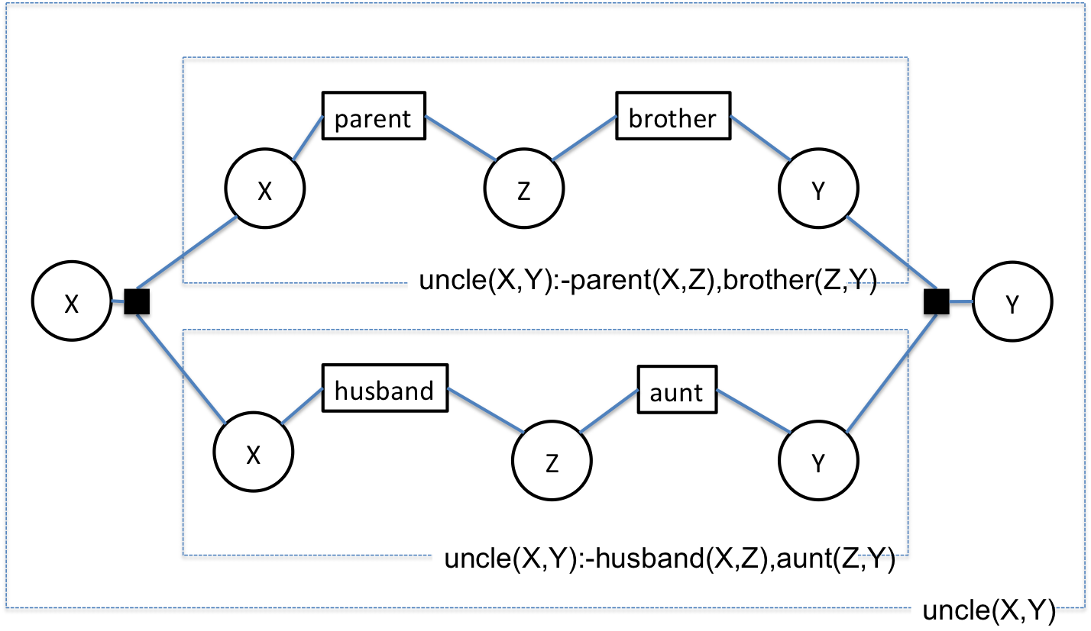
Future directions
Integration with neural/embedding approaches to KBC
Logic using differentiable matrix operations
Define subset of logic definable with sparse matrix potentials and efficient (polytree) belief propagation on a factor graph (includes some of ProPPR)
uncle(X,Y) :- parent(X,Z),brother(Z,Y) {r1}
uncle(X,Y):-husband(X,Z),aunt(Z,Y) {r2}
It looks like all we can learn is parameters of the potential predicate (parent, busband,…) ???

Slide 59
Future directions
Bind a variable to the feature values
uncle(X,Y) :- parent(X,Z),brother(Z,Y) {r1}
uncle(X,Y):-husband(X,Z),aunt(Z,Y) {r2}
Learnable weight are a factor predicate
uncle(X,Y) :- parent(X,Z),brother(Z,Y), assign(r1,R1), w(R1)
uncle(X,Y):-husband(X,Z),aunt(Z,Y), assign(r2,R2), w(R2)
It looks like all we can learn is parameters of the potential predicate (parent, busband,…) ???

Slide 60
Future directions
Integration with neural/embedding approaches to KBC
Logic using differentiable matrix operations
Define subset of logic definable with sparse matrix potentials and efficient (polytree) belief propagation on a factor graph (includes some of ProPPR)
On a polytree BP algorithm converges in fixed time ➔ simulate it to get a fixed series of message-passing steps for each query “mode” (input/output pattern)
Theorem proving is running fixed message sequence ➔ fixed sequence of matrix ops ➔ differentiable function

Slide 61
Future directions
Integration with neural/embedding approaches to KBC
Logic using differentiable matrix operations
Integrate with standard deep-learning package
Logic acts like a layer (or a theano “block”)
Can learn weights for selected predicates as well as control weights
Logic output, neural net input: abduction
Neural net output, logic input: learning with engineered features but feature definitions are tunable/learnable

Slide 62
Outline
Motivation
Background
Logic
Probability
Combining logic and probabilities: MLNs
ProPPR
Key ideas
Learning method
Results for parameter learning
Structure learning for ProPPR for KB completion
Comparison to neural KBC models
Joint IE and KB completion
Beyond ProPPR?
….

Slide 63
Concluding thanks….
Collaborators:
Katie Rivard Mazaitis, Rose Kanjirathinkal
Ni Lao, Einat Minkov
Tom Mitchell
Funders: NSF, DARPA, Google, …

