Slide 1





Online Flash Channel Modeling and Its Applications
Yixin Luo, Saugata Ghose, Yu Cai,
Erich F. Haratsch, Onur Mutlu
Carnegie Mellon University, Seagate Technology
This presentation is based on a paper to appear in IEEE JSAC Special Issue, 2016:
“Enabling Accurate and Practical Online Flash Channel Modeling for Modern MLC NAND Flash Memory”,
Yixin Luo, Saugata Ghose, Yu Cai, Erich F. Haratsch, Onur Mutlu

Slide 2

Flash as a Communication Channel
Motivation: Understanding flash channel can help minimize errors through the channel,
or tolerate more errors efficiently
Write
DATA
Read
Flash Channel
HOST
DATA
+ error

Slide 3
Prior Works on Distribution Models
Design time analysis
  Offline threshold voltage shift analysis [Cai+ DATE ’13]
  Offline RBER analysis [Parnell+ GLOBECOM ’14]
Design time optimization
  Read reference voltage optimization [Papandreou+ GLSVLSI ’14]
  ECC soft information optimization [Dong+ TCS ’13]
Can’t be run online – none of these are both accurate and easy-to-compute

Slide 4
Why Online Modeling?
Flash controllers becoming more powerful
Can use idle cycles for background optimization
Can adapt to real-world variation
Prior work
This work
Offline model
Online model
Design-time optimization/analysis
Runtime optimization/analysis

Slide 5
Goal
Create online flash channel model
  Helps with understanding flash channel
  Enables runtime optimizations
  Must be accurate and easy to compute
Develop model-driven applications
  Work to reduce or tolerate flash errors

Slide 6
Outline
What do we model?
  Program variation noise
  Program/erase cycling noise
How do we model it?
  Static flash channel model → program variation
  Dynamic flash channel model → P/E cycling noise
Applications of Online Flash Channel Model

Slide 7
Program Variation Noise
V_{a}
V_{b}
V_{c}
Probability density
ER
(11)
P1
(01)
P2
(00)
P3
(10)
Threshold voltage (V_{th})

Slide 8
Program/Erase Cycling Noise
Distribution shifts increase raw bit errors
V_{a}
V_{b}
V_{c}
Probability density
ER
(11)
P1
(01)
P2
(00)
P3
(10)
Threshold voltage (V_{th})
Raw bit errors

Slide 9
Outline
What do we model?
  Program variation noise
  Program/erase cycling noise
How do we model it?
  Static flash channel model → program variation
  Dynamic flash channel model → P/E cycling noise
Applications of Online Flash Channel Model

Slide 10
Static Flash Channel Model
Program variation noise
Threshold voltage distribution @ N P/E cycles
Program variation noise should be normally distributed → Why don’t we use a Gaussian model?

Slide 11
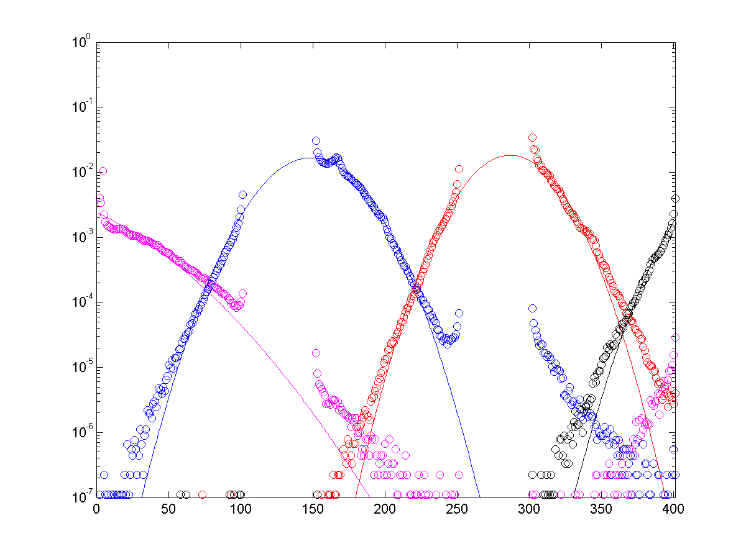
Gaussian Model Isn’t Accurate Enough
2. Program errors
1. Fatter tail than Gaussian

Slide 12
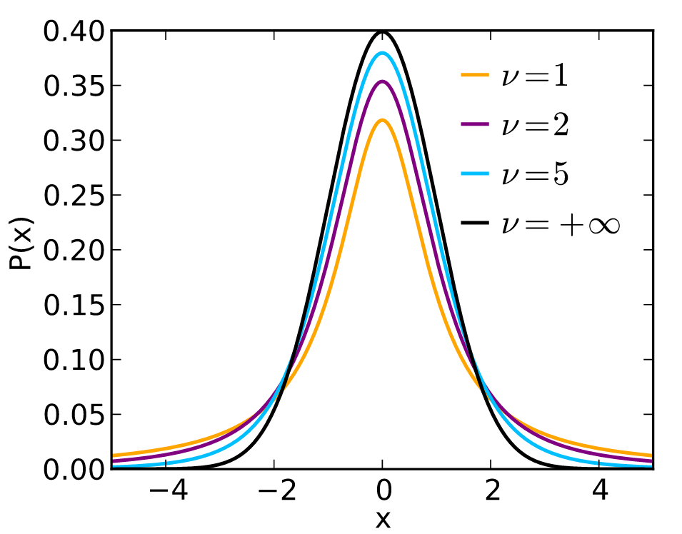
Student’s t-Distribution
Real distribution has larger tail than Gaussian
Student’s t has degree of freedom: v
  v→∞: t-distribution → Gaussian
  v→1: largest tail
Image source: https://en.wikipedia.org/wiki/Student%27s_t-distribution

Slide 13
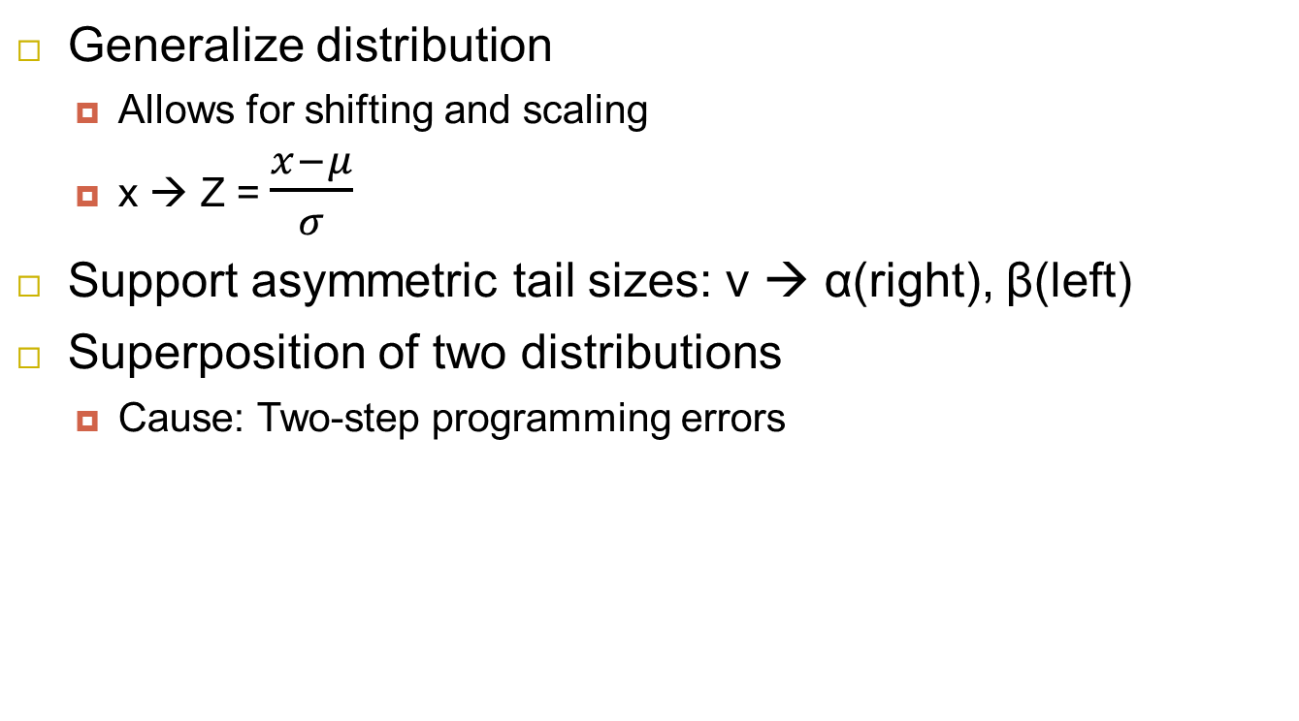
Modifications to Student’s t-Distribution
Generalize distribution
  Allows for shifting and scaling
  x → Z = $\frac{x−μ}{σ}$
Support asymmetric tail sizes: v → α(right), β(left)
Superposition of two distributions
  Cause: Two-step programming errors
Probability
Threshold voltage (V_{th})

Slide 14
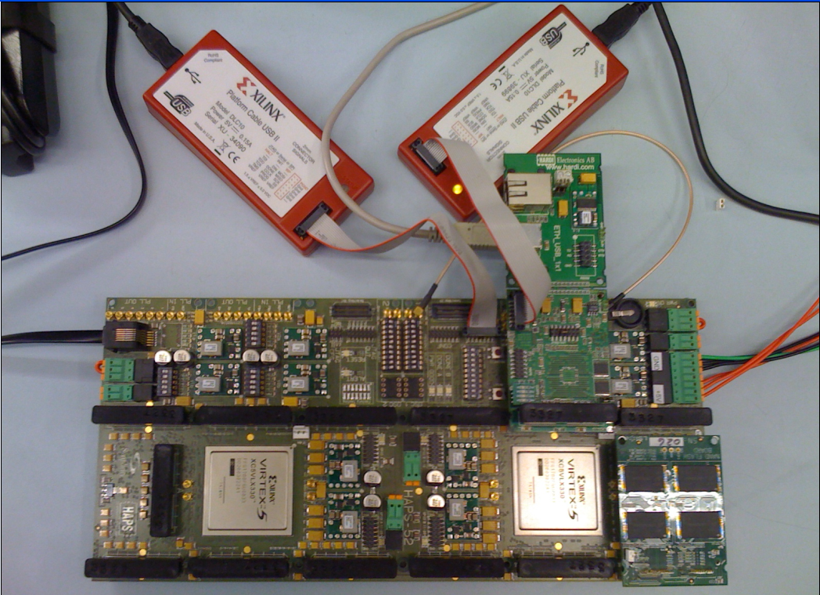
Characterization Methodology
USB Daughter Board
USB Jack
HAPS-52 Mother Board
Virtex-II Pro
(USB controller)
3x-nm
NAND Flash
Virtex-V FPGA
(NAND Controller)
NAND Daughter Board
[Cai+, FCCM 2011, DATE 2012, ICCD 2012, DATE 2013, ITJ 2013, ICCD 2013, SIGMETRICS 2014, DSN 2015, HPCA 2015]
Cai et al., FPGA-based Solid-State Drive prototyping platform, FCCM 2011.
Notes:
We are using a similar set up as used in many prior work that allow us to issue commands directly to the NAND chip.

Slide 15
Static Modeling Results
Our model (curve) vs. characterized (circle) @ 20K P/E cycle
More related results in the paper, including:
Static model fit at 2.5K, 5K, 10K P/E cycles
Modeling complexity analysis
Comparison to other flash channel models (Gaussian-based and normal-Laplace-based)
"Enabling Accurate and Practical Online Flash Channel Modeling for Modern MLC NAND Flash Memory", to appear in IEEE JSAC Special Issue, 2016

Slide 16
Complexity Results
Overall latency required per page per characterization
(Usually one page/block is used every 1000 P/E cycle)

Slide 17
Outline
What do we model?
  Program variation noise
  Program/erase cycling noise
How do we model it?
  Static flash channel model → program variation
  Dynamic flash channel model → P/E cycling noise
Applications of Online Flash Channel Model

Slide 18
Dynamic Flash Channel Model
P/E cycling noise
Threshold voltage distribution shift
Dynamic model modifies static model’s parameters: mean, variance, left/right tail, program error probability
Power-law model
  Y = a * x^{b} + c

Slide 19
Flash Channel Model Results (Dynamic)
More related results in the paper, including:
Standard deviation fit
Tail size fit
Program error probability fit
“Enabling Accurate and Practical Online Flash Channel Modeling for Modern MLC NAND Flash Memory”, to appear in IEEE JSAC Special Issue, 2016

Slide 20
Flash Channel Model Results (Dynamic)
Using N prior characterizations to predict flash channel @ 20K P/E cycle
2.72% using only 4 data points
As low as 0.8%

Slide 21
Outline
What do we model?
  Program variation noise
  Program/erase cycling noise
How do we model it?
  Student’s t-based model → program variation
  Power law-based model → P/E cycling noise
Applications of Online Flash Channel Model
Results

Slide 22
Optimal Read Reference Voltage Prediction
Improves flash lifetime
  48.9% longer flash lifetime
Minimizes number of read-retries
Faster soft ECC decoding

Slide 23
Expected Lifetime Estimation
Safely go beyond manufacturer-specified lifetime
  69.9% higher flash lifetime usage

Slide 24
Other Applications of Our Model
Raw Bit Error Rate Estimation
  Predict ECC margin, apply variable ECC strength
Soft Information Estimation for LDPC Codes
  Improves coding efficiency

Slide 25
Outline
What do we model?
  Program variation noise
  Program/erase cycling noise
How do we model it?
  Student’s t-based model → program variation
  Power law-based model → P/E cycling noise
Applications of Online Flash Channel Model

Slide 26
Conclusion
Goal: Develop an online flash channel model, and utilize this model to improve flash reliability
Static flash channel model
  0.68% modeling error
  Amortized read latency overhead <50 ns
Dynamic flash channel model
  2.72% modeling error
  Using only 4 data points (even lower overhead)
Example applications of online model
  48.9% longer flash lifetime, or 69.9% higher flash usage
  Hopefully inspires other reliability/performance improving techniques to use our online model

Slide 27
Online Flash Channel Modeling and Its Applications
Yixin Luo, Saugata Ghose, Yu Cai,
Erich F. Haratsch, Onur Mutlu
Carnegie Mellon University, Seagate Technology
This presentation is based on a paper to appear in IEEE JSAC Special Issue, 2016:
“Enabling Accurate and Practical Online Flash Channel Modeling for Modern MLC NAND Flash Memory”,
Yixin Luo, Saugata Ghose, Yu Cai, Erich F. Haratsch, Onur Mutlu

Slide 28
Questions?
Yixin Luo
yixinluo@cs.cmu.edu
http://www.cs.cmu.edu/~yixinluo/
This presentation is based on a paper to appear in IEEE JSAC Special Issue, 2016:
“Enabling Accurate and Practical Online Flash Channel Modeling for Modern MLC NAND Flash Memory”,
Yixin Luo, Saugata Ghose, Yu Cai, Erich F. Haratsch, Onur Mutlu

Slide 29
Our Other FMS 2016 Talks
“Software-Transparent Crash Consistency for Persistent Memory”
  Onur Mutlu (ETH Zurich & CMU) August 8 @ 11:40am
  PreConference Seminar C: Persistent Memory
"A Large-Scale Study of Flash Memory Errors in the Field”
  Onur Mutlu (ETH Zurich & CMU) August 10 @ 3:50pm
  Study of flash-based SSD errors in Facebook data centers over the course of 4 years
  First large-scale field study of flash memory reliability
  Forum F-22: SSD Testing (Testing Track)
"WARM: Improving NAND Flash Memory Lifetime with Write-hotness Aware Retention Management”
  Saugata Ghose (CMU Researcher) August 10 @ 5:45pm
  Forum C-22: SSD Concepts (SSDs Track)
Notes:
Also mention posters

