Slide 1
Module 1: The Physical Internet
Building an Internet simulation using household/classroom items

Slide 2
Setup

Slide 3


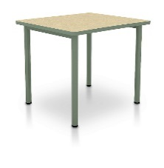
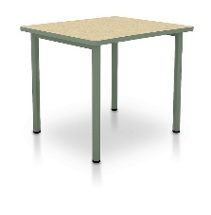
Set up desks in a fashion similar to below. Label the desks in some as websites, routers, and computers
www.google.com
www.wikipedia.org
Router 1
Router 2
Router 3
Router 4
Router 7
Router 5
Router 6
Computer 1
Computer 2
Computer 3

Slide 4
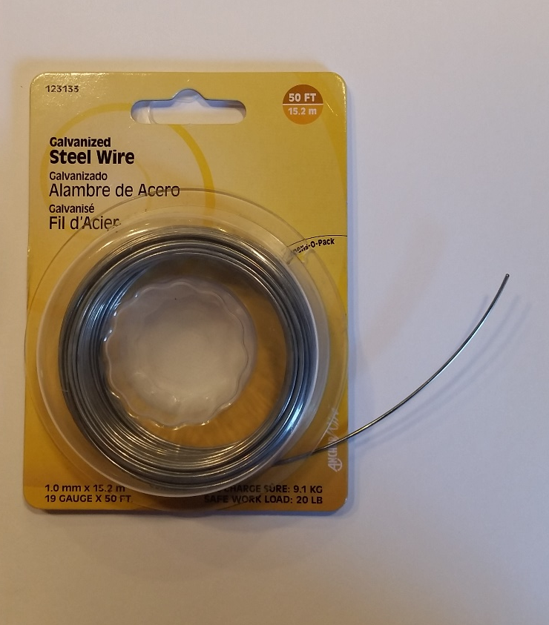
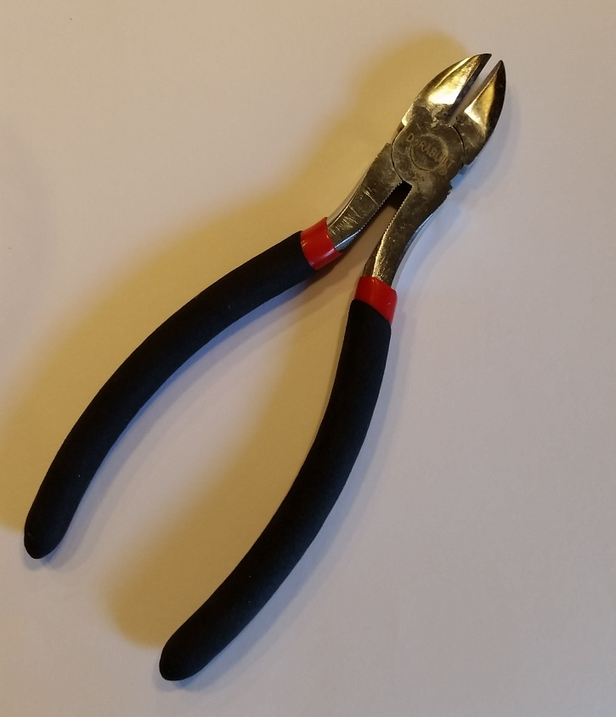
Wire will be used to connect the desks together just as wires connect components of the Internet together. This wire can be purchased at any hardware or craft store for less than 5 USD. A set of wire cutters will enable easy cutting.

Slide 5
Attach wire to legs of desk to connect the desks as shown. Where wires cross, make sure that they are vertically spaced on the legs of the desk to allow ample clearance between the two wires.
www.google.com
www.wikipedia.org
Router 1
Router 2
Router 3
Router 4
Router 7
Router 5
Router 6
Computer 1
Computer 2
Computer 3

Slide 6
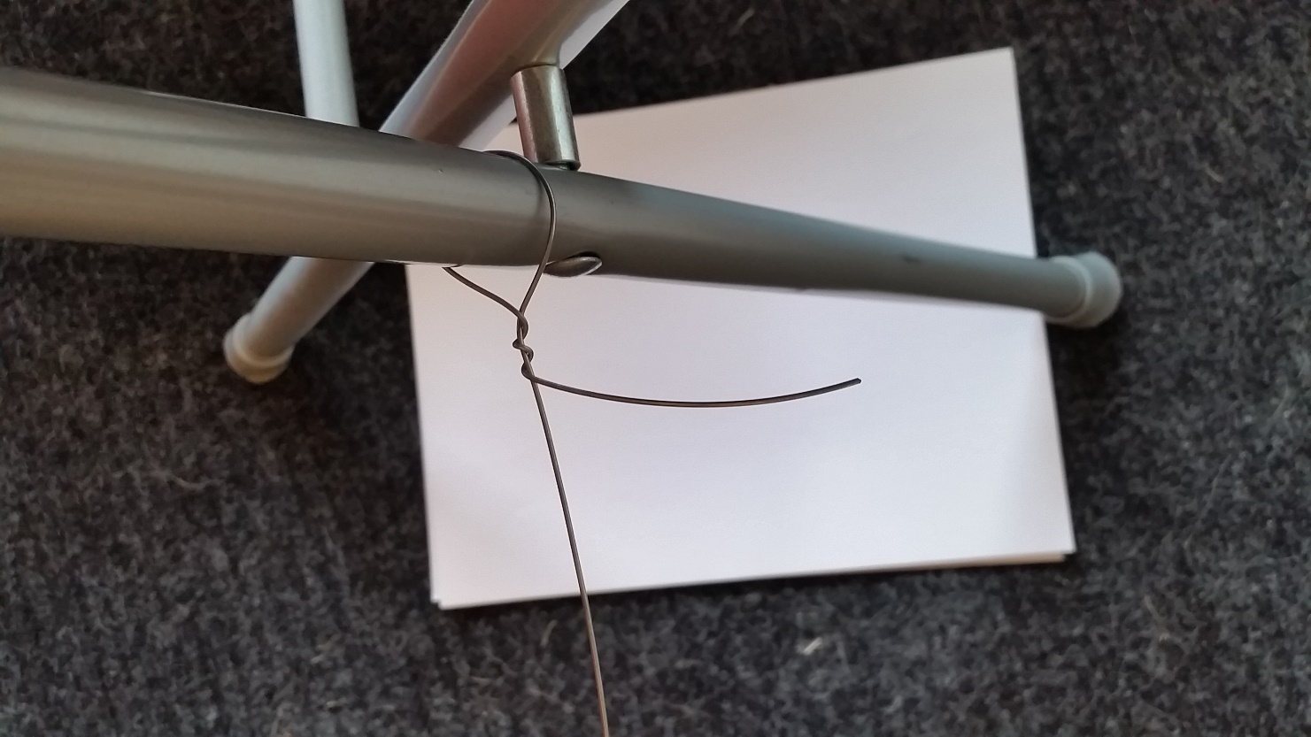
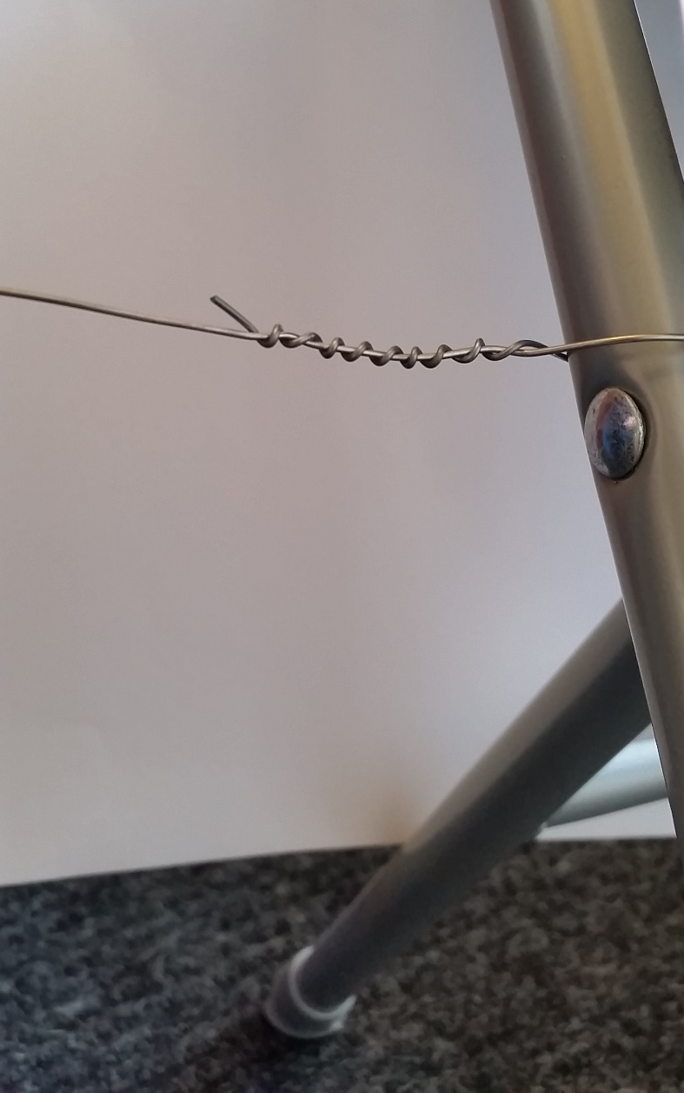
Twisting will secure the wires. Pulling the desks slightly apart after securing the wire can ensure that the wire is taut.
***Wear eye protection when working with the wire as it can recoil***

Slide 7
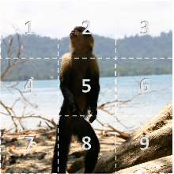
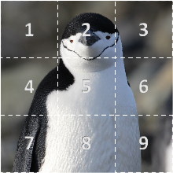
The Google desk should be given two pictures labeled pictures 1 and 2. These pictures can be cut into whatever pieces are desired for sending later.
www.google.com
www.wikipedia.org
Router 1
Router 2
Router 3
Router 4
Router 7
Router 5
Router 6
Computer 1
Computer 2
Computer 3

Slide 8
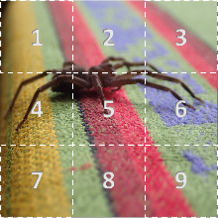
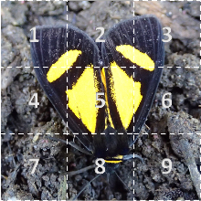
The Wikipedia desk should be given two pictures labeled pictures 1 and 2 as well. These pictures can be cut into whatever pieces are desired for sending later.
www.google.com
www.wikipedia.org
Router 1
Router 2
Router 3
Router 4
Router 7
Router 5
Router 6
Computer 1
Computer 2
Computer 3

Slide 9
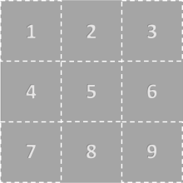
Groups at desks labeled 1-3 should be given blank grids for receiving pictures
www.google.com
www.wikipedia.org
Router 1
Router 2
Router 3
Router 4
Router 7
Router 5
Router 6
Computer 1
Computer 2
Computer 3

Slide 10
The Google Desk, Wikipedia Desk, and Computer Desks 1-3 should be given Packet Information slips of Paper to be used later
Packet Information:
Source of packet:
Destination of packet:
Source File Number:
Parts of source file contained in this packet or being acknowledged:
Acknowledgement of Receipt (Y/N):

Slide 11
The Computer 1-3 desks should be given initial picture request slips of paper (one filled-in example is shown below), and Packet information slips of paper to be used for acknowledging receipt of parts of image
Initial Request:
Packet Information:
Who needs picture:
Who has the picture:
File Requested:
Computer 1
Google
Picture 1
Source of packet:
Destination of packet:
Source File Number:
Parts of source file contained in this packet or being acknowledged:
Acknowledgement of Receipt (Y/N):

Slide 12
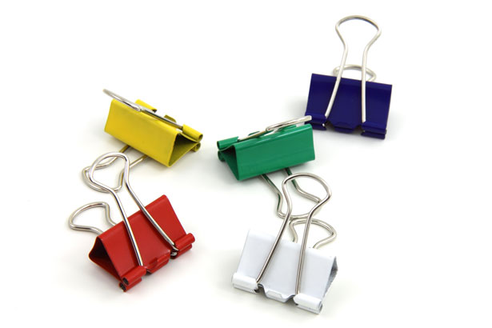
Every desk should be supplied with binder clips that can be attached to the wires for sending of packet paper slips and initial request slips
(You may elect to have clips already hooked to each wire instead of requiring students to do this each time they want to send packets along the wires)

Slide 13
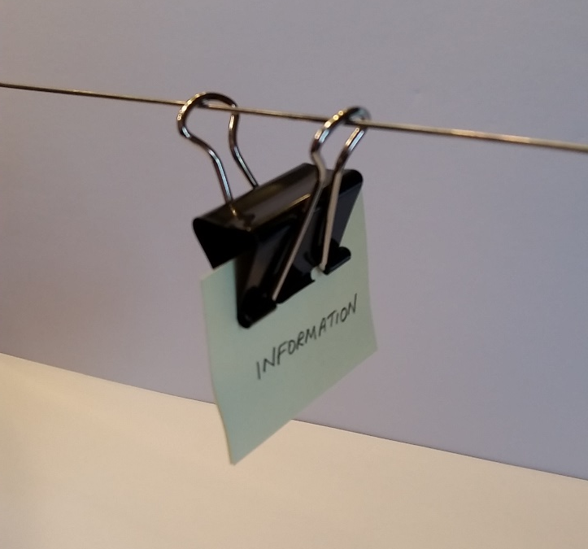
To send packets on the wire, clip the necessary materials to the binder clip, attach clip to wire, and “throw” them along the wire toward the destination. The packets should easily slide if wires are sufficiently taut and level*.
*If not using binder clips (recommended), non-coated paperclips are suggested to reduce friction (additional weight such as a coin may be required to provide momentum if using paperclips).

Slide 14
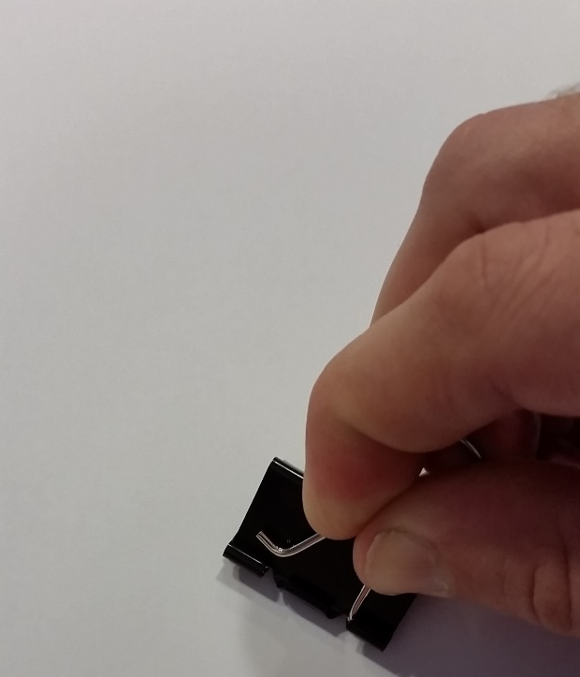
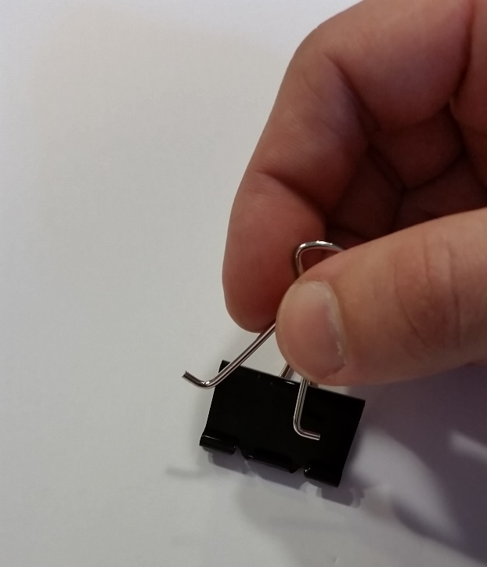
Binder clips can have their metal parts removed and reconnected in order to put them onto the wires for sending. See diagrams below if not familiar with this:
Pinch the metal legs wires together to release and pull upward
Wire part of clip can now be put over wire and then reattached to clip by reversing previous step

Slide 15
Implementation of Simulation

Slide 16



Step 1: Computers 1-3 have requests for images
www.google.com
www.wikipedia.org
Router 1
Router 2
Router 3
Router 4
Router 7
Router 5
Router 6
pic 1
pic 2
pic 2
Computer 1
Computer 2
Computer 3

Slide 17
Step 2: Computers 1-3 send requests out to routers
www.google.com
www.wikipedia.org
Router 1
Router 2
Router 3
Router 4
Router 7
Router 5
Router 6
pic 1
pic 2
pic 2
Computer 1
Computer 2
Computer 3

Slide 18
Step 3: Routers must determine best path to destinations
www.google.com
www.wikipedia.org
Router 1
Router 2
Router 3
Router 4
Router 7
Router 5
Router 6
pic 1
pic 2
pic 2
Computer 1
Computer 2
Computer 3

Slide 19
Step 4: Routers route request to next set of routers
www.google.com
www.wikipedia.org
Router 1
Router 2
Router 3
Router 4
Router 7
Router 5
Router 6
pic 1
pic 2
pic 2
Computer 1
Computer 2
Computer 3

Slide 20
Step 5: Routers must determine best path to destinations again and then send request to next set of routers
(assume only one message can be sent on a wire at a time)
www.google.com
www.wikipedia.org
Router 1
Router 2
Router 3
Router 4
pic 1
pic 2
pic 2
Router 7
Router 5
Router 6
Computer 1
Computer 2
Computer 3

Slide 21
Step 6: Routers must determine best path to destinations again and then send request to destination or next set of routers
(assume only one message can be sent on a wire at a time)
www.google.com
www.wikipedia.org
Router 1
pic 1
Router 2
pic 2
Router 3
Router 4
pic 2
Router 7
Router 5
Router 6
Computer 1
Computer 2
Computer 3

Slide 22
Step 7: Routers must determine best path to destinations again and then send request to destination or next set of routers
(assume only one message can be sent on a wire at a time)
www.google.com
www.wikipedia.org
pic 1
pic 2
Router 1
pic 2
Router 2
Router 3
Router 4
Router 7
Router 5
Router 6
Computer 1
Computer 2
Computer 3

Slide 23
Step 8: Destinations accept request and determine what picture should be sent and where it should be sent
www.google.com
www.wikipedia.org
pic 1
pic 1
pic 2
pic 1
pic 2
pic 2
pic 2
Router 1
Router 2
Router 3
Router 4
Router 7
Router 5
Router 6
Computer 1
Computer 2
Computer 3

Slide 24
Step 8: Destinations accept request and determine what picture should be sent and where it should be sent
www.google.com
www.wikipedia.org
pic 1
pic 1
pic 2
pic 1
pic 2
pic 2
pic 2
Router 1
Router 2
Router 3
Router 4
Router 7
Router 5
Router 6
Computer 1
Computer 2
Computer 3

Slide 25
Step 9: Destinations break up pictures into packets and send back to requesting computers using only one wire at a time through series of routers
www.google.com
www.wikipedia.org
pic 1
pic 1
pic 2
pic 1
pic 2
pic 2
pic 2
Router 1
Router 2
Router 3
Router 4
Router 7
Router 5
Router 6
Computer 1
Computer 2
Computer 3

Slide 26
Example: Consider pic1 from Google being sent back to Computer 1
pic 1
www.google.com
www.wikipedia.org
pic 1
Router 1
Router 2
Router 3
Router 4
Router 7
Router 5
Router 6
Computer 1
Computer 2
Computer 3

Slide 27
Example: Consider pic1 from Google being sent back to Computer 1 with packets 3 image squares in size (one could break them up into any size they wish for this exercise)
www.google.com
1,2,3
www.wikipedia.org
pic 1
Router 1
Router 2
Router 3
Router 4
Router 7
Router 5
Router 6
Computer 1
Computer 2
Computer 3

Slide 28
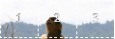
Example: Google will send back the top row of the picture and tell the computer that it is sending the top row by numbering it 1,2,3. The color of the note corresponds with the computer it hopes to reach (the packet slip will have the intended computer recipient on it during actual classroom simulation)
www.google.com
1,2,3
www.wikipedia.org
pic 1
Router 1
Router 2
Router 3
Router 4
Router 7
Router 5
Router 6
Computer 1
Computer 2
Computer 3

Slide 29
Example: Google will send back the top row of the picture and tell the computer that it is sending the top row by numbering it 1,2,3. Recall that here the color of the note corresponds with the computer it hopes to reach.
www.google.com
www.wikipedia.org
1,2,3
pic 1
Router 1
Router 2
Router 3
Router 4
Router 7
Router 5
Router 6
Computer 1
Computer 2
Computer 3

Slide 30
Example: Once the portion of the picture is received by Computer 1, it is placed in the appropriate space in the grid, and an acknowledgement of receipt of this first packet is sent back to Google.
www.google.com
www.wikipedia.org
pic 1
Router 1
Router 2
Router 3
Router 4
Router 7
Router 5
Router 6
1,2,3
Computer 1
Computer 2
Computer 3

Slide 31
Example: Once the portion of the picture is received by Computer 1, it is placed in the appropriate space in the grid, and an acknowledgement of receipt of this first packet is sent back to Google. Routers must again decide best path to Google as before.
www.google.com
www.wikipedia.org
pic 1
Router 1
Router 2
Router 3
Router 4
Router 7
Router 5
Router 6
Got 1,2,3
Computer 1
Computer 2
Computer 3

Slide 32
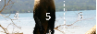
Example: Google will now send back the middle row of the picture and tell the computer that it is sending the middle row by numbering it 4,5,6. Recall, the color of the note corresponds with the computer it hopes to reach.
www.google.com
4,5,6
www.wikipedia.org
pic 1
Router 1
Router 2
Router 3
Router 4
Router 7
Router 5
Router 6
Computer 1
Computer 2
Computer 3

Slide 33
Example: Google will now send back the middle row of the picture and tell the computer that it is sending the middle row by numbering it 4,5,6. Recall, the color of the note corresponds with the computer it hopes to reach.
www.google.com
www.wikipedia.org
4,5,6
pic 1
Router 1
Router 2
Router 3
Router 4
Router 7
Router 5
Router 6
Computer 1
Computer 2
Computer 3

Slide 34
Example: Once the portion of the picture is received by Computer 1, it is placed in the appropriate space in the grid, and an acknowledgement of receipt of this second packet is sent back to Google.
www.google.com
www.wikipedia.org
pic 1
Router 1
Router 2
Router 3
Router 4
Router 7
Router 5
Router 6
Got 4,5,6
Computer 1
Computer 2
Computer 3

Slide 35
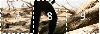
Example: Google will then send back the final row of the picture and tell the computer that it is sending the final row by numbering it 7,8,9. Note: the routers must always ensure that the quickest path is utilized (as there may be other network traffic or a line that is not currently working that may require a new path to be used that was not used previously)
www.google.com
7,8,9
www.wikipedia.org
pic 1
Router 1
Router 2
Router 3
Router 4
Router 7
Router 5
Router 6
Computer 1
Computer 2
Computer 3

Slide 36
Example: Google will then send back the final row of the picture and tell the computer that it is sending the final row by numbering it 7,8,9. Note: the routers must always ensure that the quickest path is utilized (as there may be other network traffic or a line that is not currently working that may require a new path to be used that was not used previously)
www.google.com
www.wikipedia.org
7,8,9
pic 1
Router 1
Router 2
Router 3
Router 4
Router 7
Router 5
Router 6
Computer 1
Computer 2
Computer 3

Slide 37
Example: Once the final portion of the picture is received by Computer 1, it is placed in the appropriate space in the grid, and an acknowledgement of receipt of this third packet is sent back to Google.
www.google.com
www.wikipedia.org
pic 1
Router 1
Router 2
Router 3
Router 4
Router 7
Router 5
Router 6
Got 7,8,9
Computer 1
Computer 2
Computer 3

Slide 38
Example: The same procedure would be happening simultaneously with the other two requests until all requests have been satisfied. It is important to note that no wire can be used by two packets at once. Moreover, routers must determine the best path to choose each time a packet is sent to it.
www.google.com
www.wikipedia.org
Router 1
Router 2
Router 3
Router 4
Router 7
Router 5
Router 6
Computer 1
Computer 2
Computer 3

Slide 39
If you have a larger classroom, you can separate groups into teams and time how long it takes groups to complete the process. In any case, a discussion as to what parts of the process seemed to cause the data to be sent more slowly should occur. Guiding questions are included in the curriculum guide for teacher with other resource materials of this module.
www.google.com
www.wikipedia.org
pic 1
Router 1
Router 2
Router 3
Router 4
Router 7
Router 5
Router 6
Computer 1
Computer 2
Computer 3

