Slide 1
Agentless Cloud-wide Monitoring of Virtual Disk State
Wolfgang Richter
wolf@cs.cmu.edu

Slide 2
Monitoring is Broken
✓
ec2-start-instance
✗

Slide 3
Coupling Policy with Mechanism:
CVE-2012-0493
Symantec Endpoint Protection ... does not properly perform bounds checks of the contents of CAB archives, which allows remote attackers to … execute arbitrary code via a crafted file.

Slide 4
Cloud
Customers
Cloud
Providers

Slide 5
special-talk.pptx
Windows
NTFS
Windows
FAT32
Linux
ext4
1
0
0
1
0
1
0
1
1
0
SSD
USB
Disk
1
0
0
1
0
1
0
1
1
0

Slide 6
Modern Clouds
Virtual Machine
Hypervisor
Host Cloud
Infrastructure
NAS
Virtual Disk

Slide 7
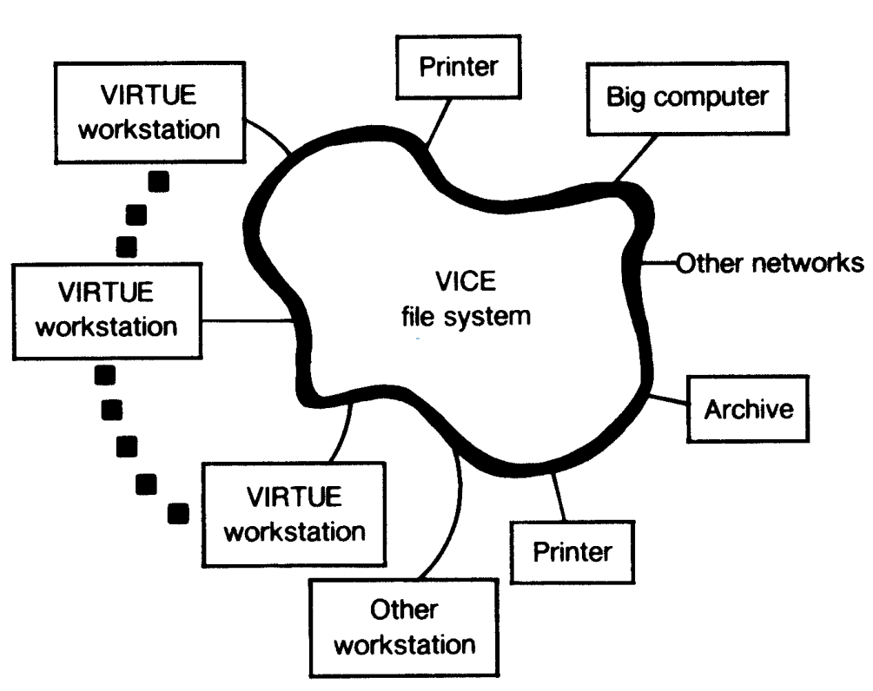
How to fix Monolithic Systems?
Distributed File Systems
Guest Support
Per-OS Implementation
Tightly Coupled
Still Monolithic
Smarter Infrastructure
Zero Configuration
Generalizable Interface
Loosely Coupled
Separates Policy and Mechanism
?
[morris1986]

Slide 8
✗ Not General
✗ Not Independent
Agents
Cloud
Customers
Cloud
Infrastructure
VMM Observable
✓ Generalizable
✓ Independent
Agentless
[garfinkel2003]

Slide 9
Agentless Monitoring of Disk State
Stronger security guarantees
Stronger correctness guarantees
Enables Generalizability Across
OS
Application
Runtime environment (libraries, configuration)
Versions (OS, library, application, configuration)
With modest infrastructure modifications

Slide 10
Cloud
Customers
Cloud
Providers
Monitoring
Services
Cloud
Providers
Monitoring
Services
[frost2013]
Notes:
Billion dollar market
70% of x86 applications are virtualized as of 2014

Slide 11
VM-based
Customers
Cloud
Infrastructure

Slide 12
Outline
Challenges
Mechanism and Interfaces
Distributed Streaming Virtual Machine Introspection
/cloud
cloud-inotify
/cloud-history
Summary and Conclusion

Slide 13
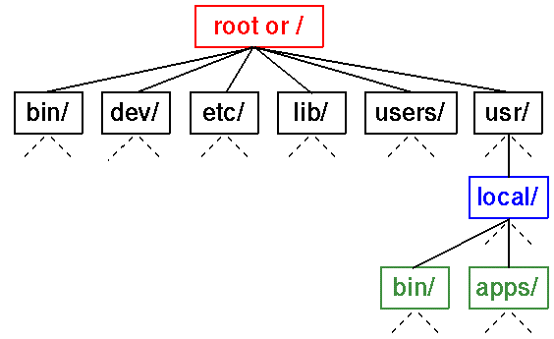
The Semantic Gap
Semantic
Gap
Interpret on-disk layout
1
0
0
1
0
1
0
1
1
0

Slide 14
Temporal Gap
Crashing would cause data corruption
t₀
t₁
t₂
File Size Increase
Data Block
Data Block
Data Block
Data Block
File Size Increase
Must buffer until metadata update

Slide 15
Achieving Generality
NTFS
Windows
File-system-specific backend
Parser
Windows
FAT32
Normalized
Metadata
Parser
Interfaces
ext4
Parser
Linux

Slide 16
Bounded Overhead
Latency-completeness-performance tradeoff
Capturing every write is costly
Too much buffering hurts latency
Must tolerate loss of writes
Extreme: detaching and re-attaching

Slide 17
Select Related Work
System | Semantic | Temporal | General | Bounded | Scalable
VMI, Garfinkel, 2003 | ✓ | ✓ | ✓ | ✗ | ✗
Maitland, Benninger, 2012 | ✓ | ✓ | ✗ | ✗ | ✗
File-aBLS, Zhang, 2006 | ✓ | ✓ | ✗ | ✗ | ✗
SDS, Sivathanu, 2003 | ✓ | ✓ | ✓ | ✗ | ✗
Notes:
Explain context of each system, where they came from, what they monitor

Slide 18
Outline
Challenges
Mechanism and Interfaces
Distributed Streaming Virtual Machine Introspection
/cloud
cloud-inotify
/cloud-history
Summary and Conclusion

Slide 19
/cloud
cloud-inotify
/cloud-history
Distributed Streaming Virtual Machine Introspection (DS-VMI)

Slide 20
/cloud
cloud-inotify
/cloud-history
Distributed Streaming Virtual Machine Introspection (DS-VMI)

Slide 21
DS-VMI
Metadata Store
VMM
Async. Queuer
n
File system specific parsing
Inference Engine
Notes:
Async. Queuer is there to minimize overhead for the running VM and decouple processing time from critical IO path
Redis is there to enable scale out and coordination amongst nodes

Slide 22
Tapping the Disk Write Stream
VM
~50 line patch
QEMU
drive-backup (nbd)
Notes:
Since we’re targeting monitoring, only writes have to be monitored → not reads
XEN – blktap customized block backend, or storage domains (new XEN feature)
VMWare – changed block tracking

Slide 23
Bootstrapping
NTFS
Normalized
Metadata
Disk Crawler
FAT32
Normalized
Metadata
Disk Crawler
ext4
Normalized
Metadata
Disk Crawler

Slide 24
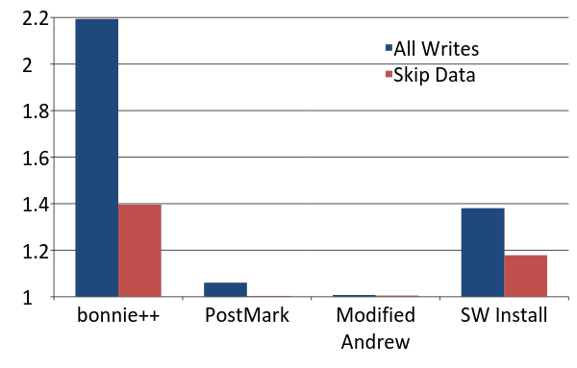
DS-VMI Overhead on Running VM
Relative Overhead
[richter2014]
Notes:
Single VM overhead

Slide 25
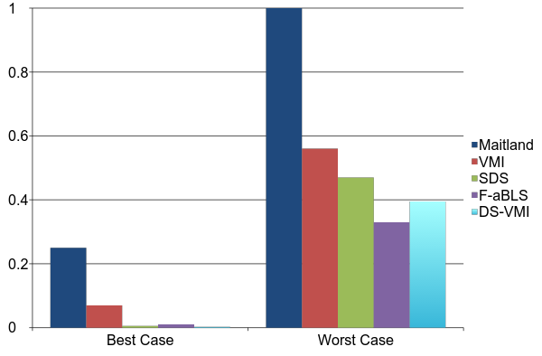
1.0
6.2x
0.8
0.6
Relative Overhead
0.4
0.2
0
Notes:
Explain apples and oranges, different workloads, different target applications, different style of implementations, different things introspected

Slide 26
/cloud
cloud-inotify
/cloud-history
Distributed Streaming Virtual Machine Introspection (DS-VMI)

Slide 27
/cloud
Eventual consistency
Legacy FS interface
Batch-based
Legacy/batch-based apps: /cloud/host/vm/path
On all hosts check permissions of /lib inside every VM instance.
find /cloud/*/*/lib \
-maxdepth 0 \
-not \
-perm 755

Slide 28
/cloud Architecture
Metadata Store
FUSE Driver
Apps
n
Virtual Disk
Inference Engine

Slide 29
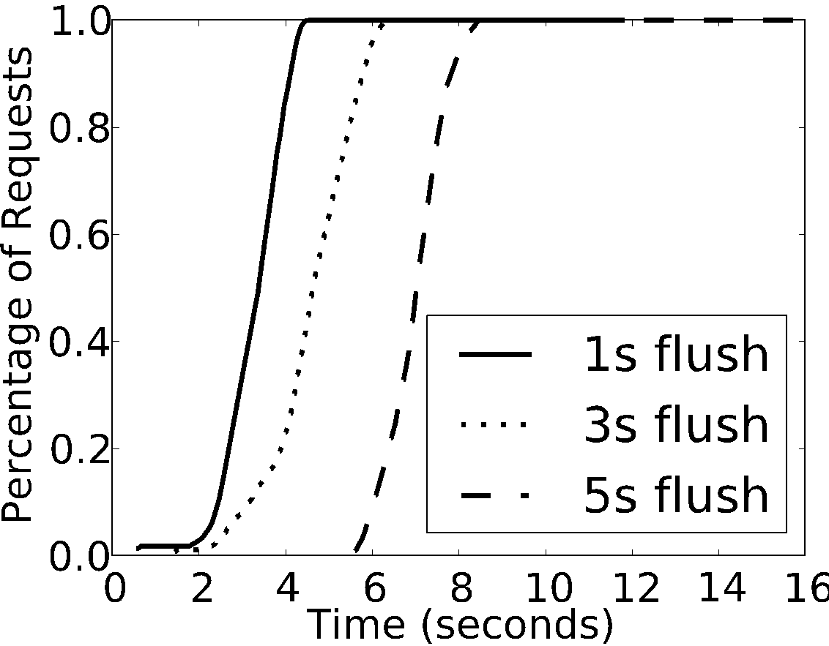
Latency – Guest Syncs
[richter2014]
Notes:
We normally assume the guest doesn’t aggressively sync, slide 56
Here we just measure the overhead that DS-VMI introduces

Slide 30
/cloud
cloud-inotify
/cloud-history
Distributed Streaming Virtual Machine Introspection (DS-VMI)

Slide 31
cloud-inotify
Strong consistency
Publish-subscribe
Event-driven
Subscription format: <host>:<VM>:<path>
gs9671:bg1:/var/log/*
On host gs9671
monitor all files under file system subtree /var/log/
in all VM’s in group bg1.

Slide 32
cloud-inotify Architecture
Loggly
* : * : /var/log/*
Metadata Store
Subscriber
<host2>:<vm2>:<path2>
n
Publish
<host>:<vm>:<path>
Inference Engine

Slide 33
OpenStack “Live” Demo
Bedford Springs
Internet
WebSocket Proxy
CMU
OpenStack
cloud-inotify
Distributed Streaming Virtual Machine Introspection (DS-VMI)
[pdlretreat2014]

Slide 34
/cloud
cloud-inotify
/cloud-history
Distributed Streaming Virtual Machine Introspection (DS-VMI)

Slide 35
CVE-2014-0160: Heartbleed
Untraceable exploit
In the wild 2 years
OpenSSL 1.0.1 - 1.0.1f
March 2012 - April 2014
Leaks server memory
Are my systems vulnerable?
Are any customers affected?

Slide 36
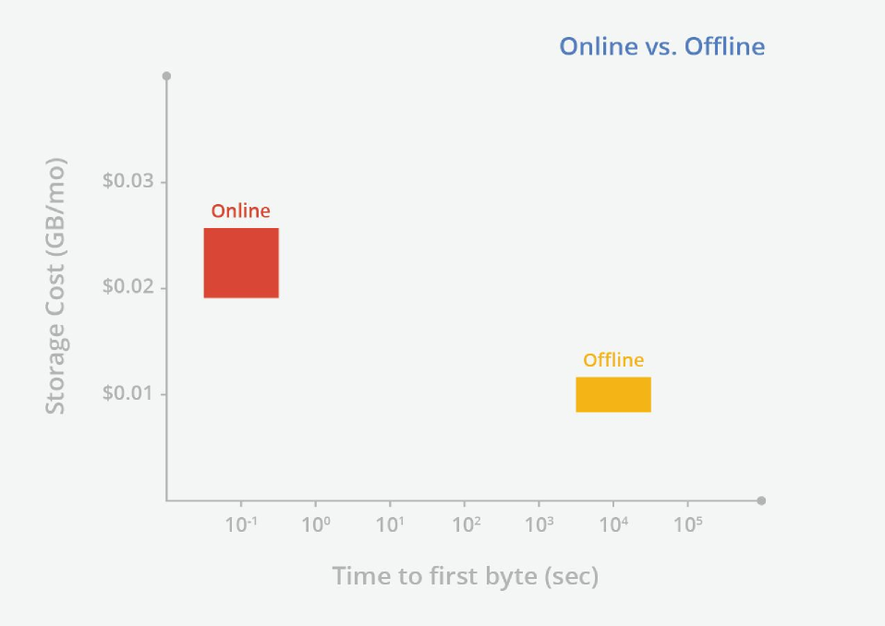
[google2015]

Slide 37
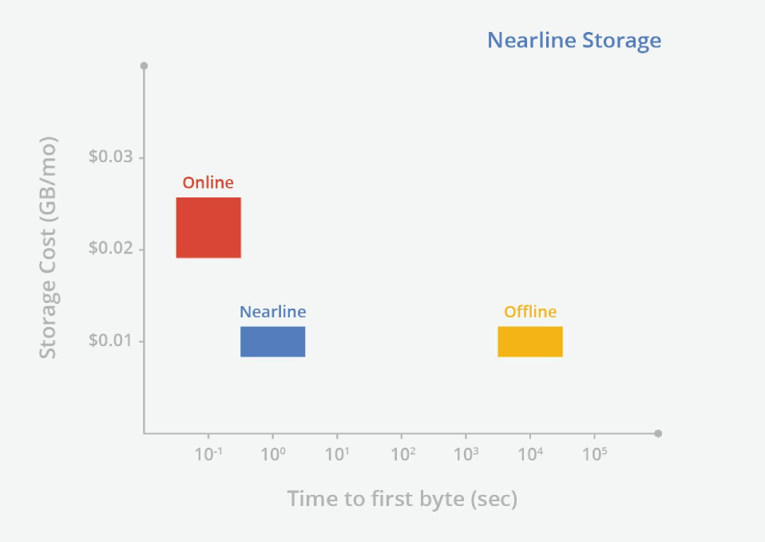
[google2015]

Slide 38
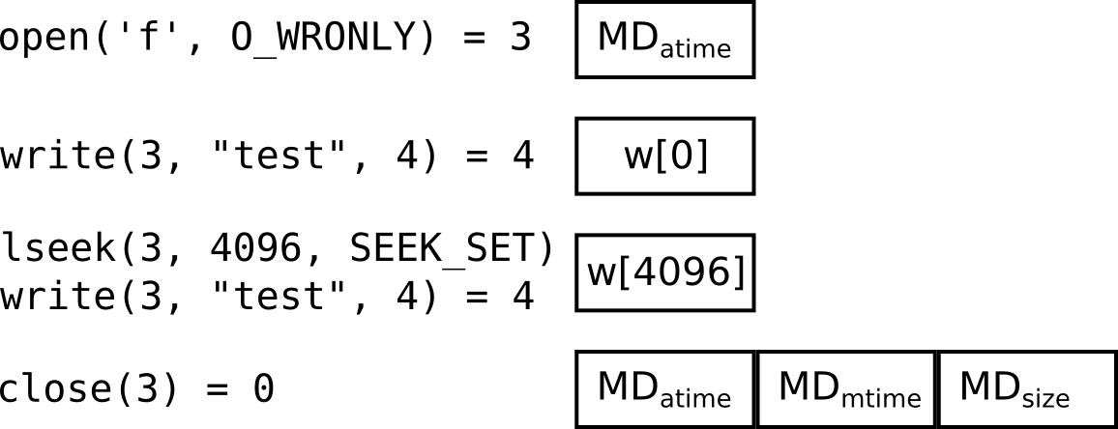
/cloud-history
Indexed Log-structure

Slide 39
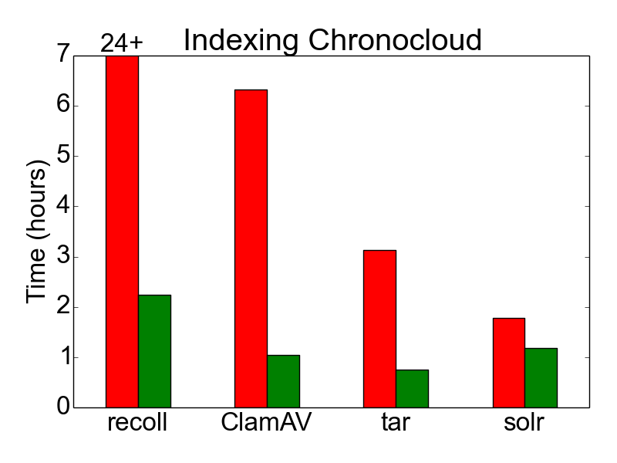
Effect of File-level Deduplication on Indexing
[vcldataset]

Slide 40
Deltaic Backup Study
58 hosts, ~1-year timeframe
3,267 file system snapshots
1.676 billion referenced files
146 TiB of crawled bytes

Slide 41
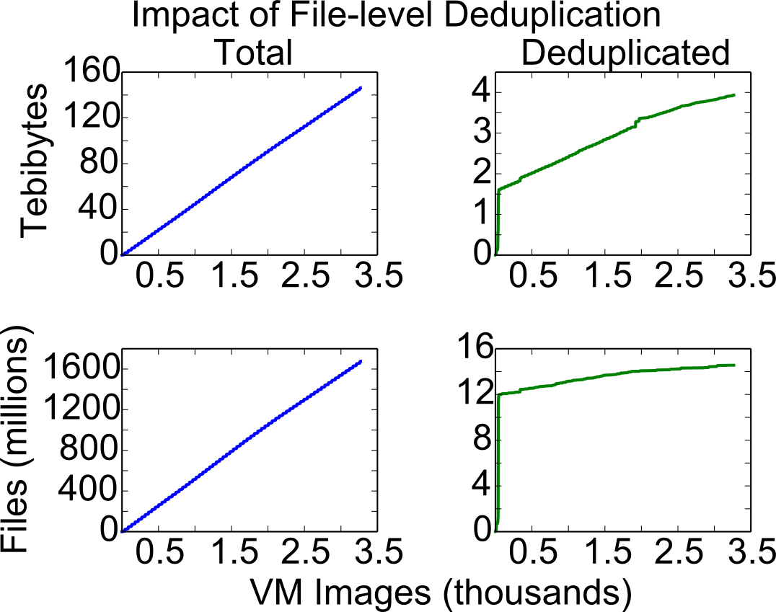

Slide 42
/cloud
cloud-inotify
/cloud-history
File-level deduplication
Distributed Streaming Virtual Machine Introspection (DS-VMI)

Slide 43
Desired Hash Properties
Quick to re-compute for random writes
DS-VMI works with a stream of writes
No extra bytes from disk required
Can’t rely on virtual disk, or reconstruction
Collision Resistant
For correctness
Compact
Network synchronization

Slide 44
Traditional Hashing?
Supports rapid recomputation of whole-file hash for append-only operations
Normal C API (SHA-3, NIST):
Update(hashState *state,
const BitSequence *data,
DataLength datalen);
[nist]

Slide 45
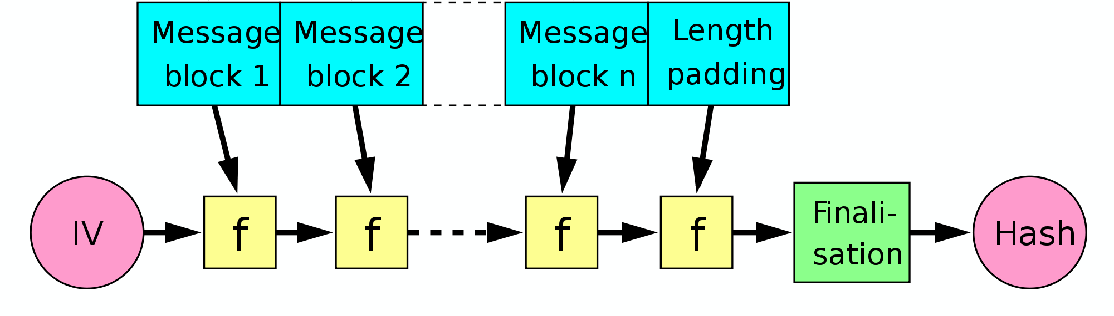
Merkle-Damgård
[wikipedia, damgård1990]

Slide 47
Incremental Hashing
Incremental
Efficient random updates
Collision-free
Cryptographically secure
Parallelizable
Faster than sequential
[bellare1997]

Slide 49
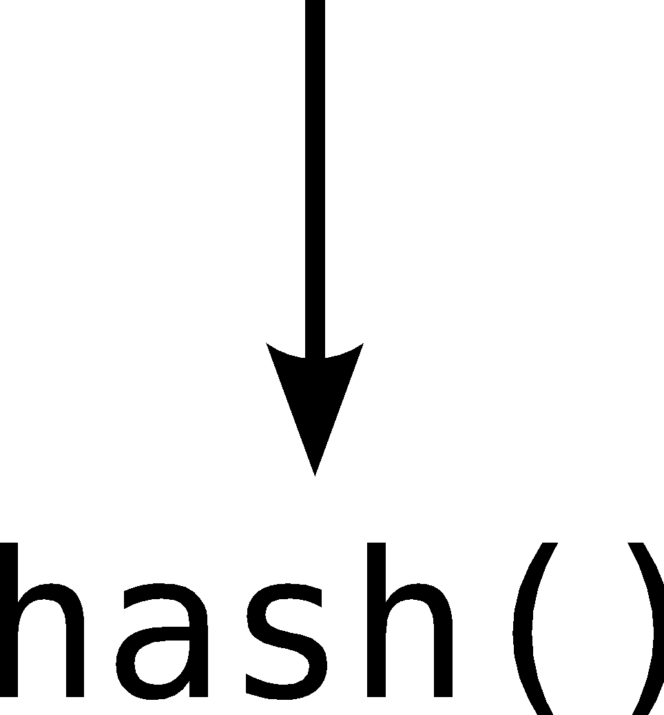
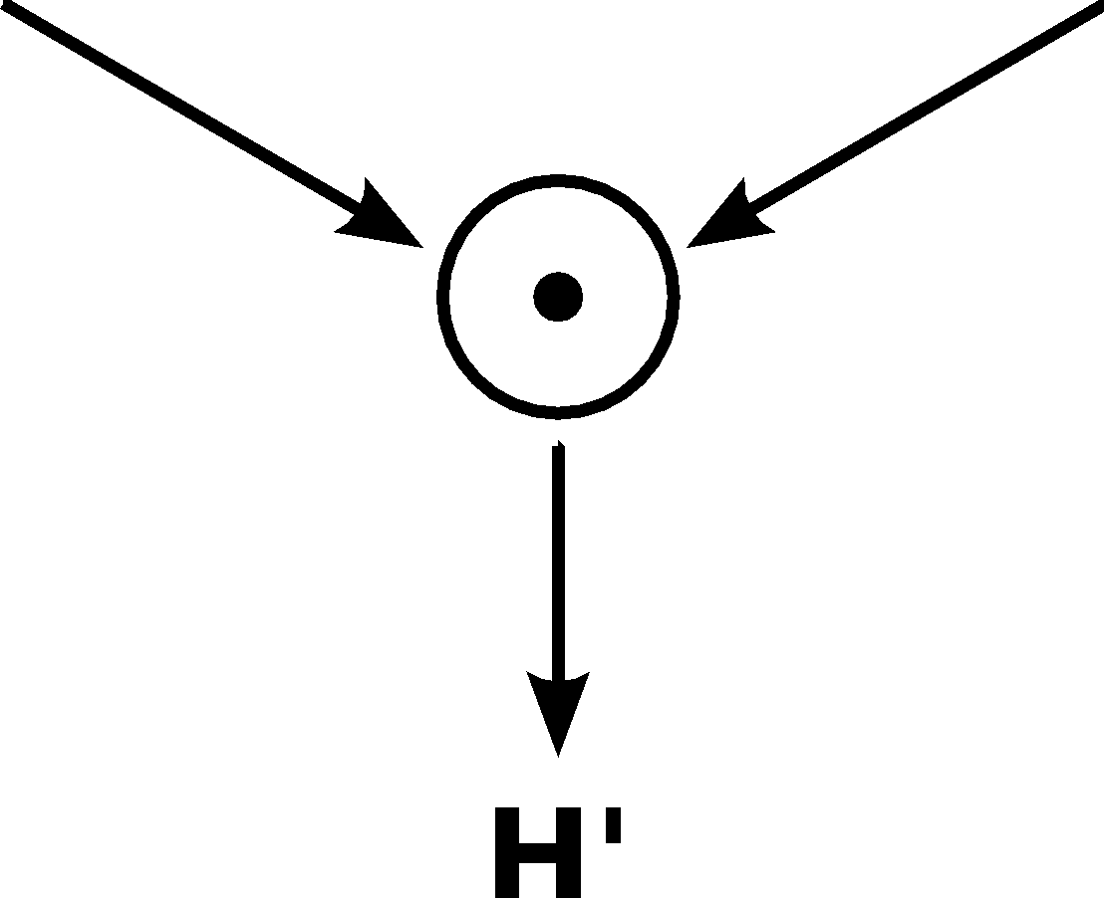

Slide 50
Hashing Analysis

Slide 51
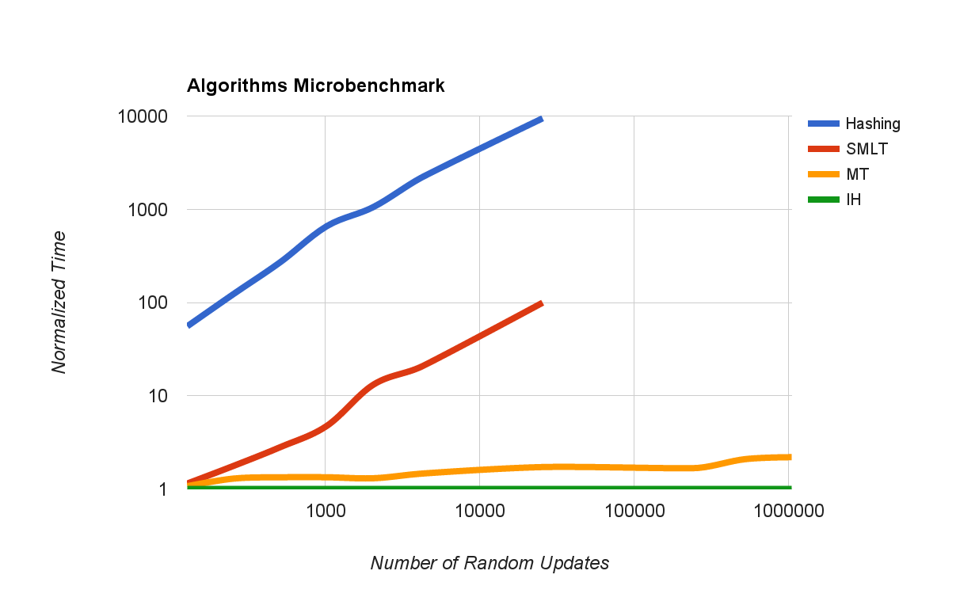

Slide 52
Summary
/cloud
cloud-inotify
/cloud-history
File-level deduplication
Distributed Streaming Virtual Machine Introspection (DS-VMI)
Open Source, Apache v2.0 License
https://github.com/cmusatyalab/gammaray
Contact me for backup dataset (250 GiB database)

Slide 53
Citations - 1
[bellare1997] Bellare, Mihir and Micciancio, Daniele. A New Paradigm for Collision-Free Hashing: Incrementality at Reduced Cost. EUROCRYPT’ 97.
[benninger2012] Benninger, C. and Neville, S.W. and Yazir, Y.O. and Matthews, C. and Coady, Y. Maitland: Lighter-Weight VM Introspection to Support Cyber-security in the Cloud. CLOUD’ 12.
[cohen2010] Cohen, Jeff and Repantis, Thomas and McDermott, Sean and Smith, Scott and Wein, Joel. Keeping track of 70,000+ servers: the Akamai query system. LISA’ 10.
[damgård1990] Ivan Bjerre Damgård. A Design Principle for Hash Functions. CRYPTO’ 89.
[frost2013] Frost & Sullivan. Analysis of the SIEM and Log Management Market. 2013, http://goo.gl/Vup9ml.
[garfinkel2003] Garfinkel, Tal and Rosenblum, Mendel. A Virtual Machine Introspection Based Architecture for Intrusion Detection. NDSSS’ 03.
[kufel2013] Kufel, L. Security Event Monitoring in a Distributed Systems Environment. 2013, IEEE Journal of Security and Privacy.
[nist] NIST. ANSI C Cryptographic API Profile for SHA-3 Candidate Algorithm Submissions. 2009, http://goo.gl/WsFCzp.

Slide 54
Citations - 2
[richter2011] Richter, Wolfgang and Ammons, Glenn and Harkes, Jan and Goode, Adam and Bila, Nilton and de Lara, Eyal and Bala, Vasanth and Satyanarayanan, Mahadev. Privacy-Sensitive VM Retrospection. HotCloud’ 11.
[richter2014] Wolfgang Richter and Canturk Isci and Benjamin Gilbert and Jan Harkes and Vasanth Bala and Mahadev Satyanarayanan. Agentless Cloud-wide Streaming of Guest File System Updates. IC2E’ 14.
[satya2010] Satyanarayanan, Mahadev and Richter, Wolfgang and Ammons, Glenn and Harkes, Jan and Goode, Adam. The Case for Content Search of VM Clouds. CloudApp’ 10.
[sivathanu2003] Sivathanu, Muthian and Prabhakaran, Vijayan and Popovici, Florentina I. and Denehy, Timothy E. and Arpaci-Dusseau, Andrea C. and Arpaci-Dusseau, Remzi H. Semantically-Smart Disk Systems. FAST’ 03.
[wei2009] Wei, Jinpeng and Zhang, Xiaolan and Ammons, Glenn and Bala, Vasanth and Ning, Peng. Managing Security of Virtual Machine Images in a Cloud Environment. CCSW’ 09.
[wikipedia] Wikipedia. Merkle-Damgård Construction. 2014, http://goo.gl/ZUQZFE.
[zhang2006] Youhui Zhang and Yu Gu and Hongyi Wang and Dongsheng Wang. Virtual-Machine-based Intrusion Detection on File-aware Block Level Storage. SBAC-PAD’ 06.

Slide 55
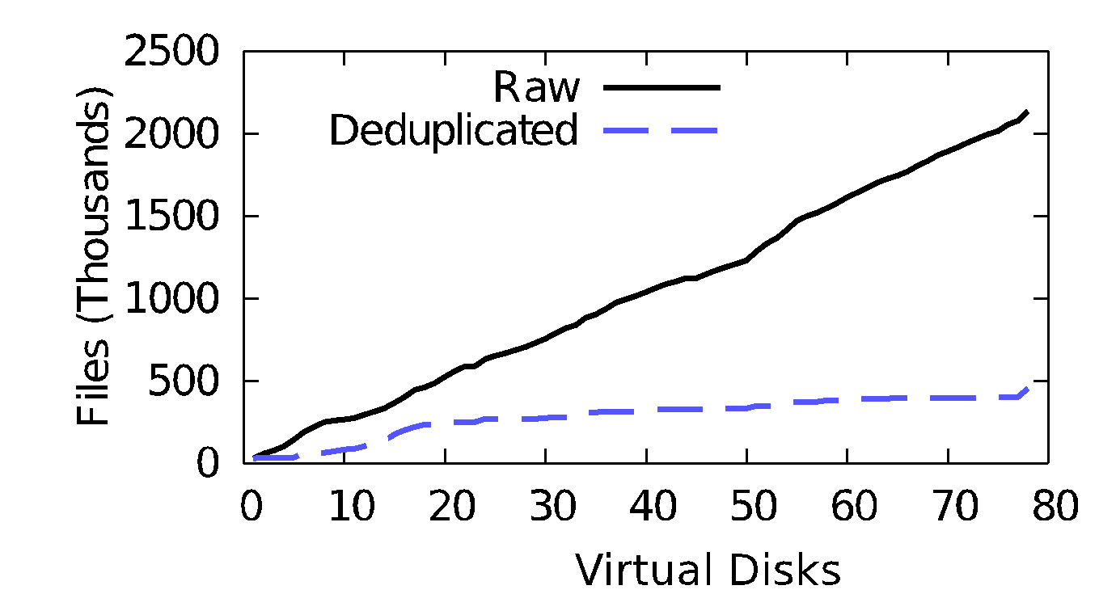
File-level Duplication?
[satya2010]

Slide 56
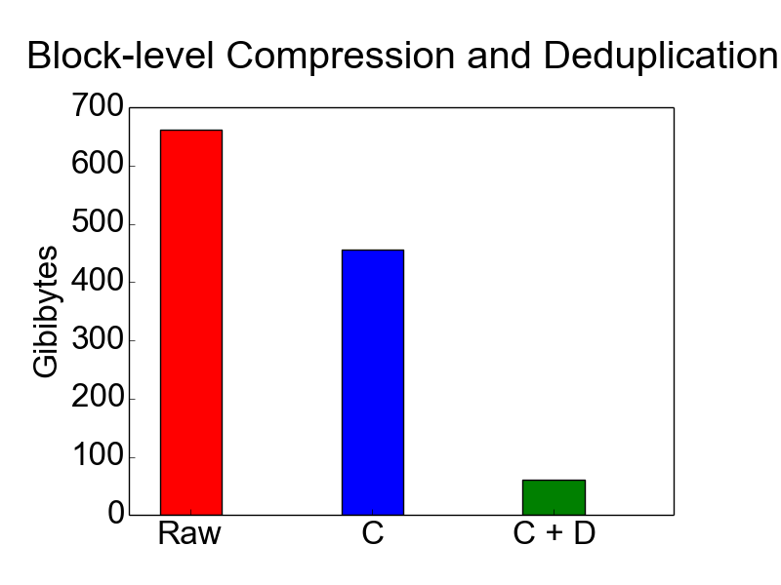

Slide 57
Ensure Block-aligned Data

Slide 58
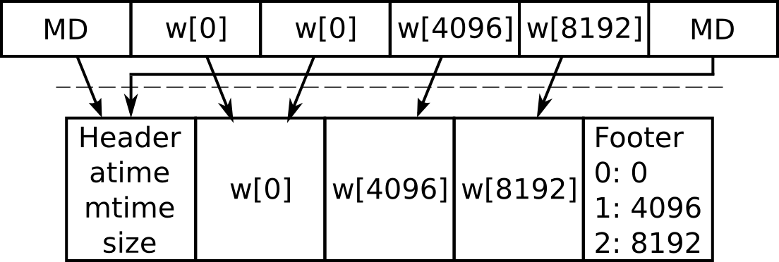
On-disk Log Layout

Slide 59
Versioning Heuristic

Slide 60
Garbage Collection

Slide 61
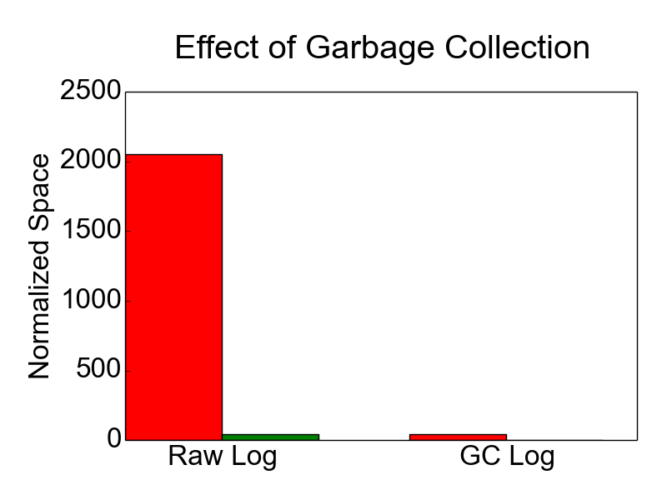

Slide 62
How Slow is Crawling? (used space)
Used (GB) | MD Raw (MB) | MD gzip (MB) | Crawl (s) | Load (s)
2.6 | 109 | 9 | 10.16 (0.89) | 13.52 (0.41)
4.6 | 117 | 11 | 10.75 (0.62) | 19.27 (1.30)
6.6 | 123 | 12 | 11.47 (0.60) | 24.04 (0.14)
8.6 | 130 | 13 | 12.77 (0.65) | 29.68 (0.31)
11 | 136 | 14 | 14.20 (0.55) | 38.84 (0.34)
13 | 143 | 15 | 18.24 (0.56) | 40.08 (0.27)
15 | 149 | 17 | 17.49 (0.81) | 42.42 (0.29)
17 | 156 | 18 | 18.47 (0.83) | 51.39 (0.33)
Metadata compressed size < 18 MB, crawl time < 20 seconds, load time < 60 seconds.
20 GB Raw disk; single ext4 partition; experiments repeated 20 times; first row stock Ubuntu 12.04 LTS Server

Slide 63
How Slow is Crawling? (used inodes)
inodes | MD Raw (MB) | MD gzip (MB) | Crawl (s) | Load (s)
127,785 | 109 | 9 | 10.16 (0.89) | 13.52 (0.41)
500,000 | 243 | 26 | 50.81 (1.26) | 31.06 (0.23)
1,000,000 | 421 | 49 | 120.73 (1.37) | 56.37 (0.51)
1,310,720* | 533 | 65 | 164.91 (1.73) | 76.14 (1.00)
Metadata compressed size < 65 MB, crawl time < 3 minutes, load time < 78 seconds.
20 GB Raw disk; single ext4 partition; experiments repeated 20 times; first row stock Ubuntu 12.04 LTS Server; * means the file system ran out of inodes and could not create more files

Slide 64
What is an agent?
An agent is a process performing administrative tasks that generally runs in the background.
Loggly – log collection and analytics
ClamAV – virus scanning
Dropbox – file backup and synchronization
Windows Update – OS / system update
Tripwire – file-based intrusion detection

Slide 65
Research Questions
What quantitative and qualitative benefits does an agentless approach have over agents?
How does agentless monitoring of disk state change the implementation of file-level monitoring?
How does agentless monitoring of disk state change the implementation of snapshotting?
What properties do interfaces need for scaling file-level monitoring workloads?

Slide 66
Introspection vs. Retrospection
Examine active state of VM during execution
Examine historical state of VMs and their snapshots
VM Instance A
A'
A1
A2
B'
B1
B2
...
Examine live logs
Examine all historic logs A*
[richter2011]

Slide 67
File-level Deduplication
[satya2010]

Slide 68
Applications stressing end-to-end performance and scalability
/cloud
cloud-inotify
/cloud-history
File-level deduplication
Distributed Streaming Virtual Machine Introspection (DS-VMI)

Slide 69
What is a monitoring agent?
A monitoring agent is a process performing administrative tasks that generally runs in the background and can not modify state.
Loggly – log collection and analytics
ClamAV – virus scanning
Dropbox – file backup and sync
Windows Update – OS / system update
Tripwire – file-based intrusion detection

Slide 70
Scalability
Support 10,000+ monitored systems
Overall latency ~10 minutes
Reasonable network bandwidth overhead
Maximize monitored VMs per host
Minimize decrease in consolidation
[cohen2010]

Slide 71
What is meant by cloud?
Users manage isolated VM(s)
VM
Customers
Real
Server
Infrastructure
Small local virtual HD

Slide 72
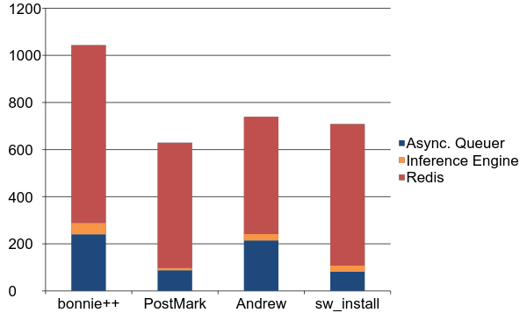
Peak Memory Overhead
~1 GB memory overhead
Memory (MB)
[richter2014]

Slide 73
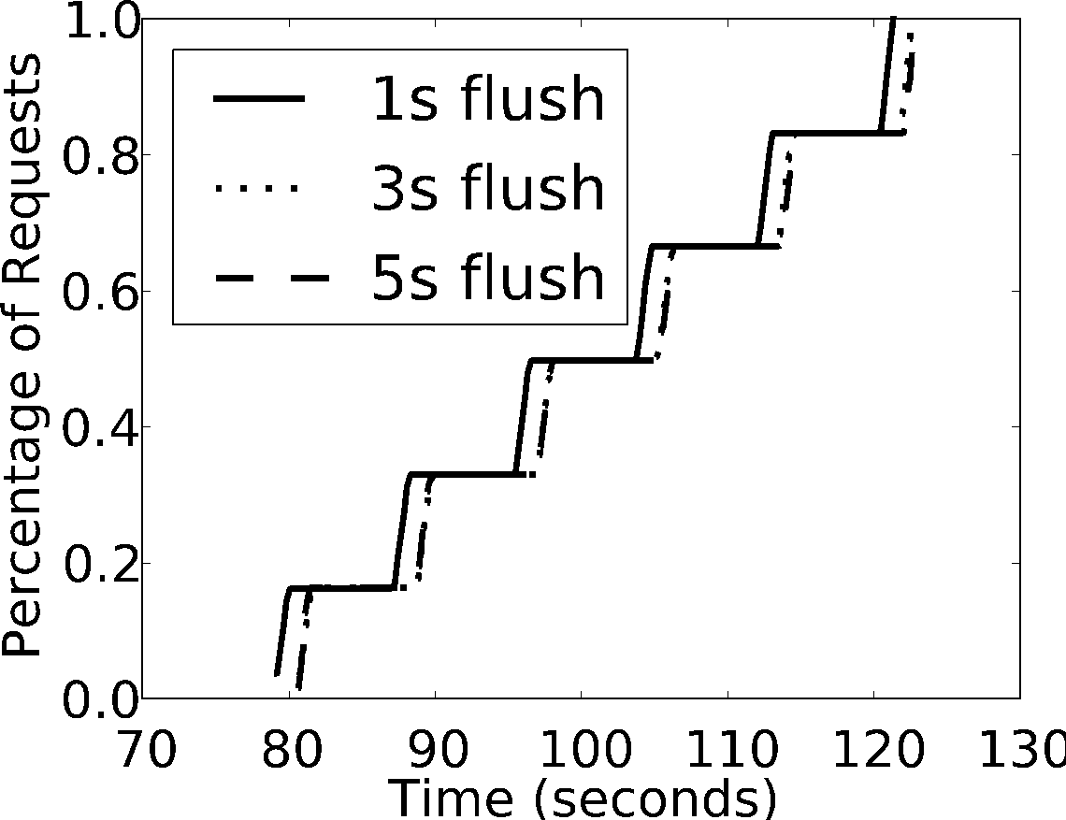
No in-VM syncing

Slide 74
KVM+QEMU
γ-ray attaches here
Guest Mode
(Guest OS)
Kernel Mode
(KVM)
User Mode
(QEMU)
I/O?
Execute Natively in Guest Mode
Handle I/O
[kivity2007]

Slide 75
Zero Guest Modifications
Independent of
Guest OS
Virtual Machine Monitor (VMM)
VM disk format
Implications
Centralize any file-level monitoring task
Remove the need for in-VM processes
Solve monitoring at an infrastructure-level
Maintain compatibility with legacy tools

Slide 76
Teaser: Problem (2)
TubeMogul suffered cloud storage failure
> 50% Fortune 500 use TubeMogul for video ads
Management instance no longer bootable
Fallback to old instance version
New network/IP configuration of new instance
Manual recovery of worker configuration (500+)
Did TubeMogul corrupt their own file system?
Can we take advantage of virtualized infrastructure to complete the puzzle?
[brousse2011]
Notes:
Having an external file-level monitoring infrastructure would have enabled a continued view into the running servers, and perhaps localize the problem quicker. Unfortunately, this is difficult to implement for bare-metal servers. Virtualized clouds provide an opportunity to create such an external monitoring infrastructure offering a view into virtual servers even when their networking configuration fails. I am presenting this new cloud capability today.

Slide 77
Teaser: Potential Win (3)
Deeper knowledge of application performance
Allocate resources more intelligently to VMs
Coupled with application service level objective
Example SLO metric: time to serve web request
Recent work shows:
80% reduced mean deviation of response time
100% increase number of hosted VMs
[sangpetch2010]
Notes:
Having an external file-level monitoring infrastructure would have enabled a continued view into the running servers, and perhaps localize the problem quicker. Unfortunately, this is difficult to implement for bare-metal servers. Virtualized clouds provide an opportunity to create such an external monitoring infrastructure offering a view into virtual servers even when their networking configuration fails. I am presenting this new cloud capability today.

Slide 78
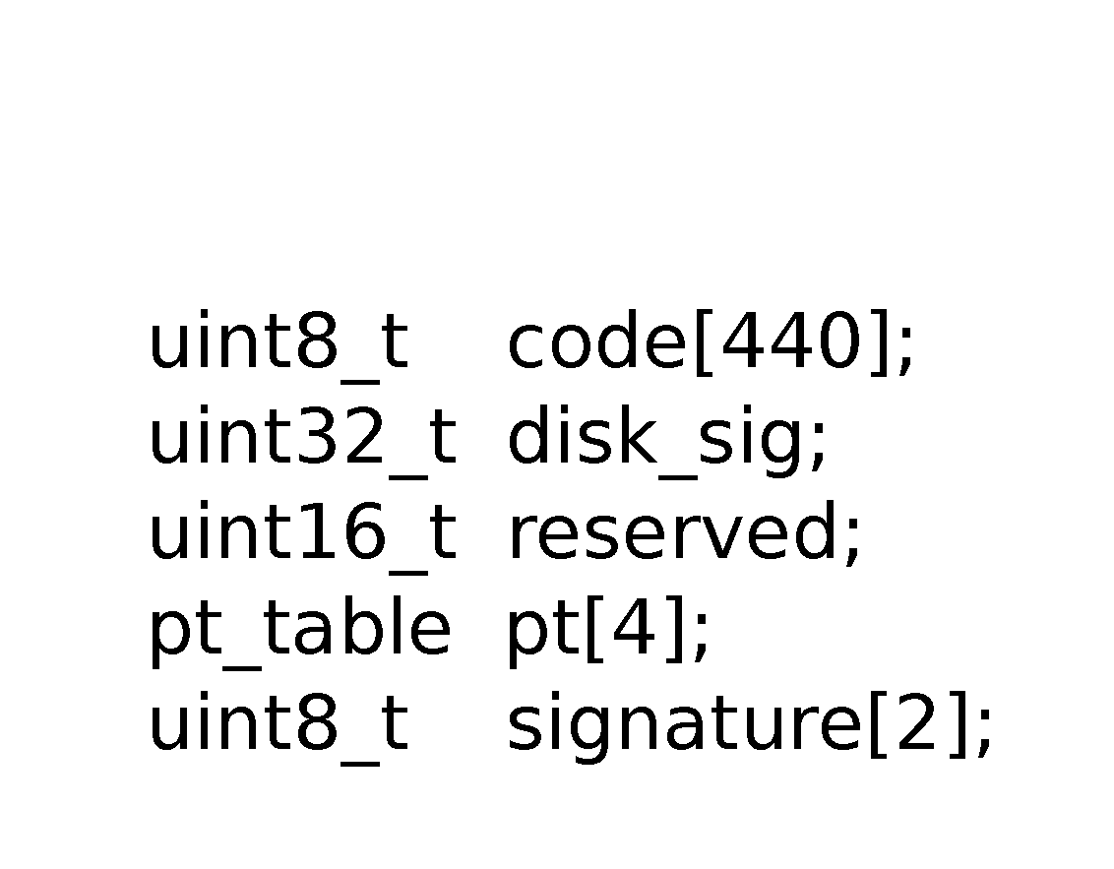
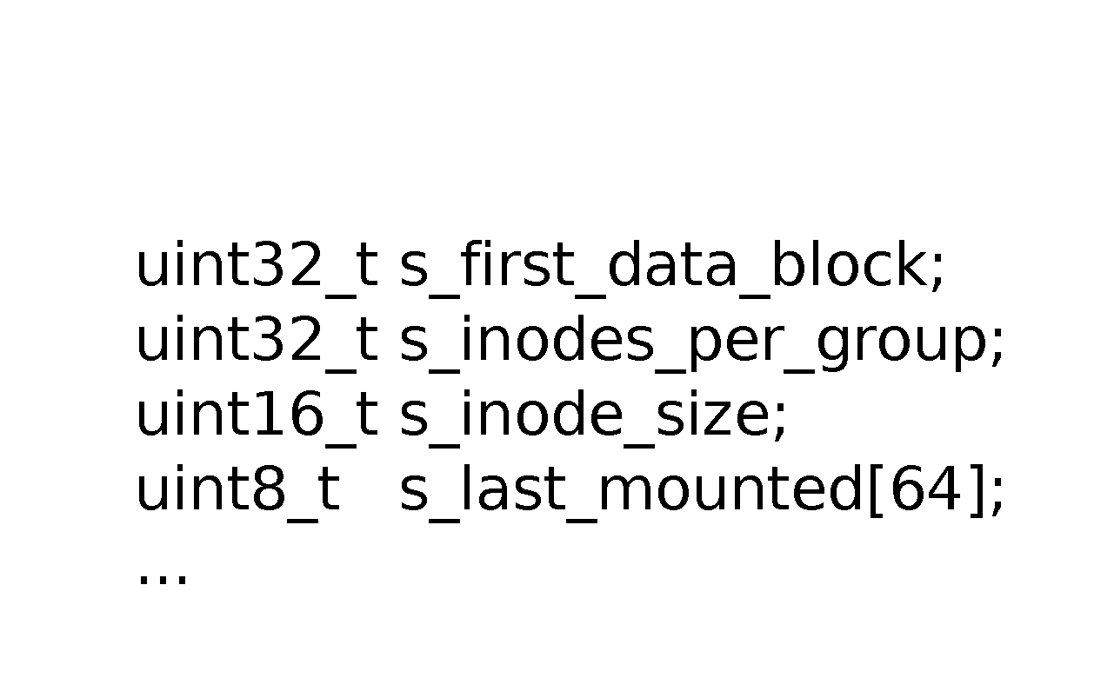
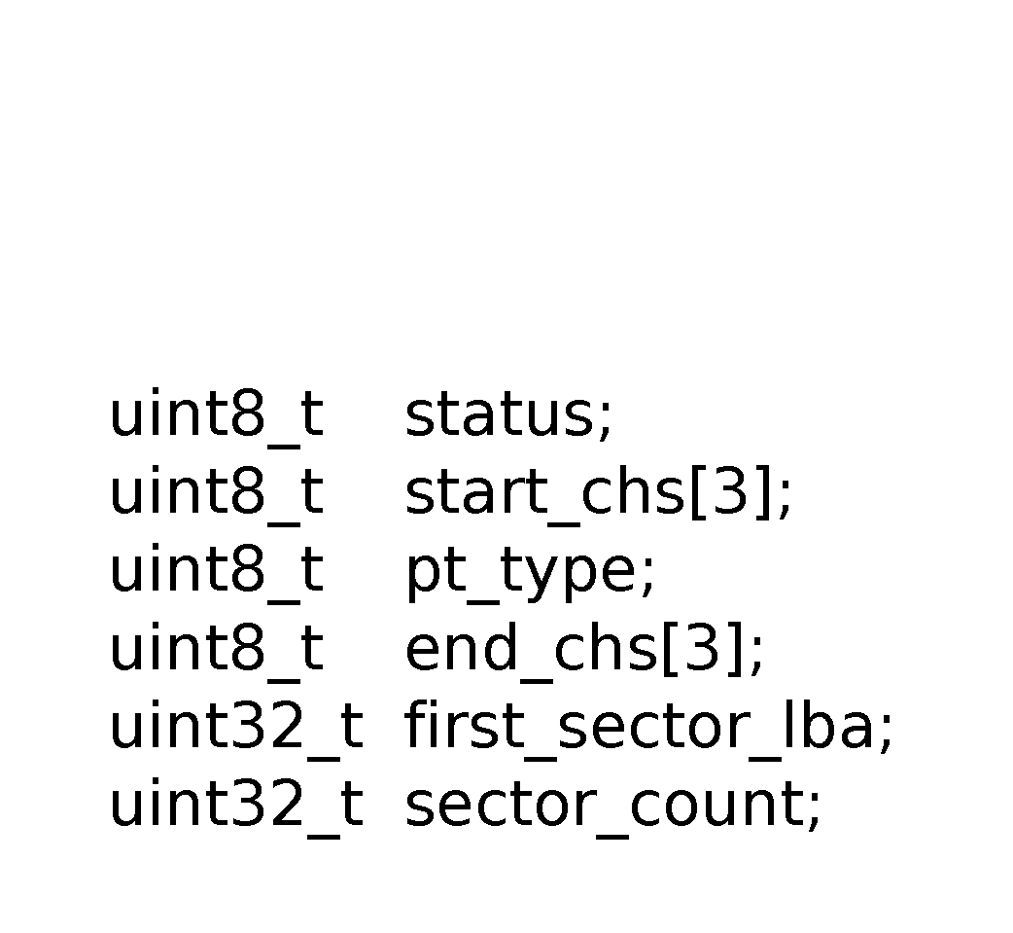
Bootstrapping: ext4 Example (1)

Slide 79
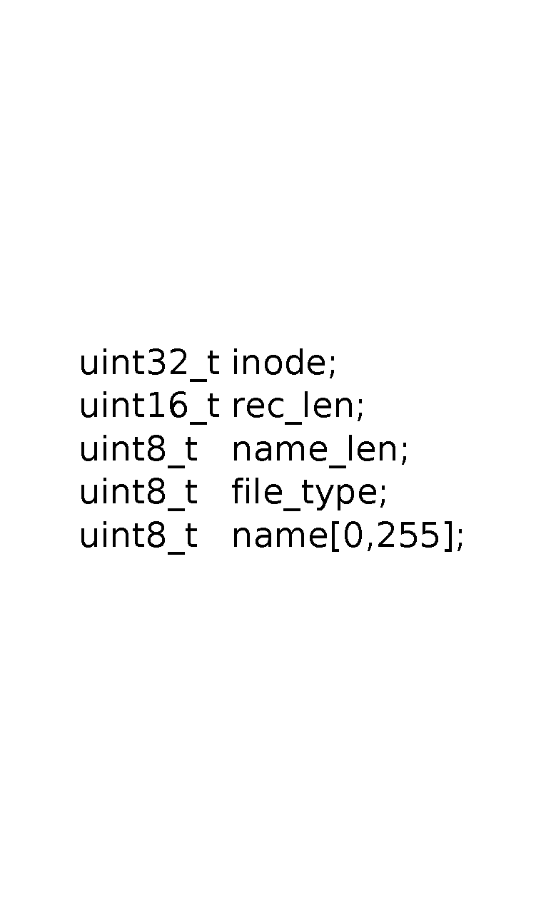
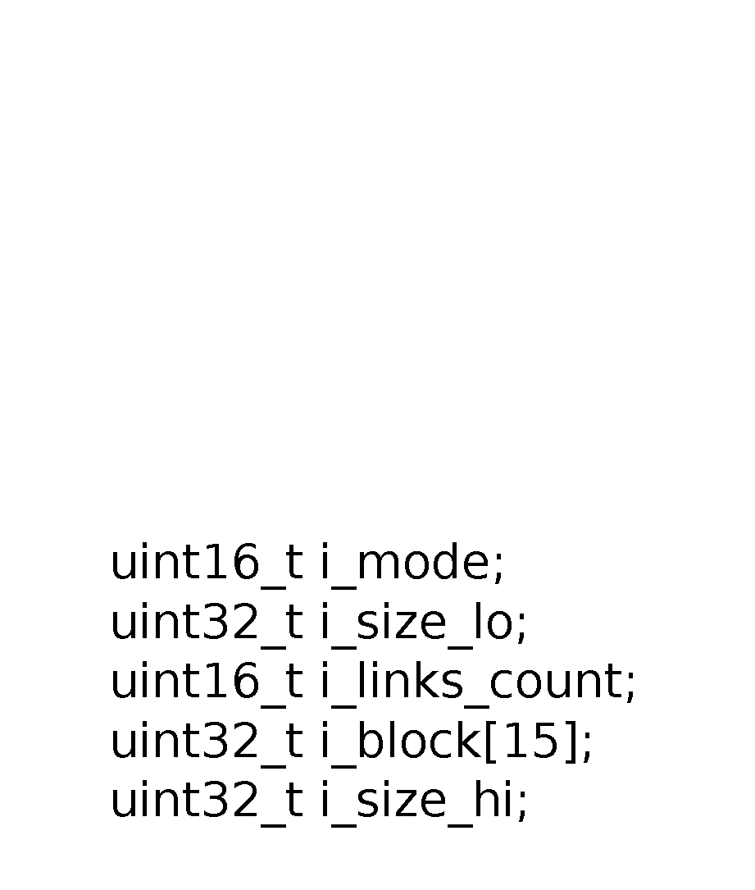
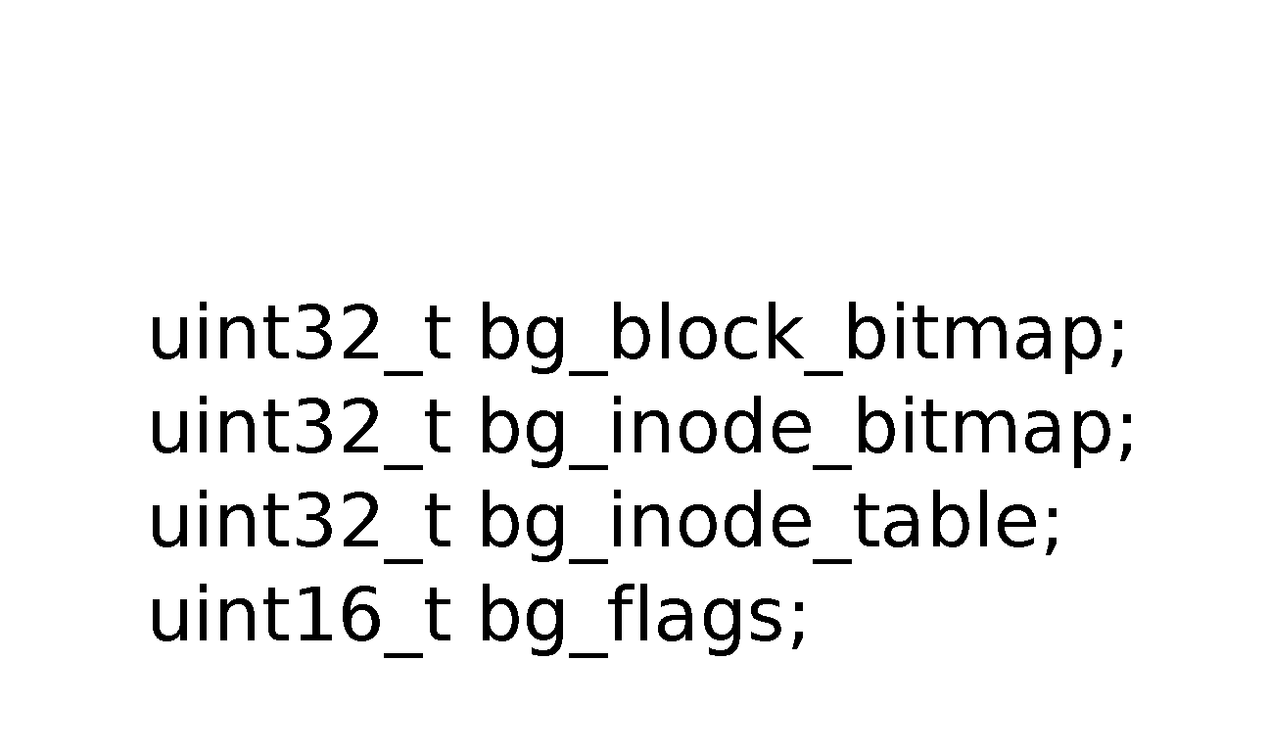
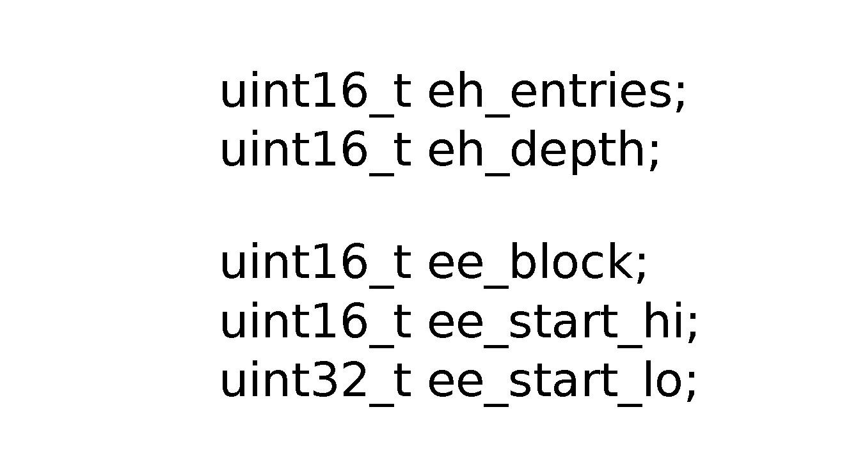
Bootstrapping: ext4 Example (2)

Slide 80
Keeping Track of 70,000+ Servers: The Akamai Query System
Scalable: goal of 70,000 monitored VMs
> 1,000,000 software components
Real-Time: flushed file updates < 10 minutes
File Updates: data write, metadata updates
Create, delete, modify permissions, write
[cohen2010]

Slide 81
Tunable Parameters
Tunable | Default
Unknown Write TTL | 5 minutes
Async Flush Timeout | 5 seconds
Async Queue Size Limit | 250 MB
Async Outstanding Write Limit | 16,384 writes
Redis Maximum Memory | 2 Gigabytes

Slide 82
Problem 1: Monitoring Large VM Deployments
Monitoring instances is critical for
Debugging distributed applications
Measuring performance
Intrusion detection
Clouds leave this unsolved for their users
Users resort to running agents within VMs
Log monitoring (Splunk), anti-virus (ClamAV), etc.

Slide 83
Problem 2: Black Box Metrics Aren’t Enough
Coarse-grained metrics are good detectors
Anomaly detection (memory usage suddenly high)
Early warning systems (onset of thrashing)
But what about answering why?
Root cause analysis (memory up from DB config)
A fundamental issue with black box metrics
[tan2012]

Slide 84
Best Practice Monitoring Today
Agents run inside the monitored system
Per-OS type
Per-Application type
Per-System configuration
Per-System update + patch
Sometimes globally aware
[kufel2013]

Slide 85
Reimagining Monitoring
General
OS and application agnostic
Independent
Misconfiguration and Compromise
Scalable
Globally aware

Slide 86
Independent Monitoring Resources

Slide 87
Leverage Global Knowledge
[wei2009]
Notes:
Vasanth Bala work → Mirage disk image library supporting file-level deduplication of checked in images
4.9x speedup
The images are derived from daily builds of a large, commer-
cial, Eclipse-based development environment. The size of
each image is around 6GB, and each image contains around
60,000 files. This experiment is run on a laptop.

Slide 88
✗ Not General
✗ Not Independent
Agents
VM
Customers
Real
Server
Infrastructure
VMM Observable
✓ Generalizable
✓ Independent
Agentless
[garfinkel2003]

Slide 89
Applications stressing end-to-end performance and scalability
/cloud
cloud-inotify
/cloud-history
File-level deduplication
Distributed Streaming Virtual Machine Introspection (DS-VMI)

Slide 90
Applications
/cloud
Virus Scanning (ClamAV)
Log Collection (Splunk)
cloud-inotify
Continuous Compliance Monitoring
/cloud-history
File Recovery
Unindexed Search

Slide 91
Planned Measurements
Latency-completeness-overhead
Vary queue sizes and flush parameters
Analyze metadata vs data
Re-attachment time
In-VM performance vs Agentless
Scalability in number of monitored systems
Number of monitored systems per host
Wikibench

Slide 92
Applications stressing end-to-end performance and scalability
/cloud
cloud-inotify
/cloud-history
File-level deduplication
Distributed Streaming Virtual Machine Introspection (DS-VMI)

Slide 93
/cloud-history
Strong consistency
Legacy FS Interface
File-level deduplicated snapshots of
sets of VM file system subtrees
Method | Skip Blocks | Skip Files | Skip Indexing | Resource Isolation | Not Misconfig.
Local FS | ✔ | ✔
Distributed FS | ✔ | ✔ | ✔
In-guest Agent | ✔ | ✔ | ✔
Block-level |  |  |  | ✔ | ✔
/cloud-history | ✔ | ✔ | ✔ | ✔ | ✔

Slide 94
Timeline
January – March:
File-level deduplication
April – June:
/cloud-history
July – August:
Applications and measurements
September – October:
Writing
November:
Finish dissertation
December:
Defense

Slide 95
Host Memory Costs
Experiment | Async Q. (MB) | Inf. Eng. (MB) | w/ Redis (MB)
bonnie++ | 240.48 | 48.69 | 1043.48
Andrew | 87.97 | 9.08 | 629.64
PostMark | 214.14 | 26.89 | 738.81
SW Install | 81.28 | 25.73 | 707.96

Slide 96
bonnie++ memory

Slide 97
bonnie++ write pattern

Slide 98
bonnie++ flush pattern

Slide 99
PostMark memory

Slide 100
PostMark write pattern

Slide 101
PostMark flush pattern

Slide 102
Andrew memory

Slide 103
Andrew write pattern

Slide 104
Andrew flush pattern

Slide 105
sw_install memory

Slide 106
sw_install write pattern

Slide 107
sw_install flush pattern

