Slide 1
Announcements
Working AWS codes are out
605 waitlist ~= 25, slots ~= 15
10-805 project deadlines now posted
William has no office hours next week

Slide 2
Recap
An algorithm for testing a huge naïve Bayes classifier
More generally: for evaluating a linear classifier on a test set efficiently on-disk, using stream-and-sort or map-reduce ops only
Sketch of algorithm for Rocchio training/testing

Slide 3
Recap
Abstractions for map-reduce (TFIDF example)
map-side vs reduce-side joins
Proposed syntax:
table2 = MAP table1 TO λ row : f(row))
Proposed syntax:
table2 = FILTER table1 BY λ row : f(row))
f(row)➔ {true,false}
Proposed syntax:
table2 = FLATMAP table1 TO λ row : f(row))
f(row)➔list of rows
Proposed syntax:
GROUP table BY λ row : f(row)
Could define f via: a function, a field of a defined record structure, …
Proposed syntax:
JOIN table1 BY λ row : f(row),
table2 BY λ row : g(row)

Slide 4
Today
Less abstract abstractions
Proposed syntax:
table2 = MAP table1 TO λ row : f(row))
Proposed syntax:
table2 = FILTER table1 BY λ row : f(row))
f(row)➔ {true,false}
Proposed syntax:
table2 = FLATMAP table1 TO λ row : f(row))
f(row)➔list of rows
Proposed syntax:
GROUP table BY λ row : f(row)
Could define f via: a function, a field of a defined record structure, …
Proposed syntax:
JOIN table1 BY λ row : f(row),
table2 BY λ row : g(row)

Slide 5
PIG: A Workflow/DATAFLOW Language

Slide 6
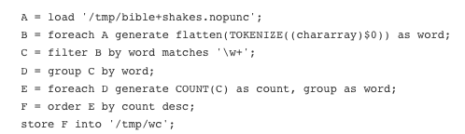
PIG: word count
Declarative “data flow” language
PIG program is a bunch of assignments where every LHS is a relation.
No loops, conditionals, etc allowed.

Slide 7
More on Pig
Pig Latin
atomic types + compound types like tuple, bag, map
execute locally/interactively or on hadoop
can embed Pig in Java (and Python and …)
can call out to Java from Pig

Slide 8
Tokenize – built-in function
Flatten – special keyword, which applies to the next step in the process – ie foreach is transformed from a MAP to a FLATMAP

Slide 9
PIG Features
PIG parses and optimizes a sequence of commands before it executes them
It’s smart enough to turn GROUP … FOREACH… SUM … into a map-reduce
LOAD ‘hdfs-path’ AS (schema)
schemas can include int, double, bag, map, tuple, …
FOREACH alias GENERATE … AS …, …
transforms each row of a relation
DESCRIBE alias/ ILLUSTRATE alias -- debugging
GROUP alias BY …
FOREACH alias GENERATE group, SUM(….)
GROUP/GENERATE … aggregate op together act like a map-reduce
JOIN r BY field, s BY field, …
inner join to produce rows: r::f1, r::f2, … s::f1, s::f2, …
CROSS r, s, …
use with care unless all but one of the relations are singleton
User defined functions as operators
also for loading, aggregates, …

Slide 10
Example: the optimizer will compress these steps into one map-reduce operation

Slide 11
ANOTHER EXAMPLE: cOMPUTING TFIDF in Pig Latin

Slide 12
Abstract Implementation: [TF]IDF
1/2
data = pairs (docid ,term) where term is a word appears in document with id docid
operators:
DISTINCT, MAP, JOIN
GROUP BY …. [RETAINING …] REDUCING TO a reduce step
docFreq = DISTINCT data
| GROUP BY λ(docid,term):term REDUCING TO count /* (term,df) */
docIds = MAP DATA BY=λ(docid,term):docid | DISTINCT
numDocs = GROUP docIds BY λdocid:1 REDUCING TO count /* (1,numDocs) */
dataPlusDF =
JOIN data BY λ(docid, term):term, docFreq BY λ(term, df):term
| MAP λ((docid,term),(term,df)):(docId,term,df) /* (docId,term,document-freq) */
unnormalizedDocVecs = JOIN dataPlusDF by λrow:1, numDocs by λrow:1
| MAP λ((docId,term,df),(dummy,numDocs)): (docId,term,log(numDocs/df))
/* (docId, term, weight-before-normalizing) : u */
key | value
found | (d123,found),(d134,found),…
aardvark | (d123,aardvark),…
key | value
found | (d123,found),(d134,found),… 2456
aardvark | (d123,aardvark),… 7
docId | term
d123 | found
d123 | aardvark
key | value
1 | 12451

Slide 13
Abstract Implementation: TFIDF
2/2
normalizers =
GROUP unnormalizedDocVecs BY λ(docId,term,w):docid
RETAINING λ(docId,term,w): w²
REDUCING TO sum /* (docid,sum-of-square-weights) */
docVec = JOIN unnormalizedDocVecs BY λ(docId,term,w):docid,
normalizers BY λ(docId,norm):docid
| MAP λ((docId,term,w), (docId,norm)): (docId,term,w/sqrt(norm))
/* (docId, term, weight) */
key
d1234 | (d1234,found,1.542), (d1234,aardvark,13.23),… 37.234
d3214 | ….
key
d1234 | (d1234,found,1.542), (d1234,aardvark,13.23),… 37.234
d3214 | …. 29.654
docId | term | w
d1234 | found | 1.542
d1234 | aardvark | 13.23
docId | w
d1234 | 37.234
d1234 | 37.234

Slide 14
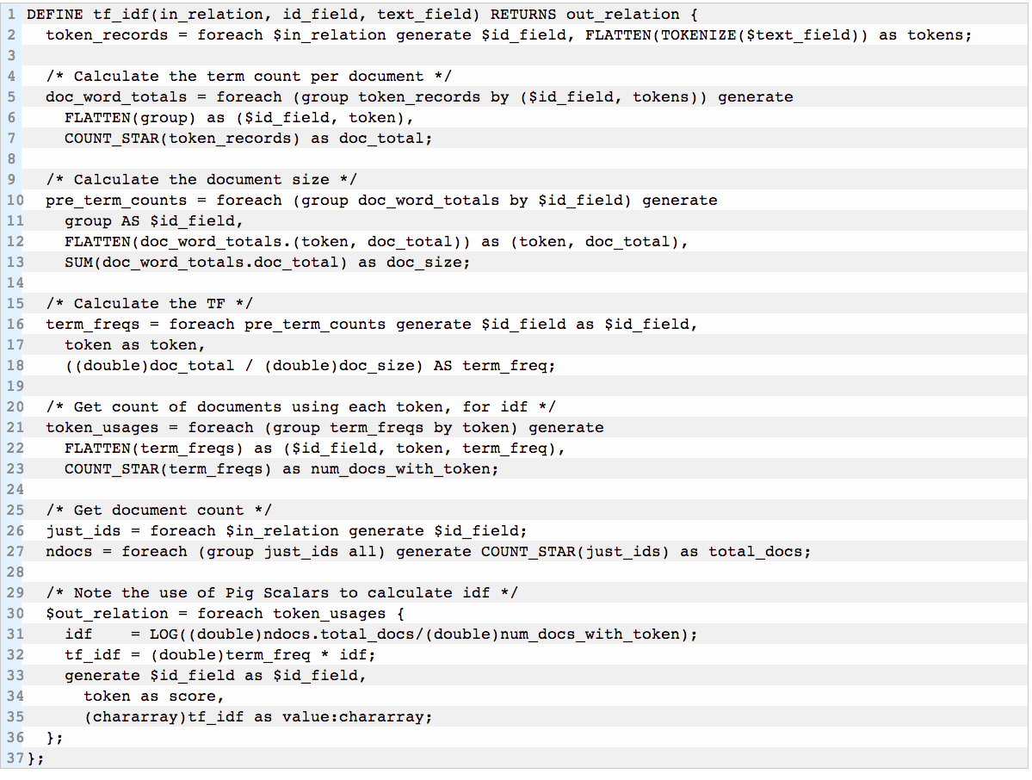
group outputs record with “group” as field name
(docid,token) ➔ (docid,token,tf(token in doc))
(docid,token,tf) ➔ (docid,token,tf,length(doc))
(docid,token,tf,n)➔(…,tf/n)
(docid,token,tf,n,tf/n)➔(…,df)
ndocs.total_docs
relation-to-scalar casting
(docid,token,tf,n,tf/n)➔(docid,token,tf/n * id)

Slide 15
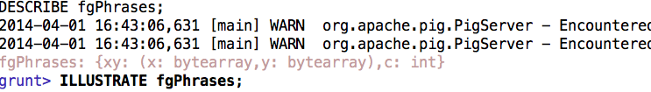
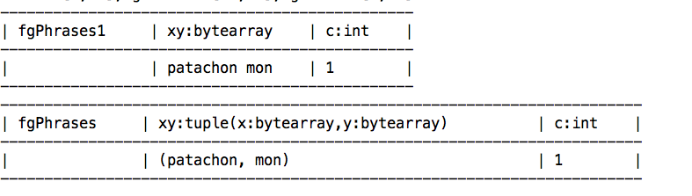
Debugging/visualization

Slide 17
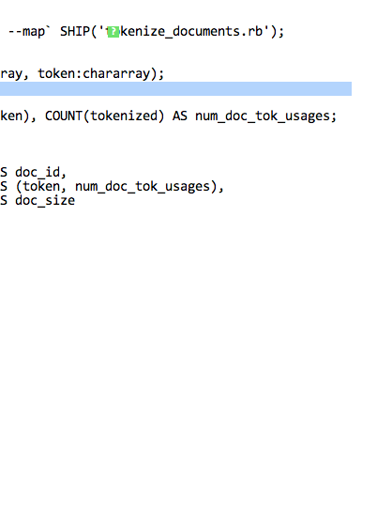
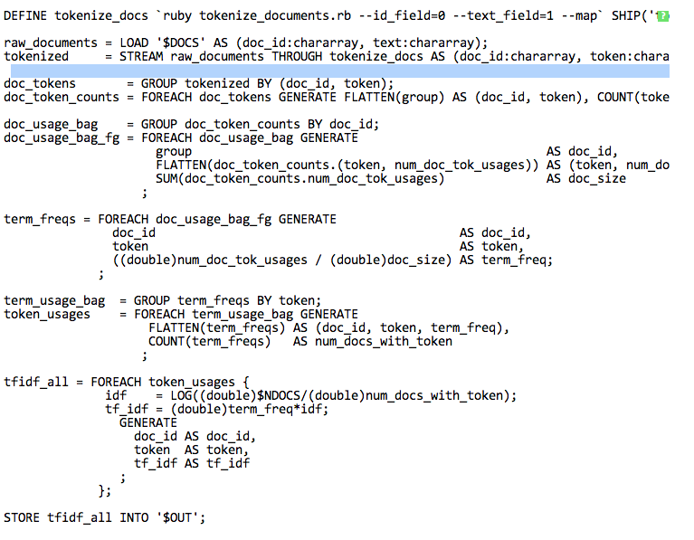
TF-IDF in PIG - another version

Slide 18
Guinea PIG

Slide 19
GuineaPig: PIG in Python
Pure Python (< 1500 lines)
Streams Python data structures
strings, numbers, tuples (a,b), lists [a,b,c]
No records: operations defined functionally
Compiles to Hadoop streaming pipeline
Optimizes sequences of MAPs
Runs locally without Hadoop
compiles to stream-and-sort pipeline
intermediate results can be viewed
Can easily run parts of a pipeline
http://curtis.ml.cmu.edu/w/courses/index.php/Guinea_Pig

Slide 20
GuineaPig: PIG in Python
Pure Python, streams Python data structures
not too much new to learn (eg field/record notation, special string operations, UDFs, …)
codebase is small and readable
Compiles to Hadoop or stream-and-sort, can easily run parts of a pipeline
intermediate results often are (and always can be) stored and inspected
plan is fairly visible
Syntax includes high-level operations but also fairly detailed description of an optimized map-reduce step
Flatten | Group(by=…, retaining=…, reducingTo=…)

Slide 21
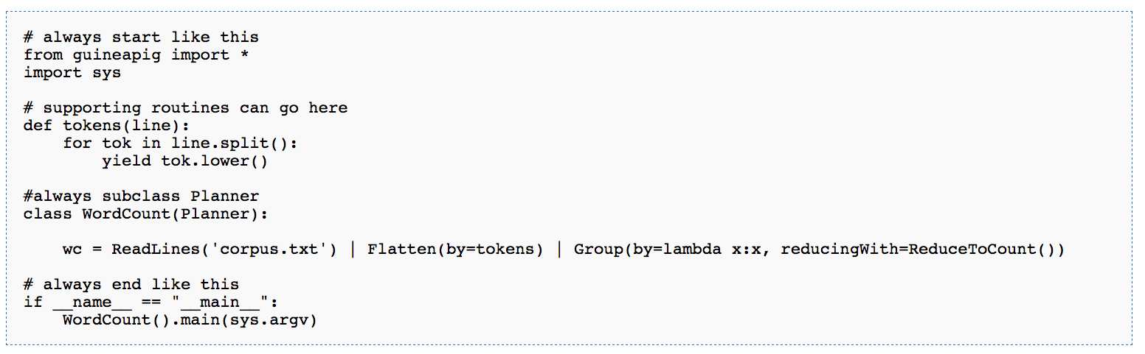

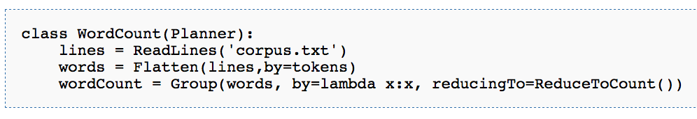
A wordcount example
class variables in the planner are data structures

Slide 22
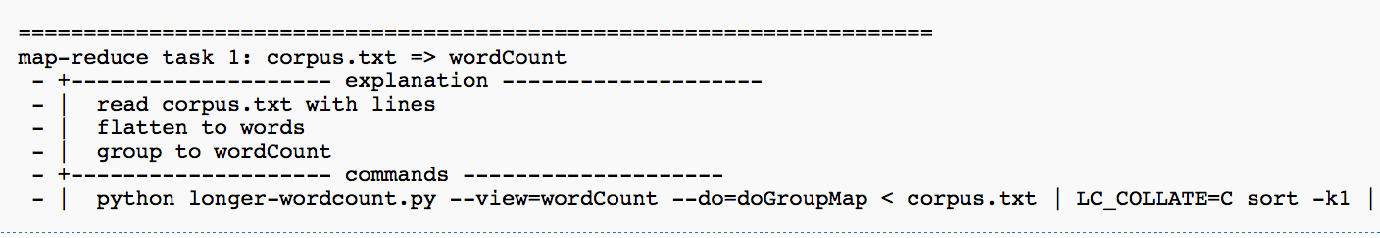
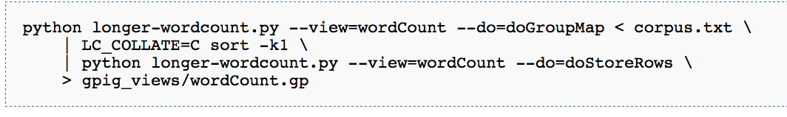
Wordcount example ….
Data structure can be converted to a series of “abstract map-reduce tasks”

Slide 23
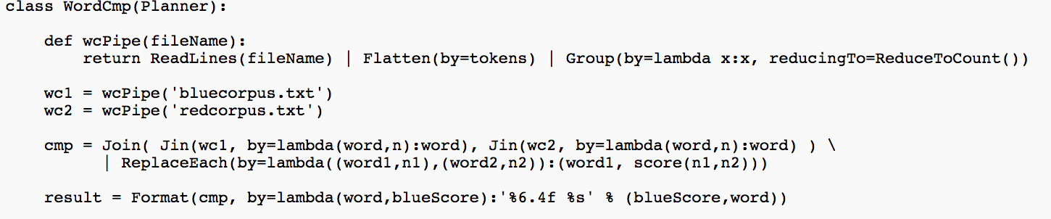
More examples of GuineaPig
Join syntax, macros, Format command
Incremental debugging, when intermediate views are stored:
% python wrdcmp.py –store result
…
% python wrdcmp.py –store result –reuse cmp

Slide 24
More examples of GuineaPig
Full Syntax for Group
Group(wc, by=lambda (word,count):word[:k],
retaining=lambda (word,count):count,
reducingTo=ReduceToSum())
equiv to:
Group(wc, by=lambda (word,count):word[:k], reducingTo=
ReduceTo(int,
lambda accum,(word,count)): accum+count))

Slide 25
ANOTHER EXAMPLE: cOMPUTING TFIDF in Guinea Pig

Slide 26
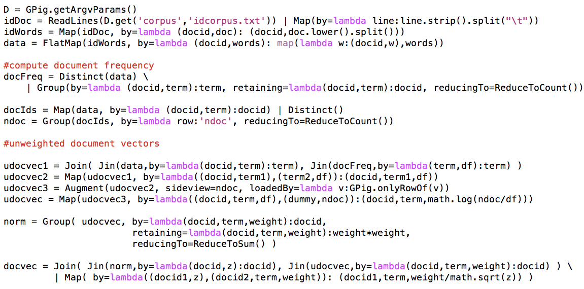
Actual Implementation

Slide 27
Actual Implementation
docId | w
d123 | found
d123 | aardvark

Slide 28
Actual Implementation
docId | w
d123 | found
d123 | aardvark
key | value
found | (d123,found),(d134,found),… 2456
aardvark | (d123,aardvark),… 7

Slide 29
Actual Implementation
Augment: loads a preloaded object b at mapper initialization time,
cycles thru the input, and generates pairs (a,b)

Slide 30
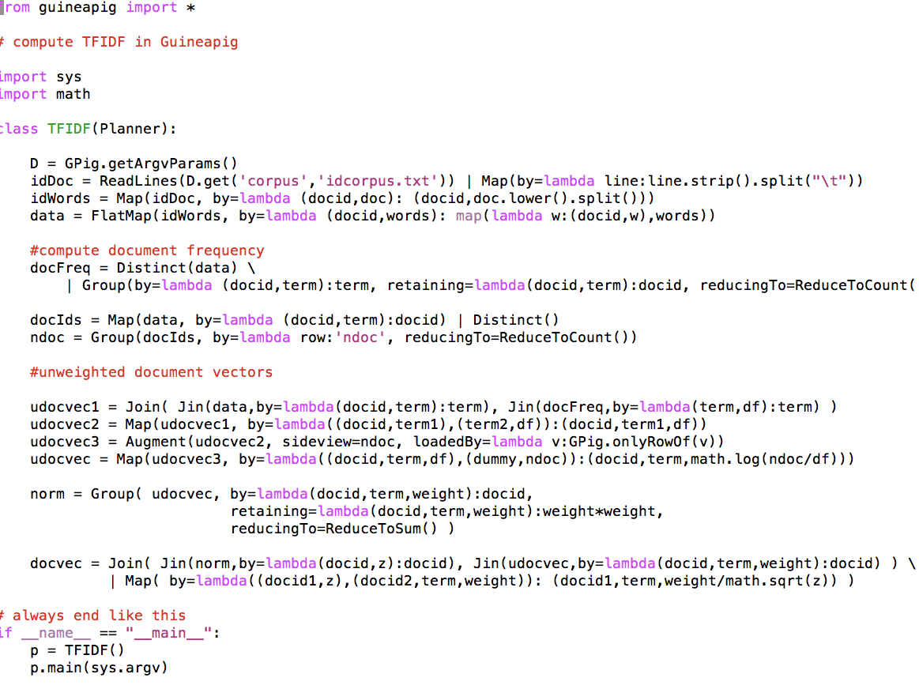
Full Implementation

Slide 31
Outline: Soft Joins with TFIDF
Why similarity joins are important
Useful similarity metrics for sets and strings
Fast methods for K-NN and similarity joins
Blocking
Indexing
Short-cut algorithms
Parallel implementation

Slide 32

In the once upon a time days of the First Age of Magic, the prudent sorcerer regarded his own true name as his most valued possession but also the greatest threat to his continued good health, for--the stories go--once an enemy, even a weak unskilled enemy, learned the sorcerer's true name, then routine and widely known spells could destroy or enslave even the most powerful. As times passed, and we graduated to the Age of Reason and thence to the first and second industrial revolutions, such notions were discredited. Now it seems that the Wheel has turned full circle (even if there never really was a First Age) and we are back to worrying about true names again:
The first hint Mr. Slippery had that his own True Name might be known--and, for that matter, known to the Great Enemy--came with the appearance of two black Lincolns humming up the long dirt driveway ... Roger Pollack was in his garden weeding, had been there nearly the whole morning.... Four heavy-set men and a hard-looking female piled out, started purposefully across his well-tended cabbage patch.…
This had been, of course, Roger Pollack's great fear. They had discovered Mr. Slippery's True Name and it was Roger Andrew Pollack TIN/SSAN 0959-34-2861.
Notes:
To do

Slide 33
Soft Joins with TFIDF: Why and What

Slide 34
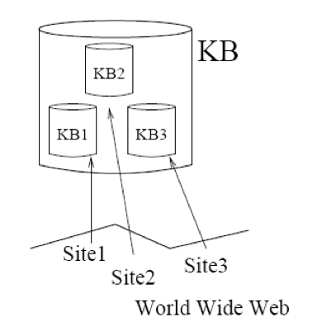
Motivation
Integrating data is important
Data from different sources may not have consistent object identifiers
Especially automatically-constructed ones
But databases will have human-readable names for the objects
But names are tricky….

Slide 35
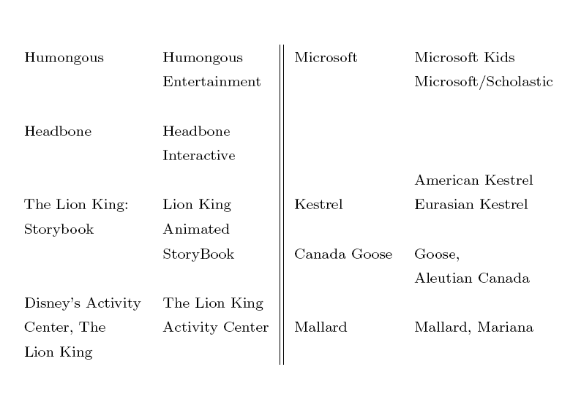

Slide 36
Sim Joins on Product Descriptions
Similarity can be high for descriptions of distinct items:
AERO TGX-Series Work Table -42'' x 96'' Model 1TGX-4296 All tables shipped KD AEROSPEC- 1TGX Tables are Aerospec Designed. In addition to above specifications; - All four sides have a V countertop edge ...
AERO TGX-Series Work Table -42'' x 48'' Model 1TGX-4248 All tables shipped KD AEROSPEC- 1TGX Tables are Aerospec Designed. In addition to above specifications; - All four sides have a V countertop ..
Similarity can be low for descriptions of identical items:
Canon Angle Finder C 2882A002 Film Camera Angle Finders Right Angle Finder C (Includes ED-C & ED-D Adapters for All SLR Cameras) Film Camera Angle Finders & Magnifiers The Angle Finder C lets you adjust ...
CANON 2882A002 ANGLE FINDER C FOR EOS REBEL® SERIES PROVIDES A FULL SCREEN IMAGE SHOWS EXPOSURE DATA BUILT-IN DIOPTRIC ADJUSTMENT COMPATIBLE WITH THE CANON® REBEL, EOS & REBEL EOS SERIES.

Slide 37
One solution: Soft (Similarity) joins
A similarity join of two sets A and B is
an ordered list of triples (s_{ij},a_{i},b_{j}) such that
a_{i} is from A
b_{j} is from B
s_{ij} is the similarity of a_{i} and b_{j}
the triples are in descending order
the list is either the top K triples by s_{ij} or ALL triples with s_{ij}>L … or sometimes some approximation of these….

Slide 38
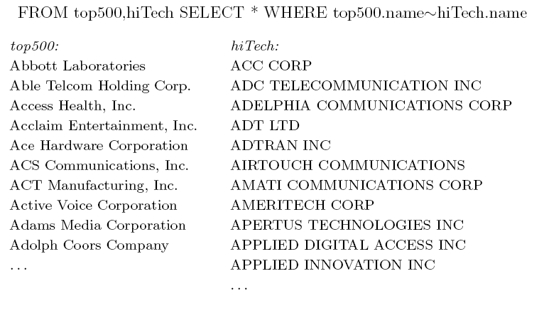
Softjoin Example - 1
A useful scalable similarity metric: IDF weighting plus cosine distance!

Slide 39
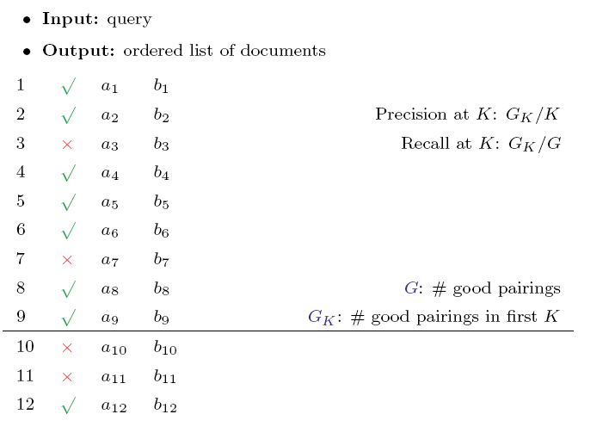
How well does TFIDF work?

Slide 40
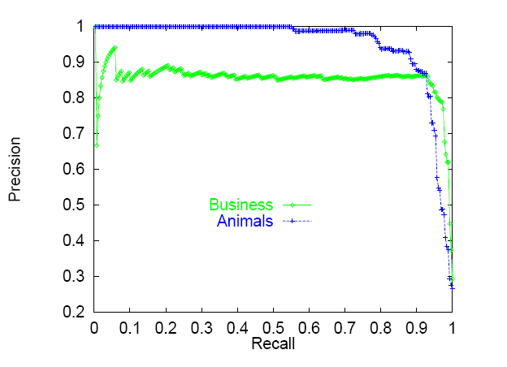
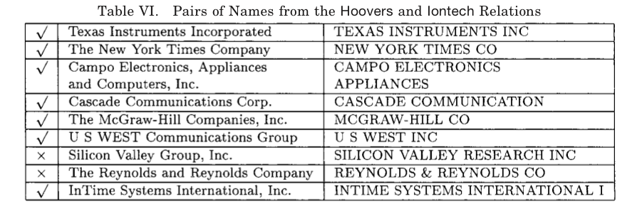

Slide 41
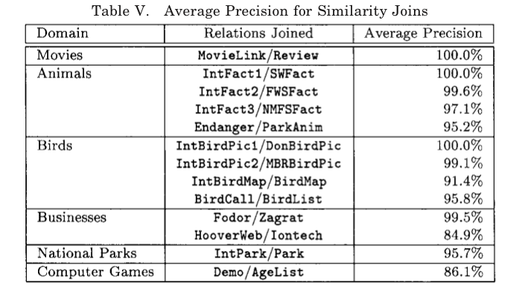
There are refinements to TFIDF distance – eg ones that extend with soft matching at the token level (e.g., softTFIDF)

Slide 42
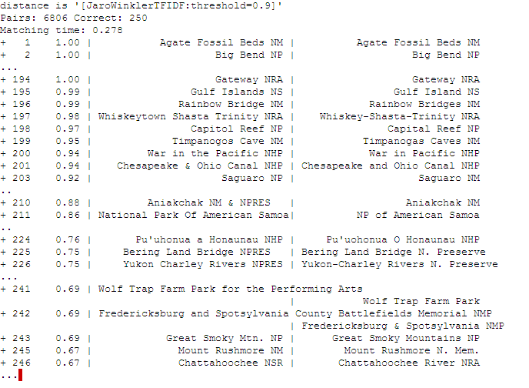
Semantic Joining with Multiscale Statistics
William Cohen
Katie Rivard, Dana Attias-Moshevitz
CMU

Slide 43
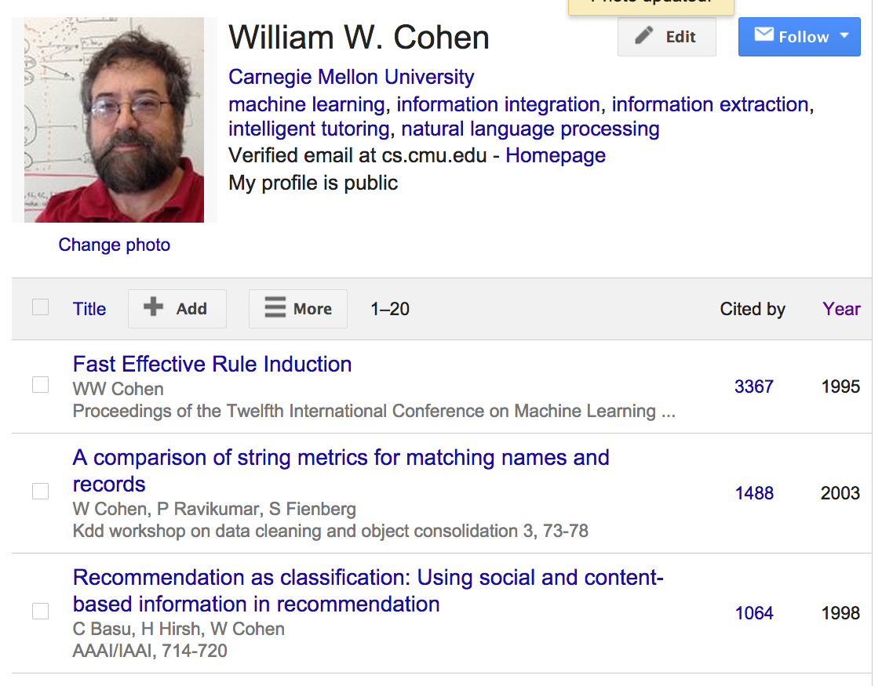

Slide 44
Soft Joins with TFIDF: How?

Slide 45
Rocchio’s algorithm
Many variants of these formulae
…as long as u(w,d)=0 for words not in d!
Store only non-zeros in u(d), so size is O(|d| )
But size of u(y) is O(|n_{V}| )

Slide 46
TFIDF similarity

Slide 47
Soft TFIDF joins
A similarity join of two sets of TFIDF-weighted vectors A and B is
an ordered list of triples (s_{ij},a_{i},b_{j}) such that
a_{i} is from A
b_{j} is from B
s_{ij} is the dot product of a_{i} and b_{j}
the triples are in descending order
the list is either the top K triples by s_{ij} or ALL triples with s_{ij}>L … or sometimes some approximation of these….

Slide 48
Parallel Soft JOINS

Slide 49
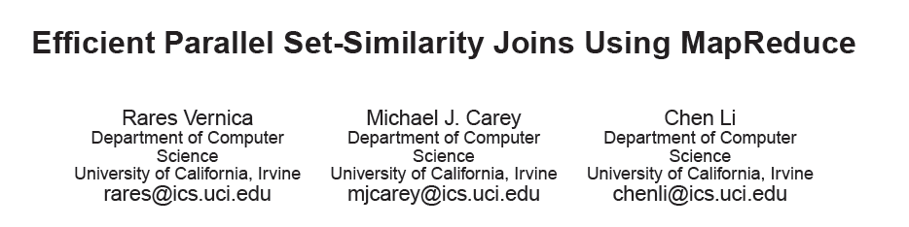
SIGMOD 2010

Slide 50
TFIDF similarity: variant for joins

Slide 51
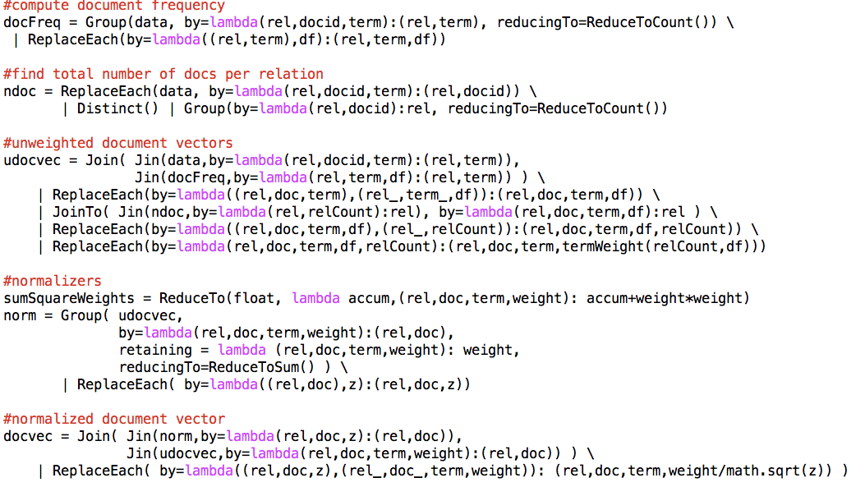
Parallel Inverted Index Softjoin - 1
want this to work for long documents or short ones…and keep the relations simple
Statistics for computing TFIDF with IDFs local to each relation

Slide 52
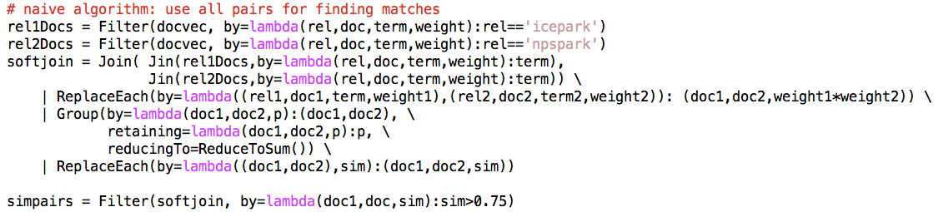
Parallel Inverted Index Softjoin - 2
What’s the algorithm?
Step 1: create document vectors as (C_{d}, d, term, weight) tuples
Step 2: join the tuples from A and B: one sort and reduce
Gives you tuples (a, b, term, w(a,term)*w(b,term))
Step 3: group the common terms by (a,b) and reduce to aggregate the components of the sum

Slide 53
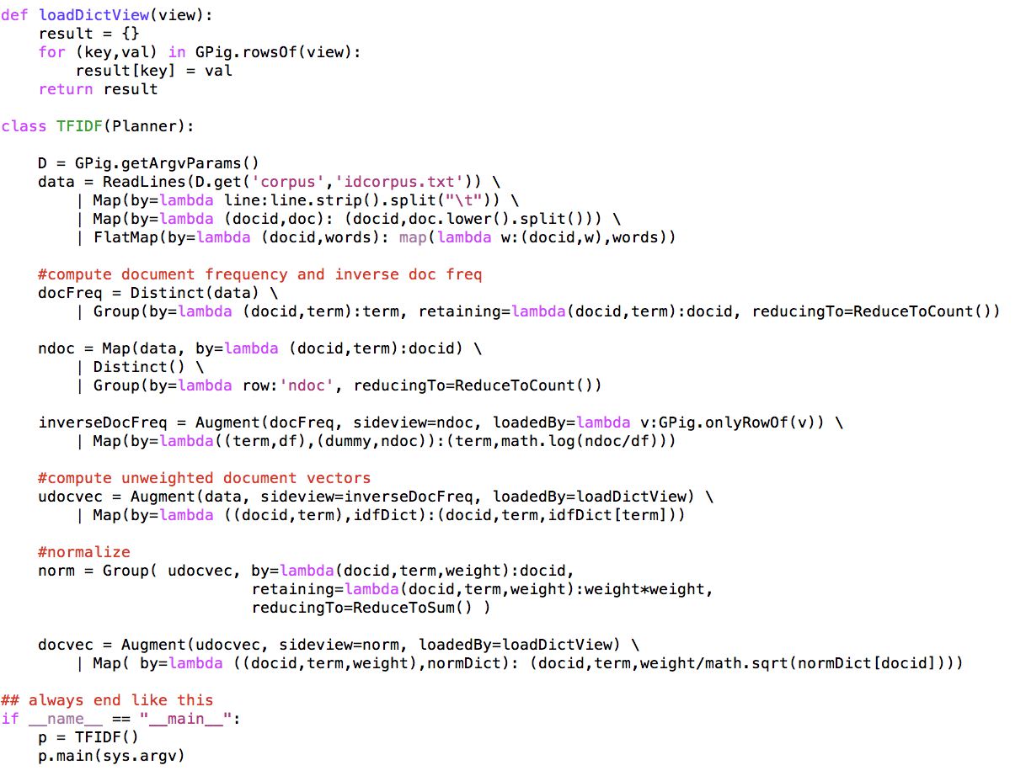
An alternative TFIDF pipeline

Slide 54
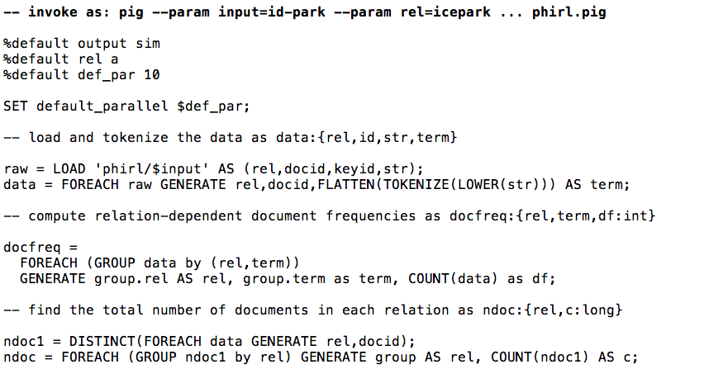
Inverted Index Softjoin – PIG 1/3

Slide 55
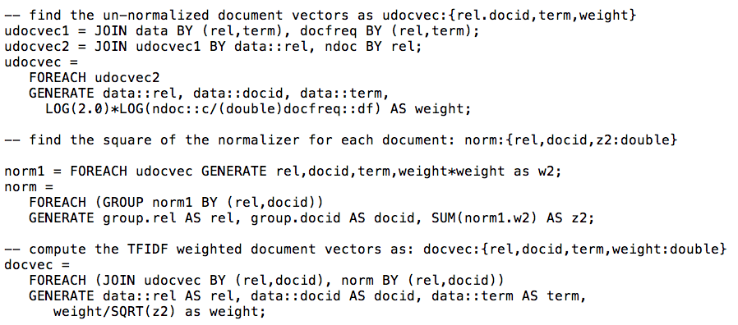
Inverted Index Softjoin – 2/3

Slide 56
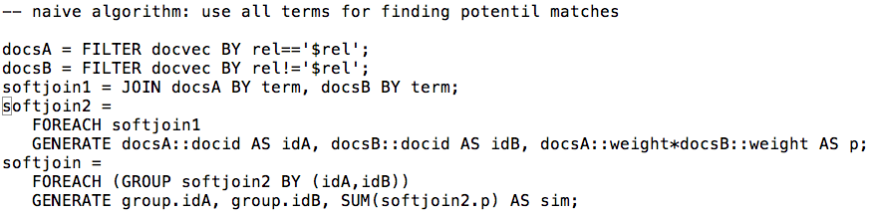
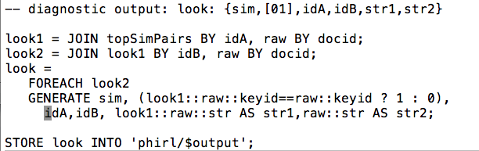
Inverted Index Softjoin – 3/3

Slide 57
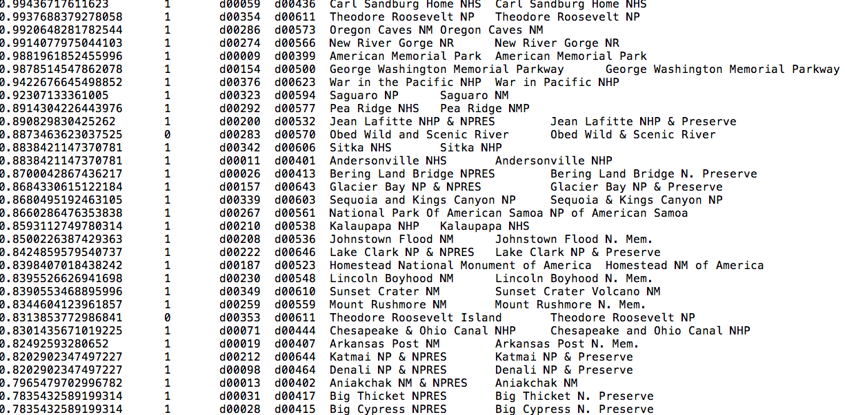
Results…..

Slide 58
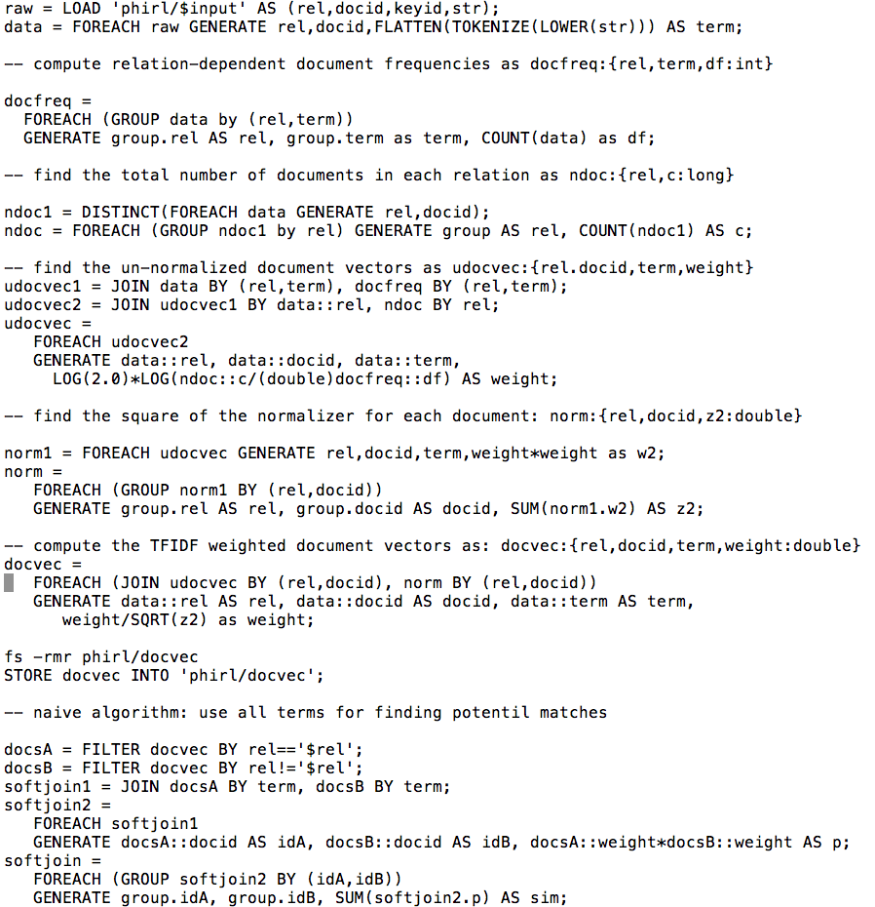

Slide 59
Making the algorithm smarter….

Slide 60
Inverted Index Softjoin - 2
we should make a smart choice about which terms to use

Slide 61
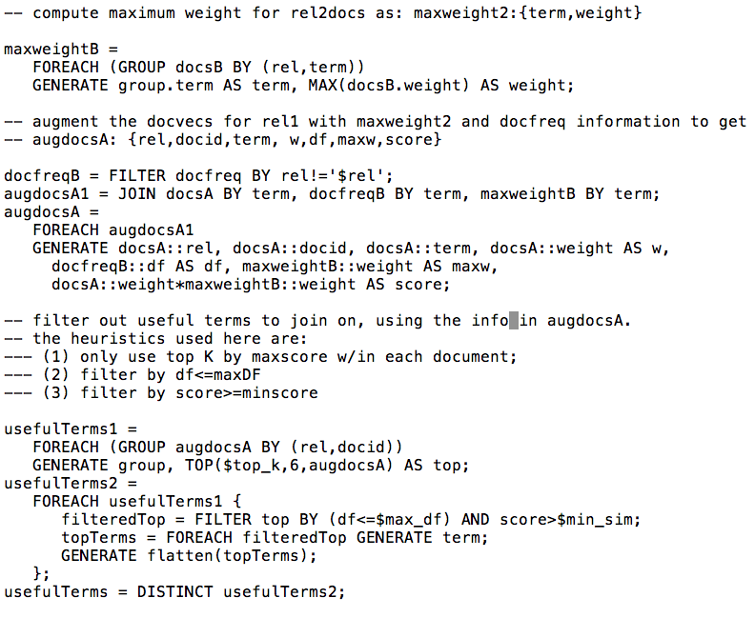
Adding heuristics to the soft join - 1

Slide 62
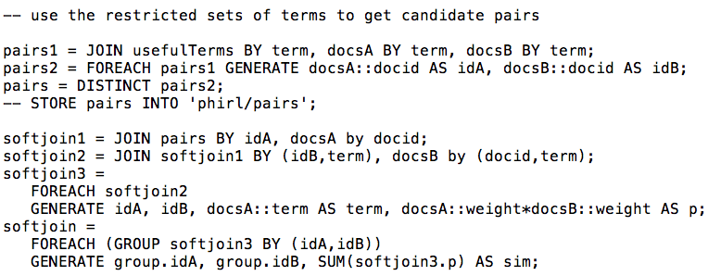
Adding heuristics to the soft join - 2

Slide 63
