Slide 1
Naïve Bayes
William W. Cohen

Slide 2
Probability - what you need to really, really know
Probabilities are cool
Random variables and events
The Axioms of Probability
Independence, binomials, multinomials
Conditional probabilities
Bayes Rule
MLE’s, smoothing, and MAPs
The joint distribution
Inference

Slide 3
computing WITH a joint probability Estimate

Slide 4
Get some data
% which die was used first and second: fair, loaded hi, or loaded lo
dice1 = randi(3,[n,1]);
dice2 = randi(3,[n,1]);
% did the 'loading' happen for die 1 and die 2: if 1, produce extreme value
load1 = randi(2,[n,1]);
load2 = randi(2,[n,1]);
% simulate rolling the dice…
r1 = roll(dice1,load1,randi(5,[n,1]),randi(6,[n,1]));
r2 = roll(dice2,load2,randi(5,[n,1]),randi(6,[n,1]));
% append the column vectorsD = [dice1,dice2,r1,r2];
D = [dice1,dice2,r1,r2];

Slide 5
Get some data
function [ face ] = roll(d,ld,upTo5,upTo6)
% if d==1
% face = randi(6)
% elseif d==2 & ld==1
% face = 6
% elseif d==2 & ld==0
% face = randi(5)
% elseif d==3 & ld==1
% face = 1
% else
% face = randi(5)+1
% end
face = (d==1).*upTo6 + ...
(d==2).*(ld==1)*6 + (d==2).*(ld==0).*upTo5 + ...
(d==3).*(ld==1)*1 + ((d==3).*(ld==0).*upTo5 + 1);
end
fair die
loaded high
loaded low

Slide 6
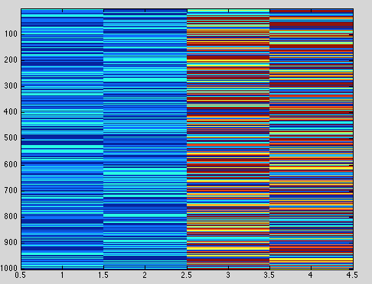
Get some data
>> D = [dice1,dice2,r1,r2];
>> D(1:10,:)
ans =
1 1 7 4
2 1 1 3
2 3 1 1
3 1 1 2
3 2 2 1
1 2 4 7
3 2 2 1
2 3 7 2
3 3 1 2
1 1 3 6
>> imagesc(D)
>>

Slide 7
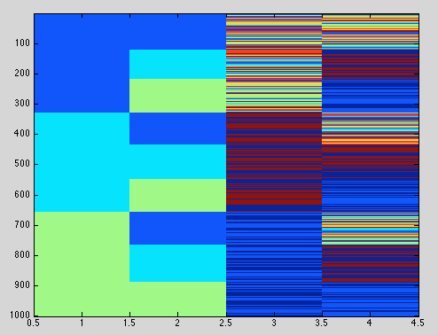
Get some data
>> D = [dice1,dice2,r1,r2];
>> D(1:10,:)
ans =
1 1 7 4
2 1 1 3
2 3 1 1
3 1 1 2
…
>> [X,I] = sort(4*D(:,1) + D(:,2));
>> S=D(I,:);
>> imagesc(S);

Slide 8
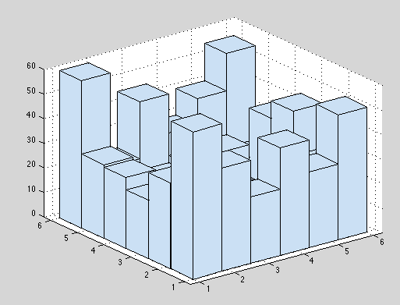
Get some data
>> D(1:10,:)
ans =
1 1 7 4
2 1 1 3
2 3 1 1
3 1 1 2
…
>> [X,I] = sort(4*D(:,1) + D(:,2));
>> S=D(I,:);
>> imagesc(S);
>> D34 = D(:,3:4);
>> hist3(D34,[6,6])

Slide 9
Estimate a joint density
>> [H,C] = hist3(D34,[6,6]);
>> H
>> H
H =
60 35 24 29 30 60
42 16 14 19 14 22
27 19 15 10 17 45
44 19 17 18 20 29
31 11 12 9 22 40
51 26 44 37 17 55
>> P = H/1000
P =
0.0600 0.0350 0.0240 0.0290 0.0300 0.0600
0.0420 0.0160 0.0140 0.0190 0.0140 0.0220
0.0270 0.0190 0.0150 0.0100 0.0170 0.0450
0.0440 0.0190 0.0170 0.0180 0.0200 0.0290
0.0310 0.0110 0.0120 0.0090 0.0220 0.0400
0.0510 0.0260 0.0440 0.0370 0.0170 0.0550

Slide 10
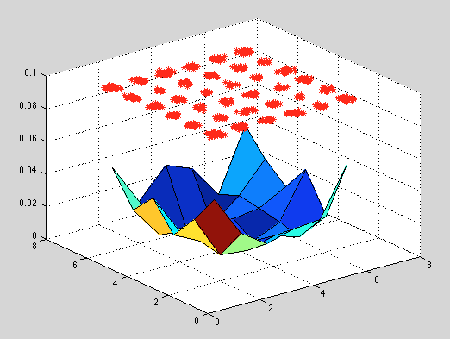
Visualize a joint density
>> surf(I,J,SP);
>> hold on
>> plot3(E(:,1),E(:,2),zeros(1000,1)+0.1,'r*');

Slide 11
Inference with the joint
What is P(both die fair|roll > 10) ?
>> sum((D(:,1)==1) & (D(:,2)==1) & (D(:,3)+D(:,4) >= 10))
ans =
9
>> sum((D(:,3)+D(:,4) >= 10))
ans =
112
>> 9/112
ans =
0.0804

Slide 12
Some of A Joint Distribution
A | B | C | D | E | p
is | the | effect | of | the | 0.00036
is | the | effect | of | a | 0.00034
. | The | effect | of | this | 0.00034
to | this | effect | : | “ | 0.00034
be | the | effect | of | the | …
 | … | … | … | … | …
not | the | effect | of | any | 0.00024
 | … | … | … | … | …
does | not | affect | the | general | 0.00020
does | not | affect | the | question | 0.00020
any | manner | affect | the | principle | 0.00018

Slide 13
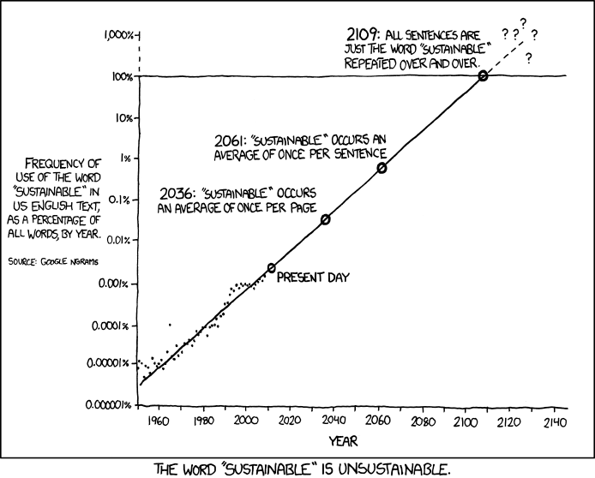
http://xkcd.com/ngram-charts/

Slide 14
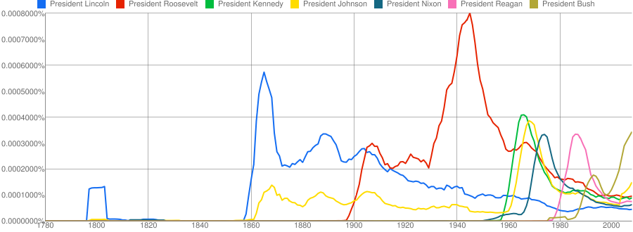
Coupled Temporal Scoping of Relational Facts.
P.P. Talukdar, D.T. Wijaya and T.M. Mitchell. In Proceedings of the ACM International Conference on Web Search and Data Mining (WSDM), 2012
Understanding Semantic Change of Words Over Centuries.
D.T. Wijaya and R. Yeniterzi. In Workshop on Detecting and Exploiting Cultural Diversity on the Social Web (DETECT), 2011 at CIKM 2011

Slide 15
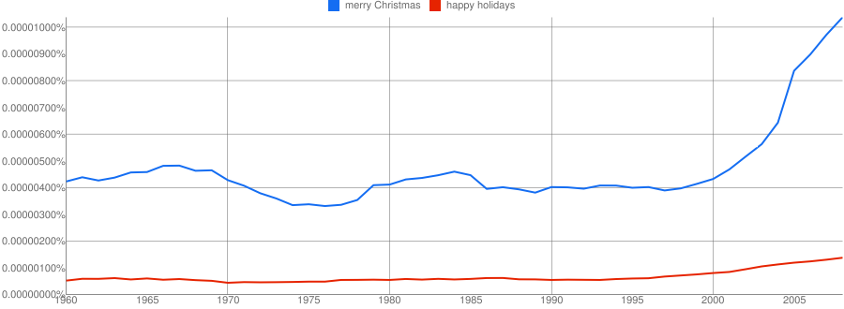
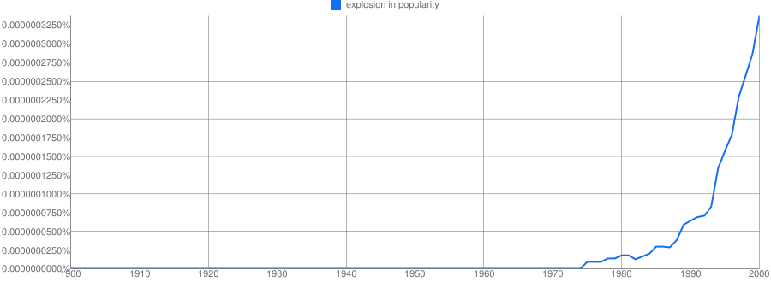

Slide 16
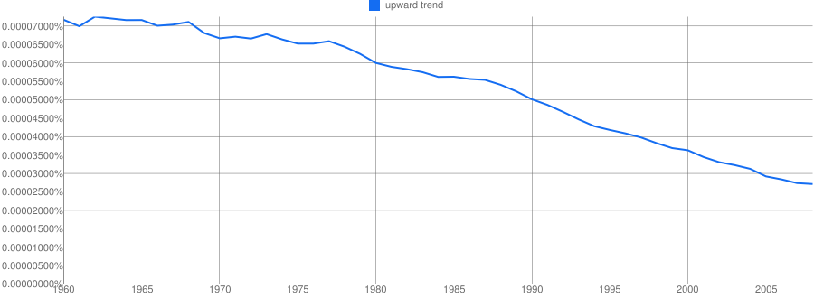

Slide 17
Some of A Joint Distribution
A | B | C | D | E | p
is | the | effect | of | the | 0.00036
is | the | effect | of | a | 0.00034
. | The | effect | of | this | 0.00034
to | this | effect | : | “ | 0.00034
be | the | effect | of | the | …
 | … | … | … | … | …
not | the | effect | of | any | 0.00024
 | … | … | … | … | …
does | not | affect | the | general | 0.00020
does | not | affect | the | question | 0.00020
any | manner | affect | the | principle | 0.00018

Slide 18
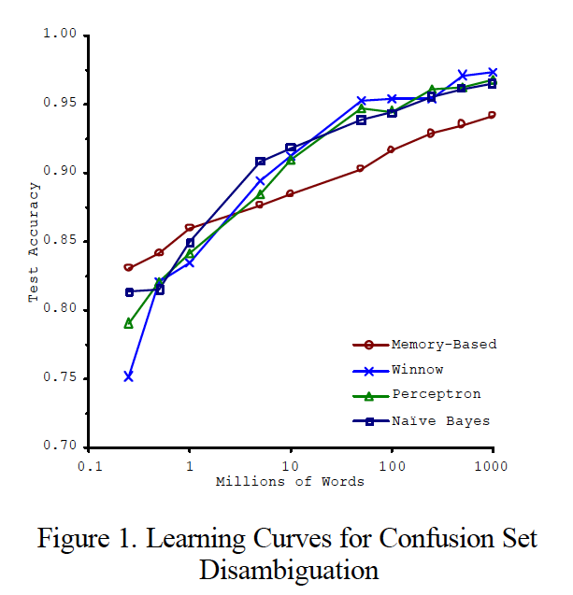
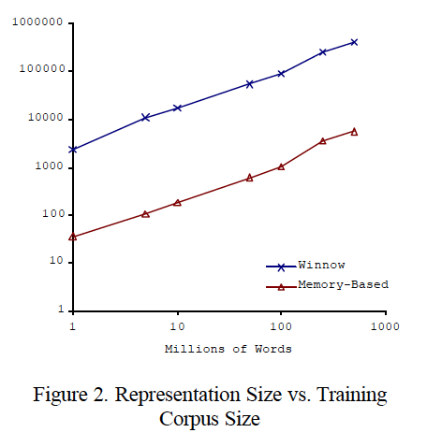
Big ML c. 2001 (Banko & Brill, “Scaling to Very Very Large…”, ACL 2001)
Task: distinguish pairs of easily-confused words (“affect” vs “effect”) in context

Slide 19
Experiment
Extract all 5-grams A,B,C,D,E where C = affect or effect from Google n-gram data
  Ignore year information (how?)
  About 100M occurrences of a 5-gram
  Less than 50k distinct 5-grams
    with freq>40
  About 20 hrs with one disk
Take a test set - Reuters 22173 and extract all similar 5-grams
  723 occurrences, mostly distinct
  Predict using Pr(C|A,B,D,E)
    Back off to Pr(C|A,B,D)
      Back off to Pr(C|B,D), …

Slide 20
Performance …
Pattern | Used | Errors
P(C|A,B,D,E) | 101 | 1
P(C|A,B,D) | 157 | 6
P(C|B,D) | 163 | 13
P(C|B) | 244 | 78
P(C) | 58 | 31
Is this good performance?
If we care about recall, what should we do?

Slide 21
More from Andrew Moore’s slides…

Slide 22
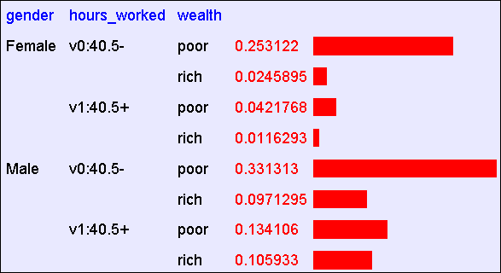
Flashback
Size of table:
2¹⁵=32768 (if all binary) ➔ avg of 1.5 examples per row
Actual m = 1,974,927, 360 (if continuous attributes binarized)
Abstract: Predict whether income exceeds $50K/yr based on census data. Also known as "Census Income" dataset. [Kohavi, 1996]
Number of Instances: 48,842
Number of Attributes: 14 (in UCI’s copy of dataset) + 1; 3 (here)

Slide 23
Naïve Density Estimation
What’s an alternative to the joint distribution?
The naïve model generalizes strongly:
Assume that each attribute is distributed independently of any of the other attributes.

Slide 24
Using the Naïve Distribution
Once you have a Naïve Distribution you can easily compute any row of the joint distribution.
Suppose A, B, C and D are independently distributed. What is P(A ^ ~B ^ C ^ ~D)?

Slide 25
Using the Naïve Distribution
Once you have a Naïve Distribution you can easily compute any row of the joint distribution.
Suppose A, B, C and D are independently distributed. What is P(A ^ ~B ^ C ^ ~D)?
P(A) P(~B) P(C) P(~D)

Slide 26
Naïve Distribution General Case
Suppose X₁,X₂,…,X_{d} are independently distributed.
So if we have a Naïve Distribution we can construct any row of the implied Joint Distribution on demand.
How do we learn this?

Slide 27
Learning a Naïve Density Estimator
MLE
Dirichlet (MAP)
Another trivial learning algorithm!

Slide 28
Is this an interesting learning algorithm?
No
^
For n-grams, what is P(C=effect|A=will)?
In joint: P(C=effect|A=will) = 0.38
In naïve: P(C=effect|A=will) = P(C=effect) = #[C=effect]/#totalNgrams = 0.94 (!)
What is P(C=effect|B=no)?
In joint: P(C=effect|B=no) = 0.999
In naïve: P(C=effect|B=no) = P(C=effect) = 0.94
^
^
^
^
^
^
^

Slide 29
Can we make this interesting? Yes!
Key ideas:
  Pick the class variable Y
  Instead of estimating P(X₁,…,X_{n},Y) = P(X₁)*…*P(X_{n})*Y, estimate P(X₁,…,X_{n}|Y) = P(X₁|Y)*…*P(X_{n}|Y)
  Or, assume P(X_{i}|Y)=Pr(X_{i}|X₁,…,X_{i-1},X_{i+1},…X_{n},Y)
  Or, that X_{i} is conditionally independent of every X_{j}, j!=i, given Y.
  How to estimate?
MLE or MAP

Slide 30
The Naïve Bayes classifier – v1
Dataset: each example has
  A unique id id
    Why? For debugging the feature extractor
  d attributes X₁,…,X_{d}
    Each X_{i} takes a discrete value in dom(X_{i})
  One class label Y in dom(Y)
You have a train dataset and a test dataset

Slide 31
The Naïve Bayes classifier – v0
You have a train dataset and a test dataset
Initialize an “event counter” (hashtable) C
For each example id, y, x₁,….,x_{d} in train:
  C(“Y=ANY”) ++; C(“Y=y”) ++
  For j in 1..d:
    C(“Y=y ^ X_{j}=x_{j}”) ++
For each example id, y, x₁,….,x_{d} in test:
  For each y’ in dom(Y):
    Compute Pr(y’,x₁,….,x_{d}) =
  Return the best y’

Slide 32
The Naïve Bayes classifier – v0
You have a train dataset and a test dataset
Initialize an “event counter” (hashtable) C
For each example id, y, x₁,….,x_{d} in train:
  C(“Y=ANY”) ++; C(“Y=y”) ++
  For j in 1..d:
    C(“Y=y ^ X_{j}=x_{j}”) ++
For each example id, y, x₁,….,x_{d} in test:
  For each y’ in dom(Y):
    Compute Pr(y’,x₁,….,x_{d}) =
  Return the best y’

Slide 33
In-class demo
Pilfered from Tom Mitchell

Slide 34
Example: Live in Squirrel Hill?
P(S|G,D,E)
P(S=1): .4
P(D=1 | S=1): 3/23
P(D=1 | S=0): 2/33
P(G=1|S=1): 21/22
P(G=1|S=0): 10/33
P(E=1|S=1): 13/24
P(E=1|S=0): 19/32
P(S=0): .6
P(D=0 | S=1): 20/23
P(D=0 | S=0): 31/33
P(G=0|S=1):
P(G=0|S=0):
P(E=0|S=1): 11/24
P(E=0|S=0): 13/32
Test case:
  s,g,d,e = 1,1,0,0,
  forall S,G,D,E: P(S|G,D,E)= c * P(G|S) * P(D|S) * P(E|S) *P(S)
  P(S|g, d, e) = c * P(D=0|S=0) * P(G=1|S=0) * P(E=0|S=0) *P(S=0)
  S=1: 20/23 * 21/22 * 11/24 = 0.38*0.4=0.152 S=0: 31/33 * 10/33 * 13/32 * 0.6 = 0.07

Slide 35
Example: Live in Squirrel Hill?
P(S|G,D,E)
Test case:
  s,g,d,e =
  P(S|g, d, e) = c * P(g|S) * P(d|S) * P(e|S) *P(S)
Test case:
  s,g,d,e =
  P(S|g, d, e) = c * P(g|S) * P(d|S) * P(e|S) *P(S)
Test case:
  s,g,d,e =
  P(S|g, d, e) = c * P(g|S) * P(d|S) * P(e|S) *P(S)
Test case:
  s,g,d,e =
  P(S|g, d, e) = c * P(g|S) * P(d|S) * P(e|S) *P(S)

Slide 36
The Naïve Bayes classifier – v0
You have a train dataset and a test dataset
Initialize an “event counter” (hashtable) C
For each example id, y, x₁,….,x_{d} in train:
  C(“Y=ANY”) ++; C(“Y=y”) ++
  For j in 1..d:
    C(“Y=y ^ X_{j}=x_{j}”) ++
For each example id, y, x₁,….,x_{d} in test:
  For each y’ in dom(Y):
    Compute Pr(y’,x₁,….,x_{d}) =
  Return the best y’
This may overfit, so …

Slide 37
The Naïve Bayes classifier – v1
You have a train dataset and a test dataset
Initialize an “event counter” (hashtable) C
For each example id, y, x₁,….,x_{d} in train:
  C(“Y=ANY”) ++; C(“Y=y”) ++
  For j in 1..d:
    C(“Y=y ^ X_{j}=x_{j}”) ++
For each example id, y, x₁,….,x_{d} in test:
  For each y’ in dom(Y):
    Compute Pr(y’,x₁,….,x_{d}) =
  Return the best y’
where:
q_{j} = 1/|dom(X_{j})|
q_{y} = 1/|dom(Y)|
m=1
This may underflow, so …

Slide 38
The Naïve Bayes classifier – v1
You have a train dataset and a test dataset
Initialize an “event counter” (hashtable) C
For each example id, y, x₁,….,x_{d} in train:
  C(“Y=ANY”) ++; C(“Y=y”) ++
  For j in 1..d:
    C(“Y=y ^ X_{j}=x_{j}”) ++
For each example id, y, x₁,….,x_{d} in test:
  For each y’ in dom(Y):
    Compute log Pr(y’,x₁,….,x_{d}) =
  Return the best y’
where:
q_{j} = 1/|dom(X_{j})|
q_{y} = 1/|dom(Y)|
m=1

Slide 39
The Naïve Bayes classifier – v2
For text documents, what features do you use?
One common choice:
  X₁ = first word in the document
  X₂ = second word in the document
  X₃ = third …
  X₄ = …
  …
But: Pr(X₁₃=hockey|Y=sports) is probably not that different from Pr(X₁₁=hockey|Y=sports)…so instead of treating them as different variables, treat them as different copies of the same variable

Slide 40
The Naïve Bayes classifier – v1
You have a train dataset and a test dataset
Initialize an “event counter” (hashtable) C
For each example id, y, x₁,….,x_{d} in train:
  C(“Y=ANY”) ++; C(“Y=y”) ++
  For j in 1..d:
    C(“Y=y ^ X_{j}=x_{j}”) ++
For each example id, y, x₁,….,x_{d} in test:
  For each y’ in dom(Y):
    Compute Pr(y’,x₁,….,x_{d}) =
  Return the best y’

Slide 41
The Naïve Bayes classifier – v2
You have a train dataset and a test dataset
Initialize an “event counter” (hashtable) C
For each example id, y, x₁,….,x_{d} in train:
  C(“Y=ANY”) ++; C(“Y=y”) ++
  For j in 1..d:
    C(“Y=y ^ X_{j}=x_{j}”) ++
For each example id, y, x₁,….,x_{d} in test:
  For each y’ in dom(Y):
    Compute Pr(y’,x₁,….,x_{d}) =
  Return the best y’

Slide 42
The Naïve Bayes classifier – v2
You have a train dataset and a test dataset
Initialize an “event counter” (hashtable) C
For each example id, y, x₁,….,x_{d} in train:
  C(“Y=ANY”) ++; C(“Y=y”) ++
  For j in 1..d:
    C(“Y=y ^ X=x_{j}”) ++
For each example id, y, x₁,….,x_{d} in test:
  For each y’ in dom(Y):
    Compute Pr(y’,x₁,….,x_{d}) =
  Return the best y’

Slide 43
The Naïve Bayes classifier – v2
You have a train dataset and a test dataset
Initialize an “event counter” (hashtable) C
For each example id, y, x₁,….,x_{d} in train:
  C(“Y=ANY”) ++; C(“Y=y”) ++
  For j in 1..d:
    C(“Y=y ^ X=x_{j}”) ++
For each example id, y, x₁,….,x_{d} in test:
  For each y’ in dom(Y):
    Compute log Pr(y’,x₁,….,x_{d}) =
  Return the best y’
where:
q_{j} = 1/|V|
q_{y} = 1/|dom(Y)|
m=1

Slide 44
The Naïve Bayes classifier – v2
You have a train dataset and a test dataset
To classify documents, these might be:
  http://wcohen.com academic,FacultyHome William W. Cohen Research Professor Machine Learning Department Carnegie Mellon University Member of the Language Technology Institute the joint CMU-Pitt Program in Computational Biology the Lane Center for Computational Biology and the Center for Bioimage Informatics Director of the Undergraduate Minor in Machine Learning Bio Teaching Projects Publications recent all Software Datasets Talks Students Colleagues Blog Contact Info Other Stuff …
  http://google.com commercial Search Images Videos ….
  …
How about for n-grams?

Slide 45
The Naïve Bayes classifier – v2
You have a train dataset and a test dataset
To do C-S spelling correction these might be
  ng1223 effect a_the b_main d_of e_the
  ng1224 affect a_shows b_not d_mice e_in
  ….
I.e., encode event X_{i}=w with another event X=i_w
Question: are there any differences in behavior from using A,B,C,D ?

Slide 46
Complexity of Naïve Bayes
Assume hashtable holding all counts fits in memory
Sequential reads
You have a train dataset and a test dataset
Initialize an “event counter” (hashtable) C
For each example id, y, x₁,….,x_{d} in train:
  C(“Y=ANY”) ++; C(“Y=y”) ++
  For j in 1..d:
    C(“Y=y ^ X=x_{j}”) ++
For each example id, y, x₁,….,x_{d} in test:
  For each y’ in dom(Y):
    Compute log Pr(y’,x₁,….,x_{d}) =
  Return the best y’
Complexity: O(n), n=size of train
where:
q_{j} = 1/|V|
q_{y} = 1/|dom(Y)|
m=1
Sequential reads
Complexity: O(dom(Y)|*n’), n’=size of test

Slide 47
Complexity of Naïve Bayes
You have a train dataset and a test dataset
Process:
  Count events in the train dataset
    O(n₁), where n₁ is total size of train
  Write the counts to disk
    O(min(|dom(X)|*|dom(Y)|, n₁)
    O(|V|), if V is vocabulary and dom(Y) is small
  Classify the test dataset
    O(|V|+n₂)
  Worst-case memory usage:
    O(min(|dom(X)|*|dom(Y)|, n₁)

Slide 48
Naïve Bayes v2
This is one example of a streaming classifier
  Each example is only read only once
  You can create a classifier and perform classifications at any point
  Memory is minimal (<< O(n))
    Ideally it would be constant
    Traditionally less than O(sqrt(N))
  Order doesn’t matter
    Nice because we may not control the order of examples in real life
    This is a hard one to get a learning system to have!
There are few competitive learning methods that as stream-y as naïve Bayes…

Slide 49
First assignment will be….
Implement naïve Bayes v2
Run and test it on Reuters RCV2
  O(100k) newswire stories
  One of the largest widely-used classification datasets
  Details on the wiki
  Turn in by Mon 1/27
Hint to all:
  The next assignment will be a Naïve Bayes that does not use a hashtable for event counts
    Next Wednesday’s lecture
  You will want to reuse some stuff from this assignment later….

