Slide 1
Semi-Supervised Learning With Graphs
William Cohen

Slide 2
Review – Graph Algorithms so far….
PageRank and how to scale it up
Personalized PageRank/Random Walk with Restart and
how to implement it
how to use it for extracting part of a graph
Other uses for graphs?
not so much
HW6
We might come back to this more
You can also look at the March 19 lecture from the spring 2015 version of this class.

Slide 3
Main topics today
Scalable semi-supervised learning on graphs
SSL with RWR
SSL with coEM/wvRN/HF
Scalable unsupervised learning on graphs
Power iteration clustering
…

Slide 4
Semi-supervised learning
A pool of labeled examples L
A (usually larger) pool of unlabeled examples U
Can you improve accuracy somehow using U?

Slide 5
Semi-Supervised Bootstrapped Learning/Self-training
Extract cities:
Paris
Pittsburgh
Seattle
Cupertino
San Francisco
Austin
denial
anxiety
selfishness
Berlin
mayor of arg1
live in arg1
arg1 is home of
traits such as arg1

Slide 6
Semi-Supervised Bootstrapped Learning via Label Propagation
mayor of arg1
arg1 is home of
San Francisco
Austin
Paris
Pittsburgh
anxiety
live in arg1
traits such as arg1
denial
selfishness
Seattle

Slide 7
Semi-Supervised Bootstrapped Learning via Label Propagation
mayor of arg1
arg1 is home of
Information from other categories tells you “how far” (when to stop propagating)
San Francisco
Austin
Paris
Pittsburgh
anxiety
traits such as arg1
live in arg1
traits such as arg1
arrogance
denial
selfishness
denial
selfishness
Seattle
Nodes “near” seeds
Nodes “far from” seeds

Slide 8
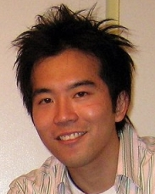
ASONAM-2010 (Advances in Social Networks Analysis and Mining)

Slide 9
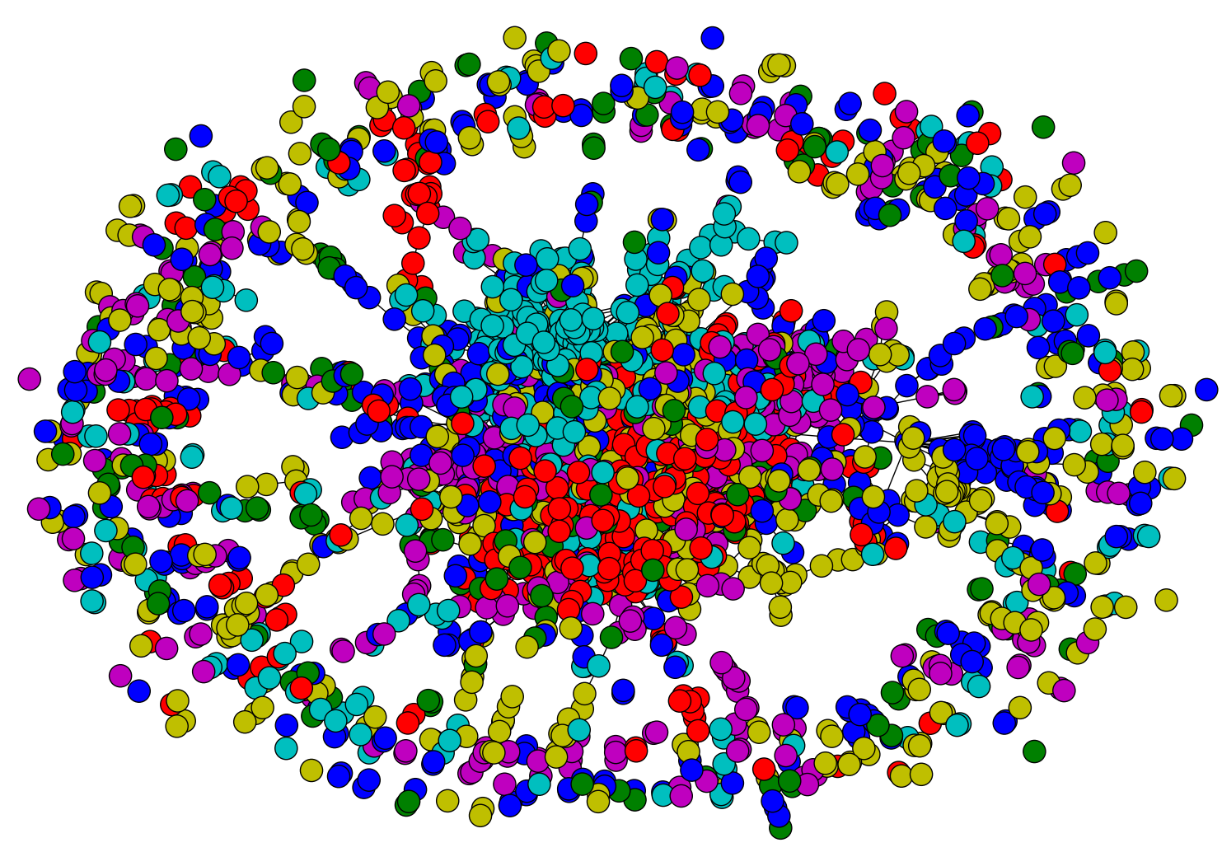
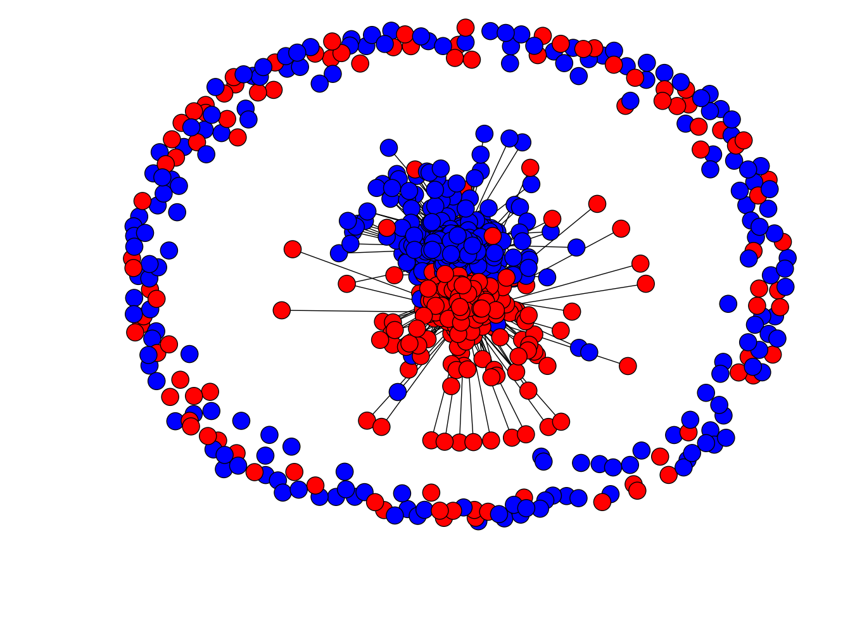
Network Datasets with Known Classes
UBMCBlog
AGBlog
MSPBlog
Cora
Citeseer

Slide 10
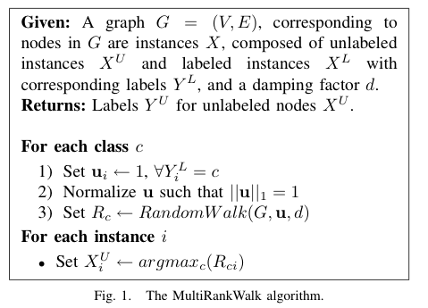
RWR - fixpoint of:
Seed selection
order by PageRank, degree, or randomly
go down list until you have at least k examples/class

Slide 11
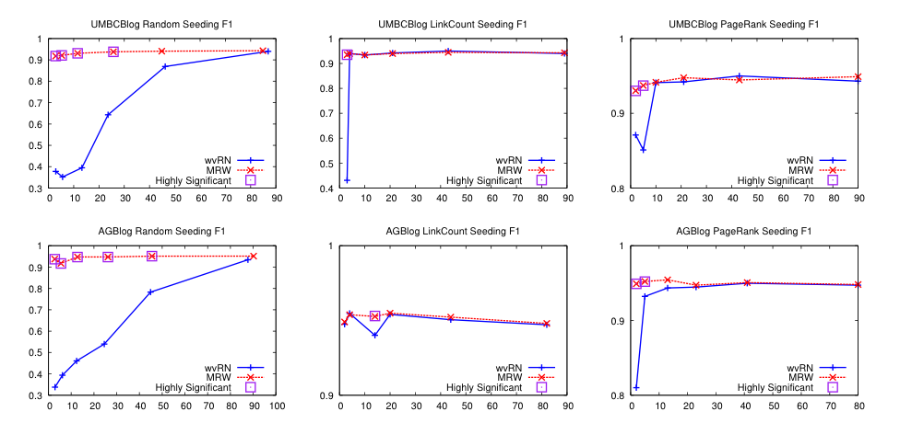
Results – Blog data
We’ll discuss this soon….
Random
Degree
PageRank

Slide 12
Results – More blog data
Random
Degree
PageRank

Slide 13
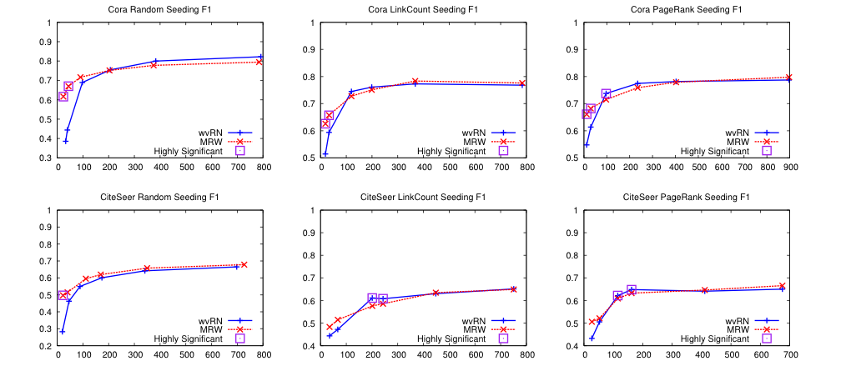
Results – Citation data
Random
Degree
PageRank

Slide 14
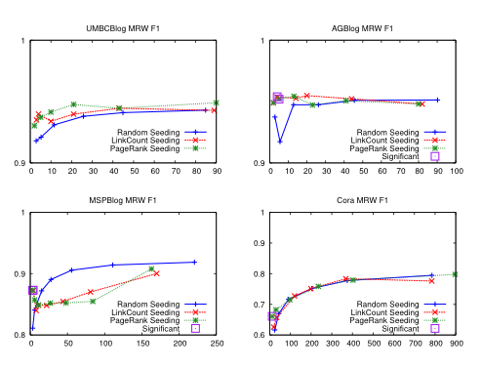
Seeding – MultiRankWalk

Slide 15
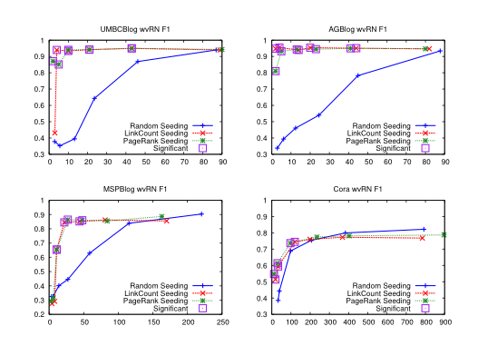
Seeding – HF/wvRN

Slide 16
What is HF aka coEM aka wvRN?

Slide 17
CoEM/HF/wvRN
One definition [MacKassey & Provost, JMLR 2007]:…
Another definition: A harmonic field – the score of each node in the graph is the harmonic (linearly weighted) average of its neighbors’ scores;
[X. Zhu, Z. Ghahramani, and J. Lafferty, ICML 2003]

Slide 18
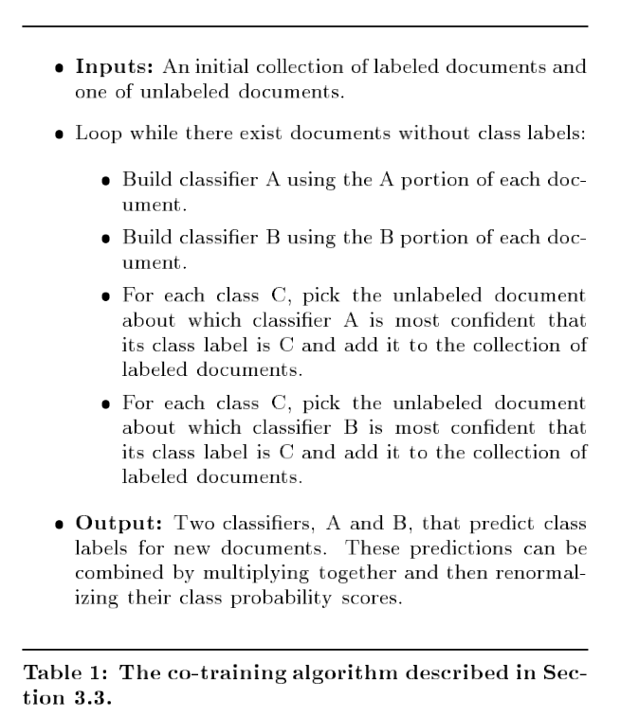
CoEM/wvRN/HF
Another justification of the same algorithm….
… start with co-training with a naïve Bayes learner

Slide 19
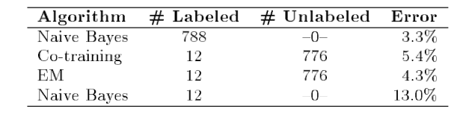
CoEM/wvRN/HF
One algorithm with several justifications….
One is to start with co-training with a naïve Bayes learner
And compare to an EM version of naïve Bayes
E: soft-classify unlabeled examples with NB classifier
M: re-train classifier with soft-labeled examples
Notes:
on webkb – anchor text and words on page

Slide 20
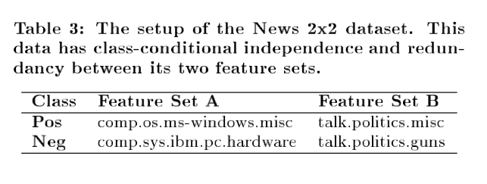
CoEM/wvRN/HF
A second experiment
each + example: concatenate features from two documents, one of class A+, one of class B+
each - example: concatenate features from two documents, one of class A-, one of class B-
features are prefixed with “A”, “B” ➔ disjoint
Notes:
on webkb – anchor text and words on page

Slide 21
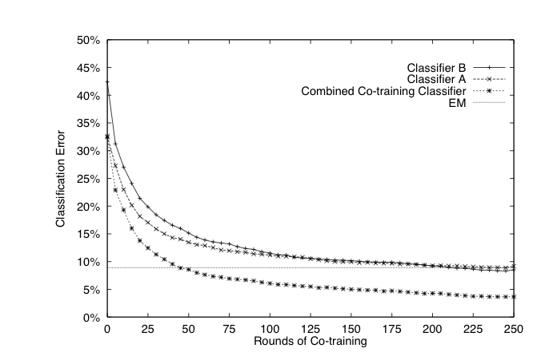
CoEM/wvRN/HF
A second experiment
each + example: concatenate features from two documents, one of class A+, one of class B+
each - example: concatenate features from two documents, one of class A-, one of class B-
features are prefixed with “A”, “B” ➔ disjoint
NOW co-training outperforms EM
Notes:
on webkb – anchor text and words on page

Slide 22
CoEM/wvRN/HF
vs an EM version of naïve Bayes
E: soft-classify unlabeled examples with NB classifier
M: re-train classifier with soft-labeled examples
Co-training with a naïve Bayes learner
incremental hard assignments
iterative soft assignments
Notes:
on webkb – anchor text and words on page

Slide 23
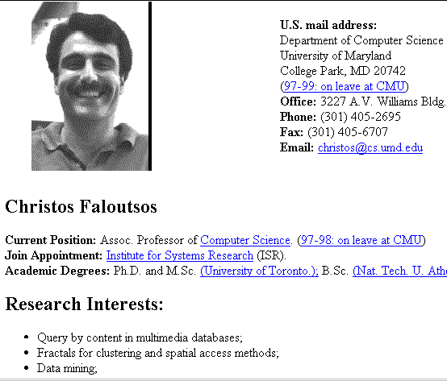
Co-Training Rote Learner
hyperlinks
pages
+
+
+
+
My advisor
+
+
+
+
+
-
-
-
-
-
-
-
-
-
-
-
-

Slide 24
Co-EM Rote Learner: equivalent to HF on a bipartite graph
NPs
contexts
+
Pittsburgh
+
+
+
+
+
+
lives in _
+
+
-
-
-
-
-
-
-
-
-
-
-
-

Slide 25
What is HF aka coEM aka wvRN?
Algorithmically:
HF propagates weights and then resets the seeds to their initial value
MRW propagates weights and does not reset seeds

Slide 26
MultiRank Walk vs HF/wvRN/CoEM
Seeds are marked S
HF
MRW

Slide 27
Back to Experiments: Network Datasets with Known Classes
UBMCBlog
AGBlog
MSPBlog
Cora
Citeseer

Slide 28
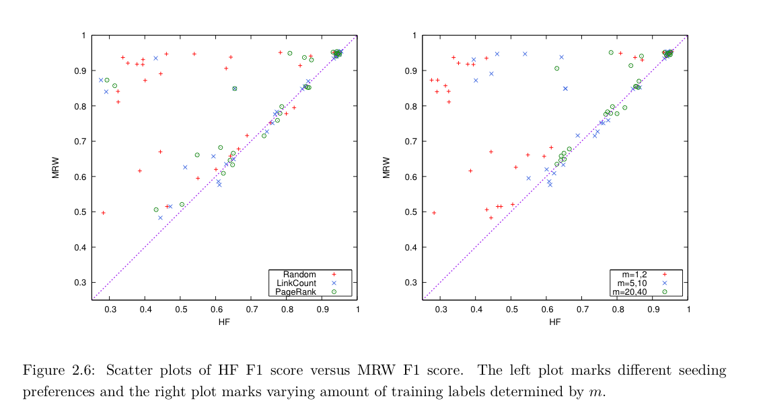
MultiRankWalk vs wvRN/HF/CoEM

Slide 29
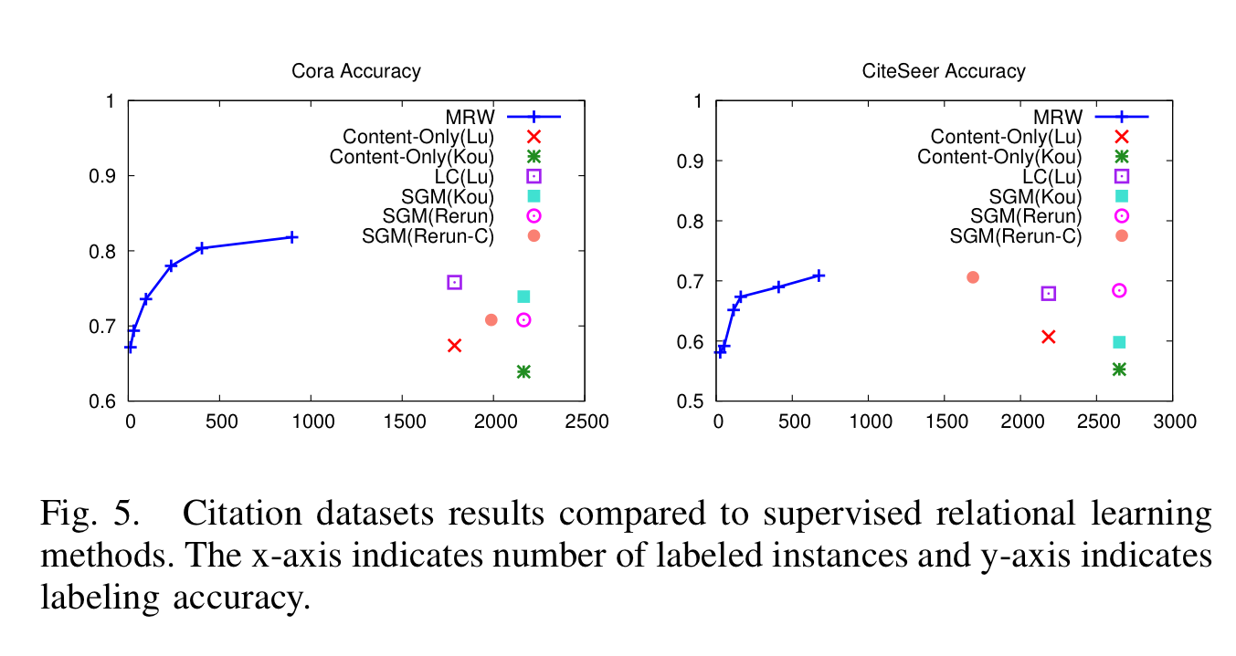
How well does MWR work?
Notes:
Re-run-C connected version of dataset
Lu is Lu & Getoor, 2003

Slide 30
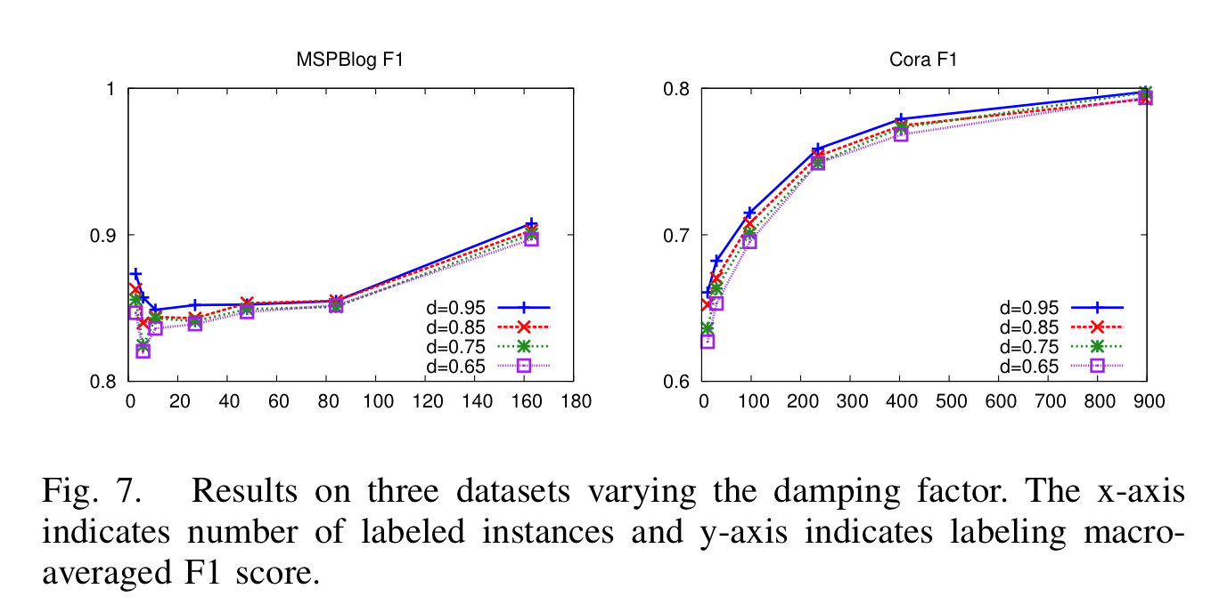
Parameter Sensitivity

Slide 31
Semi-supervised learning
A pool of labeled examples L
A (usually larger) pool of unlabeled examples U
Can you improve accuracy somehow using U?
These methods are different from EM
optimizes Pr(Data|Model)
How do SSL learning methods (like label propagation) relate to optimization?

Slide 32
SSL as optimization slides from Partha Talukdar

Slide 34
yet another name for HF/wvRN/coEM

Slide 35
match seeds
prior
smoothness

Slide 39
How to do this minimization?
First, differentiate to find min is at
Jacobi method:
To solve Ax=b for x
Iterate:
… or:

Slide 41
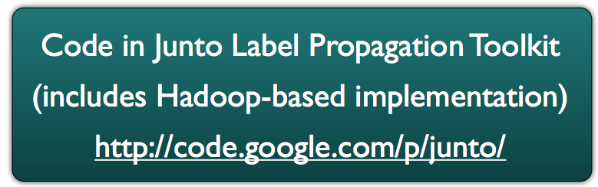

Slide 42
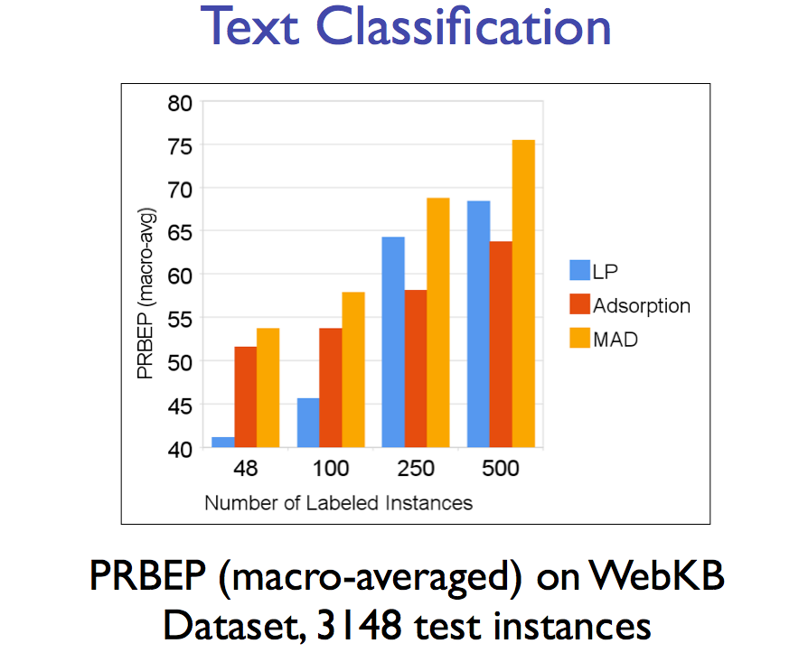
/HF/…
precision-recall break even point

Slide 43
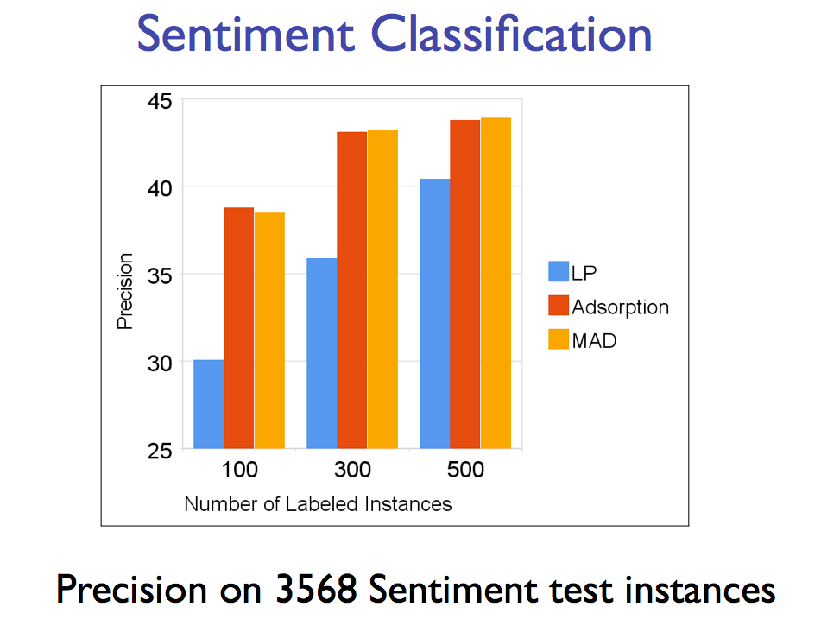
/HF/…

Slide 44
/HF/…

Slide 45
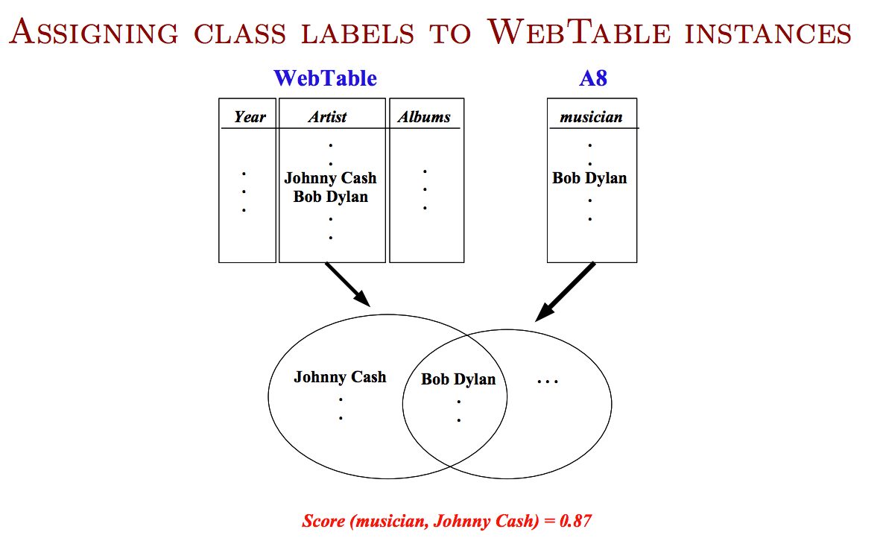
from HTML tables on the web that are used for data, not formatting
from mining patterns like “musicians such as Bob Dylan”

Slide 46
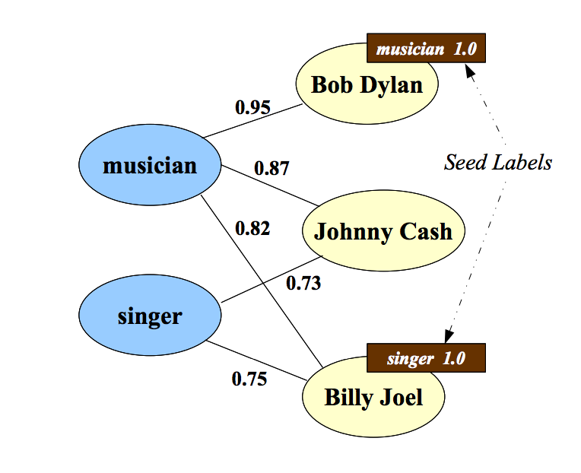

Slide 48
More recent work (AIStats 2014)
Propagating labels requires usually small number of optimization passes
Basically like label propagation passes
Each is linear in
the number of edges
and the number of labels being propagated
Can you do better?
basic idea: store labels in a countmin sketch
which is basically an compact approximation of an object→double mapping

Slide 49
Flashback: CM Sketch Structure
from: Minos Garofalakis
h₁(s)
+c
<s, +c>
+c
d=log 1/δ
+c
h_{d}(s)
+c
w = 2/ε
Each string is mapped to one bucket per row
Estimate A[j] by taking min_{k} { CM[k,h_{k}(j)] }
Errors are always over-estimates
Sizes: d=log 1/, w=2/ ➔ error is usually less than ||A||₁

Slide 50
More recent work (AIStats 2014)
Propagating labels requires usually small number of optimization passes
Basically like label propagation passes
Each is linear in
the number of edges
and the number of labels being propagated
the sketch size
sketches can be combined linearly without “unpacking” them: sketch(av + bw) = a*sketch(v)+b*sketch(w)
sketchs are good at storing skewed distributions

Slide 51
More recent work (AIStats 2014)
Label distributions are often very skewed
sparse initial labels
community structure: labels from other subcommunities have small weight

Slide 52
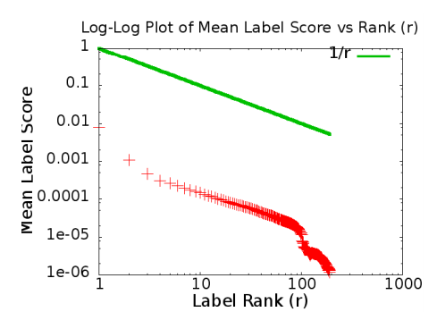
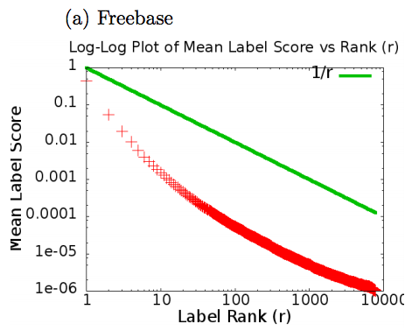
More recent work (AIStats 2014)
“self-injection”: similarity computation
Freebase
Flick-10k

Slide 53
More recent work (AIStats 2014)
Freebase

Slide 54
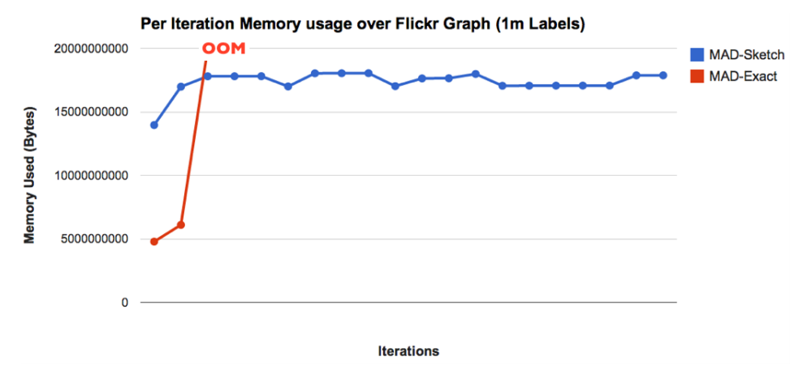
More recent work (AIStats 2014)
100 Gb available

