Slide 1
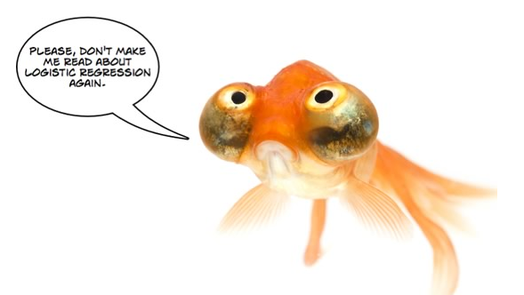
Efficient Logistic Regression with Stochastic Gradient Descent
William Cohen

Slide 2
SGD for Logistic Regression

Slide 3
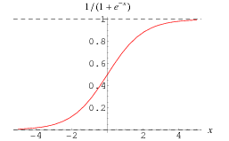
SGD for Logistic regression
Start with Rocchio-like linear classifier:
Replace sign(...) with something differentiable:
Also scale from 0-1 not -1 to +1
Decide to optimize:
Differentiate….

Slide 4
Magically, when we differentiate, we end up with something very simple and elegant…..
The update for gradient descent with rate λ is just:

Slide 5
An observation: sparsity!
Key computational point:
if x^{j}=0 then the gradient of w^{j} is zero
so when processing an example you only need to update weights for the non-zero features of an example.

Slide 6
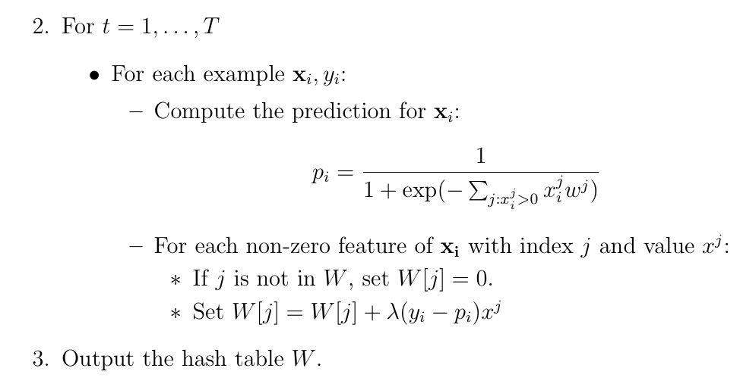
SGD for logistic regression
The algorithm:
-- do this in random order

Slide 7
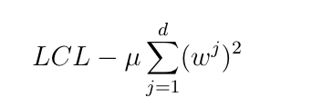
Adding regularization
Replace LCL
with LCL + penalty for large weights, eg
So:
becomes:

Slide 8
Regularized logistic regression
Replace LCL
with LCL + penalty for large weights, eg
So the update for wj becomes:
Or

Slide 9
Naively this is not a sparse update
Algorithm:
Time goes from O(nT) to O(mVT) where
n = number of non-zero entries,
m = number of examples
V = number of features
T = number of passes over data

Slide 10
Sparse regularized logistic regression
Final algorithm:
Initialize hashtables W, A and set k=0
For each iteration t=1,…T
For each example (x_{i},y_{i})
p_{i} = … ; k++
For each non-zero feature W[j]
W[j] *= (1 - λ2μ)^{k-A[j]}
W[j] = W[j] + λ(y_{i} - p^{i})x_{j}
A[j] = k
k = “clock” reading
A[j] = clock reading last time feature j was “active”
we implement the “weight decay” update using a “lazy” strategy: weights are decayed in one shot when a feature is “active”

Slide 11
Sparse regularized logistic regression (v2)
Initialize hashtables W, A and set k=0
For each iteration t=1,…T
For each example (x_{i},y_{i})
k++
For each non-zero feature W[j]
W[j] *= (1 - λ2μ)^{k-A[j]}
p_{i} = …
For each non-zero feature W[j]
W[j] = W[j] + λ(y_{i} - p^{i})x_{j}
A[j] = k
Finally:
Before you write out each W[j] do **
k = “clock” reading
A[j] = clock reading last time feature j was “active”
we implement the “weight decay” update using a “lazy” strategy: weights are decayed in one shot when a feature is “active”
**

Slide 12
Summary
What’s happened here:
Our update involves a sparse part and a dense part
Sparse: empirical loss on this example
Dense: regularization loss – not affected by the example
We remove the dense part of the update
Old example update:
for each feature { do something example-independent}
For each active feature { do something example-dependent}
New example update:
For each active feature :
{simulate the prior example-independent updates}
{do something example-dependent}

Slide 13
Summary
We can separate the LCL update and weight decay updates but remember:
we need to apply “weight decay” to just the active features in an example x_{i} before we compute the prediction p_{i}
we need to apply “weight decay” to all features before we save the classifier
my suggestion:
an abstraction for a logistic regression classifier

Slide 14
A possible SGD implementation
class SGDLogistic Regression {
/** Predict using current weights **/
double predict(Map features);
/** Apply weight decay to a single feature and record when in A[ ]**/
void regularize(string feature, int currentK);
/** Regularize all features then save to disk **/
void save(string fileName,int currentK);
/** Load a saved classifier **/
static SGDClassifier load(String fileName);
/** Train on one example **/
void train1(Map features, double trueLabel, int k) {
// regularize each feature
// predict and apply update
}
}
// main ‘train’ program assumes a stream of randomly-ordered examples and outputs classifier to disk; main ‘test’ program prints predictions for each test case in input.

Slide 15
A possible SGD implementation
class SGDLogistic Regression {
…
}
// main ‘train’ program assumes a stream of randomly-ordered examples and outputs classifier to disk; main ‘test’ program prints predictions for each test case in input.
<100 lines (in python)
Other mains:
A “shuffler:”
stream thru a training file T times and output instances
output is randomly ordered, as much as possible, given a buffer of size B
Something to collect predictions + true labels and produce error rates, etc.

Slide 16
A possible SGD implementation
Parameter settings:
W[j] *= (1 - λ2μ)^{k-A[j]}
W[j] = W[j] + λ(y_{i} - p^{i})x_{j}
I didn’t tune especially but used
μ=0.1
λ=η* E⁻² where E is “epoch”, η=½
epoch: number of times you’ve iterated over the dataset, starting at E=1

Slide 17
BOUNDED-MEMORY LOGISTIC REGRESSION

Slide 18
Outline
Logistic regression and SGD
Learning as optimization
Logistic regression:
a linear classifier optimizing P(y|x)
Stochastic gradient descent
“streaming optimization” for ML problems
Regularized logistic regression
Sparse regularized logistic regression
Memory-saving logistic regression

Slide 19
Question
In text classification most words are
rare
not correlated with any class
given low weights in the LR classifier
unlikely to affect classification
not very interesting

Slide 20
Question
In text classification most bigrams are
rare
not correlated with any class
given low weights in the LR classifier
unlikely to affect classification
not very interesting

Slide 21
Question
Most of the weights in a classifier are
important
not important

Slide 22
How can we exploit this?
One idea: combine uncommon words together randomly
Examples:
replace all occurrances of “humanitarianism” or “biopsy” with “humanitarianismOrBiopsy”
replace all occurrances of “schizoid” or “duchy” with “schizoidOrDuchy”
replace all occurrances of “gynecologist” or “constrictor” with “gynecologistOrConstrictor”
…
For Naïve Bayes this breaks independence assumptions
it’s not obviously a problem for logistic regression, though
I could combine
two low-weight words (won’t matter much)
a low-weight and a high-weight word (won’t matter much)
two high-weight words (not very likely to happen)
How much of this can I get away with?
certainly a little
is it enough to make a difference? how much memory does it save?

Slide 23
How can we exploit this?
Another observation:
the values in my hash table are weights
the keys in my hash table are strings for the feature names
We need them to avoid collisions
But maybe we don’t care about collisions?
Allowing “schizoid” & “duchy” to collide is equivalent to replacing all occurrences of “schizoid” or “duchy” with “schizoidOrDuchy”

Slide 24
Learning as optimization for regularized logistic regression
Algorithm:
Initialize hashtables W, A and set k=0
For each iteration t=1,…T
For each example (x_{i},y_{i})
p_{i} = … ; k++
For each feature j: x_{i}^{j}>0:
W[j] *= (1 - λ2μ)^{k-A[j]}
W[j] = W[j] + λ(y_{i} - p^{i})x_{j}
A[j] = k

Slide 25
Learning as optimization for regularized logistic regression
Algorithm:
Initialize arrays W, A of size R and set k=0
For each iteration t=1,…T
For each example (x_{i},y_{i})
Let V be hash table so that
p_{i} = … ; k++
For each hash value h: V[h]>0:
W[h] *= (1 - λ2μ)^{k-A[j]}
W[h] = W[h] + λ(y_{i} - p^{i})V[h]
A[j] = k

Slide 26
Learning as optimization for regularized logistic regression
Algorithm:
Initialize arrays W, A of size R and set k=0
For each iteration t=1,…T
For each example (x_{i},y_{i})
Let V be hash table so that
p_{i} = … ; k++
???

Slide 27
SOME EXPERIMENTS

Slide 28
ICML 2009

Slide 29
An interesting example
Spam filtering for Yahoo mail
Lots of examples and lots of users
Two options:
one filter for everyone—but users disagree
one filter for each user—but some users are lazy and don’t label anything
Third option:
classify (msg,user) pairs
features of message i are words w_{i,1},…,w_{i,ki}
feature of user is his/her id u
features of pair are: w_{i,1},…,w_{i,ki} and u•w_{i,1},…,u•w_{i,ki}
based on an idea by Hal Daumé

Slide 30
An example
E.g., this email to wcohen
features:
dear, madam, sir,…. investment, broker,…, wcohen•dear, wcohen•madam, wcohen,…,
idea: the learner will figure out how to personalize my spam filter by using the wcohen•X features

Slide 31
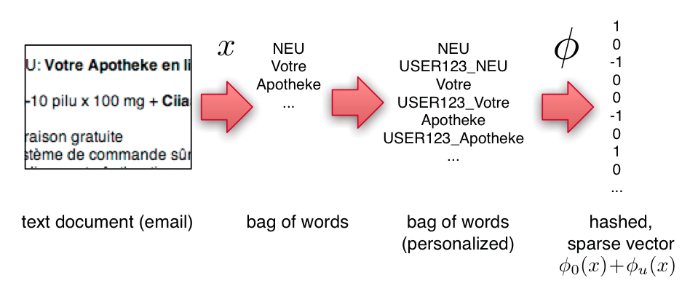
An example
Compute personalized features and multiple hashes on-the-fly:
a great opportunity to use several processors and speed up i/o

Slide 32
Experiments
3.2M emails
40M tokens
430k users
16T unique features – after personalization

Slide 33
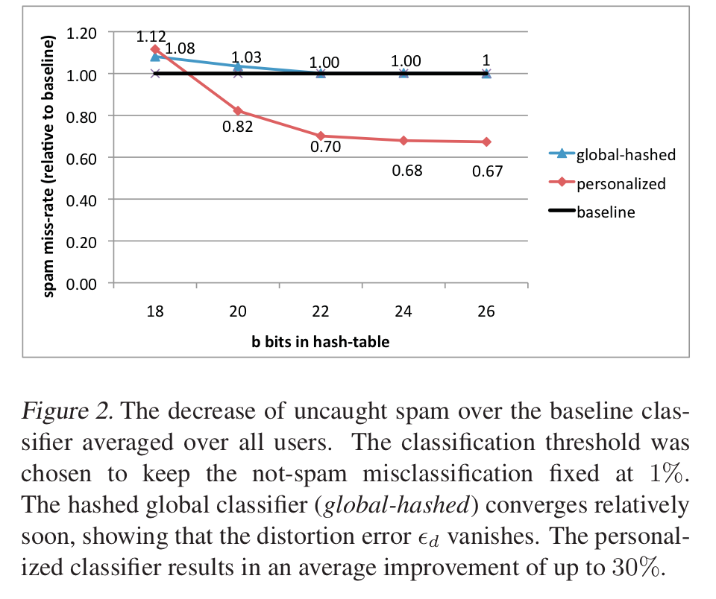
An example
2^26 entries = 1 Gb @ 8bytes/weight
Notes:
3,2M emails
400k users
40M tokens

Slide 34
