Slide 1
Efficient Logistic Regression with Stochastic Gradient Descent
William Cohen

Slide 2
A few more comments on sparsifying the logistic regression update

Slide 3

Learning as optimization for regularized logistic regression
Final algorithm:
Initialize hashtable W
For each iteration t=1,…T
For each example (x_{i},y_{i})
p_{i} = …
For each feature W[j]
W[j] = W[j] - λ2μW[j]
If x_{i}^{j}>0 then
W[j] = W[j] + λ(y_{i} - p^{i})x_{j}

Slide 4
Learning as optimization for regularized logistic regression
Final algorithm:
Initialize hashtable W
For each iteration t=1,…T
For each example (x_{i},y_{i})
p_{i} = …
For each feature W[j]
W[j] *= (1 - λ2μ)
If x_{i}^{j}>0 then
W[j] = W[j] + λ(y_{i} - p^{i})x_{j}

Slide 5
Learning as optimization for regularized logistic regression
Final algorithm:
Initialize hashtable W
For each iteration t=1,…T
For each example (x_{i},y_{i})
p_{i} = …
For each feature W[j]
If x_{i}^{j}>0 then
W[j] *= (1 - λ2μ)^{A}
W[j] = W[j] + λ(y_{i} - p^{i})x_{j}
A is number of examples seen since the last time we did an x>0 update on W[j]

Slide 6
Learning as optimization for regularized logistic regression
Final algorithm:
Initialize hashtables W, A and set k=0
For each iteration t=1,…T
For each example (x_{i},y_{i})
p_{i} = … ; k++
For each feature W[j]
If x_{i}^{j}>0 then
W[j] *= (1 - λ2μ)^{k-A[j]}
W[j] = W[j] + λ(y_{i} - p^{i})x_{j}
A[j] = k
k-A[j] is number of examples seen since the last time we did an x>0 update on W[j]

Slide 7
Comments
Same trick can be applied in other contexts
Other regularizers (eg L1, …)
Conjugate gradient (Langford)
FTRL (Follow the regularized leader)
Voted perceptron averaging
…?

Slide 8
sparsifying the Averaged Perceptron Update

Slide 9
Complexity of perceptron learning
Algorithm:
v=0
for each example x,y:
if sign(v.x) != y
v = v + yx
O(n)
init hashtable
for x_{i}!=0, v_{i} += yx_{i}
O(|x|)=O(|d|)

Slide 10
Complexity of averaged perceptron
Algorithm:
vk=0
va = 0
for each example x,y:
if sign(vk.x) != y
va = va + vk
vk = vk + yx
mk = 1
else
nk++
O(n) O(n|V|)
init hashtables
for vk_{i}!=0, va_{i} += vk_{i}
for x_{i}!=0, v_{i} += yx_{i}
O(|V|)
O(|x|)=O(|d|)

Slide 11
Alternative averaged perceptron
Algorithm:
vk = 0
va = 0
for each example x,y:
va = va + vk
t = t+1
if sign(vk.x) != y
vk = vk + y*x
Return va/t
Observe:
S_{k} is the set of examples including the first k mistakes

Slide 12
Alternative averaged perceptron
Algorithm:
vk = 0
va = 0
for each example x,y:
va = va + vk
t = t+1
if sign(vk.x) != y
vk = vk + y*x
Return va/t
So when there’s a mistake at time t on x,y:
y*x is added to va on every subsequent iteration
Suppose you know T, the total number of examples in the stream…

Slide 13
Alternative averaged perceptron
Algorithm:
vk = 0
va = 0
for each example x,y:
va = va + vk
t = t+1
if sign(vk.x) != y
vk = vk + y*x
va = va + (T-t)*y*x
Return va/T
T = the total number of examples in the stream…
All subsequent additions of x to va
Unpublished? I figured this out recently, Leon Bottou knows it too

Slide 14
Formalization of the “Hash Trick”:
First: Review of Kernels

Slide 15
The kernel perceptron
instance x_{i}
B
A
^
y_{i}
y_{i}
^
Compute: y_{i} = v_{k} . x_{i}
If mistake: v_{k+1} = v_{k} + y_{i} x_{i}
Mathematically the same as before … but allows use of the kernel trick

Slide 16
The kernel perceptron
instance x_{i}
B
A
^
y_{i}
y_{i}
^
Compute: y_{i} = v_{k} . x_{i}
If mistake: v_{k+1} = v_{k} + y_{i} x_{i}
Mathematically the same as before … but allows use of the “kernel trick”
Other kernel methods (SVM, Gaussian processes) aren’t constrained to limited set (+1/-1/0) of weights on the K(x,v) values.

Slide 17
Some common kernels
Linear kernel:
Polynomial kernel:
Gaussian kernel:
More later….

Slide 18
Kernels 101
Duality
and computational properties
Reproducing Kernel Hilbert Space (RKHS)
Gram matrix
Positive semi-definite
Closure properties

Slide 19
Kernels 101
Explicitly map from x to φ(x) – i.e. to the point corresponding to x in the Hilbert space
Implicitly map from x to φ(x) by changing the kernel function K
Duality: two ways to look at this
Two different computational ways of getting the same behavior

Slide 20
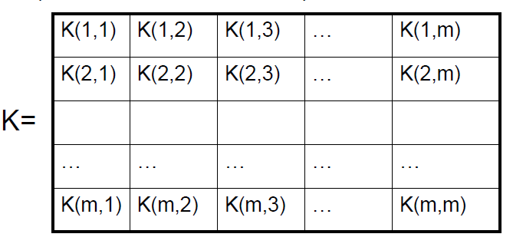
Kernels 101
K(x,x’) = K(x’,x) ➔ Gram matrix is symmetric
K(x,x) > 0 ➔ diagonal of K is positive ➔ K is “positive semi-definite” ➔ z^{T} K z >= 0 for all z
Duality
Gram matrix: K: k_{ij} = K(x_{i},x_{j})

Slide 21
Kernels 101
Duality
Gram matrix: K: k_{ij} = K(x_{i},x_{j})
K(x,x’) = K(x’,x) ➔ Gram matrix is symmetric
K(x,x) > 0 ➔ diagonal of K is positive ⬄ K is “positive semi-definite” ⬄ … ⬄ z^{T} K z >= 0 for all z
Fun fact: Gram matrix positive semi-definite ⬄ K(x_{i},x_{j})=φ(x_{i}), φ(x_{j}) for some φ
Proof: φ(x) uses the eigenvectors of K to represent x

Slide 22
Hash Kernels and “The Hash Trick”

Slide 23
Question
Most of the weights in a classifier are
small and not important

Slide 24
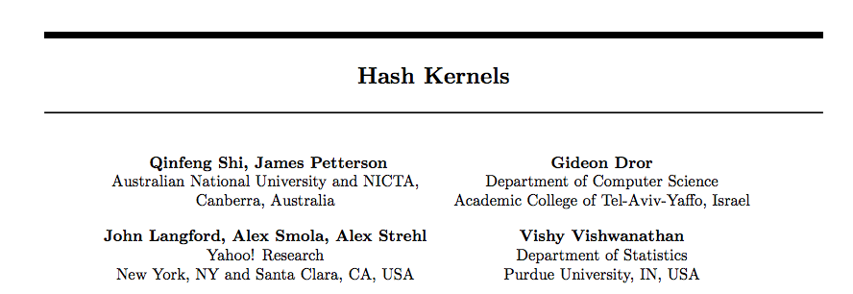

Slide 25
Some details
Slightly different hash to avoid systematic bias
m is the number of buckets you hash into (R in my discussion)

Slide 26
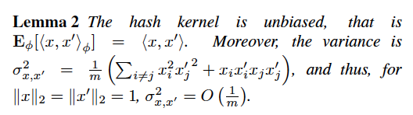
Some details
Slightly different hash to avoid systematic bias
m is the number of buckets you hash into (R in my discussion)

Slide 27
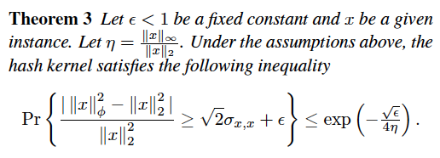
Some details
I.e. – a hashed vector is probably close to the original vector

Slide 28
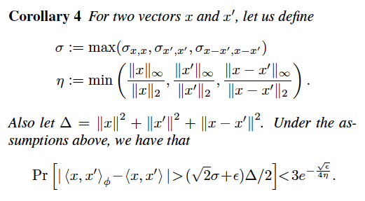
Some details
I.e. the inner products between x and x’ are probably not changed too much by the hash function: a classifier will probably still work

Slide 29
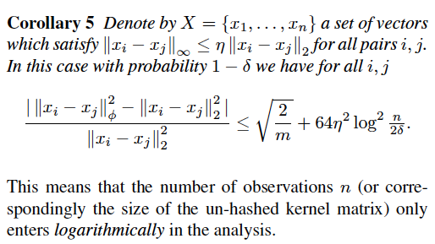
Some details
Notes:
should read this proof

Slide 30
The hash kernel: implementation
One problem: debugging is harder
Features are no longer meaningful
There’s a new way to ruin a classifier
Change the hash function ☹
You can separately compute the set of all words that hash to h and guess what features mean
Build an inverted index h→w1,w2,…,

Slide 31
A variant of feature hashing
Hash each feature multiple times with different hash functions
Now, each w has k chances to not collide with another useful w’
An easy way to get multiple hash functions
Generate some random strings s₁,…,s_{L}
Let the k-th hash function for w be the ordinary hash of concatenation w•s_{k}

Slide 32
A variant of feature hashing
Why would this work?
Claim: with 100,000 features and 100,000,000 buckets:
k=1 ➔Pr(any duplication) ≈1
k=2 ➔Pr(any duplication) ≈0.4
k=3 ➔ Pr(any duplication) ≈0.01

Slide 33
Experiments
Shi et al, JMLR 2009
http://jmlr.csail.mit.edu/papers/v10/shi09a.html
RCV1 dataset
Use hash kernels with TF-approx-IDF representation
TF and IDF done at level of hashed features, not words
IDF is approximated from subset of data

Slide 34
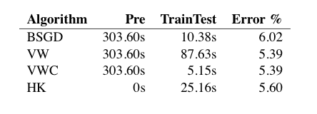
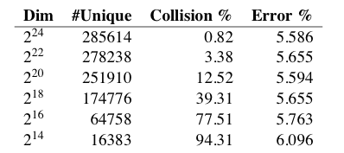
Results

Slide 35
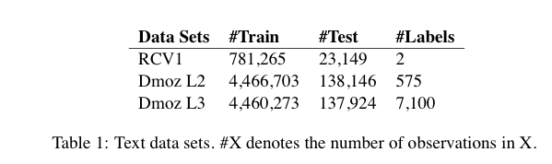
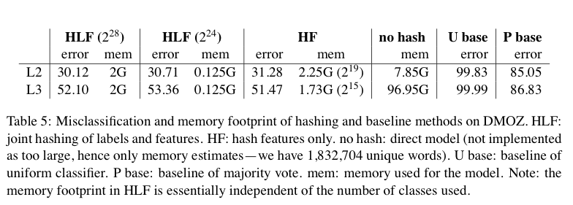
Results

Slide 36
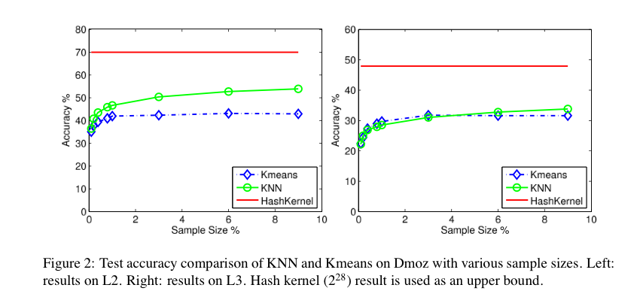
Results

