Slide 1
10-605

Slide 2
The course so far
Map-reduce and parallel counting
Streaming learning algorithms
some tricks like lazy L2 and hashing
Parallelizing streaming learning algorithms
param mixing – for clusters
vectorization and minibatches – for GPUs
Now: Some more tricks like hashing
randomized data structures aka sketches
these can make a huge difference in memory in many cases

Slide 3
THE Hash Trick: A Review

Slide 4
Hash Trick - Insights
Save memory: don’t store hash keys
Allow collisions
even though it distorts your data some
Let the learner (downstream) take up the slack

Slide 5
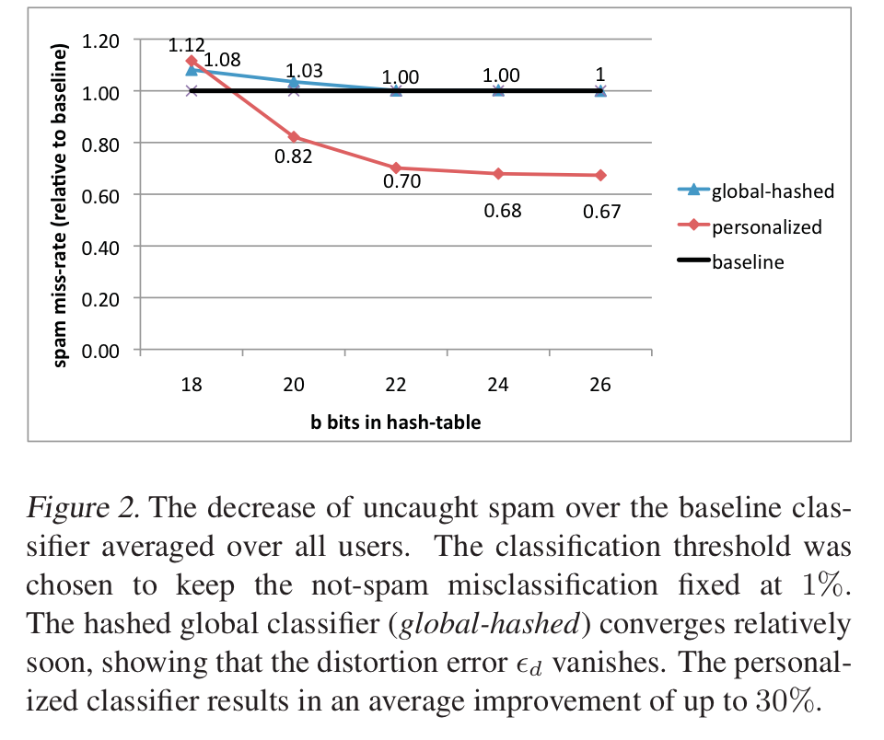
An example
2^26 entries = 1 Gb @ 8bytes/weight
Notes:
3,2M emails
400k users
40M tokens

Slide 6
Motivating Bloom Filters: Variant of the Hash Trick

Slide 7
A variant of feature hashing
Hash each feature multiple times with different hash functions
Now, each w has k chances to not collide with another useful w’
An easy way to get multiple hash functions
Generate some random strings s₁,…,s_{L}
Let the k-th hash function for w be the ordinary hash of concatenation w•s_{k}

Slide 8
A variant of feature hashing
a!=b are binary vectors
Hash each feature multiple times with different hash functions
Now, each w has k chances to not collide with another useful w’
An easy way to get multiple hash functions
Generate some random strings s₁,…,s_{L}
Let the k-th hash function for w be the ordinary hash of concatenation w•s_{k}
V(a)
1 | 0 | 1 | 0
0 | 1 | 1 | 0
1 | 0 | 1 | 0
1 | 1 | 0 | 0
V(a)
1 | 0 | 1 | 0
1 | 0 | 1 | 0
1 | 1 | 2 | 0
V(b)
V(b)
1 | 1 | 1 | 0

Slide 9
A variant of feature hashing
Why would this work?
Claim: with 100,000 features and 100,000,000 buckets:
k=1 ➔Pr(any feature duplication) ≈1
k=2 ➔Pr(any feature duplication) ≈0.4
k=3 ➔ Pr(any feature duplication) ≈0.01

Slide 10
Hash Trick - Insights
Save memory: don’t store hash keys
Allow collisions
even though it distorts your data some
Let the learner (downstream) take up the slack
Bloom filters are another famous trick that exploits these insights….

Slide 11
Bloom Filters

Slide 12
Bloom filters
Interface to a Bloom filter
BloomFilter(int maxSize, double p);
void bf.add(String s); // insert s
bool bd.contains(String s);
// If s was added return true;
// else with probability at least 1-p return false;
// else with probability at most p return true;
I.e., a noisy “set” where you can test membership (and that’s it)
Notes:
note a hash table would do this in constant time and storage
the hash trick does this as well

Slide 13
Bloom filters
An implementation
Allocate M bits, bit[0]…,bit[1-M]
Pick K hash functions hash(1,2),hash(2,s),….
E.g: hash(i,s) = hash(s+ randomString[i])
To add string s:
For i=1 to k, set bit[hash(i,s)] = 1
To check contains(s):
For i=1 to k, test bit[hash(i,s)]
Return “true” if they’re all set; otherwise, return “false”
We’ll discuss how to set M and K soon, but for now:
Let M = 1.5*maxSize // less than two bits per item!
Let K = 2*log(1/p) // about right with this M

Slide 14
Bloom filters
0 | 0 | 0 | 0 | 0 | 0 | 0 | 0 | 0 | 0
bf.add(“fred flintstone”):
h1
h2
h3
0 | 1 | 1 | 0 | 0 | 0 | 0 | 1 | 0 | 0
bf.add(“barney rubble”):
h1
h2
h3
1 | 1 | 1 | 0 | 0 | 1 | 0 | 1 | 0 | 0

Slide 15
Bloom filters
1 | 1 | 1 | 0 | 0 | 1 | 0 | 1 | 0 | 0
bf.contains (“fred flintstone”):
h1
h2
1 | 1 | 1 | 0 | 0 | 1 | 0 | 1 | 0 | 0
bf.contains(“barney rubble”):
h1
h2
h3
1 | 1 | 1 | 0 | 0 | 1 | 0 | 1 | 0 | 0

Slide 16
Bloom filters
1 | 1 | 1 | 0 | 0 | 1 | 0 | 1 | 0 | 0
bf.contains(“wilma flintstone”):
h1
h2
h3
1 | 1 | 1 | 0 | 0 | 1 | 0 | 1 | 0 | 0
bf.contains(“wilma flintstone”):
h1
h2
h3
1 | 1 | 1 | 0 | 0 | 1 | 0 | 1 | 0 | 0

Slide 17
Bloom filters: analysis
Analysis (m bits, k hashers):
Assume hash(i,s) is a random function
Look at Pr(bit j is unset after n add’s):
… and Pr(collision) = Pr(not all k bits set)
…. fix m and n and minimize k:
f(m,n,k) =
k =

Slide 18
Bloom filters
Analysis:
Plug optimal k=m/n*ln(2) back into Pr(collision):
Now we can fix any two of p, n, m and solve for the 3rd:
E.g., the value for m in terms of n and p:
f(m,n) =

Slide 19
Bloom filters
Interface to a Bloom filter
BloomFilter(int maxSize /* n */, double p);
void bf.add(String s); // insert s
bool bd.contains(String s);
// If s was added return true;
// else with probability at least 1-p return false;
// else with probability at most p return true;
I.e., a noisy “set” where you can test membership (and that’s it)
Notes:
note a hash table would do this in constant time and storage
the hash trick does this as well

Slide 20
Bloom filters: demo

Slide 21
What do you do with a Bloom Filter?

Slide 22
Some uses of Bloom filters
An example application
Finding items in “sharded” data
Easy if you know the sharding rule
Harder if you don’t (like Google n-grams)

Slide 23
Some Uses of Bloom filters
An example application
Finding items in “sharded” data
Easy if you know the sharding rule
Harder if you don’t (like Google n-grams)
Simple idea:
Build a BF of the contents of each shard
To look for key, load in the BF’s one by one, and search only the shards that probably contain key
Analysis: you won’t miss anything, you might look in some extra shards
You’ll hit O(1) extra shards if you set p=1/#shards

Slide 24
Some Uses of Bloom filters
An example application
discarding singleton features from a classifier
Scan through data once and check each w:
if bf1.contains(w): bf2.add(w)
else bf1.add(w)
Now:
bf1.contains(w) ⬄ w appears >= once
bf2.contains(w) ⬄ w appears >= 2x
Then train, ignoring words not in bf2

Slide 25
Some Uses of Bloom filters
An example application
discarding rare features from a classifier
seldom hurts much, can speed up experiments
Scan through data once and check each w:
if bf1.contains(w):
if bf2.contains(w): bf3.add(w)
else bf2.add(w)
else bf1.add(w)
Now:
bf2.contains(w) ⬄ w appears >= 2x
bf3.contains(w) ⬄ w appears >= 3x
Then train, ignoring words not in bf3

Slide 26
The Count-Min Sketch

Slide 27
A variant of feature hashing
Hash each feature multiple times with different hash functions
Now, each w has k chances to not collide with another useful w’
Get multiple hash functions as in Bloom filters
Part Bloom filter, part hash kernel
but predates either, called “count-min sketch” -- Cormode and Muthukrishnan

Slide 28
Bloom filters
An implementation
Allocate M bits, bit[0]…,bit[1-M]
Pick K hash functions hash(1,2),hash(2,s),….
E.g: hash(i,s) = hash(s+ randomString[i])
To add string s:
For i=1 to k, set bit[hash(i,s)] = 1
To check contains(s):
For i=1 to k, test bit[hash(i,s)]
Return “true” if they’re all set; otherwise, return “false”
We’ll discuss how to set M and K soon, but for now:
Let M = 1.5*maxSize // less than two bits per item!
Let K = 2*log(1/p) // about right with this M

Slide 29
Bloom Filter→Count-min sketch
An implementation
Allocate a matrix CM with d rows, w columns
Pick d hash functions h₁(s),h₂(s),….
To increment counter A[s] for s by c
For i=1 to d, set CM[i, hash(i,s)] += c
To retrieve value of A[s]:
For i=1 to d, retrieve M[i, hash(i,s)]
Return minimum of these values
Similar idea as Bloom filter:
if there are d collisions, you return a value that’s too large; otherwise, you return the correct value.
Question: what does this look like if d=1?

Slide 30
CM Sketch Structure
from: Minos Garofalakis
h₁(s)
+c
<s, +c>
+c
d=log 1/δ
+c
h_{d}(s)
+c
w = 2/ε
Each string is mapped to one bucket per row
Estimate A[j] by taking min_{k} { CM[k,h_{k}(j)] }
Errors are always over-estimates
Analysis: d=log 1/δ, w=2/ε ➔ error is usually less than e||A||₁
i.e. with prob > 1-δ

Slide 31
from: Minos Garofalakis
<s, +c>
c
c
You can find the sum of two sketches by doing element-wise summation
c
c
<t, +d>
d
+
d
Also, you can compute a weighted sum of MC sketches
d
d
d
c
Same result as adding <s,+c> and then <t,+d> to an empty sketch
c+d
c
d
d
c

Slide 32
CM Sketch Guarantees
from: Minos Garofalakis
[Cormode, Muthukrishnan’04] CM sketch guarantees approximation error on point queries less than ε||A||₁ in space O(1/ε log 1/δ)
Probability of more error is less than 1-δ
This is sometimes enough:
Estimating a multinomial: if A[s] = Pr(s|…) then ||A||₁ = 1
Multiclass classification: if A_{x}[s] = Pr(x in class s) then ||A_{x}||₁ is probably small, since most x’s will be in only a few classes

Slide 33
CM Sketch Guarantees
from: Minos Garofalakis
[Cormode, Muthukrishnan’04] CM sketch guarantees approximation error on point queries less than ε||A||₁ in space O(1/ε log 1/δ)
CM sketches are also accurate for skewed values---i.e., only a few entries s with large A[s]

Slide 34
What do you do with a count-min sketch?

Slide 35
An Application of a Count-Min Sketch
Problem: find the semantic orientation of a work (positive or negative) using a large corpus.
Idea:
positive words co-occur more frequently than expected near positive words; likewise for negative words
so pick a few pos/neg seeds and compute
x appears near y

Slide 36
An Application of a Count-Min Sketch
x appears near y
Example: Turney, 2002 used two seeds, “excellent” and “poor”
In general, SO(w) can be written in terms of logs of products of counters for w, with and without seeds

Slide 37
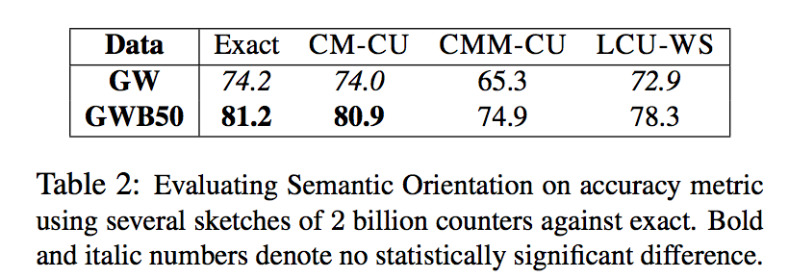
An Application of a Count-Min Sketch
Use 2B counters, 5 hash functions, “near” means a 7-word window, GigaWord (10 Gb) and GigaWord + Web news 50 Gb)

Slide 38
An Application of a Count-Min Sketch
CM-CU: CM with “conservative update” - for <j,+c> increment counters just enough to make the new estimate for j grow by c

Slide 39
Deep Learning and Sketches

Slide 40
ICLR 2017

Slide 41
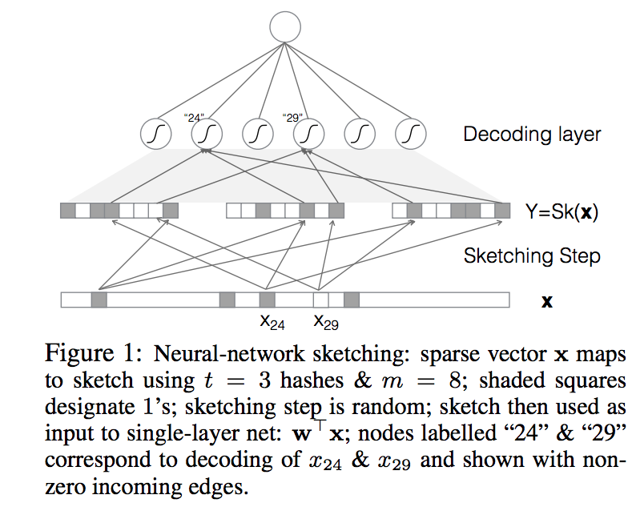
ICLR 2017
summation w/o nonlinearity
weights and reLU compute the AND that decodes x₂₄
Claim: for any w there is a one-layer neural network that can compute* <w,x> using as input a Bloom-filter sketch** of x, if x is a k-hot binary vector over d dimensions.
w₂₄
* with prob $≥1−δ$
** o$f size O(ek log {|\left|w\right||}_{0}/δ$)

Slide 42
ICLR 2017
weights and reLU compute the AND that decodes x₂₄
now weights and reLU compute x₂₄* x₂₉
Also:
weights in network are between 0 and 1
only $O(ek log {|\left|w\right||}_{0}/δ$) of the weights are non-zero
you can express more complex functions with a few more non-zero weights – e.g. polynomial kernels
we can learn these networks using an L1 regularizer

Slide 43
RCV1, 4 categories, 113k dimensions, most examples are 120-sparse
mt is sketch size
3 values of L1-regularizer are used

Slide 44
entity-tagging task with very large feature vocabulary
mt is sketch size
3 values of L1-regularizer are used
compared to feature hashing

Slide 45
ICLR 2017
What if you are mapping many inputs to many possible outputs?
Song recommendation: output is a song
Language modeling: output is a word
…

Slide 46
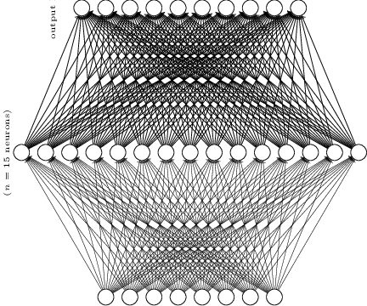
50k possible books
What if you are mapping many inputs to many possible outputs?
Book recommendation: output is a book
Language modeling: output is a word
Solution: output a sketch!

Slide 47
$$Σ$$
$$Σ$$
X
X
To score y, addup the scores of the codes for y
Softmax predicts the BF encoding bits
What if you are mapping many inputs to many possible outputs?
Book recommendation: output is a book
Language modeling: output is a word
Solution: output a sketch!

Slide 48
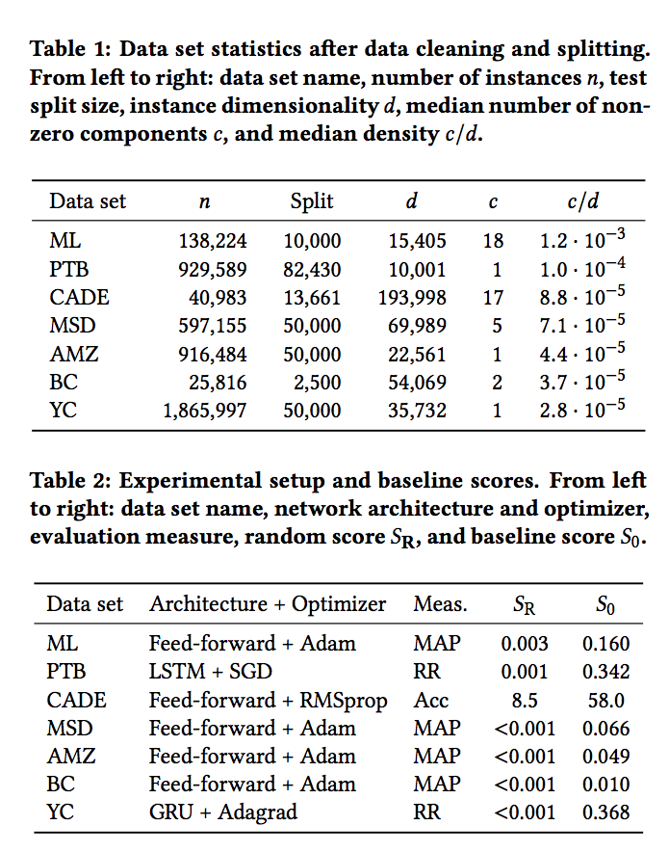

Slide 49
