Slide 1
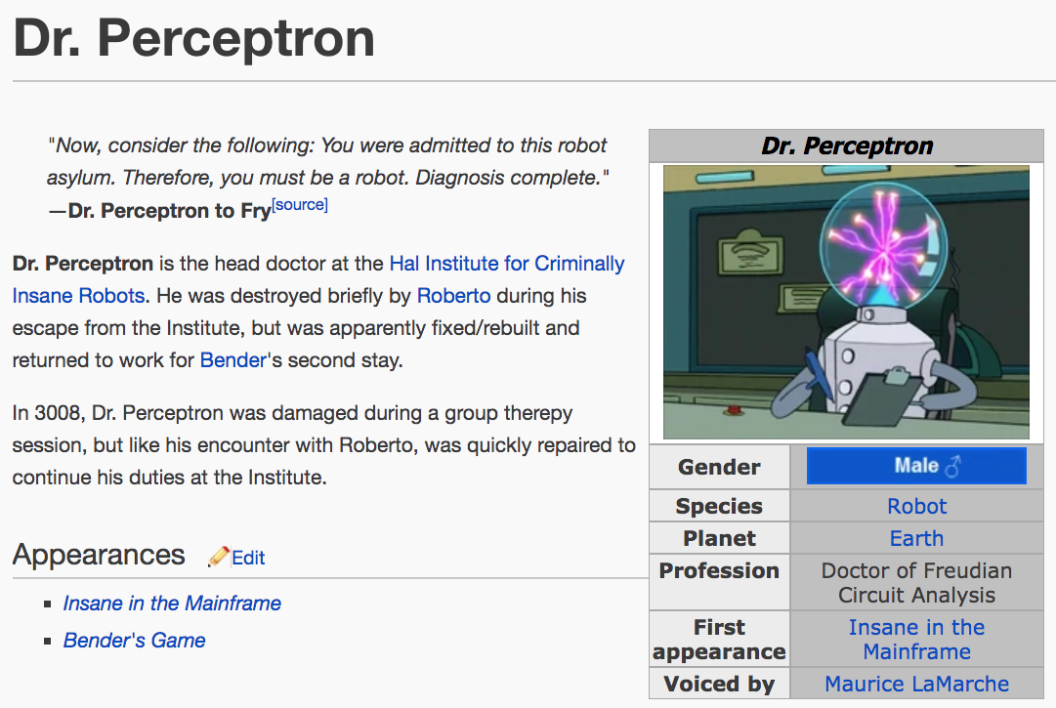
http://futurama.wikia.com/wiki/Dr._Perceptron

Slide 2
Where we are…
Experiments with a hash-trick implementation of logistic regression
Next question:
  how do you parallelize SGD, or more generally, this kind of streaming algorithm?
  each example affects the next prediction ➔ order matters ➔ parallelization changes the behavior
  we will step back to perceptrons and then step forward to parallel perceptrons
  then another nice parallel learning algorithm
  then a midterm

Slide 3
Recap: perceptrons

Slide 4

The perceptron
^
instance x_{i}
B
Compute: y_{i} =sign( v_{k} . x_{i} )
A
^
If mistake: v_{k+1} = v_{k} + y_{i} x_{i}
y_{i}
y_{i}
2

Slide 5
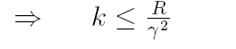
The perceptron
^
instance x_{i}
B
Compute: y_{i} =sign( v_{k} . x_{i} )
A
^
If mistake: v_{k+1} = v_{k} + y_{i} x_{i}
y_{i}
y_{i}
A lot like SGD update for logistic regression!
u
+ +
+
positive
Mistake bound:
- -
-
2
-u
2γ
2
negative
margin

Slide 6
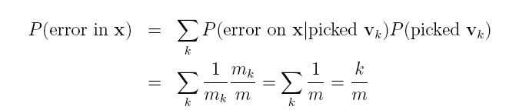
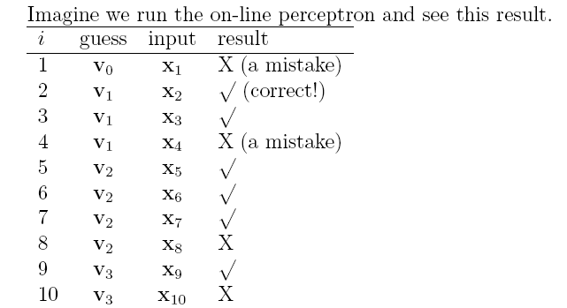
On-line to batch learning
Pick a v_{k} at random according to m_{k}/m, the fraction of examples it was used for.
Predict using the v_{k} you just picked.
(Actually, use some sort of deterministic approximation to this).
m₁=3
m₂=4
m=10

Slide 7
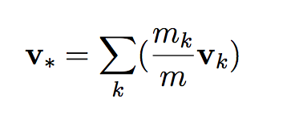
predict using sign(v*. x)
Pick a v_{k} at random according to m_{k}/m, the fraction of examples it was used for.
Predict using the v_{k} you just picked.
(Actually, use some sort of deterministic approximation to this).
m₁=3
m₂=4
m=10

Slide 8
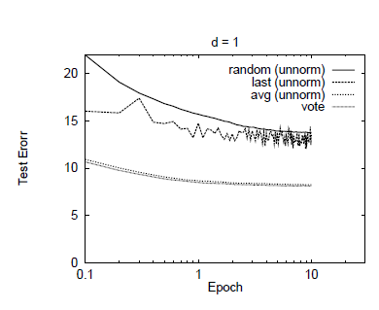
predict using sign(v*. x)
Also: there’s a sparsification trick that makes learning the averaged perceptron fast
Last perceptron
Averaging/voting

Slide 9
Kernels and Perceptrons

Slide 10
The kernel perceptron
instance x_{i}
B
A
^
y_{i}
y_{i}
^
Compute: y_{i} = v_{k} . x_{i}
If mistake: v_{k+1} = v_{k} + y_{i} x_{i}
Mathematically the same as before … but allows use of the kernel trick

Slide 11
The kernel perceptron
instance x_{i}
B
A
^
y_{i}
y_{i}
^
Compute: y_{i} = v_{k} . x_{i}
If mistake: v_{k+1} = v_{k} + y_{i} x_{i}
Mathematically the same as before … but allows use of the “kernel trick”
Other kernel methods (SVM, Gaussian processes) aren’t constrained to limited set (+1/-1/0) of weights on the K(x,v) values.

Slide 12
Some common kernels
Linear kernel:
Polynomial kernel:
Gaussian kernel:

Slide 13
Some common kernels
Polynomial kernel:
for d=2
$${\left(\left\langle x_{1,}x_{2}\right\rangle ∙\left\langle {x′}_{1,}{x′}_{2}\right\rangle +1\right)}^{2}$$
$${= \left(x_{1}{x′}_{1}+x_{2}{x′}_{2}+1\right)}^{2}$$
=$\left(x_{1}{x′}_{1}+x_{2}{x′}_{2}+1\right)\left(x_{1}{x′}_{1}+x_{2}{x′}_{2}+1\right)$
${=\left(x_{1}{x′}_{1}\right)}^{2}$+2$\left(x_{1}{x^{′}}_{1}x_{2}{x^{′}}_{2}\right)+2{(x}_{1}{x′}_{1})$+${ \left(x_{2}{x′}_{2}\right)}^{2}$+2($x_{2}{x′}_{2})$+1
$$≅\left\langle {1,x}_{1,}x_{2},x_{1}x_{2},x_{1}^{2},x_{2}^{2}\right\rangle ∙\left\langle {1,x′}_{1,}{x′}_{2},{x′}_{1}{x′}_{2},{x′}_{1}^{2},{x′}_{2}^{2}\right\rangle$$
$$=\left\langle {1,\sqrt{2}x}_{1,}{\sqrt{2}x}_{2},{\sqrt{2}x}_{1}x_{2},x_{1}^{2},x_{2}^{2}\right\rangle ∙\left\langle {1,\sqrt{2}x′}_{1,}{\sqrt{2}x′}_{2},{\sqrt{2}x′}_{1}{x′}_{2},{x′}_{1}^{2},{x′}_{2}^{2}\right\rangle$$

Slide 14
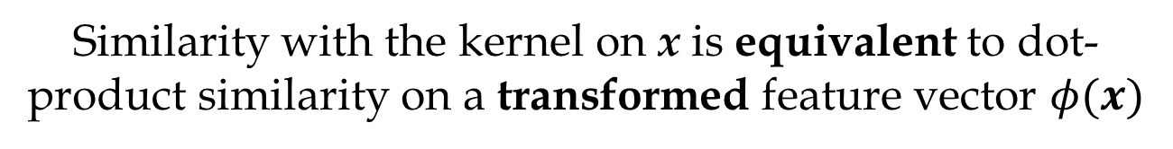
Some common kernels
Polynomial kernel:
for d=2
$${\left(\left\langle x_{1,}x_{2}\right\rangle ∙\left\langle {x′}_{1,}{x′}_{2}\right\rangle +1\right)}^{2}$$
$$=\left\langle {1,\sqrt{2}x}_{1,}{\sqrt{2}x}_{2},{\sqrt{2}x}_{1}x_{2},x_{1}^{2},x_{2}^{2}\right\rangle ∙\left\langle {1,\sqrt{2}x′}_{1,}{\sqrt{2}x′}_{2},{\sqrt{2}x′}_{1}{x′}_{2},{x′}_{1}^{2},{x′}_{2}^{2}\right\rangle$$
Similarity with the kernel on x is equivalent to dot-product similarity on a transformed feature vector $φ(x)$

Slide 15
Kernels 101
Explicitly map from x to φ(x) – i.e. to the point corresponding to x in the Hilbert space (RKHS)
Implicitly map from x to φ(x) by changing the kernel function K
Duality: two ways to look at this
Observation about perceptron
Generalization of perceptron
same behavior but compute time/space are different
Generalization: add weights to the sums for w

Slide 16
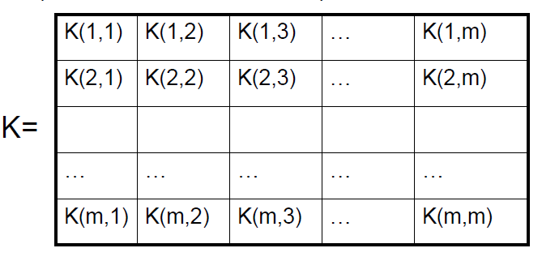
Kernels 101
K(x,x’) = K(x’,x) ➔ Gram matrix is symmetric
K(x,x) > 0 ➔ diagonal of K is positive ➔ K is “positive semi-definite” ➔ z^{T} K z >= 0 for all z
Duality
Gram matrix: K: k_{ij} = K(x_{i},x_{j})

Slide 17
A familiar Kernel

Slide 18

Learning as optimization for regularized logistic regression + hashes
Algorithm:
Initialize arrays W, A of size R and set k=0
For each iteration t=1,…T
  For each example (x_{i},y_{i})
    V is a hash table
    For j : x^{j}>0 increment V[h[j]] by x^{j}
    p_{i} = … ; k++
    For each hash value h: V[h]>0:
        W[h] *= (1 - λ2μ)^{k-A[h]}
        W[h] = W[h] + λ(y_{i} - p^{i})V[h]
        A[h] = k

Slide 19


Slide 20
Some details
Slightly different hash to avoid systematic bias
m is the number of buckets you hash into (R in my discussion)

Slide 21
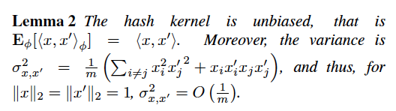
Some details
Slightly different hash to avoid systematic bias
I.e., for large feature sets the variance should be low

Slide 22
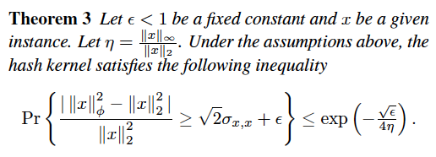
Some details
I.e. – a hashed vector is probably close to the original vector

Slide 23
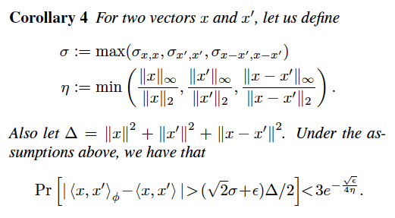
Some details
I.e. the inner products between x and x’ are probably not changed too much by the hash function: a classifier will probably still work

Slide 24
The Voted Perceptron for Ranking and Structured Classification
William Cohen

Slide 25
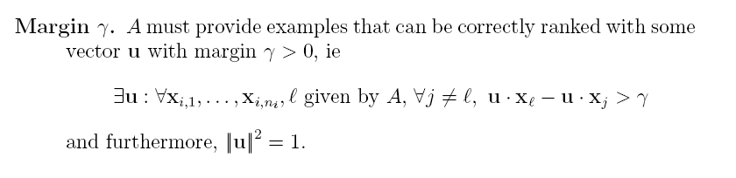
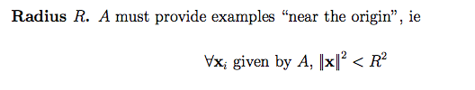
The voted perceptron for ranking
instances x₁ x₂ x₃ x₄…
^
A
B
Compute: y_{i} = v_{k} . x_{i}
Return: the index b* of the “best” x_{i}
b*
If mistake: v_{k+1} = v_{k} + x_{b} - x_{b*}
b

Slide 26
u
Ranking some x’s with the target vector u
x
γ
x
x
x
x
-u

Slide 27
u
Ranking some x’s with some guess vector v – part 1
x
γ
v
x
x
x
x
-u

Slide 28
u
Ranking some x’s with some guess vector v – part 2.
The purple-circled x is x_{b*} - the one the learner has chosen to rank highest. The green circled x is x_{b}, the right answer.
x
v
x
x
x
x
-u

Slide 29
u
Correcting v by adding x_{b} – x_{b*}
x
v
x
x
x
x
-u

Slide 30
Correcting v by adding x_{b} – x_{b*}
(part 2)
V_{k+1}
x
v_{k}
x
x
x
x

Slide 31
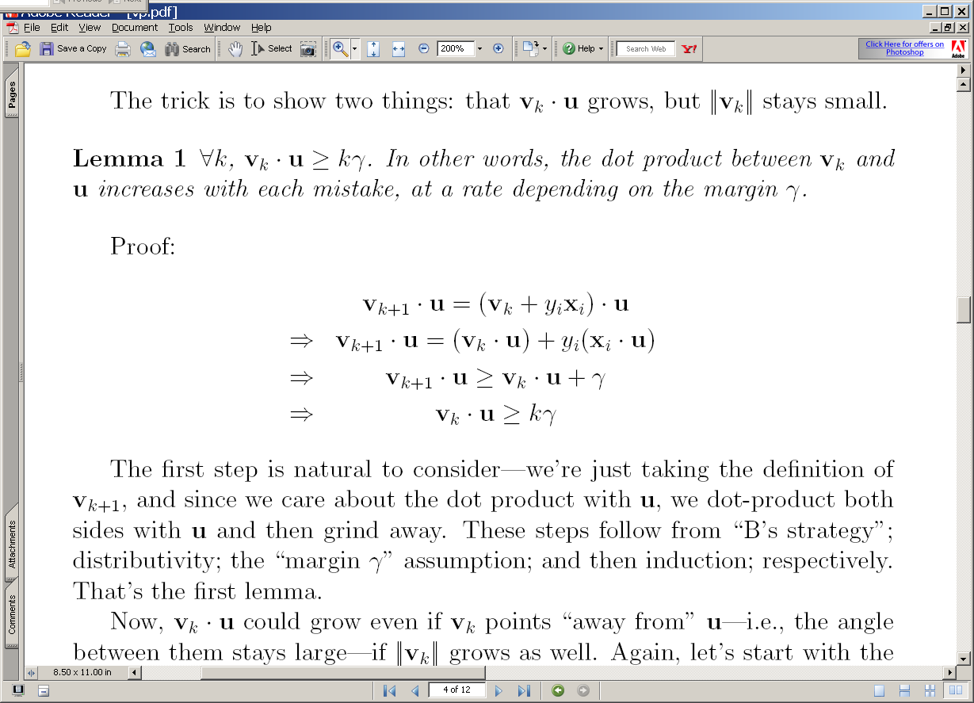
(3a) The guess v₂ after the two positive examples: v₂=v₁+x₂
u
+x₂
v₂
>γ
v₁
-u
2γ

Slide 32
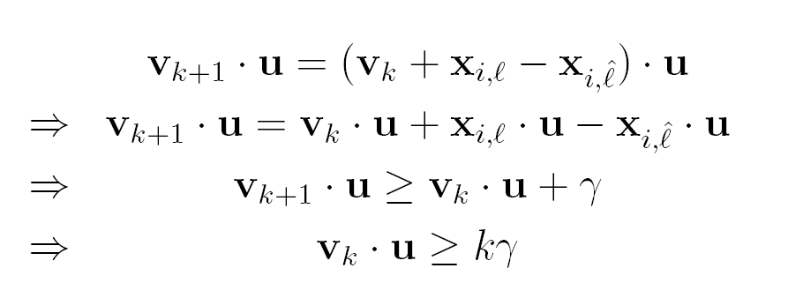
(3a) The guess v₂ after the two positive examples: v₂=v₁+x₂
u
+x₂
v₂
>γ
v₁
-u
2γ
3

Slide 33
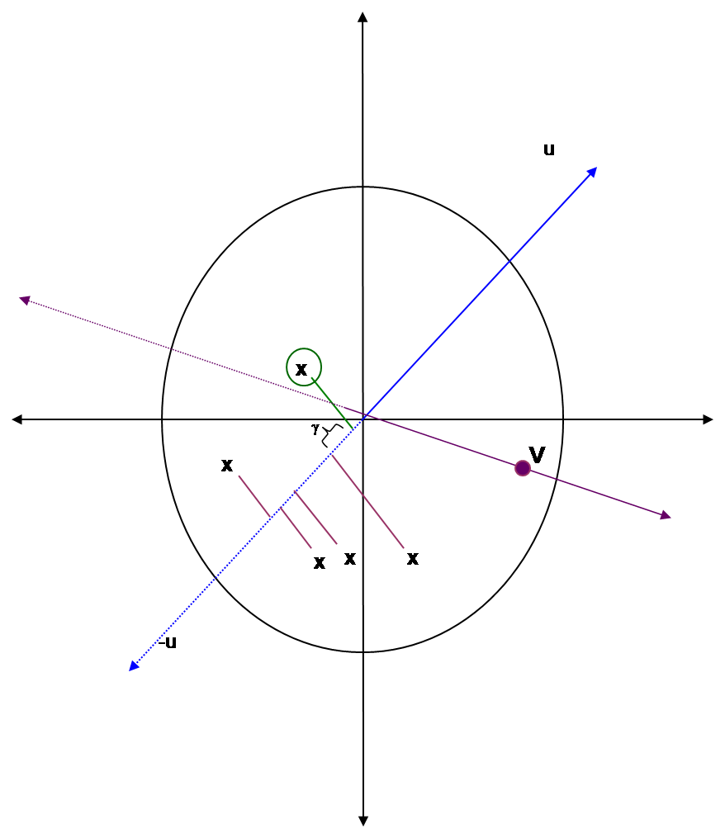
(3a) The guess v₂ after the two positive examples: v₂=v₁+x₂
u
+x₂
v₂
>γ
v₁
-u
2γ
3

Slide 34
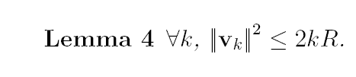
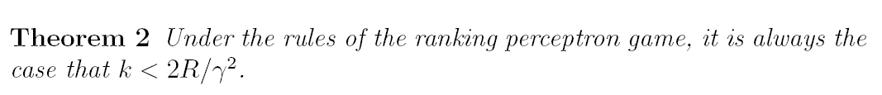
Notice this doesn’t depend at all on the number of x’s being ranked
(3a) The guess v₂ after the two positive examples: v₂=v₁+x₂
u
+x₂
v₂
>γ
v₁
-u
2γ
Neither proof depends on the dimension of the x’s.

Slide 35
Ranking perceptrons ➔ structured perceptrons
The API:
  A sends B a (maybe huge) set of items to rank
  B finds the single best one according to the current weight vector
  A tells B which one was actually best
Structured classification on a sequence
  Input: list of words: x=(w₁,…,w_{n})
  Output: list of labels: y=(y_{1,}…,y_{n})
  If there are K classes, there are K^{n} labels possible for x

Slide 36
Borkar et al’s: HMMs for segmentation
  Example: Addresses, bib records
  Problem: some DBs may split records up differently (eg no “mail stop” field, combine address and apt #, …) or not at all
  Solution: Learn to segment textual form of records
Author
Year
Title
Journal
Page
Volume
P.P.Wangikar, T.P. Graycar, D.A. Estell, D.S. Clark, J.S. Dordick (1993) Protein and Solvent Engineering of Subtilising BPN' in Nearly Anhydrous Organic Media J.Amer. Chem. Soc. 115, 12231-12237.

Slide 37
IE with Hidden Markov Models
Emission probabilities
Transition probabilities
0.5
Title
Learning
Convex
…
0.06
0.03
..
Author
Smith
Cohen
Jordan
…
0.01
0.05
0.3
…
0.9
0.5
0.1
0.8
Year
Journal
dddd
dd
0.8
0.2
0.2
Comm.
Trans.
Chemical
0.04
0.02
0.004
Notes:
Probabilitistic transitions and outputs make the model more robust to errors and slight variations

Slide 38
Inference for linear-chain CRFs
When will prof Cohen post the notes …
Idea 1: features are properties of two adjacent tokens, and the pair of labels assigned to them (Begin,Inside,Outside)
(y(i)==B or y(i)==I) and (token(i) is capitalized)
(y(i)==I and y(i-1)==B) and (token(i) is hyphenated)
(y(i)==B and y(i-1)==B)
  eg “tell Rose William is on the way”
Idea 2: construct a graph where each path is a possible sequence labeling.

Slide 39
Inference for a linear-chain CRF
When will prof Cohen post the notes …
B
B
B
B
B
B
B
I
I
I
I
I
I
I
O
O
O
O
O
O
O
Inference: find the highest-weight path given a weighting of features
This can be done efficiently using dynamic programming (Viterbi)

Slide 40
Ranking perceptrons ➔ structured perceptrons
The API:
  A sends B a (maybe huge) set of items to rank
  B finds the single best one according to the current weight vector
  A tells B which one was actually best
Structured classification on a sequence
  Input: list of words: x=(w₁,…,w_{n})
  Output: list of labels: y=(y_{1,}…,y_{n})
  If there are K classes, there are K^{n} labels possible for x

Slide 41
Ranking perceptrons ➔ structured perceptrons
New API:
  A sends B the word sequence x
  B finds the single best y according to the current weight vector using Viterbi
  A tells B which y was actually best
  This is equivalent to ranking pairs g=(x,y’)
Structured classification on a sequence
  Input: list of words: x=(w₁,…,w_{n})
  Output: list of labels: y=(y_{1,}…,y_{n})
  If there are K classes, there are K^{n} labels possible for x

Slide 42
The voted perceptron for ranking
instances x₁ x₂ x₃ x₄…
^
A
B
Compute: y_{i} = v_{k} . x_{i}
Return: the index b* of the “best” x_{i}
b*
If mistake: v_{k+1} = v_{k} + x_{b} - x_{b*}
b
Change number one is notation: replace x with g

Slide 43
The voted perceptron for structured classification tasks
instances g₁ g₂ g₃ g₄…
^
A
B
Compute: y_{i} = v_{k} . g_{i}
Return: the index b* of the “best” g_{i}
If mistake: v_{k+1} = v_{k} + g_{b} - g_{b*}
b*
b
A sends B feature functions, and instructions for creating the instances g:
  A sends a word vector x_{i}. Then B could create the instances g₁ =F(x_{i},y₁), g₂= F(x_{i},y₂), …
  but instead B just returns the y* that gives the best score for the dot product v_{k} . F(x_{i},y*) by using Viterbi.
A sends B the correct label sequence y_{i.}
On errors, B sets v_{k+1} = v_{k} + g_{b} - g_{b*} = v_{k} + F(x_{i},y) - F(x_{i},y*)

Slide 44


Results from the original paper….
EMNLP 2002, Best paper

Slide 45
Collins’ Experiments
POS tagging
NP Chunking (words and POS tags from Brill’s tagger as features) and BIO output tags
Compared logistic regression methods (MaxEnt) and “Voted Perceptron trained HMM’s”
  With and w/o averaging
  With and w/o feature selection (count>5)

Slide 46
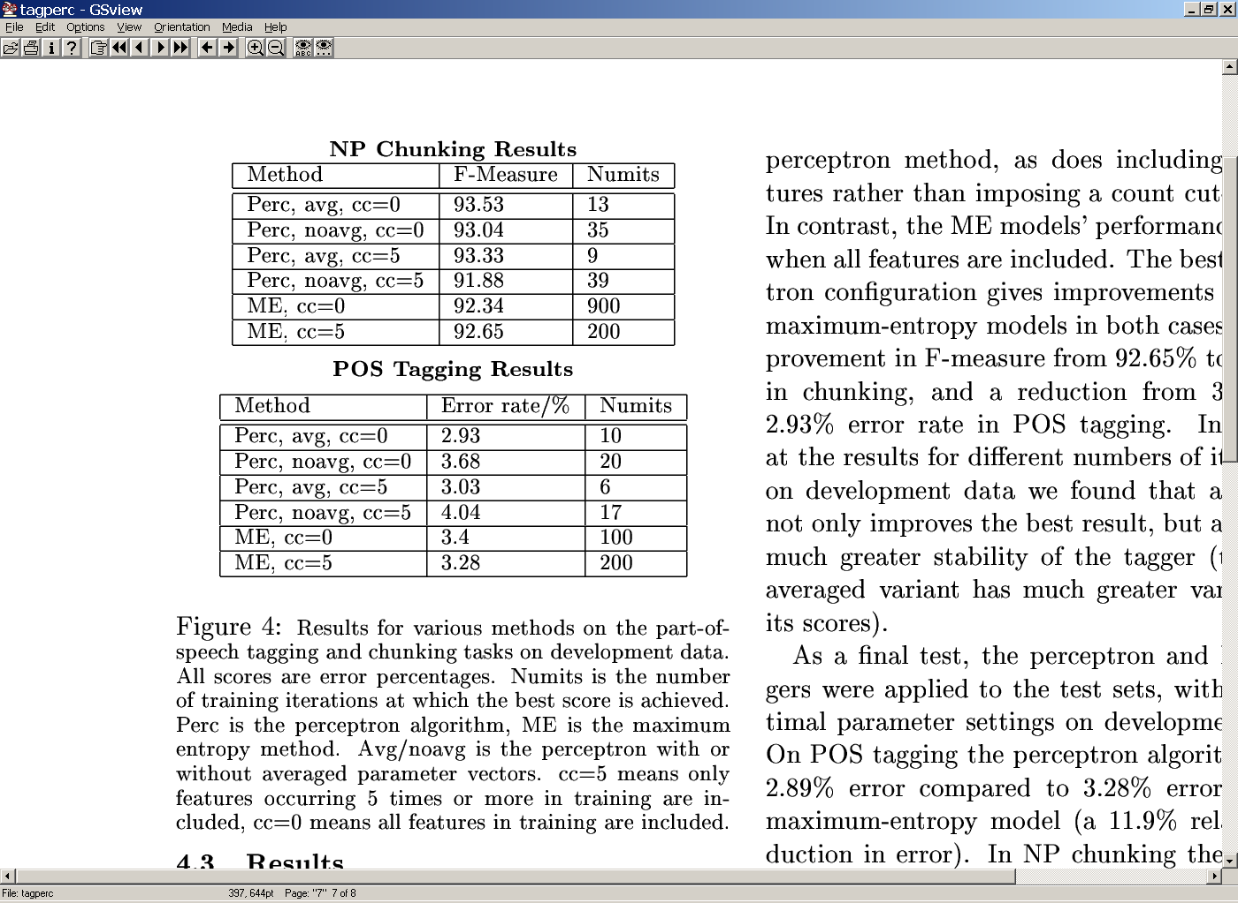
Collins’ results

Slide 47
Where we are…
Experiments with a hash-trick implementation of logistic regression
Next question:
  how do you parallelize SGD, or more generally, this kind of streaming algorithm?
  each example affects the next prediction ➔ order matters ➔ parallelization changes the behavior
  we will step back to perceptrons and then step forward to parallel perceptrons
  then another nice parallel learning algorithm
  then a midterm

