Slide 1
Overview of this week
Debugging tips for ML algorithms
Graph algorithms at scale
A prototypical graph algorithm: PageRank
In memory
Putting more and more on disk …
Sampling from a graph
What is a good sample (graph statistics)
What methods work (PPR/RWR)
HW: PageRank-Nibble method + Gephi

Slide 2
Graph Algorithms At Scale
William Cohen

Slide 3
Graph algorithms
PageRank implementations
in memory
streaming, node list in memory
streaming, no memory
map-reduce
A little like Naïve Bayes variants
data in memory
word counts in memory
stream-and-sort
map-reduce

Slide 4
Google’s PageRank
Inlinks are “good” (recommendations)
Inlinks from a “good” site are better than inlinks from a “bad” site
but inlinks from sites with many outlinks are not as “good”...
“Good” and “bad” are relative.
web site xxx
web site xxx
web site xxx
web site a b c d e f g
web
site
pdq pdq ..
web site yyyy
web site a b c d e f g
web site yyyy

Slide 5
Google’s PageRank
web site xxx
Imagine a “pagehopper” that always either
follows a random link, or
jumps to random page
web site xxx
web site a b c d e f g
web
site
pdq pdq ..
web site yyyy
web site a b c d e f g
web site yyyy

Slide 6
Google’s PageRank (Brin & Page, http://www-db.stanford.edu/~backrub/google.html)
web site xxx
Imagine a “pagehopper” that always either
follows a random link, or
jumps to random page
PageRank ranks pages by the amount of time the pagehopper spends on a page:
or, if there were many pagehoppers, PageRank is the expected “crowd size”
web site xxx
web site a b c d e f g
web
site
pdq pdq ..
web site yyyy
web site a b c d e f g
web site yyyy

Slide 7
PageRank in Memory
Let u = (1/N, …, 1/N)
dimension = #nodes N
Let A = adjacency matrix: [a_{ij}=1 ⬄ i links to j]
Let W = [w_{ij} = a_{ij}/outdegree(i)]
w_{ij} is probability of jump from i to j
Let v⁰ = (1,1,….,1)
or anything else you want
Repeat until converged:
Let v^{t+1} = cu + (1-c)Wv^{t}
c is probability of jumping “anywhere randomly”

Slide 8
Streaming PageRank
Assume we can store v but not W in memory
Repeat until converged:
Let v^{t+1} = cu + (1-c)Wv^{t}
Store A as a row matrix: each line is
i j_{i,1},…,j_{i,d} [the neighbors of i]
Store v’ and v in memory: v’ starts out as cu
For each line “i j_{i,1},…,j_{i,d} “
For each j in j_{i,1},…,j_{i,d}
v’[j] += (1-c)v[i]/d
Everything needed for update is right there in row….

Slide 9
Streaming PageRank: with some long rows
Repeat until converged:
Let v^{t+1} = cu + (1-c)Wv^{t}
Store A as a list of edges: each line is: “i d(i) j”
Store v’ and v in memory: v’ starts out as cu
For each line “i d j“
v’[j] += (1-c)v[i]/d
We need to get the degree of i and store it locally

Slide 10
Recap: Issues with Hadoop
Too much typing
programs are not concise
Too low level
missing abstractions
hard to specify a workflow
Not well suited to iterative operations
E.g., E/M, k-means clustering, …
Workflow and memory-loading issues
First: an iterative algorithm in Pig Latin

Slide 11
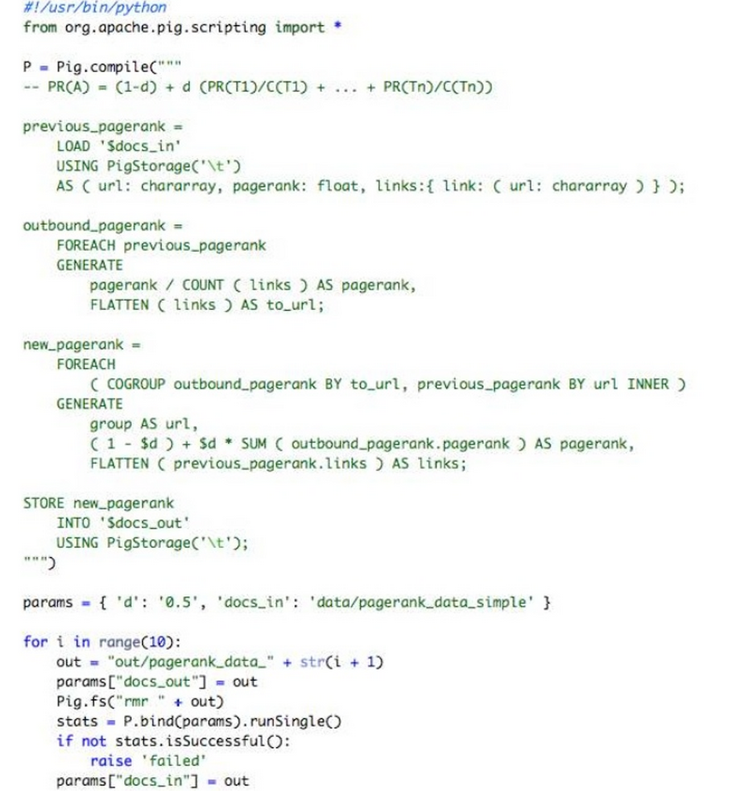
How to use loops, conditionals, etc?
Embed PIG in a real programming language.
Julien Le Dem - Yahoo

Slide 12
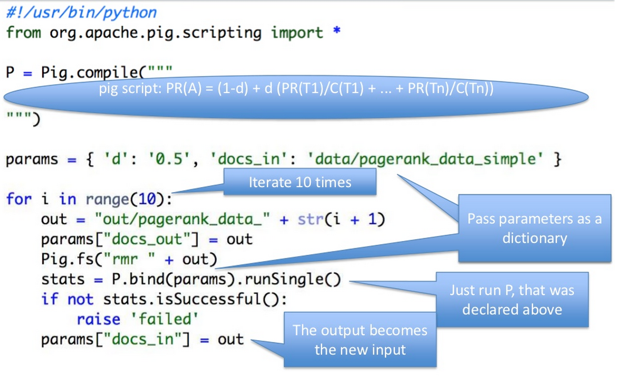

Slide 13
lots of i/o happening here…

Slide 14
Graph algorithms
PageRank implementations
in memory
streaming, node list in memory
streaming, no memory
map-reduce
A little like Naïve Bayes variants
data in memory
word counts in memory
stream-and-sort
map-reduce

Slide 15
Streaming PageRank: preprocessing
Original encoding is edges (i,j)
Mapper replaces i,j with i,1
Reducer is a SumReducer
Result is pairs (i,d(i))
Then: join this back with edges (i,j)
For each i,j pair:
send j as a message to node i in the degree table
messages always sorted after non-messages
the reducer for the degree table sees i,d(i) first
then j1, j2, ….
can output the key,value pairs with key=i, value=d(i), j

Slide 16
Preprocessing Control Flow: 1
I | J
i1 | j1,1
i1 | j1,2
… | …
i1 | j1,k1
i2 | j2,1
… | …
i3 | j3,1
… | …
I
i1 | 1
i1 | 1
… | …
i1 | 1
i2 | 1
… | …
i3 | 1
… | …
I
i1 | 1
i1 | 1
… | …
i1 | 1
i2 | 1
… | …
i3 | 1
… | …
I | d(i)
i1 | d(i1)
.. | …
i2 | d(i2)
… | …
i3 | d)i3)
… | …
MAP
SORT
REDUCE
Summing values

Slide 17
Preprocessing Control Flow: 2
I | J
i1 | ~j1,1
i1 | ~j1,2
… | …
i2 | ~j2,1
… | …
I | J
i1 | j1,1
i1 | j1,2
… | …
i2 | j2,1
… | …
I
i1 | d(i1)
i1 | ~j1,1
i1 | ~j1,2
.. | …
i2 | d(i2)
i2 | ~j2,1
i2 | ~j2,2
… | …
I
i1 | d(i1) | j1,1
i1 | d(i1) | j1,2
… | … | …
i1 | d(i1) | j1,n1
i2 | d(i2) | j2,1
… | … | …
i3 | d(i3) | j3,1
… | … | …
I | d(i)
i1 | d(i1)
.. | …
i2 | d(i2)
… | …
I | d(i)
i1 | d(i1)
.. | …
i2 | d(i2)
… | …
MAP
SORT
REDUCE
copy or convert to messages
join degree with edges

Slide 18
Streaming PageRank: with some long rows
Repeat until converged:
Let v^{t+1} = cu + (1-c)Wv^{t}
Pure streaming: use a table mapping nodes to degree+pageRank
Lines are i: degree=d,pr=v
For each edge i,j
Send to i (in degree/pagerank) table: outlink j
For each line i: degree=d,pr=v:
send to i: incrementVBy c
for each message “outlink j”:
send to j: incrementVBy (1-c)*v/d
For each line i: degree=d,pr=v
sum up the incrementVBy messages to compute v’
output new row: i: degree=d,pr=v’
One identity mapper with two inputs (edges, degree/pr table)
Reducer outputs the incrementVBy messages
Two-input mapper + reducer

Slide 19
Control Flow: Streaming PR
I | J
i1 | j1,1
i1 | j1,2
… | …
i2 | j2,1
… | …
I | d/v
i1 | d(i1),v(i1)
i1 | ~j1,1
i1 | ~j1,2
.. | …
i2 | d(i2),v(i2)
i2 | ~j2,1
i2 | ~j2,2
… | …
to | delta
i1 | c
j1,1 | (1-c)v(i1)/d(i1)
… | …
j1,n1 | i
i2 | c
j2,1 | …
… | …
i3 | c
I | delta
i1 | c
i1 | (1-c)v(…)….
i1 | (1-c)…
.. | …
i2 | c
i2 | (1-c)…
i2 | ….
… | …
I | d/v
i1 | d(i1),v(i1)
i2 | d(i2),v(i2)
… | …
REDUCE
MAP
SORT
MAP
SORT
send “pageRank updates ” to outlinks
copy or convert to messages

Slide 20
Control Flow: Streaming PR
to | delta
i1 | c
j1,1 | (1-c)v(i1)/d(i1)
… | …
j1,n1 | i
i2 | c
j2,1 | …
… | …
i3 | c
I | delta
i1 | c
i1 | (1-c)v(…)….
i1 | (1-c)…
.. | …
i2 | c
i2 | (1-c)…
i2 | ….
… | …
I | v’
i1 | ~v’(i1)
i2 | ~v’(i2)
… | …
I | d/v
i1 | d(i1),v’(i1)
i2 | d(i2),v’(i2)
… | …
I | d/v
i1 | d(i1),v(i1)
i2 | d(i2),v(i2)
… | …
REDUCE
MAP
SORT
REDUCE
MAP
SORT
REDUCE
Summing values
Replace v with v’

Slide 21
Control Flow: Streaming PR
I | J
i1 | j1,1
i1 | j1,2
… | …
i2 | j2,1
… | …
and back around for next iteration….
I | d/v
i1 | d(i1),v(i1)
i2 | d(i2),v(i2)
… | …
MAP
copy or convert to messages

Slide 22
More on graph algorithms
PageRank is a one simple example of a graph algorithm
but an important one
personalized PageRank (aka “random walk with restart”) is an important operation in machine learning/data analysis settings
PageRank is typical in some ways
Trivial when graph fits in memory
Easy when node weights fit in memory
More complex to do with constant memory
A major expense is scanning through the graph many times
… same as with SGD/Logistic regression
disk-based streaming is much more expensive than memory-based approaches
Locality of access is very important!
gains if you can pre-cluster the graph even approximately
avoid sending messages across the network – keep them local

