Slide 1
(A)

Slide 2
(B)

Slide 3
(C)

Slide 4
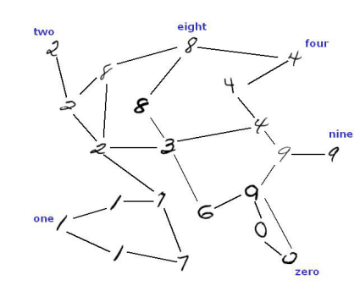
(A)
Seed labels

Slide 5
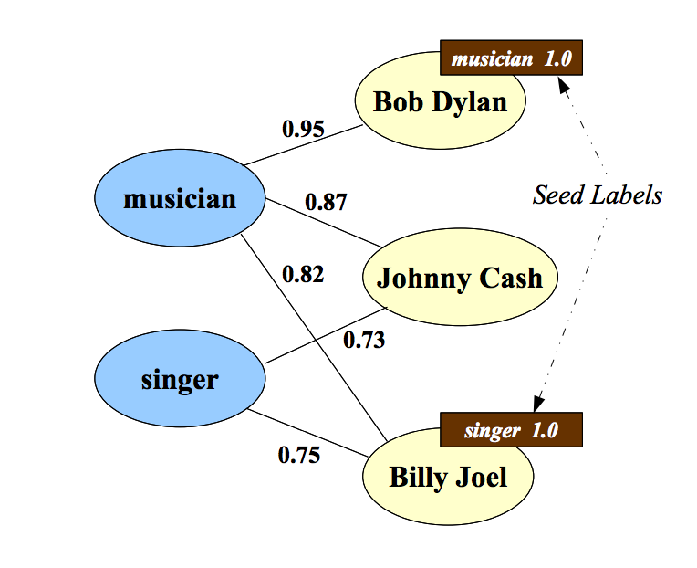
(B)

Slide 6
(A)
(B)
(C)
*
*
*

