Slide 1
Phrase Finding;
Stream-and-Sort vs
“Request-and-Answer”
William W. Cohen

Slide 2
Outline
Even more on stream-and-sort and naïve Bayes
Another problem: “meaningful” phrase finding
Implementing phrase finding efficiently
Some other phrase-related problems

Slide 3
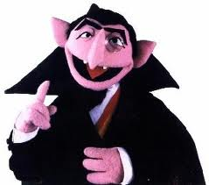
Last Week
How to implement Naïve Bayes
  Time is linear in size of data (one scan!)
  We need to count, e.g. C( X=word ^ Y=label)
How to implement Naïve Bayes with large vocabulary and small memory
  General technique: “Stream and sort”
    Very little seeking (only in merges in merge sort)
    Memory-efficient

Slide 4
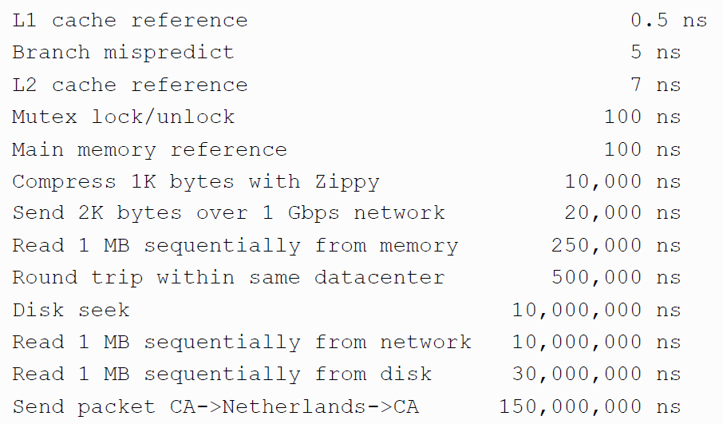
Numbers (Jeff Dean says) Everyone Should Know
~= 10x
~= 15x
40x
~= 100,000x
Notes:
150x – commercial flight vs a brisk walk
100,000x – 5 hr flights would take 57 years
100,000x – 500 miles vs about 8 meters
15,000,000x – here to beijing vs 100 meters

Slide 5
Distributed Counting → Stream and Sort Counting
Hash table1
example 1
example 2
example 3
….
Machine 1
Hash table2
Machine 2
“C[x] +=D”
Message-routing logic
Counting logic
. . .
Hash table2
Machine K
Machine 0

Slide 6
Distributed Counting → Stream and Sort Counting
Communication is limited to one direction
example 1
example 2
example 3
….
C[x1] += D1
C[x1] += D2
….
“C[x] +=D”
Logic to combine counter updates
Sort
Counting logic
Machine A
Machine C
Machine B

Slide 7
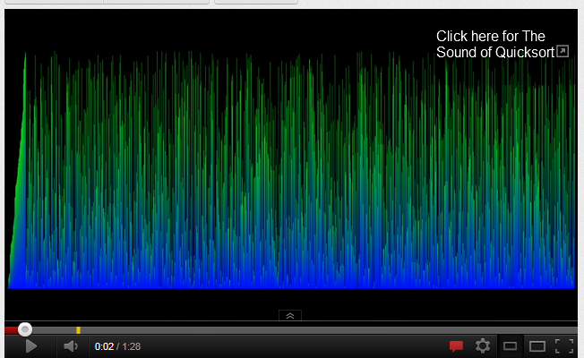
Alternative visualization

Slide 8
Stream and Sort Counting → Distributed Counting
Standardized message routing logic
example 1
example 2
example 3
….
C[x1] += D1
C[x1] += D2
….
“C[x] +=D”
Logic to combine counter updates
Counting logic
Sort
Machines A1,…
Machines C1,..,
Machines B1,…,
Trivial to parallelize!
Easy to parallelize!

Slide 9
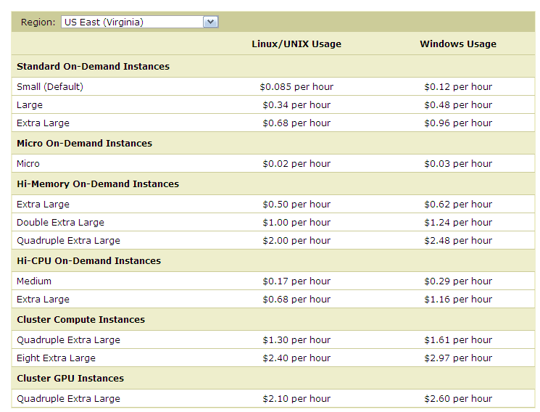
Micro:
0.6G memory
Standard:
S: 1.7Gb
L: 7.5Gb
XL: 15Mb
Hi Memory:
XXL: 34.2
XXXXL: 68.4

Slide 10
Last Week
How to implement Naïve Bayes
  Time is linear in size of data (one scan!)
  We need to count C( X=word ^ Y=label)
How to implement Naïve Bayes with large vocabulary and small memory
  General technique: “Stream and sort”
    Very little seeking (only in merges in merge sort)
    Memory-efficient
Question:
  did you see the tragic flaw in our implementation?

Slide 11
Large-vocabulary Naïve Bayes
Y=business += 1
Y=business += 1
…
Y=business ^ X =aaa += 1
…
Y=business ^ X=zynga += 1
Y=sports ^ X=hat += 1
Y=sports ^ X=hockey += 1
Y=sports ^ X=hockey += 1
Y=sports ^ X=hockey += 1
…
Y=sports ^ X=hoe += 1
…
Y=sports += 1
…
Create a hashtable C
For each example id, y, x₁,….,x_{d} in train:
  C(“Y=ANY”) ++; C(“Y=y”) ++
  Print “Y=ANY += 1”
  Print “Y=y += 1”
  For j in 1..d:
    C(“Y=y ^ X=x_{j}”) ++
    Print “Y=y ^ X=x_{j} += 1”
Sort the event-counter update “messages”
  We’re collecting together messages about the same counter
Scan and add the sorted messages and output the final counter values

Slide 12
Large-vocabulary Naïve Bayes
Scan-and-add:
streaming
previousKey = Null
sumForPreviousKey = 0
For each (event,delta) in input:
  If event==previousKey
    sumForPreviousKey += delta
  Else
    OutputPreviousKey()
    previousKey = event
    sumForPreviousKey = delta
OutputPreviousKey()
define OutputPreviousKey():
If PreviousKey!=Null
  print PreviousKey,sumForPreviousKey
Y=business += 1
Y=business += 1
…
Y=business ^ X =aaa += 1
…
Y=business ^ X=zynga += 1
Y=sports ^ X=hat += 1
Y=sports ^ X=hockey += 1
Y=sports ^ X=hockey += 1
Y=sports ^ X=hockey += 1
…
Y=sports ^ X=hoe += 1
…
Y=sports += 1
…
Accumulating the event counts requires constant storage … as long as the input is sorted.

Slide 13
Flaw: Large-vocabulary Naïve Bayes is Expensive to Use
For each example id, y, x₁,….,x_{d} in test:
Sort the event-counter update “messages”
Scan and add the sorted messages and output the final counter values
For each example id, y, x₁,….,x_{d} in test:
  For each y’ in dom(Y):
    Compute log Pr(y’,x₁,….,x_{d}) =
Model size: max O(n), O(|V||dom(Y)|)

Slide 14
The workaround I suggested
For each example id, y, x₁,….,x_{d} in test:
Sort the event-counter update “messages”
Scan and add the sorted messages and output the final counter values
Initialize a HashSet NEEDED and a hashtable C
For each example id, y, x₁,….,x_{d} in test:
  Add x₁,….,x_{d} to NEEDED
For each event, C(event) in the summed counters
  If event involves a NEEDED term x read it into C
For each example id, y, x₁,….,x_{d} in test:
  For each y’ in dom(Y):
    Compute log Pr(y’,x₁,….,x_{d}) = ….

Slide 15
Can we do better?
First some more examples of stream-and-sort….

Slide 16
Some other stream and sort tasks
Coming up: classify Wikipedia pages
  Features:
    words on page: src w₁ w₂ ….
    outlinks from page: src dst₁ dst₂ …
    how about inlinks to the page?

Slide 17
Some other stream and sort tasks
    outlinks from page: src dst₁ dst₂ …
  Algorithm:
    For each input line src dst₁ dst₂ … dst_{n} print out
      dst₁ inlinks.= src
      dst₂ inlinks.= src
      …
      dst_{n} inlinks.= src
    Sort this output
    Collect the messages and group to get
      dst src₁ src₂ … src_{n}

Slide 18
Some other stream and sort tasks
prevKey = Null
sumForPrevKey = 0
For each (event += delta) in input:
  If event==prevKey
    sumForPrevKey += delta
  Else
    OutputPrevKey()
    prevKey = event
    sumForPrevKey = delta
OutputPrevKey()
define OutputPrevKey():
If PrevKey!=Null
  print PrevKey,sumForPrevKey
prevKey = Null
linksToPrevKey = [ ]
For each (dst inlinks.= src) in input:
  If dst==prevKey
    linksPrevKey.append(src)
  Else
    OutputPrevKey()
    prevKey = dst
    linksToPrevKey=[src]
OutputPrevKey()
define OutputPrevKey():
If PrevKey!=Null
  print PrevKey, linksToPrevKey

Slide 19
Some other stream and sort tasks
What if we run this same program on the words on a page?
  Features:
    words on page: src w₁ w₂ ….
    outlinks from page: src dst₁ dst₂ …
Out2In.java
w₁ src_{1,1} src_{1,2} src_{1,3} ….
w₂ src_{2,1} …
…
an inverted index for the documents

Slide 20
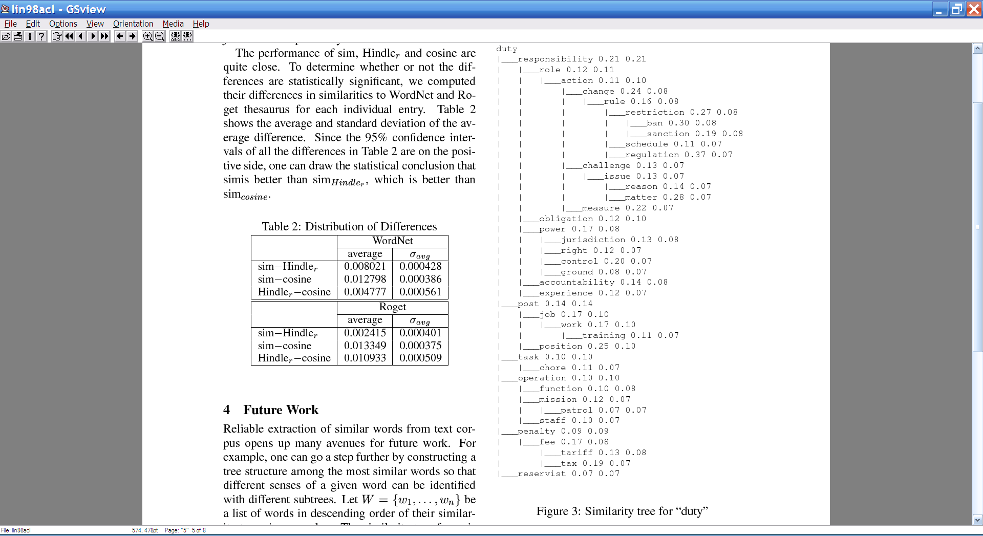
Some other stream and sort tasks
Later on: distributional clustering of words

Slide 21
Some other stream and sort tasks
Later on: distributional clustering of words
Algorithm:
For each word w in a corpus print w and the words in a window around it
  Print “wi context .= (w_{i-k},…,w_{i-1},w_{i+1},…,w_{i+k} )”
Sort the messages and collect all contexts for each w – thus creating an instance associated with w
Cluster the dataset
  Or train a classifier and classify it

Slide 22
Some other stream and sort tasks
prevKey = Null
sumForPrevKey = 0
For each (event += delta) in input:
  If event==prevKey
    sumForPrevKey += delta
  Else
    OutputPrevKey()
    prevKey = event
    sumForPrevKey = delta
OutputPrevKey()
define OutputPrevKey():
If PrevKey!=Null
  print PrevKey,sumForPrevKey
prevKey = Null
ctxOfPrevKey = [ ]
For each (w c.= w₁,…,w_{k}) in input:
  If dst==prevKey
    ctxOfPrevKey.append(
      w₁,…,w_{k} )
  Else
    OutputPrevKey()
    prevKey = w
    ctxOfPrevKey=[w₁,..,w_{k}]
OutputPrevKey()
define OutputPrevKey():
If PrevKey!=Null
  print PrevKey, ctxOfPrevKey

Slide 23
Some other stream and sort tasks
Finding unambiguous geographical names
GeoNames.org: for each place in its database, stores
  Several alternative names
  Latitude/Longitude
  …
Lets you put places on a map (e.g., Google Maps)
Problem: many names are ambiguous, especially if you allow an approximate match
  Paris, London, … even Carnegie Mellon

Slide 24
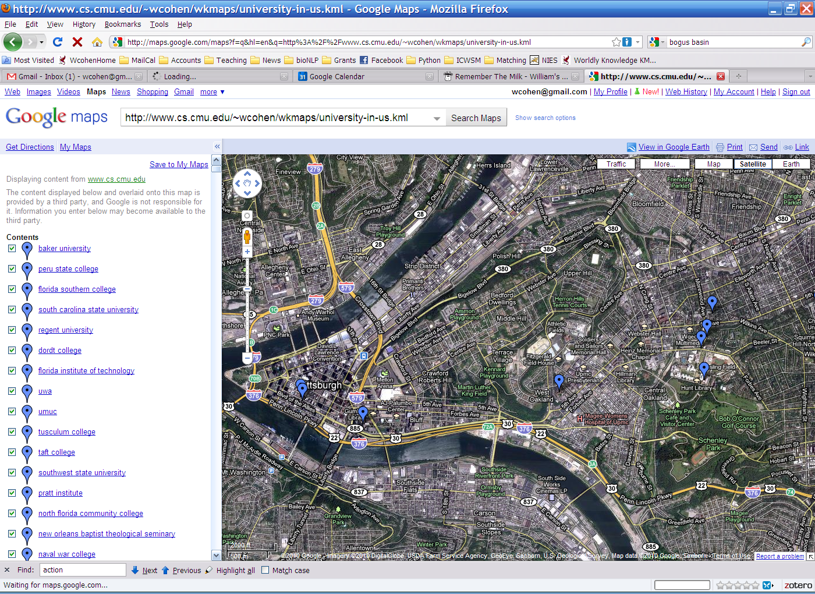
Point Park (College|University)
Carnegie Mellon [University [School]]

Slide 25
Some other stream and sort tasks
Finding almost unambiguous geographical names
  Input:
    O(100k) strings, e.g. s₁₃₇ = “Carnegie Mellon University”
    GeoNames.org: large database of lat/long locations with many alternative names
  Algorithm:
    For each geoname <x,y; p1,p2,….,p3>
      For each string si that matches any pj
        Output “si matches pj at x,y”
    Sort
    Scan through output and filter out strings with almost all matches nearby:
      s₁₃₇ matches Carnegie Mellon University at lat1,lon1
      s₁₃₇ matches Carnegie Mellon at lat1,lon1
      s₁₃₇ matches Mellon University at lat1,lon1
      s₁₃₇ matches Carnegie Mellon School at lat2,lon2
      s₁₃₇ matches Carnegie Mellon at lat2,lon2
      s₁₃₈ matches ….
    …

Slide 26
Some other stream and sort tasks
prevKey = Null
sumForPrevKey = 0
For each (event += delta) in input:
  If event==prevKey
    sumForPrevKey += delta
  Else
    OutputPrevKey()
    prevKey = event
    sumForPrevKey = delta
OutputPrevKey()
define OutputPrevKey():
If PrevKey!=Null
  print PrevKey,sumForPrevKey
prevKey = Null
locOfPrevKey = Gaussian()
For each (place at lat,lon) in input:
  If dst==prevKey
    locOfPrevKey.observe(lat, lon)
  Else
    OutputPrevKey()
    prevKey = place
    locOfPrevKey = Gaussian()
    locOfPrevKey.observe(lat, lon)
OutputPrevKey()
define OutputPrevKey():
If PrevKey!=Null and locOfPrevKey.stdDev() < 1 mile
  print PrevKey, locOfPrevKey.avg()

Slide 27
Flaw: Large-vocabulary Naïve Bayes is Expensive to Use
For each example id, y, x₁,….,x_{d} in test:
Sort the event-counter update “messages”
Scan and add the sorted messages and output the final counter values
For each example id, y, x₁,….,x_{d} in test:
  For each y’ in dom(Y):
    Compute log Pr(y’,x₁,….,x_{d}) =
Model size: max O(n), O(|V||dom(Y)|)

Slide 28
Can we do better?
Test data
Event counts
id₁ w_{1,1} w_{1,2} w_{1,3} …. w_{1,k1}
id₂ w_{2,1} w_{2,2} w_{2,3} ….
id₃ w_{3,1} w_{3,2} ….
id₄ w_{4,1} w_{4,2} …
id₅ w_{5,1} w_{5,2} ….
..
X=w₁^Y=sports
X=w₁^Y=worldNews
X=..
X=w₂^Y=…
X=…
…
5245
1054
2120
37
3
…
What we’d like
id₁ w_{1,1} w_{1,2} w_{1,3} …. w_{1,k1}
id₂ w_{2,1} w_{2,2} w_{2,3} ….
id₃ w_{3,1} w_{3,2} ….
id₄ w_{4,1} w_{4,2} …
C[X=w_{1,1}^Y=sports]=5245, C[X=w_{1,1}^Y=..],C[X=w_{1,2}^…]
C[X=w_{2,1}^Y=….]=1054,…, C[X=w_{2,k2}^…]
C[X=w_{3,1}^Y=….]=…
…

Slide 29
Can we do better?
Event counts
X=w₁^Y=sports
X=w₁^Y=worldNews
X=..
X=w₂^Y=…
X=…
…
5245
1054
2120
37
3
…
Step 1: group counters by word w
How:
Stream and sort:
  for each C[X=w^Y=y]=n
    print “w C[Y=y]=n”
  sort and build a list of values associated with each key w
w | Counts associated with W
aardvark | C[w^Y=sports]=2
agent | C[w^Y=sports]=1027,C[w^Y=worldNews]=564
… | …
zynga | C[w^Y=sports]=21,C[w^Y=worldNews]=4464

Slide 30
If these records were in a key-value DB we would know what to do….
Test data
Record of all event counts for each word
id₁ w_{1,1} w_{1,2} w_{1,3} …. w_{1,k1}
id₂ w_{2,1} w_{2,2} w_{2,3} ….
id₃ w_{3,1} w_{3,2} ….
id₄ w_{4,1} w_{4,2} …
id₅ w_{5,1} w_{5,2} ….
..
w | Counts associated with W
aardvark | C[w^Y=sports]=2
agent | C[w^Y=sports]=1027,C[w^Y=worldNews]=564
… | …
zynga | C[w^Y=sports]=21,C[w^Y=worldNews]=4464
Step 2: stream through and for each test case
id_{i} w_{i,1} w_{i,2} w_{i,3} …. w_{i,ki}
request the event counters needed to classify id_{i} from the event-count DB, then classify using the answers
Classification logic

Slide 31
Is there a stream-and-sort analog of this request-and-answer pattern?
Test data
Record of all event counts for each word
id₁ w_{1,1} w_{1,2} w_{1,3} …. w_{1,k1}
id₂ w_{2,1} w_{2,2} w_{2,3} ….
id₃ w_{3,1} w_{3,2} ….
id₄ w_{4,1} w_{4,2} …
id₅ w_{5,1} w_{5,2} ….
..
w | Counts associated with W
aardvark | C[w^Y=sports]=2
agent | C[w^Y=sports]=1027,C[w^Y=worldNews]=564
… | …
zynga | C[w^Y=sports]=21,C[w^Y=worldNews]=4464
Step 2: stream through and for each test case
id_{i} w_{i,1} w_{i,2} w_{i,3} …. w_{i,ki}
request the event counters needed to classify id_{i} from the event-count DB, then classify using the answers
Classification logic

Slide 32
Recall: Stream and Sort Counting: sort messages so the recipient can stream through them
example 1
example 2
example 3
….
C[x1] += D1
C[x1] += D2
….
“C[x] +=D”
Logic to combine counter updates
Sort
Counting logic
Machine A
Machine C
Machine B

Slide 33
Is there a stream-and-sort analog of this request-and-answer pattern?
Test data
Record of all event counts for each word
id₁ w_{1,1} w_{1,2} w_{1,3} …. w_{1,k1}
id₂ w_{2,1} w_{2,2} w_{2,3} ….
id₃ w_{3,1} w_{3,2} ….
id₄ w_{4,1} w_{4,2} …
id₅ w_{5,1} w_{5,2} ….
..
w | Counts associated with W
aardvark | C[w^Y=sports]=2
agent | C[w^Y=sports]=1027,C[w^Y=worldNews]=564
… | …
zynga | C[w^Y=sports]=21,C[w^Y=worldNews]=4464
W_{1,1} counters to id₁
W_{1,2} counters to id₂
…
W_{i,j} counters to id_{i}
…
Classification logic

Slide 34
Is there a stream-and-sort analog of this request-and-answer pattern?
Test data
Record of all event counts for each word
id₁ found an aarvark in zynga’s farmville today!
id₂ …
id₃ ….
id₄ …
id₅ …
..
w | Counts associated with W
aardvark | C[w^Y=sports]=2
agent | C[w^Y=sports]=1027,C[w^Y=worldNews]=564
… | …
zynga | C[w^Y=sports]=21,C[w^Y=worldNews]=4464
found ctrs to id₁
aardvark ctrs to id₁
…
today ctrs to id₁
…
Classification logic

Slide 35
Is there a stream-and-sort analog of this request-and-answer pattern?
Test data
Record of all event counts for each word
id₁ found an aarvark in zynga’s farmville today!
id₂ …
id₃ ….
id₄ …
id₅ …
..
w | Counts associated with W
aardvark | C[w^Y=sports]=2
agent | C[w^Y=sports]=1027,C[w^Y=worldNews]=564
… | …
zynga | C[w^Y=sports]=21,C[w^Y=worldNews]=4464
~ is the last ascii character
% export LC_COLLATE=C
means that it will sort after anything else with unix sort
found ~ctrs to id₁
aardvark ~ctrs to id₁
…
today ~ctrs to id₁
…
Classification logic

Slide 36
Is there a stream-and-sort analog of this request-and-answer pattern?
Test data
Record of all event counts for each word
id₁ found an aardvark in zynga’s farmville today!
id₂ …
id₃ ….
id₄ …
id₅ …
..
w | Counts associated with W
aardvark | C[w^Y=sports]=2
agent | C[w^Y=sports]=1027,C[w^Y=worldNews]=564
… | …
zynga | C[w^Y=sports]=21,C[w^Y=worldNews]=4464
Counter records
found ~ctr to id₁
aardvark ~ctr to id₂
…
today ~ctr to id_{i}
…
Classification logic
Combine and sort
requests

Slide 37
A stream-and-sort analog of the request-and-answer pattern…
w | Counts
aardvark | C[w^Y=sports]=2
aardvark | ~ctr to id1
agent | C[w^Y=sports]=…
agent | ~ctr to id345
agent | ~ctr to id9854
… | ~ctr to id345
agent | ~ctr to id34742
…
zynga | C[…]
zynga | ~ctr to id1
Record of all event counts for each word
w | Counts
aardvark | C[w^Y=sports]=2
agent | …
…
zynga | …
Counter records
found ~ctr to id₁
aardvark ~ctr to id₁
…
today ~ctr to id₁
…
Combine and sort
Request-handling logic
requests

Slide 38
A stream-and-sort analog of the request-and-answer pattern…
w | Counts
aardvark | C[w^Y=sports]=2
aardvark | ~ctr to id1
agent | C[w^Y=sports]=…
agent | ~ctr to id345
agent | ~ctr to id9854
… | ~ctr to id345
agent | ~ctr to id34742
…
zynga | C[…]
zynga | ~ctr to id1
previousKey = somethingImpossible
For each (key,val) in input:
  If key==previousKey
    Answer(recordForPrevKey,val)
  Else
    previousKey = key
    recordForPrevKey = val
define Answer(record,request):
find id where “request = ~ctr to id”
print “id ~ctr for request is record”
Combine and sort
Request-handling logic
requests

Slide 39
A stream-and-sort analog of the request-and-answer pattern…
w | Counts
aardvark | C[w^Y=sports]=2
aardvark | ~ctr to id1
agent | C[w^Y=sports]=…
agent | ~ctr to id345
agent | ~ctr to id9854
… | ~ctr to id345
agent | ~ctr to id34742
…
zynga | C[…]
zynga | ~ctr to id1
previousKey = somethingImpossible
For each (key,val) in input:
  If key==previousKey
    Answer(recordForPrevKey,val)
  Else
    previousKey = key
    recordForPrevKey = val
define Answer(record,request):
find id where “request = ~ctr to id”
print “id ~ctr for request is record”
Output:
id1 ~ctr for aardvark is C[w^Y=sports]=2
…
id1 ~ctr for zynga is ….
…
Combine and sort
Request-handling logic
requests

Slide 40
A stream-and-sort analog of the request-and-answer pattern…
w | Counts
aardvark | C[w^Y=sports]=2
aardvark | ~ctr to id1
agent | C[w^Y=sports]=…
agent | ~ctr to id345
agent | ~ctr to id9854
… | ~ctr to id345
agent | ~ctr to id34742
…
zynga | C[…]
zynga | ~ctr to id1
Output:
id1 ~ctr for aardvark is C[w^Y=sports]=2
…
id1 ~ctr for zynga is ….
…
id₁ found an aardvark in zynga’s farmville today!
id₂ …
id₃ ….
id₄ …
id₅ …
..
Request-handling logic
Combine and sort
????

Slide 41
What we’d wanted
id₁ w_{1,1} w_{1,2} w_{1,3} …. w_{1,k1}
id₂ w_{2,1} w_{2,2} w_{2,3} ….
id₃ w_{3,1} w_{3,2} ….
id₄ w_{4,1} w_{4,2} …
C[X=w_{1,1}^Y=sports]=5245, C[X=w_{1,1}^Y=..],C[X=w_{1,2}^…]
C[X=w_{2,1}^Y=….]=1054,…, C[X=w_{2,k2}^…]
C[X=w_{3,1}^Y=….]=…
…
What we ended up with
Key | Value
id1 | found aardvark zynga farmville today
 | ~ctr for aardvark is C[w^Y=sports]=2
 | ~ctr for found is C[w^Y=sports]=1027,C[w^Y=worldNews]=564
 | …
id2 | w_{2,1} w_{2,2} w_{2,3} ….
 | ~ctr for w_{2,1} is …
… | …

Slide 42
Implementation summary
java CountForNB train.dat … > eventCounts.dat
java CountsByWord eventCounts.dat | sort
| java CollectRecords > words.dat
java requestWordCounts test.dat
| cat - words.dat | sort | java answerWordCountRequests
| cat - test.dat| sort | testNBUsingRequests
train.dat
counts.dat
id₁ w_{1,1} w_{1,2} w_{1,3} …. w_{1,k1}
id₂ w_{2,1} w_{2,2} w_{2,3} ….
id₃ w_{3,1} w_{3,2} ….
id₄ w_{4,1} w_{4,2} …
id₅ w_{5,1} w_{5,2} ….
..
X=w1^Y=sports
X=w1^Y=worldNews
X=..
X=w2^Y=…
X=…
…
5245
1054
2120
37
3
…

Slide 43
Implementation summary
java CountForNB train.dat … > eventCounts.dat
java CountsByWord eventCounts.dat | sort
| java CollectRecords > words.dat
java requestWordCounts test.dat
| cat - words.dat | sort | java answerWordCountRequests
| cat - test.dat| sort | testNBUsingRequests
words.dat
w | Counts associated with W
aardvark | C[w^Y=sports]=2
agent | C[w^Y=sports]=1027,C[w^Y=worldNews]=564
… | …
zynga | C[w^Y=sports]=21,C[w^Y=worldNews]=4464

Slide 44
Implementation summary
java CountForNB train.dat … > eventCounts.dat
java CountsByWord eventCounts.dat | sort
| java CollectRecords > words.dat
java requestWordCounts test.dat
| cat - words.dat | sort | java answerWordCountRequests
| cat - test.dat| sort | testNBUsingRequests
output looks like this
input looks like this
words.dat
found ~ctr to id₁
aardvark ~ctr to id₂
…
today ~ctr to id_{i}
…
w | Counts
aardvark | C[w^Y=sports]=2
agent | …
…
zynga | …
w | Counts
aardvark | C[w^Y=sports]=2
aardvark | ~ctr to id1
agent | C[w^Y=sports]=…
agent | ~ctr to id345
agent | ~ctr to id9854
… | ~ctr to id345
agent | ~ctr to id34742
…
zynga | C[…]
zynga | ~ctr to id1

Slide 45
Implementation summary
java CountForNB train.dat … > eventCounts.dat
java CountsByWord eventCounts.dat | sort
| java CollectRecords > words.dat
java requestWordCounts test.dat
| tees words.dat | sort | java answerWordCountRequests
| tee test.dat| sort | testNBUsingRequests
Output looks like this
Output:
id1 ~ctr for aardvark is C[w^Y=sports]=2
…
id1 ~ctr for zynga is ….
…
test.dat
id₁ found an aardvark in zynga’s farmville today!
id₂ …
id₃ ….
id₄ …
id₅ …
..

Slide 46
Implementation summary
java CountForNB train.dat … > eventCounts.dat
java CountsByWord eventCounts.dat | sort
| java CollectRecords > words.dat
java requestWordCounts test.dat
| tees words.dat | sort | java answerWordCountRequests
| tee test.dat| sort | testNBUsingRequests
Input looks like this
Key | Value
id1 | found aardvark zynga farmville today
 | ~ctr for aardvark is C[w^Y=sports]=2
 | ~ctr for found is C[w^Y=sports]=1027,C[w^Y=worldNews]=564
 | …
id2 | w_{2,1} w_{2,2} w_{2,3} ….
 | ~ctr for w_{2,1} is …
… | …

Slide 47
Outline
Even more on stream-and-sort and naïve Bayes
Another problem: “meaningful” phrase finding
Implementing phrase finding efficiently
Some other phrase-related problems

Slide 48
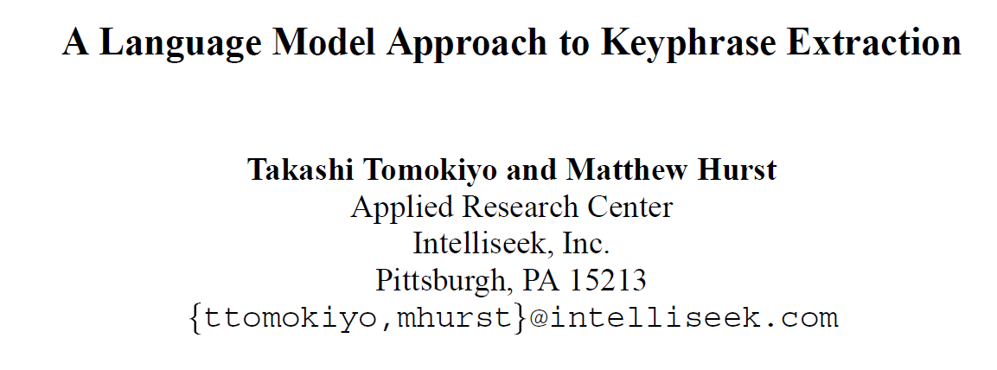
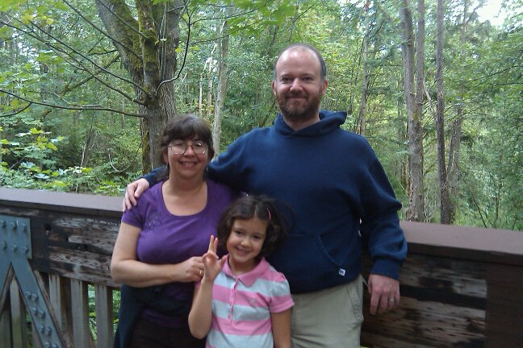
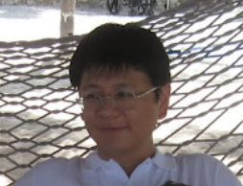


Slide 49
ACL Workshop 2003

Slide 50
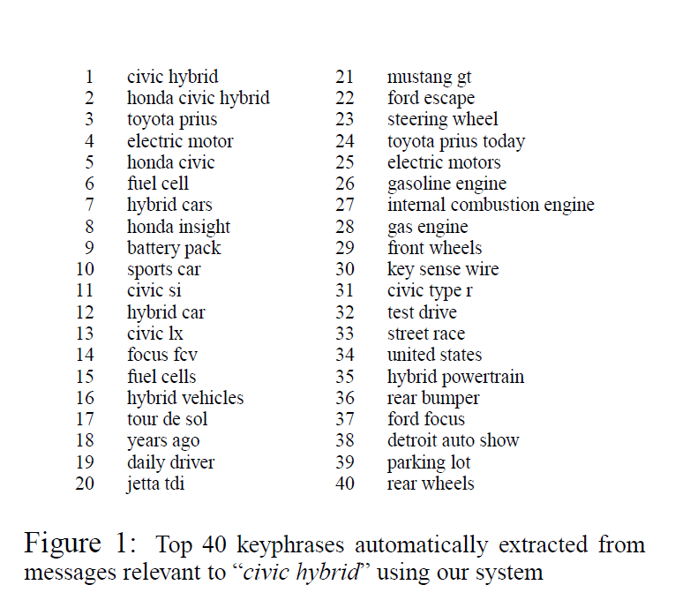

Slide 51
Why phrase-finding?
There are lots of phrases
There’s not supervised data
It’s hard to articulate
  What makes a phrase a phrase, vs just an n-gram?
    a phrase is independently meaningful (“test drive”, “red meat”) or not (“are interesting”, “are lots”)
  What makes a phrase interesting?

Slide 52
The breakdown: what makes a good phrase
Two properties:
  Phraseness: “the degree to which a given word sequence is considered to be a phrase”
    Statistics: how often words co-occur together vs separately
  Informativeness: “how well a phrase captures or illustrates the key ideas in a set of documents” – something novel and important relative to a domain
    Background corpus and foreground corpus; how often phrases occur in each

Slide 53
“Phraseness”₁ – based on BLRT
Binomial Ratio Likelihood Test (BLRT):
  Draw samples:
    n₁ draws, k₁ successes
    n₂ draws, k₂ successes
    Are they from one binominal (i.e., k₁/n₁ and k₂/n₂ were different due to chance) or from two distinct binomials?
  Define
    p₁=k₁ / n₁, p₂=k₂ / n_{2,} p=(k₁+k₂)/(n₁+n₂),
    L(p,k,n) = p^{k}(1-p)^{n-k}

Slide 54
“Phraseness”₁ – based on BLRT
Binomial Ratio Likelihood Test (BLRT):
  Draw samples:
    n₁ draws, k₁ successes
    n₂ draws, k₂ successes
    Are they from one binominal (i.e., k₁/n₁ and k₂/n₂ were different due to chance) or from two distinct binomials?
  Define
    p_{i}=k_{i}/n_{i}, p=(k₁+k₂)/(n₁+n₂),
    L(p,k,n) = p^{k}(1-p)^{n-k}

Slide 55
“Phraseness”₁ – based on BLRT
  Define
    p_{i}=k_{i} /n_{i}, p=(k₁+k₂)/(n₁+n₂),
    L(p,k,n) = p^{k}(1-p)^{n-k}
Phrase x y: W₁=x ^ W₂=y
 |  | comment
k₁ | C(W₁=x ^ W₂=y) | how often bigram x y occurs in corpus C
n₁ | C(W₁=x) | how often word x occurs in corpus C
k₂ | C(W₁≠x^W₂=y) | how often y occurs in C after a non-x
n₂ | C(W₁≠x) | how often a non-x occurs in C
Does y occur at the same frequency after x as in other positions?

Slide 56
“Informativeness”₁ – based on BLRT
  Define
    p_{i}=k_{i} /n_{i}, p=(k₁+k₂)/(n₁+n₂),
    L(p,k,n) = p^{k}(1-p)^{n-k}
Phrase x y: W₁=x ^ W₂=y and two corpora, C and B
 |  | comment
k₁ | C(W₁=x ^ W₂=y) | how often bigram x y occurs in corpus C
n₁ | C(W₁=* ^ W₂=*) | how many bigrams in corpus C
k₂ | B(W₁=x^W₂=y) | how often x y occurs in background corpus
n₂ | B(W₁=* ^ W₂=*) | how many bigrams in background corpus
Does x y occur at the same frequency in both corpora?

Slide 57
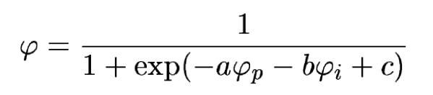
The breakdown: what makes a good phrase
“Phraseness” and “informativeness” are then combined with a tiny classifier, tuned on labeled data.
Background corpus: 20 newsgroups dataset (20k messages, 7.4M words)
Foreground corpus: rec.arts.movies.current-films June-Sep 2002 (4M words)
Results?

Slide 58
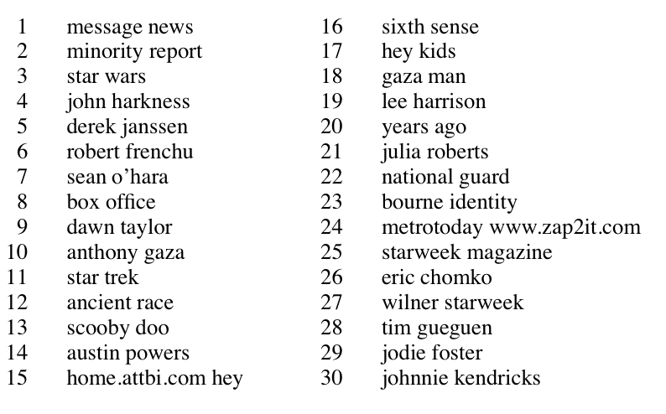

Slide 59
The breakdown: what makes a good phrase
Two properties:
  Phraseness: “the degree to which a given word sequence is considered to be a phrase”
    Statistics: how often words co-occur together vs separately
  Informativeness: “how well a phrase captures or illustrates the key ideas in a set of documents” – something novel and important relative to a domain
    Background corpus and foreground corpus; how often phrases occur in each
  Another intuition: our goal is to compare distributions and see how different they are:
    Phraseness: estimate x y with bigram model or unigram model
    Informativeness: estimate with foreground vs background corpus

Slide 60


The breakdown: what makes a good phrase
  Another intuition: our goal is to compare distributions and see how different they are:
    Phraseness: estimate x y with bigram model or unigram model
    Informativeness: estimate with foreground vs background corpus
  To compare distributions, use KL-divergence
“Pointwise KL divergence”

Slide 61

The breakdown: what makes a good phrase
  To compare distributions, use KL-divergence
Phraseness: difference between bigram and unigram language model in foreground
“Pointwise KL divergence”
Bigram model: P(x y)=P(x)P(y|x)
Unigram model: P(x y)=P(x)P(y)

Slide 62
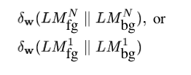

The breakdown: what makes a good phrase
  To compare distributions, use KL-divergence
Informativeness: difference between foreground and background models
“Pointwise KL divergence”
Bigram model: P(x y)=P(x)P(y|x)
Unigram model: P(x y)=P(x)P(y)

Slide 63
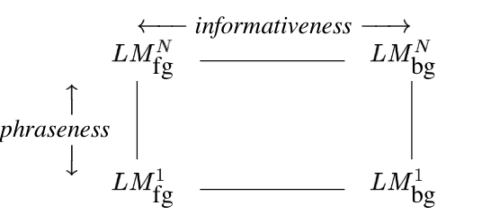
The breakdown: what makes a good phrase
  To compare distributions, use KL-divergence
Combined: difference between foreground bigram model and background unigram model
“Pointwise KL divergence”
Bigram model: P(x y)=P(x)P(y|x)
Unigram model: P(x y)=P(x)P(y)

Slide 64
The breakdown: what makes a good phrase
  To compare distributions, use KL-divergence
Subtle advantages:
BLRT scores “more frequent in foreground” and “more frequent in background” symmetrically, pointwise KL does not.
Phrasiness and informativeness scores are more comparable – straightforward combination w/o a classifier is reasonable.
Language modeling is well-studied:
  extensions to n-grams, smoothing methods, …
  we can build on this work in a modular way
Combined: difference between foreground bigram model and background unigram model

Slide 65
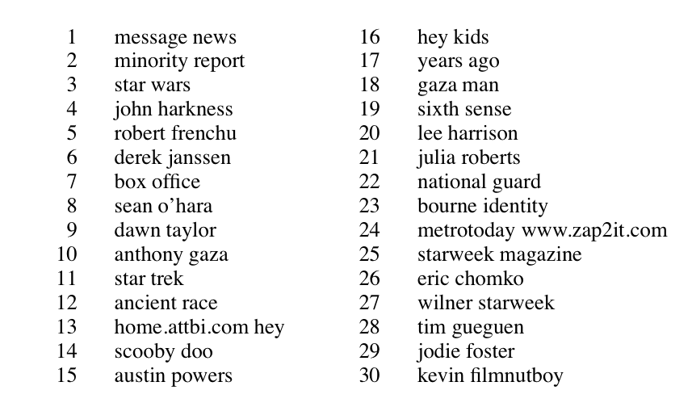
Pointwise KL, combined
Notes:
pointwise KL combined

Slide 66
Why phrase-finding?
Phrases are where the standard supervised “bag of words” representation starts to break.
There’s not supervised data, so it’s hard to see what’s “right” and why
It’s a nice example of using unsupervised signals to solve a task that could be formulated as supervised learning
It’s a nice level of complexity, if you want to do it in a scalable way.

Slide 67
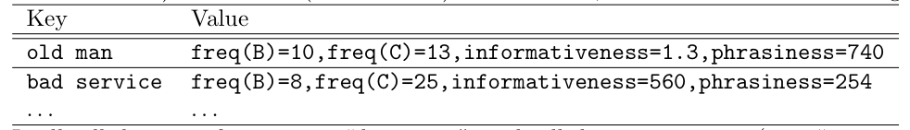
Implementation
Request-and-answer pattern
  Main data structure: tables of key-value pairs
    key is a phrase x y
    value is a mapping from a attribute names (like phraseness, freq-in-B, …) to numeric values.
  Keys and values are just strings
  We’ll operate mostly by sending messages to this data structure and getting results back, or else streaming thru the whole table
  For really big data: we’d also need tables where key is a word and val is set of attributes of the word (freq-in-B, freq-in-C, …)

Slide 68
Generating and scoring phrases: 1
Stream through foreground corpus and count events “W₁=x ^ W₂=y” the same way we do in training naive Bayes: stream-and sort and accumulate deltas (a “sum-reduce”)
  Don’t bother generating boring phrases (e.g., crossing a sentence, contain a stopword, …)
Then stream through the output and convert to phrase, attributes-of-phrase records with one attribute: freq-in-C=n
Stream through foreground corpus and count events “W₁=x” in a (memory-based) hashtable….
This is enough* to compute phrasiness:
  ψ_{p}(x y) = f( freq-in-C(x), freq-in-C(y), freq-in-C(x y))
…so you can do that with a scan through the phrase table that adds an extra attribute (holding word frequencies in memory).
* actually you also need total # words and total #phrases….

Slide 69
Generating and scoring phrases: 2
Stream through background corpus and count events “W₁=x ^ W₂=y” and convert to phrase, attributes-of-phrase records with one attribute: freq-in-B=n
Sort the two phrase-tables: freq-in-B and freq-in-C and run the output through another “reducer” that
  appends together all the attributes associated with the same key, so we now have elements like

Slide 70
Generating and scoring phrases: 3
Scan the through the phrase table one more time and add the informativeness attribute and the overall quality attribute
Summary, assuming word vocabulary n_{W} is small:
Scan foreground corpus C for phrases: O(n_{C}) producing m_{C} phrase records – of course m_{C} << n_{C}
Compute phrasiness: O(m_{C})
Scan background corpus B for phrases: O(n_{B}) producing m_{B}
Sort together and combine records: O(m log m), m=m_{B} + m_{C}
Compute informativeness and combined quality: O(m)
Assumes word counts fit in memory

Slide 71
Ramping it up – keeping word counts out of memory
Goal: records for xy with attributes freq-in-B, freq-in-C, freq-of-x-in-C, freq-of-y-in-C, …
Assume I have built built phrase tables and word tables….how do I incorporate the word attributes into the phrase records?
For each phrase xy, request necessary word frequencies:
  Print “x ~request=freq-in-C,from=xy”
  Print “y ~request=freq-in-C,from=xy”
Sort all the word requests in with the word tables
Scan through the result and generate the answers: for each word w, a₁=n₁,a₂=n₂,….
  Print “xy ~request=freq-in-C,from=w”
Sort the answers in with the xy records
Scan through and augment the xy records appropriately

Slide 72
Generating and scoring phrases: 3
Summary
Scan foreground corpus C for phrases, words: O(n_{C})
  producing m_{C} phrase records, v_{C} word records
Scan phrase records producing word-freq requests: O(m_{C} )
  producing 2m_{C} requests
Sort requests with word records: O((2m_{C} + v_{C} )log(2m_{C} + v_{C}))
= O(m_{C}log m_{C}) since v_{C} < m_{C}
Scan through and answer requests: O(m_{C})
Sort answers with phrase records: O(m_{C}log m_{C})
Repeat 1-5 for background corpus: O(n_{B} + m_{B}logm_{B})
Combine the two phrase tables: O(m log m), m = m_{B} + m_{C}
Compute all the statistics: O(m)

Slide 73
More cool work with phrases
Turney: Thumbs up or thumbs down?: semantic orientation applied to unsupervised classification of reviews.ACL ‘02.
Task: review classification (65-85% accurate, depending on domain)
  Identify candidate phrases (e.g., adj-noun bigrams, using POS tags)
  Figure out the semantic orientation of each phrase using “pointwise mutual information” and aggregate
SO(phrase) = PMI(phrase,'excellent') − PMI(phrase,'poor')

Slide 74
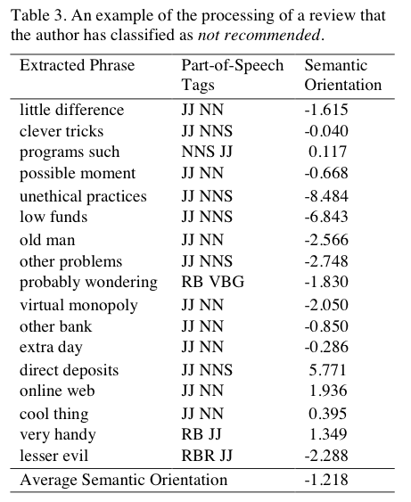
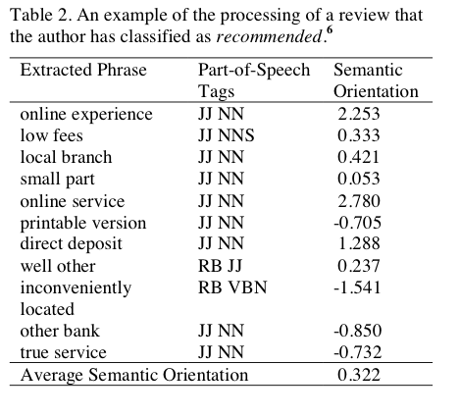

Slide 75
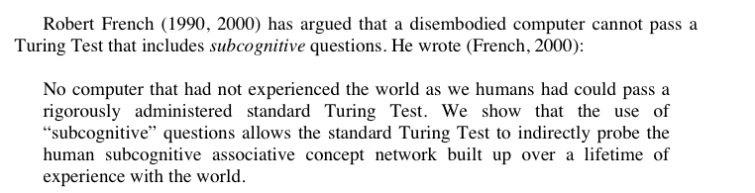
“Answering Subcognitive Turing Test Questions: A Reply to French” - Turney

Slide 76
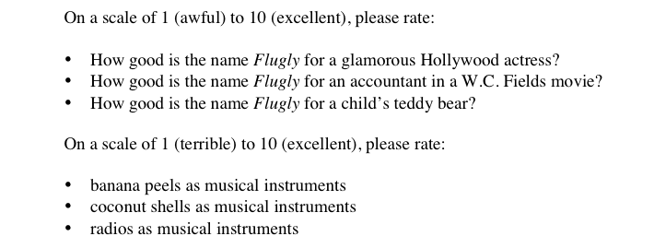
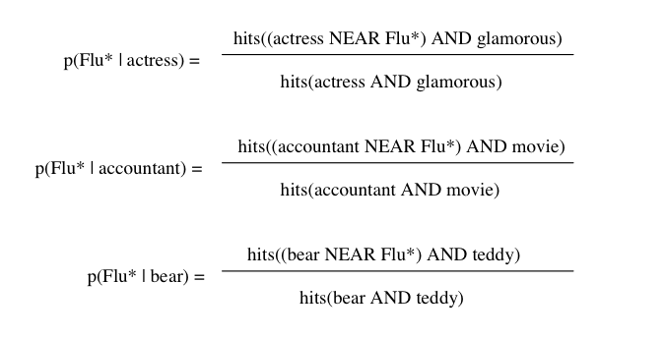
More from Turney
LOW
HIGHER
HIGHEST

Slide 77
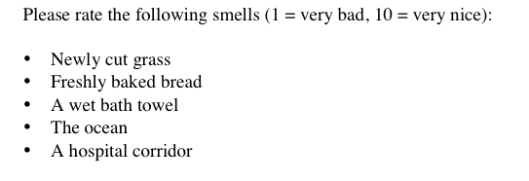

Slide 78
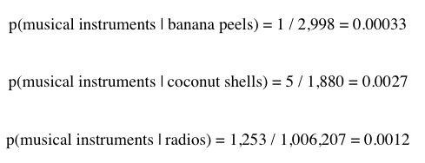

Slide 79
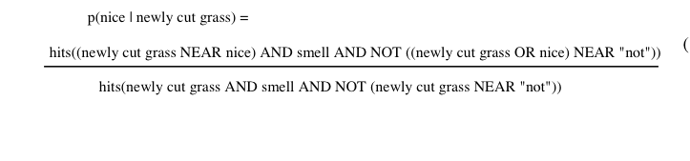
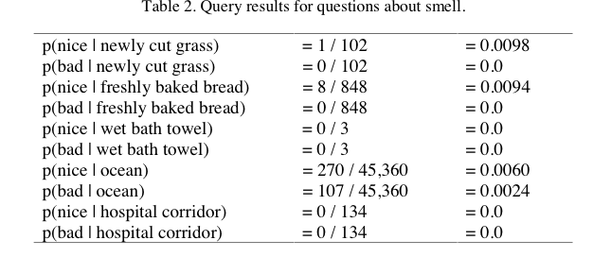

Slide 80
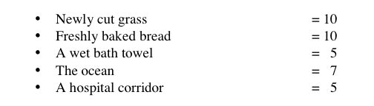

Slide 81


More cool work with phrases
Locating Complex Named Entities in Web Text. Doug Downey, Matthew Broadhead, and Oren Etzioni, IJCAI 2007.
Task: identify complex named entities like “Proctor and Gamble”, “War of 1812”, “Dumb and Dumber”, “Secretary of State William Cohen”, …
Formulation: decide whether to or not to merge nearby sequences of capitalized words axb, using variant of
For k=1, ck is PM (w/o the log). For k=2, ck is “Symmetric Conditional Probability”

Slide 82
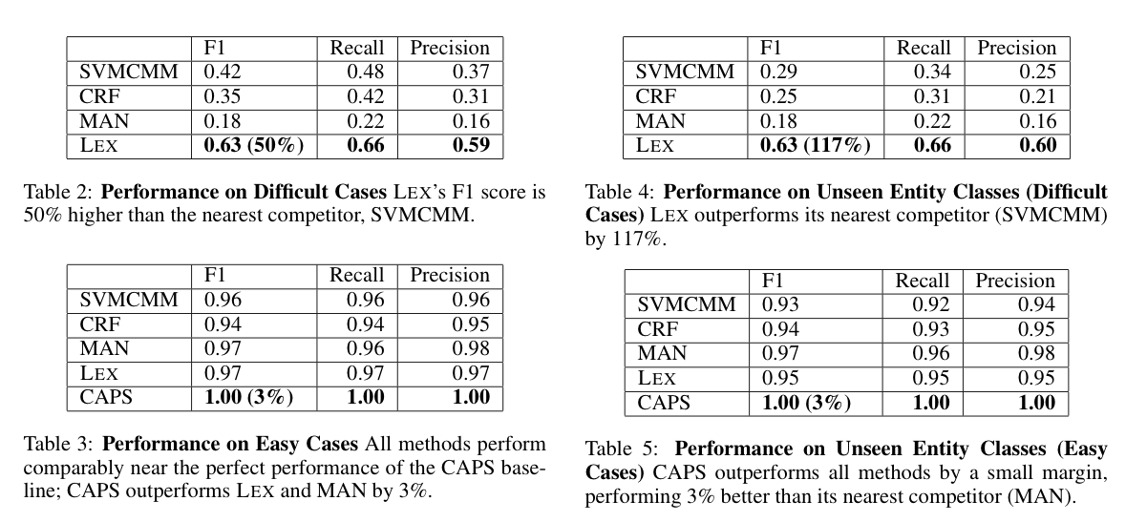
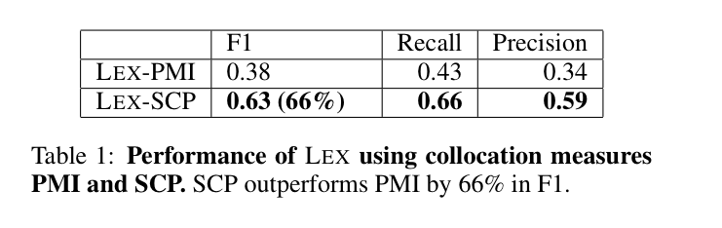
Downey et al results

Slide 83
Outline
Even more on stream-and-sort and naïve Bayes
  Request-answer pattern
Another problem: “meaningful” phrase finding
  Statistics for identifying phrases (or more generally correlations and differences)
  Also using foreground and background corpora
Implementing “phrase finding” efficiently
  Using request-answer
Some other phrase-related problems
  Semantic orientation
  Complex named entity recognition

