Slide 1
S_{1:3}({“fred flintstone”})
h1
h2
h3
0 | 1 | 0 | 1 | 0 | 0 | 0 | 1 | 0
S_{1:3}({“barney rubble”})
h1
h2
h3
1 | 0 | 0 | 1 | 0 | 0 | 1 | 0 | 0
S_{1:3}(({“fred flintstone”,“barney rubble”})
1 | 1 | 0 | 1 | 0 | 0 | 1 | 1 | 0

Slide 2
Bloom filters – a variant
split the bit vector into k ranges, one for each hash function
0 | 0 | 0 | 0 | 0 | 0 | 0 | 0 | 0
bf.contains(“fred flintstore”):
return AND of all hashed bits
h3
h1
h2
1 | 1 | 0 | 1 | 0 | 0 | 1 | 1 | 0
bf.contains(“pebbles”):
h3
h1
h2
1 | 1 | 0 | 1 | 0 | 0 | 1 | 1 | 0

Slide 3
Bloom filters – a variant
split the bit vector into k ranges, one for each hash function
0 | 0 | 0 | 0 | 0 | 0 | 0 | 0 | 0
a false positive!
bf.contains(“pebbles”):
h3
h1
h2
1 | 1 | 0 | 1 | 0 | 0 | 1 | 1 | 0

Slide 4
Bloom Filters → Count-Min Sketches

Slide 5
Count-min sketches
split a real vector into k ranges, one for each hash function
0 | 0 | 0 | 0 | 0 | 0 | 0 | 0 | 0
cm.inc(“fred flintstone”, 3):
add the value to each hash location
h3
h1
h2
0 | 3 | 0 | 3 | 0 | 0 | 0 | 3 | 0
cm.inc(“barney rubble”,5):
h3
h1
h2
5 | 3 | 0 | 8 | 0 | 0 | 5 | 3 | 0

Slide 6
Count-min sketches
split a real vector into k ranges, one for each hash function
0 | 0 | 0 | 0 | 0 | 0 | 0 | 0 | 0
cm.get(“fred flintstone”):
3
take min when retrieving a value
h3
h1
h2
5 | 3 | 0 | 8 | 0 | 0 | 5 | 3 | 0
cm.get(“barney rubble):
5
h3
h1
h2
5 | 3 | 0 | 8 | 0 | 0 | 5 | 3 | 0

Slide 7
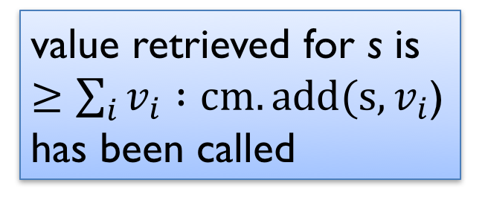
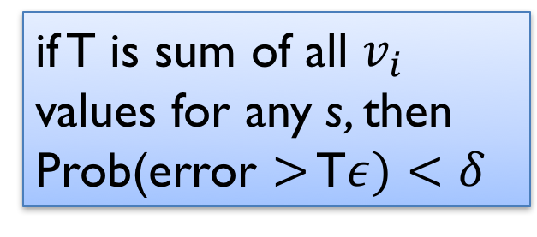
Count-min sketches
split a real vector into k ranges, one for each hash function
value retrieved for s is $≥\sum_{i}{v_{i}} :cm.add(s,v_{i}$) has been called
cm.get(“barney rubble):
h3
h1
h2
5 | 3 | 0 | 8 | 0 | 0 | 5 | 3 | 0
if T is sum of all $v_{i}$ values for any s, then Prob(error $>$ T$ε)<δ$
cm.add(“pebbles”, 2):
h3
h1
h2
7 | 3 | 0 | 10 | 0 | 0 | 5 | 5 | 0

Slide 8


Count-min sketches
Equivalently, use a matrix, and each hash leads to a different row
$$w=2/ε$$
cm.inc(“fred flintstone”, 3):
0 | 3 | 0
3 | 0 | 0
0 | 3 | 0
d = $\log{1/δ}$
cm.inc(“barney rubble”,5):
5 | 3 | 0
8 | 0 | 0
5 | 3 | 0

