Slide 1
Beyond Naïve Bayes:
Some Other Efficient Learning Methods
William W. Cohen

Slide 2
Two fast algorithms
Naïve Bayes: one pass
Rocchio: two passes
  if vocabulary fits in memory
Both method are algorithmically similar
  count and combine
Thought experiment: what if we duplicated some features in our dataset many times?
  e.g., Repeat all words that start with “t” 10 times.

Slide 3
Two fast algorithms
This isn’t silly – often there are features that are “noisy” duplicates, or important phrases of different length
Naïve Bayes: one pass
Rocchio: two passes
  if vocabulary fits in memory
Both method are algorithmically similar
  count and combine
Thought thought thought thought thought thought thought thought thought thought experiment: what if we duplicated some features in our dataset many times times times times times times times times times times?
  e.g., Repeat all words that start with “t” “t” “t” “t” “t” “t” “t” “t” “t” “t” ten ten ten ten ten ten ten ten ten ten times times times times times times times times times times.
  Result: some features will be over-weighted in classifier

Slide 4
Two fast algorithms
This isn’t silly – often there are features that are “noisy” duplicates, or important phrases of different length
Naïve Bayes: one pass
Rocchio: two passes
  if vocabulary fits in memory
Both method are algorithmically similar
  count and combine
Result: some features will be over-weighted in classifier
  unless you can somehow notice are correct for interactions/dependencies between features
Claim: naïve Bayes is fast because it’s naive

Slide 5
Naïve Bayes is a linear algorithm
Naïve Bayes
sparse vector of TF values for each word in the document…plus a “bias” term for f(y)
dense vector of g(x,y) scores for each word in the vocabulary .. plus f(y) to match bias term

Slide 6
One way to look for interactions: on-line, incremental learning
Scan thu data:
whenever we see x with y we increase g(x,y)
whenever we see x with ~y we increase g(x,~y)
Naïve Bayes
dense vector of g(x,y) scores for each word in the vocabulary

Slide 7
One simple way to look for interactions
Train Data
^
instance x_{i}
B
Compute: y_{i} = v_{k} . x_{i}
If mistake: v_{k+1} = v_{k} + correction
+1,-1: label y_{i}
To detect interactions:
increase/decrease v_{k} only if we need to (for that example)
otherwise, leave it unchanged
We can be sensitive to duplication by stopping updates when we get better performance

Slide 8
One simple way to look for interactions
Naïve Bayes – two class version
Scan thru data:
whenever we see x with y we increase g(x,y)-g(x,~y)
whenever we see x with ~y we decrease g(x,y)-g(x,~y)
We do this regardless of whether it seems to help or not on the data….if there are duplications, the weights will become arbitrarily large
To detect interactions:
increase/decrease g(x,y)-g(x,~y) only if we need to (for that example)
otherwise, leave it unchanged
dense vector of g(x,y) scores for each word in the vocabulary

Slide 9
Theory: the prediction game
Player A:
  picks a “target concept” c
    for now - from a finite set of possibilities C (e.g., all decision trees of size m)
  for t=1,….,
    Player A picks x=(x₁,…,x_{n}) and sends it to B
      For now, from a finite set of possibilities (e.g., all binary vectors of length n)
    B predicts a label, ŷ, and sends it to A
    A sends B the true label y=c(x)
    we record if B made a mistake or not
  We care about the worst case number of mistakes B will make over all possible concept & training sequences of any length
    The “Mistake bound” for B, M_{B}(C), is this bound

Slide 10
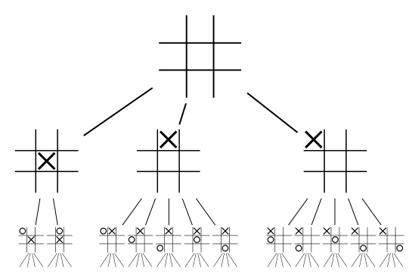
Some possible algorithms for B
not practical – just possible
The “optimal algorithm”
  Build a min-max game tree for the prediction game and use perfect play
C
00
01
10
11
ŷ(01)=0
ŷ(01)=1
y=0
y=1
{c in C:c(01)=1}
{c in C: c(01)=0}

Slide 11
Some possible algorithms for B
not practical – just possible
The “optimal algorithm”
  Build a min-max game tree for the prediction game and use perfect play
Suppose B only makes a mistake on each x a finite number of times k (say k=1).
After each mistake, the set of possible concepts will decrease…so the tree will have bounded size.
C
00
01
10
11
ŷ(01)=0
ŷ(01)=1
y=0
y=1
{c in C:c(01)=1}
{c in C: c(01)=0}

Slide 12
Some possible algorithms for B
not practical – just possible
The “Halving algorithm”
  Remember all the previous examples
  To predict, cycle through all c in the “version space” of consistent concepts in c, and record which predict 1 and which predict 0
  Predict according to the majority vote
Analysis:
  With every mistake, the size of the version space is decreased in size by at least half
  So M_{halving}(C) <= log₂(|C|)

Slide 13
Some possible algorithms for B
The “Halving algorithm”
  Remember all the previous examples
  To predict, cycle through all c in the “version space” of consistent concepts in c, and record which predict 1 and which predict 0
  Predict according to the majority vote
Analysis:
  With every mistake, the size of the version space is decreased in size by at least half
  So M_{halving}(C) <= log₂(|C|)
not practical – just possible
C
00
01
10
11
ŷ(01)=0
ŷ(01)=1
y=0
y=1
{c in C:c(01)=1}
{c in C: c(01)=0}

Slide 14
More results
A set s is “shattered” by C if for any subset s’ of s, there is a c in C that contains all the instances in s’ and none of the instances in s-s’.
The “VC dimension” of C is |s|, where s is the largest set shattered by C.
Notes:
hyperplane – 2d-1

Slide 15
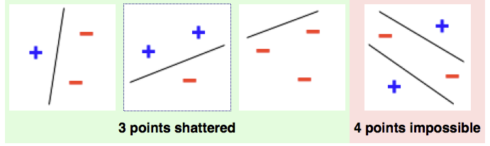
More results
A set s is “shattered” by C if for any subset s’ of s, there is a c in C that contains all the instances in s’ and none of the instances in s-s’.
The “VC dimension” of C is |s|, where s is the largest set shattered by C.
VCdim is closely related to pac-learnability of concepts in C.
Notes:
hyperplane – 2d-1

Slide 16
More results
A set s is “shattered” by C if for any subset s’ of s, there is a c in C that contains all the instances in s’ and none of the instances in s-s’.
The “VC dimension” of C is |s|, where s is the largest set shattered by C.
C
Theorem:
M_{opt}(C)>=VC(C)
Proof: game tree has depth >= VC(C)
00
01
10
11
ŷ(01)=0
ŷ(01)=1
y=0
y=1
{c in C:c(01)=1}
{c in C: c(01)=0}
Notes:
hyperplane – 2d-1

Slide 17
More results
A set s is “shattered” by C if for any subset s’ of s, there is a c in C that contains all the instances in s’ and none of the instances in s-s’.
The “VC dimension” of C is |s|, where s is the largest set shattered by C.
C
Corollary: for finite C
VC(C) <= M_{opt}(C) <= log2(|C|)
00
01
10
11
ŷ(01)=0
ŷ(01)=1
Proof: M_{opt}(C) <= M_{halving}(C)
<=log2(|C|)
y=0
y=1
{c in C:c(01)=1}
{c in C: c(01)=0}
Notes:
hyperplane – 2d-1

Slide 18
More results
A set s is “shattered” by C if for any subset s’ of s, there is a c in C that contains all the instances in s’ and none of the instances in s-s’.
The “VC dimension” of C is |s|, where s is the largest set shattered by C.
Theorem: it can be that
M_{opt}(C) >> VC(C)
Proof: C = set of one-dimensional threshold functions.
-
?
+
Notes:
hyperplane – 2d-1

Slide 19
The prediction game
Are there practical algorithms where we can compute the mistake bound?

Slide 20
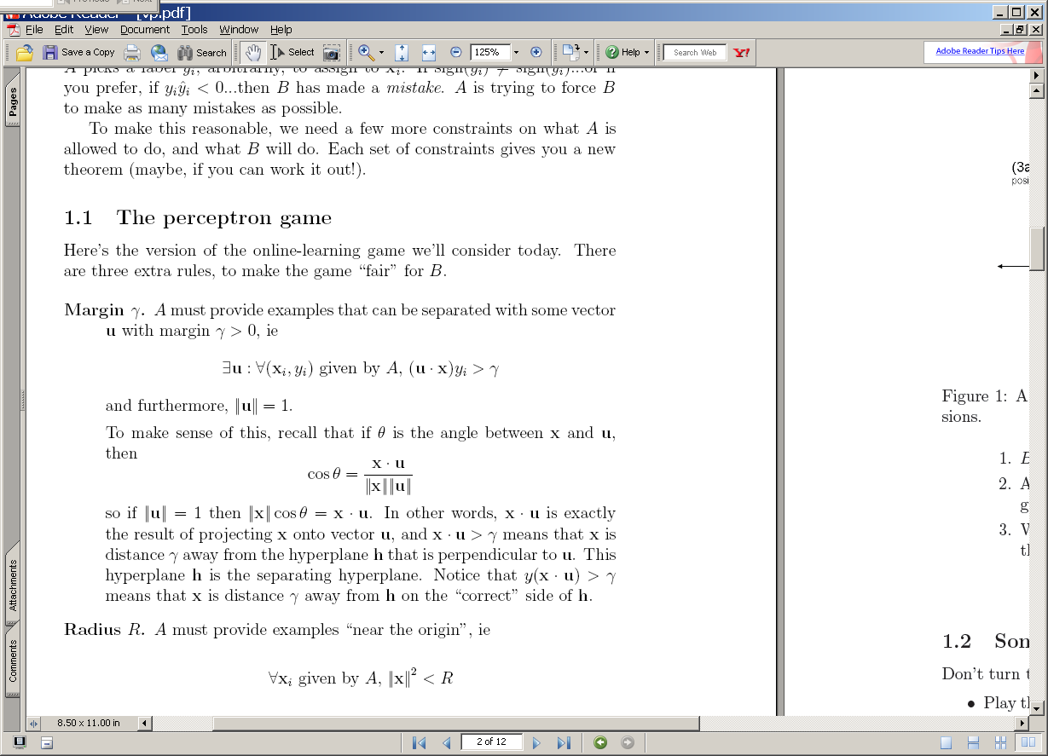
The voted perceptron
^
instance x_{i}
B
Compute: y_{i} = v_{k} . x_{i}
A
^
If mistake: v_{k+1} = v_{k} + y_{i} x_{i}
y_{i}
y_{i}

Slide 21
(1) A target u
(2) The guess v₁ after one positive example.
u
u
v₁
+x₁
-u
-u
2γ
2γ
(3a) The guess v₂ after the two positive examples: v₂=v₁+x₂
(3b) The guess v₂ after the one positive and one negative example: v₂=v₁-x₂
u
u
+x₂
v₂
v₂
v₁
v₁
+x₁
-x₂
-u
-u
2γ
2γ
If mistake: v_{k+1} = v_{k} + y_{i} x_{i}

Slide 22
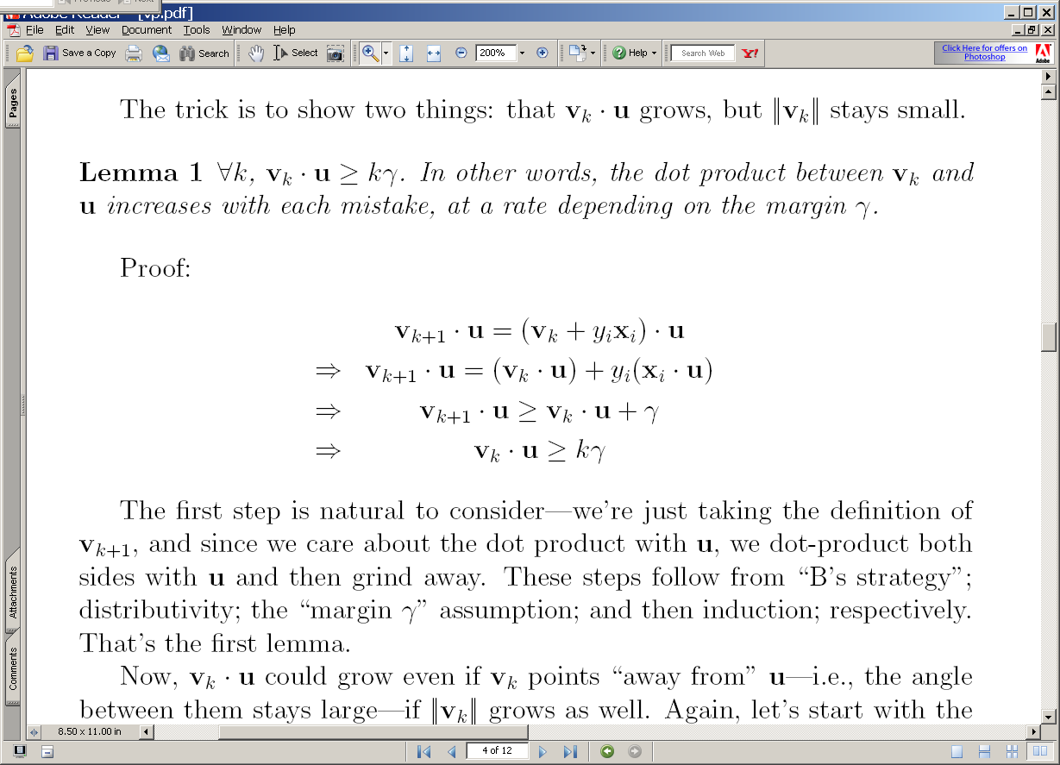
(3a) The guess v₂ after the two positive examples: v₂=v₁+x₂
(3b) The guess v₂ after the one positive and one negative example: v₂=v₁-x₂
u
u
+x₂
v₂
v₂
>γ
v₁
v₁
+x₁
-x₂
-u
-u
2γ
2γ

Slide 23
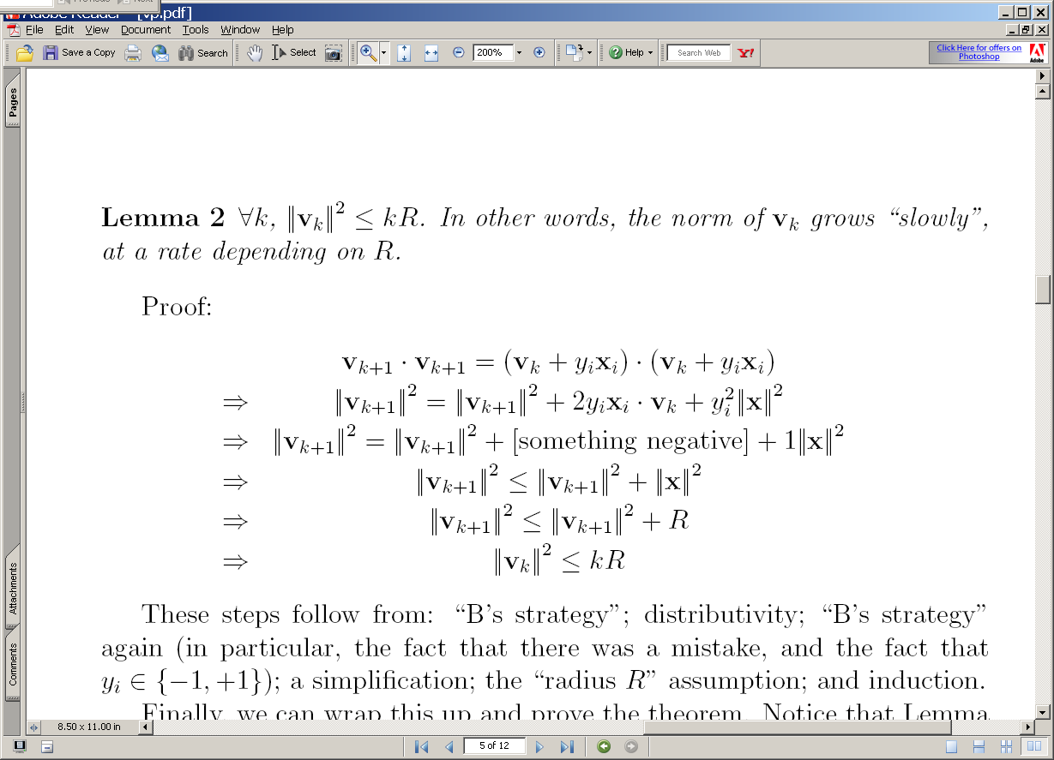
(3a) The guess v₂ after the two positive examples: v₂=v₁+x₂
(3b) The guess v₂ after the one positive and one negative example: v₂=v₁-x₂
u
u
+x₂
v₂
v₂
v₁
v₁
+x₁
-x₂
-u
-u
2γ
2γ

Slide 24
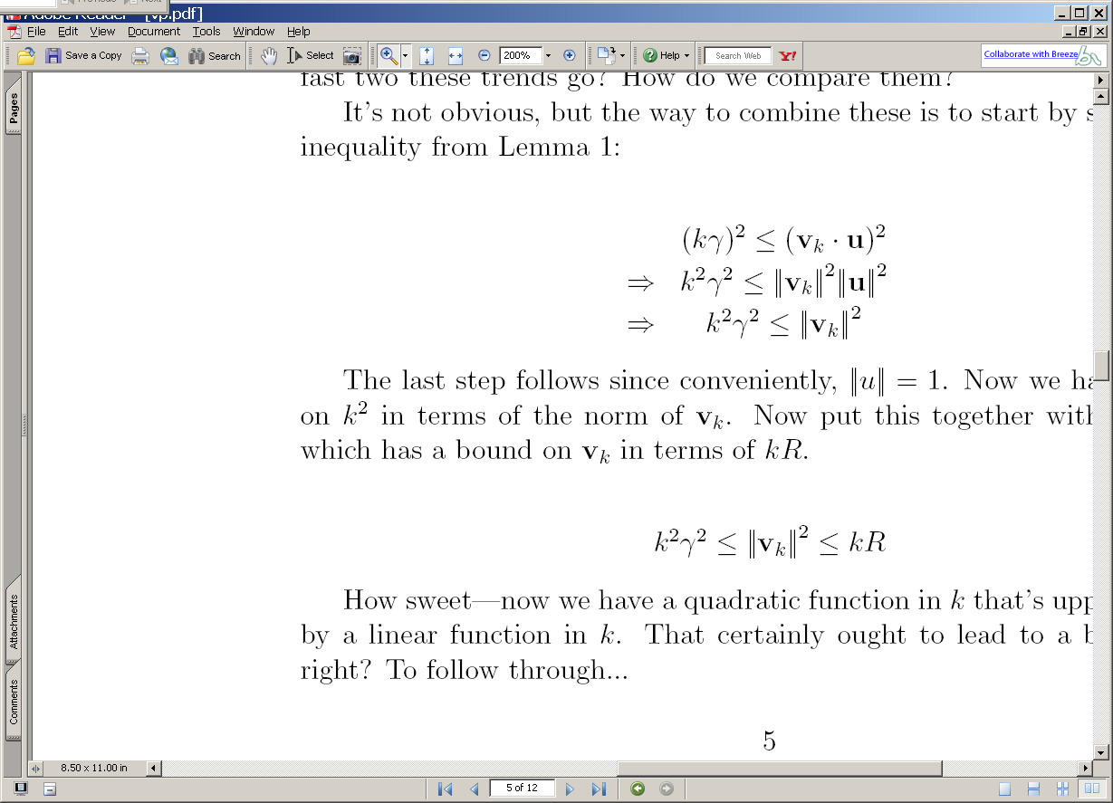
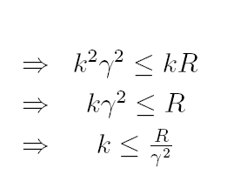
2
2
2
2
2

Slide 25
Summary
We have shown that
  If : exists a u with unit norm that has margin γ on examples in the seq (x₁,y₁),(x₂,y₂),….
  Then : the perceptron algorithm makes < R²/ γ² mistakes on the sequence (where R >= ||x_{i}||)
  Independent of dimension of the data or classifier (!)
  This doesn’t follow from M(C)<=VCDim(C)
We don’t know if this algorithm could be better
  There are many variants that rely on similar analysis (ROMMA, Passive-Aggressive, MIRA, …)
We don’t know what happens if the data’s not separable
  Unless I explain the “Δ trick” to you
We don’t know what classifier to use “after” training

Slide 26
The Δ Trick
Replace x_{i} with x’_{i} so X becomes [X | I Δ]
Replace R² in our bounds with R² + Δ²
Let d_{i} = max(0, γ - y_{i} x_{i} u)
Let u’ = (u₁,…,u_{n}, y₁d₁/Δ, … y_{m}d_{m}/Δ) * 1/Z
  So Z=sqrt(1 + D²/ Δ²), for D=sqrt(d₁²+…+d_{m}²)
Mistake bound is (R² + Δ²)Z² / γ²
Let Δ = sqrt(RD) ➔ k <= ((R + D)/ γ)²

Slide 27
Summary
We have shown that
  If : exists a u with unit norm that has margin γ on examples in the seq (x₁,y₁),(x₂,y₂),….
  Then : the perceptron algorithm makes < R²/ γ² mistakes on the sequence (where R >= ||x_{i}||)
  Independent of dimension of the data or classifier (!)
We don’t know what happens if the data’s not separable
  Unless I explain the “Δ trick” to you
We don’t know what classifier to use “after” training

Slide 28
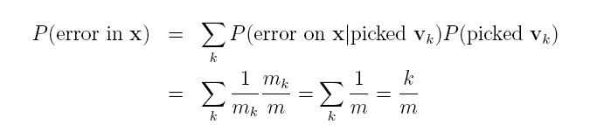
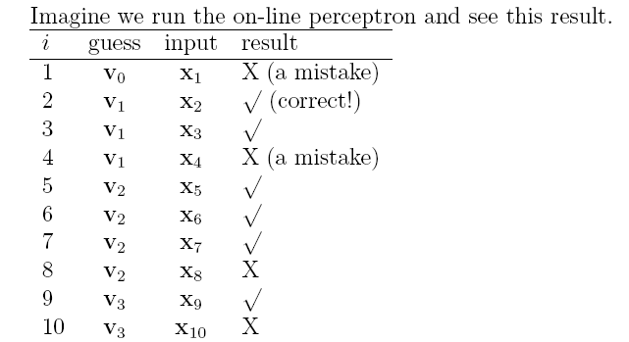
On-line to batch learning
Pick a v_{k} at random according to m_{k}/m, the fraction of examples it was used for.
Predict using the v_{k} you just picked.
(Actually, use some sort of deterministic approximation to this).

Slide 29
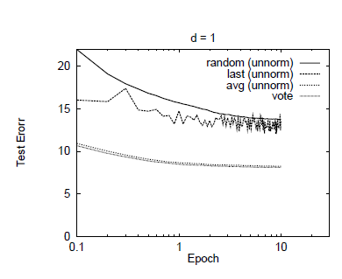

Slide 30
Complexity of perceptron learning
Algorithm:
v=0
for each example x,y:
  if sign(v.x) != y
    v = v + yx
O(n)
init hashtable
    for x_{i}!=0, v_{i} += yx_{i}
O(|x|)=O(|d|)

Slide 31
Complexity of averaged perceptron
Algorithm:
vk=0
va = 0
for each example x,y:
  if sign(vk.x) != y
    va = va + vk
    vk = vk + yx
    mk = 1
  else
    nk++
O(n) O(n|V|)
init hashtables
    for vk_{i}!=0, va_{i} += vk_{i}
    for x_{i}!=0, v_{i} += yx_{i}
O(|V|)
O(|x|)=O(|d|)

Slide 32
Parallelizing perceptrons
Instances/labels
Split into example subsets
Instances/labels – 1
Instances/labels – 2
Instances/labels – 3
Compute vk’s on subsets
vk/va -1
vk/va- 2
vk/va-3
Combine somehow?
vk
Notes:
Rennie, Shih, Teevan, and Karger (2003) Tackling the Poor Assumptions of Naive Bayes Text Classifiers.
lingpipe-blog.com/.../rennie-shih-teevan-and-karger-2003-tackling-p...
Feb 16, 2009 – Rennie, Shih, Teevan, Karger (2003) Tackling the Poor Assumptions of Naive Bayes Text Classifiers. In ICML. Rennie et al. introduce four ...
Tackling the - AAAI

Slide 33
Parallelizing perceptrons
Instances/labels
Split into example subsets
Instances/labels – 1
Instances/labels – 2
Instances/labels – 3
Compute vk’s on subsets
vk/va -1
vk/va- 2
vk/va-3
Combine somehow
vk/va
Notes:
Rennie, Shih, Teevan, and Karger (2003) Tackling the Poor Assumptions of Naive Bayes Text Classifiers.
lingpipe-blog.com/.../rennie-shih-teevan-and-karger-2003-tackling-p...
Feb 16, 2009 – Rennie, Shih, Teevan, Karger (2003) Tackling the Poor Assumptions of Naive Bayes Text Classifiers. In ICML. Rennie et al. introduce four ...
Tackling the - AAAI

Slide 34
Parallelizing perceptrons
vk/va
Instances/labels
Split into example subsets
Instances/labels – 1
Instances/labels – 2
Instances/labels – 3
Compute vk’s on subsets
vk/va -1
vk/va- 2
vk/va-3
Synchronize with messages
vk/va
Notes:
Rennie, Shih, Teevan, and Karger (2003) Tackling the Poor Assumptions of Naive Bayes Text Classifiers.
lingpipe-blog.com/.../rennie-shih-teevan-and-karger-2003-tackling-p...
Feb 16, 2009 – Rennie, Shih, Teevan, Karger (2003) Tackling the Poor Assumptions of Naive Bayes Text Classifiers. In ICML. Rennie et al. introduce four ...
Tackling the - AAAI

Slide 35
Review/outline
How to implement Naïve Bayes
  Time is linear in size of data (one scan!)
  We need to count C( X=word ^ Y=label)
Can you parallelize Naïve Bayes?
  Trivial solution 1
    Split the data up into multiple subsets
    Count and total each subset independently
    Add up the counts
  Result should be the same
This is unusual for streaming learning algorithms
  Why? no interaction between feature weight updates
  For perceptron that’s not the case

Slide 36
A hidden agenda
Part of machine learning is good grasp of theory
Part of ML is a good grasp of what hacks tend to work
These are not always the same
  Especially in big-data situations
Catalog of useful tricks so far
  Brute-force estimation of a joint distribution
  Naive Bayes
  Stream-and-sort, request-and-answer patterns
  BLRT and KL-divergence (and when to use them)
  TF-IDF weighting – especially IDF
    it’s often useful even when we don’t understand why
  Perceptron/mistake bound model
    often leads to fast, competitive, easy-to-implement methods
    parallel versions are non-trivial to implement/understand

