Slide 1
Kernels and Perceptrons

Slide 2
The perceptron
x is a vector
y is -1 or +1
^
instance x_{i}
B
Compute: y_{i} = sign(v_{k} . x_{i} )
A
^
If mistake: v_{k+1} = v_{k} + y_{i} x_{i}
y_{i}
y_{i}
u
+x₂
Depends on how easy the learning problem is, not dimension of vectors x
Fairly intuitive:
“Similarity” of v to u looks like (v.u)/|v.v|
(v.u) grows by >= γafter mistake
(v.v) grows by <= R²
v₂
>γ
v₁
-u
2γ

Slide 3
The kernel perceptron
instance x_{i}
B
A
^
y_{i}
y_{i}
^
Compute: y_{i} = sign(v_{k} . x_{i} )
If mistake: v_{k+1} = v_{k} + y_{i} x_{i}
Mathematically the same as before … but allows use of the kernel trick

Slide 4
The kernel perceptron
instance x_{i}
B
A
^
y_{i}
y_{i}
^
Compute: y_{i} = v_{k} . x_{i}
If mistake: v_{k+1} = v_{k} + y_{i} x_{i}
Mathematically the same as before … but allows use of the “kernel trick”
Other kernel methods (SVM, Gaussian processes) aren’t constrained to limited set (+1/-1/0) of weights on the K(x,v) values.

Slide 5
Some common kernels
Linear kernel:
Polynomial kernel:
Gaussian kernel:
More later….

Slide 6
Kernels 101
Duality
and computational properties
Reproducing Kernel Hilbert Space (RKHS)
Gram matrix
Positive semi-definite
Closure properties

Slide 7
Kernels 101
Explicitly map from x to φ(x) – i.e. to the point corresponding to x in the Hilbert space
Implicitly map from x to φ(x) by changing the kernel function K
Duality: two ways to look at this
Two different computational ways of getting the same behavior

Slide 8
Kernels 101
K(x,x’) = K(x’,x) ➔ Gram matrix is symmetric
Duality
Gram matrix: K: k_{ij} = K(x_{i},x_{j})

Slide 9
Kernels 101
Duality
Gram matrix: K: k_{ij} = K(x_{i},x_{j})
K(x,x’) = K(x’,x) ➔ Gram matrix is symmetric
K is “positive semi-definite” ⬄ … ⬄ z^{T} K z >= 0 for all z
Fun fact: Gram matrix positive semi-definite ⬄ K(x_{i},x_{j})=φ(x_{i}), φ(x_{j}) for some φ
Proof: φ(x) uses the eigenvectors of K to represent x

Slide 10
Hash Kernels and “The Hash Trick”

Slide 11
Question
Most of the weights in a classifier are
small and not important
So we can use the “hash trick”

Slide 12
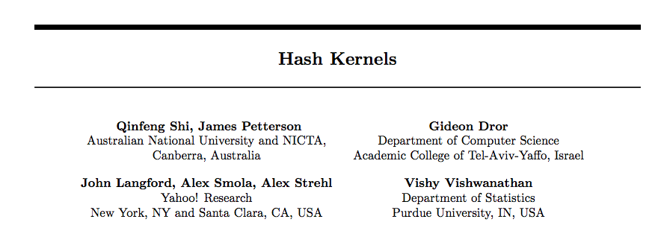

Slide 13
The hash trick as a kernel
Usually we implicitly map from x to φ(x)
All computations of learner are in terms of K(x,x’) = <φ(x), φ(x’) >
Because φ(x) is large
In this case we explicitly map from x to φ(x)
φ(x) is small

Slide 14
Some details
Slightly different hash to avoid systematic bias
m is the number of buckets you hash into (R in my discussion)

Slide 15
Some details
Slightly different hash to avoid systematic bias
m is the number of buckets you hash into (R in my discussion)

Slide 16
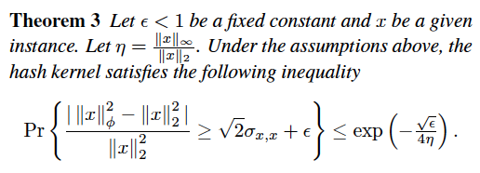
Some details
I.e. – a hashed vector is probably close to the original vector

Slide 17
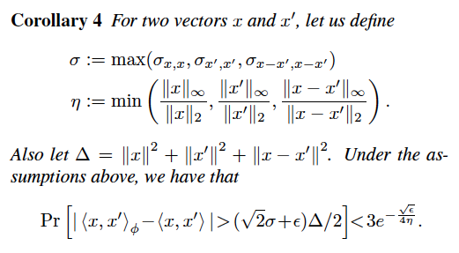
Some details
I.e. the inner products between x and x’ are probably not changed too much by the hash function: a classifier will probably still work

Slide 18
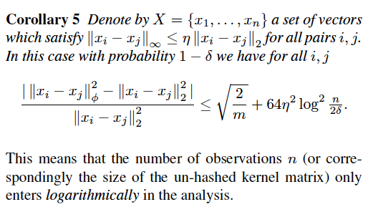
Some details
Notes:
should read this proof

Slide 19
The hash kernel: implementation
One problem: debugging is harder
Features are no longer meaningful
There’s a new way to ruin a classifier
Change the hash function ☹
You can separately compute the set of all words that hash to h and guess what features mean
Build an inverted index h→w1,w2,…,

Slide 20
Adaptive Gradients

Slide 21
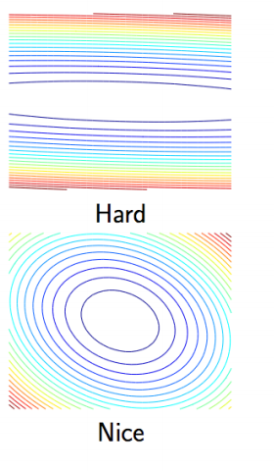
Motivation
What’s the best learning rate?
If a feature is rare, but relevant, it should be high, else learning will be slow
Regularization makes this better/worse?
But then you could overshoot the local minima when you train

Slide 22
Motivation
What’s the best learning rate?
Depends on typical gradient for a feature
Small ➔ fast rate
Large ➔ slow rate
Sadly we can’t afford to ignore rare features
We could have a lot of them

Slide 23
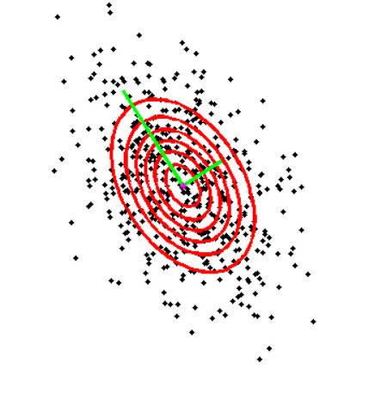
Motivation
What’s the best learning rate?
Let’s pretend our observed gradients are from a zero-mean Gaussian and find variances, then scale dimension j by sd(j)⁻¹

Slide 24
Motivation
What’s the best learning rate?
Let’s pretend our observed gradients are from a zero-mean Gaussian and find variances, then scale dimension j by sd(j)⁻¹
Ignore co-variances for efficiency

Slide 25
Motivation
What’s the best learning rate?
Let’s pretend our observed gradients are from a zero-mean Gaussian and find variances, then scale dimension j by sd(j)⁻¹
Ignore co-variances for efficiency

Slide 26
Adagrad
Gradient at time τ- covariances
η= 1 is usually ok

Slide 29
All-reduce

Slide 30
Introduction
Common pattern:
do some learning in parallel
aggregate local changes from each processor
to shared parameters
distribute the new shared parameters
back to each processor
and repeat….
AllReduce implemented in MPI, recently in VW code (John Langford) in a Hadoop/compatible scheme
MAP
ALLREDUCE

Slide 31
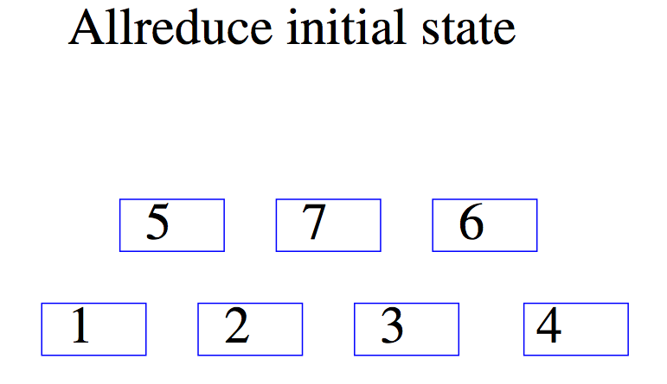
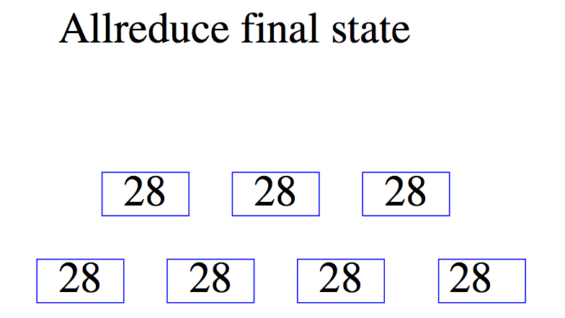

Slide 32
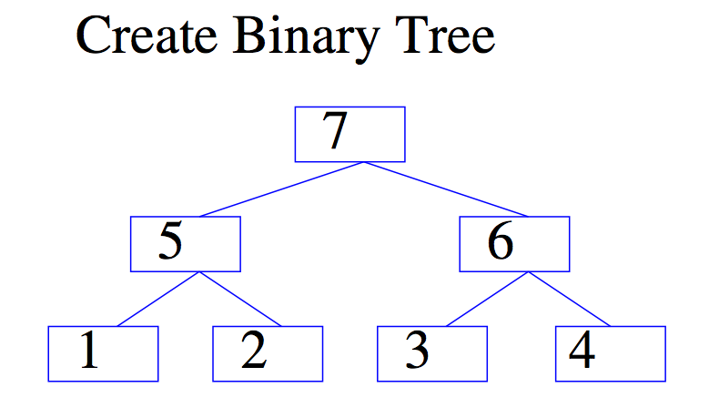

Slide 33
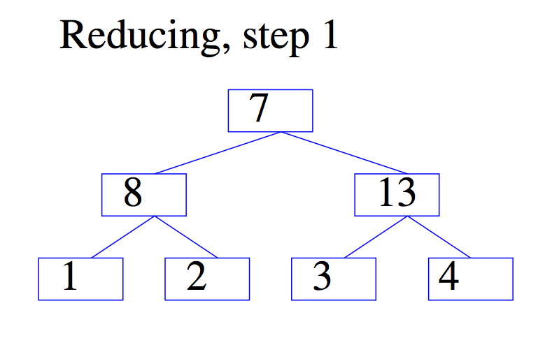

Slide 34
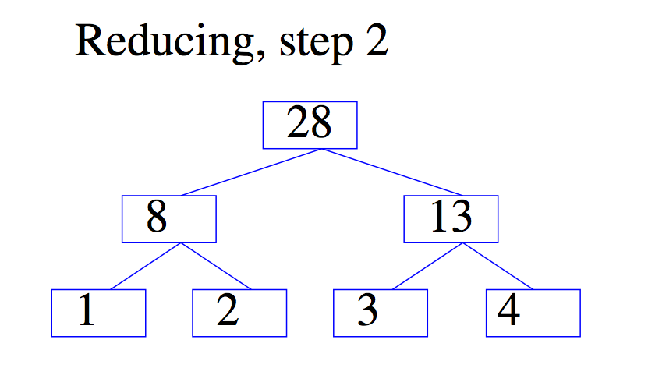

Slide 35
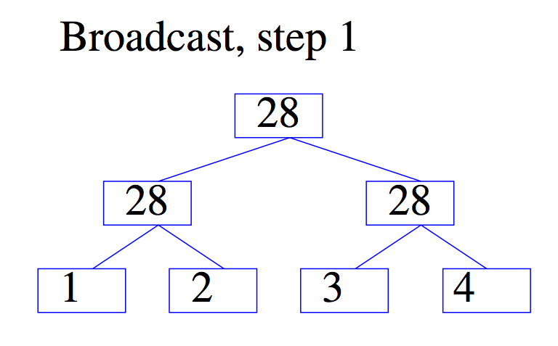

Slide 36
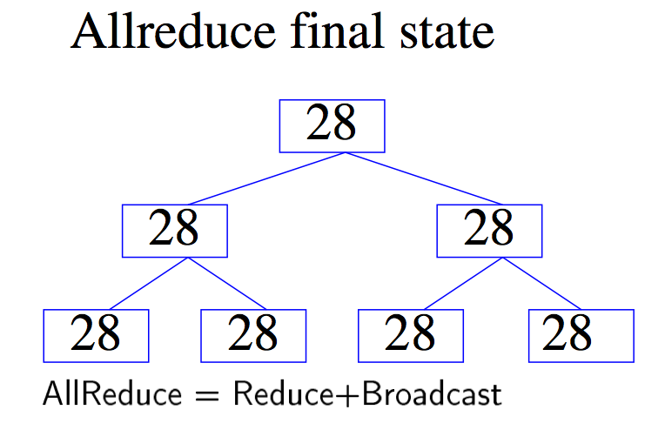

Slide 37
Gory details of VW Hadoop-AllReduce
Spanning-tree server:
Separate process constructs a spanning tree of the compute nodes in the cluster and then acts as a server
Worker nodes (“fake” mappers):
Input for worker is locally cached
Workers all connect to spanning-tree server
Workers all execute the same code, which might contain AllReduce calls:
Workers synchronize whenever they reach an all-reduce

Slide 38
Hadoop AllReduce
don’t wait for duplicate jobs

Slide 39
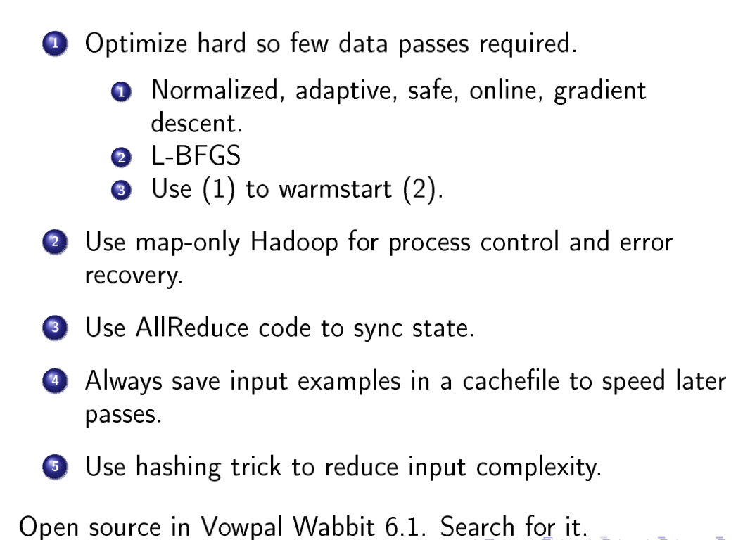
Second-order method - like Newton’s method

Slide 40
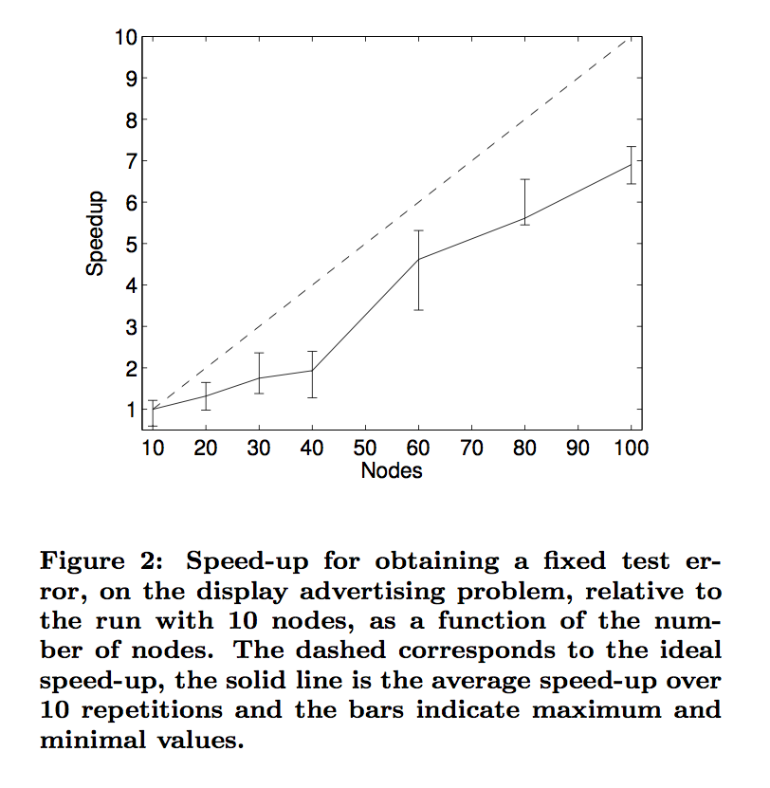
2 ²⁴ features
~=100 non-zeros/example
2.3B examples
example is user/page/ad and conjunctions of these, positive if there was a click-thru on the ad

Slide 41
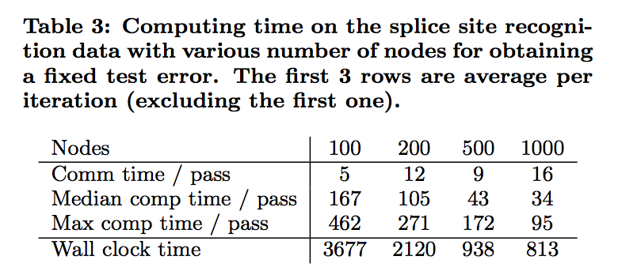
50M examples
explicitly constructed kernel ➔ 11.7M features
3,300 nonzeros/example
old method: SVM, 3 days: reporting time to get to fixed test error

Slide 42
