Slide 1
Scaling up LDA
William Cohen

Slide 2
Outline
LDA/Gibbs algorithm details
How to speed it up by parallelizing
How to speed it up by faster sampling
  Why sampling is key
  Some sampling ideas for LDA

Slide 3
Review - LDA
Latent Dirichlet Allocation with Gibbs
θ
α
Randomly initialize each z_{m,n}
Repeat for t=1,….
  For each doc m, word n
    Find Pr(z_{mn}=k|other z’s)
    Sample z_{mn} according to that distr.
z
w
N
M
β

Slide 4
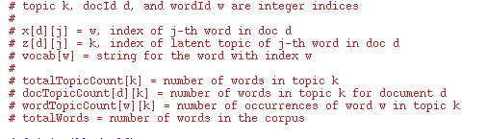
Way way more detail

Slide 5
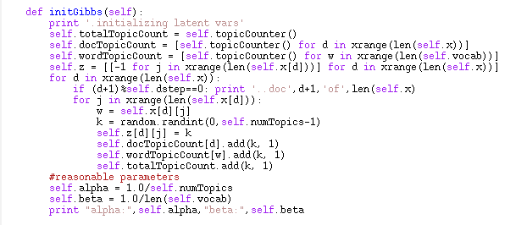
More detail

Slide 6
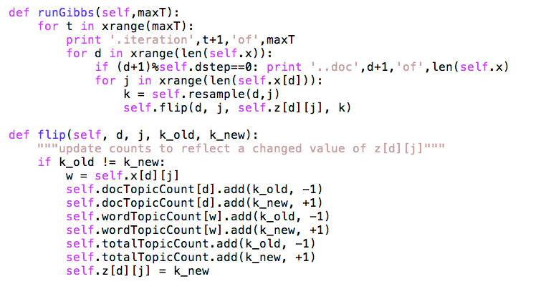

Slide 7
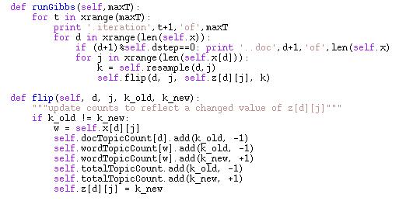
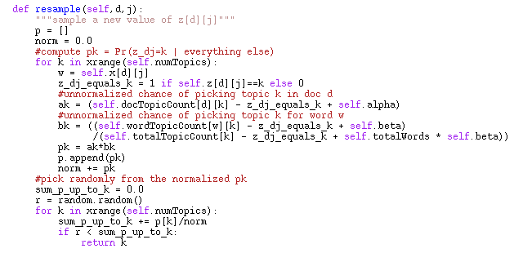

Slide 8
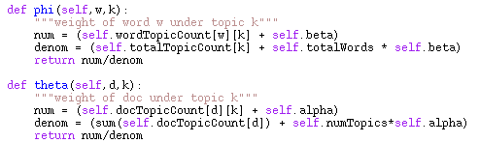
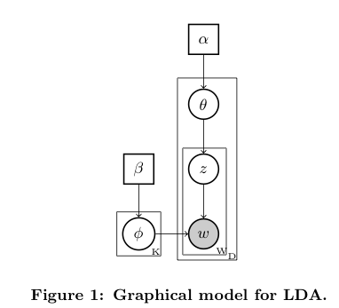
What gets learned…..

Slide 9
In A Math-ier Notation
N[*,k]
N[d,k]
N[*,*]=V
M[w,k]

Slide 10
for each document d and word position j in d
z[d,j] = k, a random topic
N[d,k]++
W[w,k]++ where w = id of j-th word in d

Slide 11
for each pass t=1,2,….
for each document d and word position j in d
z[d,j] = k, a new random topic
update N, W to reflect the new assignment of z:
  N[d,k]++; N[d,k’] - - where k’ is old z[d,j]
  W[w,k]++; W[w,k’] - - where w is w[d,j]

Slide 13
z=1
z=2
random
z=3
unit height
…
…
You spend a lot of time sampling
There’s a loop over all topics here in the sampler

Slide 14
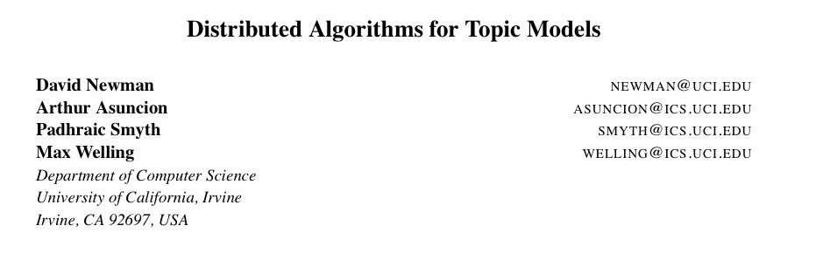
JMLR 2009

Slide 15
Observation
How much does the choice of z depend on the other z’s in the same document?
  quite a lot
How much does the choice of z depend on the other z’s in elsewhere in the corpus?
  maybe not so much
  depends on Pr(w|t) but that changes slowly
Can we parallelize Gibbs and still get good results?

Slide 16
Question
Can we parallelize Gibbs sampling?
  formally, no: every choice of z depends on all the other z’s
  Gibbs needs to be sequential
    just like SGD

Slide 17
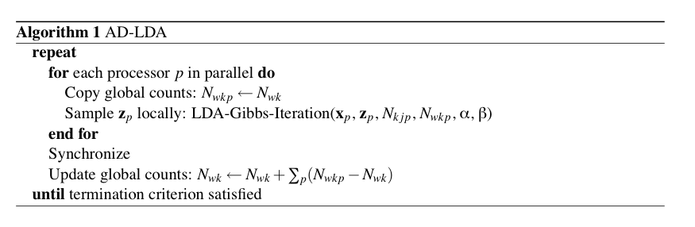
What if you try and parallelize?
Split document/term matrix randomly and distribute to p processors .. then run “Approximate Distributed LDA”

Slide 18
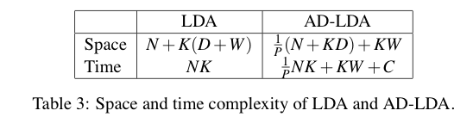
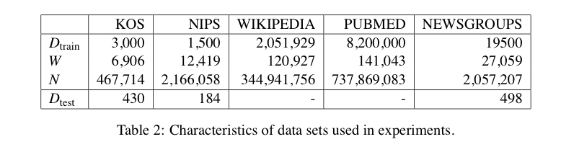
What if you try and parallelize?
D=#docs W=#word(types) K=#topics N=words in corpus

Slide 19
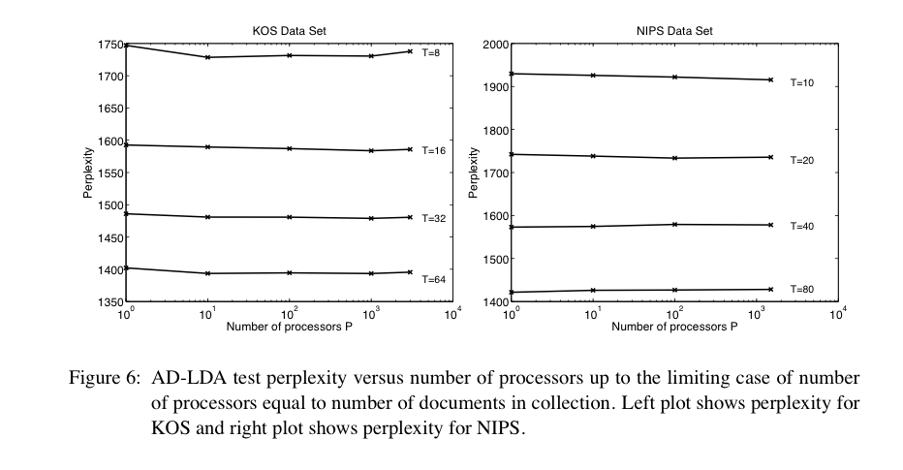

Slide 20
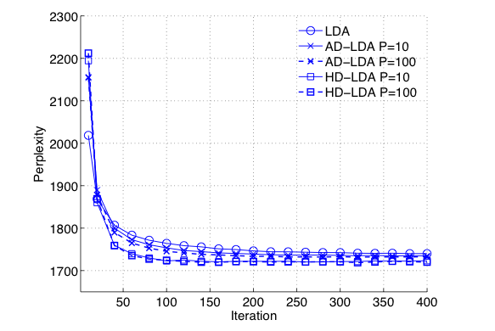

Slide 21
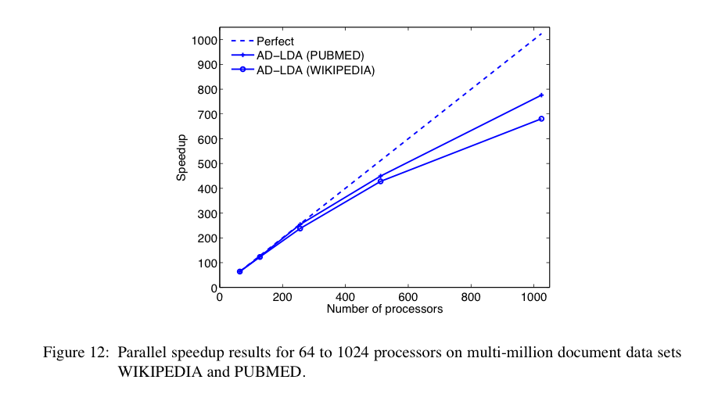

Slide 22
Update c. 2014
Algorithms:
  Distributed variational EM
  Asynchronous LDA (AS-LDA)
  Approximate Distributed LDA (AD-LDA)
  Ensemble versions of LDA: HLDA, DCM-LDA
Implementations:
  GitHub Yahoo_LDA
    not Hadoop, special-purpose communication code for synchronizing the global counts
    Alex Smola, Yahoo→CMU
  Mahout LDA
    Andy Schlaikjer, CMU→Twitter

Slide 23
Outline
LDA/Gibbs algorithm details
How to speed it up by parallelizing
How to speed it up by faster sampling
  Why sampling is key
  Some sampling ideas for LDA

Slide 24
Stopped here Tues

Slide 25
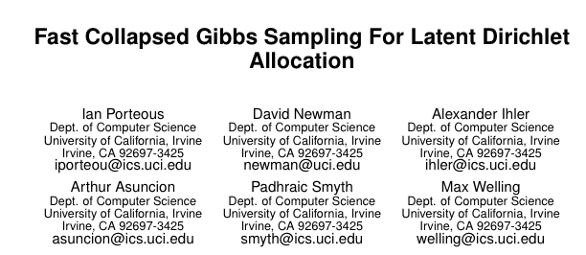

Slide 26
z=1
z=2
random
z=3
unit height
…
…

Slide 27
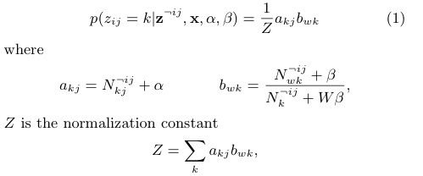

Slide 28
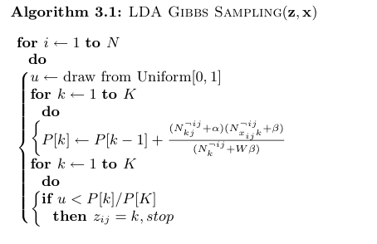
Running total of P(z=k|…) or P(z<=k)

Slide 29
Discussion….
Where do you spend your time?
  sampling the z’s
  each sampling step involves a loop over all topics
  number of topics grows with corpus size
  this seems wasteful
    even with many topics, words are often only assigned to a few different topics
      low frequency words appear < K times … and there are lots and lots of them!
      even frequent words are not in every topic

Slide 30
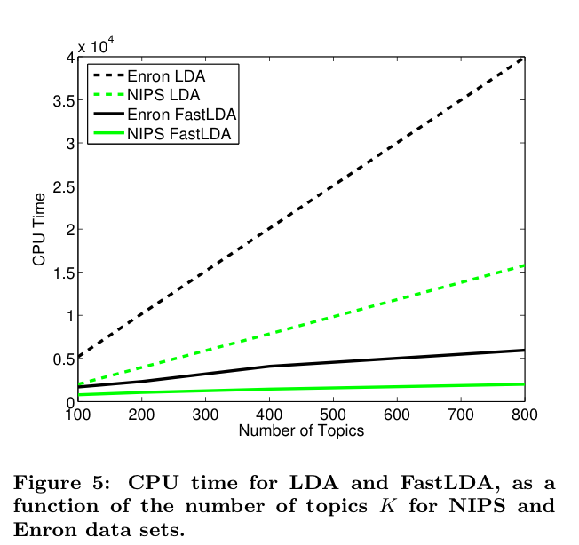
Results from Porteus et al

Slide 31
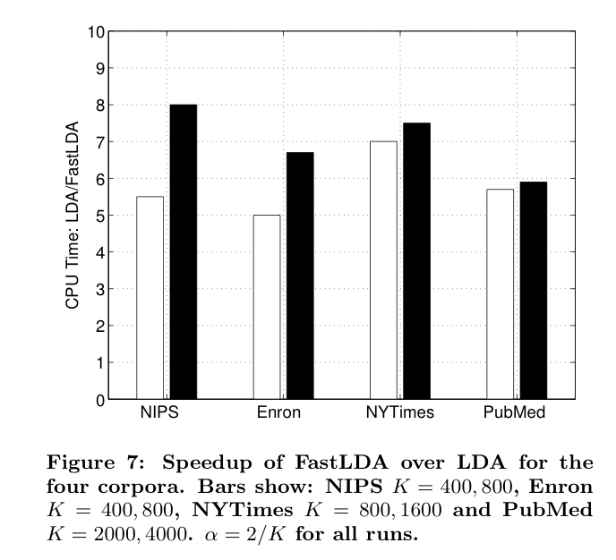
Results

Slide 32
Outline
LDA/Gibbs algorithm details
How to speed it up by parallelizing
How to speed it up by faster sampling
  Why sampling is key
  Some sampling ideas for LDA
    The Mimno/McCallum decomposition

Slide 33
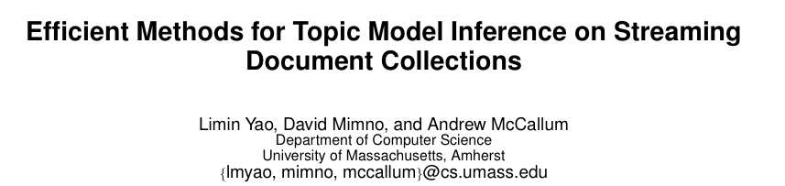
KDD 09

Slide 34


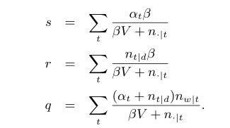
z=s+r+q

Slide 35
If U<s:
  lookup U on line segment with tic-marks at α₁β/(βV + n_{.|1}), α₂β/(βV + n_{.|2}), …
If s<U<r:
  lookup U on line segment for r
Only need to check t such that n_{t|d}>0
z=s+r+q

Slide 36
If U<s:
  lookup U on line segment with tic-marks at α₁β/(βV + n_{.|1}), α₂β/(βV + n_{.|2}), …
If s<U<s+r:
  lookup U on line segment for r
If s+r<U:
  lookup U on line segment for q
Only need to check t such that n_{w|t}>0
z=s+r+q

Slide 37
Only need to check occasionally (< 10% of the time)
Only need to check t such that n_{t|d}>0
Only need to check t such that n_{w|t}>0
z=s+r+q

Slide 38
Only need to store (and maintain) total words per topic and α’s,β,V
Trick; count up n_{t|d} for d when you start working on d and update incrementally
Only need to store n_{t|d} for current d
Need to store n_{w|t} for each word, topic pair …???
z=s+r+q

Slide 39

1. Precompute, for each t,
2. Quickly find t’s such that n_{w|t} is large for w
Most (>90%) of the time and space is here…
Need to store n_{w|t} for each word, topic pair …???
z=s+r+q

Slide 40
1. Precompute, for each t,
2. Quickly find t’s such that n_{w|t} is large for w
map w to an int array
  no larger than frequency w
  no larger than #topics
encode (t,n) as a bit vector
  n in the high-order bits
  t in the low-order bits
keep ints sorted in descending order
Most (>90%) of the time and space is here…
Need to store n_{w|t} for each word, topic pair …???

Slide 41
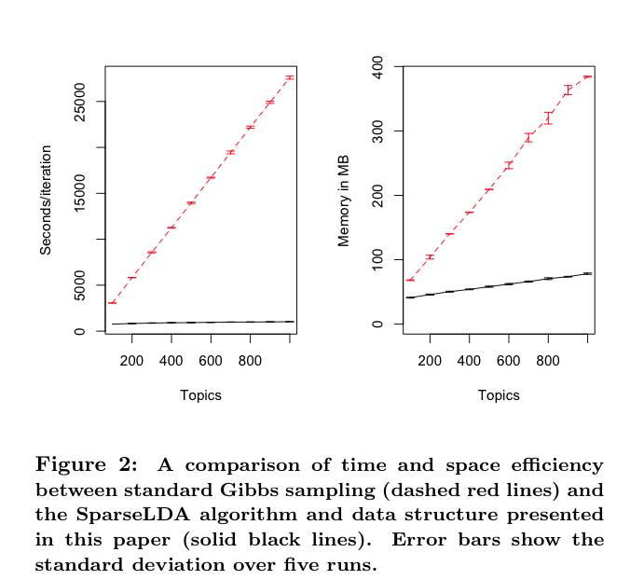

Slide 42
Outline
LDA/Gibbs algorithm details
How to speed it up by parallelizing
How to speed it up by faster sampling
  Why sampling is key
  Some sampling ideas for LDA
    The Mimno/McCallum decomposition (SparseLDA)
    Alias tables (Walker 1977; Li, Ahmed, Ravi, Smola KDD 2014)

Slide 43

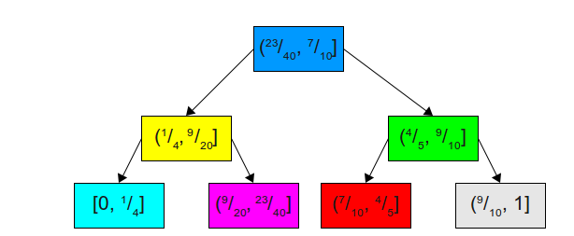

Alias tables
O(K)
Basic problem: how can we sample from a biased coin quickly?
If the distribution changes slowly maybe we can do some preprocessing and then sample multiple times. Proof of concept: generate r~uniform and use a binary tree
r in (23/40,7/10]
O(log2K)
http://www.keithschwarz.com/darts-dice-coins/

Slide 44
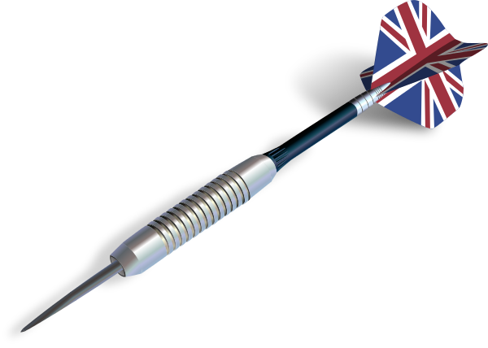

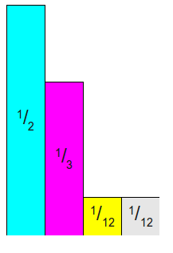
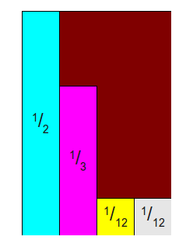
Alias tables
Another idea…
Simulate the dart with two drawn values:
rx ➔ int(u1*K)
ry ➔ u1*p_{max}
keep throwing till you hit a stripe
http://www.keithschwarz.com/darts-dice-coins/

Slide 45
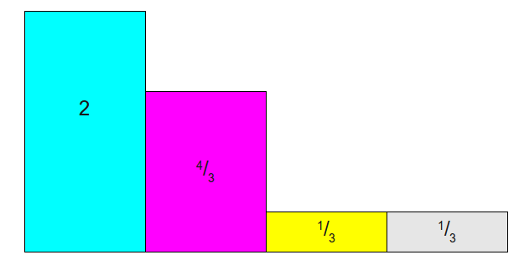
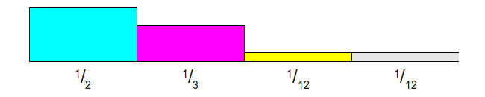
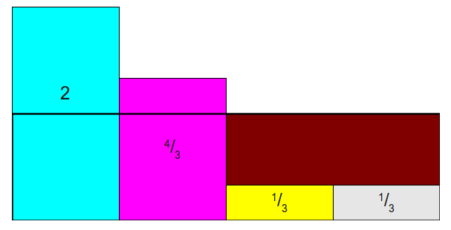
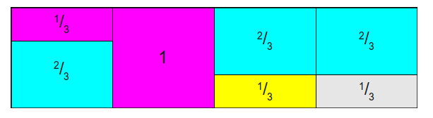
Alias tables
An even more clever idea: minimize the brown space (where the dart “misses”) by sizing the rectangle’s height to the average probability, not the maximum probability, and cutting and pasting a bit.
You can always do this using only two colors in each column of the final alias table and the dart never misses!
mathematically speaking…
http://www.keithschwarz.com/darts-dice-coins/

Slide 46
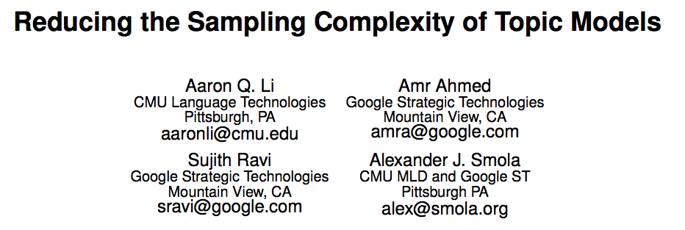
KDD 2014
Key ideas
use variant of Mimno/McCallum decomposition
Use alias tables to sample from the dense parts
Since the alias table gradually goes stale, use Metropolis-Hastings sampling instead of Gibbs

Slide 47
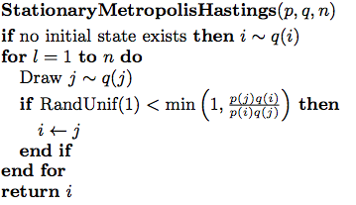
KDD 2014
else the dart missed
q is stale, easy-to-draw from distribution
p is updated distribution
computing ratios p(i)/q(i) is cheap
usually the ratio is close to one

Slide 48
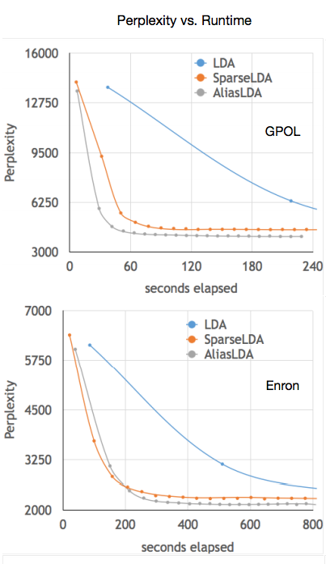
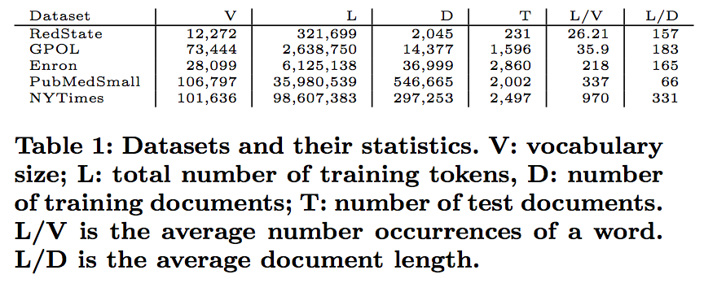
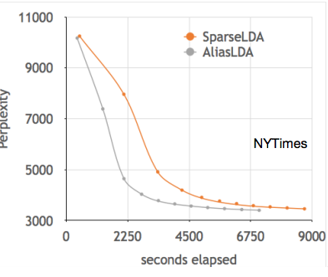
KDD 2014

