Slide 1
Announcements
William W. Cohen

Slide 2
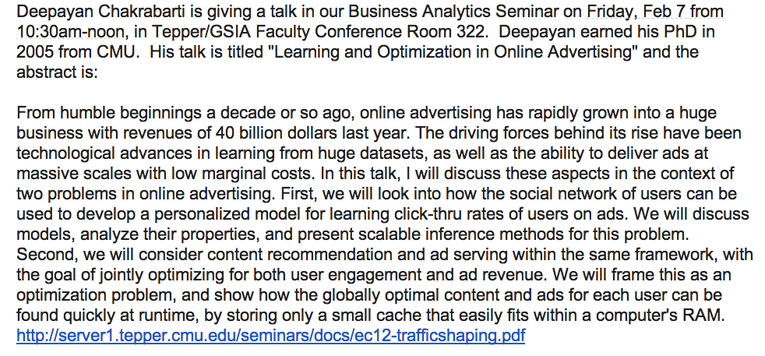
Upcoming talks - 1

Slide 3
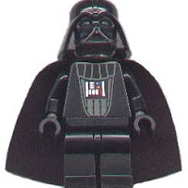
Upcoming talks - 2
Next Wed - guest speaker in this class is Matt Hurst, of Bing Local Search.
“Everything You Wanted to Know about Local Search but were Afraid to Ask”
Talk will not be recorded.

