Slide 1






SGD on Hadoop for Big dATA
& Huge Models
Alex Beutel
Based on work done with Abhimanu Kumar, Vagelis Papalexakis, Partha Talukdar, Qirong Ho, Christos Faloutsos, and Eric Xing

Slide 2
Outline
When to use SGD for distributed learning
Optimization
  Review of DSGD
  SGD for Tensors
  SGD for ML models – topic modeling, dictionary learning, MMSB
Hadoop
  General algorithm
  Setting up the MapReduce body
  Reducer communication
  Distributed normalization
  “Always-On SGD” – How to deal with the straggler problem
Experiments
Looking Forward – Graphical Models and the Cloud

Slide 3
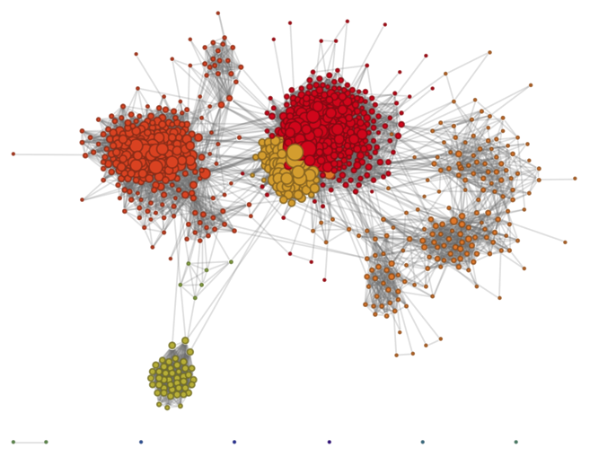





When distributed SGD is useful
1 Billion users on Facebook
Collaborative Filtering
Predict movie preferences
Tensor Decomposition
Find communities in temporal graphs
300 Million Photos uploaded
to Facebook per day!
400 million tweets per day
Topic Modeling
What are the topics of webpages, tweets, or status updates
Dictionary Learning
Remove noise or missing pixels from images

Slide 4
Gradient Descent

Slide 5
Stochastic Gradient Descent (SGD)

Slide 6
Stochastic Gradient Descent (SGD)

Slide 7
DSGD for Matrices (Gemulla, 2011)
Movies
V
Users
X
U
≈
Genres

Slide 8
DSGD for Matrices (Gemulla, 2011)
V
U
X
≈
Independent!

Slide 9
DSGD for Matrices (Gemulla, 2011)
Independent Blocks

Slide 10
DSGD for Matrices (Gemulla, 2011)
Partition your data & model into d × d blocks
Results in d=3 strata
Process strata sequentially,
process blocks in each stratum in parallel

Slide 11
Tensors

Slide 12
What is a tensor?
Tensors are used for structured data > 2 dimensions
Think of as a 3D-matrix
For example:
Derek Jeter plays baseball
Subject
Object
Verb

Slide 13
Tensor Decomposition
W
V
X
≈
U

Slide 14
Tensor Decomposition
W
V
X
≈
U

Slide 15
Tensor Decomposition
Independent
W
V
X
≈
U
Not Independent

Slide 16
Tensor Decomposition

Slide 17
For d=3 blocks per stratum, we require d²=9 strata

Slide 18
Coupled Matrix + Tensor Decomposition
Subject
Y
X
Object
Document
Verb

Slide 19
Coupled Matrix + Tensor Decomposition
W
A
V
Y
X
≈
U

Slide 20
Coupled Matrix + Tensor Decomposition

Slide 21
Constraints & Projections

Slide 22
Example: Topic Modeling
Words
Topics
Documents

Slide 23
Constraints
Sometimes we want to restrict response:
  Non-negative
  Sparsity
  Simplex (so vectors become probabilities)
  Keep inside unit ball

Slide 24
How to enforce? Projections
Example: Non-negative

Slide 25
More projections
Sparsity (soft thresholding):
Simplex
Unit ball

Slide 26
Dictionary Learning
Learn a dictionary of concepts and a sparse reconstruction
Useful for fixing noise and missing pixels of images
Sparse encoding
Within unit ball

Slide 27
Mixed Membership Network Decomp.
Used for modeling communities in graphs (e.g. a social network)
Simplex
Non-negative

Slide 28
Implementing on Hadoop

Slide 29
High level algorithm
Stratum 1
Stratum 2
Stratum 3
…
for Epoch e = 1 … T do
for Subepoch s = 1 … d² do
Let be the set of blocks in stratum s
for block b = 1 … d in parallel do
Run SGD on all points in block
end
end
end

Slide 30
Bad Hadoop Algorithm: Subepoch 1
Mappers
Reducers
Run SGD on
Update:
Run SGD on
Update:
U₂
V₁
W₃
U₃
V₂
W₁
Run SGD on
Update:
U₁
V₃
W₂

Slide 31
Bad Hadoop Algorithm: Subepoch 2
Mappers
Reducers
Run SGD on
Update:
Run SGD on
Update:
U₂
V₁
W₂
U₃
V₂
W₃
Run SGD on
Update:
U₁
V₃
W₁

Slide 32
Hadoop Challenges
MapReduce is typically very bad for iterative algorithms
  T × d² iterations
Sizable overhead per Hadoop job
Little flexibility

Slide 33

High Level Algorithm
W₃
W₃
W₂
W₂
W₁
V₁
W₁
V₁
V₂
V₂
V₃
V₃
U₁
U₂
U₁
U₂
U₃
U₃
U₁
V₁
W₁
U₂
V₂
W₂
U₃
V₃
W₃

Slide 34
High Level Algorithm
W₃
W₃
W₂
W₂
W₁
V₁
W₁
V₁
V₂
V₂
V₃
V₃
U₁
U₂
U₁
U₂
U₃
U₃
U₁
V₁
W₁
U₂
V₂
W₂
U₃
V₃
W₃

Slide 35
High Level Algorithm
W₃
W₃
W₂
W₂
W₁
V₁
W₁
V₁
V₂
V₂
V₃
V₃
U₁
U₂
U₁
U₂
U₃
U₃
U₁
V₁
W₃
U₂
V₂
W₁
U₃
V₃
W₂

Slide 36
High Level Algorithm
W₃
W₃
W₂
W₂
W₁
V₁
W₁
V₁
V₂
V₂
V₃
V₃
U₁
U₂
U₁
U₂
U₃
U₃
U₁
V₁
W₂
U₂
V₂
W₃
U₃
V₃
W₁

Slide 37
Hadoop Algorithm
Reducers
Mappers
Process points:
Map each point
Partition &
Sort
to its block
Use:
Partitioner
KeyComparator
GroupingComparator
with necessary info to order

Slide 38
Hadoop Algorithm
Reducers
Mappers
Process points:
…
Map each point
Partition &
Sort
to its block
with necessary info to order
…

Slide 39
Hadoop Algorithm
Reducers
Mappers
Run SGD on
Update:
Process points:
…
U₁
V₁
W₁
Map each point
Partition &
Sort
Run SGD on
Update:
to its block
U₂
V₂
W₂
with necessary info to order
Run SGD on
Update:
…
U₃
V₃
W₃

Slide 40
Hadoop Algorithm
Reducers
Mappers
Run SGD on
Update:
Process points:
…
U₁
V₁
W₁
Map each point
Partition &
Sort
Run SGD on
Update:
to its block
U₂
V₂
W₂
with necessary info to order
Run SGD on
Update:
…
U₃
V₃
W₃

Slide 41
Hadoop Algorithm
Reducers
Mappers
Run SGD on
Update:
Process points:
…
U₁
V₁
W₁
HDFS
Map each point
Partition &
Sort
Run SGD on
Update:
to its block
U₂
V₂
W₂
HDFS
with necessary info to order
Run SGD on
Update:
…
U₃
V₃
W₃

Slide 42
Hadoop Summary
Use mappers to send data points to the correct reducers in order
Use reducers as machines in a normal cluster
Use HDFS as the communication channel between reducers

Slide 43
Distributed Normalization
Words
Topics
π₁
β₁
Documents
π₂
β₂
π₃
β₃

Slide 44
Distributed Normalization
Transfer σ^{(b)} to all machines
Each machine calculates σ:
σ^{(b)} is a k-dimensional vector,
summing the terms of β_{b}
π₁
β₁
σ⁽²⁾
σ⁽²⁾
σ⁽²⁾
Normalize:
σ⁽¹⁾
σ⁽³⁾
π₂
β₂
π₃
β₃
σ⁽¹⁾
σ⁽¹⁾
σ⁽³⁾
σ⁽³⁾

Slide 45
Barriers & Stragglers
Reducers
Mappers
Run SGD on
Update:
Process points:
…
U₁
V₁
W₁
HDFS
Partition &
Sort
Wasting time
waiting!
Map each point
Run SGD on
Update:
to its block
U₂
V₂
W₂
HDFS
with necessary info to order
Run SGD on
Update:
…
U₃
V₃
W₃

Slide 46
Solution: “Always-On SGD”
For each reducer:
Run SGD on all points in current block Z
Shuffle points in Z and decrease step size
Check if other reducers are ready to sync
Wait
Run SGD on points in Z again
If not ready to sync
If not ready to sync
Sync parameters
and get new block Z

Slide 47
“Always-On SGD”
Reducers
Run SGD on old points again!
Run SGD on
Update:
Process points:
…
U₁
V₁
W₁
HDFS
Map each point
Partition &
Sort
Run SGD on
Update:
to its block
U₂
V₂
W₂
HDFS
with necessary info to order
Run SGD on
Update:
…
U₃
V₃
W₃

Slide 48
“Always-On SGD”
Reducer 1
Reducer2
Reducer 3
Reducer 4
First SGD pass of block Z
Read Parameters from HDFS
Extra SGD Updates
Write Parameters to HDFS

Slide 49
Experiments

Slide 50
FlexiFaCT (Tensor Decomposition)
Convergence

Slide 51
FlexiFaCT (Tensor Decomposition)
Scalability in Data Size

Slide 52
FlexiFaCT (Tensor Decomposition)
Scalability in Tensor Dimension
Handles up to 2 billion parameters!
Notes:
Rank=50

Slide 53
FlexiFaCT (Tensor Decomposition)
Scalability in Rank of Decomposition
Handles up to 4 billion parameters!

Slide 54
FlexiFaCT (Tensor Decomposition)
Scalability in Number of Machines

Slide 55
Fugue (Using “Always-On SGD”)
Dictionary Learning: Convergence

Slide 56
Fugue (Using “Always-On SGD”)
Community Detection: Convergence

Slide 57
Fugue (Using “Always-On SGD”)
Topic Modeling: Convergence

Slide 58
Fugue (Using “Always-On SGD”)
Topic Modeling: Scalability in Data Size

Slide 59
Fugue (Using “Always-On SGD”)
Topic Modeling: Scalability in Rank

Slide 60
Fugue (Using “Always-On SGD”)
Topic Modeling: Scalability over Machines

Slide 61
Fugue (Using “Always-On SGD”)
Topic Modeling: Number of Machines

Slide 62
Fugue (Using “Always-On SGD”)

Slide 63
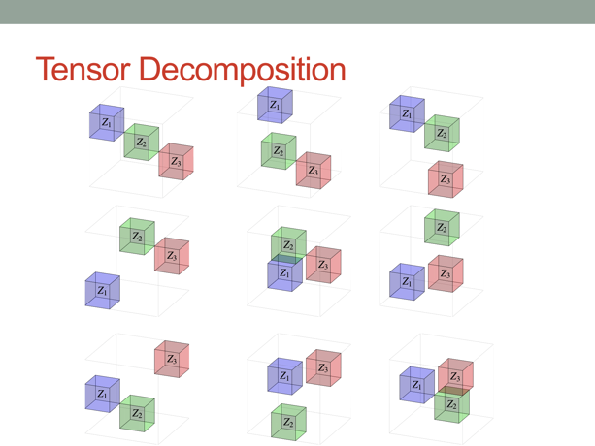
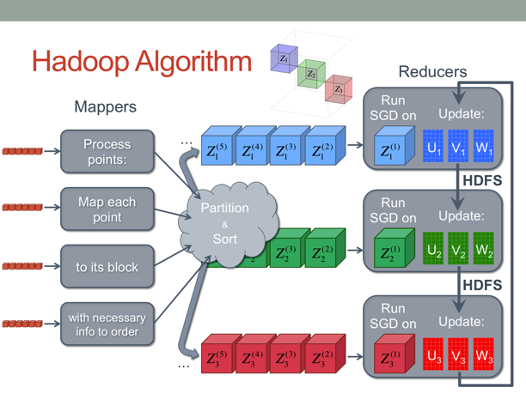
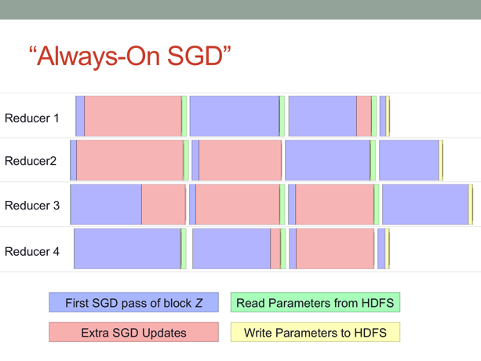
Key Points
Flexible method for tensors & ML models
Can use stock Hadoop through using HDFS for communication
When waiting for slower machines, run updates on old data again

Slide 64
Further System improvements
Joint work with Markus Weimer, Tom Minka, Yordan Zaykov and Vijay Narayanan at Microsoft

Slide 65
Task Pipelining
Time
Load Block 1
Run Model on Block 1
Save
Block 1
Load Block 2
Run Model on Block 2
Save
Block 2
…
Load Block 1
Load Block 2
Load Block 3
Load Block 4
Run Model on Block 1
Run Model on Block 2
Run Model on Block 3
Run Model on Block 4
Save
Block 1
Save
Block 2
Save
Block 3
Save
Block 4
Load Block 1
Load Block 2
Load Block 3
Load Block 4
Load Block 5
Load Block 6
Run Model on Block 1
Run Model on Block 2
Run Model on Block 3
Run Model on Block 4
Run Model on Block 5
Save
Block 1
Save
Block 2
Save
Block 3
Save
Block 4

Slide 66
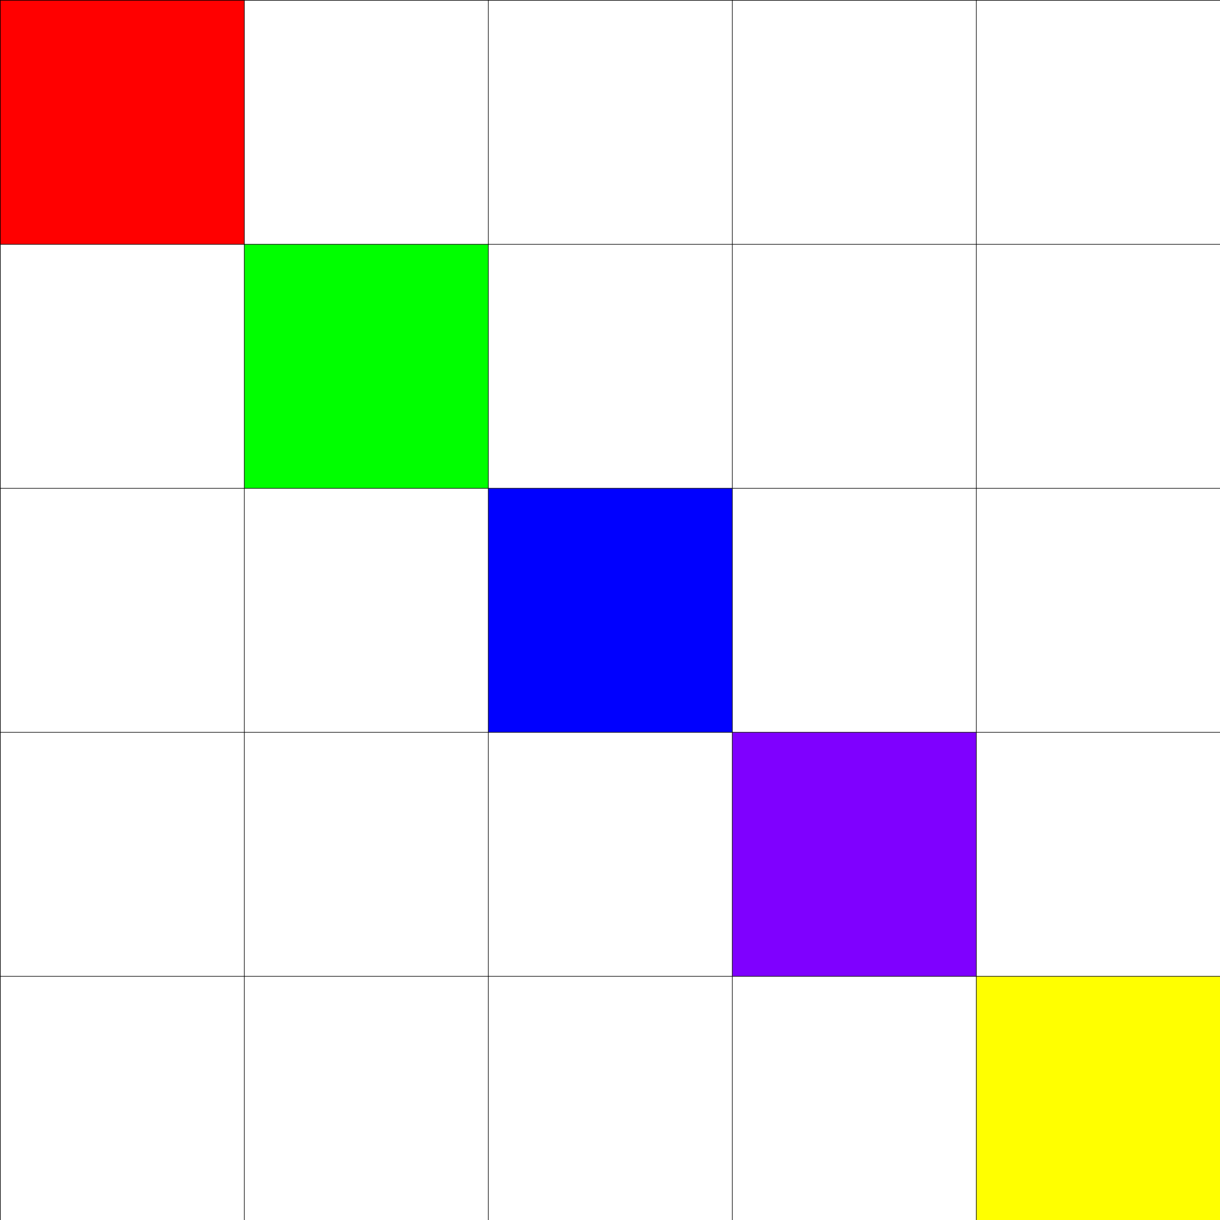
Block scheduling

Slide 67
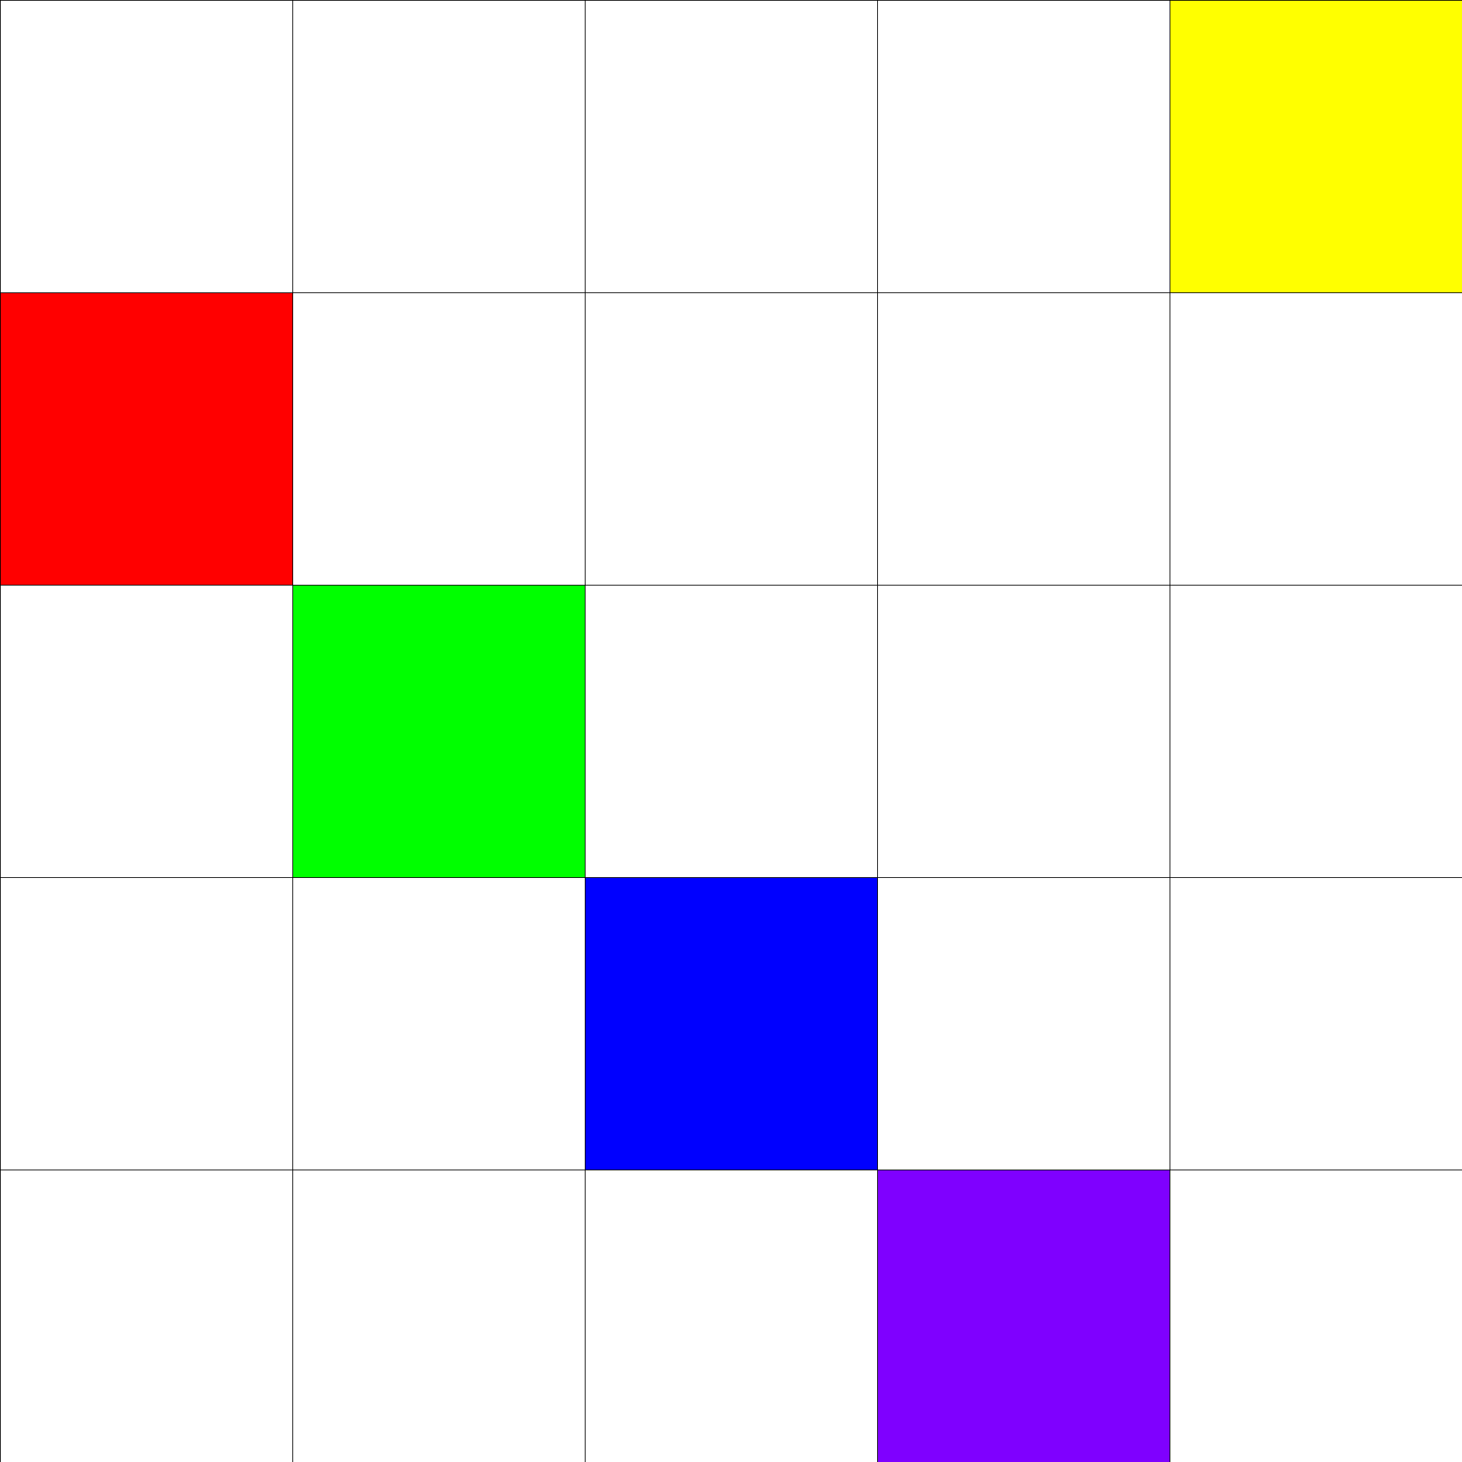
Block scheduling

Slide 68
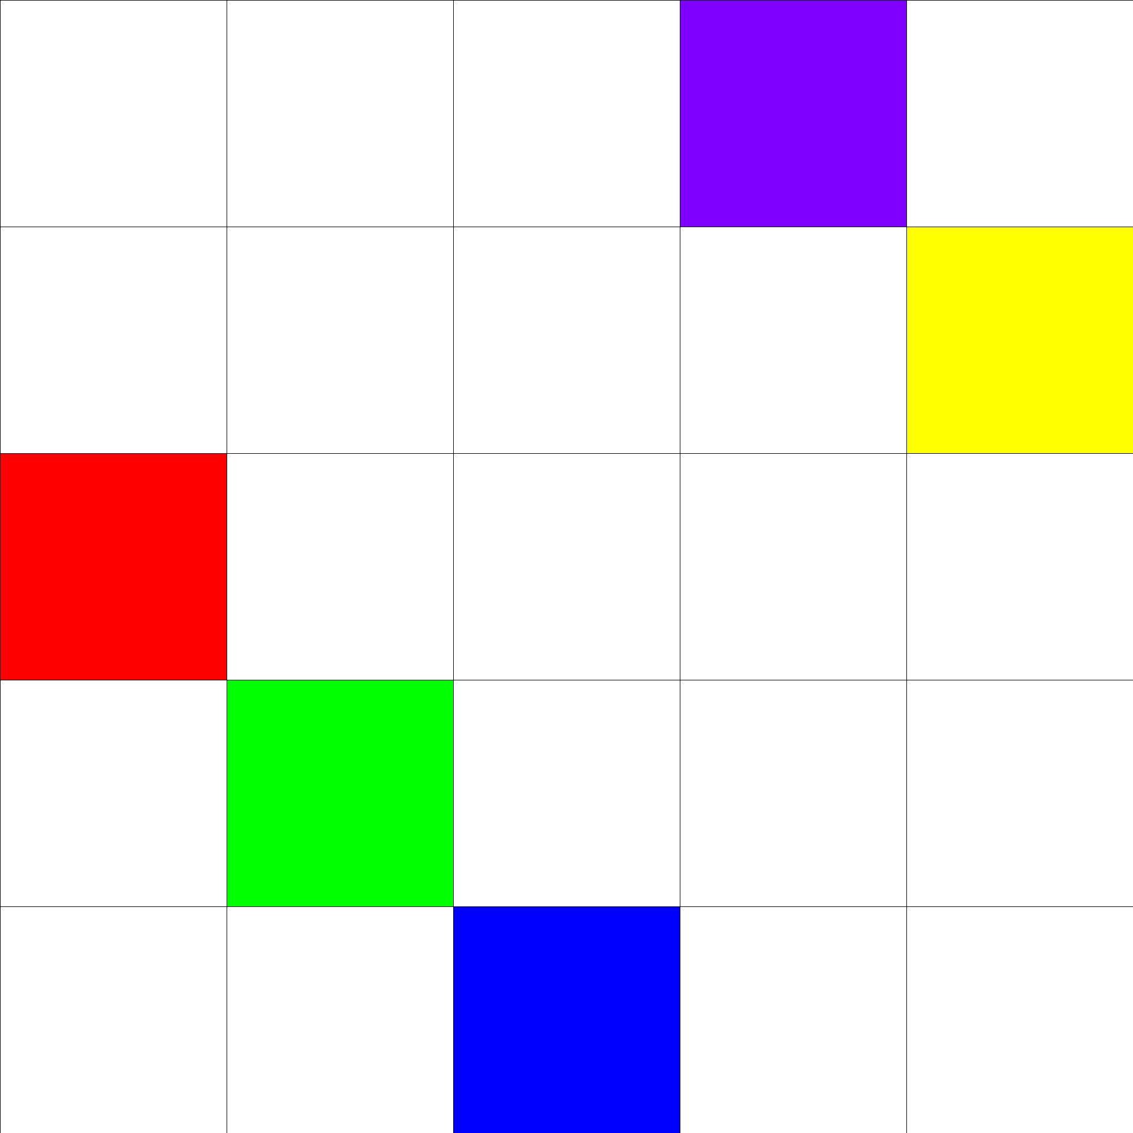
Block scheduling

Slide 69
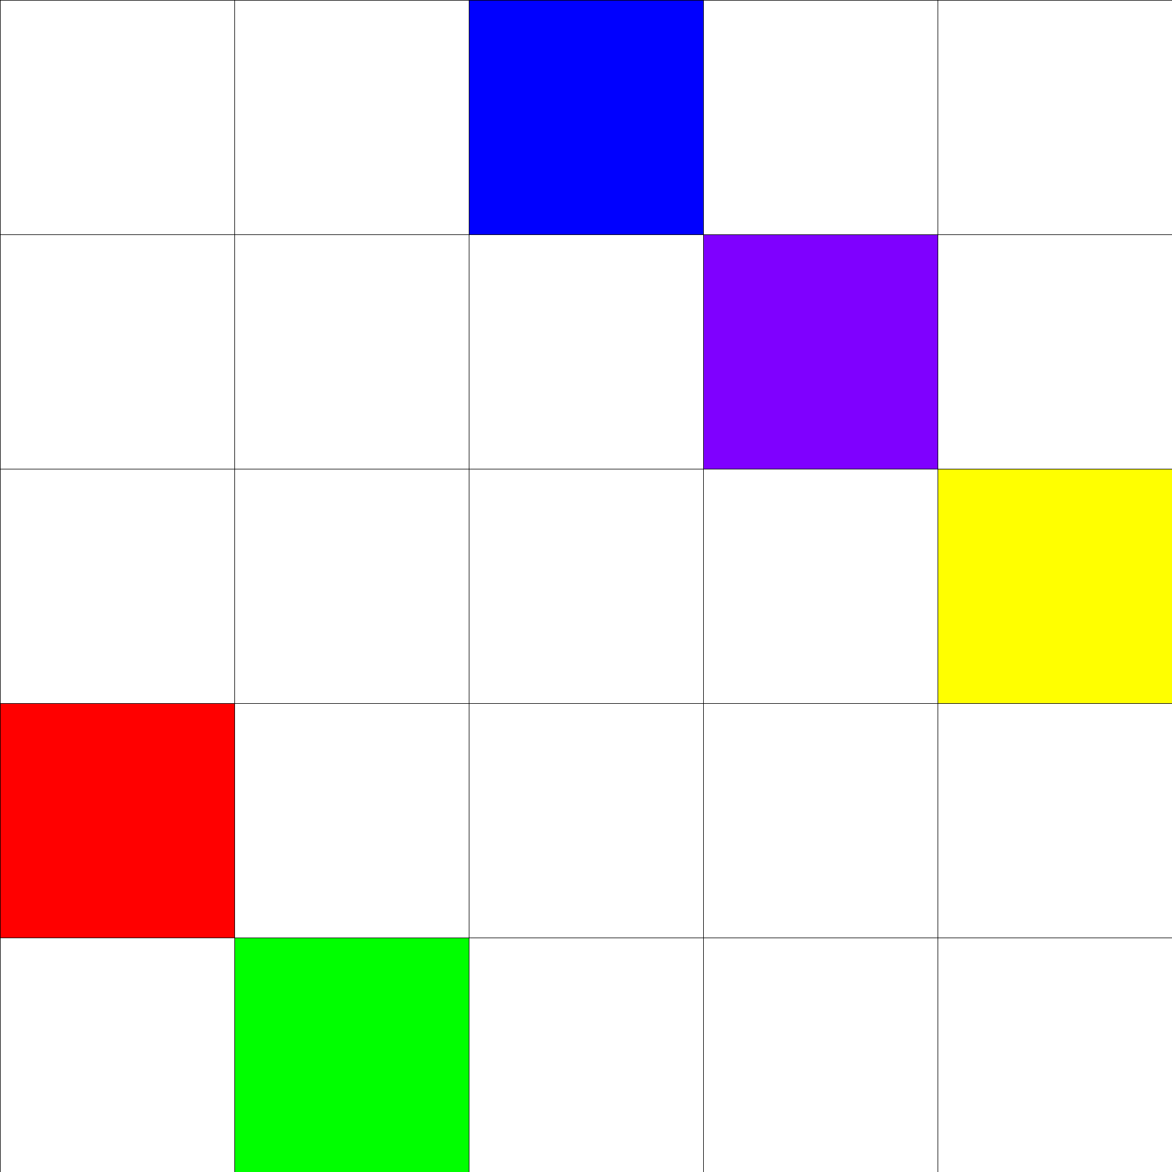
Block scheduling

Slide 70
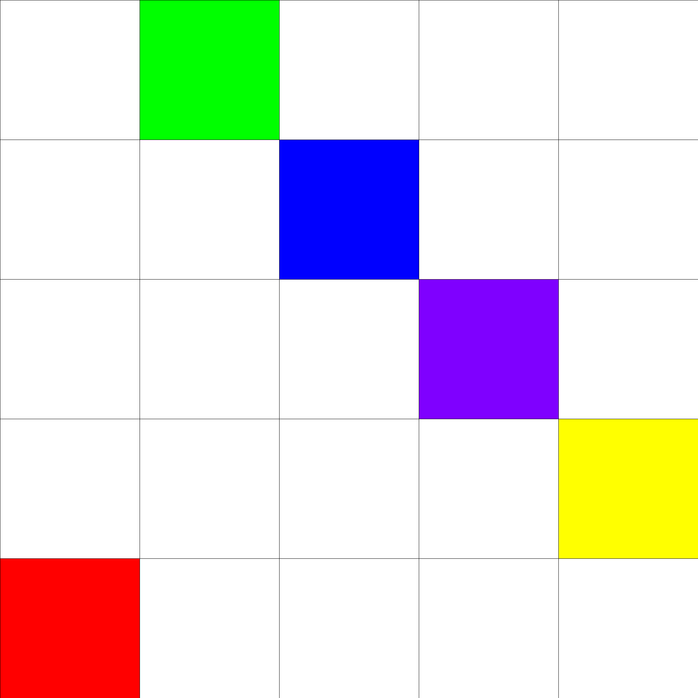
Block scheduling

Slide 71
Block scheduling

Slide 72
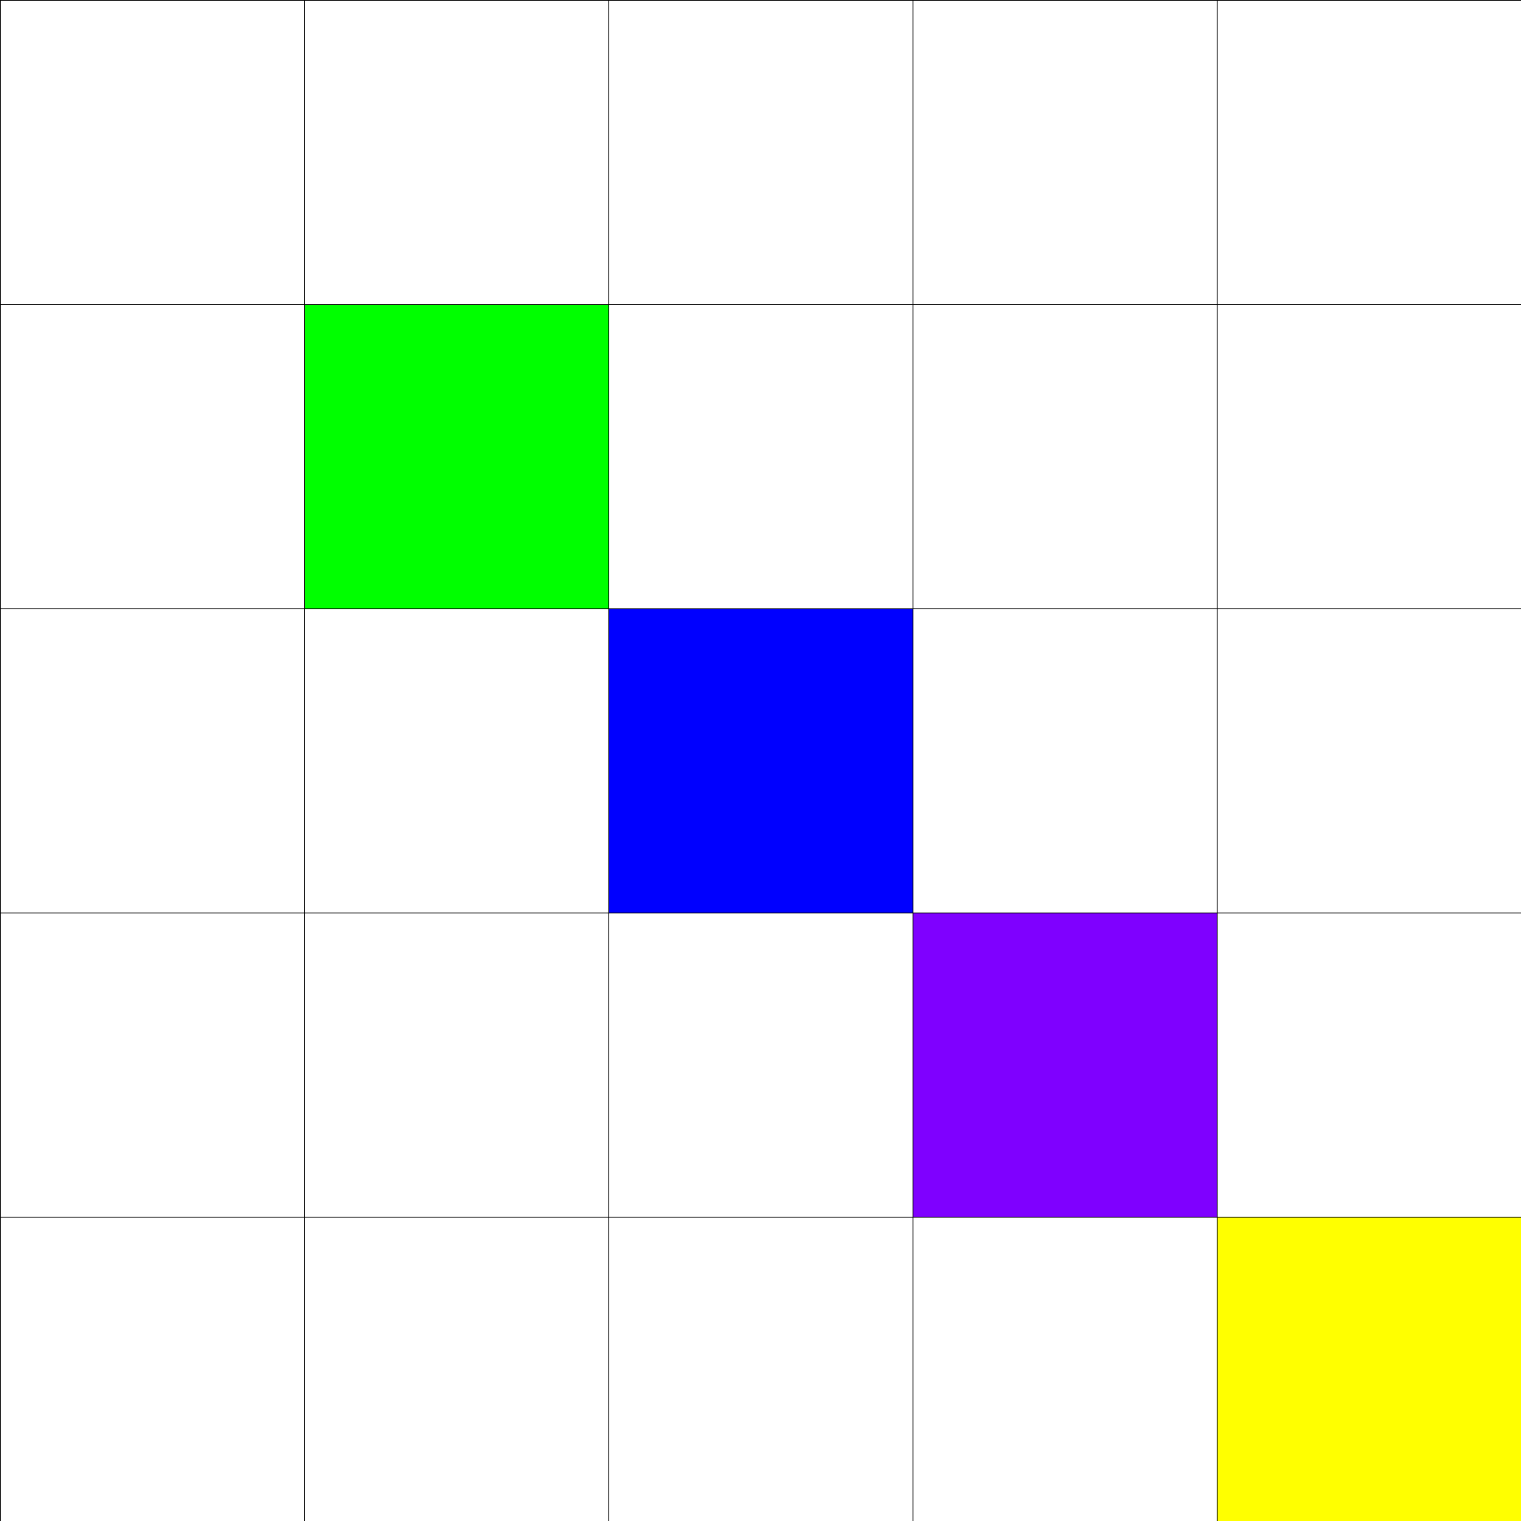
Block scheduling
No Free Block!

Slide 73
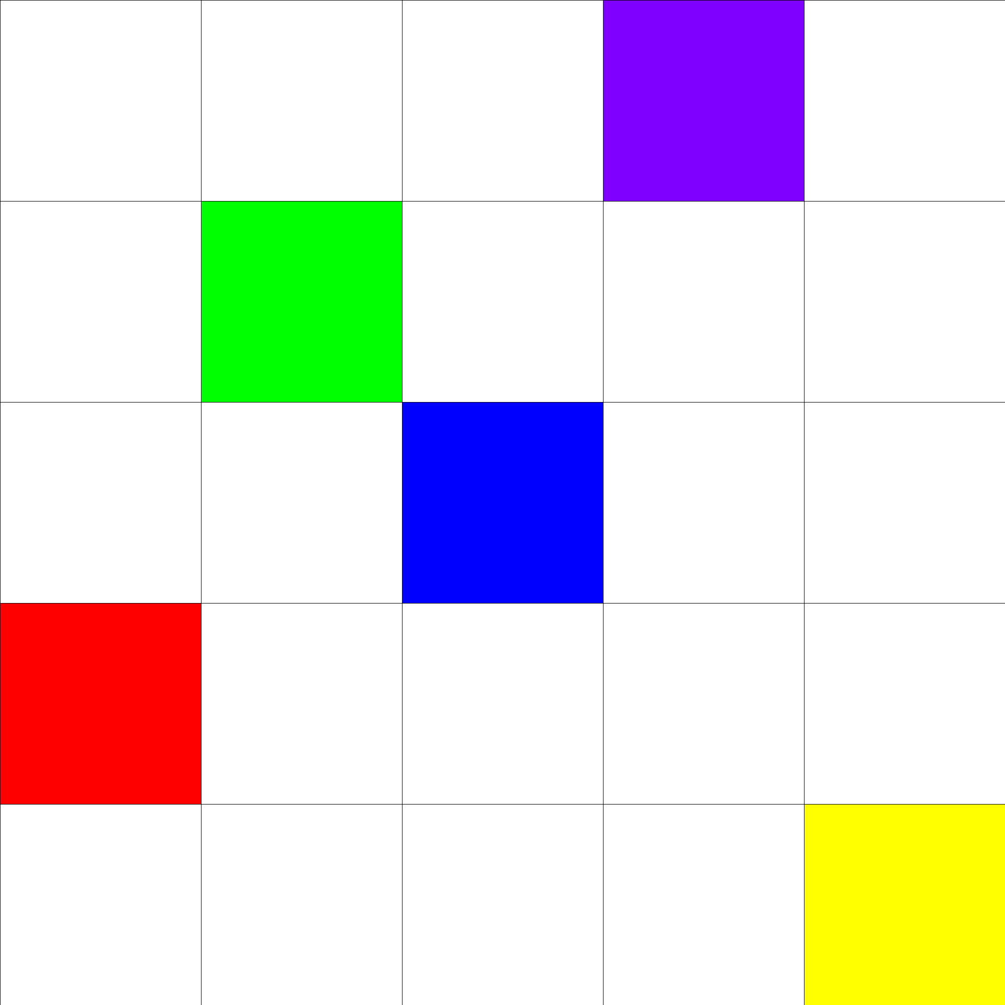
Block scheduling

Slide 74
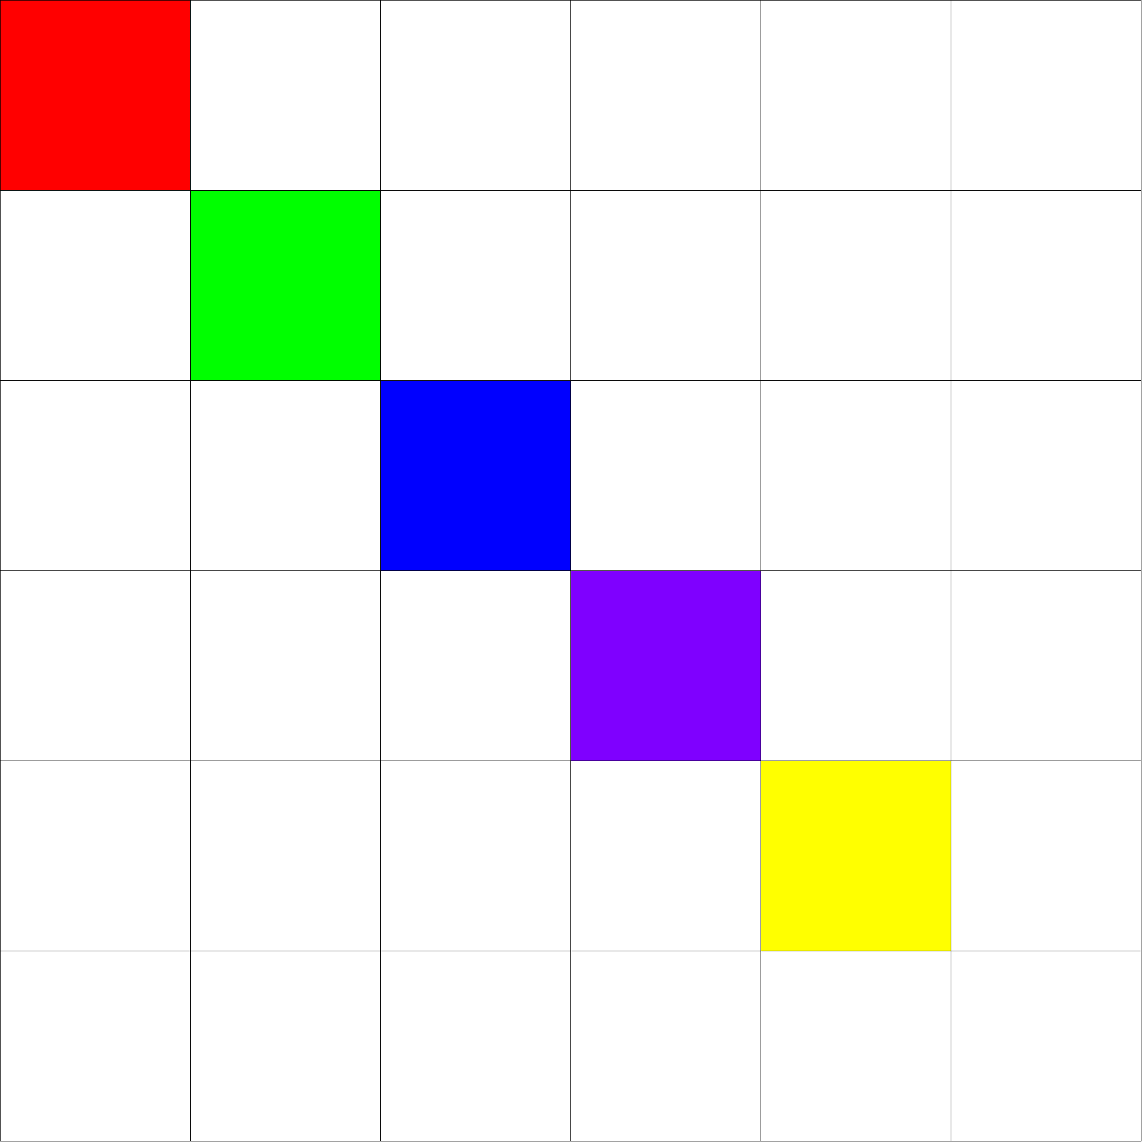
Asynchronous scheduling
[Zhuang, 2013]
1 column
bigger
1 row bigger

Slide 75
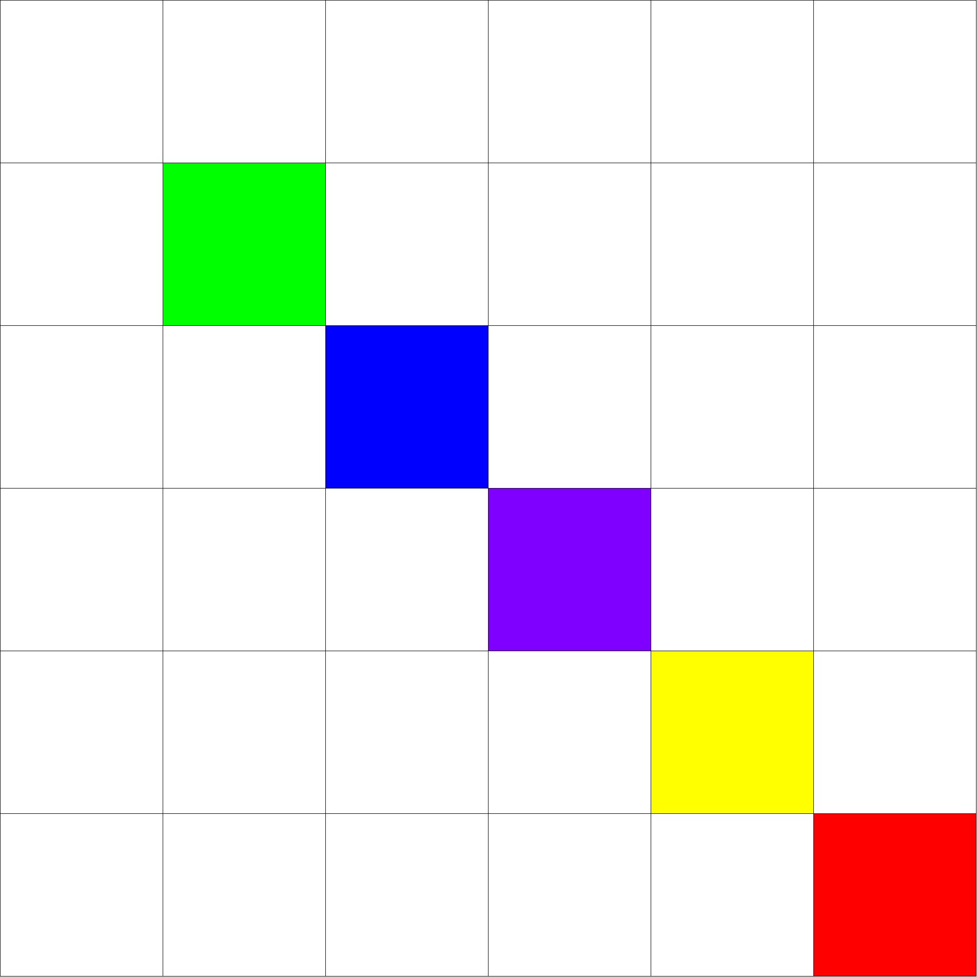
Asynchronous scheduling

Slide 76
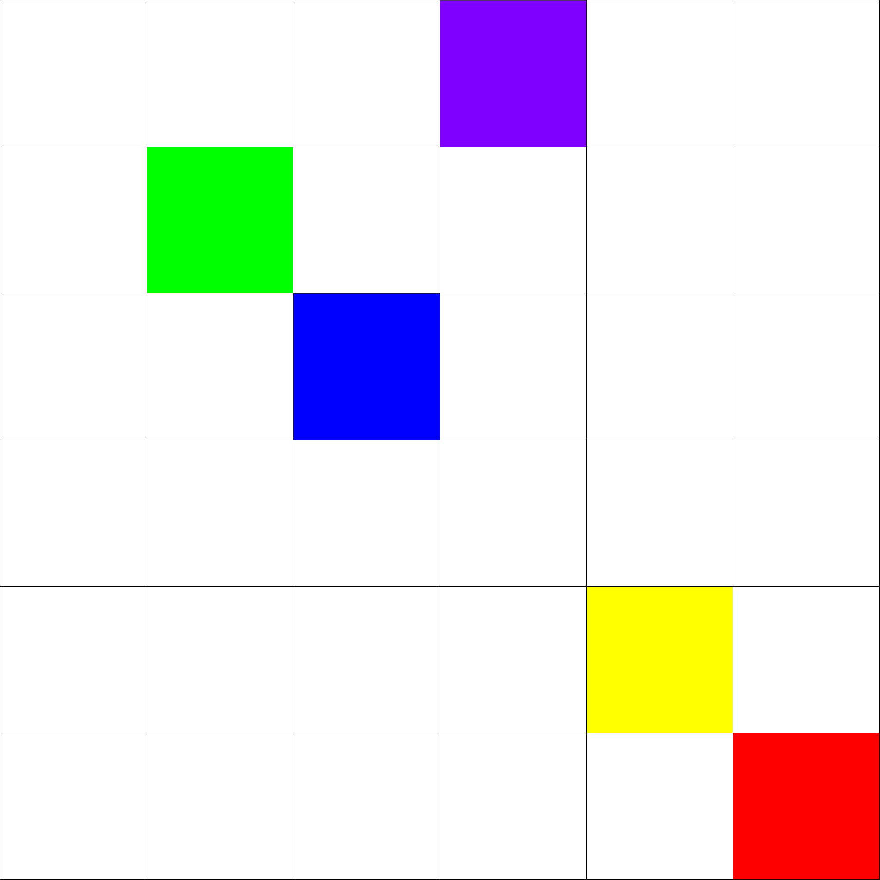
Asynchronous scheduling

Slide 77
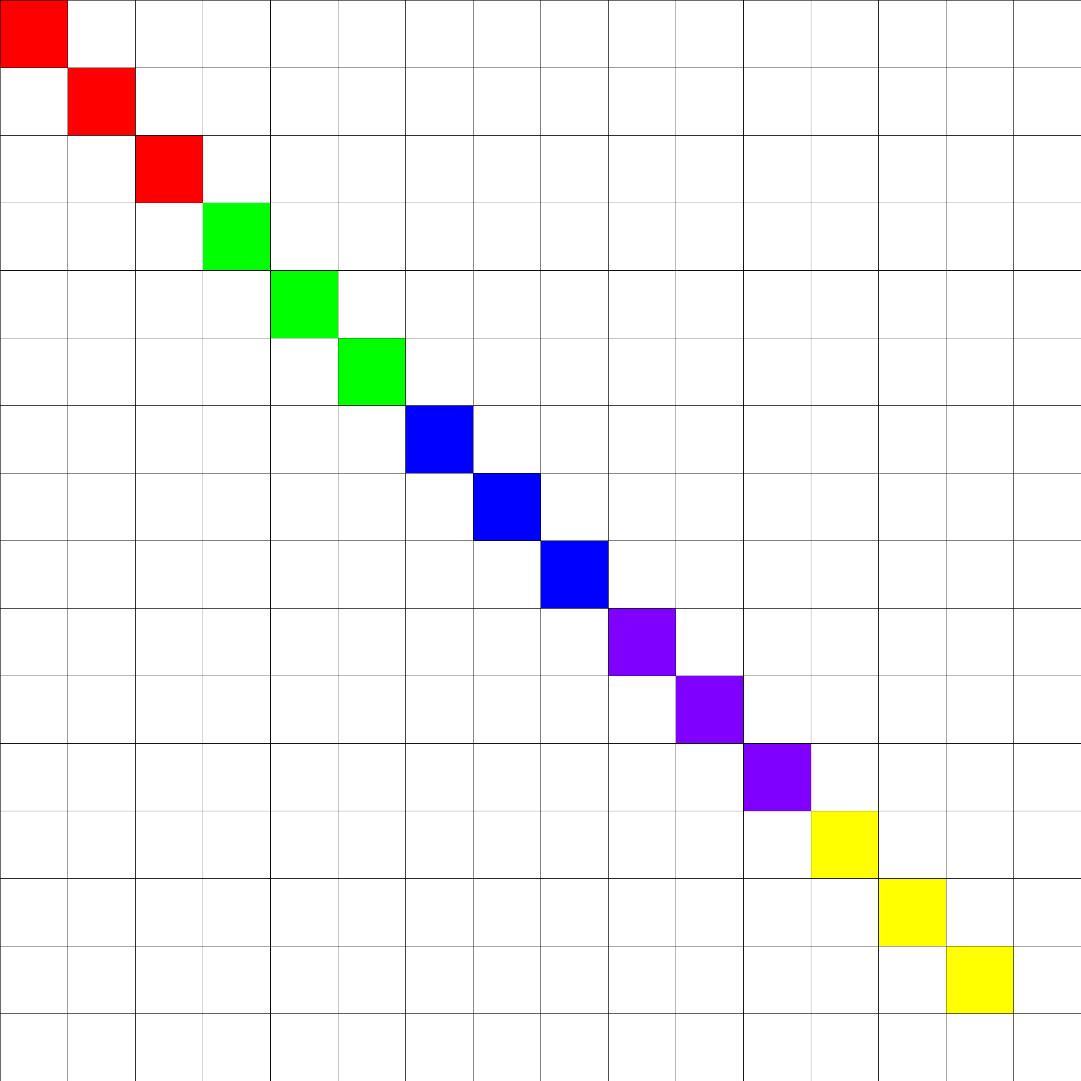
Asynchronous high-latency scheduling

Slide 78
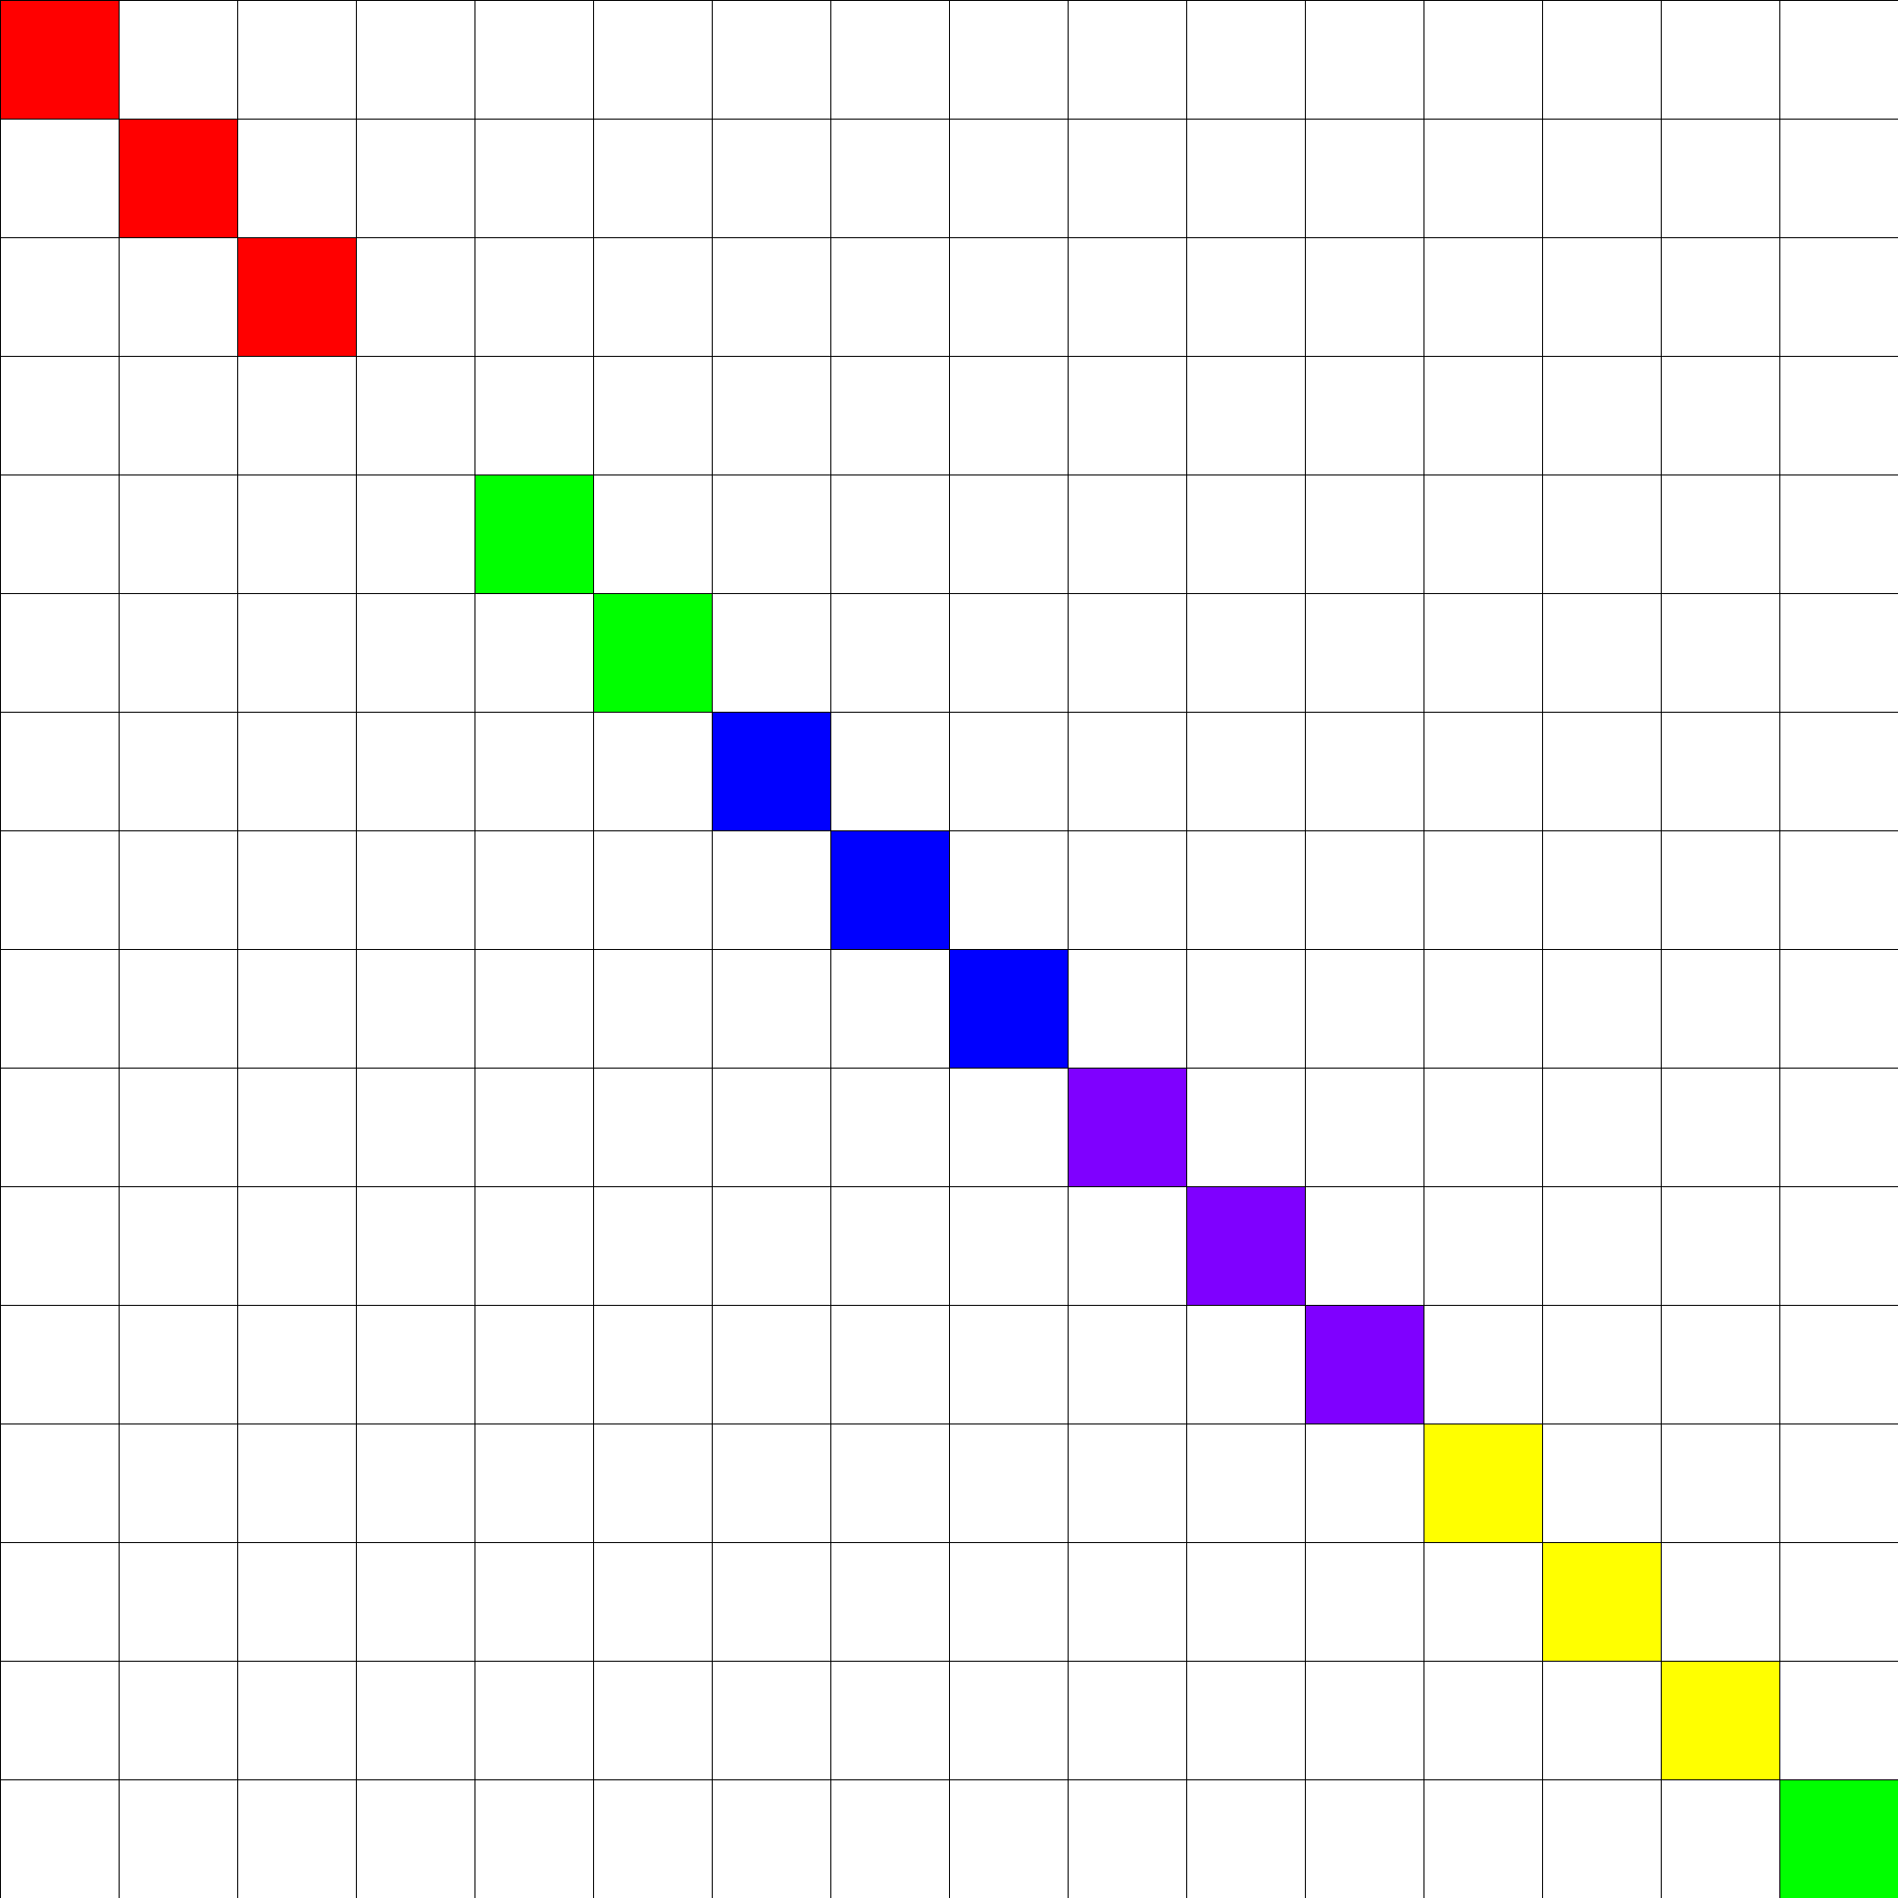
Asynchronous high-latency scheduling

Slide 79
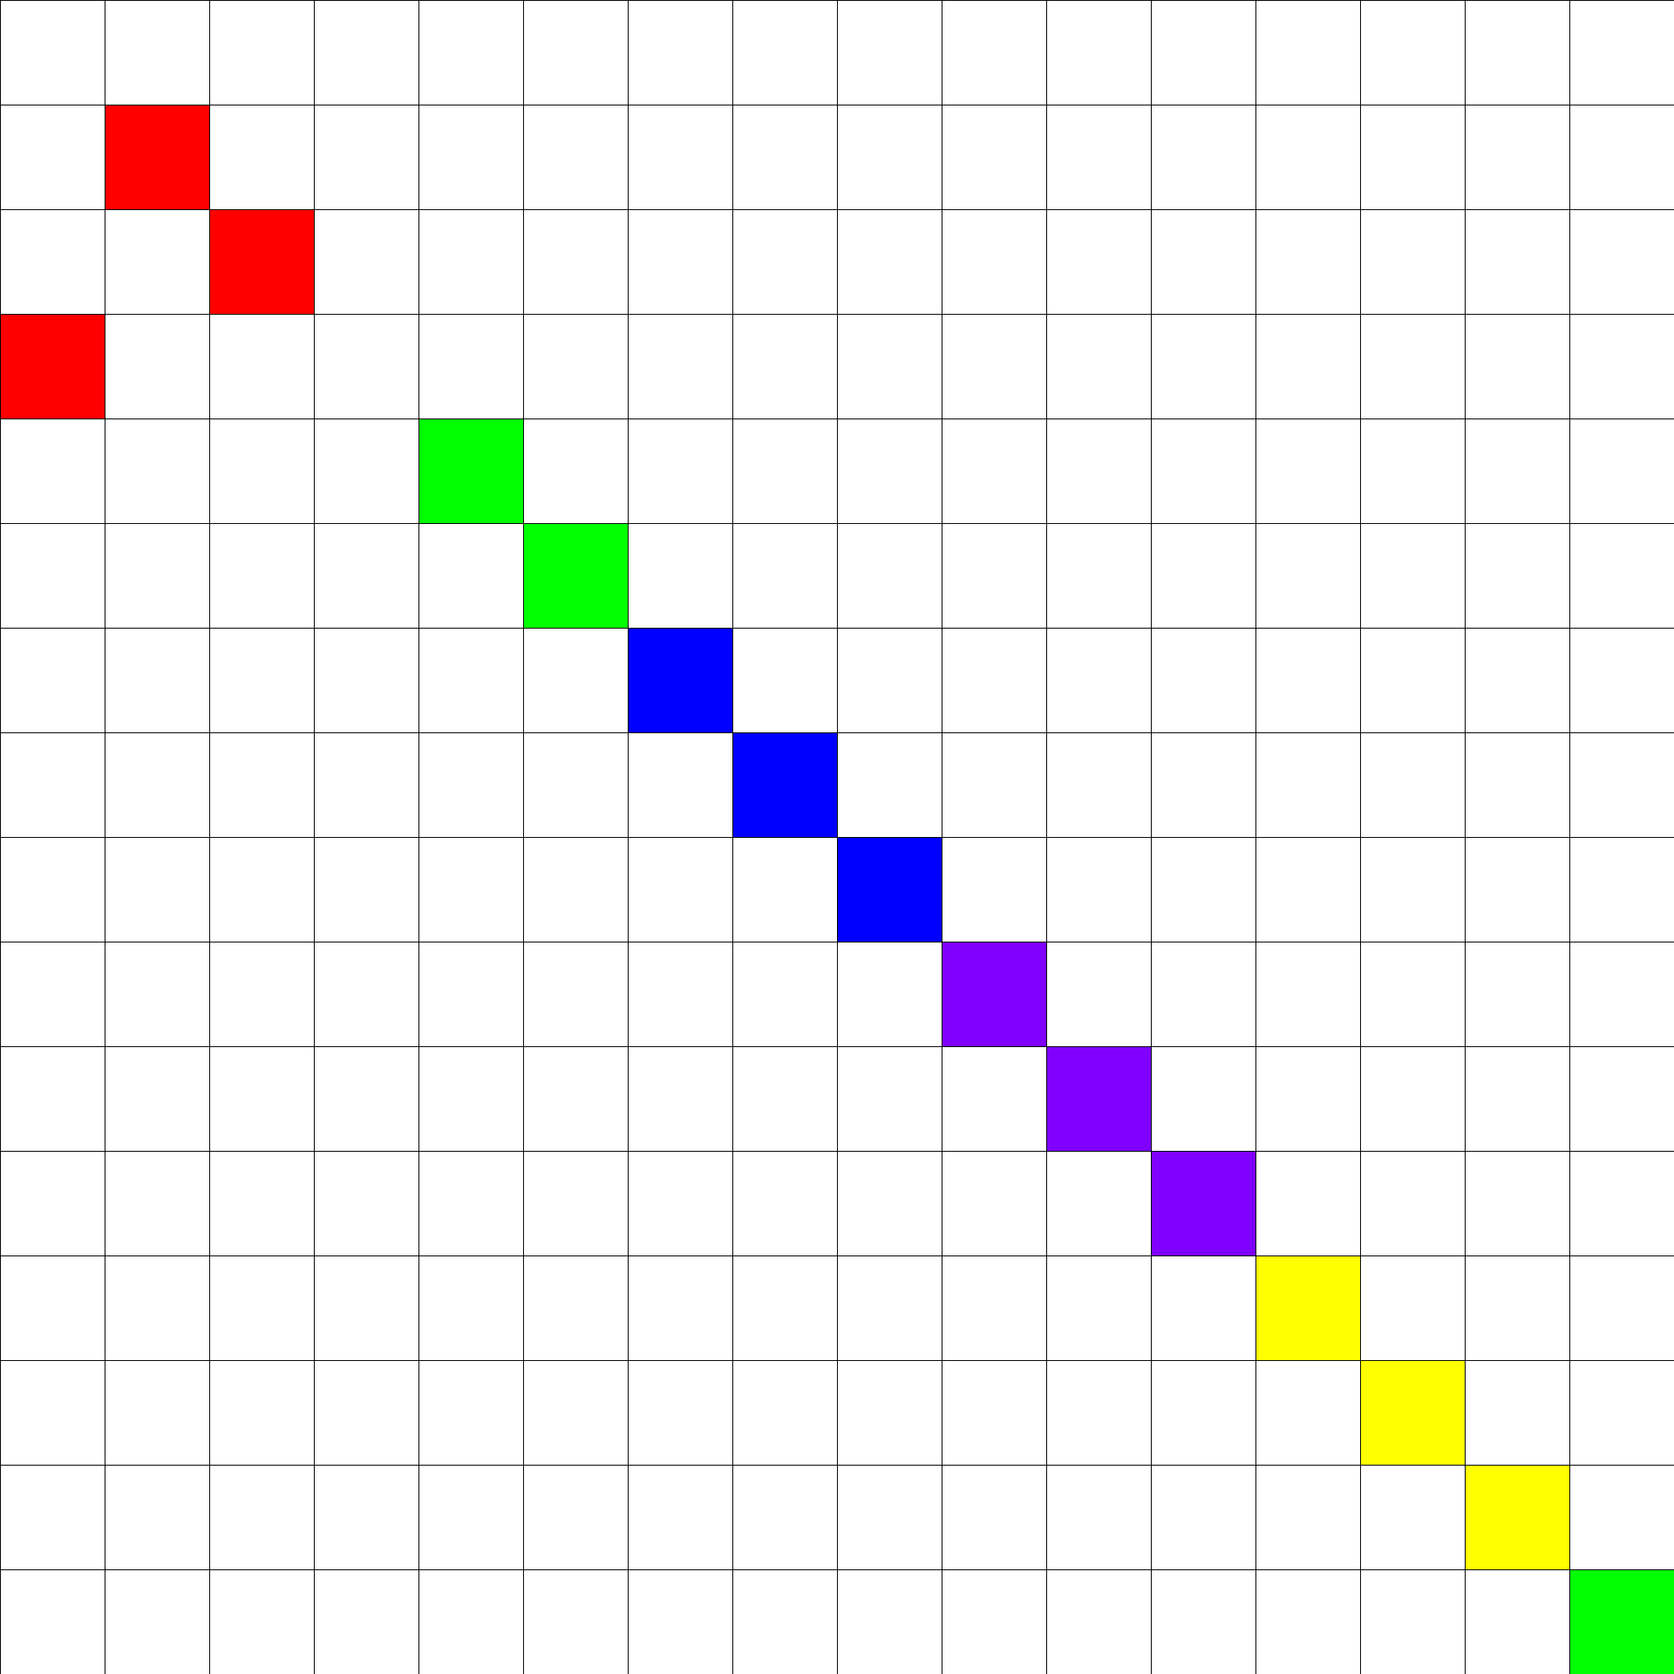
Asynchronous high-latency scheduling
But t parallel tasks with queue length q requires (qt+1)² blocks

Slide 80
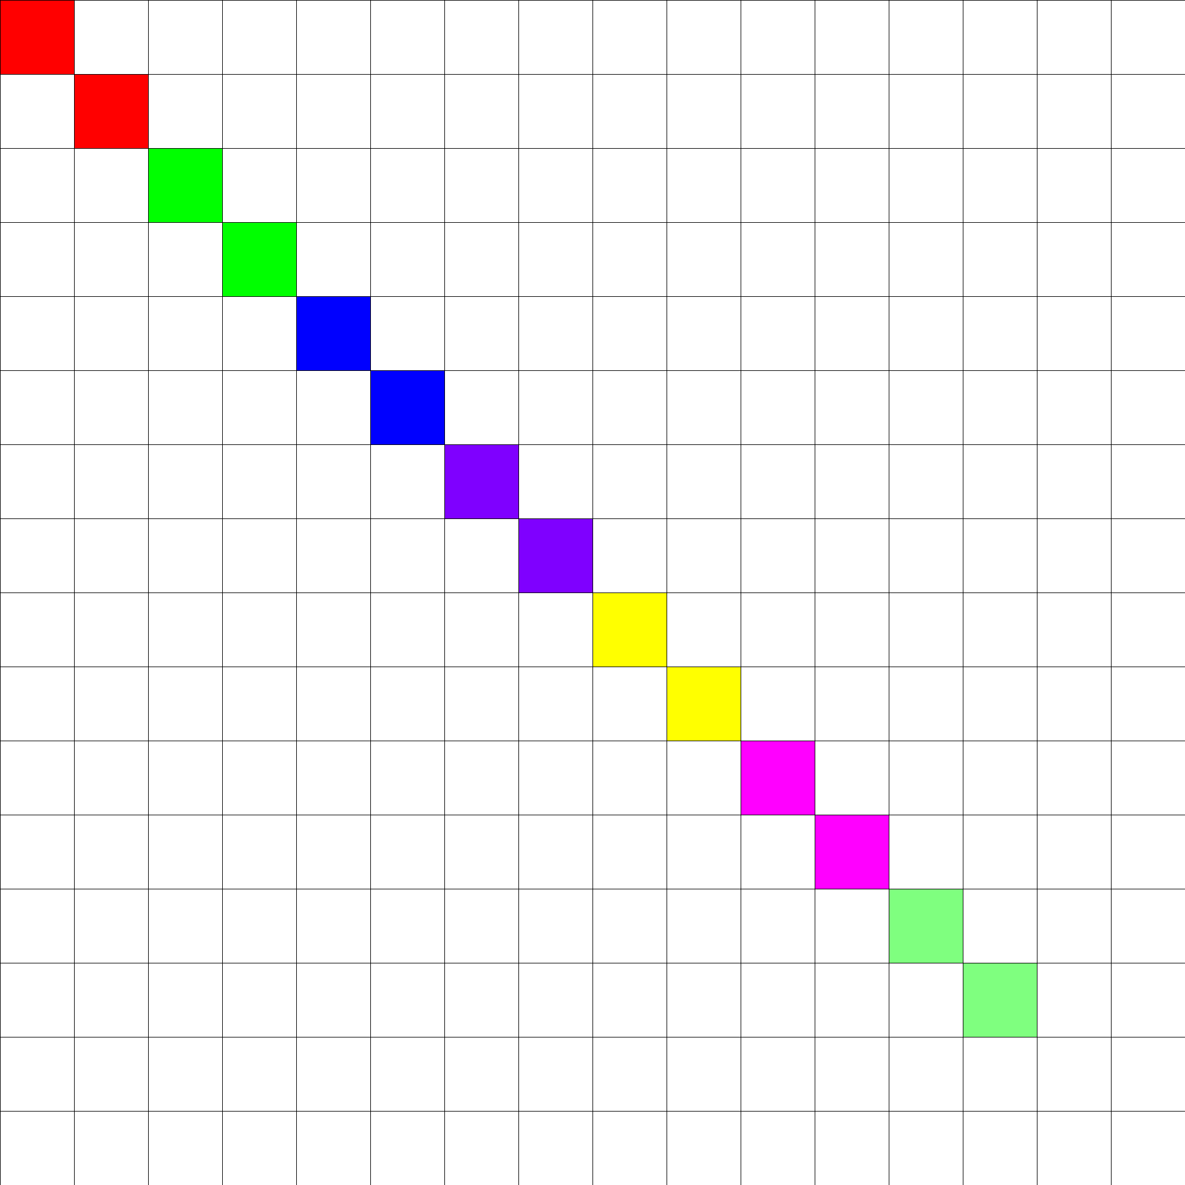
Asynchronous high-latency scheduling

Slide 81
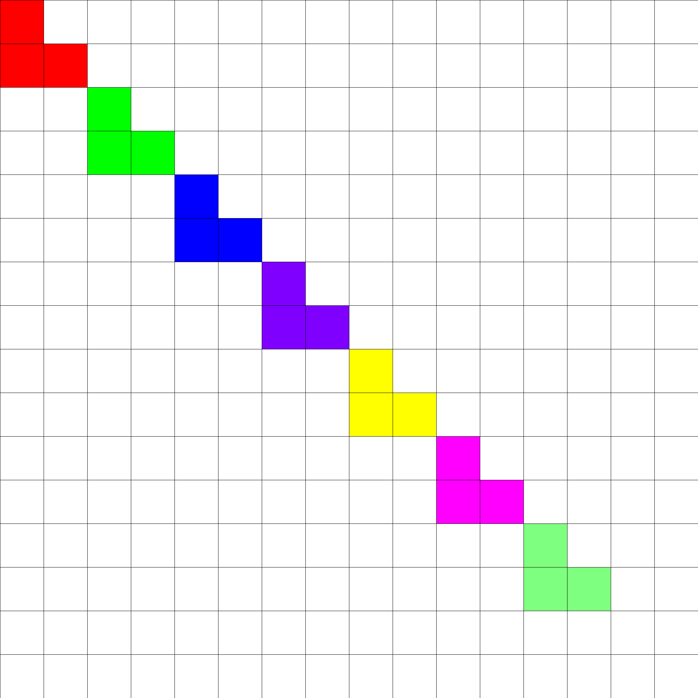
Asynchronous high-latency scheduling
Squaring the number of blocks squares the queue length

Slide 82
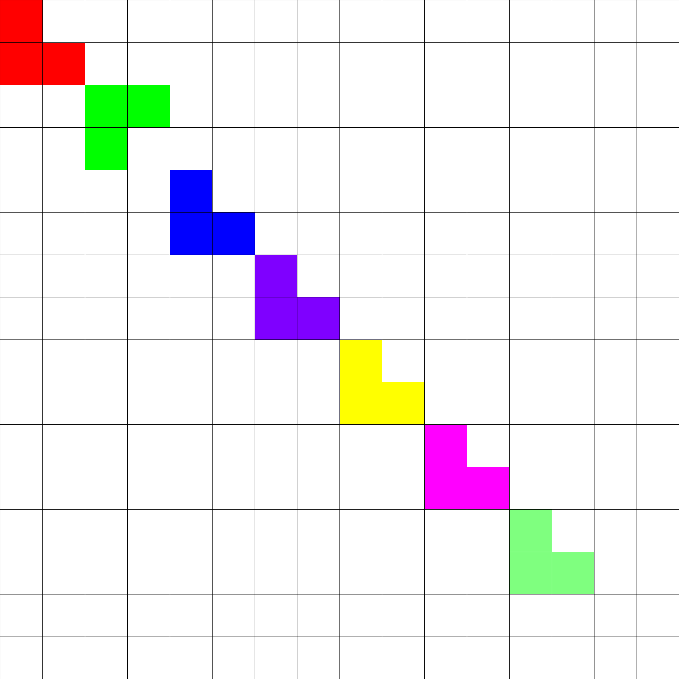
Asynchronous high-latency scheduling

Slide 83
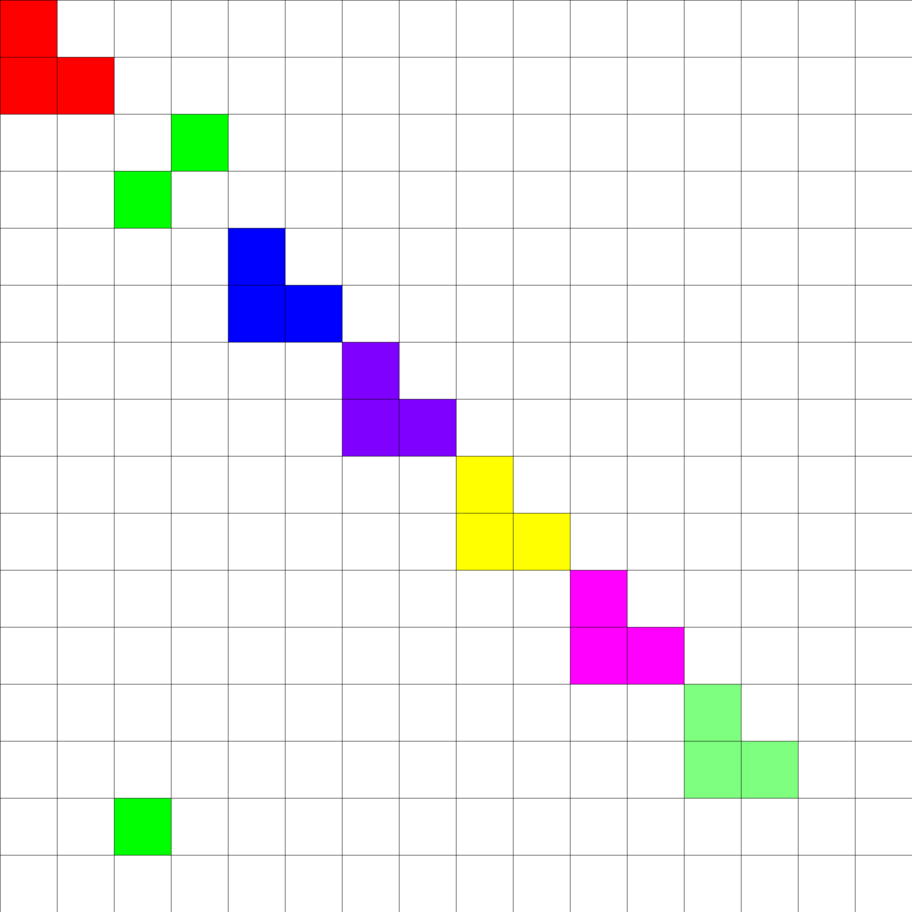
Asynchronous high-latency scheduling

Slide 84
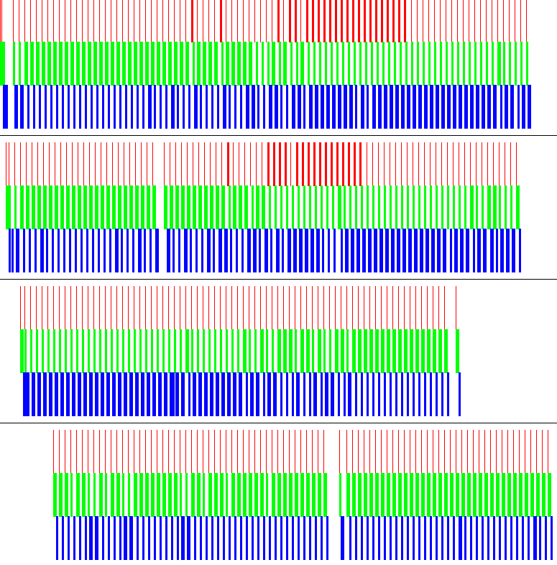
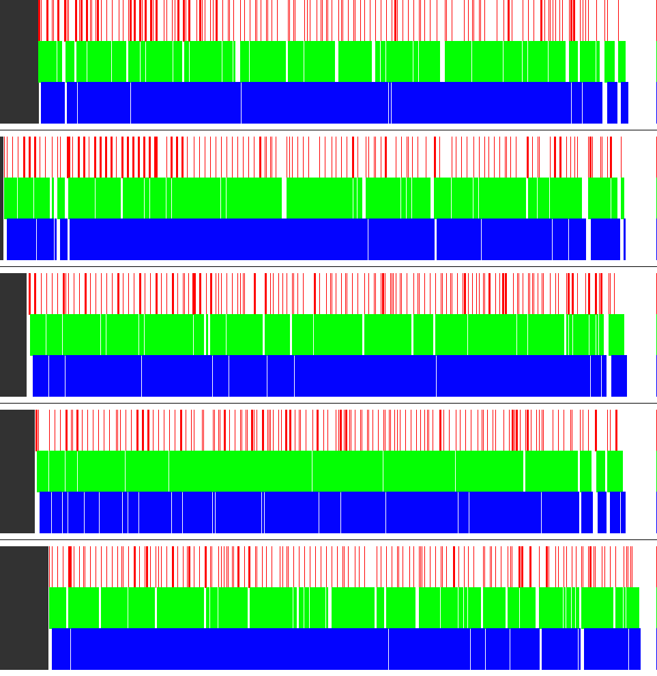
Pipelining
Without
With

Slide 85
Limited impact of failures

Slide 86
Bayesian Graphical Models
Joint work with Markus Weimer, Tom Minka, Yordan Zaykov and Vijay Narayanan

Slide 87
Matrix Factorization
Movies
V
Users
X
U
≈
Genres

Slide 88








Bayesian MF
5
4
α_{U}
5
4
1
~
5
4

Slide 89
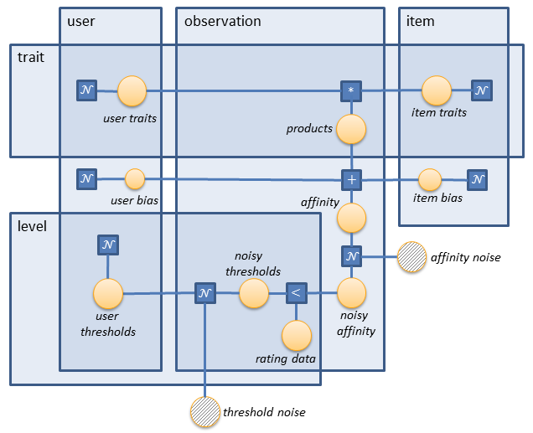
Graphical Models

Slide 90
Belief Propagation
α_{V}
Updates!
α_{U}
Dot product
5

Slide 91
Parallel Inference
Dot product
5
Dot product
4

Slide 92
Partition data & parameters (Gemulla, 2011)
Partition your data & model into d × d blocks
Results in d=3 strata
Process strata sequentially,
process blocks in each stratum in parallel

Slide 93
Parallel Inference
α_{V}
α_{U}
Dot product
5
Dot product
4

Slide 94
Questions?
Alex Beutel
abeutel@cs.cmu.edu
http://alexbeutel.com

