Slide 1

In the once upon a time days of the First Age of Magic, the prudent sorcerer regarded his own true name as his most valued possession but also the greatest threat to his continued good health, for--the stories go--once an enemy, even a weak unskilled enemy, learned the sorcerer's true name, then routine and widely known spells could destroy or enslave even the most powerful. As times passed, and we graduated to the Age of Reason and thence to the first and second industrial revolutions, such notions were discredited. Now it seems that the Wheel has turned full circle (even if there never really was a First Age) and we are back to worrying about true names again:
The first hint Mr. Slippery had that his own True Name might be known--and, for that matter, known to the Great Enemy--came with the appearance of two black Lincolns humming up the long dirt driveway ... Roger Pollack was in his garden weeding, had been there nearly the whole morning.... Four heavy-set men and a hard-looking female piled out, started purposefully across his well-tended cabbage patch.…
This had been, of course, Roger Pollack's great fear. They had discovered Mr. Slippery's True Name and it was Roger Andrew Pollack TIN/SSAN 0959-34-2861.
Notes:
To do

Slide 2
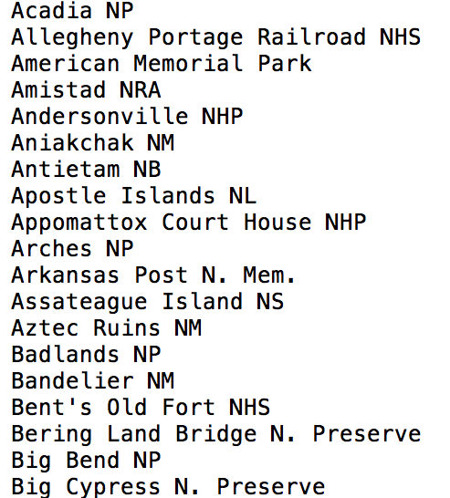
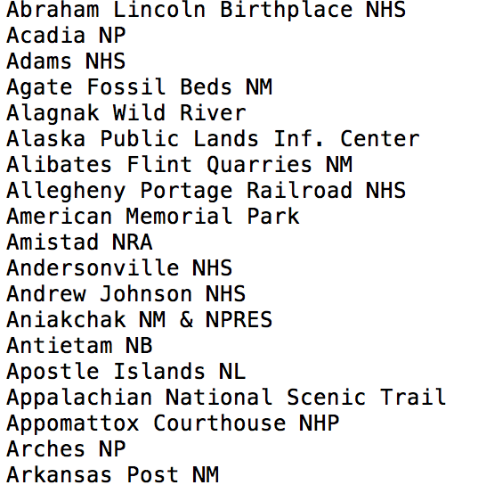
Recap: soft joins/similarity joins
Input: Two Different Lists of Entity Names
…
…

Slide 3
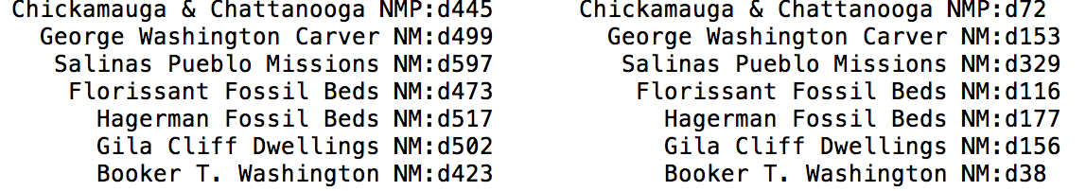
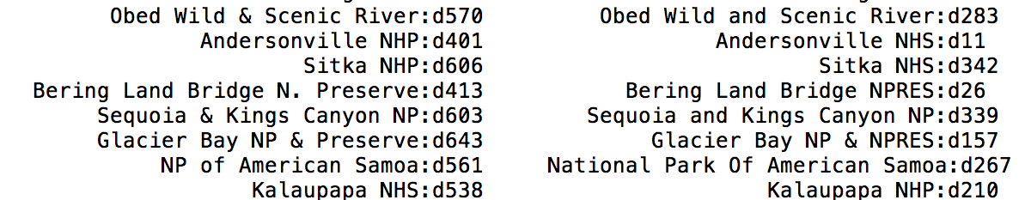
Recap: soft joins/similarity joins
Output: Pairs of Names Ranked by Similarity
identical
similar
…
…
less similar

Slide 4
Example: soft joins/similarity joins
Output: Pairs of Names Ranked by Similarity
A surprisingly good similarity score is TFIDF cosine distance.
Mismatches on frequent terms (“&” vs “and”, “N.”, “Preserve”, “NHP”, …) are discounted
Matches on rare term (“Kalaupapa”, “Samoa”) are rewarded.
…
…

Slide 5
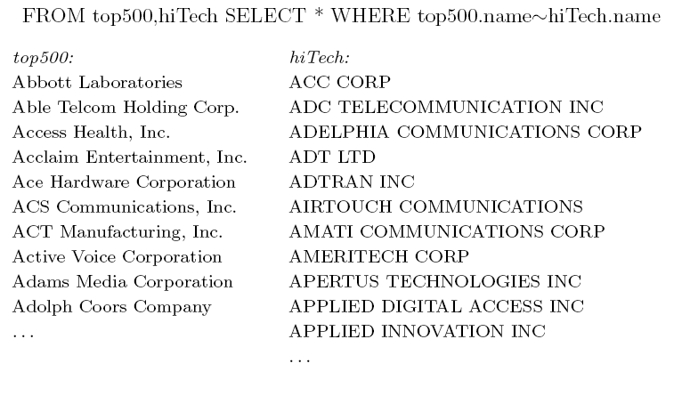
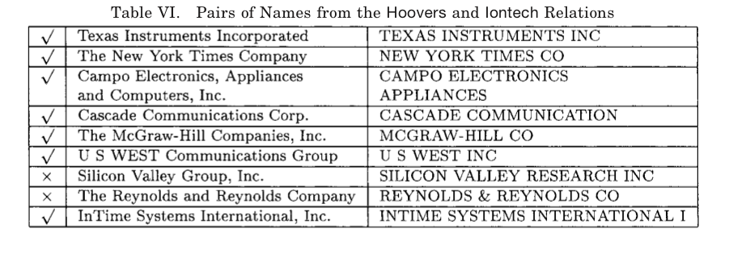
Softjoin Example - 1
~ means “similar to”
A useful scalable similarity metric: IDF weighting plus cosine distance!

Slide 6
One solution: Soft (Similarity) joins
A similarity join of two sets A and B is
  an ordered list of triples (s_{ij},a_{i},b_{j}) such that
    a_{i} is from A
    b_{j} is from B
    s_{ij} is the similarity of a_{i} and b_{j}
    the triples are in descending order
    the list is either the top K triples by s_{ij} or ALL triples with s_{ij}>L … or sometimes some approximation of these….

Slide 7
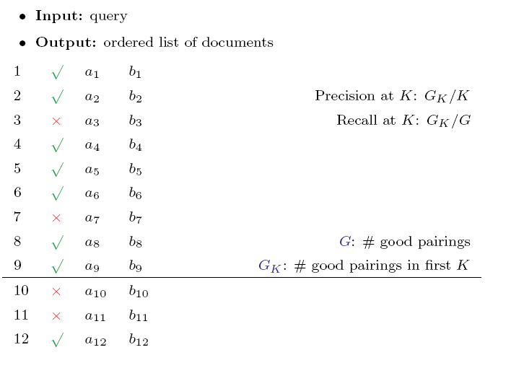
How well does TFIDF work?

Slide 8
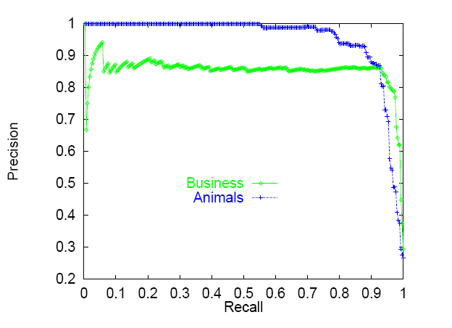

Slide 9
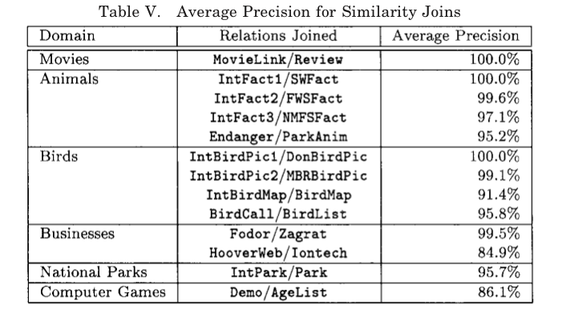
There are refinements to TFIDF distance – eg ones that extend with soft matching at the token level (e.g., softTFIDF)

Slide 10
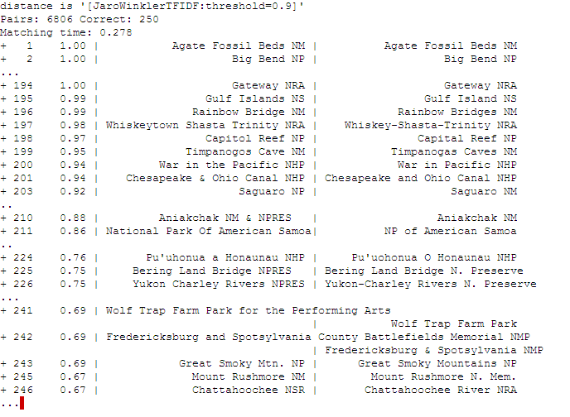
Semantic Joining with Multiscale Statistics
William Cohen
Katie Rivard, Dana Attias-Moshevitz
CMU

Slide 11
Semantic Joining with Multiscale Statistics
William Cohen
Katie Rivard, Dana Attias-Moshevitz
CMU

Slide 12
Soft Joins with TFIDF:
How?

Slide 13
Rocchio’s algorithm
Many variants of these formulae
…as long as u(w,d)=0 for words not in d!
Store only non-zeros in u(d), so size is O(|d| )
But size of u(y) is O(|n_{V}| )

Slide 14
TFIDF similarity

Slide 15
TFIDF soft joins
A similarity join of two sets of TFIDF-weighted vectors A and B is
  an ordered list of triples (s_{ij},a_{i},b_{j}) such that
    a_{i} is from A
    b_{j} is from B
    s_{ij} is the dot product of a_{i} and b_{j}
    the triples are in descending order
    the list is either the top K triples by s_{ij} or ALL triples with s_{ij}>L … or sometimes some approximation of these….

Slide 16
Parallel Soft JOINS

Slide 17

SIGMOD 2010

Slide 18
TFIDF similarity: variant for joins

Slide 19
Sim Joins on Product Descriptions
  Similarity can be high for descriptions of distinct items:
    AERO TGX-Series Work Table -42'' x 96'' Model 1TGX-4296 All tables shipped KD AEROSPEC- 1TGX Tables are Aerospec Designed. In addition to above specifications; - All four sides have a V countertop edge ...
    AERO TGX-Series Work Table -42'' x 48'' Model 1TGX-4248 All tables shipped KD AEROSPEC- 1TGX Tables are Aerospec Designed. In addition to above specifications; - All four sides have a V countertop ..
  Similarity can be low for descriptions of identical items:
    Canon Angle Finder C 2882A002 Film Camera Angle Finders Right Angle Finder C (Includes ED-C & ED-D Adapters for All SLR Cameras) Film Camera Angle Finders & Magnifiers The Angle Finder C lets you adjust ...
    CANON 2882A002 ANGLE FINDER C FOR EOS REBEL® SERIES PROVIDES A FULL SCREEN IMAGE SHOWS EXPOSURE DATA BUILT-IN DIOPTRIC ADJUSTMENT COMPATIBLE WITH THE CANON® REBEL, EOS & REBEL EOS SERIES.

Slide 20
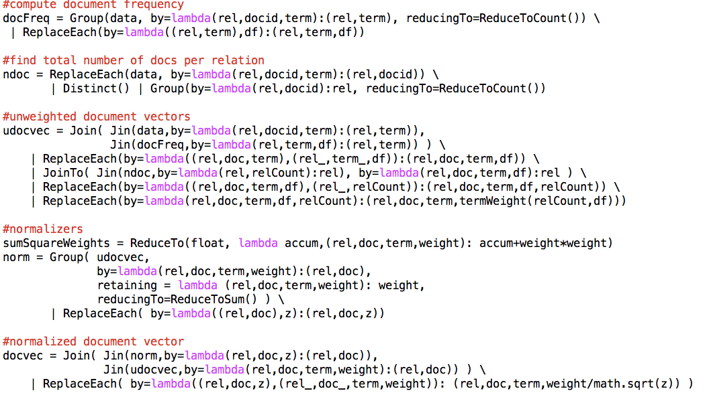
Parallel Inverted Index Softjoin - 1
want this to work for long documents or short ones…and keep the relations simple
sumSquareWeights
Statistics for computing TFIDF with IDFs local to each relation

Slide 21
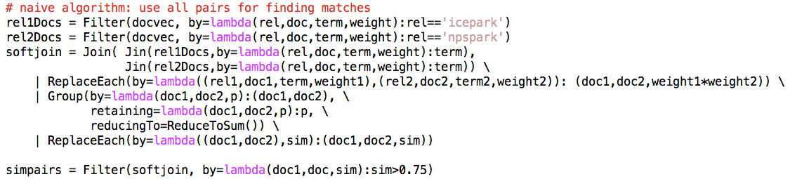
Parallel Inverted Index Softjoin - 2
What’s the algorithm?
Step 1: create document vectors as (C_{d}, d, term, weight) tuples
Step 2: join the tuples from A and B: one sort and reduce
  Gives you tuples (a, b, term, w(a,term)*w(b,term))
Step 3: group the common terms by (a,b) and reduce to aggregate the components of the sum

Slide 22
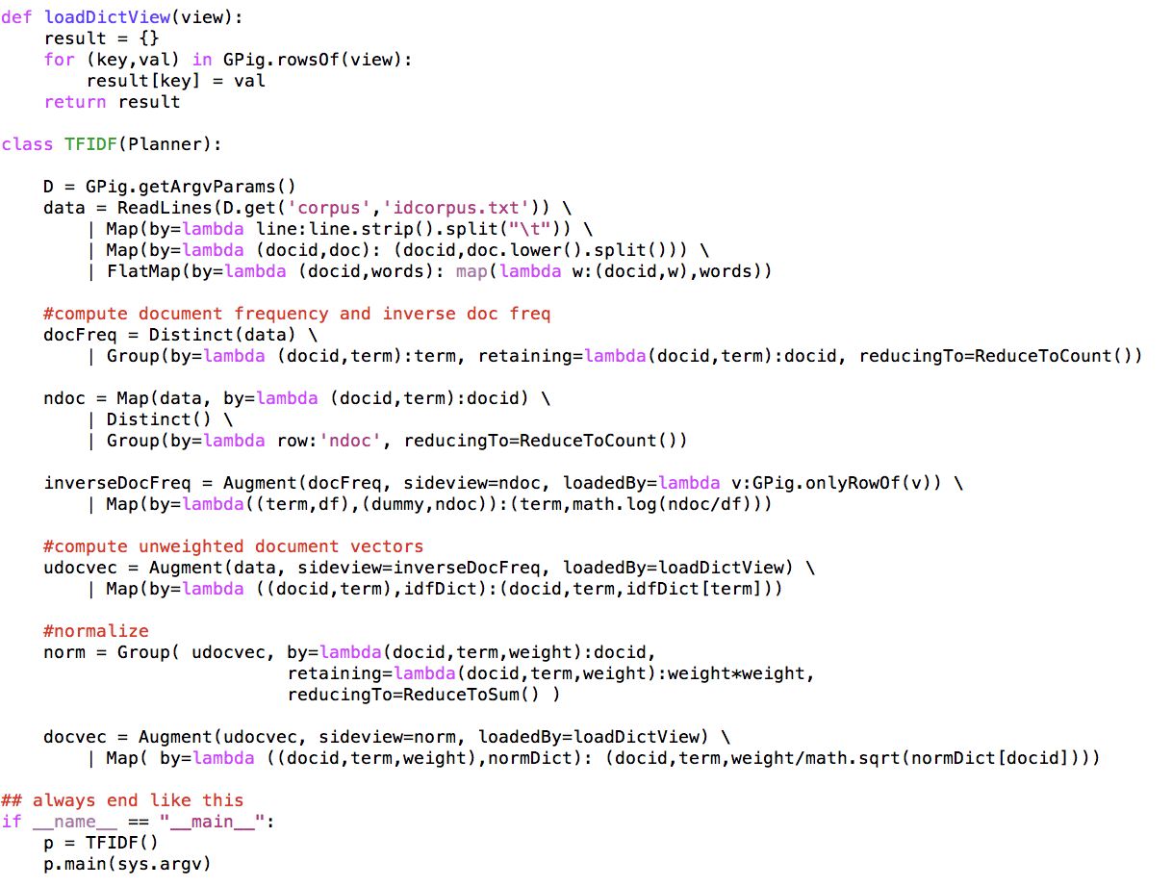
An alternative TFIDF pipeline

Slide 23
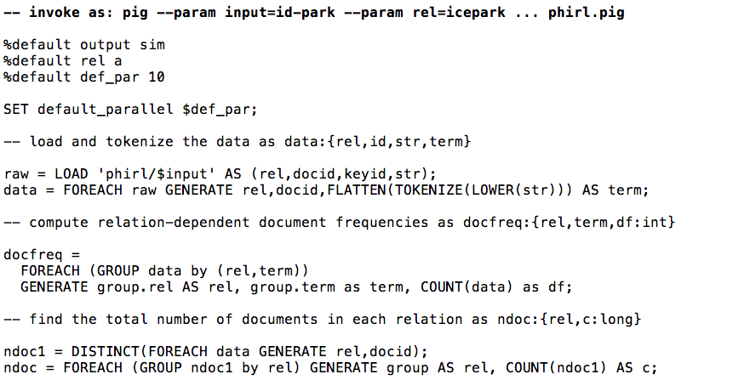
Inverted Index Softjoin – PIG 1/3

Slide 24
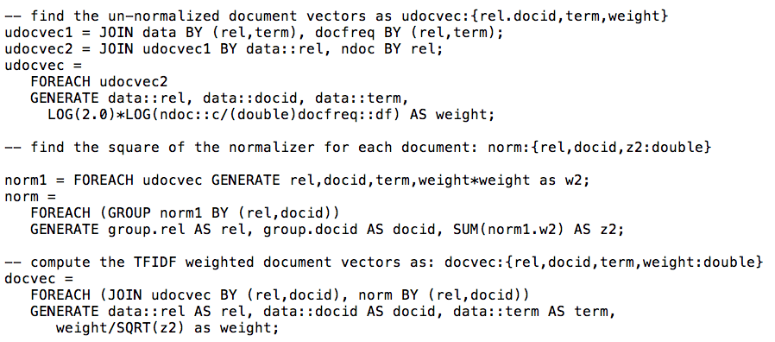
Inverted Index Softjoin – 2/3

Slide 25
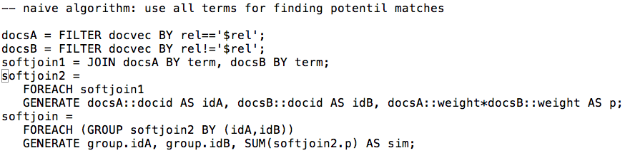
Inverted Index Softjoin – 3/3

Slide 26
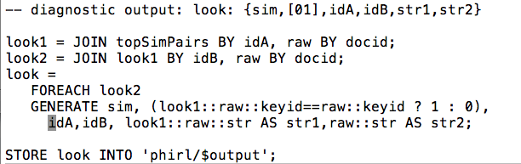
Inverted Index Softjoin – 3/3

Slide 27
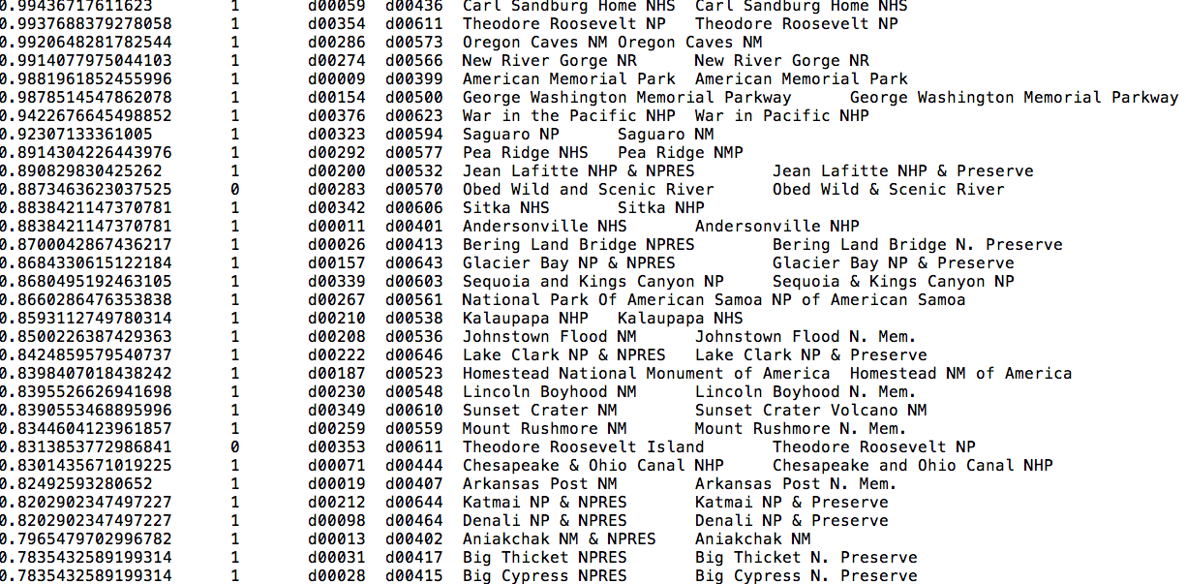
Results…..

Slide 28
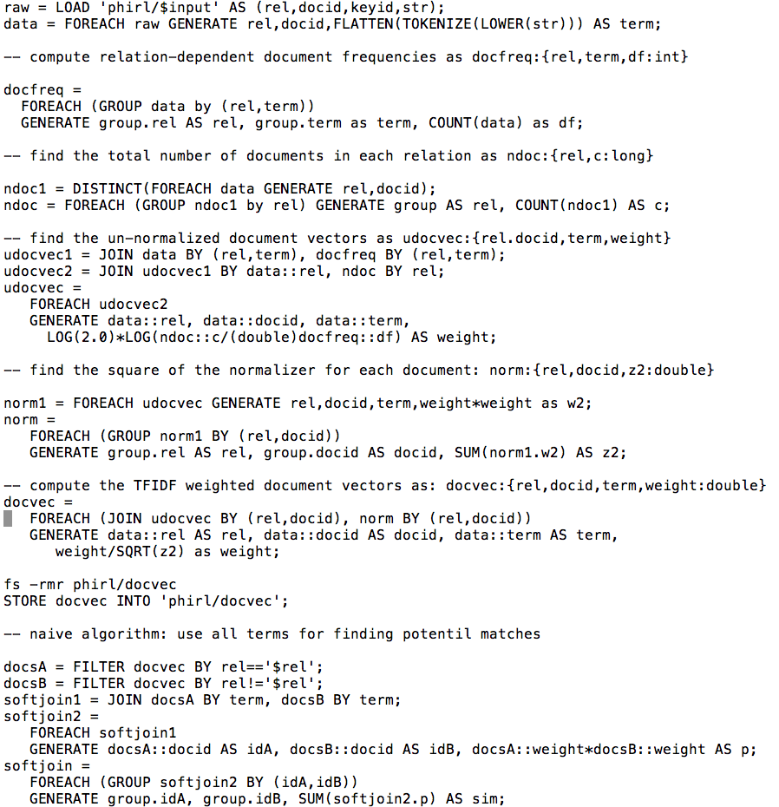

Slide 29
Making the algorithm smarter….

Slide 30
Inverted Index Softjoin - 2
we should make a smart choice about which terms to use

Slide 31
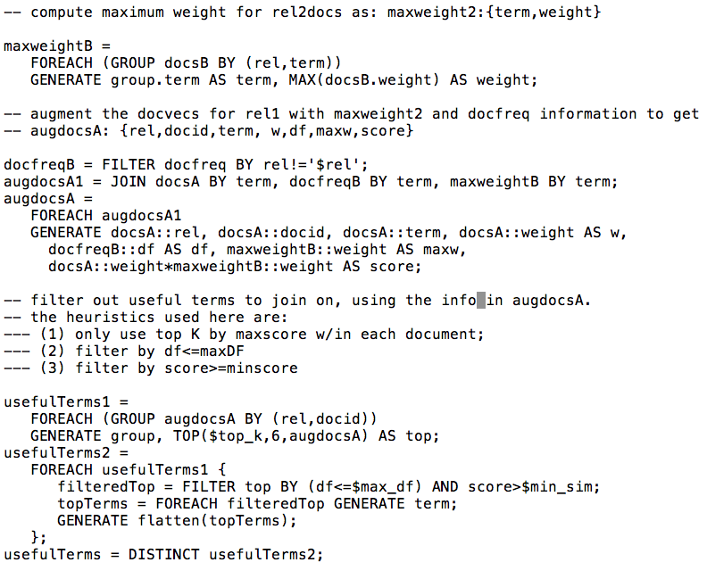
Adding heuristics to the soft join - 1
score for w in doc a

Slide 32
Adding heuristics to the soft join - 1

Slide 33
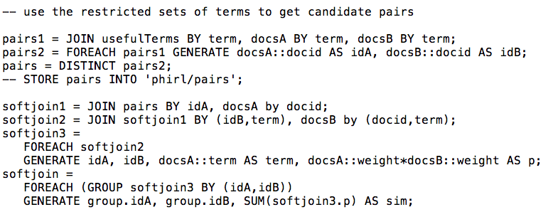
Adding heuristics to the soft join - 2

Slide 34
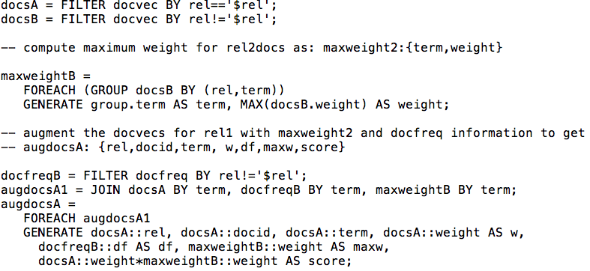
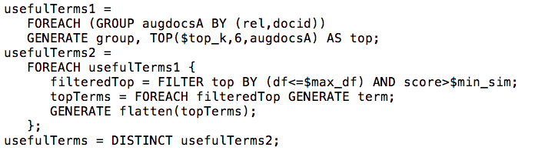
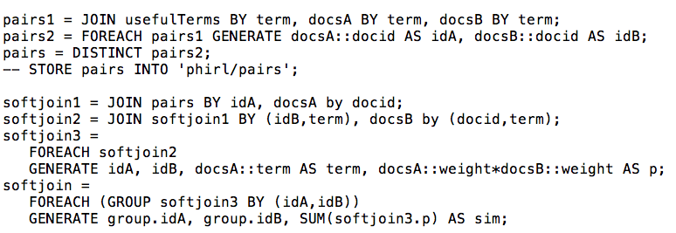

Slide 35
PageRank at Scale

Slide 36
Google’s PageRank
Inlinks are “good” (recommendations)
Inlinks from a “good” site are better than inlinks from a “bad” site
but inlinks from sites with many outlinks are not as “good”...
“Good” and “bad” are relative.
web site xxx
web site xxx
web site xxx
web site a b c d e f g
web
site
pdq pdq ..
web site yyyy
web site a b c d e f g
web site yyyy

Slide 37
Google’s PageRank
web site xxx
Imagine a “pagehopper” that always either
follows a random link, or
jumps to random page
web site xxx
web site a b c d e f g
web
site
pdq pdq ..
web site yyyy
web site a b c d e f g
web site yyyy

Slide 38
Google’s PageRank
(Brin & Page, http://www-db.stanford.edu/~backrub/google.html)
web site xxx
Imagine a “pagehopper” that always either
follows a random link, or
jumps to random page
PageRank ranks pages by the amount of time the pagehopper spends on a page:
or, if there were many pagehoppers, PageRank is the expected “crowd size”
web site xxx
web site a b c d e f g
web
site
pdq pdq ..
web site yyyy
web site a b c d e f g
web site yyyy

Slide 39
PageRank in Memory
Let u = (1/N, …, 1/N)
  dimension = #nodes N
Let A = adjacency matrix: [a_{ij}=1 ⬄ i links to j]
Let W = [w_{ij} = a_{ij}/outdegree(i)]
  w_{ij} is probability of jump from i to j
Let v⁰ = (1,1,….,1)
  or anything else you want
Repeat until converged:
  Let v^{t+1} = cu + (1-c)Wv^{t}
    c is probability of jumping “anywhere randomly”
W

Slide 40
Streaming PageRank
Assume we can store v but not W in memory
Repeat until converged:
  Let v^{t+1} = cu + (1-c) v^{t}W
Store A as a row matrix: each line is
  i j_{i,1},…,j_{i,d} [the neighbors of i]
Store v’ and v in memory: v’ starts out as cu
For each line “i j_{i,1},…,j_{i,d} “
  For each j in j_{i,1},…,j_{i,d}
    v’[j] += (1-c)v[i]/d
Everything needed for update is right there in row….

Slide 41
Streaming PageRank: with some long rows
Repeat until converged:
  Let v^{t+1} = cu + (1-c) v^{t}W
Store A as a list of edges: each line is: “i d(i) j”
Store v’ and v in memory: v’ starts out as cu
For each line “i d j“
    v’[j] += (1-c)v[i]/d
We need to get the degree of i and store it locally

Slide 42
Streaming PageRank: preprocessing
Original encoding is edges (i,j)
Mapper replaces i,j with i,1
Reducer is a SumReducer
Result is pairs (i,d(i))
Then: join this back with edges (i,j)
For each i,j pair:
  send j as a message to node i in the degree table
    messages always sorted after non-messages
  the reducer for the degree table sees i,d(i) first
    then j1, j2, ….
    can output the key,value pairs with key=i, value=d(i), j

Slide 43
Preprocessing Control Flow: 1
I | J
i1 | j1,1
i1 | j1,2
… | …
i1 | j1,k1
i2 | j2,1
… | …
i3 | j3,1
… | …
I
i1 | 1
i1 | 1
… | …
i1 | 1
i2 | 1
… | …
i3 | 1
… | …
I
i1 | 1
i1 | 1
… | …
i1 | 1
i2 | 1
… | …
i3 | 1
… | …
I | d(i)
i1 | d(i1)
.. | …
i2 | d(i2)
… | …
i3 | d)i3)
… | …
MAP
SORT
REDUCE
Summing values

Slide 44
Preprocessing Control Flow: 2
I | J
i1 | ~j1,1
i1 | ~j1,2
… | …
i2 | ~j2,1
… | …
I | J
i1 | j1,1
i1 | j1,2
… | …
i2 | j2,1
… | …
I
i1 | d(i1)
i1 | ~j1,1
i1 | ~j1,2
.. | …
i2 | d(i2)
i2 | ~j2,1
i2 | ~j2,2
… | …
I
i1 | d(i1) | j1,1
i1 | d(i1) | j1,2
… | … | …
i1 | d(i1) | j1,n1
i2 | d(i2) | j2,1
… | … | …
i3 | d(i3) | j3,1
… | … | …
I | d(i)
i1 | d(i1)
.. | …
i2 | d(i2)
… | …
I | d(i)
i1 | d(i1)
.. | …
i2 | d(i2)
… | …
MAP
SORT
REDUCE
copy or convert to messages
join degree with edges

Slide 45
Streaming PageRank: with some long rows
Repeat until converged:
  Let v^{t+1} = cu + (1-c)Wv^{t}
Pure streaming: use a table of nodes→ degree+pageRank
  Lines are i: degree=d,pr=v
For each edge i,j
  Send to i (in degree/pagerank) table: outlink j
For each line i: degree=d,pr=v:
  send to i: incrementVBy c
  for each message “outlink j”:
    send to j: incrementVBy (1-c)*v/d
For each line i: degree=d,pr=v
  sum up the incrementVBy messages to compute v’
  output new row: i: degree=d,pr=v’
One identity mapper with two inputs (edges, degree/pr table)
Reducer outputs the incrementVBy messages
Two-input mapper + reducer

Slide 46
Control Flow: Streaming PR
I | J
i1 | j1,1
i1 | j1,2
… | …
i2 | j2,1
… | …
I | d/v
i1 | d(i1),v(i1)
i1 | ~j1,1
i1 | ~j1,2
.. | …
i2 | d(i2),v(i2)
i2 | ~j2,1
i2 | ~j2,2
… | …
to | delta
i1 | c
j1,1 | (1-c)v(i1)/d(i1)
… | …
j1,n1 | i
i2 | c
j2,1 | …
… | …
i3 | c
I | delta
i1 | c
i1 | (1-c)v(…)….
i1 | (1-c)…
.. | …
i2 | c
i2 | (1-c)…
i2 | ….
… | …
I | d/v
i1 | d(i1),v(i1)
i2 | d(i2),v(i2)
… | …
REDUCE
MAP
SORT
MAP
SORT
send “pageRank updates ” to outlinks
copy or convert to messages

Slide 47
Control Flow: Streaming PR
to | delta
i1 | c
j1,1 | (1-c)v(i1)/d(i1)
… | …
j1,n1 | i
i2 | c
j2,1 | …
… | …
i3 | c
I | delta
i1 | c
i1 | (1-c)v(…)….
i1 | (1-c)…
.. | …
i2 | c
i2 | (1-c)…
i2 | ….
… | …
I | v’
i1 | ~v’(i1)
i2 | ~v’(i2)
… | …
I | d/v
i1 | d(i1),v’(i1)
i2 | d(i2),v’(i2)
… | …
I | d/v
i1 | d(i1),v(i1)
i2 | d(i2),v(i2)
… | …
REDUCE
MAP
SORT
REDUCE
MAP
SORT
REDUCE
Summing values
Replace v with v’

Slide 48
Control Flow: Streaming PR
I | J
i1 | j1,1
i1 | j1,2
… | …
i2 | j2,1
… | …
and back around for next iteration….
I | d/v
i1 | d(i1),v(i1)
i2 | d(i2),v(i2)
… | …
MAP
copy or convert to messages

Slide 49
PageRank in Pig

Slide 50
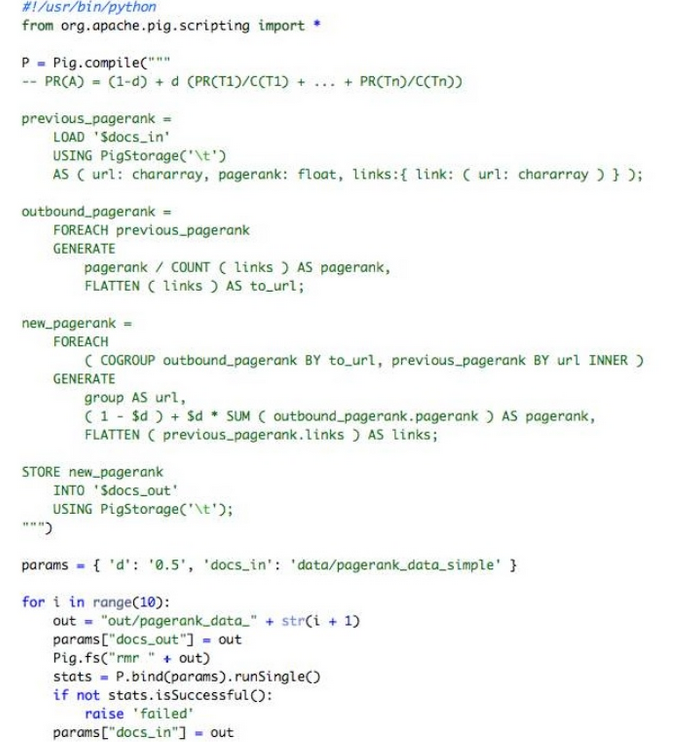
How to use loops, conditionals, etc?
Embed PIG in a real programming language.
Julien Le Dem - Yahoo

Slide 51
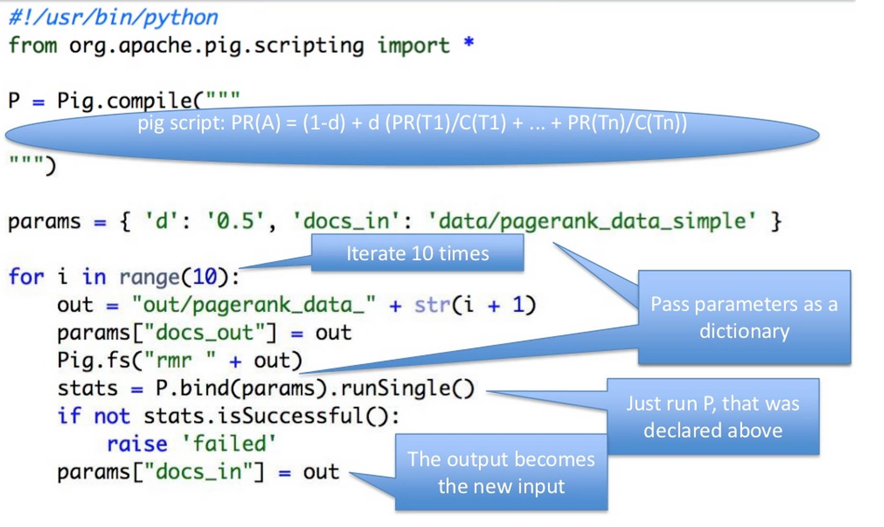

Slide 52
lots of i/o happening here…

Slide 53
An example from Ron Bekkerman

Slide 54
Example: k-means clustering
An EM-like algorithm:
Initialize k cluster centroids
E-step: associate each data instance with the closest centroid
  Find expected values of cluster assignments given the data and centroids
M-step: recalculate centroids as an average of the associated data instances
  Find new centroids that maximize that expectation

Slide 55
k-means Clustering
centroids

Slide 56
Parallelizing k-means

Slide 57
Parallelizing k-means

Slide 58
Parallelizing k-means

Slide 59
k-means on MapReduce
Panda et al, Chapter 2
Mappers read data portions and centroids
Mappers assign data instances to clusters
Mappers compute new local centroids and local cluster sizes
Reducers aggregate local centroids (weighted by local cluster sizes) into new global centroids
Reducers write the new centroids

Slide 60
k-means in Apache Pig: input data
Assume we need to cluster documents
  Stored in a 3-column table D:
Initial centroids are k randomly chosen docs
  Stored in table C in the same format as above
Document | Word | Count
doc1 | Carnegie | 2
doc1 | Mellon | 2

Slide 61
k-means in Apache Pig: E-step
D_C = JOIN C BY w, D BY w;
PROD = FOREACH D_C GENERATE d, c, i_{d} * i_{c} AS i_{d}i_{c} ;
PROD_{g} = GROUP PROD BY (d, c);
DOT_PROD = FOREACH PROD_{g} GENERATE d, c, SUM(i_{d}i_{c}) AS dXc;
SQR = FOREACH C GENERATE c, i_{c} * i_{c} AS i_{c}²;
SQR_{g} = GROUP SQR BY c;
LEN_C = FOREACH SQR_{g} GENERATE c, SQRT(SUM(i_{c}²)) AS len_{c};
DOT_LEN = JOIN LEN_C BY c, DOT_PROD BY c;
SIM = FOREACH DOT_LEN GENERATE d, c, dXc / len_{c};
SIM_{g} = GROUP SIM BY d;
CLUSTERS = FOREACH SIM_{g} GENERATE TOP(1, 2, SIM);

Slide 62
k-means in Apache Pig: E-step
D_C = JOIN C BY w, D BY w;
PROD = FOREACH D_C GENERATE d, c, i_{d} * i_{c} AS i_{d}i_{c} ;
PROD_{g} = GROUP PROD BY (d, c);
DOT_PROD = FOREACH PROD_{g} GENERATE d, c, SUM(i_{d}i_{c}) AS dXc;
SQR = FOREACH C GENERATE c, i_{c} * i_{c} AS i_{c}²;
SQR_{g} = GROUP SQR BY c;
LEN_C = FOREACH SQR_{g} GENERATE c, SQRT(SUM(i_{c}²)) AS len_{c};
DOT_LEN = JOIN LEN_C BY c, DOT_PROD BY c;
SIM = FOREACH DOT_LEN GENERATE d, c, dXc / len_{c};
SIM_{g} = GROUP SIM BY d;
CLUSTERS = FOREACH SIM_{g} GENERATE TOP(1, 2, SIM);

Slide 63
k-means in Apache Pig: E-step
D_C = JOIN C BY w, D BY w;
PROD = FOREACH D_C GENERATE d, c, i_{d} * i_{c} AS i_{d}i_{c} ;
PROD_{g} = GROUP PROD BY (d, c);
DOT_PROD = FOREACH PROD_{g} GENERATE d, c, SUM(i_{d}i_{c}) AS dXc;
SQR = FOREACH C GENERATE c, i_{c} * i_{c} AS i_{c}²;
SQR_{g} = GROUP SQR BY c;
LEN_C = FOREACH SQR_{g} GENERATE c, SQRT(SUM(i_{c}²)) AS len_{c};
DOT_LEN = JOIN LEN_C BY c, DOT_PROD BY c;
SIM = FOREACH DOT_LEN GENERATE d, c, dXc / len_{c};
SIM_{g} = GROUP SIM BY d;
CLUSTERS = FOREACH SIM_{g} GENERATE TOP(1, 2, SIM);

Slide 64
k-means in Apache Pig: E-step
D_C = JOIN C BY w, D BY w;
PROD = FOREACH D_C GENERATE d, c, i_{d} * i_{c} AS i_{d}i_{c} ;
PROD_{g} = GROUP PROD BY (d, c);
DOT_PROD = FOREACH PROD_{g} GENERATE d, c, SUM(i_{d}i_{c}) AS dXc;
SQR = FOREACH C GENERATE c, i_{c} * i_{c} AS i_{c}²;
SQR_{g} = GROUP SQR BY c;
LEN_C = FOREACH SQR_{g} GENERATE c, SQRT(SUM(i_{c}²)) AS len_{c};
DOT_LEN = JOIN LEN_C BY c, DOT_PROD BY c;
SIM = FOREACH DOT_LEN GENERATE d, c, dXc / len_{c};
SIM_{g} = GROUP SIM BY d;
CLUSTERS = FOREACH SIM_{g} GENERATE TOP(1, 2, SIM);

Slide 65
k-means in Apache Pig: E-step
D_C = JOIN C BY w, D BY w;
PROD = FOREACH D_C GENERATE d, c, i_{d} * i_{c} AS i_{d}i_{c} ;
PROD_{g} = GROUP PROD BY (d, c);
DOT_PROD = FOREACH PROD_{g} GENERATE d, c, SUM(i_{d}i_{c}) AS dXc;
SQR = FOREACH C GENERATE c, i_{c} * i_{c} AS i_{c}²;
SQR_{g} = GROUP SQR BY c;
LEN_C = FOREACH SQR_{g} GENERATE c, SQRT(SUM(i_{c}²)) AS len_{c};
DOT_LEN = JOIN LEN_C BY c, DOT_PROD BY c;
SIM = FOREACH DOT_LEN GENERATE d, c, dXc / len_{c};
SIM_{g} = GROUP SIM BY d;
CLUSTERS = FOREACH SIM_{g} GENERATE TOP(1, 2, SIM);

Slide 66
k-means in Apache Pig: E-step
D_C = JOIN C BY w, D BY w;
PROD = FOREACH D_C GENERATE d, c, i_{d} * i_{c} AS i_{d}i_{c} ;
PROD_{g} = GROUP PROD BY (d, c);
DOT_PROD = FOREACH PROD_{g} GENERATE d, c, SUM(i_{d}i_{c}) AS dXc;
SQR = FOREACH C GENERATE c, i_{c} * i_{c} AS i_{c}²;
SQR_{g} = GROUP SQR BY c;
LEN_C = FOREACH SQR_{g} GENERATE c, SQRT(SUM(i_{c}²)) AS len_{c};
DOT_LEN = JOIN LEN_C BY c, DOT_PROD BY c;
SIM = FOREACH DOT_LEN GENERATE d, c, dXc / len_{c};
SIM_{g} = GROUP SIM BY d;
CLUSTERS = FOREACH SIM_{g} GENERATE TOP(1, 2, SIM);

Slide 67
k-means in Apache Pig: M-step
D_C_W = JOIN CLUSTERS BY d, D BY d;
D_C_W_{g} = GROUP D_C_W BY (c, w);
SUMS = FOREACH D_C_W_{g} GENERATE c, w, SUM(i_{d}) AS sum;
D_C_W_{gg} = GROUP D_C_W BY c;
SIZES = FOREACH D_C_W_{gg} GENERATE c, COUNT(D_C_W) AS size;
SUMS_SIZES = JOIN SIZES BY c, SUMS BY c;
C = FOREACH SUMS_SIZES GENERATE c, w, sum / size AS i_{c} ;
Finally - embed in Java (or Python or ….) to do the looping

Slide 68
How to use loops, conditionals, etc?
Embed PIG in a real programming language.
h/t Julien Le Dem - Yahoo

Slide 70
The problem with k-means in Hadoop
  I/O costs

Slide 71
Data is read, and model is written, with every iteration
Panda et al, Chapter 2
Mappers read data portions and centroids
Mappers assign data instances to clusters
Mappers compute new local centroids and local cluster sizes
Reducers aggregate local centroids (weighted by local cluster sizes) into new global centroids
Reducers write the new centroids

Slide 72
Spark

Slide 73
Spark
Set of concise dataflow operations (“transformation”)
Dataflow operations are embedded in an API together with “actions”
Too much typing
  programs are not concise
Too low level
  missing abstractions
  hard to specify a workflow
Not well suited to iterative operations
  E.g., E/M, k-means clustering, …
  Workflow and memory-loading issues
Sharded files are replaced by “RDDs” – resiliant distributed datasets
RDDs can be cached in cluster memory and recreated to recover from error

Slide 74

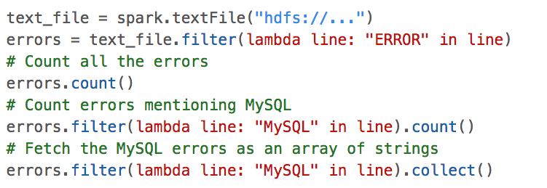
Spark examples
spark is a spark context object

Slide 75
Spark examples
errors is a transformation, and thus a data strucure that explains HOW to do something
count() is an action: it will actually execute the plan for errors and return a value.
everything is sharded, like in
Hadoop and GuineaPig
errors.filter() is a transformation
collect() is an action

Slide 76
Spark examples
everything is sharded … and the shards are stored in memory of worker machines not local disk (if possible)
# modify errors to be stored in cluster memory
subsequent actions will be much faster
You can also persist() an RDD on disk, which
is like marking it as opts(stored=True) in GuineaPig. Spark’s not smart about persisting data.

Slide 77
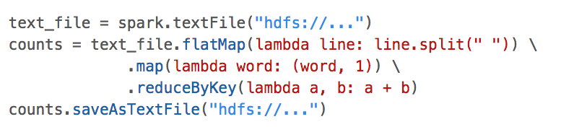
Spark examples: wordcount
the action
transformation on (key,value) pairs , which are special

Slide 78
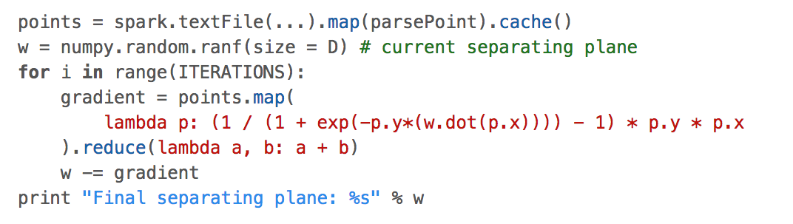
Spark examples: batch logistic regression
p.x and w are vectors, from the numpy package
p.x and w are vectors, from the numpy package. Python overloads operations like * and + for vectors.
reduce is an action – it produces a numby vector

Slide 79
Spark examples: batch logistic regression
Important note: numpy vectors/matrices are not just “syntactic sugar”.
They are much more compact than something like a list of python floats.
numpy operations like dot, *, + are calls to optimized C code
a little python logic around a lot of numpy calls is pretty efficient

Slide 80
Spark examples: batch logistic regression
w is defined outside the lambda function, but used inside it
So: python builds a closure – code including the current value of w – and Spark ships it off to each worker. So w is copied, and must be read-only.

Slide 81
Spark examples: batch logistic regression
dataset of points is cached in cluster memory to reduce i/o

Slide 82
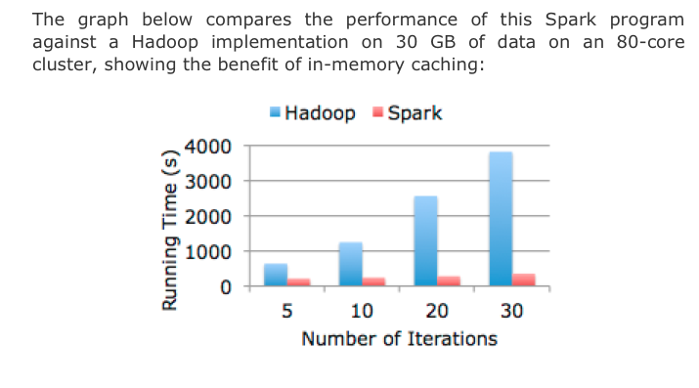
Spark logistic regression example

Slide 83
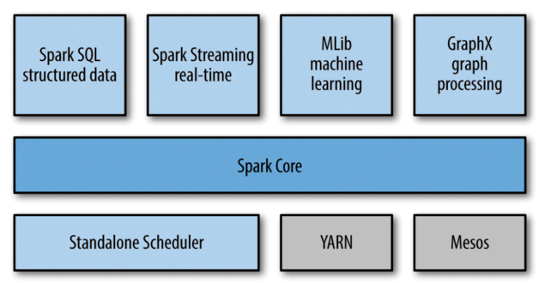
Spark

Slide 84
Spark details: broadcast
So: python builds a closure – code including the current value of w – and Spark ships it off to each worker. So w is copied, and must be read-only.

Slide 85
Spark details: broadcast
little penalty for distributing something that’s not used by all workers
what’s sent is a small pointer to w (e.g., the name of a file containing a serialized version of w) and when value is called, some clever all-reduce like machinery is used to reduce network load.
alternative: create a broadcast variable, e.g.,
w_broad = spark.broadcast(w)
which is accessed by the worker via
w_broad.value()

Slide 86
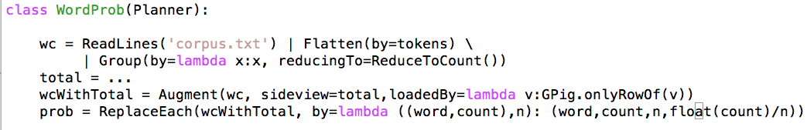
Spark details: mapPartitions
Common issue:
map task requires loading in some small shared value
more generally, map task requires some sort of initialization before processing a shard
GuineaPig:
  special Augment … sideview … pattern for shared values
  can kludge up any initializer using Augment
Raw Hadoop: mapper.configure() and mapper.close() methods

Slide 87
Spark details: mapPartitions
Spark:
rdd.mapPartitions(f): will call f(iteratorOverShard) once per shard, and return an iterator over the mapped values.
f() can do any setup/close steps it needs
Also:
there are transformations to partition an RDD with a user-selected function, like in Hadoop. Usually you partition and persist/cache.

