Slide 1
Unsupervised learning on graphs

Slide 2
Announcements….
One-day extension for everyone on Autodiff HW
Also, no quiz

Slide 3
Announcements….
There’s no class Thursday ☺
There’s class Tuesday ☹
  I’m swapping the LDA and parameter-server lectures, so LDA will be Tuesday
I don’t have office hours next Monday 11/21
Tues 12/6 – the last Tuesday – will be project reports from 10-805 groups
  5 reports, 12 mins speaking each
  send me slides (pdf preferably) by 10am
  yeah I know you’re not done till 12/11

Slide 4
Spectral clustering as iterative averaging

Slide 5
Spectral Clustering: Graph = Matrix
 | A | B | C | D | E | F | G | H | I | J
A |  | 1 |  | 1 |  | 1
B | 1 |  | 1
C |  | 1
D | 1 |  |  |  |  | 1
E |  |  |  |  |  | 1
F | 1 |  |  | 1 | 1
G |  |  |  |  |  |  |  |  | 1
H |  |  |  |  |  |  | 1 |  | 1 | 1
I |  |  |  |  |  |  | 1 | 1 |  | 1
J |  |  |  |  |  |  |  | 1 | 1
C
A
B
G
I
H
J
F
D
E

Slide 6
Spectral Clustering: Graph = Matrix
Transitively Closed Components = “Blocks”
sometimes called a block-stochastic matrix:
each node has a latent “block”
fixed probability qi for links between elements of block i
fixed probability q0 for links between elements of different blocks
 | A | B | C | D | E | F | G | H | I | J
A | _ | 1 | 1 |  |  | 1
B | 1 | _ | 1
C | 1 | 1 | _
D |  |  |  | _ | 1 | 1
E |  |  |  | 1 | _ | 1
F | 1 |  |  | 1 | 1 | _
G |  |  |  |  |  |  | _ |  | 1 | 1
H |  |  |  |  |  |  |  | _ | 1 | 1
I |  |  |  |  |  |  | 1 | 1 | _ | 1
J |  |  |  |  |  |  | 1 | 1 | 1 | _
C
A
B
G
I
H
J
F
D
E
Of course we can’t see the “blocks” unless the nodes
are sorted by cluster…

Slide 7
Spectral Clustering: Graph = Matrix
Vector = Node → Weight
M
v
 | A | B | C | D | E | F | G | H | I | J
A | _ | 1 | 1 |  |  | 1
B | 1 | _ | 1
C | 1 | 1 | _
D |  |  |  | _ | 1 | 1
E |  |  |  | 1 | _ | 1
F | 1 |  |  | 1 | 1 | _
G |  |  |  |  |  |  | _ |  | 1 | 1
H |  |  |  |  |  |  |  | _ | 1 | 1
I |  |  |  |  |  |  | 1 | 1 | _ | 1
J |  |  |  |  |  |  | 1 | 1 | 1 | _
 | A
A | 3
B | 2
C | 3
D
E
F
G
H
I
J
C
A
B
G
I
H
J
F
D
E
M

Slide 8
Spectral Clustering: Graph = Matrix
M*v₁ = v₂ “propogates weights from neighbors”
M
*
v₁
=
v₂
 | A | B | C | D | E | F | G | H | I | J
A | _ | 1 | 1 |  |  | 1
B | 1 | _ | 1
C | 1 | 1 | _
D |  |  |  | _ | 1 | 1
E |  |  |  | 1 | _ | 1
F |  |  |  | 1 | 1 | _
G |  |  |  |  |  |  | _ |  | 1 | 1
H |  |  |  |  |  |  |  | _ | 1 | 1
I |  |  |  |  |  |  | 1 | 1 | _ | 1
J |  |  |  |  |  |  | 1 | 1 | 1 | _
A | 3
B | 2
C | 3
D
E
F
G
H
I
J
A | 2*1+3*1+0*1
B | 3*1+3*1
C | 3*1+2*1
D
E
F
G
H
I
J
C
A
B
G
I
H
J
F
D
E
M

Slide 9
Spectral Clustering: Graph = Matrix
W*v₁ = v₂ “propogates weights from neighbors”
W
*
v₁
=
v₂
W: normalized so columns sum to 1
 | A | B | C | D | E | F | G | H | I | J
A | _ | .5 | .5 |  |  | .3
B | .3 | _ | .5
C | .3 | .5 | _
D |  |  |  | _ | .5 | .3
E |  |  |  | .5 | _ | .3
F | .3 |  |  | .5 | .5 | _
G |  |  |  |  |  |  | _ |  | .3 | .3
H |  |  |  |  |  |  |  | _ | .3 | .3
I |  |  |  |  |  |  | .5 | .5 | _ | .3
J |  |  |  |  |  |  | .5 | .5 | .3 | _
A | 3
B | 2
C | 3
D
E
F
G
H
I
J
A | 2*.5+3*.5+0*.3
B | 3*.3+3*.5
C | 3*.33+2*.5
D
E
F
G
H
I
J
C
A
B
G
I
H
J
F
D
E

Slide 10
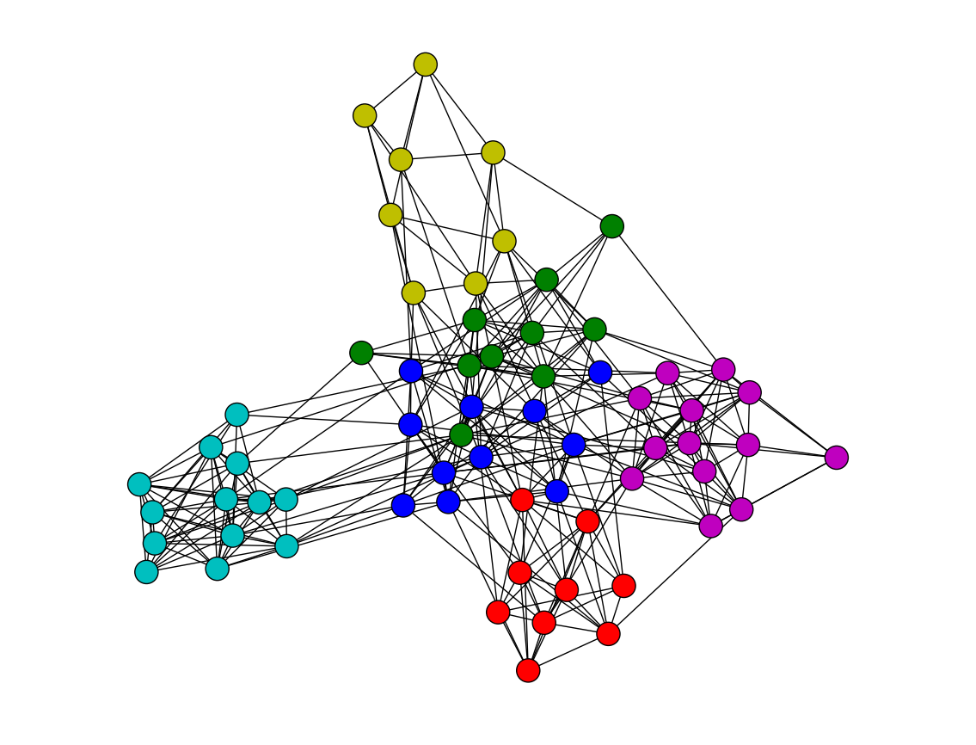
Spectral Clustering: Graph = Matrix
W*v₁ = v₂ “propogates weights from neighbors”
Q: How do I pick v to be an eigenvector for a block-stochastic matrix?

Slide 11
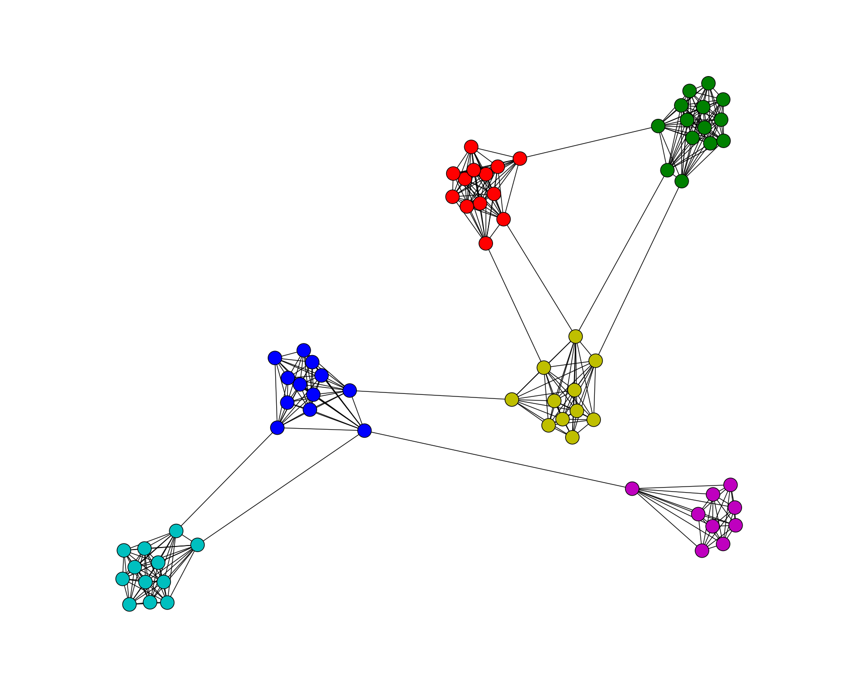
Spectral Clustering: Graph = Matrix
W*v₁ = v₂ “propogates weights from neighbors”
How do I pick v to be an eigenvector for a block-stochastic matrix?

Slide 12
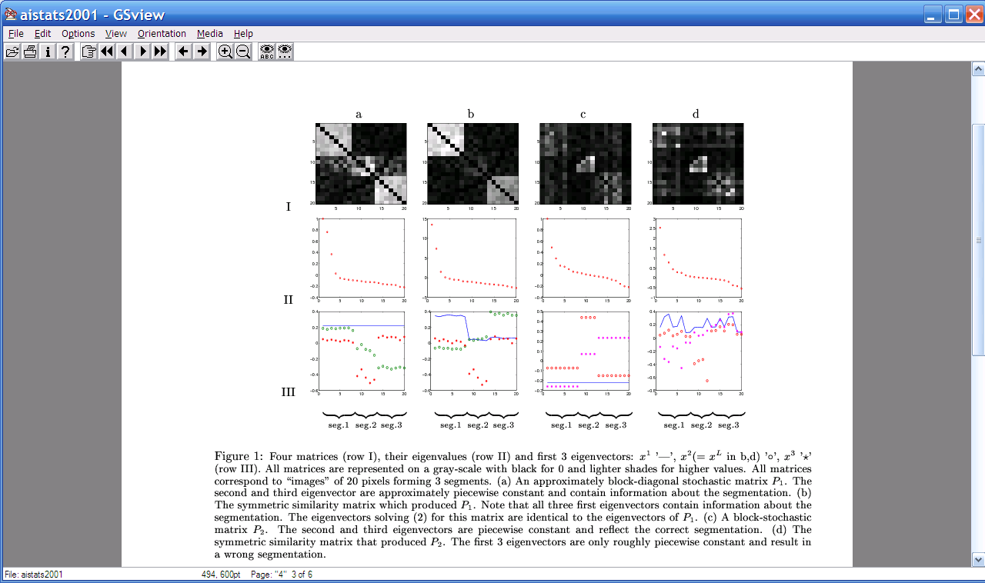
Spectral Clustering: Graph = Matrix
W*v₁ = v₂ “propogates weights from neighbors”
λ₁
e₁
λ₂
“eigengap”
e₃
λ₃
λ₄
e₂
λ₅,_{6,7,….}
[Shi & Meila, 2002]

Slide 13
Spectral Clustering: Graph = Matrix
W*v₁ = v₂ “propogates weights from neighbors”
e₃
0.4
0.2
x
x
x
x
x
x
x
x
x
0.0
x
x
z
x
z
z
z
z
z
z
z
z
-0.2
z
z
y
y
-0.4
y
e₃
y
y
e₂
-0.4
-0.2
0
0.2
e₂
[Shi & Meila, 2002]

Slide 14
Spectral Clustering: Graph = Matrix
W*v₁ = v₂ “propogates weights from neighbors”
If W is connected but roughly block diagonal with k blocks then
the top eigenvector is a constant vector
the next k eigenvectors are roughly piecewise constant with “pieces” corresponding to blocks
M

Slide 15
Spectral Clustering: Graph = Matrix
W*v₁ = v₂ “propogates weights from neighbors”
If W is connected but roughly block diagonal with k blocks then
the “top” eigenvector is a constant vector
the next k eigenvectors are roughly piecewise constant with “pieces” corresponding to blocks
Spectral clustering:
Find the top k+1 eigenvectors v₁,…,v_{k+1}
Discard the “top” one
Replace every node a with k-dimensional vector x_{a} = <v₂(a),…,v_{k+1} (a) >
Cluster with k-means
M

Slide 16
Spectral Clustering: Pros and Cons
Elegant, and well-founded mathematically
Tends to avoid local minima
  Optimal solution to relaxed version of mincut problem (Normalized cut, aka NCut)
Works quite well when relations are approximately transitive (like similarity, social connections)
Expensive for very large datasets
  Computing eigenvectors is the bottleneck
  Approximate eigenvector computation not always useful
Noisy datasets sometimes cause problems
  Picking number of eigenvectors and k is tricky
  “Informative” eigenvectors need not be in top few
  Performance can drop suddenly from good to terrible

Slide 17
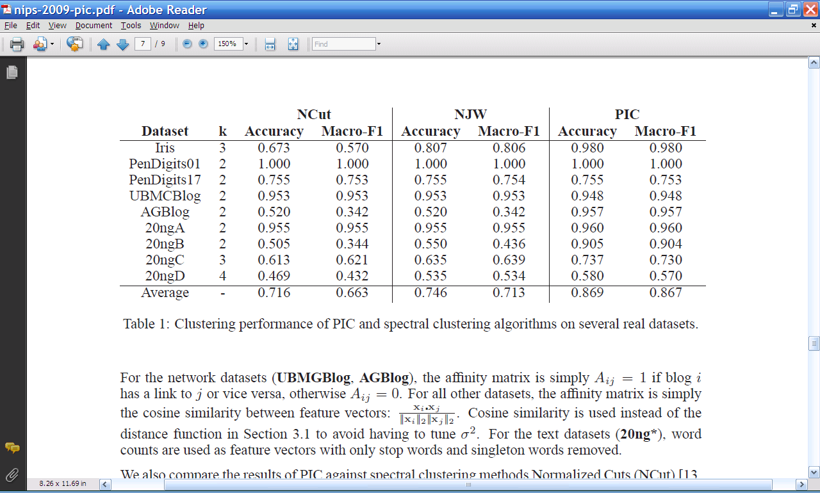
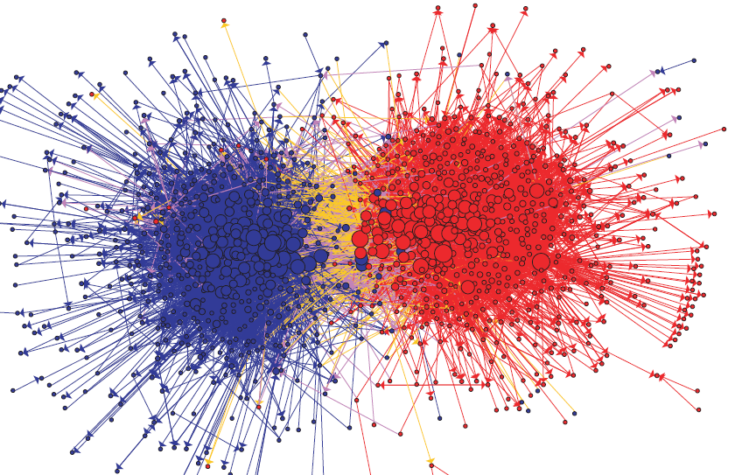
Experimental results: best-case assignment of class labels to clusters

Slide 18
Spectral clustering as Optimization

Slide 19
Spectral Clustering: Graph = Matrix
W*v₁ = v₂ “propogates weights from neighbors”
smallest eigenvecs of D-A are largest eigenvecs of A
smallest eigenvecs of I-W are largest eigenvecs of W
Suppose each y(i)=+1 or -1:
Then y is a cluster indicator that splits the nodes into two sets
what is y^{T}(D-A)y ?
D-A is the Laplacian of the graph A

Slide 20
I-W is the normalized Laplacian
= size of CUT(y)
NCUT: roughly minimize ratio of transitions between classes vs transitions within classes

Slide 21
Spectral Clustering: Graph = Matrix
W*v₁ = v₂ “propogates weights from neighbors”
smallest eigenvecs of D-A are largest eigenvecs of A
smallest eigenvecs of I-W are largest eigenvecs of W
Suppose each y(i)=+1 or -1:
Then y is a cluster indicator that cuts the nodes into two
what is y^{T}(D-A)y ? The cost of the graph cut defined by y
what is y^{T}(I-W)y ? Also a cost of a graph cut defined by y
How to minimize it?
  Turns out: to minimize y^{T} X y / (y^{T}y) find smallest eigenvector of X
  But: this will not be +1/-1, so it’s a “relaxed” solution

Slide 22
Spectral Clustering: Graph = Matrix
W*v₁ = v₂ “propogates weights from neighbors”
λ₁
e₁
λ₂
“eigengap”
e₃
λ₃
λ₄
e₂
λ₅,_{6,7,….}
[Shi & Meila, 2002]

Slide 23
Another way to think about spectral clustering….
Most normal people think about spectral clustering like that - as relaxed optimization
…me, not so much
I like the connection to “averaging”…because…. it leads to a nice fast variation of spectral clustering called power iteration clustering

Slide 24
Power Iteration Clustering

Slide 25
Spectral Clustering: Graph = Matrix
 | A | B | C | D | E | F | G | H | I | J
A |  | 1 |  | 1 |  | 1
B | 1 |  | 1
C |  | 1
D | 1 |  |  |  |  | 1
E |  |  |  |  |  | 1
F | 1 |  |  | 1 | 1
G |  |  |  |  |  |  |  |  | 1
H |  |  |  |  |  |  | 1 |  | 1 | 1
I |  |  |  |  |  |  | 1 | 1 |  | 1
J |  |  |  |  |  |  |  | 1 | 1
C
A
B
G
I
H
J
F
D
E

Slide 26
Spectral Clustering: Graph = Matrix
Transitively Closed Components = “Blocks”
sometimes called a block-stochastic matrix:
each node has a latent “block”
fixed probability qi for links between elements of block i
fixed probability q0 for links between elements of different blocks
 | A | B | C | D | E | F | G | H | I | J
A | _ | 1 | 1 |  |  | 1
B | 1 | _ | 1
C | 1 | 1 | _
D |  |  |  | _ | 1 | 1
E |  |  |  | 1 | _ | 1
F | 1 |  |  | 1 | 1 | _
G |  |  |  |  |  |  | _ |  | 1 | 1
H |  |  |  |  |  |  |  | _ | 1 | 1
I |  |  |  |  |  |  | 1 | 1 | _ | 1
J |  |  |  |  |  |  | 1 | 1 | 1 | _
C
A
B
G
I
H
J
F
D
E
Of course we can’t see the “blocks” unless the nodes
are sorted by cluster…

Slide 27
Spectral Clustering: Graph = Matrix
Vector = Node → Weight
M
v
 | A | B | C | D | E | F | G | H | I | J
A | _ | 1 | 1 |  |  | 1
B | 1 | _ | 1
C | 1 | 1 | _
D |  |  |  | _ | 1 | 1
E |  |  |  | 1 | _ | 1
F | 1 |  |  | 1 | 1 | _
G |  |  |  |  |  |  | _ |  | 1 | 1
H |  |  |  |  |  |  |  | _ | 1 | 1
I |  |  |  |  |  |  | 1 | 1 | _ | 1
J |  |  |  |  |  |  | 1 | 1 | 1 | _
 | A
A | 3
B | 2
C | 3
D
E
F
G
H
I
J
C
A
B
G
I
H
J
F
D
E
M

Slide 28
Spectral Clustering: Graph = Matrix
M*v₁ = v₂ “propogates weights from neighbors”
M
*
v₁
=
v₂
 | A | B | C | D | E | F | G | H | I | J
A | _ | 1 | 1 |  |  | 1
B | 1 | _ | 1
C | 1 | 1 | _
D |  |  |  | _ | 1 | 1
E |  |  |  | 1 | _ | 1
F |  |  |  | 1 | 1 | _
G |  |  |  |  |  |  | _ |  | 1 | 1
H |  |  |  |  |  |  |  | _ | 1 | 1
I |  |  |  |  |  |  | 1 | 1 | _ | 1
J |  |  |  |  |  |  | 1 | 1 | 1 | _
A | 3
B | 2
C | 3
D
E
F
G
H
I
J
A | 2*1+3*1+0*1
B | 3*1+3*1
C | 3*1+2*1
D
E
F
G
H
I
J
C
A
B
G
I
H
J
F
D
E
M

Slide 29
Spectral Clustering: Graph = Matrix
W*v₁ = v₂ “propogates weights from neighbors”
W
*
v₁
=
v₂
W: normalized so columns sum to 1
 | A | B | C | D | E | F | G | H | I | J
A | _ | .5 | .5 |  |  | .3
B | .3 | _ | .5
C | .3 | .5 | _
D |  |  |  | _ | .5 | .3
E |  |  |  | .5 | _ | .3
F | .3 |  |  | .5 | .5 | _
G |  |  |  |  |  |  | _ |  | .3 | .3
H |  |  |  |  |  |  |  | _ | .3 | .3
I |  |  |  |  |  |  | .5 | .5 | _ | .3
J |  |  |  |  |  |  | .5 | .5 | .3 | _
A | 3
B | 2
C | 3
D
E
F
G
H
I
J
A | 2*.5+3*.5+0*.3
B | 3*.3+3*.5
C | 3*.33+2*.5
D
E
F
G
H
I
J
C
A
B
G
I
H
J
F
D
E

Slide 30
Repeated averaging with neighbors as a clustering method
Pick a vector v⁰ (maybe at random)
Compute v¹ = Wv⁰
  i.e., replace v⁰[x] with weighted average of v⁰[y] for the neighbors y of x
Plot v¹[x] for each x
Repeat for v², v³, …
Variants widely used for semi-supervised learning
  HF/CoEM/wvRN - average + clamping of labels for nodes with known labels
Without clamping, will converge to constant v^{t}
What are the dynamics of this process?

Slide 31
Spectral Clustering: Graph = Matrix
W*v₁ = v₂ “propogates weights from neighbors”
λ₁
e₁
λ₂
“eigengap”
e₃
λ₃
λ₄
e₂
λ₅,_{6,7,….}
[Shi & Meila, 2002]

Slide 32
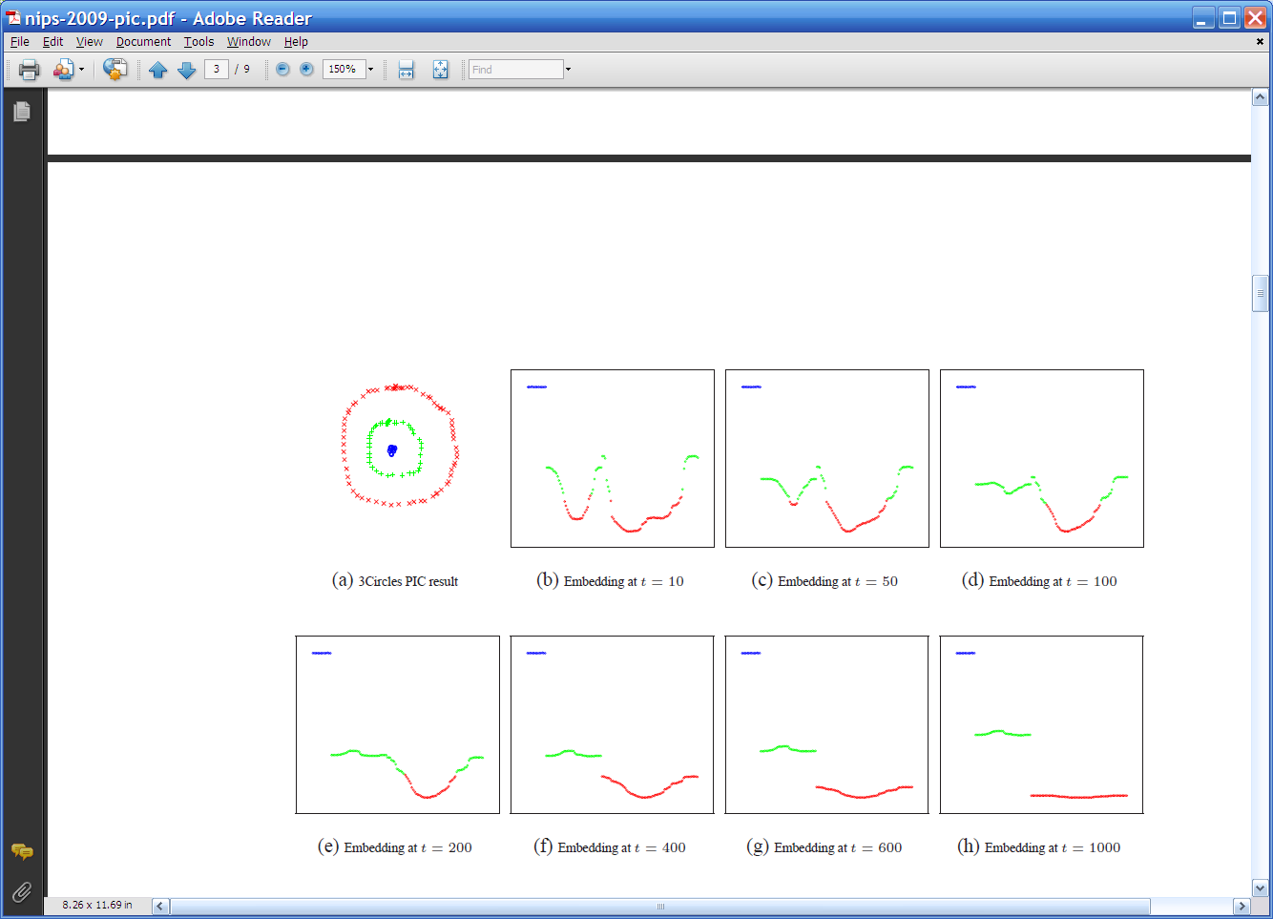
Repeated averaging with neighbors on a sample problem…
blue
green
___red___
Create a graph, connecting all points in the 2-D initial space to all other points
  Weighted by distance
Run power iteration (averaging) for 10 steps
Plot node id x vs v¹⁰(x)
  nodes are ordered and colored by actual cluster number
g
g
g
g
g
g
g
g
g
r
r
r
r
…
b
b
r
r
r
b
b
b

Slide 33
Repeated averaging with neighbors on a sample problem…
blue
green
___red___
blue
green
___red___
blue
green
___red___
larger
smaller

Slide 34
Repeated averaging with neighbors on a sample problem…
blue
green
___red___
blue
green
___red___
blue
green
___red___
blue
green
___red___
blue
green
___red___

Slide 35
Repeated averaging with neighbors on a sample problem…
very small

Slide 36
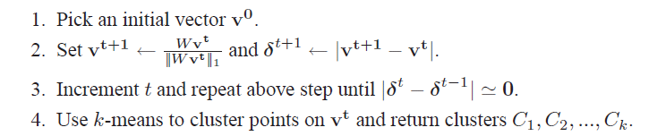
PIC: Power Iteration Clustering run power iteration (repeated averaging w/ neighbors) with early stopping
  V⁰: random start, or “degree matrix” D, or …
  Easy to implement and efficient
  Very easily parallelized
  Experimentally, often better than traditional spectral methods
  Surprising since the embedded space is 1-dimensional!

Slide 37
Experiments
“Network” problems: natural graph structure
  PolBooks: 105 political books, 3 classes, linked by copurchaser
  UMBCBlog: 404 political blogs, 2 classes, blogroll links
  AGBlog: 1222 political blogs, 2 classes, blogroll links
“Manifold” problems: cosine distance between classification instances
  Iris: 150 flowers, 3 classes
  PenDigits01,17: 200 handwritten digits, 2 classes (0-1 or 1-7)
  20ngA: 200 docs, misc.forsale vs soc.religion.christian
  20ngB: 400 docs, misc.forsale vs soc.religion.christian
  20ngC: 20ngB + 200 docs from talk.politics.guns
  20ngD: 20ngC + 200 docs from rec.sport.baseball

Slide 38

Experimental results: best-case assignment of class labels to clusters

Slide 39
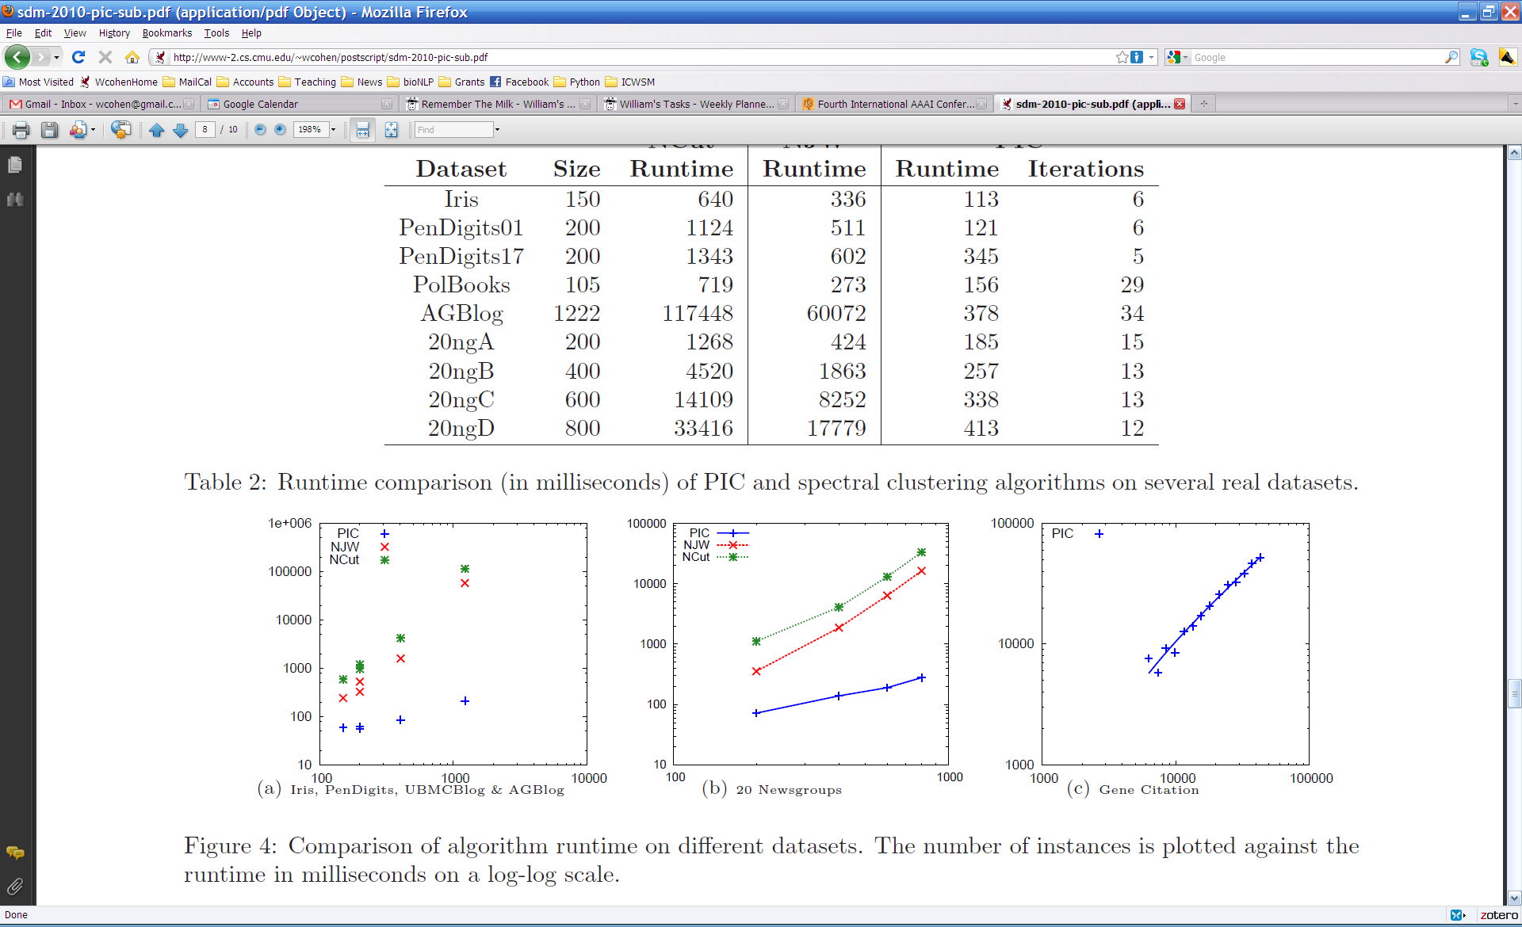

Slide 40
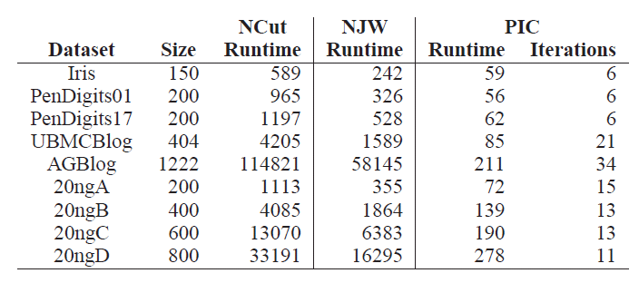
Experiments: run time and scalability
Time in millisec

Slide 41
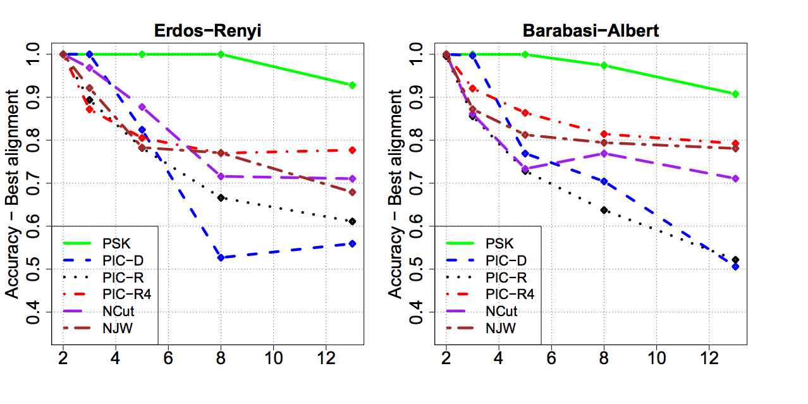
More experiments
Varying the number of clusters for PIC and PIC4 (starts with random 4-d point rather than a random 1-d point).

Slide 42
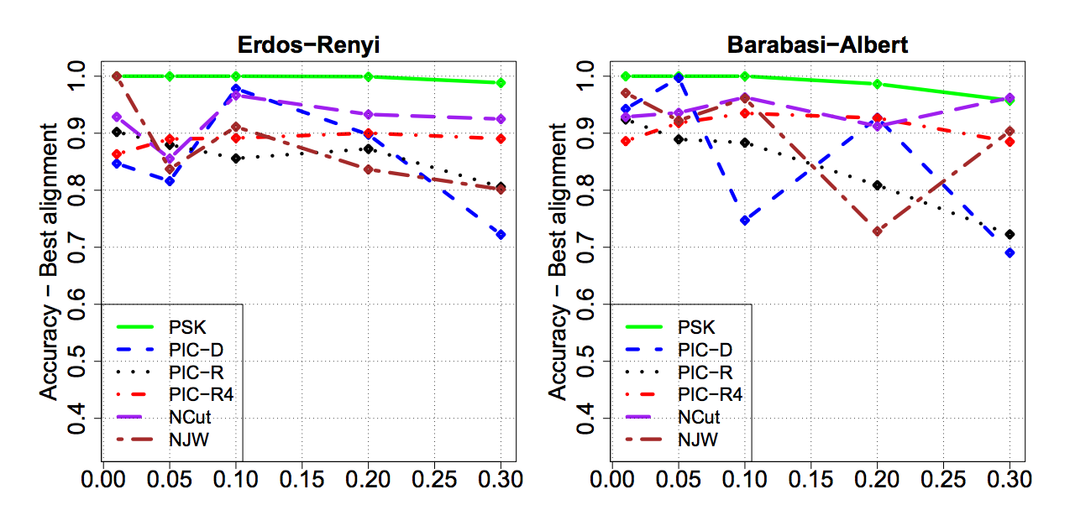
More experiments
Varying the amount of noise for PIC and PIC4 (starts with random 4-d point rather than a random 1-d point).

Slide 43
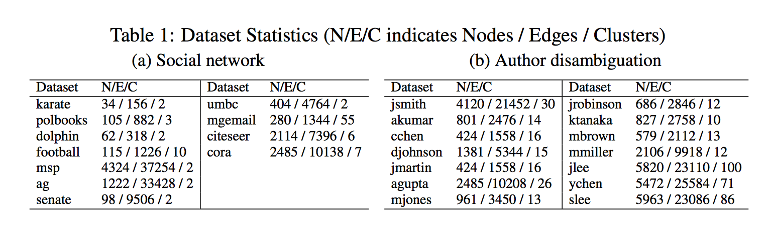
More experiments
More “real” network datasets from various domains

Slide 44
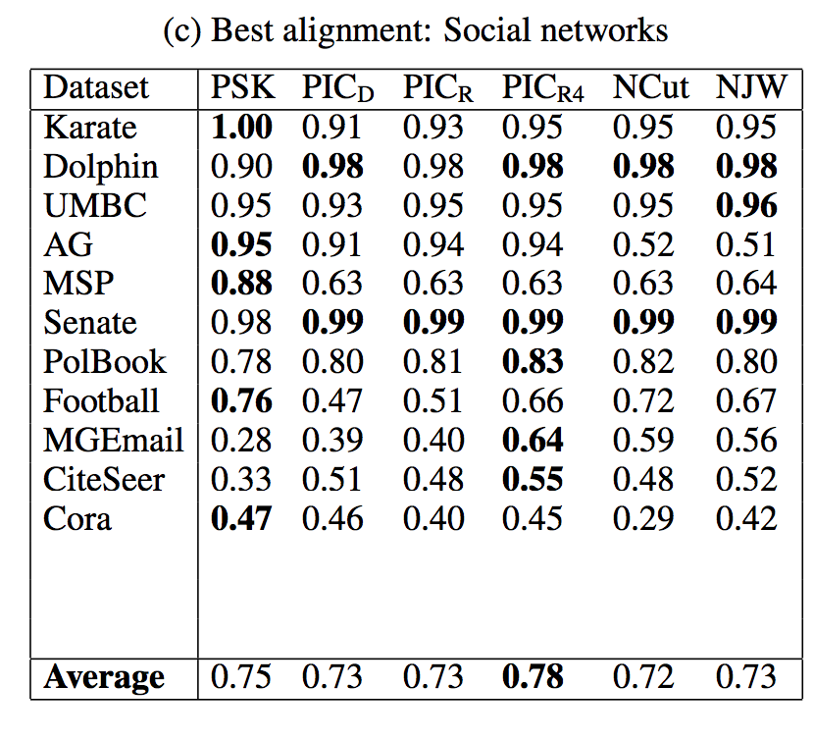
More experiments

Slide 45
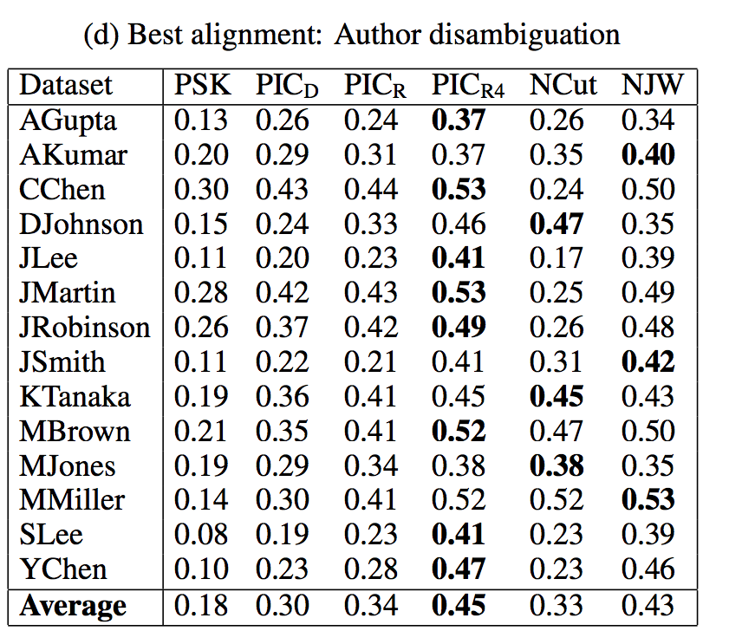

Slide 46
Learning on Graphs For Non-Graph Datasets

Slide 47
Why I’m talking about graphs
Lots of large data is graphs
  Facebook, Twitter, citation data, and other social networks
  The web, the blogosphere, the semantic web, Freebase, Wikipedia, Twitter, and other information networks
  Text corpora (like RCV1), large datasets with discrete feature values, and other bipartite networks
    nodes = documents or words
    links connect document → word or word → document
  Computer networks, biological networks (proteins, ecosystems, brains, …), …
  Heterogeneous networks with multiple types of nodes
    people, groups, documents

Slide 48

Simplest Case: Bi-partite Graphs
CALO
William
graph
proposal
CMU
Notes:
Usually, information retrieval systems, for both the web and email, index data a bipartite graph, which includes words, or terms, on one hand – and files, on the other hand.
Given a query, which is a set of words, the retrieval engine ranks documents by their relevance, or similarity, to the query.
However, email can be represented by a richer graph. With nodes representing persons, dates, meetings and email-addresses.
In this graph, persons are inter-connected via messages that they send or receive, and via the meetings they attend. Files are inter-connected through the social network of the recipients, similar content and so on.
So, we have a typed graph – where every node has a type. And, in addition, the edges in the graph are directed and have types as well.
For example, “sent to” from email to recipient. Or “has subject term” going from an email message and a term appearing in its subject line.
Given a schema of relations, a whole corpus of email can be represented as one joint graph. For email, you can easily extract this information by parsing the email header.

Slide 49
Motivation: Experimental Datasets `Used for PIC are…
“Network” problems: natural graph structure
  PolBooks: 105 political books, 3 classes, linked by copurchaser
  UMBCBlog: 404 political blogs, 2 classes, blogroll links
  AGBlog: 1222 political blogs, 2 classes, blogroll links
  Also: Zachary’s karate club, citation networks, ...
“Manifold” problems: cosine distance between all pairs of classification instances
  Iris: 150 flowers, 3 classes
  PenDigits01,17: 200 handwritten digits, 2 classes (0-1 or 1-7)
  20ngA: 200 docs, misc.forsale vs soc.religion.christian
  20ngB: 400 docs, misc.forsale vs soc.religion.christian
  …
Gets expensive fast

Slide 50
Spectral Clustering: Graph = Matrix
A*v₁ = v₂ “propogates weights from neighbors”
A
*
v₁
=
v₂
 | A | B | C | D | E | F | G | H | I | J
A | _ | 1 | 1 |  |  | 1
B | 1 | _ | 1
C | 1 | 1 | _
D |  |  |  | _ | 1 | 1
E |  |  |  | 1 | _ | 1
F |  |  |  | 1 | 1 | _
G |  |  |  |  |  |  | _ |  | 1 | 1
H |  |  |  |  |  |  |  | _ | 1 | 1
I |  |  |  |  |  |  | 1 | 1 | _ | 1
J |  |  |  |  |  |  | 1 | 1 | 1 | _
A | 3
B | 2
C | 3
D
E
F
G
H
I
J
A | 2*1+3*1+0*1
B | 3*1+3*1
C | 3*1+2*1
D
E
F
G
H
I
J
C
A
B
G
I
H
J
F
D
E
M

Slide 51
Spectral Clustering: Graph = Matrix
W*v₁ = v₂ “propogates weights from neighbors”
W
*
v₁
=
v₂
W: normalized so columns sum to 1
 | A | B | C | D | E | F | G | H | I | J
A | _ | .5 | .5 |  |  | .3
B | .3 | _ | .5
C | .3 | .5 | _
D |  |  |  | _ | .5 | .3
E |  |  |  | .5 | _ | .3
F | .3 |  |  | .5 | .5 | _
G |  |  |  |  |  |  | _ |  | .3 | .3
H |  |  |  |  |  |  |  | _ | .3 | .3
I |  |  |  |  |  |  | .5 | .5 | _ | .3
J |  |  |  |  |  |  | .5 | .5 | .3 | _
A | 3
B | 2
C | 3
D
E
F
G
H
I
J
A | 2*.5+3*.5+0*.3
B | 3*.3+3*.5
C | 3*.33+2*.5
D
E
F
G
H
I
J
C
A
B
G
I
H
J
F
D
E
W = D⁻¹*A
D[i,i]=1/degree(i)

Slide 52
Lazy computation of distances and normalizers
Recall PIC’s update is
  v^{t} = W * v^{t-1 =} = D⁻¹A * v^{t-1}
  …where D is the [diagonal] degree matrix: D=A*1
My favorite distance metric for text is length-normalized TFIDF:
  Def’n: A(i,j)=<v_{i},v_{j}>/||v_{i}||*||v_{j}||
  Let N(i,i)=||v_{i}|| … and N(i,j)=0 for i!=j
  Let F(i,k)=TFIDF weight of word w_{k} in document v_{i}
  Then: A = N⁻¹F^{T}FN⁻¹
1 is a column vector of 1’s
<u,v>=inner product
||u|| is L2-norm

Slide 53
Lazy computation of distances and normalizers
Equivalent to using TFIDF/cosine on all pairs of examples but requires only sparse matrices
Recall PIC’s update is
  v^{t} = W * v^{t-1 =} = D⁻¹A * v^{t-1}
  …where D is the [diagonal] degree matrix: D=A*1
  Let F(i,k)=TFIDF weight of word w_{k} in document v_{i}
  Compute N(i,i)=||v_{i}|| … and N(i,j)=0 for i!=j
  Don’t compute A = N⁻¹F^{T}FN⁻¹
  Let D(i,i)= N⁻¹F^{T}FN⁻¹*1 where 1 is an all-1’s vector
    Computed as D=N⁻¹⁽F^{T(}F(N⁻¹*1))) for efficiency
  New update:
    v^{t} = D⁻¹A * v^{t-1} = D⁻¹ N⁻¹F^{T}FN⁻¹ *v^{t-1}

Slide 54
Lazy computation of distances and normalizers
Equivalent to using TFIDF/cosine on all pairs of examples but requires only sparse matrices
Recall PIC’s update is
  v^{t} = W * v^{t-1 =} = D⁻¹A * v^{t-1}
  …where D is the [diagonal] degree matrix: D=A*1
  Let F(i,k)=TFIDF weight of word w_{k} in document v_{i}
  Compute N(i,i)=||v_{i}|| … and N(i,j)=0 for i!=j
  Don’t compute A = N⁻¹F^{T}FN⁻¹
  Let D(i,i)= N⁻¹F^{T}FN⁻¹*1 where 1 is an all-1’s vector
    Computed as D=N⁻¹⁽F^{T(}F(N⁻¹*1))) for efficiency
  New update:
    v^{t} = D⁻¹A * v^{t-1} = D⁻¹(N⁻¹(F^{T}(F(N⁻¹ *v^{t-1} ))))
Only uses matrix-vector products

Slide 55
Experimental results
RCV1 text classification dataset
  800k + newswire stories
  Category labels from industry vocabulary
  Took single-label documents and categories with at least 500 instances
  Result: 193,844 documents, 103 categories
Generated 100 random category pairs
  Each is all documents from two categories
  Range in size and difficulty
  Pick category 1, with m₁ examples
  Pick category 2 such that 0.5m₁<m₂<2m₁

Slide 56
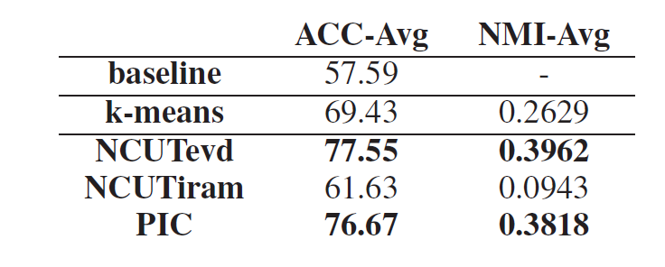
Results
NCUTevd: Ncut with exact eigenvectors
NCUTiram: Implicit restarted Arnoldi method
No stat. signif. diffs between NCUTevd and PIC

Slide 57
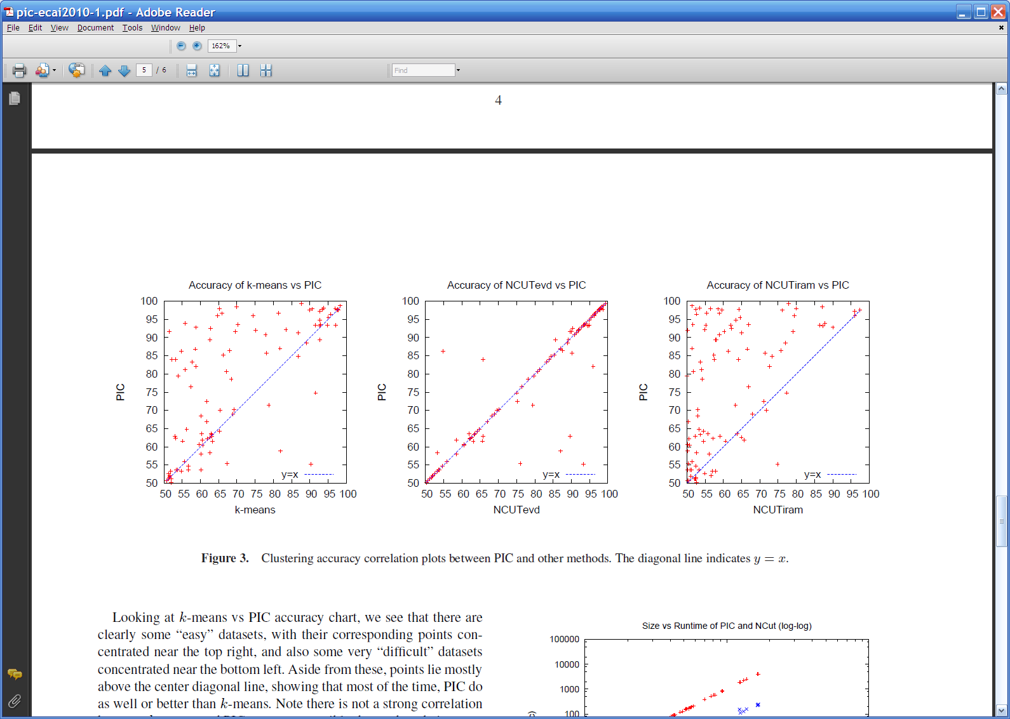
Results

Slide 58
Results

Slide 59
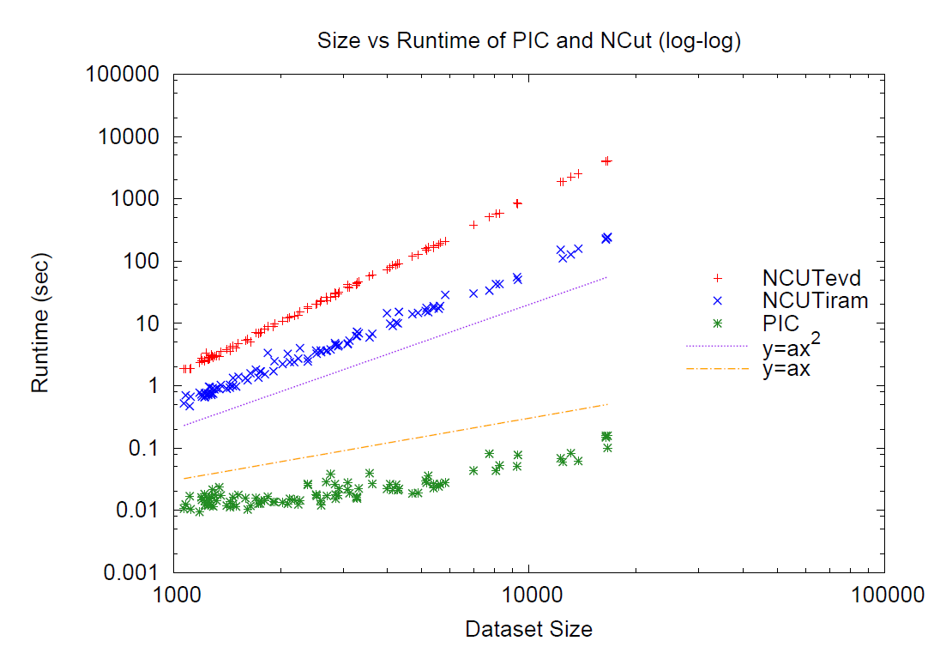
Results

Slide 60
Results
Linear run-time implies constant number of iterations
Number of iterations to “acceleration-convergence” is hard to analyze:
  Faster than a single complete run of power iteration to convergence
  On our datasets
    10-20 iterations is typical
    30-35 is exceptional

Slide 61
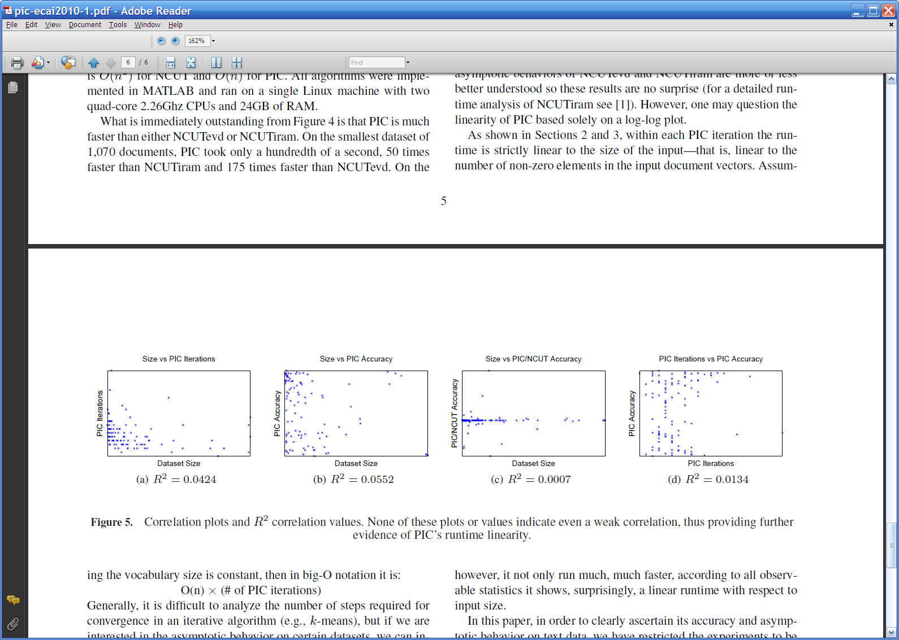

Slide 62
The “Manifold Trick” for Graph-based SSL

Slide 63
PIC: Power Iteration Clustering run power iteration (repeated averaging w/ neighbors) with early stopping

Slide 64
Harmonic Functions/CoEM/wvRN
then replace v^{t+1}(i) with seed values +1/-1 for labeled data
for 5-10 iterations
Classify data using final values from v

Slide 65
Implicit Manifolds on the NELL datasets
mayor of arg1
arg1 is home of
San Francisco
Austin
Paris
Pittsburgh
anxiety
traits such as arg1
live in arg1
traits such as arg1
arrogance
denial
selfishness
denial
selfishness
Seattle
Nodes “near” seeds
Nodes “far from” seeds

Slide 66
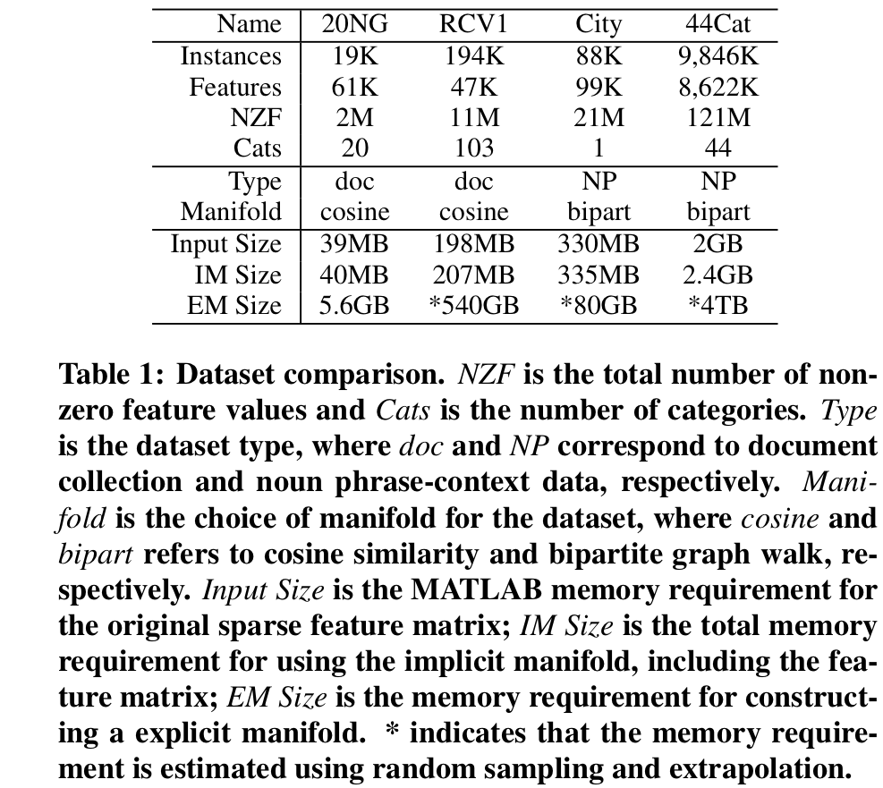
Using the Manifold Trick for SSL

Slide 67
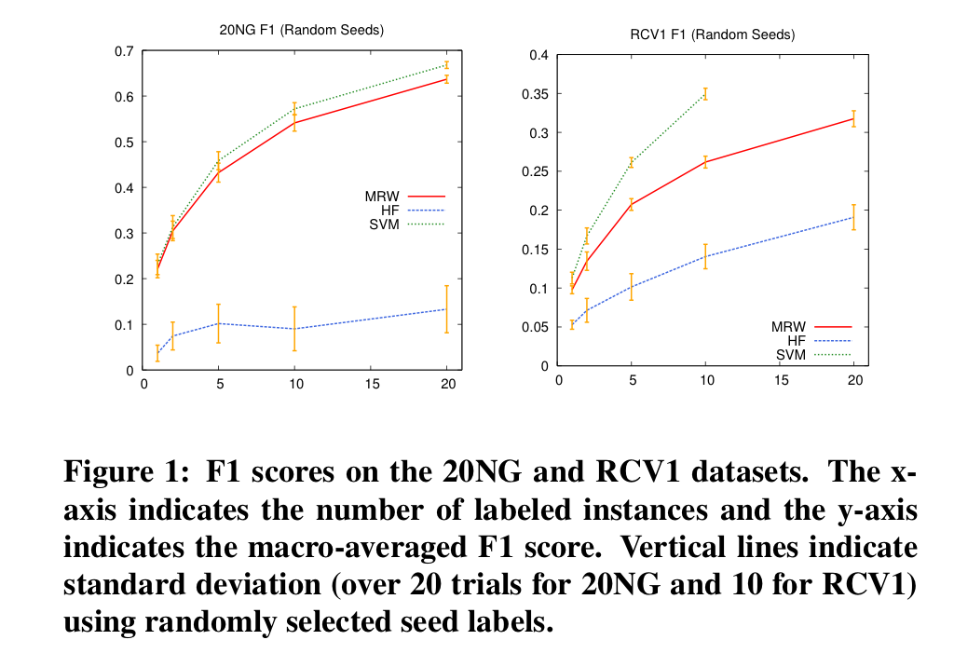
Using the Manifold Trick for SSL

Slide 68
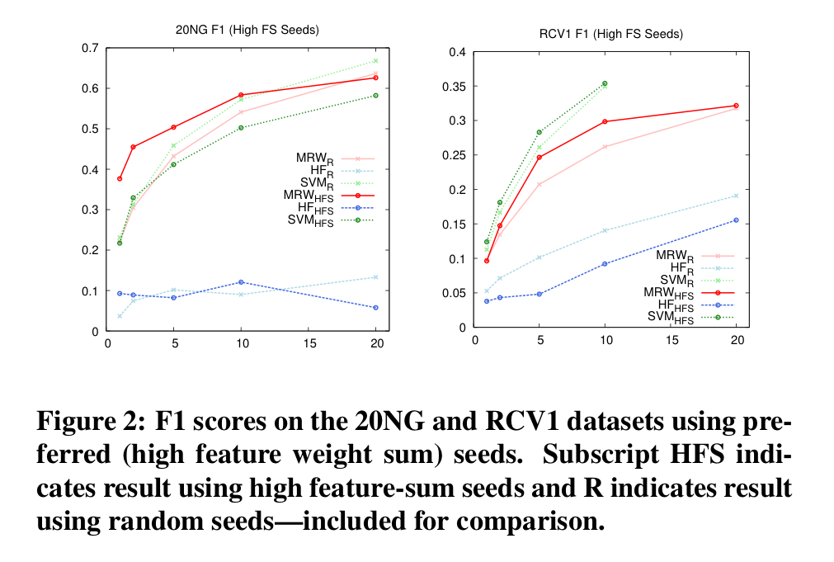
Using the Manifold Trick for SSL

Slide 69
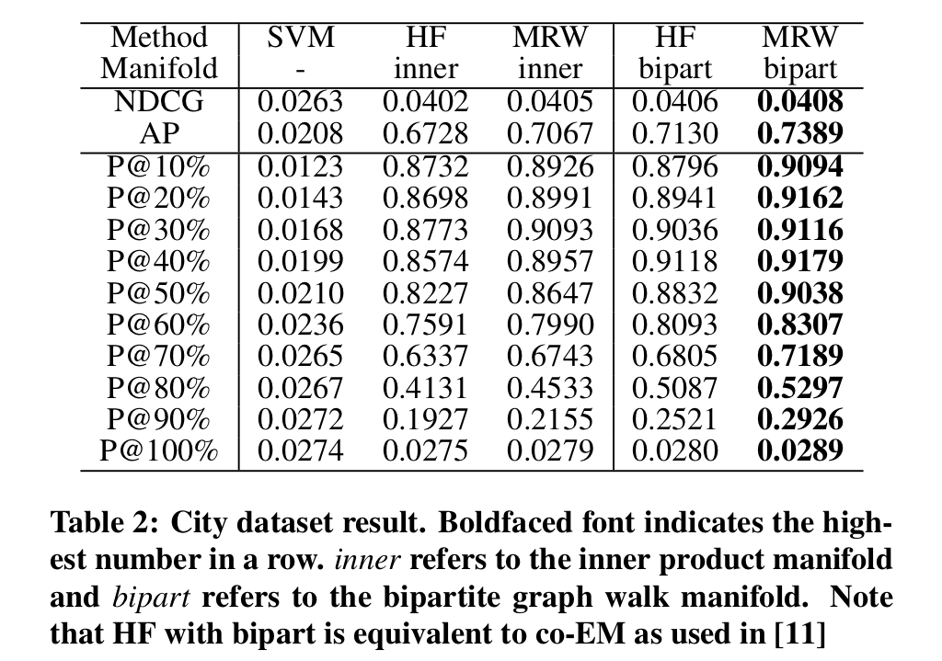
Using the Manifold Trick for SSL

Slide 70
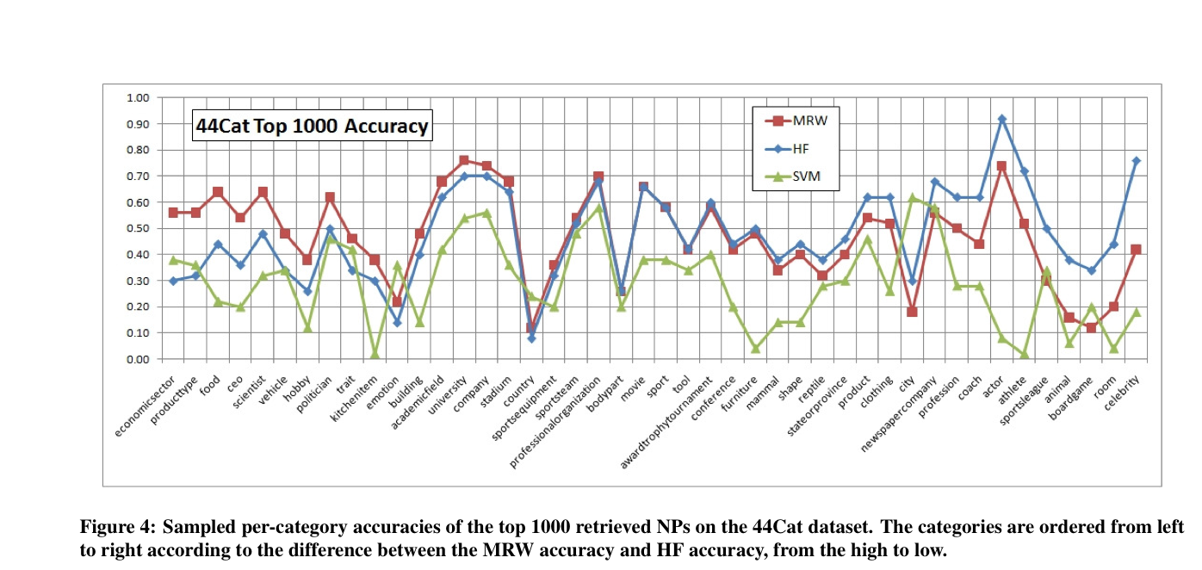
Using the Manifold Trick for SSL

Slide 71
Using the Manifold Trick for SSL
A smoothing trick:

Slide 72
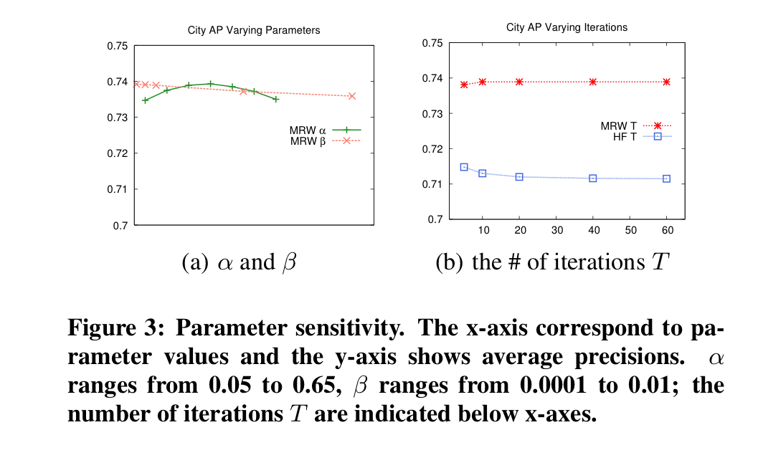
Using the Manifold Trick for SSL

