Slide 1
Recap

Slide 2
Summary to date
Computational complexity: what and how to count
Memory vs disk access
Cost of scanning vs seeks for disk (and memory)
Probability review
Classification with a “density estimator”
Naïve Bayes as a density estimator/classifier
How to implement Naïve Bayes
Time is linear in size of data (one scan!)
Assuming the event counters fit in memory
We need to count
C(Y=label), C( X=word ^ Y=label),…

Slide 3
Naïve Bayes: Counts in Memory
You have a train dataset and a test dataset
Initialize an “event counter” (hashtable) C
For each example id, y, x₁,….,x_{d} in train:
C(“Y=ANY”) ++; C(“Y=y”) ++
For j in 1..d:
C(“Y=y ^ X=x_{j}”) ++
C(“Y=y ^ X=ANY”) ++
For each example id, y, x₁,….,x_{d} in test:
For each y’ in dom(Y):
Compute log Pr(y’,x₁,….,x_{d}) =
Return the best y’
where:
q_{x} = 1/|V|
q_{y} = 1/|dom(Y)|
m=1

Slide 4
ScaLing To Large Vocabularies: WHY?

Slide 5
Complexity of Naïve Bayes
Assume hashtable holding all counts fits in memory
Sequential reads
You have a train dataset and a test dataset
Initialize an “event counter” (hashtable) C
For each example id, y, x₁,….,x_{d} in train:
C(“Y=ANY”) ++; C(“Y=y”) ++
For j in 1..d:
C(“Y=y ^ X=x_{j}”) ++
…
For each example id, y, x₁,….,x_{d} in test:
For each y’ in dom(Y):
Compute log Pr(y’,x₁,….,x_{d}) =
Return the best y’
Complexity: O(n), n=size of train
where:
q_{x} = 1/|V|
q_{y} = 1/|dom(Y)|
mq_{x}=1
Sequential reads
Complexity: O(|dom(Y)|*n’), n’=size of test

Slide 6
The Naïve Bayes classifier – v1
Dataset: each example has
A unique id id
Why? For debugging the feature extractor
d attributes X₁,…,X_{d}
Each X_{i} takes a discrete value in dom(X_{i})
One class label Y in dom(Y)
You have a train dataset and a test dataset
Assume:
the dataset doesn’t fit in memory
the model doesn’t either

Slide 7
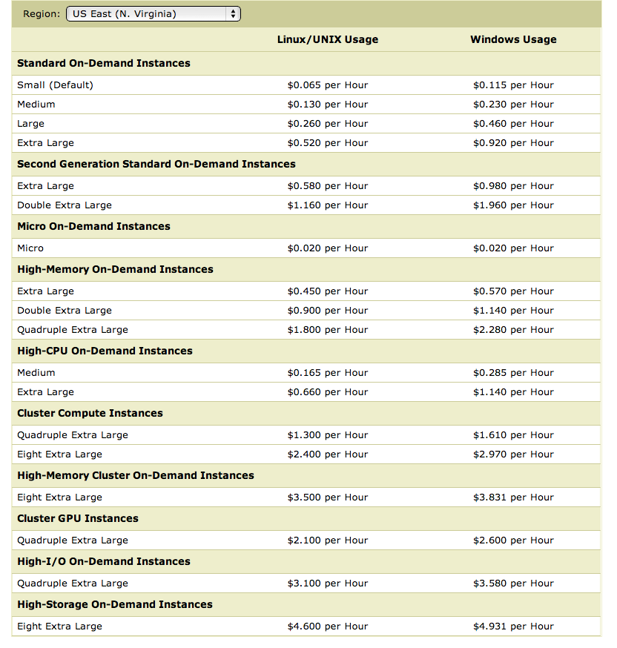
What’s next
How to implement Naïve Bayes
Assuming the event counters do not fit in memory
Why?
Micro:
0.5G memory
Standard:
S: 2Gb
XL: 8Gb
10xlarge: 160Gb
x1.32xlarge:
2Tb, 128 cores
$0.00652/hr
$0.03/hr
$0.104/hr
$2.34/hr
$13.33/hr

Slide 8
What’s next
How to implement Naïve Bayes
Assuming the event counters do not fit in memory
Why?
Zipf’s law: many words that you see, you don’t see often.

Slide 9
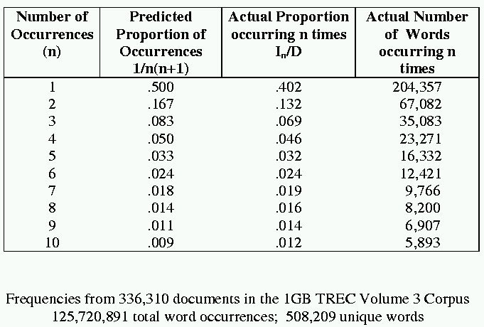
[Via Bruce Croft]

Slide 10
What’s next
How to implement Naïve Bayes
Assuming the event counters do not fit in memory
Why?
Heaps’ Law: If V is the size of the vocabulary and the n is the length of the corpus in words:
Typical constants:
K ≈ 1/10 − 1/100
β ≈ 0.4−0.6 (approx. square-root)
Why?
Proper names, missspellings, neologisms, …
Summary:
For text classification for a corpus with O(n) words, expect to use O(sqrt(n)) storage for vocabulary.
Scaling might be worse for other cases (e.g., hypertext, phrases, …)

Slide 11
Alternatives….

Slide 12
What’s next
How to implement Naïve Bayes
Assuming the event counters do not fit in memory
Possible approaches:
Use a database? (or at least a key-value store)

Slide 13
Numbers (Jeff Dean says) Everyone Should Know
~= 10x
~= 15x
40x
~= 100,000x
Notes:
150x – commercial flight vs a brisk walk
100,000x – 5 hr flights would take 57 years
100,000x – 500 miles vs about 8 meters
15,000,000x – here to beijing vs 100 meters

Slide 14
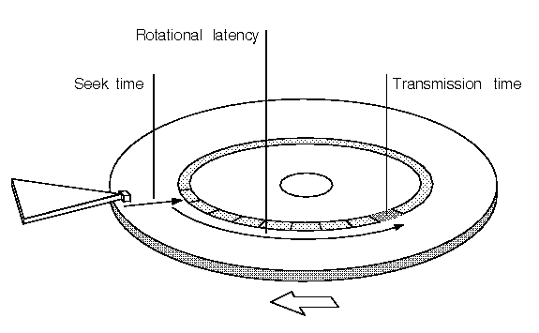

Slide 15
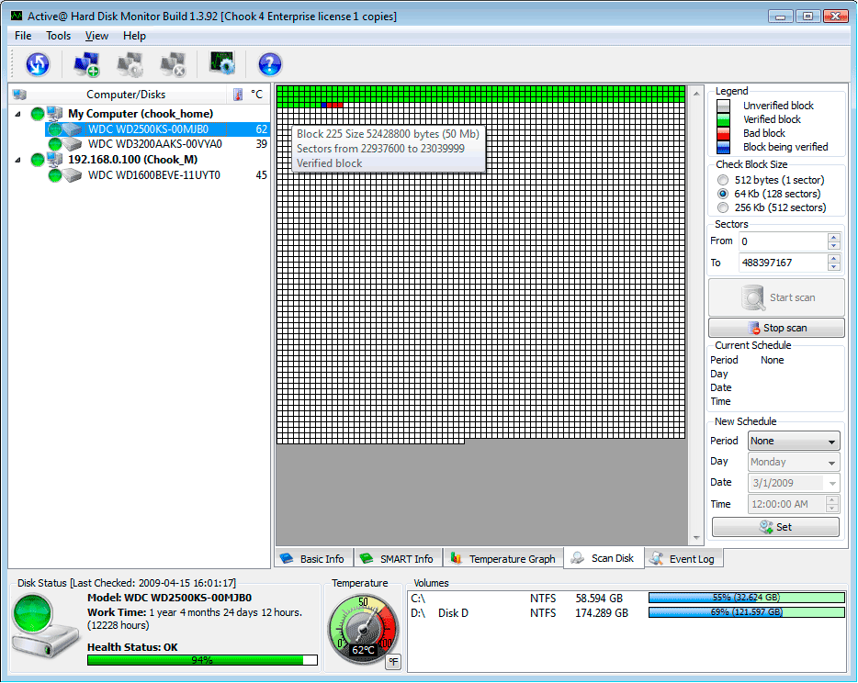
A single large file can be spread out among many non-adjacent blocks/sectors…
and then you need to seek around to scan the contents of the file…

Slide 16
What’s next
How to implement Naïve Bayes
Assuming the event counters do not fit in memory
Possible approaches:
Use a database?
Counts are stored on disk, not in memory
…So, accessing a count might involve some seeks
Caveat: many DBs are good at caching frequently-used values, so seeks might be infrequent …..
O(n*scan) ➔ O(n*scan*seek)

Slide 17
What’s next
How to implement Naïve Bayes
Assuming the event counters do not fit in memory
Possible approaches:
Use a memory-based distributed database?
Counts are stored on disk, not in memory
…So, accessing a count might involve some seeks
Caveat: many DBs are good at caching frequently-used values, so seeks might be infrequent …..
O(n*scan) ➔ O(n*scan*???)

Slide 18
Counting
example 1
example 2
example 3
….
“increment C[x] by D”
Hash table, database, etc
Counting logic

Slide 19
Counting
example 1
example 2
example 3
….
“increment C[x] by D”
Hash table, database, etc
Counting logic
Hashtable issue: memory is too small
Database issue: seeks are slow

Slide 20
Distributed Counting
Hash table1
example 1
example 2
example 3
….
Machine 1
Hash table2
Machine 2
“increment C[x] by D”
Counting logic
. . .
Hash table2
Machine K
Machine 0
Now we have enough memory….

Slide 21
Distributed Counting
Hash table1
example 1
example 2
example 3
….
Machine 1
Hash table2
Machine 2
“increment C[x] by D”
Counting logic
. . .
New issues:
Machines and memory cost $$!
Routing increment requests to right machine
Sending increment requests across the network
Communication complexity
Hash table2
Machine K
Machine 0

Slide 22
Numbers (Jeff Dean says) Everyone Should Know
~= 10x
~= 15x
40x
~= 100,000x
Notes:
150x – commercial flight vs a brisk walk
100,000x – 5 hr flights would take 57 years
100,000x – 500 miles vs about 8 meters
15,000,000x – here to beijing vs 100 meters

Slide 23
What’s next
How to implement Naïve Bayes
Assuming the event counters do not fit in memory
Possible approaches:
Use a memory-based distributed database?
Extra cost: Communication costs: O(n) … but that’s “ok”
Extra complexity: routing requests correctly
Note: If the increment requests were ordered seeks would not be needed!
O(n*scan) ➔ O(n*scan+n*send)
1) Distributing data in memory across machines is not as cheap as accessing memory locally because of communication costs.
2) The problem we’re dealing with is not size. It’s the interaction between size and locality: we have a large structure that’s being accessed in a non-local way.

Slide 24
What’s next
How to implement Naïve Bayes
Assuming the event counters do not fit in memory
Possible approaches:
Use a memory-based distributed database?
Extra cost: Communication costs: O(n) … but that’s “ok”
Extra complexity: routing requests correctly
Compress the counter hash table?
Use integers as keys instead of strings?
Use approximate counts?
Discard infrequent/unhelpful words?
Trade off time for space somehow?
Observation: if the counter updates were better-ordered we could avoid using disk
O(n*scan) ➔ O(n*scan+n*send)
Great ideas which we’ll discuss more later

Slide 25
Large-vocabulary Naïve Bayes
Counting
One way trade off time for space:
Assume you need K times as much memory as you actually have
Method:
Construct a hash function h(event)
For i=0,…,K-1:
Scan thru the train dataset
Increment counters for event only if h(event) mod K == i
Save this counter set to disk at the end of the scan
After K scans you have a complete counter set
Comment:
this works for any counting task, not just naïve Bayes
What we’re really doing here is organizing our “messages” to get more locality….

Slide 26
How To Organize Data To Enable Large-scale Counting

Slide 27
Large vocabulary counting
Another approach:
Start with
Q: “what can we do for large sets quickly”?
A: sorting
It’s O(n log n), not much worse than linear
You can do it for very large datasets using a merge sort
sort k subsets that fit in memory,
merge results, which can be done in linear time

Slide 28
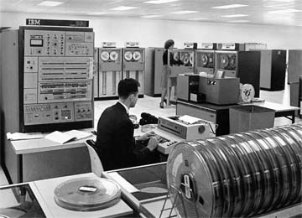
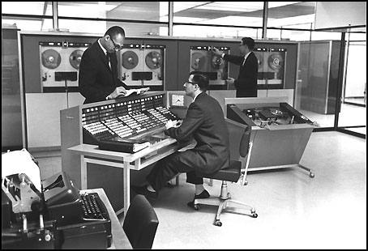
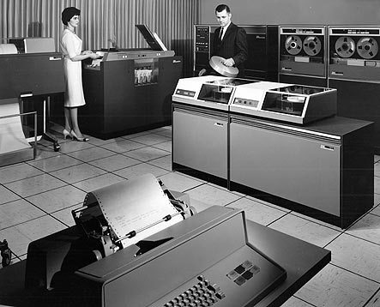

Slide 29
Alternative visualization

Slide 30
Aside: More on Sorting

Slide 31
Bottom-Up Merge Sort
use: input array A[n]; buffer array B[n]
assert: A[ ] contains sorted runs of length r=1
for run-length r=1,2,4,8,…
merge adjacent length-r runs in A[ ], copying the result into the buffer B[ ]
assert: B[ ] contains sorted runs of length 2*r
swap roles of A and B

Slide 32
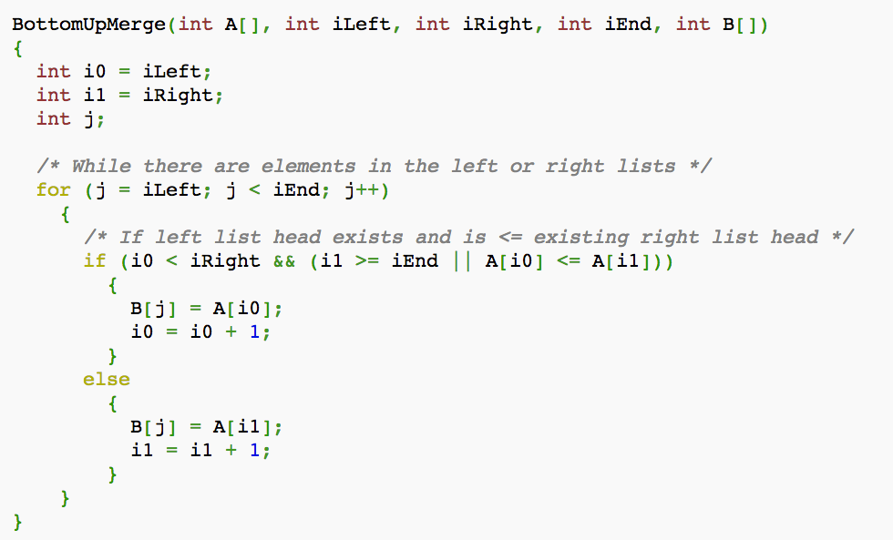

Slide 33
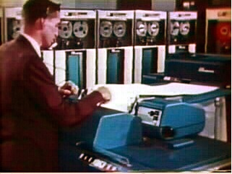
Wikipedia on Old-School Merge Sort
Use four tape drives A,B,C,D
1. merge runs from A,B and write them alternately into C,D
2. merge runs from C,D and write them alternately into A,B
3. And so on….
Requires only constant memory.

Slide 34
Unix Sort
Load as much as you can [actually --buffer-size=SIZE] into memory and do an in-memory sort [usually quicksort].
If you have more to do, then spill this sorted buffer out on to disk, and get a another buffer’s worth of data.
Finally, merge your spill buffers.

Slide 35
Sorting Out of Memory With Pipes
generate lines | sort | process lines

Slide 36
How Unix Pipes Work
Processes are all started at the same time
Data streaming thru the pipeline is held in a queue: writer → […queue…] → reader
If the queue is full:
the writing process is blocked
If the queue is empty:
the reading process is blocked
(I think) queues are usually smallish: 64k

Slide 37
How stream-and-sort works
Pipeline is stream → […queue…] → sort
Algorithm you get:
sort reads --buffer-size lines in, sorts them, spills them to disk
sort merges spill files after stream closes
stream is blocked when sort falls behind
and sort is blocked if it gets ahead

Slide 38
The Stream-And-Sort Design Pattern for Naive Bayes

Slide 39
Large-vocabulary Naïve Bayes
Create a hashtable C
For each example id, y, x₁,….,x_{d} in train:
C(“Y=ANY”) ++; C(“Y=y”) ++
For j in 1..d:
C(“Y=y ^ X=x_{j}”) ++

Slide 40
Large-vocabulary Naïve Bayes
Create a hashtable C
For each example id, y, x₁,….,x_{d} in train:
C(“Y=ANY”) ++; C(“Y=y”) ++
Print “Y=ANY += 1”
Print “Y=y += 1”
For j in 1..d:
C(“Y=y ^ X=x_{j}”) ++
Print “Y=y ^ X=x_{j} += 1”
Sort the event-counter update “messages”
Scan the sorted messages and compute and output the final counter values
Think of these as “messages” to another component to increment the counters
java MyTrainertrain | sort | java MyCountAdder > model

Slide 41
Large-vocabulary Naïve Bayes
Y=business += 1
Y=business += 1
…
Y=business ^ X =aaa += 1
…
Y=business ^ X=zynga += 1
Y=sports ^ X=hat += 1
Y=sports ^ X=hockey += 1
Y=sports ^ X=hockey += 1
Y=sports ^ X=hockey += 1
…
Y=sports ^ X=hoe += 1
…
Y=sports += 1
…
Create a hashtable C
For each example id, y, x₁,….,x_{d} in train:
C(“Y=ANY”) ++; C(“Y=y”) ++
Print “Y=ANY += 1”
Print “Y=y += 1”
For j in 1..d:
C(“Y=y ^ X=x_{j}”) ++
Print “Y=y ^ X=x_{j} += 1”
Sort the event-counter update “messages”
We’re collecting together messages about the same counter
Scan and add the sorted messages and output the final counter values

Slide 42
Large-vocabulary Naïve Bayes
Scan-and-add:
streaming
previousKey = Null
sumForPreviousKey = 0
For each (event,delta) in input:
If event==previousKey
sumForPreviousKey += delta
Else
OutputPreviousKey()
previousKey = event
sumForPreviousKey = delta
OutputPreviousKey()
define OutputPreviousKey():
If PreviousKey!=Null
print PreviousKey,sumForPreviousKey
Y=business += 1
Y=business += 1
…
Y=business ^ X =aaa += 1
…
Y=business ^ X=zynga += 1
Y=sports ^ X=hat += 1
Y=sports ^ X=hockey += 1
Y=sports ^ X=hockey += 1
Y=sports ^ X=hockey += 1
…
Y=sports ^ X=hoe += 1
…
Y=sports += 1
…
Accumulating the event counts requires constant storage … as long as the input is sorted.

Slide 43
Distributed Counting → Stream and Sort Counting
Hash table1
example 1
example 2
example 3
….
Machine 1
Hash table2
Machine 2
“C[x] +=D”
Message-routing logic
Counting logic
. . .
Hash table2
Machine K
Machine 0

Slide 44
Distributed Counting → Stream and Sort Counting
example 1
example 2
example 3
….
C[x1] += D1
C[x1] += D2
….
“C[x] +=D”
Logic to combine counter updates
Sort
Counting logic
Machine A
Machine C
Machine B

Slide 45
Stream and Sort Counting → Distributed Counting
Standardized message routing logic
example 1
example 2
example 3
….
C[x1] += D1
C[x1] += D2
….
“C[x] +=D”
Logic to combine counter updates
Counting logic
Sort
Machines A1,…
Machines C1,..,
Machines B1,…,
Trivial to parallelize!
Easy to parallelize!

Slide 46
Locality is good
Micro:
0.6G memory
Standard:
S: 1.7Gb
L: 7.5Gb
XL: 15Mb
Hi Memory:
XXL: 34.2
XXXXL: 68.4

Slide 47
Large-vocabulary Naïve Bayes
For each example id, y, x₁,….,x_{d} in train:
Print Y=ANY += 1
Print Y=y += 1
For j in 1..d:
Print Y=y ^ X=x_{j} += 1
Sort the event-counter update “messages”
Scan and add the sorted messages and output the final counter values
Complexity: O(n), n=size of train
(Assuming a constant number of labels apply to each document)
Complexity: O(nlogn)
Complexity: O(n)
java MyTrainertrain | sort | java MyCountAdder > model
Model size: min( O(n), O(|V||dom(Y)|))

Slide 48
Stream-And-Sort + Local Partial Counting

Slide 49
Today
Naïve Bayes with huge feature sets
i.e. ones that don’t fit in memory
Pros and cons of possible approaches
Traditional “DB” (actually, key-value store)
Memory-based distributed DB
Stream-and-sort counting
Optimizations
Other tasks for stream-and-sort

Slide 50
Optimizations
java MyTrainertrain | sort | java MyCountAdder > model
O(n)
Input size=n
Output size=n
O(nlogn)
Input size=n
Output size=n
O(n)
Input size=n
Output size=m
m<<n … say O(sqrt(n))
A useful optimization: decrease the size of the input to the sort
Reduces the size from O(n) to O(m)
Compress the output by using simpler messages
(“C[event] += 1”) ➔ “event 1”
Compress the output more – e.g. string→integer code
Tradeoff – ease of debugging vs efficiency – are messages meaningful or meaningful in context?

Slide 51
Optimization: partial local counting
For each example id, y, x₁,….,x_{d} in train:
Print “Y=y += 1”
For j in 1..d:
Print “Y=y ^ X=x_{j} += 1”
Sort the event-counter update “messages”
Scan and add the sorted messages and output the final counter values
Initialize hashtable C
For each example id, y, x₁,….,x_{d} in train:
C[Y=y] += 1
For j in 1..d:
C[Y=y ^ X=x_{j}] += 1
If memory is getting full: output all values from C as messages and re-initialize C
Sort the event-counter update “messages”
Scan and add the sorted messages
java MyTrainertrain | sort | java MyCountAdder > model

Slide 52
Review: Large-vocab Naïve Bayes
Create a hashtable C
For each example id, y, x₁,….,x_{d} in train:
C.inc(“Y=y”)
For j in 1..d:
C.inc(“Y=y ^ X=x_{j}”)
class EventCounter {
void inc(String event) {
// increment the right hashtable slot
if (hashtable.size()>BUFFER_SIZE) {
for (e,n) in hashtable.entries : print e + “\t” + n
hashtable.clear();
}
}
}

Slide 53
Distributed Counting → Stream and Sort Counting
example 1
example 2
example 3
….
C[x1] += D1
C[x1] += D2
….
“C[x] +=D”
Logic to combine counter updates
Sort
Counting logic
BUFFER
Machine A
Machine C
Machine B

Slide 54
How much does buffering help?
small-events.txt: nb.jar
time java -cp nb.jar com.wcohen.SmallStreamNB < RCV1.small_train.txt \
| sort -k1,1 \
| java -cp nb.jar com.wcohen.StreamSumReducer> small-events.txt
test-small: small-events.txt nb.jar
time java -cp nb.jar com.wcohen.SmallStreamNB \
RCV1.small_test.txt MCAT,CCAT,GCAT,ECAT 2000 < small-events.txt \
| cut -f3 | sort | uniq -c
BUFFER_SIZE | Time | Message Size
none |  | 1.7M words
100 | 47s | 1.2M
1,000 | 42s | 1.0M
10,000 | 30s | 0.7M
100,000 | 16s | 0.24M
1,000,000 | 13s | 0.16M
limit |  | 0.05M

Slide 55
More Stream-And-Sort Examples

Slide 56
Some other stream and sort tasks
Coming up: classify Wikipedia pages
Features:
words on page: src w₁ w₂ ….
outlinks from page: src dst₁ dst₂ …
how about inlinks to the page?

Slide 57
Some other stream and sort tasks
outlinks from page: src dst₁ dst₂ …
Algorithm:
For each input line src dst₁ dst₂ … dst_{n} print out
dst₁ inlinks.= src
dst₂ inlinks.= src
…
dst_{n} inlinks.= src
Sort this output
Collect the messages and group to get
dst src₁ src₂ … src_{n}

Slide 58
Some other stream and sort tasks
prevKey = Null
sumForPrevKey = 0
For each (event += delta) in input:
If event==prevKey
sumForPrevKey += delta
Else
OutputPrevKey()
prevKey = event
sumForPrevKey = delta
OutputPrevKey()
define OutputPrevKey():
If PrevKey!=Null
print PrevKey,sumForPrevKey
prevKey = Null
linksToPrevKey = [ ]
For each (dst inlinks.= src) in input:
If dst==prevKey
linksPrevKey.append(src)
Else
OutputPrevKey()
prevKey = dst
linksToPrevKey=[src]
OutputPrevKey()
define OutputPrevKey():
If PrevKey!=Null
print PrevKey, linksToPrevKey

Slide 59
Some other stream and sort tasks
What if we run this same program on the words on a page?
Features:
words on page: src w₁ w₂ ….
outlinks from page: src dst₁ dst₂ …
Out2In.java
w₁ src_{1,1} src_{1,2} src_{1,3} ….
w₂ src_{2,1} …
…
an inverted index for the documents

Slide 60
Some other stream and sort tasks
outlinks from page: src dst₁ dst₂ …
Algorithm:
For each input line src dst₁ dst₂ … dst_{n} print out
dst₁ inlinks.= src
dst₂ inlinks.= src
…
dst_{n} inlinks.= src
Sort this output
Collect the messages and group to get
dst src₁ src₂ … src_{n}

Slide 61
Some other stream and sort tasks
Later on: distributional clustering of words

Slide 62
Some other stream and sort tasks
Later on: distributional clustering of words
Algorithm:
For each word w in a corpus print w and the words in a window around it
Print “wi context .= (w_{i-k},…,w_{i-1},w_{i+1},…,w_{i+k} )”
Sort the messages and collect all contexts for each w – thus creating an instance associated with w
Cluster the dataset
Or train a classifier and classify it

Slide 63
Some other stream and sort tasks
prevKey = Null
sumForPrevKey = 0
For each (event += delta) in input:
If event==prevKey
sumForPrevKey += delta
Else
OutputPrevKey()
prevKey = event
sumForPrevKey = delta
OutputPrevKey()
define OutputPrevKey():
If PrevKey!=Null
print PrevKey,sumForPrevKey
prevKey = Null
ctxOfPrevKey = [ ]
For each (w c.= w₁,…,w_{k}) in input:
If dst==prevKey
ctxOfPrevKey.append(
w₁,…,w_{k} )
Else
OutputPrevKey()
prevKey = w
ctxOfPrevKey=[w₁,..,w_{k}]
OutputPrevKey()
define OutputPrevKey():
If PrevKey!=Null
print PrevKey, ctxOfPrevKey

Slide 64
Some other stream and sort tasks
Finding unambiguous geographical names
GeoNames.org: for each place in its database, stores
Several alternative names
Latitude/Longitude
…
Lets you put places on a map (e.g., Google Maps)
Problem: many names are ambiguous, especially if you allow an approximate match
Paris, London, … even Carnegie Mellon

Slide 65
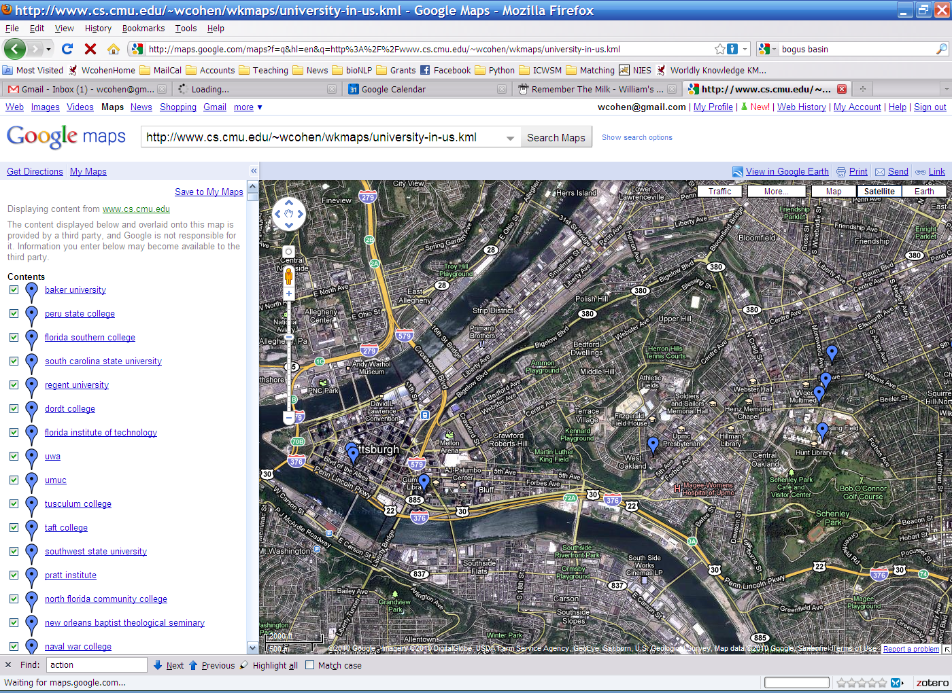
Point Park (College|University)
Carnegie Mellon [University [School]]

Slide 66
Some other stream and sort tasks
Finding almost unambiguous geographical names
GeoNames.org: for each place in the database
print all plausible soft-match substrings in each alternative name, paired with the lat/long, e.g.
Carnegie Mellon University at lat1,lon1
Carnegie Mellon at lat1,lon1
Mellon University at lat1,lon1
Carnegie Mellon School at lat2,lon2
Carnegie Mellon at lat2,lon2
Mellon School at lat2,lon2
…
Sort and collect… and filter

Slide 67
Some other stream and sort tasks
prevKey = Null
sumForPrevKey = 0
For each (event += delta) in input:
If event==prevKey
sumForPrevKey += delta
Else
OutputPrevKey()
prevKey = event
sumForPrevKey = delta
OutputPrevKey()
define OutputPrevKey():
If PrevKey!=Null
print PrevKey,sumForPrevKey
prevKey = Null
locOfPrevKey = Gaussian()
For each (place at lat,lon) in input:
If dst==prevKey
locOfPrevKey.observe(lat, lon)
Else
OutputPrevKey()
prevKey = place
locOfPrevKey = Gaussian()
locOfPrevKey.observe(lat, lon)
OutputPrevKey()
define OutputPrevKey():
If PrevKey!=Null and locOfPrevKey.stdDev() < 1 mile
print PrevKey, locOfPrevKey.avg()

Slide 68
Looking ahead: Parallelizing Stream And Sort

Slide 69
Stream and Sort Counting → Distributed Counting
Standardized message routing logic
example 1
example 2
example 3
….
C[x1] += D1
C[x1] += D2
….
“C[x] +=D”
Logic to combine counter updates
Counting logic
Sort
Machines A1,…
Machines C1,..,
Machines B1,…,
Trivial to parallelize!
Easy to parallelize!

Slide 70
Stream and Sort Counting → Distributed Counting
example 1
example 2
example 3
….
C[x1] += D1
C[x1] += D2
….
Spill 1
Spill 2
Merge Spill Files
Spill 3
Logic to combine counter updates
Counting logic
…
Sort
“C[x] +=D”
Machines A1,…
Machines C1,..,

Slide 71
Stream and Sort Counting → Distributed Counting
example 1
example 2
example 3
….
C[x1] += D1
C[x1] += D2
….
Spill 1
Spill 2
Merge Spill Files
Spill 3
Logic to combine counter updates
Counting logic
…
Sort
“C[x] +=D”
Counter Machine
Combiner Machine

Slide 72
Stream and Sort Counting → Distributed Counting
Counter Machine 1
Combiner Machine 1
example 1
example 2
example 3
….
C[x1] += D1
C[x1] += D2
….
Spill 1
Spill 2
Spill 3
Merge Spill Files
Logic to combine counter updates
Counting logic
Partition/Sort
…
Spill n
example 1
example 2
example 3
….
Spill 1
C[x1] += D1
C[x1] += D2
….
Spill 2
Merge Spill Files
Spill 3
Counting logic
combine counter updates
Partition/Sort
…
Counter Machine 2
Combiner Machine 2

Slide 73
Confession: This Naïve Bayes Has a Problem….

Slide 74
Today
Naïve Bayes with huge feature sets
i.e. ones that don’t fit in memory
Pros and cons of possible approaches
Traditional “DB” (actually, key-value store)
Memory-based distributed DB
Stream-and-sort counting
Optimizations
Other tasks for stream-and-sort
Finally: A “detail” about large-vocabulary Naïve Bayes…..

Slide 75
Complexity of Naïve Bayes
Assume hashtable holding all counts fits in memory
Sequential reads
You have a train dataset and a test dataset
Initialize an “event counter” (hashtable) C
For each example id, y, x₁,….,x_{d} in train:
C(“Y=y”) ++
For j in 1..d:
C(“Y=y ^ X=x_{j}”) ++
….
For each example id, y, x₁,….,x_{d} in test:
For each y’ in dom(Y):
Compute log Pr(y’,x₁,….,x_{d}) =
Return the best y’
Complexity: O(n), n=size of train
where:
q_{j} = 1/|V|
q_{y} = 1/|dom(Y)|
mq_{x}=1
Sequential reads
Complexity: O(|dom(Y)|*n’), n’=size of test

Slide 76
Using Large-vocabulary Naïve Bayes
For each example id, y, x₁,….,x_{d} in train:
Sort the event-counter update “messages”
Scan and add the sorted messages and output the final counter values
For each example id, y, x₁,….,x_{d} in test:
For each y’ in dom(Y):
Compute log Pr(y’,x₁,….,x_{d}) =
Model size: max O(n), O(|V||dom(Y)|)

Slide 77
Using Large-vocabulary Naïve Bayes
[For assignment]
For each example id, y, x₁,….,x_{d} in train:
Sort the event-counter update “messages”
Scan and add the sorted messages and output the final counter values
Initialize a HashSet NEEDED and a hashtable C
For each example id, y, x₁,….,x_{d} in test:
Add x₁,….,x_{d} to NEEDED
For each event, C(event) in the summed counters
If event involves a NEEDED term x read it into C
For each example id, y, x₁,….,x_{d} in test:
For each y’ in dom(Y):
Compute log Pr(y’,x₁,….,x_{d}) = ….
Model size: O(|V|)
Time: O(n₂), size of test
Memory: same
Time: O(n₂)
Memory: same
Time: O(n₂)
Memory: same

Slide 78
Large-Vocabulary Naïve Bayes
Learning/Counting
Using Counts
Counts on disk with a key-value store
Counts as messages to a set of distributed processes
Repeated scans to build up partial counts
Counts as messages in a stream-and-sort system
Assignment: Counts as messages but buffered in memory
Assignment:
Scan through counts to find those needed for test set
Classify with counts in memory
Put counts in a database
Use partial counts and repeated scans of the test data?
Re-organize the counts and test set so that you can classify in a stream

