Slide 1
Randomized Algorithms
William Cohen
Notes:
start with BFs

Slide 2
Outline
Randomized methods: today
  SGD with the hash trick (recap)
  Bloom filters
Later:
  count-min sketches
  locality sensitive hashing

Slide 3
THE Hash Trick: A Review

Slide 4
Hash Trick - Insights
Save memory: don’t store hash keys
Allow collisions
  even though it distorts your data some
Let the learner (downstream) take up the slack

Slide 5

Learning as optimization for regularized logistic regression
Algorithm:
Initialize arrays W, A of size R and set k=0
For each iteration t=1,…T
  For each example (x_{i},y_{i})
    Let V be hash table so that
    p_{i} = … ; k++
    For each hash value h: V[h]>0:
        W[h] *= (1 - λ2μ)^{k-A[j]}
        W[h] = W[h] + λ(y_{i} - p^{i})V[h]
        A[h] = k

Slide 6
Learning as optimization for regularized logistic regression
Initialize arrays W, A of size R and set k=0
For each iteration t=1,…T
  For each example (x_{i},y_{i})
    k++; let V be a new array of size R; let tmp=0
    For each j: x_{i} ^{j} >0: V[hash(j)%R] += x_{i} ^{j}
    Let ip=0
    For each h: V[h]>0:
      W[h] *= (1 - λ2μ)^{k-A[h]}
      ip+= V[h]*W[h]
      A[h] = k
    p = 1/(1+exp(-ip))
    For each h: V[h]>0:
      W[h] = W[h] + λ(y_{i} - p^{i})V[h]
regularize W[h]’s

Slide 7
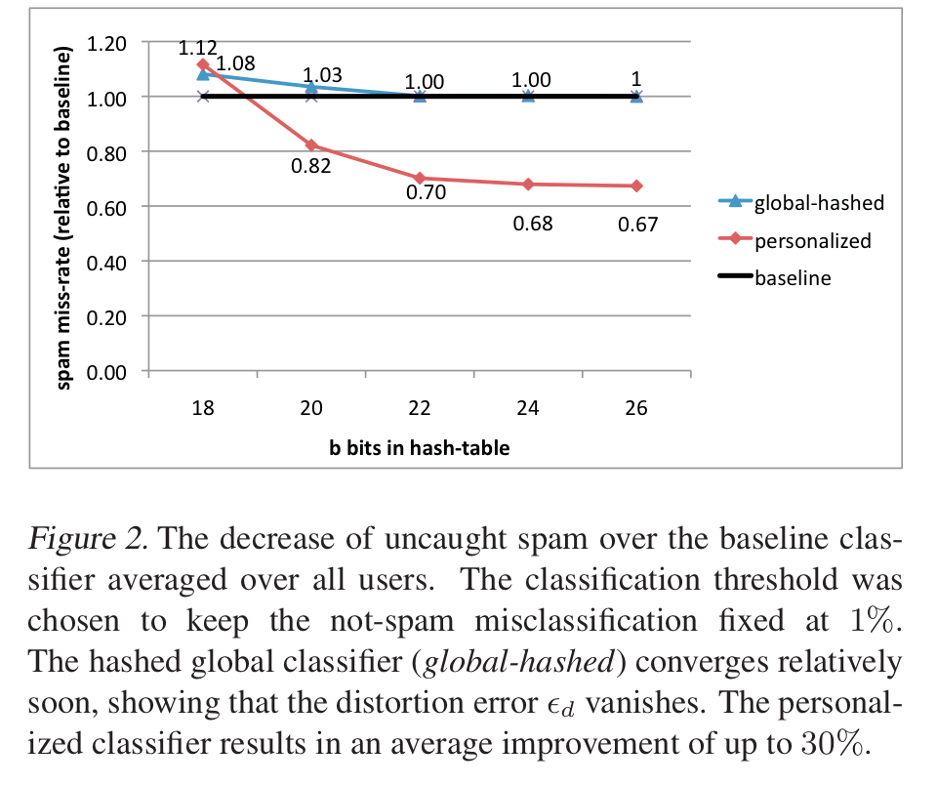
An example
2^26 entries = 1 Gb @ 8bytes/weight
Notes:
3,2M emails
400k users
40M tokens

Slide 8
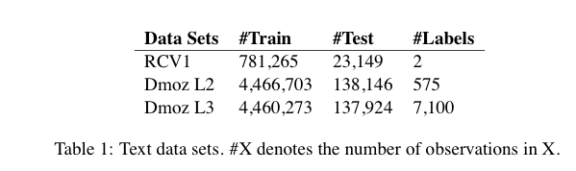
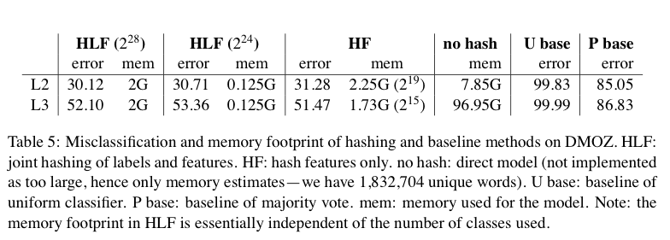
Results

Slide 9
Motivating Bloom Filters

Slide 10
A variant of feature hashing
Hash each feature multiple times with different hash functions
Now, each w has k chances to not collide with another useful w’
An easy way to get multiple hash functions
  Generate some random strings s₁,…,s_{L}
  Let the k-th hash function for w be the ordinary hash of concatenation w•s_{k}

Slide 11
A variant of feature hashing
a!=b are binary vectors
Hash each feature multiple times with different hash functions
Now, each w has k chances to not collide with another useful w’
An easy way to get multiple hash functions
  Generate some random strings s₁,…,s_{L}
  Let the k-th hash function for w be the ordinary hash of concatenation w•s_{k}
V(a)
1 | 0 | 1 | 0
0 | 1 | 1 | 0
1 | 0 | 1 | 0
1 | 1 | 0 | 0
V(a)
1 | 0 | 1 | 0
1 | 0 | 1 | 0
1 | 1 | 2 | 0
V(b)
V(b)
1 | 1 | 1 | 0

Slide 12
A variant of feature hashing
Why would this work?
Claim: with 100,000 features and 100,000,000 buckets:
  k=1 ➔Pr(any feature duplication) ≈1
  k=2 ➔Pr(any feature duplication) ≈0.4
  k=3 ➔ Pr(any feature duplication) ≈0.01

Slide 13
Hash Trick - Insights
Save memory: don’t store hash keys
Allow collisions
  even though it distorts your data some
Let the learner (downstream) take up the slack
Here’s another famous trick that exploits these insights….

Slide 14
Bloom Filters

Slide 15
Bloom filters
Interface to a Bloom filter
  BloomFilter(int maxSize, double p);
  void bf.add(String s); // insert s
  bool bd.contains(String s);
    // If s was added return true;
    // else with probability at least 1-p return false;
    // else with probability at most p return true;
  I.e., a noisy “set” where you can test membership (and that’s it)
Notes:
note a hash table would do this in constant time and storage
the hash trick does this as well

Slide 16
Bloom filters
An implementation
  Allocate M bits, bit[0]…,bit[1-M]
  Pick K hash functions hash(1,2),hash(2,s),….
    E.g: hash(i,s) = hash(s+ randomString[i])
  To add string s:
    For i=1 to k, set bit[hash(i,s)] = 1
  To check contains(s):
    For i=1 to k, test bit[hash(i,s)]
    Return “true” if they’re all set; otherwise, return “false”
  We’ll discuss how to set M and K soon, but for now:
    Let M = 1.5*maxSize // less than two bits per item!
    Let K = 2*log(1/p) // about right with this M

Slide 17
Bloom filters
0 | 0 | 0 | 0 | 0 | 0 | 0 | 0 | 0 | 0
bf.add(“fred flintstone”):
h1
h2
h3
0 | 1 | 1 | 0 | 0 | 0 | 0 | 1 | 0 | 0
bf.add(“barney rubble”):
h1
h2
h3
1 | 1 | 1 | 0 | 0 | 1 | 0 | 1 | 0 | 0

Slide 18
Bloom filters
1 | 1 | 1 | 0 | 0 | 1 | 0 | 1 | 0 | 0
bf.contains (“fred flintstone”):
h1
h2
1 | 1 | 1 | 0 | 0 | 1 | 0 | 1 | 0 | 0
bf.contains(“barney rubble”):
h1
h2
h3
1 | 1 | 1 | 0 | 0 | 1 | 0 | 1 | 0 | 0

Slide 19
Bloom filters
1 | 1 | 1 | 0 | 0 | 1 | 0 | 1 | 0 | 0
bf.contains(“wilma flintstone”):
h1
h2
h3
1 | 1 | 1 | 0 | 0 | 1 | 0 | 1 | 0 | 0
bf.contains(“wilma flintstone”):
h1
h2
h3
1 | 1 | 1 | 0 | 0 | 1 | 0 | 1 | 0 | 0

Slide 20



Bloom filters: analysis
Analysis (m bits, k hashers):
  Assume hash(i,s) is a random function
  Look at Pr(bit j is unset after n add’s):
  … and Pr(collision) = Pr(not all k bits set)
  …. fix m and n and minimize k:
f(m,n,k) =
k =

Slide 21


Bloom filters
Analysis:
  Plug optimal k=m/n*ln(2) back into Pr(collision):
  Now we can fix any two of p, n, m and solve for the 3rd:
  E.g., the value for m in terms of n and p:
f(m,n) =

Slide 22
Bloom filters
Interface to a Bloom filter
  BloomFilter(int maxSize /* n */, double p);
  void bf.add(String s); // insert s
  bool bd.contains(String s);
    // If s was added return true;
    // else with probability at least 1-p return false;
    // else with probability at most p return true;
  I.e., a noisy “set” where you can test membership (and that’s it)
Notes:
note a hash table would do this in constant time and storage
the hash trick does this as well

Slide 23
Bloom filters: demo

Slide 24
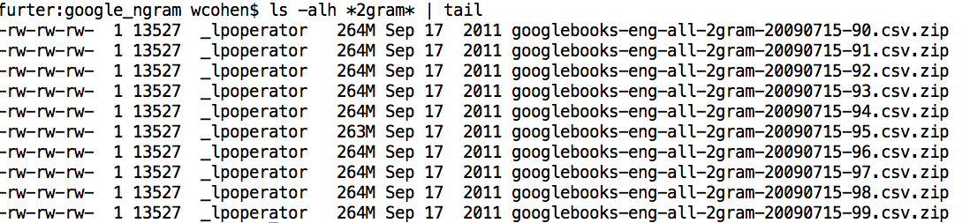
Bloom filters
An example application
  Finding items in “sharded” data
    Easy if you know the sharding rule
    Harder if you don’t (like Google n-grams)

Slide 25
Bloom filters
An example application
  Finding items in “sharded” data
    Easy if you know the sharding rule
    Harder if you don’t (like Google n-grams)
Simple idea:
  Build a BF of the contents of each shard
  To look for key, load in the BF’s one by one, and search only the shards that probably contain key
  Analysis: you won’t miss anything, you might look in some extra shards
  You’ll hit O(1) extra shards if you set p=1/#shards

Slide 26
Bloom filters
An example application
  discarding singleton features from a classifier
Scan through data once and check each w:
  if bf1.contains(w): bf2.add(w)
  else bf1.add(w)
Now:
  bf1.contains(w) ⬄ w appears >= once
  bf2.contains(w) ⬄ w appears >= 2x
Then train, ignoring words not in bf2

Slide 27
Bloom filters
An example application
  discarding rare features from a classifier
  seldom hurts much, can speed up experiments
Scan through data once and check each w:
  if bf1.contains(w):
    if bf2.contains(w): bf3.add(w)
    else bf2.add(w)
  else bf1.add(w)
Now:
  bf2.contains(w) ⬄ w appears >= 2x
  bf3.contains(w) ⬄ w appears >= 3x
Then train, ignoring words not in bf3

Slide 28
The Count-Min Sketch

Slide 29
A variant of feature hashing
Hash each feature multiple times with different hash functions
Now, each w has k chances to not collide with another useful w’
Get multiple hash functions as in Bloom filters
Part Bloom filter, part hash kernel
  but predates either, called “count-min sketch” -- Cormode and Muthukrishnan

Slide 30
Bloom filters
An implementation
  Allocate M bits, bit[0]…,bit[1-M]
  Pick K hash functions hash(1,2),hash(2,s),….
    E.g: hash(i,s) = hash(s+ randomString[i])
  To add string s:
    For i=1 to k, set bit[hash(i,s)] = 1
  To check contains(s):
    For i=1 to k, test bit[hash(i,s)]
    Return “true” if they’re all set; otherwise, return “false”
  We’ll discuss how to set M and K soon, but for now:
    Let M = 1.5*maxSize // less than two bits per item!
    Let K = 2*log(1/p) // about right with this M

Slide 31
Bloom Filter→Count-min sketch
An implementation
  Allocate a matrix CM with d rows, w columns
  Pick d hash functions h₁(s),h₂(s),….
  To increment counter A[s] for s by c
    For i=1 to d, set CM[i, hash(i,s)] += c
  To retrieve value of A[s]:
    For i=1 to d, retrieve M[i, hash(i,s)]
    Return minimum of these values
  Similar idea as Bloom filter:
    if there are d collisions, you return a value that’s too large; otherwise, you return the correct value.
Question: what does this look like if d=1?

Slide 32
CM Sketch Structure
from: Minos Garofalakis
h₁(s)
+c
<s, +c>
+c
d=log 1/δ
+c
h_{d}(s)
+c
w = 2/ε
Each string is mapped to one bucket per row
Estimate A[j] by taking min_{k} { CM[k,h_{k}(j)] }
Errors are always over-estimates
Analysis: d=log 1/, w=2/ ➔ error is usually less than ||A||₁
i.e. with prob > 1-

Slide 33
from: Minos Garofalakis
<s, +c>
c
c
You can find the sum of two sketches by doing element-wise summation
c
c
<t, +d>
d
+
d
Also, you can compute a weighted sum of MC sketches
d
d
d
c
Same result as adding <s,+c> and then <t,+d> to an empty sketch
c+d
c
d
d
c

Slide 34
CM Sketch Guarantees
from: Minos Garofalakis
[Cormode, Muthukrishnan’04] CM sketch guarantees approximation error on point queries less than ε||A||₁ in space O(1/ε log 1/δ)
  Probability of more error is less than 1-δ
This is sometimes enough:
  Estimating a multinomial: if A[s] = Pr(s|…) then ||A||₁ = 1
  Multiclass classification: if A_{x}[s] = Pr(x in class s) then ||A_{x}||₁ is probably small, since most x’s will be in only a few classes

Slide 35
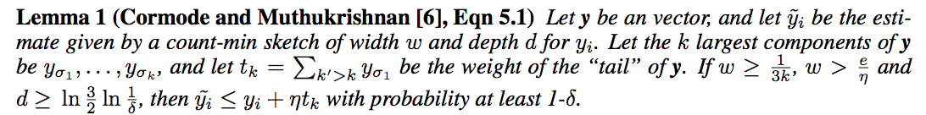
CM Sketch Guarantees
from: Minos Garofalakis
[Cormode, Muthukrishnan’04] CM sketch guarantees approximation error on point queries less than ε||A||₁ in space O(1/ε log 1/δ)
CM sketches are also accurate for skewed values---i.e., only a few entries s with large A[s]

Slide 36


An Application of a Count-Min Sketch
Problem: find the semantic orientation of a work (positive or negative) using a large corpus.
Idea:
  positive words co-occur more frequently than expected near positive words; likewise for negative words
  so pick a few pos/neg seeds and compute
x appears near y

Slide 37
An Application of a Count-Min Sketch
x appears near y
Example: Turney, 2002 used two seeds, “excellent” and “poor”
In general, SO(w) can be written in terms of logs of products of counters for w, with and without seeds

Slide 38
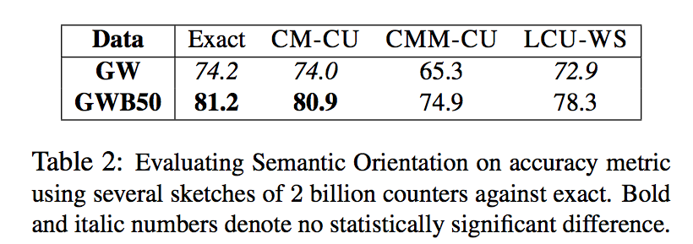
An Application of a Count-Min Sketch
Use 2B counters, 5 hash functions, “near” means a 7-word window, GigaWord (10 Gb) and GigaWord + Web news 50 Gb)

Slide 39
An Application of a Count-Min Sketch
CM-CU: CM with “conservative update” - for <j,+c> increment counters just enough to make the new estimate for j grow by c

Slide 40
Locality Sensitive Hashing (LSH)

Slide 41
LSH: key ideas
Goal:
  map feature vector x to bit vector bx
  ensure that bx preserves “similarity”

Slide 42

Random Projections

Slide 43
Random projections
u
+
+
+
+
+
+
+
+
+
-
-
-
-
-
-
-
-
-
-u
2γ

Slide 44
Random projections
To make those points “close” we need to project to a direction orthogonal to the line between them
+
+
+
+
+
+
+
+
+
-
-
-
-
-
-
-
-
-

Slide 45
Random projections
Any other direction will keep the distant points distant.
+
+
+
+
+
+
+
+
+
-
-
-
-
-
-
-
-
-
So if I pick a random r and r.x and r.x’ are closer than γ then probably x and x’ were close to start with.
-u

Slide 46
LSH: key ideas
Goal:
  map feature vector x to bit vector bx
  ensure that bx preserves “similarity”
Basic idea: use random projections of x
  Repeat many times:
    Pick a random hyperplane r by picking random weights for each feature (say from a Gaussian)
    Compute the inner product of r with x
    Record if x is “close to” r (r.x>=0)
      the next bit in bx
    Theory says that is x’ and x have small cosine distance then bx and bx’ will have small Hamming distance

Slide 47
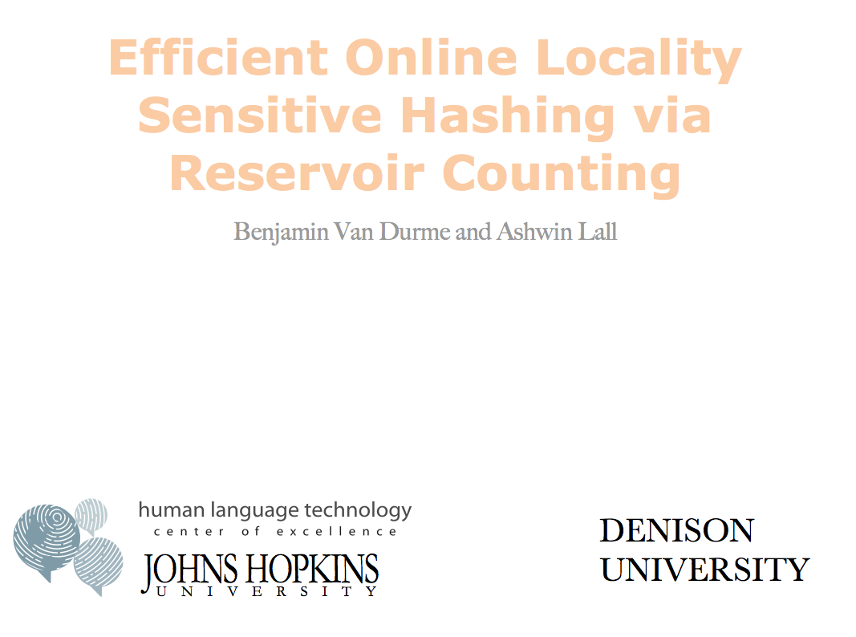



Slide 48
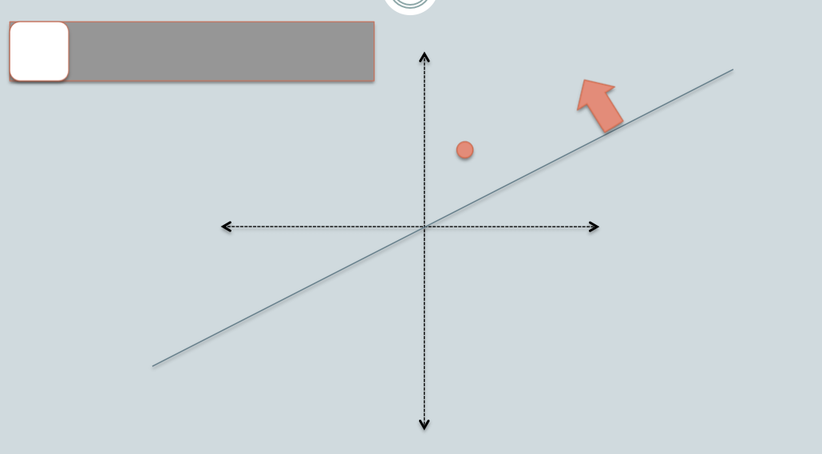

Slide 49
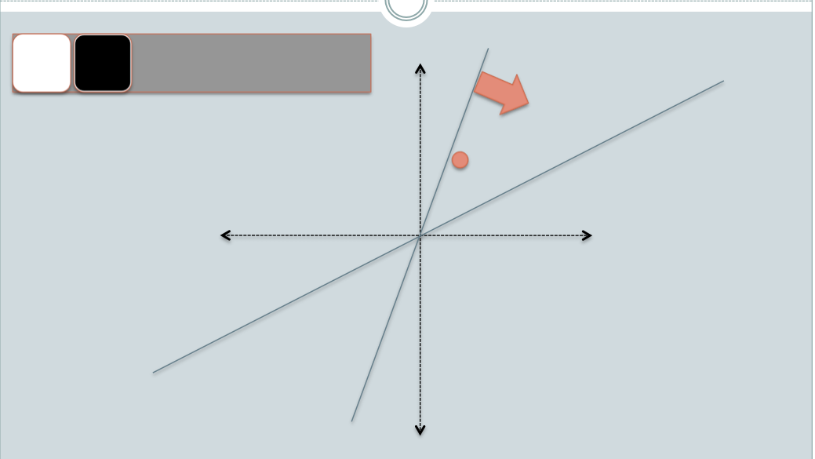

Slide 50
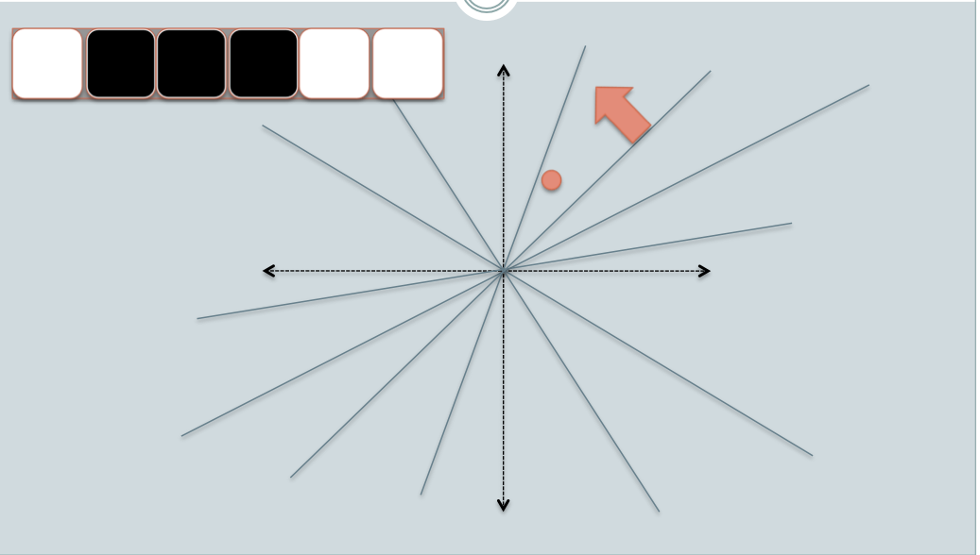

Slide 51
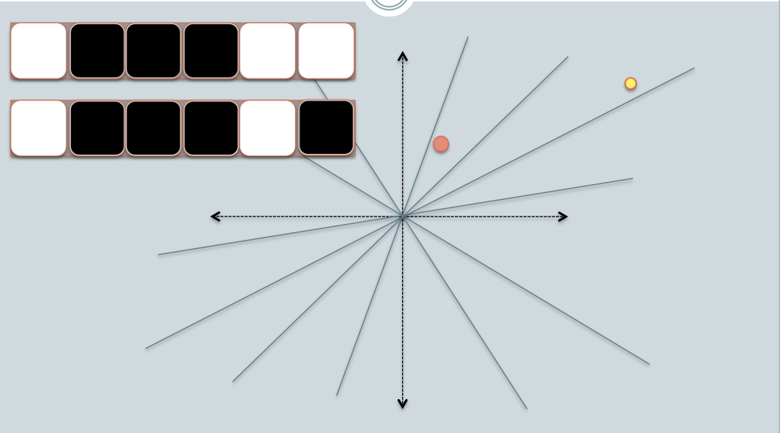

Slide 52
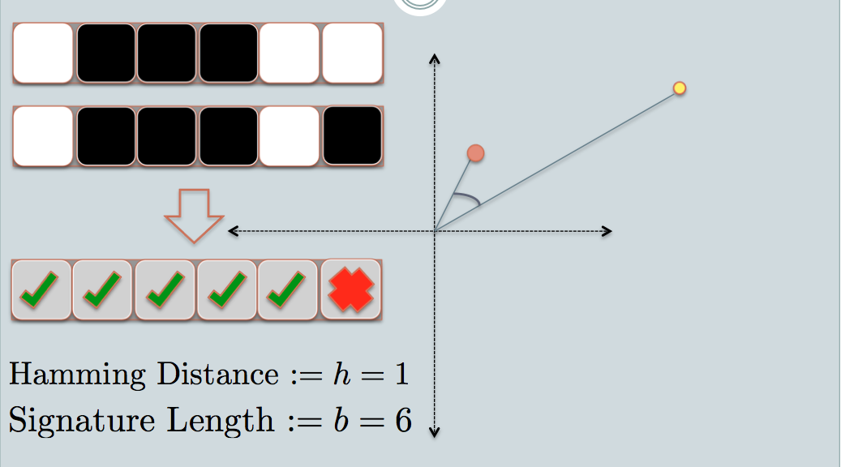
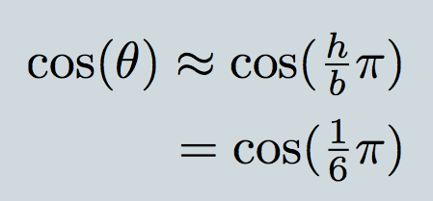

Slide 53
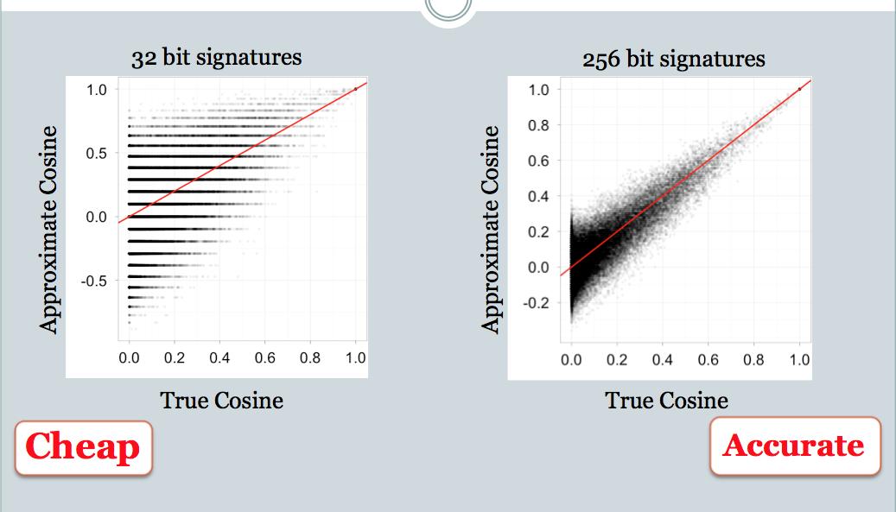

Slide 54
LSH applications
Compact storage of data
  and we can still compute similarities
LSH also gives very fast approximations:
  approx nearest neighbor method
    just look at other items with bx’=bx
    also very fast nearest-neighbor methods for Hamming distance
  very fast clustering
    cluster = all things with same bx vector

Slide 55
Locality Sensitive Hashing (LSH) and Pooling Random Values

Slide 56
LSH algorithm
Naïve algorithm:
  Initialization:
    For i=1 to outputBits:
      For each feature f:
        Draw r(f,i) ~ Normal(0,1)
  Given an instance x
    For i=1 to outputBits:
      LSH[i] =
      sum(x[f]*r[i,f] for f with non-zero weight in x) > 0 ? 1 : 0
    Return the bit-vector LSH

Slide 57
LSH algorithm
But: storing the k classifiers is expensive in high dimensions
  For each of 256 bits, a dense vector of weights for every feature in the vocabulary
Storing seeds and random number generators:
  Possible but somewhat fragile

Slide 58
LSH: “pooling” (van Durme)
Better algorithm:
  Initialization:
    Create a pool:
      Pick a random seed s
      For i=1 to poolSize:
        Draw pool[i] ~ Normal(0,1)
    For i=1 to outputBits:
      Devise a random hash function hash(i,f):
        E.g.: hash(i,f) = hashcode(f) XOR randomBitString[i]
  Given an instance x
    For i=1 to outputBits:
      LSH[i] = sum(
      x[f] * pool[hash(i,f) % poolSize] for f in x) > 0 ? 1 : 0
    Return the bit-vector LSH

Slide 59
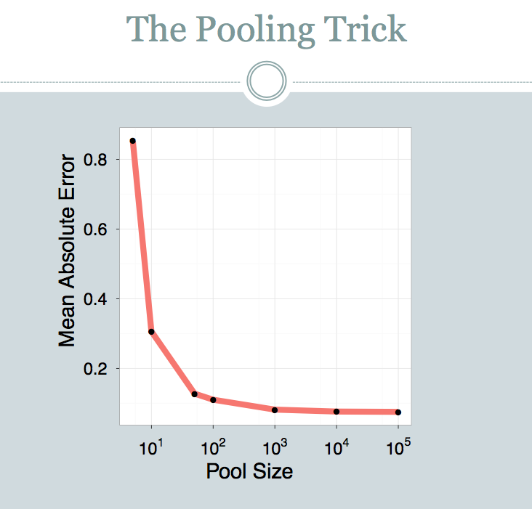

Slide 60
LSH: key ideas: pooling
Advantages:
  with pooling, this is a compact re-encoding of the data
    you don’t need to store the r’s, just the pool

Slide 61
Locality Sensitive Hashing (LSH) in an On-line Setting

Slide 62
LSH: key ideas: online computation
Common task: distributional clustering
  for a word w, x(w) is sparse vector of words that co-occur with w
  cluster the w’s

Slide 63
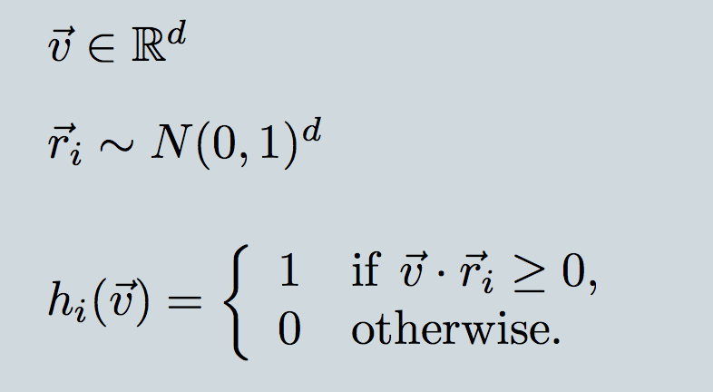
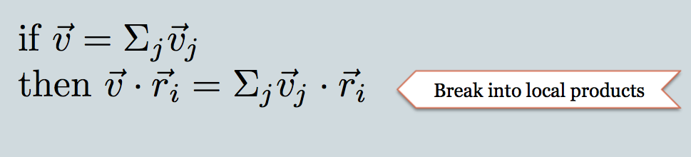
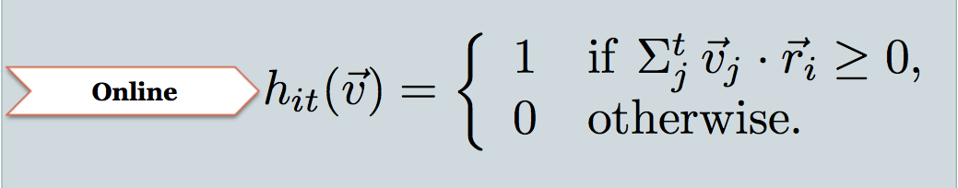

Slide 64
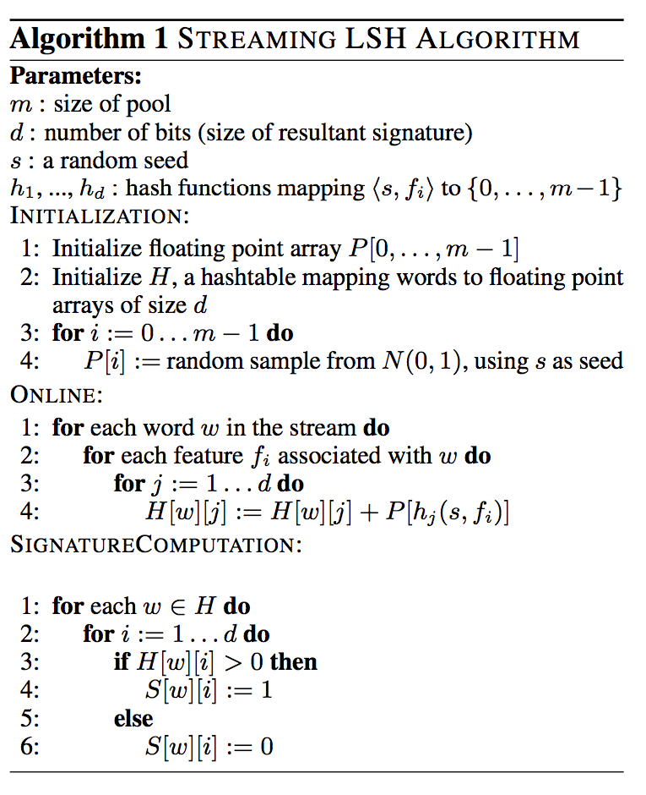

Slide 65
Experiment
Corpus: 700M+ tokens, 1.1M distinct bigrams
For each, build a feature vector of words that co-occur near it, using on-line LSH
Check results with 50,000 actual vectors

Slide 66
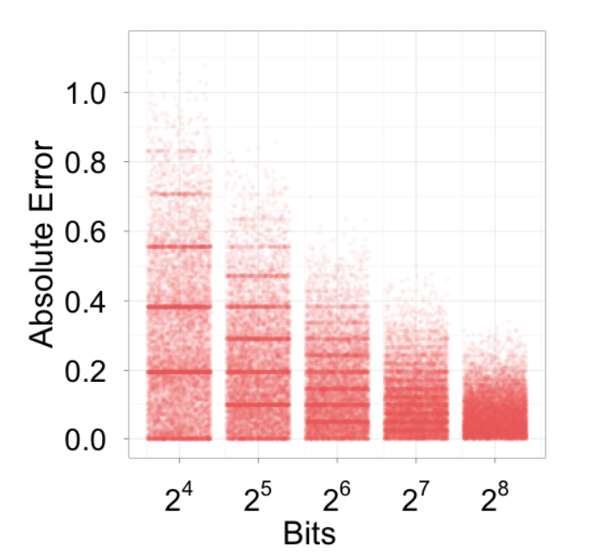
Experiment

Slide 67
