Slide 1
Randomized Algorithms Part 3
William Cohen

Slide 2
Outline
Randomized methods - so far
SGD with the hash trick
Bloom filters
count-min sketches
Today:
Review and discussion
More on count-min
Morris counters
locality sensitive hashing

Slide 3
Locality Sensitive Hashing (LSH)
Bloom filters:
set of objects mapped to a bit vector
allows: add to set, check containment
Countmin sketch:
sparse vector, x mapped to small dense matrix
allows: recover approximate value of x_{i} especially useful for largest values
Locality sensitive hash:
feature vector, x mapped to bit vector, bx
allows: compute approximate similarity of bx and by

Slide 4
LSH: key ideas
Goal:
map feature vector x to bit vector bx
ensure that bx preserves “similarity”

Slide 5

Random Projections

Slide 6
Random projections
u
+
+
+
+
+
+
+
+
+
-
-
-
-
-
-
-
-
-
-u
2γ

Slide 7
Random projections
To make those points “close” we need to project to a direction orthogonal to the line between them
u
+
+
+
+
+
+
+
+
+
-
-
-
-
-
-
-
-
-
-u
2γ

Slide 8
Random projections
Any other direction will keep the distant points distant.
u
+
+
+
+
+
+
+
+
+
-
-
-
-
-
-
-
-
-
So if I pick a random r and r.x and r.x’ are closer than γ then probably x and x’ were close to start with.
-u
2γ

Slide 9
LSH: key ideas
Goal:
map feature vector x to bit vector bx
ensure that bx preserves “similarity”
Basic idea: use random projections of x
Repeat many times:
Pick a random hyperplane r by picking random weights for each feature (say from a Gaussian)
Compute the inner product of r with x
Record if x is “close to” r (r.x>=0)
the next bit in bx
Theory says that is x’ and x have small cosine distance then bx and bx’ will have small Hamming distance

Slide 10
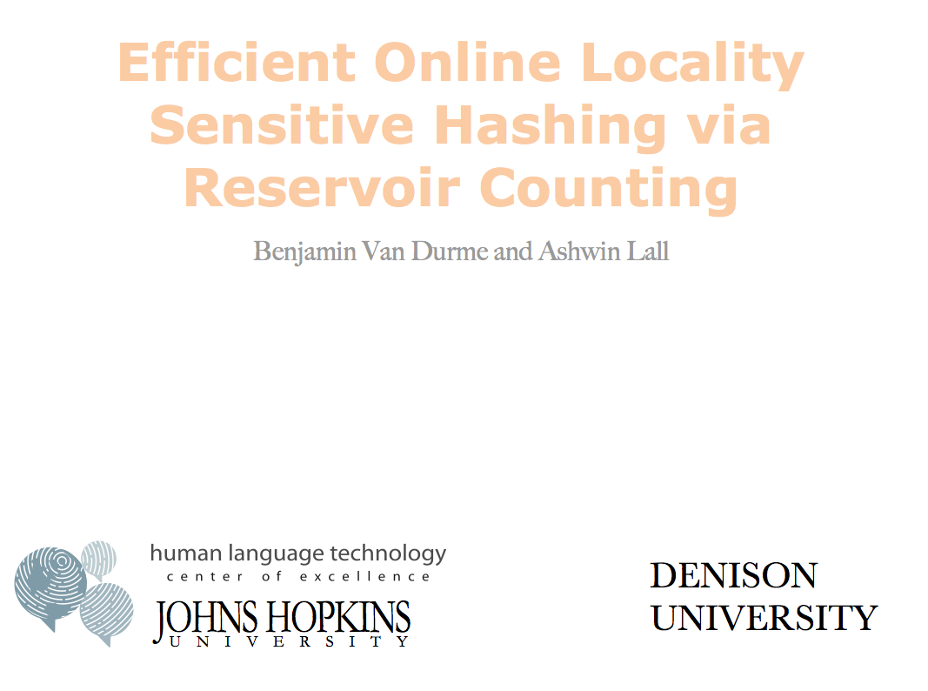



Slide 11
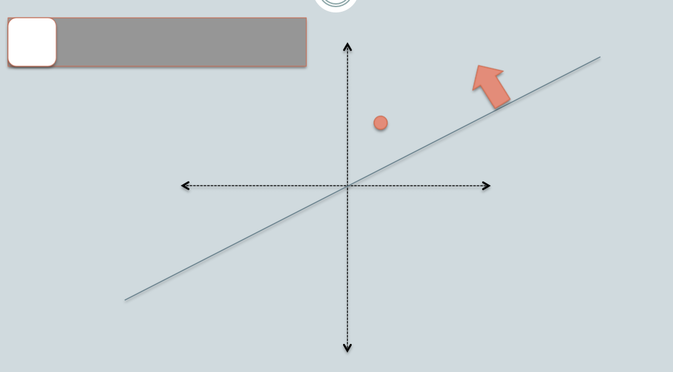

Slide 12
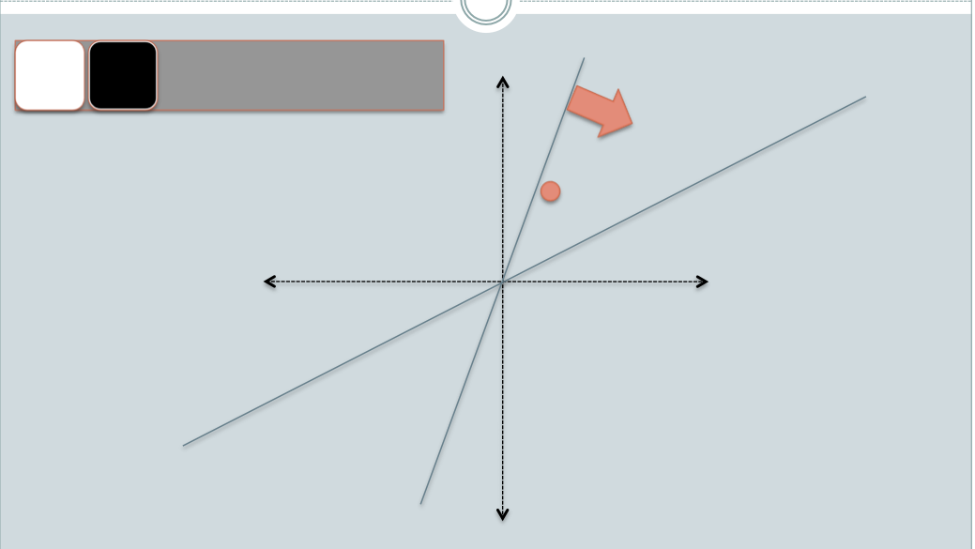

Slide 13
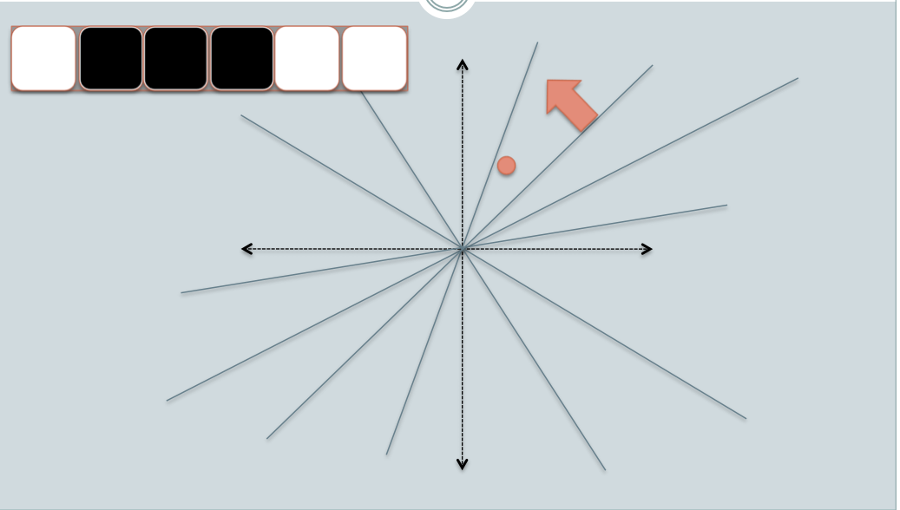

Slide 14
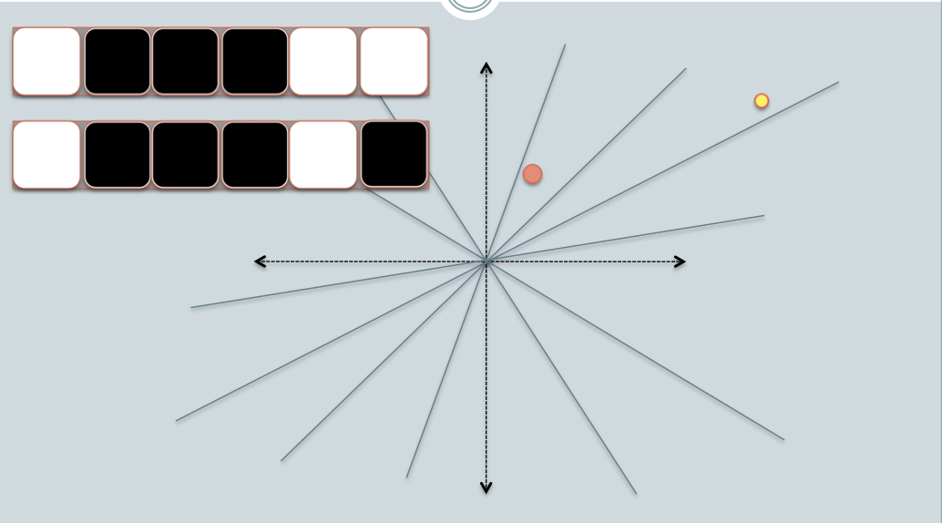

Slide 15
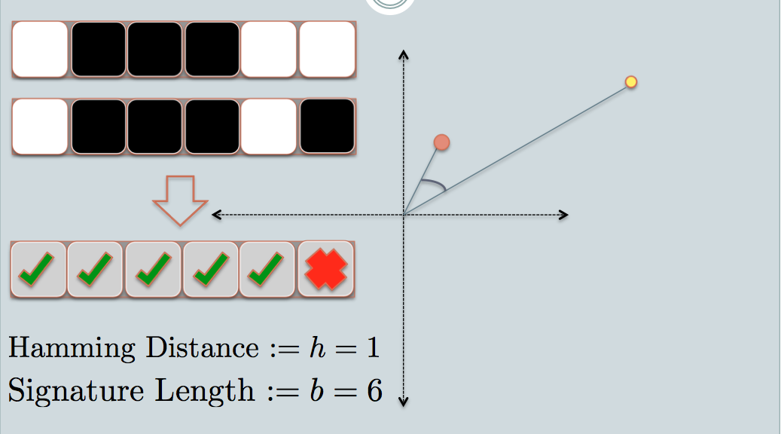
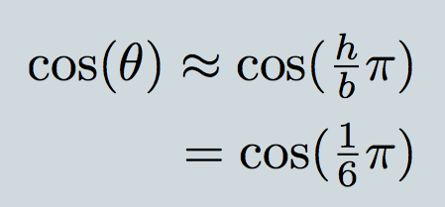

Slide 16
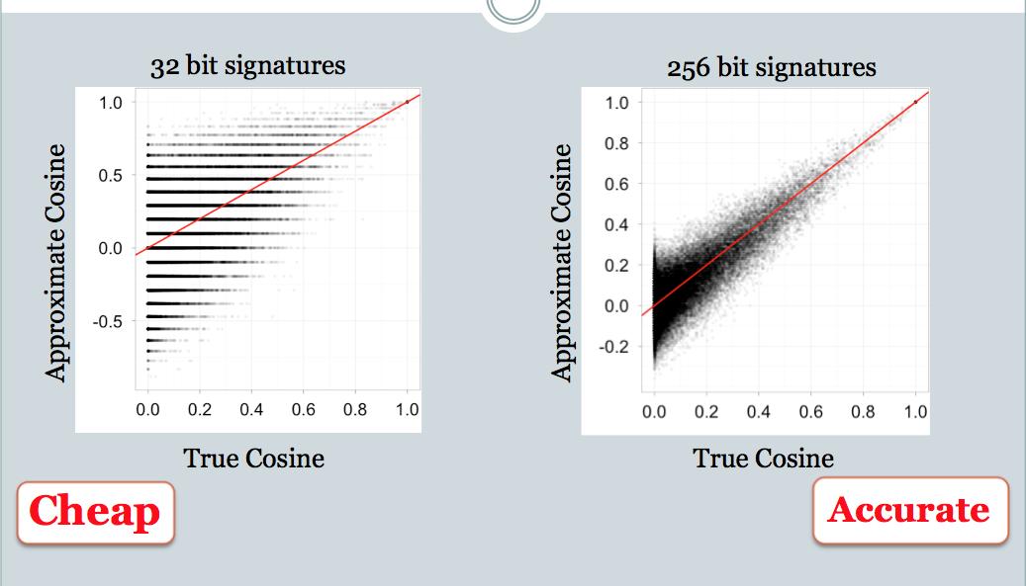

Slide 17
LSH applications
Compact storage of data
and we can still compute similarities
LSH also gives very fast …:
approx nearest neighbor method
just look at other items with bx’=bx
also very fast nearest-neighbor methods for Hamming distance
approximate clustering/blocking
cluster = all things with same bx vector

Slide 18
Locality Sensitive Hashing (LSH) and Pooling Random Values

Slide 19
LSH algorithm
Naïve algorithm:
Initialization:
For i=1 to outputBits:
For each feature f:
Draw r(f,i) ~ Normal(0,1)
Given an instance x
For i=1 to outputBits:
LSH[i] =
sum(x[f]*r[i,f] for f with non-zero weight in x) > 0 ? 1 : 0
Return the bit-vector LSH

Slide 20
LSH algorithm
But: storing the k classifiers is expensive in high dimensions
For each of 256 bits, a dense vector of weights for every feature in the vocabulary
Storing seeds and random number generators:
Possible but somewhat fragile

Slide 21
LSH: “pooling” (van Durme)
Better algorithm:
Initialization:
Create a pool:
Pick a random seed s
For i=1 to poolSize:
Draw pool[i] ~ Normal(0,1)
For i=1 to outputBits:
Devise a random hash function hash(i,f):
E.g.: hash(i,f) = hashcode(f) XOR randomBitString[i]
Given an instance x
For i=1 to outputBits:
LSH[i] = sum(x[f] * pool[hash(i,f) % poolSize] for f in x) > 0 ? 1 : 0)
Return the bit-vector LSH

Slide 22
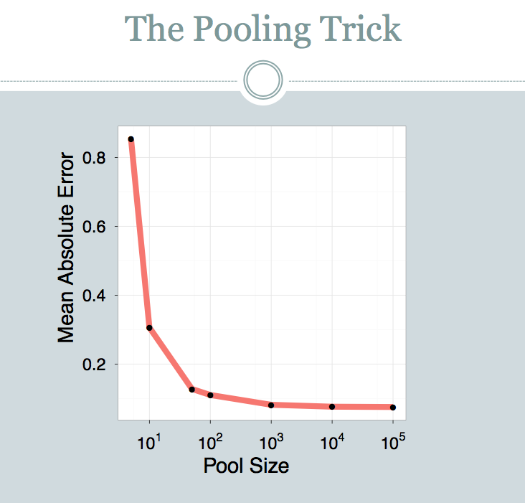

Slide 23
LSH: key ideas: pooling
Advantages:
with pooling, this is a compact re-encoding of the data
you don’t need to store the r’s, just the pool

Slide 24
Locality Sensitive Hashing (LSH) in an On-line Setting

Slide 25
LSH: key ideas: online computation
Common task: distributional clustering
for a word w, x(w) is sparse vector of words that co-occur with w
cluster the w’s

Slide 26
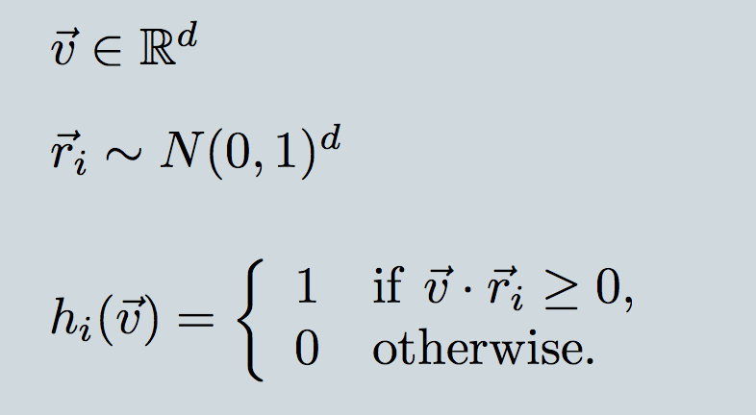
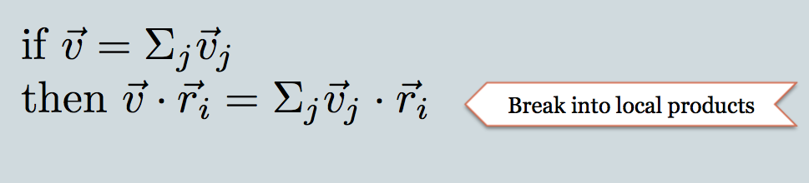
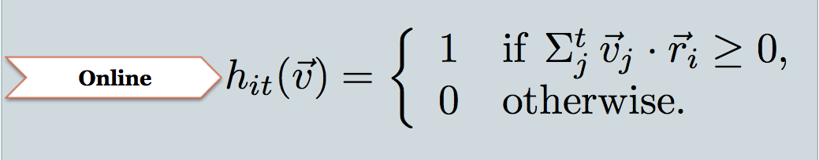

Slide 27
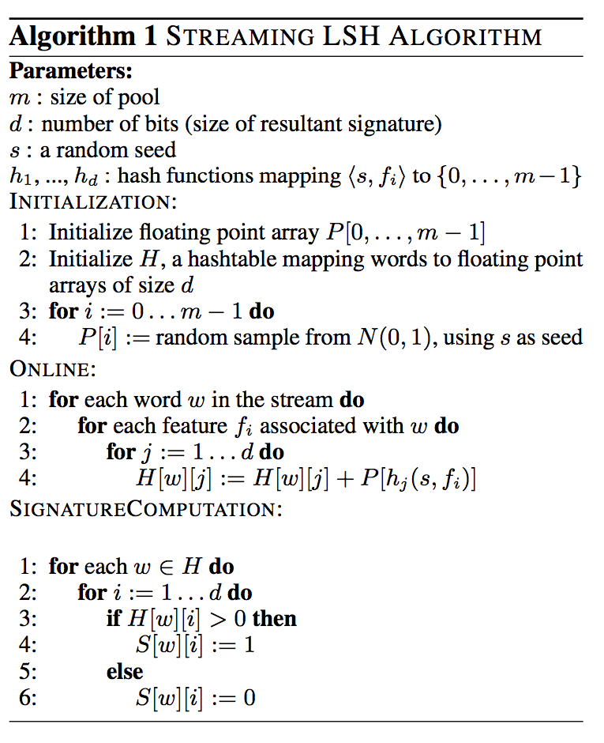

Slide 28
Experiment
Corpus: 700M+ tokens, 1.1M distinct bigrams
For each, build a feature vector of words that co-occur near it, using on-line LSH
Check results with 50,000 actual vectors
similar to problem we looked at Tuesday using sketches

Slide 29
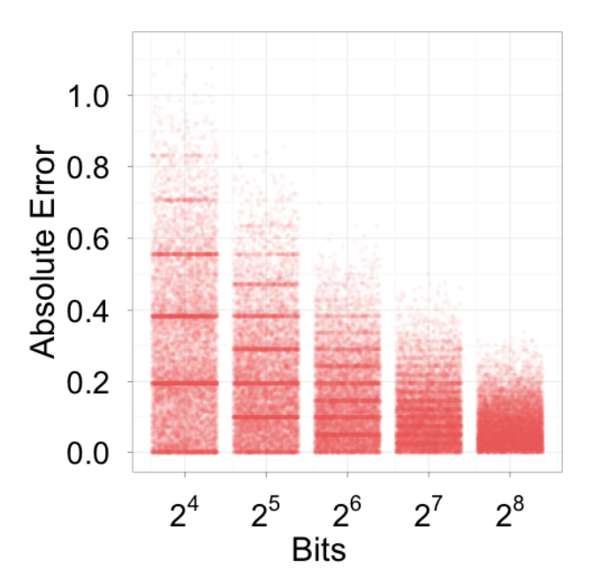
Experiment

Slide 30
