Slide 1
Randomized Algorithms Wrap-Up
William Cohen
Notes:
start with BFs

Slide 2
Announcements
Quiz today!
Projects
there are no slots for 605 students free
if you want to do a project send me a 1-2 page proposal with your cvs by Friday and I will consider it

Slide 3
Randomized Algorithms for ML

Slide 4
Bloom filters
Interface to a Bloom filter
BloomFilter(int maxSize, double p);
void bf.add(String s); // insert s
bool bf.contains(String s);
// If s was added return true;
// else with probability at least 1-p return false;
// else with probability at most p return true;
I.e., a noisy “set” where you can test membership (and that’s it)
Notes:
note a hash table would do this in constant time and storage
the hash trick does this as well

Slide 5
Bloom filters
An implementation
Allocate M bits, bit[0]…,bit[1-M]
Pick K hash functions hash(1,2),hash(2,s),….
E.g: hash(i,s) = hash(s+ randomString[i])
To add string s:
For i=1 to k, set bit[hash(i,s)] = 1
To check contains(s):
For i=1 to k, test bit[hash(i,s)]
Return “true” if they’re all set; otherwise, return “false”
We’ll discuss how to set M and K soon, but for now:
Let M = 1.5*maxSize // less than two bits per item!
Let K = 2*log(1/p) // about right with this M

Slide 6


Count-min sketch
Interface to a CM sketch
CM(double ε, double δ);
void cm.increment(String s, double d);
// like A[s] += d; N += d
bool cm.lookup(String s);
// return v ≈ A[s] with small error
// it’s always true that v ≥ A[s]
// Prob( v > A[s] + ε*N) < δ
I.e., a noisy HashMap<String,Double> where you can increment and retrieve values
space:
update:
Notes:
note a hash table would do this in constant time and storage
the hash trick does this as well

Slide 7
Bloom Filter→Count-min sketch
d = O(1/δ) w=O(1/ε)
An implementation
Allocate a matrix CM with d rows, w columns
Pick d hash functions h₁(s),h₂(s),….
To increment counter A[s] for s by c
For i=1 to d, set CM[i, hash(i,s)] += c
To retrieve value of A[s]:
For i=1 to d, retrieve M[i, hash(i,s)]
Return minimum of these values
Similar idea as Bloom filter:
if there are d collisions, you return a value that’s too large; otherwise, you return the correct value.
Same as a hash kernel if d=1

Slide 8
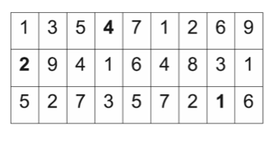
BF and CM sketch: key points
BF can store sets compactly
CM can store counters compactly
The error is low if the counts are highly skewed and you’re interested mainly in large counts
“Heavy hitters”
Both can be computed in a distributed way:
BF(S) + BF(T) = BF(S+T)
CM(S) + CM(T) = CM(S+T)

Slide 9
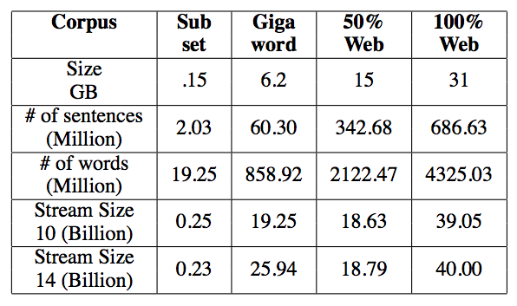
An Application of a Count-Min Sketch
Experiment: count words and pairs of words that co-occur in a 14-word window in text
8Gb of space for exact

Slide 10
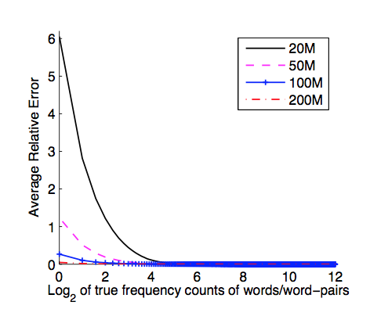
An Application of a Count-Min Sketch
Experiment: count words and pairs of words that co-occur in a 14-word window in text
d=3 models

Slide 11
Locality Sensitive Hashing (LSH)

Slide 12
LSH: key ideas
Goal:
map feature vector x to bit vector bx
ensure that bx preserves “similarity”
Basic idea: use random projections of x
Repeat many times:
Pick a random hyperplane r by picking random weights for each feature (say from a Gaussian)
Compute the inner product of r with x
Record if x is “close to” r (r.x>=0)
the next bit in bx
Theory says that is x’ and x have small cosine distance then bx and bx’ will have small Hamming distance

Slide 13
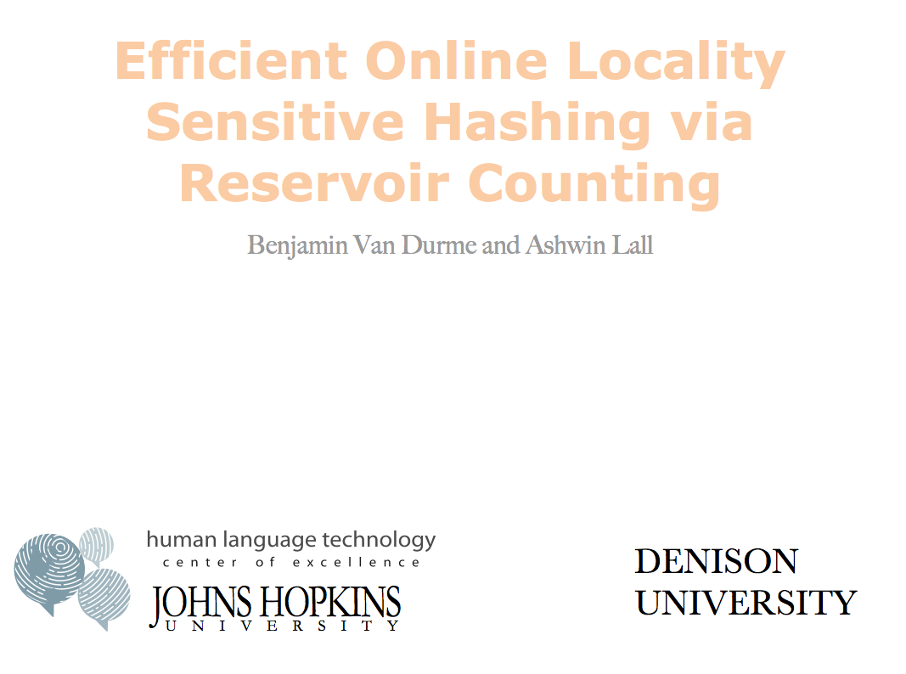



Slide 14
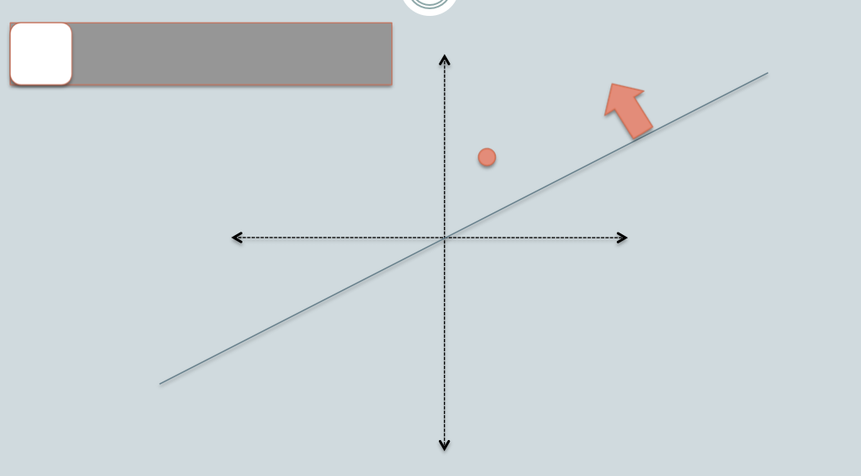

Slide 15
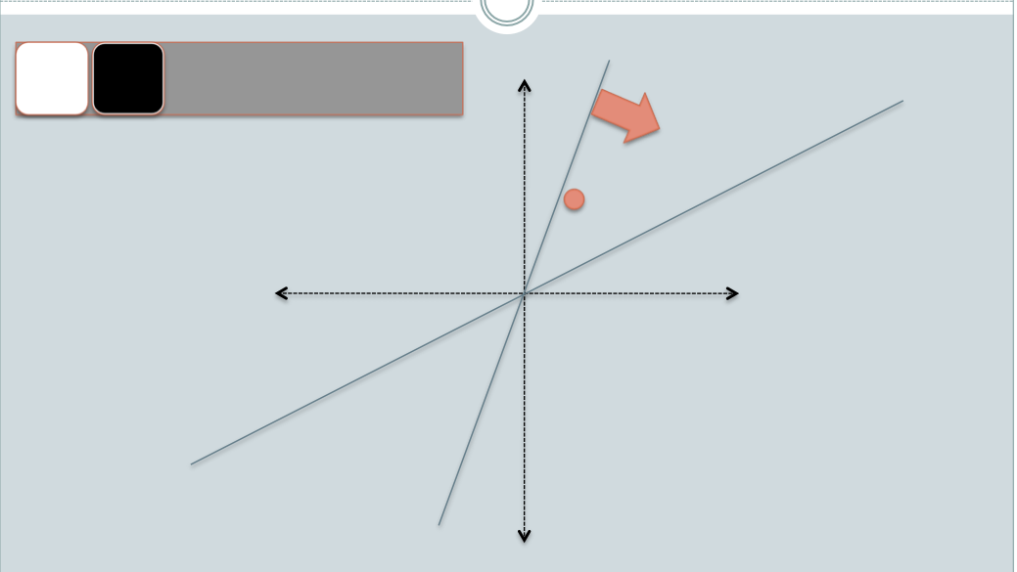

Slide 16
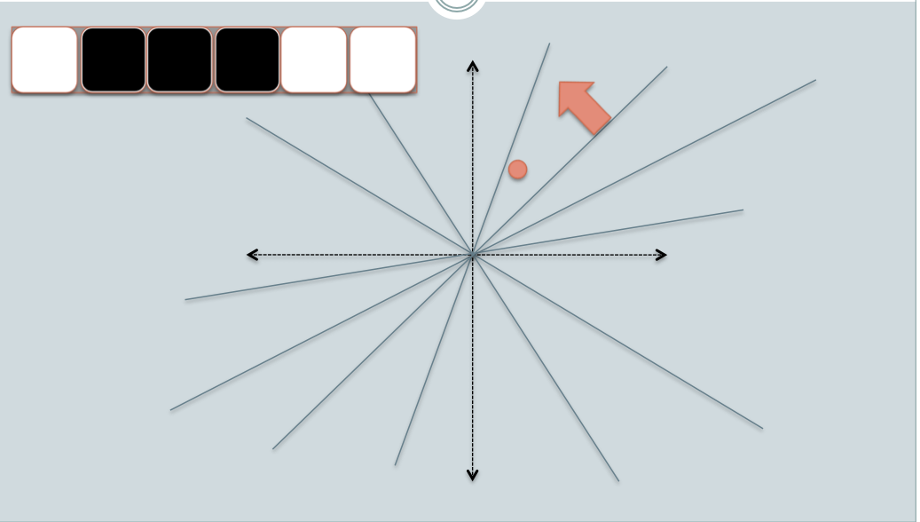

Slide 17
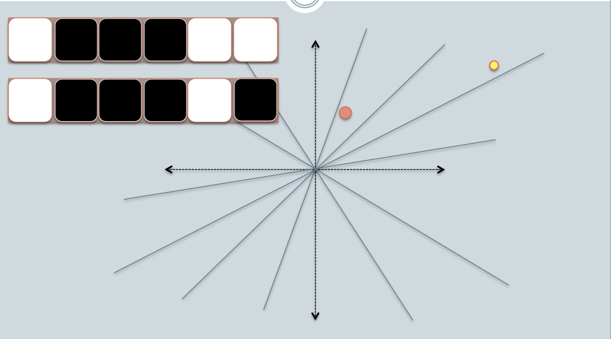

Slide 18
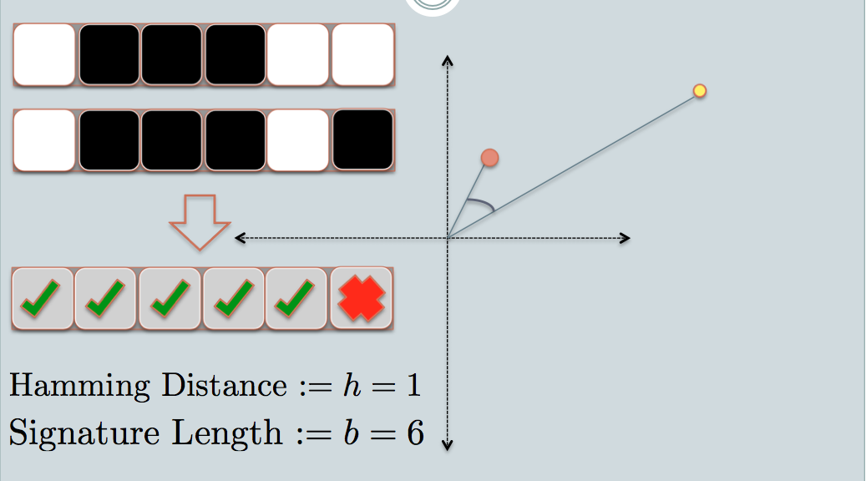
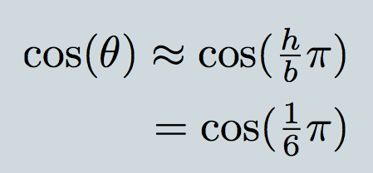

Slide 19
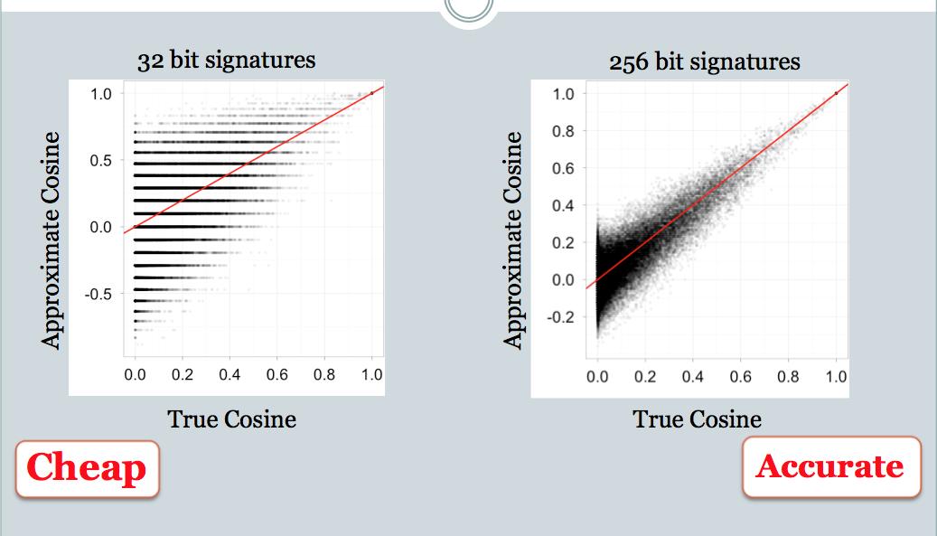

Slide 20
LSH applications
Compact storage of data
and we can still compute similarities
LSH also gives very fast approximations:
approx nearest neighbor method
just look at other items with bx’=bx
also very fast nearest-neighbor methods for Hamming distance
very fast clustering
cluster = all things with same bx vector

Slide 21
Applications of randomized algorithms
Approximate counters, e.g., language modeling
CM or BF++
Approximate nearest-neighbors: e.g., importance sampling (fastex), …
Approximate dot-products
LSH
Approximate clustering/duplicate detection
random projections
Approximate PCA
random projection trees

Slide 22
Some More Key IDeaS

Slide 23
Locality Sensitive Hashing (LSH) and Pooling Random Values

Slide 24
LSH algorithm
Naïve algorithm:
Initialization:
For i=1 to outputBits:
For each feature f:
Draw r(f,i) ~ Normal(0,1)
Given an instance x
For i=1 to outputBits:
LSH[i] =
sum(x[f]*r[i,f] for f with non-zero weight in x) > 0 ? 1 : 0
Return the bit-vector LSH

Slide 25
LSH algorithm
But: storing the k classifiers is expensive in high dimensions
For each of 256 bits, a dense vector of weights for every feature in the vocabulary
Storing seeds and random number generators:
Possible but somewhat fragile

Slide 26
LSH: “pooling” (van Durme)
Better algorithm:
Initialization:
Create a pool:
Pick a random seed s
For i=1 to poolSize:
Draw pool[i] ~ Normal(0,1)
For i=1 to outputBits:
Devise a random hash function hash(i,f):
E.g.: hash(i,f) = hashcode(f) XOR randomBitString[i]
Given an instance x
For i=1 to outputBits:
LSH[i] = sum(
x[f] * pool[hash(i,f) % poolSize] for f in x) > 0 ? 1 : 0
Return the bit-vector LSH

Slide 27
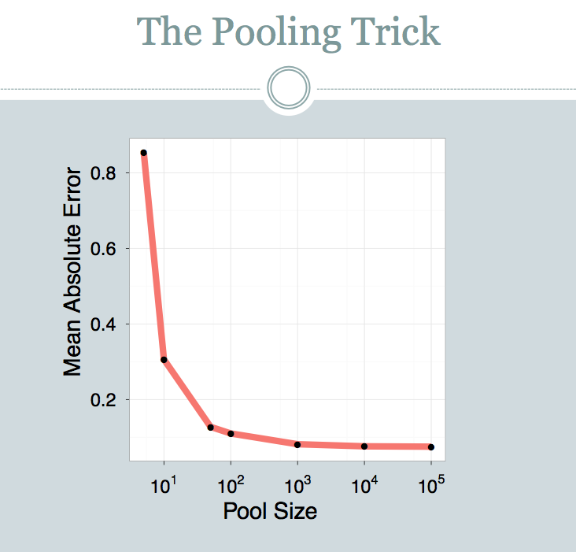

Slide 28
LSH: key ideas: pooling
Advantages:
with pooling, this is a compact re-encoding of the data
you don’t need to store the r’s, just the pool

Slide 29
Locality Sensitive Hashing (LSH) in an On-line Setting

Slide 30
LSH: key ideas: online computation
Common task: distributional clustering
for a word w, v(w) is sparse vector of words that co-occur with w
cluster the v’s

Slide 31
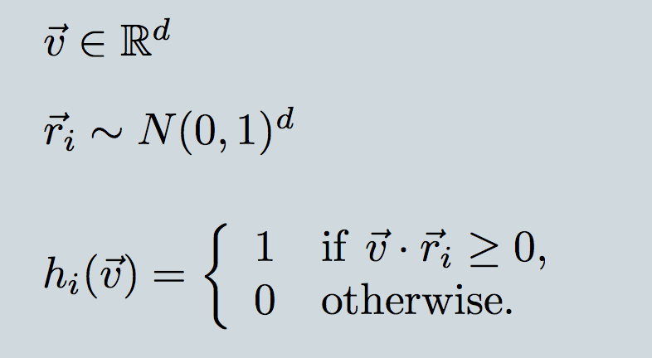
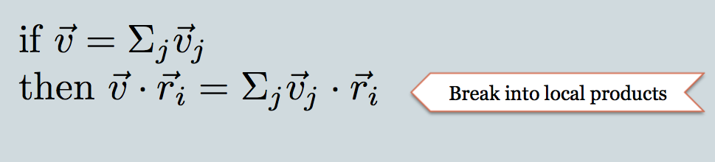
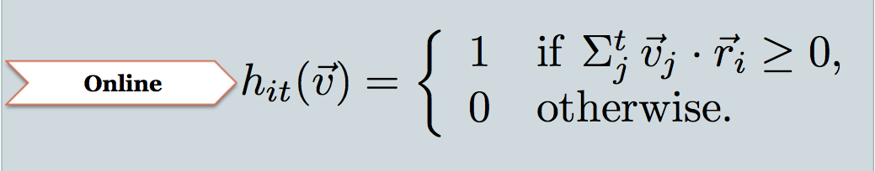

Slide 32
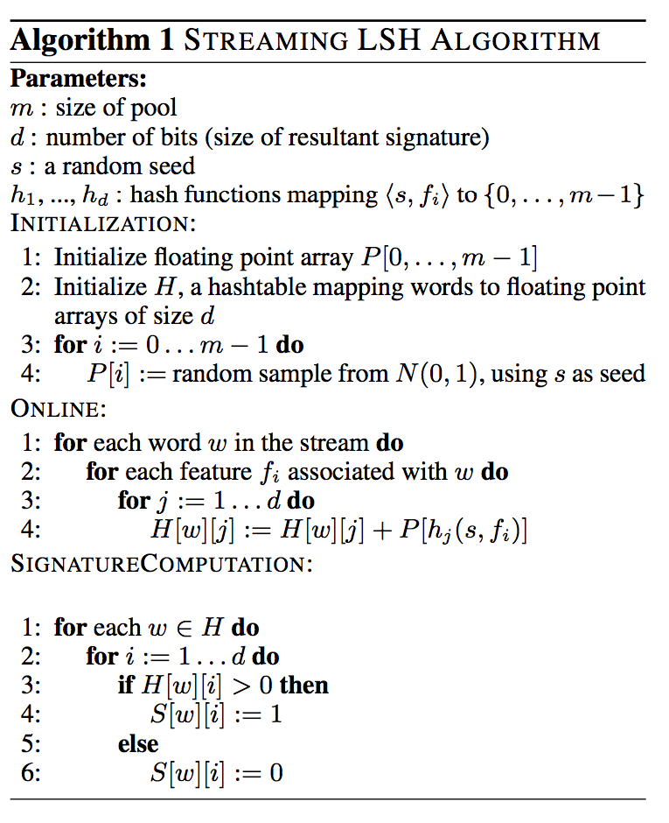

Slide 33
Experiment
Corpus: 700M+ tokens, 1.1M distinct bigrams
For each, build a feature vector of words that co-occur near it, using on-line LSH
Check results with 50,000 actual vectors

Slide 34
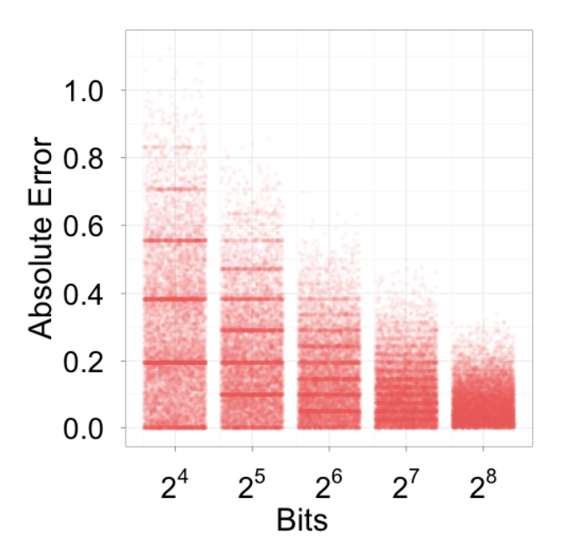
Experiment

Slide 35
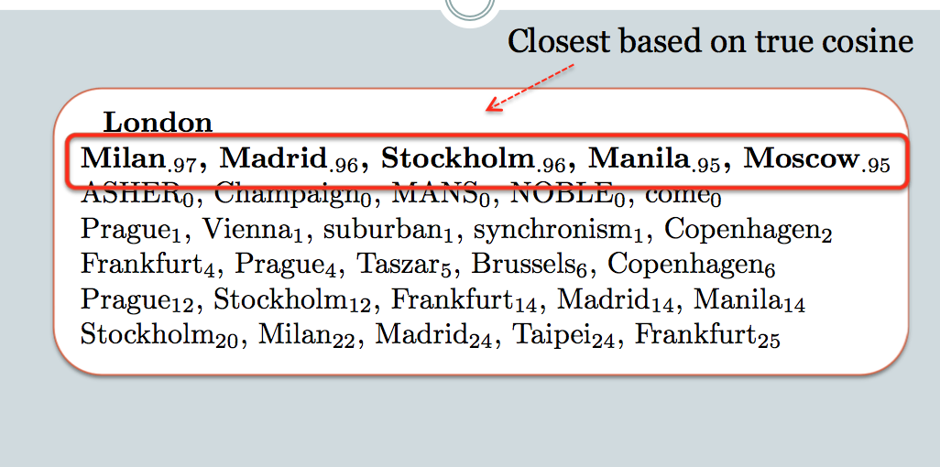
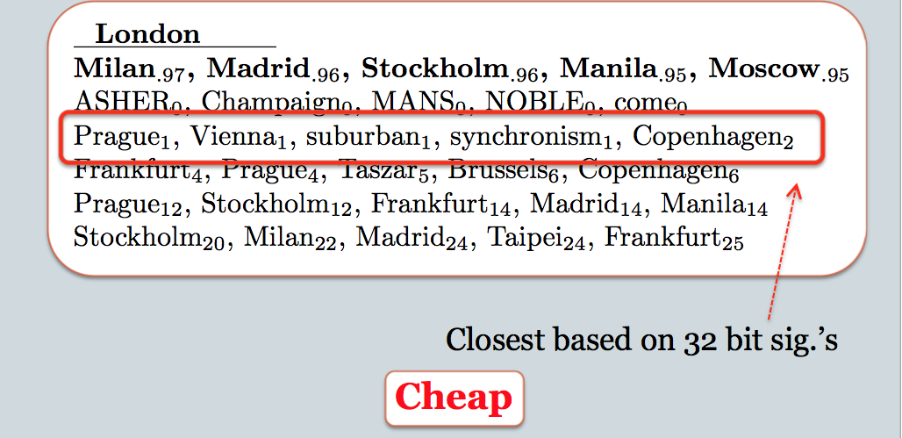
128 bit sigs

