Slide 1
Course overview: 10-605/805
William Cohen

Slide 2
Administrivia

Slide 3
Who/Where/When
Office Hours:
Still TBA for all of us, check the wiki
Course assistant: Dorothy Holland-Minkley (dfh@cs)
Wiki: google://”cohen CMU”→teaching →
http://curtis.ml.cmu.edu/w/courses/index.php/Machine_Learning_with_Large_Datasets_10-605_in_Fall_2016
this should point to everything else: Piazza, Autolab, ….
Instructor:
William W. Cohen
TAs:
Bhuwan Dhingra; Yuxing Zhang; Xu Lanxiao
Tzu-Ming Kuo; Chenran Li; Yulan Huang
Karandeep Johar; Jingyuan Liu

Slide 4
How Many
This room holds 150
There are 330 signed up + waitlisted
I hope the waitlist clears but I can’t promise
It always has before
It’s coming back next fall (I’m on leave spring)
Materials will be on-line

Slide 5
Who/Where/When
William W. Cohen
1990-mid 1990’s: AT&T Bell Labs (working on ILP and scalable propositional rule-learning algorithms)
Mid 1990’s—2000: AT&T Research (text classification, data integration, knowledge-as-text, information extraction)
2000-2002: Whizbang! Labs (info extraction from Web)
2002-2008, 2010-now: CMU (IE, biotext, social networks, learning in graphs, info extraction from Web, scalable first-order learning)
2008-2009: Visiting Scientist at Google

Slide 6
TAs

Slide 7
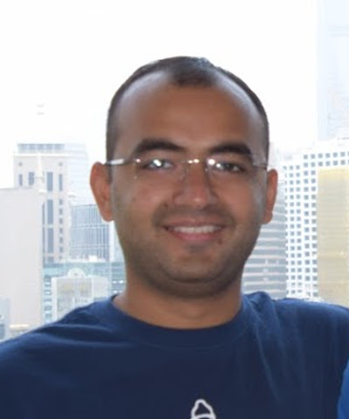
TA – Bhuwan Dhingra (GHC 6227)
I am a second year PhD student in LTI working with Prof William Cohen and Prof Russ Salakhutdinov. My research focuses on deep learning for natural language processing, and I have been involved in a variety of different projects. Outside work I enjoy hiking and traveling. I’ve been told I am a calm person, so don’t hesitate with any of your questions!

Slide 8

Karandeep Johar– MS in CS
I am a second year Masters student in the Computer Science Department , School of Computer Science
I’m interested in scaling machine learning algorithms for large datasets and solving problems that arise when we try and apply them in real world contexts.

Slide 9

Lanxiao Xu – MLD
I'm a second year Masters student in MLD, School of Computer Science.
I took this course last year and was very interested in building machine learning models in large scale context.
The contents of this course is very closely related to how people apply ML techniques in practice. You will learn a lof of awesome things such as Hadoop, Spark and Pig, which are constantly used in industry.

Slide 10

Tzu-Ming Kuo– MCDS in LTI
I'm a second year Masters student in LTI, School of Computer Science.
I'm interested in applying Machine Learning to solve various problems. This summer I interned at LinkedIn data science team, augmenting LinkedIn
Economic Graph. Many topics I learnt in this course was really helpful and crucial to my intern project!

Slide 11
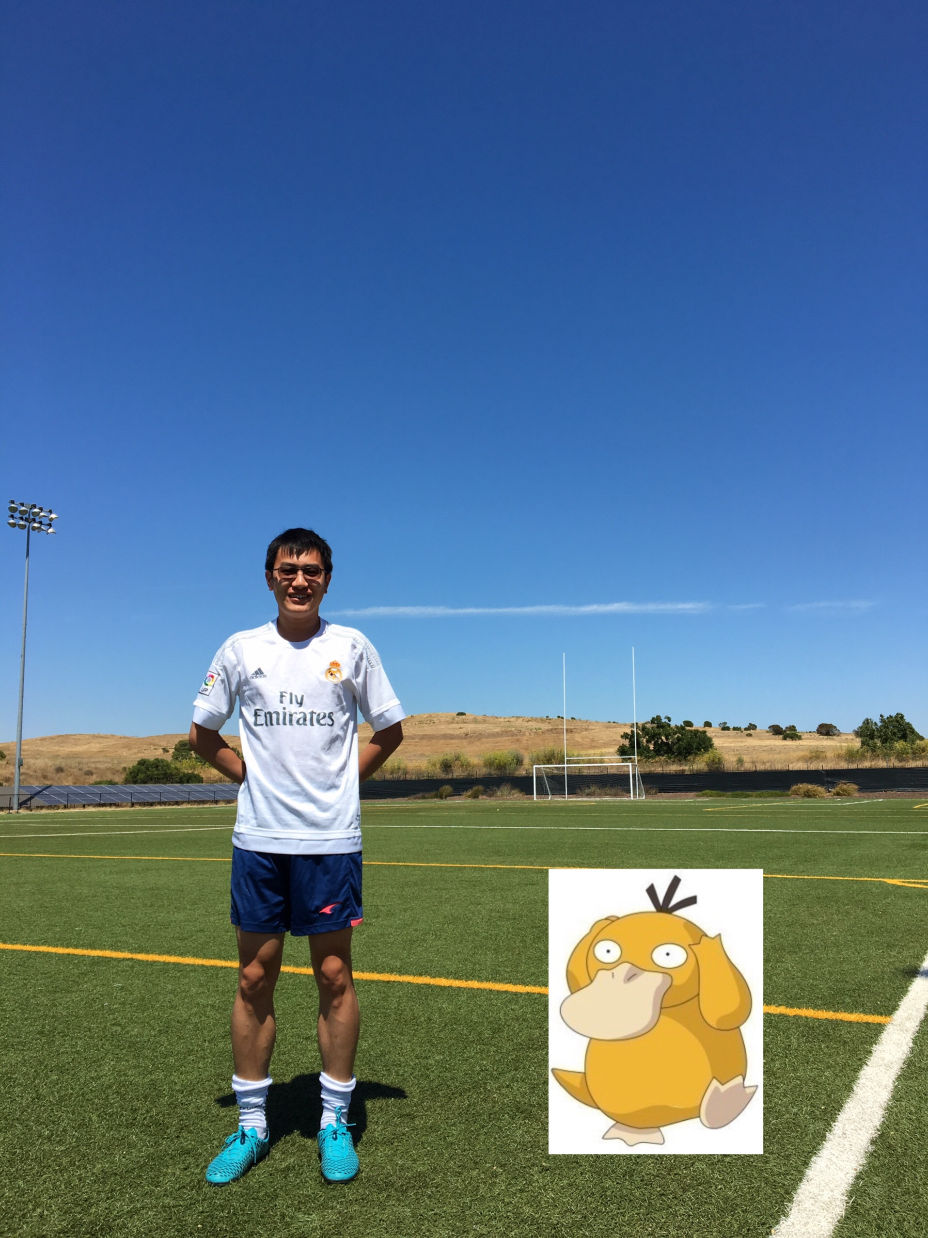
Chenran Li
Second year MIIS student.
Took 10-605 last year and enjoyed it a lot.
Interned at Google this summer and caught a lot of Psyducks there.

Slide 12

Jingyuan Liu
I'm a second year master student from MIIS program, LTI.
Took 10605 a year ago, super fun experience!
RA in Petuum Team, implemented scalable machine learning algorithms with Parameter Server.
Intern in LinkedIn Data Science Team, data extraction and clean with MapReduce (sclading), scalable regression model.

Slide 13

Yuxing Zhang – MS in MLD
I'm a second year master student in machine learning department.
I'm interested in working on large scale machine learning systems. I took 605 last year and found it a very interesting and useful course.

Slide 14
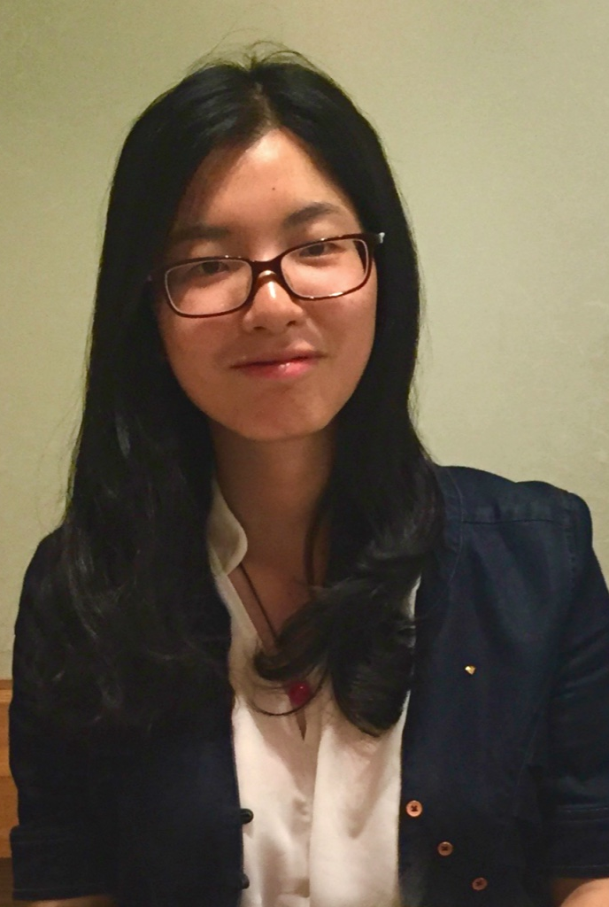
Yulan Huang – MIIS in LTI
I'm a second year Masters student in LTI, School of Computer Science.
I'm interested in applying machine learning techniques to real world problems. I took 605 last year and enjoyed it a lot. You will have a deeper understanding about both machine learning algorithms and machine learning in distributed systems.

Slide 15
What/How
I kind of like language tasks, especially for this task:
The data (usually) makes sense
The models (usually) make sense
The models (usually) are complex, so
More data actually helps
Learning simple models vs complex ones is sometimes computationally different

Slide 16
What/How
Programming Language:
Java and Hadoop
Python (more than last year)
Resources:
Your desktop/laptop (to start)
You’ll need approximately 0.5Tb space.
Opencloud hadoop cluster:
104 worker nodes, with 8 cores, 16 GB RAM, 4 1TB.
30 worker nodes, with 8 cores, 16 GB RAM, 250Gb+
Amazon Elastic Cloud
Amazon EC2 [http://aws.amazon.com/ec2/]
Allocation: $50 worth of time per student

Slide 17
What/How: 10-605
Lecture course for MS and advanced undergrads
60% assignments (6/7)
Mostly biweekly programming assignments
Not a lot of lines of code, but it will take you time to get them right
You can drop one, but some are cumulative
15% midterm
20% final
5% class participation & quizzes

Slide 18
What/How: 10-605 805
Project course for PhDs and MS students
MS students, send me your cv for permission to enroll
40% assignments (4/7)
15% midterm
40% project (no final)
open-ended, self-directed project
final deliverable is a conference-length paper
5% class participation & quizzes

Slide 19
What/How: 10-605 students working on a project with an 10-805 student
Lecture course for MS and advance undergrads
50% assignments (5/7)
Biweekly programming assignments
Not a lot of lines of code, but it will take you time to get them right
You can drop one, but some are very cumulative
15% midterm
30% project (no final)
5% class participation & quizzes
There will be some match-making we do but it’s up to the 805 students to decide how much help they want/need.

Slide 20
What/How: 10-605 students working on a project with an 10-805 student
Lecture course for MS and advance undergrads
50% assignments (5/7)
Biweekly programming assignments
Not a lot of lines of code, but it will take you time to get them right
You can drop one, but some are very cumulative
15% midterm
30% project (no final)
5% class participation & quizzes
There will be some match-making we do but it’s up to the 805 students to decide how much help they want/need.

Slide 21
Quizzes and class participation
You should keep up with lectures
The 5% is to keep you honest
I’ve tried two things:
Piazza polls (so sign in for Piazza with your andrew account)
QnA quizzes
All of these will close w/in 24 hours
What matters most is IF you do them
There is one for today so check the wiki!

Slide 22
What/How: 10-805 and 11-805
Projects
2012: everyone did projects and 5 HWs
Guest lectures from industry, experts
2013: projects were optional
not everyone wanted to do projects in
I wanted to give more programming depth
2014: nobody did projects
I had too many students
Spring/fall 2015, fall 2016
805/605 split

Slide 23
What/How: cheating vs working together
I have a long and explicit policy
stolen from Roni Rosenfeld - read the web page
tl;dr: transmit information like they did in the stone age, brain-to-brain, and document it
do not copy anything digitally
exceptions (eg projects) will be explicitly stated
everybody involved will fail by default
every infraction always gets reported up to the Office of Academic Integrity, the head of your program, the dean of your school, ….

Slide 24
What/How: 601 co-req
You should have as a prereq or co-req one of the MLD’s intro ML courses: 10-401, 10-601, 10-701, 10-715
Lectures are designed to complement that material
computational aspects vs informational aspects
If it’s a co-req you need permission
via email to wcohen+coreq@gmail.com
we’re gonna check

Slide 25
Big Data History: From the Dawn of Time To The Present

Slide 26
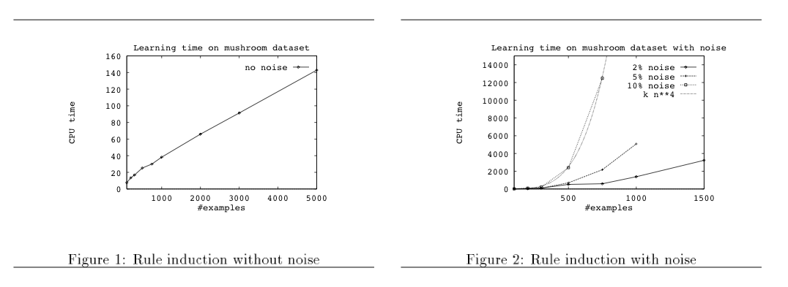
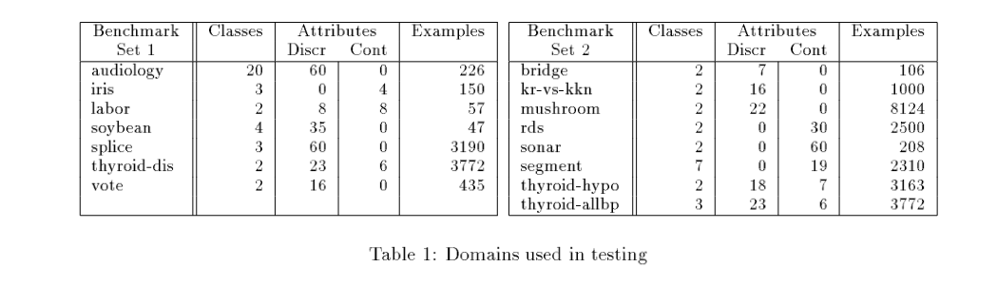
Big ML c. 1993 (Cohen, “Efficient…Rule Learning”, IJCAI 1993)
$ ripper ../tdata/talks
Final hypothesis is:
talk_announcement :- WORDS ~ talk, WORDS ~ Subject_talk (54/1).
talk_announcement :- WORDS ~ '2d416' (26/3).
talk_announcement :- WORDS ~ system, WORDS ~ 'To_1126@research' (4/0).
talk_announcement :- WORDS ~ mh, WORDS ~ time (5/1).
talk_announcement :- WORDS ~ talk, WORDS ~ used (3/0).
talk_announcement :- WORDS ~ presentations (2/1).
default non_talk_announcement (390/1).

Slide 27
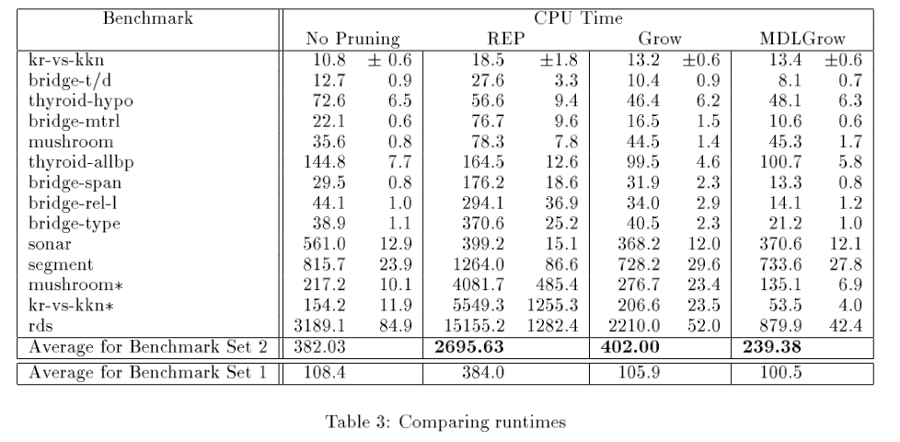

Slide 28
More on this paper
Algorithm
Phase 1: build rules
Discrete greedy search:
Starting with empty rule set, add conditions greedily
Phase 2: prune rules
starting with phase 1 output, remove conditions
talk_announcement :- WORDS ~ talk, WORDS ~ Subject_talk, WORDS ~ p_comma.
talk_announcement :- WORDS ~ '2d416', WORDS ~ be.
talk_announcement :- WORDS ~ show, WORDS ~ talk (7/0).
talk_announcement :- WORDS ~ mh, WORDS ~ time, WORDS ~ research (4/0).
talk_announcement :- WORDS ~ system, WORDS ~ 'To_1126@research' (3/0).
talk_announcement :- WORDS ~ '2d416', WORDS ~ memory (3/0).
talk_announcement :- WORDS ~ interfaces, WORDS ~ From_p_exclaim_point (2/0).
talk_announcement :- WORDS ~ presentations, WORDS ~ From_att (2/0).
default non_talk_announcement .

Slide 29
More on this paper
Algorithm
Phase 1: build rules
Discrete greedy search:
Starting with empty rule set, add conditions greedily
Phase 2: prune rules
starting with phase 1 output, remove conditions, greedily
talk_announcement :- WORDS ~ talk, WORDS ~ Subject_talk, WORDS ~ p_comma (54/0).
talk_announcement :- WORDS ~ '2d416', WORDS ~ be (19/0).
talk_announcement :- WORDS ~ show, WORDS ~ talk (7/0).
talk_announcement :- WORDS ~ mh, WORDS ~ time, WORDS ~ research (4/0).
talk_announcement :- WORDS ~ system, WORDS ~ 'To_1126@research' (3/0).
talk_announcement :- WORDS ~ '2d416', WORDS ~ memory (3/0).
talk_announcement :- WORDS ~ interfaces, WORDS ~ From_p_exclaim_point (2/0).
talk_announcement :- WORDS ~ presentations, WORDS ~ From_att (2/0).
default non_talk_announcement .

Slide 30
More on this paper
Algorithm
Phase 1: build rules
Discrete greedy search:
Starting with empty rule set, add conditions greedily
Phase 2: prune rules
starting with phase 1 output, remove conditions, greedily
talk_announcement :- WORDS ~ talk, WORDS ~ Subject_talk (54/1).
talk_announcement :- WORDS ~ '2d416' (26/3).
talk_announcement :- WORDS ~ system, WORDS ~ 'To_1126@research' (4/0).
talk_announcement :- WORDS ~ mh, WORDS ~ time (5/1).
talk_announcement :- WORDS ~ talk, WORDS ~ used (3/0).
talk_announcement :- WORDS ~ presentations (2/1).
default non_talk_announcement (390/1).

Slide 31
More on this paper
Algorithm
Analysis
Fit the POS,NEG example
While POS isn’t empty:
Let R be “if True ➔ pos”
While NEG isn’t empty:
Pick the “best” [i] condition c of the form “xi=True” or “xi=false”
Add c to the LHS of R
Remove examples that don’t satisfy c from NEG
Add R to the rule set [ii]
Remove examples that satisfy R from POS
Prune the rule set:
…
The total number of iterations of L1 is the number of conditions in the rule set – call it m
Picking the “best” condition requires looking at all examples – say there are n of these
Time is at least m*n
The problem:
When there are noisy positive examples the algorithm builds rules that cover just 1-2 of them
So with huge noisy datasets you build huge rulesets
L1
quadratic
cubic!
[i] “Best” is wrt some statistics on c’s coverage of POS,NEG
[ii] R is now of the form “if xi1=_ and xi2=_ and … ➔ pos”

Slide 32
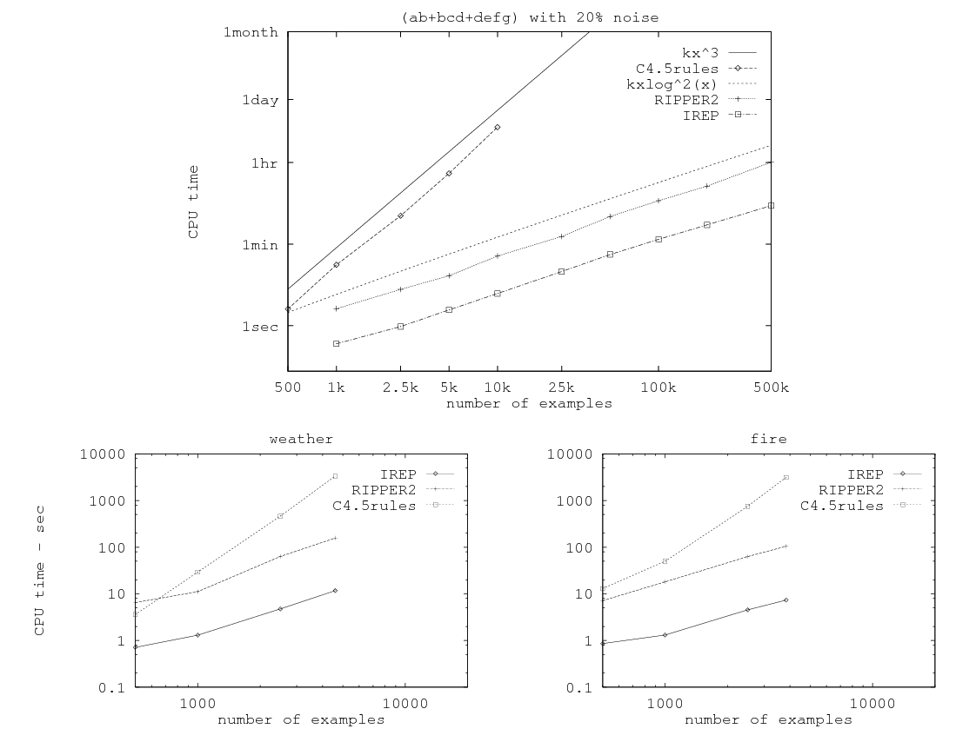
Related paper from 1995…

Slide 33
So in mid 1990’s…..
Experimental datasets were small
Many commonly used algorithms were asymptotically “slow”
Not many people really cared

Slide 34
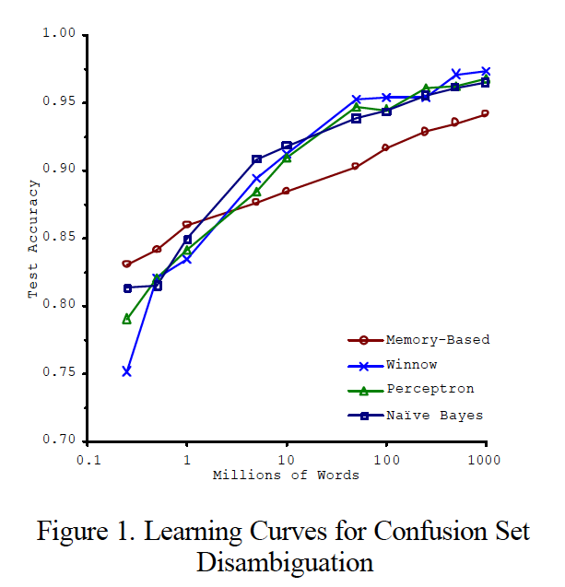
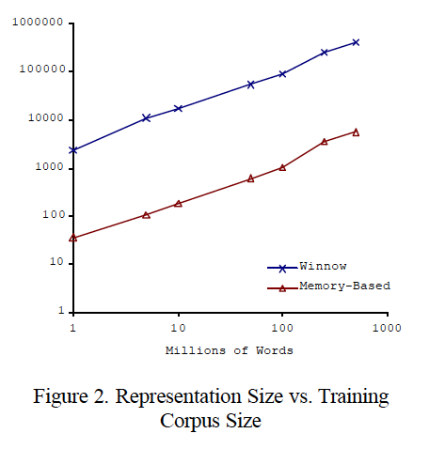
Big ML c. 2001 (Banko & Brill, “Scaling to Very Very Large…”, ACL 2001)
Task: distinguish pairs of easily-confused words (“affect” vs “effect”) in context

Slide 35
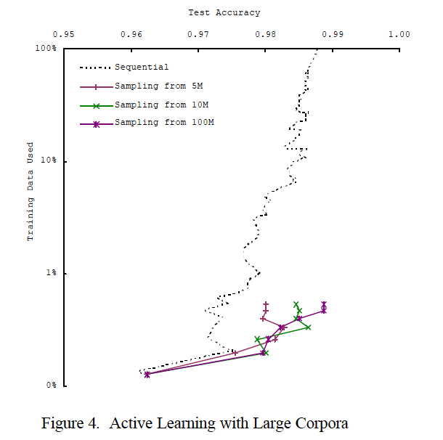
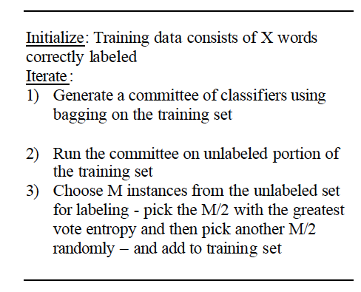
Big ML c. 2001 (Banko & Brill, “Scaling to Very Very Large…”, ACL 2001)

Slide 36
Why More Data Helps: A Demo
Data:
All 5-grams that appear >= 40 times in a corpus of 1M English books
approx 80B words
5-grams: 30Gb compressed, 250-300Gb uncompressed
Each 5-gram contains frequency distribution over years
Wrote code to compute
Pr(A,B,C,D,E|C=affect or C=effect)
Pr(any subset of A,…,E|any other fixed values of A,…,E with C=affect V effect)
Demo:
/Users/wcohen/Documents/code/pyhack/bigml
eg: python ngram-query.py data/aeffect-train.txt _ _B effect _ _
Notes:
python ngram-query.py data/aeffect-train.txt _ _ _C _ _ : mostly effect
python ngram-query.py data/aeffect-train.txt _ _B affect _ _: before affect

Slide 37
Why More Data Helps
Data:
All 5-grams that appear >= 40 times in a corpus of 1M English books
approx 80B words
5-grams: 30Gb compressed, 250-300Gb uncompressed
Each 5-gram contains frequency distribution over years
Wrote code to compute
Pr(A,B,C,D,E|C=affect or C=effect)
Pr(any subset of A,…,E|any other fixed values of A,…,E with C=affect V effect)
Observations [from playing with data]:
Mostly effect not affect
Most common word before affect is not
After not effect most common word is a
…
Notes:
python ngram-query.py data/aeffect-train.txt _ _ _C _ _ : mostly effect
python ngram-query.py data/aeffect-train.txt _ _B affect _ _: before affect

Slide 38
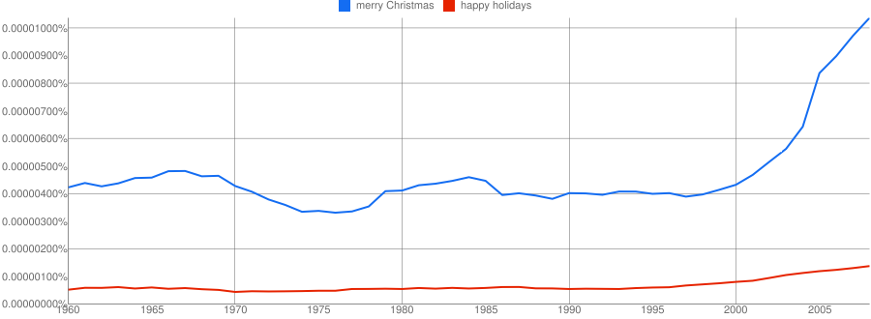
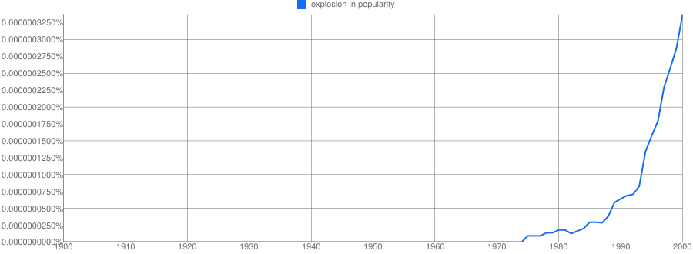

Slide 39
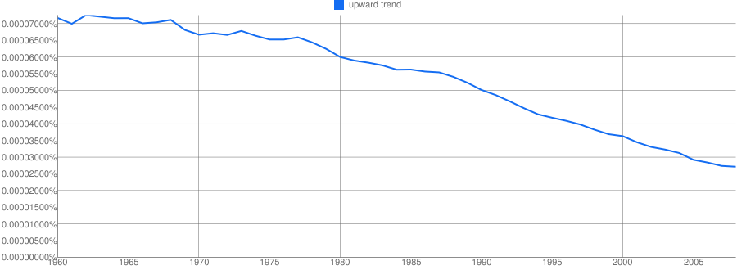

Slide 40
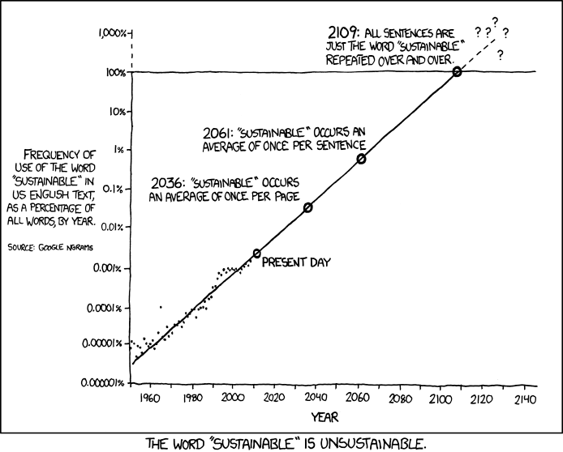
http://xkcd.com/ngram-charts/

Slide 41
Big ML c. 2001 (Banko & Brill, “Scaling to Very Very Large…”, ACL 2001)
Task: distinguish pairs of easily-confused words (“affect” vs “effect”) in context

Slide 42
So in 2001…..
We’re learning:
“there’s no data like more data”
For many tasks, there’s no real substitute for using lots of data

Slide 43
…and in 2009
Eugene Wigner’s article “The Unreasonable Effectiveness of Mathematics in the Natural Sciences” examines why so much of physics can be neatly explained with simple mathematical formulas such as f = ma or e = mc². Meanwhile, sciences that involve human beings rather than elementary particles have proven more resistant to elegant mathematics. Economists suffer from physics envy over their inability to neatly model human behavior. An informal, incomplete grammar of the English language runs over 1,700 pages.
Perhaps when it comes to natural language processing and related fields, we’re doomed to complex theories that will never have the elegance of physics equations. But if that’s so, we should stop acting as if our goal is to author extremely elegant theories, and instead embrace complexity and make use of the best ally we have: the unreasonable effectiveness of data.
Norvig, Pereira, Halevy, “The Unreasonable Effectiveness of Data”, 2009

Slide 44
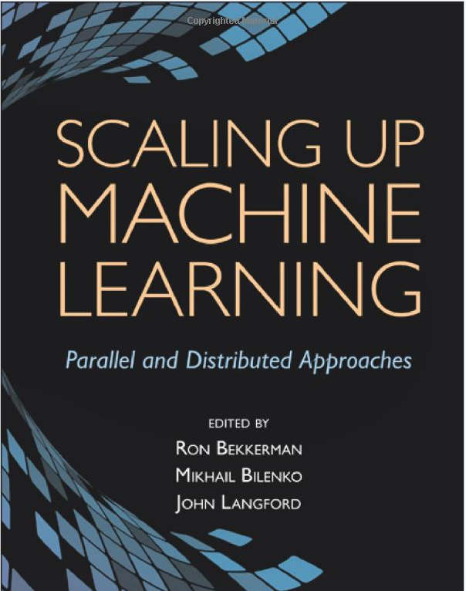
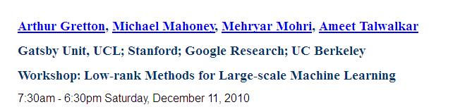
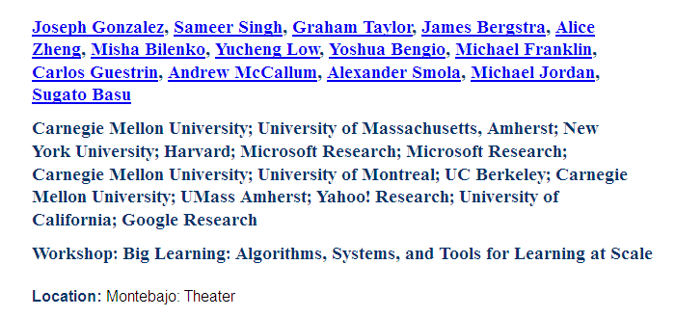
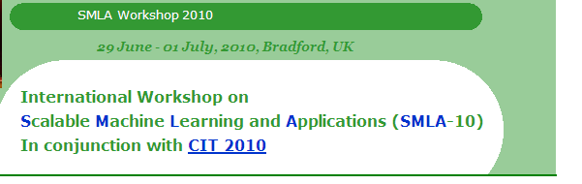
…and in 2012
Dec 2011

Slide 45
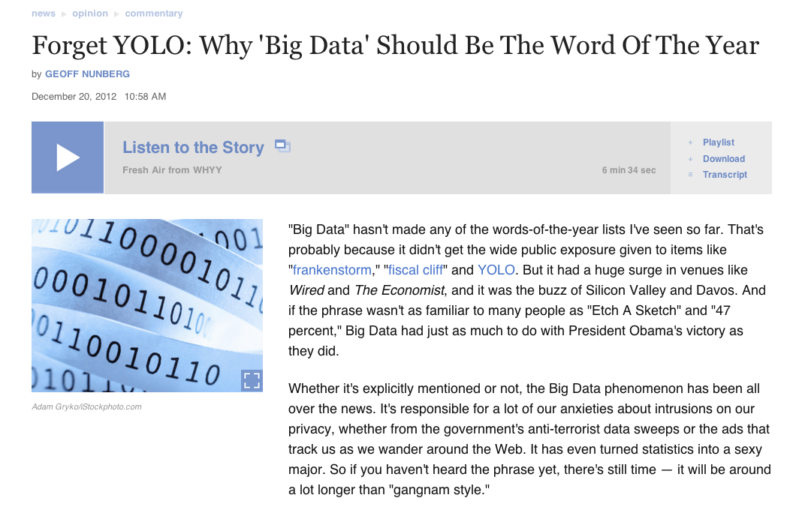
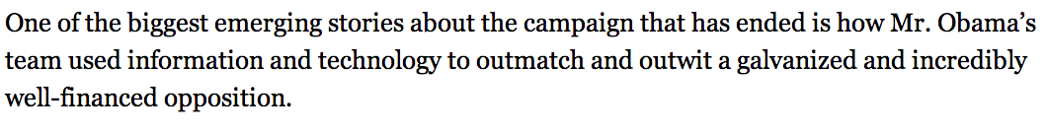


…and in 2013

Slide 46
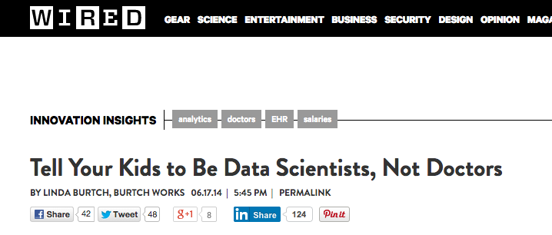
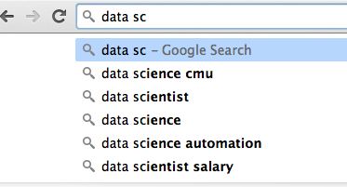
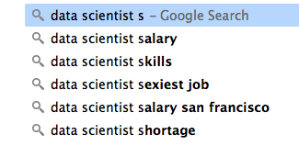
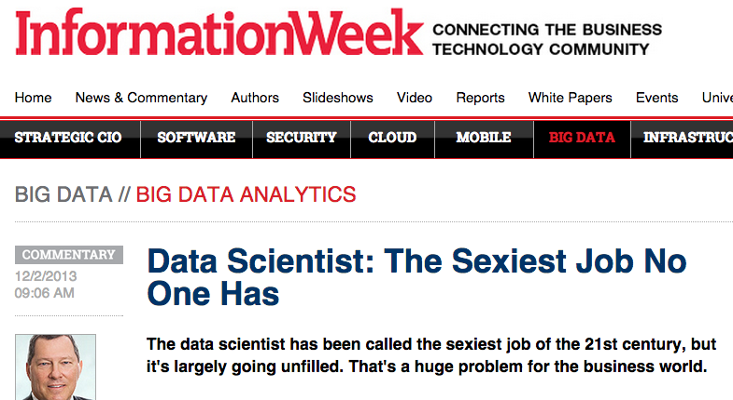
…and in 2014

Slide 47
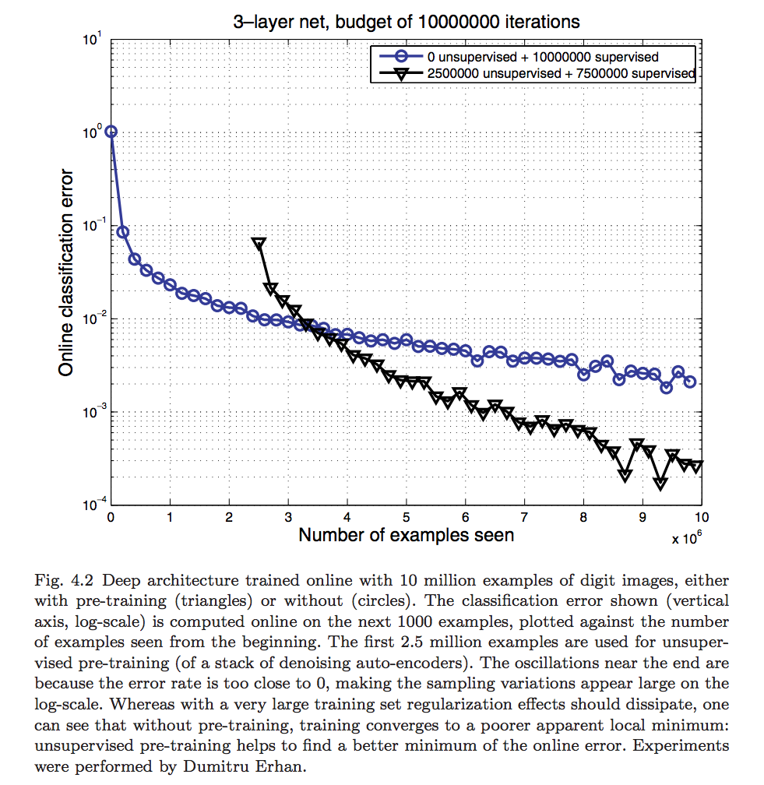
Bengio, Foundations & Trends, 2009

Slide 48
2.5M examples for “pretraining”
1M vs 10M
examples
naïve vs clever optimization

Slide 49
Today….
Commonly used deep learning datasets:
Images:
ImageNet: 20k+ categories, 14M+ images
MS COCO: 91 categories, 2.5M labels, 328k images
Reading comprehension:
Children’s book test: 600k + context/query pairs
CNN/Daily mail: ~300k docs, 1.2M cloze questions
Other:
Ubuntu dialog: 7M+ utterances, 1M+ dialogs
…

Slide 50
Review: Asymptotic Complexity

Slide 51
How do we use very large amounts of data?
*
Working with big data is not about
code optimization
learning details of todays hardware/software:
GraphLab, Hadoop, Spark, parallel hardware, ….
Working with big data is about
Understanding the cost of what you want to do
Understanding what the tools that are available offer
Understanding how much can be accomplished with linear or nearly-linear operations (e.g., sorting, …)
Understanding how to organize your computations so that they effectively use whatever’s fast
Understanding how to test/debug/verify with large data
* according to William

Slide 52
Asymptotic Analysis: Basic Principles
Usually we only care about positive f(n), g(n), n here…

Slide 53
Asymptotic Analysis: Basic Principles
Less pedantically:
Some useful rules:
Only highest-order terms matter
Leading constants don’t matter
Degree of something in a log doesn’t matter

Slide 54
Back to rule pruning….
Algorithm
Analysis
Fit the POS,NEG exampleWhile POS isn’t empty:
Let R be “if True ➔ pos”
While NEG isn’t empty:
Pick the “best” [1] condition c of the form “xi=True” or “xi=false”
Add c to the LHS of R
Remove examples that don’t satisfy c from NEG
Add R to the rule set [2]
Remove examples that satisfy R from POS
Prune the rule set:
For each condition c in the rule set:
Evaluate the accuracy of the ruleset w/o c on heldout data
If removing any c improves accuracy
Remove c and repeat the pruning step
Assume n examples
Assume m conditions in rule set
Growing rules takes time at least Ω(m*n) if evaluating c is Ω(n)
When data is clean m is small, fitting takes linear time
When k% of data is noisy, m is Ω(n*0.01*k) so growing rules takes Ω(n²)
Pruning a rule set with m = 0.01*kn extra conditions is very slow: Ω(n³) if implemented naively
[1] “Best” is wrt some statistics on c’s coverage of POS,NEG
[2] R is now of the form “if xi1=_ and xi2=_ and … ➔ pos”

Slide 55
Empirical analysis of complexity: plot run-time on a log-log plot and measure the slope (using linear regression)

Slide 56
Where do asymptotics break down?
When the constants are too big
or n is too small
When we can’t predict what the program will do
Eg, how many iterations before convergence? Does it depend on data size or not?
This is when you need experiments
When there are different types of operations with different costs
We need to understand what we should count

Slide 57
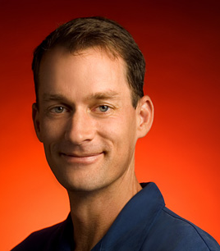
What do we count?
Compilers don’t warn Jeff Dean. Jeff Dean warns compilers.
Jeff Dean builds his code before committing it, but only to check for compiler and linker bugs.
Jeff Dean writes directly in binary. He then writes the source code as a documentation for other developers.
Jeff Dean once shifted a bit so hard, it ended up on another computer.
When Jeff Dean has an ergonomic evaluation, it is for the protection of his keyboard.
gcc -O4 emails your code to Jeff Dean for a rewrite.
When he heard that Jeff Dean's autobiography would be exclusive to the platform, Richard Stallman bought a Kindle.
Jeff Dean puts his pants on one leg at a time, but if he had more legs, you’d realize the algorithm is actually only O(logn)

Slide 58
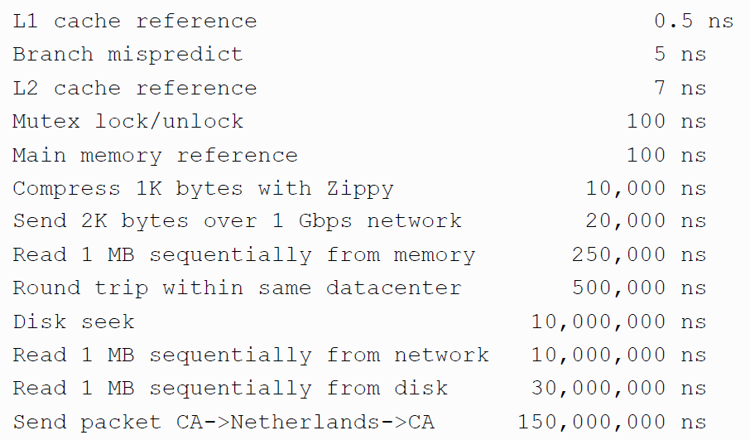
Numbers (Jeff Dean says) Everyone Should Know

Slide 59
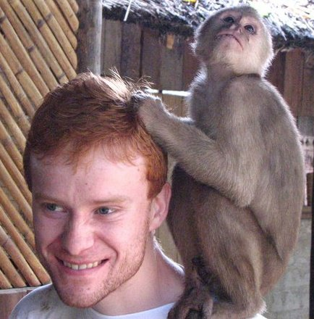
Update: Colin Scott, UCB
file:///Users/wcohen/Documents/code/interactive_latencies/interactive_latency.html

Slide 60
What’s Happening with Hardware?
Clock speed: stuck at 3Ghz for ~ 10 years
Net bandwidth doubles ~ 2 years
Disk bandwidth doubles ~ 2 years
SSD bandwidth doubles ~ 3 years
Disk seek speed doubles ~ 10 years
SSD latency nearly saturated

Slide 61
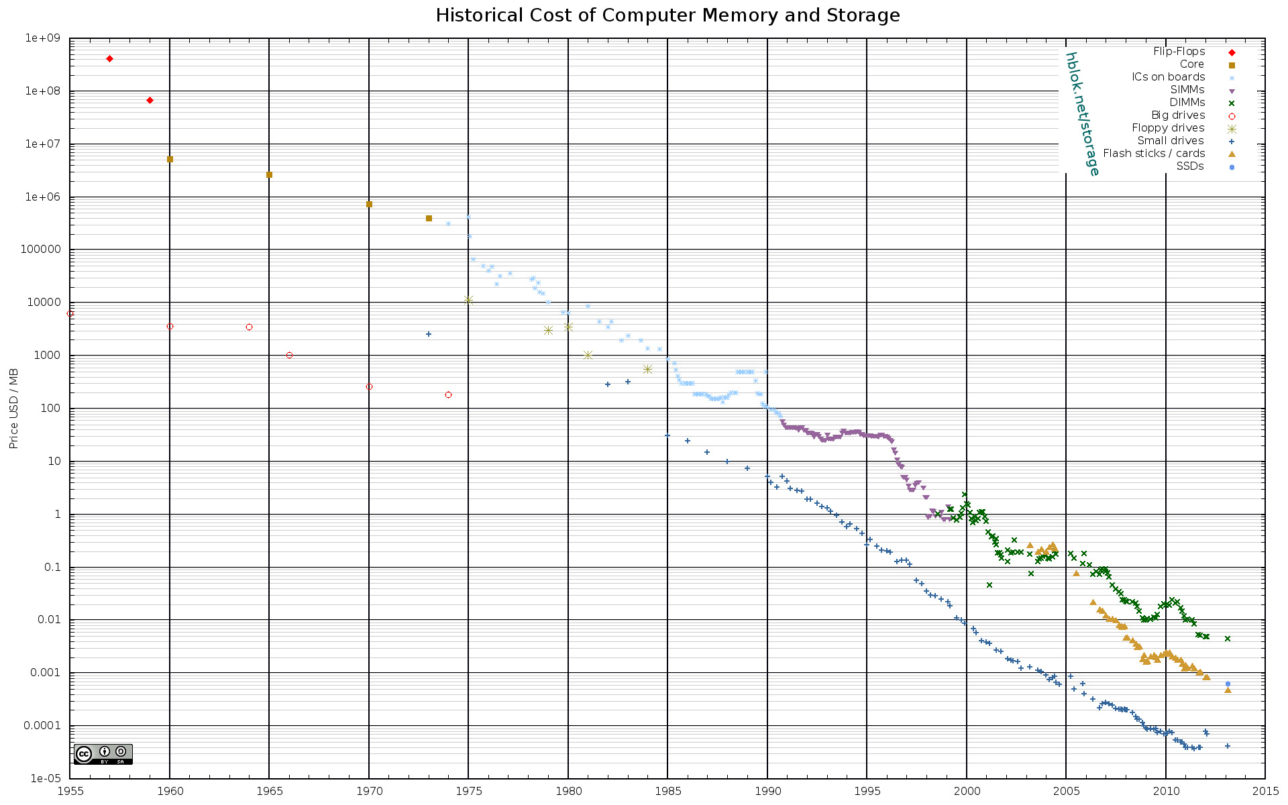

Slide 62
Numbers (Jeff Dean says) Everyone Should Know

Slide 63
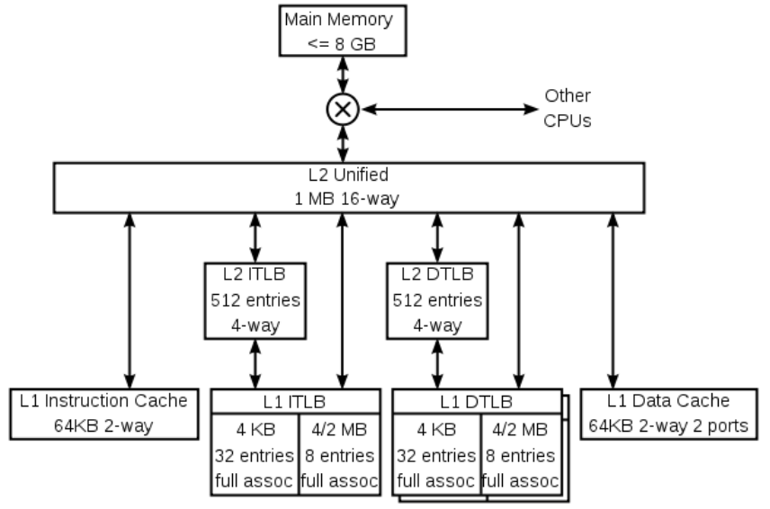
A typical CPU (not to scale)
K8 core in the AMD Athlon 64 CPU
Hard disk (1Tb)
128x bigger
16x bigger
256x bigger
Notes:
16 – me vs chihuhua – or vs midsize car
256 – me vs 2 iphones – or vs a sperm whale or 3 elephants

Slide 64

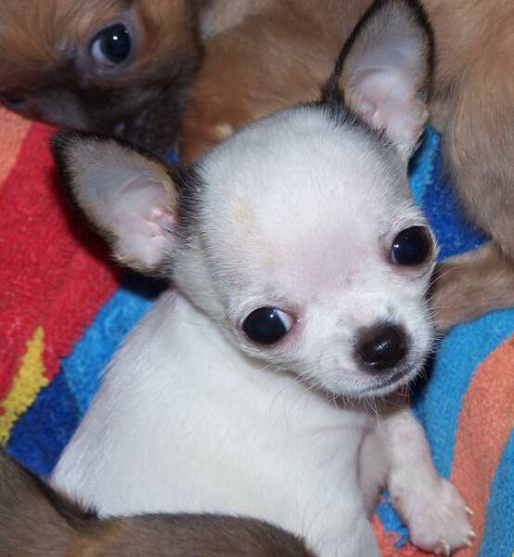

A typical CPU (not to scale)
K8 core in the AMD Athlon 64 CPU
Hard disk (1Tb)
128x bigger
16x bigger
256x bigger
Notes:
16 – me vs chihuhua – or vs midsize car
256 – me vs 2 iphones – or vs a sperm whale or 3 elephants

Slide 65
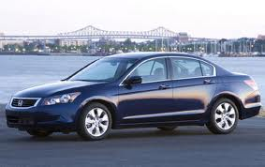
A typical CPU (not to scale)
K8 core in the AMD Athlon 64 CPU
Hard disk (1Tb)
128x bigger
16x bigger
256x bigger
Notes:
16 – me vs chihuhua – or vs midsize car
256 – me vs 2 iphones – or vs a sperm whale or 3 elephants

Slide 66
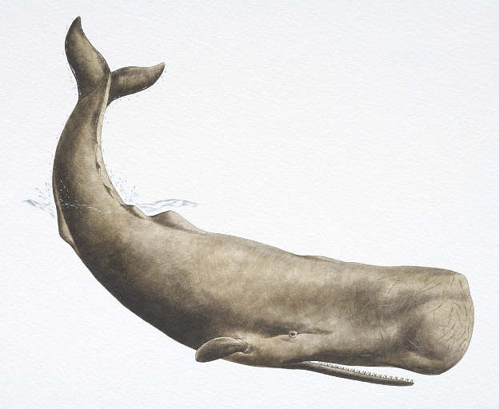
A typical CPU (not to scale)
K8 core in the AMD Athlon 64 CPU
Hard disk (1Tb)
128x bigger
16x bigger
256x bigger
Notes:
16 – me vs chihuhua – or vs midsize car
256 – me vs 2 iphones – or vs a sperm whale or 3 elephants

Slide 67
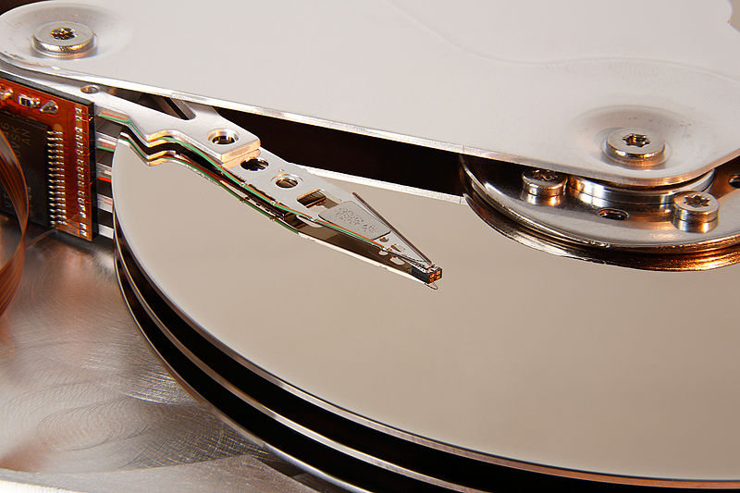
A typical disk
Notes:
16 – me vs chihuhua – or vs midsize car
256 – me vs 2 iphones – or vs a sperm whale or 3 elephants

Slide 68
Numbers (Jeff Dean says) Everyone Should Know
40x
~= 100,000x
Notes:
150x – commercial flight vs a brisk walk
100,000x – 5 hr flights would take 57 years
100,000x – 500 miles vs about 8 meters
15,000,000x – here to beijing vs 100 meters

Slide 69
What do we count?
Compilers don’t warn Jeff Dean. Jeff Dean warns compilers.
….
Memory access/instructions are qualitatively different from disk access
Seeks are qualitatively different from sequential reads on disk
Cache, disk fetches, etc work best when you stream through data sequentially
Best case for data processing: stream through the data once in sequential order, as it’s found on disk.

Slide 70
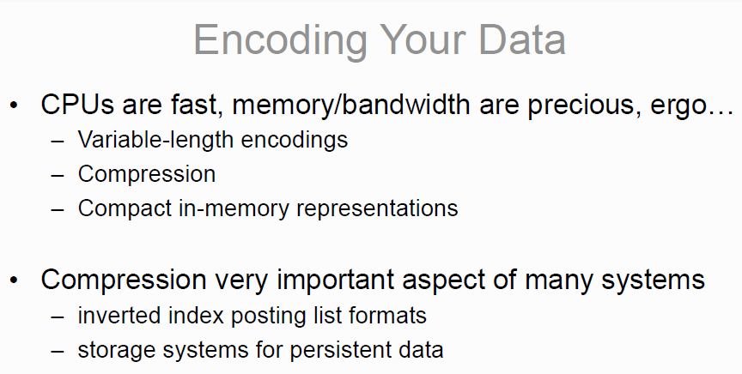
Other lessons -?
*
* but not important enough for this class’s assignments….

Slide 71
What/How
Next lecture: probability review and Naïve Bayes.
Homework:
Watch the review lecture I linked to on the wiki
I’m not going to repeat it

