Slide 1
Mistake Bounds
William W. Cohen

Slide 2
One simple way to look for interactions
Naïve Bayes – two class version
Scan thru data:
whenever we see x with y we increase g(x,y)-g(x,~y)
whenever we see x with ~y we decrease g(x,y)-g(x,~y)
We do this regardless of whether it seems to help or not on the data….if there are duplications, the weights will become arbitrarily large
To detect interactions:
increase/decrease g(x,y)-g(x,~y) only if we need to (for that example)
otherwise, leave it unchanged
dense vector of g(x,y) scores for each word in the vocabulary

Slide 3
Online Learning
Train Data
^
instance x_{i}
B
Compute: y_{i} = v_{k} . x_{i}
If mistake: v_{k+1} = v_{k} + correction
+1,-1: label y_{i}
To detect interactions:
increase/decrease v_{k} only if we need to (for that example)
otherwise, leave it unchanged
We can be sensitive to duplication by stopping updates when we get better performance

Slide 4
Theory: the prediction game
Player A:
picks a “target concept” c
for now - from a finite set of possibilities C (e.g., all decision trees of size m)
for t=1,….,
Player A picks x=(x₁,…,x_{n}) and sends it to B
For now, from a finite set of possibilities (e.g., all binary vectors of length n)
B predicts a label, ŷ, and sends it to A
A sends B the true label y=c(x)
we record if B made a mistake or not
We care about the worst case number of mistakes B will make over all possible concept & training sequences of any length
The “Mistake bound” for B, M_{B}(C), is this bound

Slide 5
The prediction game
Are there practical algorithms where we can compute the mistake bound?

Slide 6
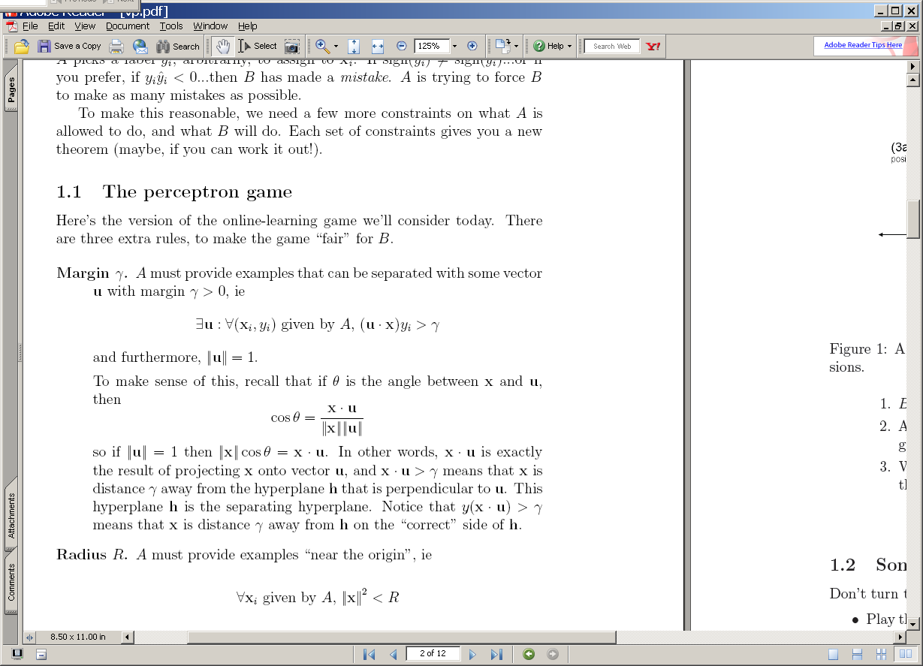
The perceptron
^
instance x_{i}
B
Compute: y_{i} = v_{k} . x_{i}
A
^
If mistake: v_{k+1} = v_{k} + y_{i} x_{i}
y_{i}
y_{i}

Slide 7
(1) A target u
(2) The guess v₁ after one positive example.
u
u
v₁
+x₁
-u
-u
2γ
2γ
(3a) The guess v₂ after the two positive examples: v₂=v₁+x₂
(3b) The guess v₂ after the one positive and one negative example: v₂=v₁-x₂
u
u
+x₂
v₂
v₂
v₁
v₁
+x₁
-x₂
-u
-u
2γ
2γ
If mistake: v_{k+1} = v_{k} + y_{i} x_{i}

Slide 8
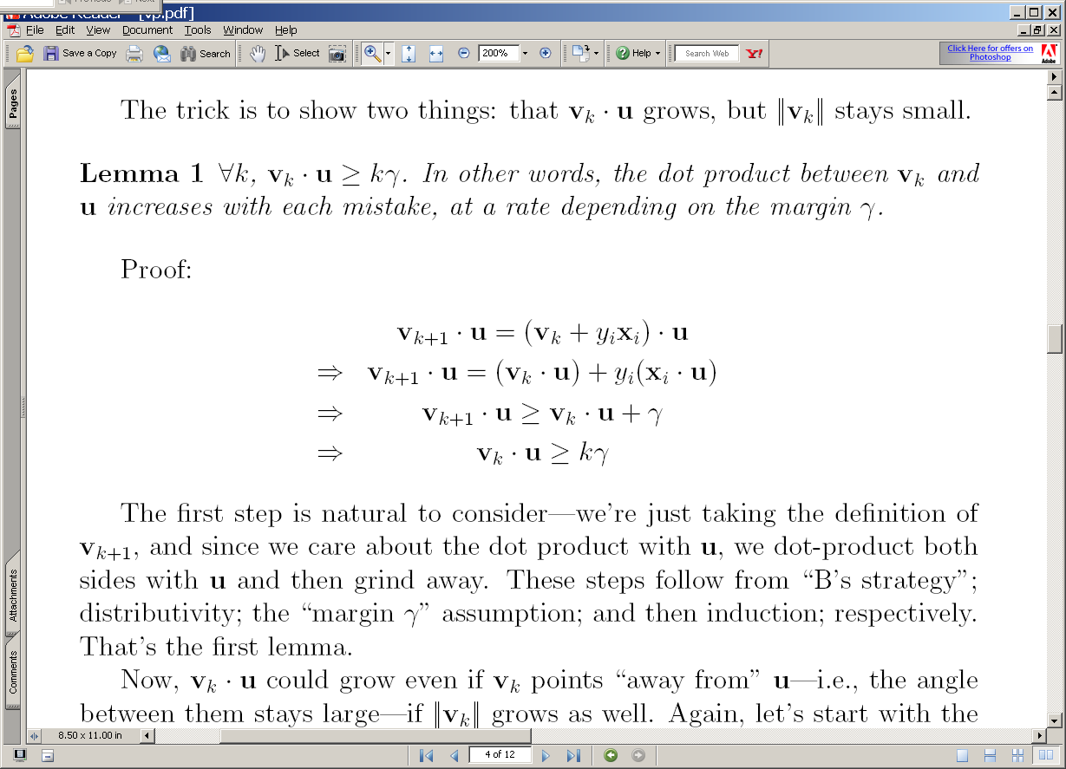
(3a) The guess v₂ after the two positive examples: v₂=v₁+x₂
(3b) The guess v₂ after the one positive and one negative example: v₂=v₁-x₂
u
u
+x₂
v₂
v₂
>γ
v₁
v₁
+x₁
-x₂
-u
-u
2γ
2γ

Slide 9
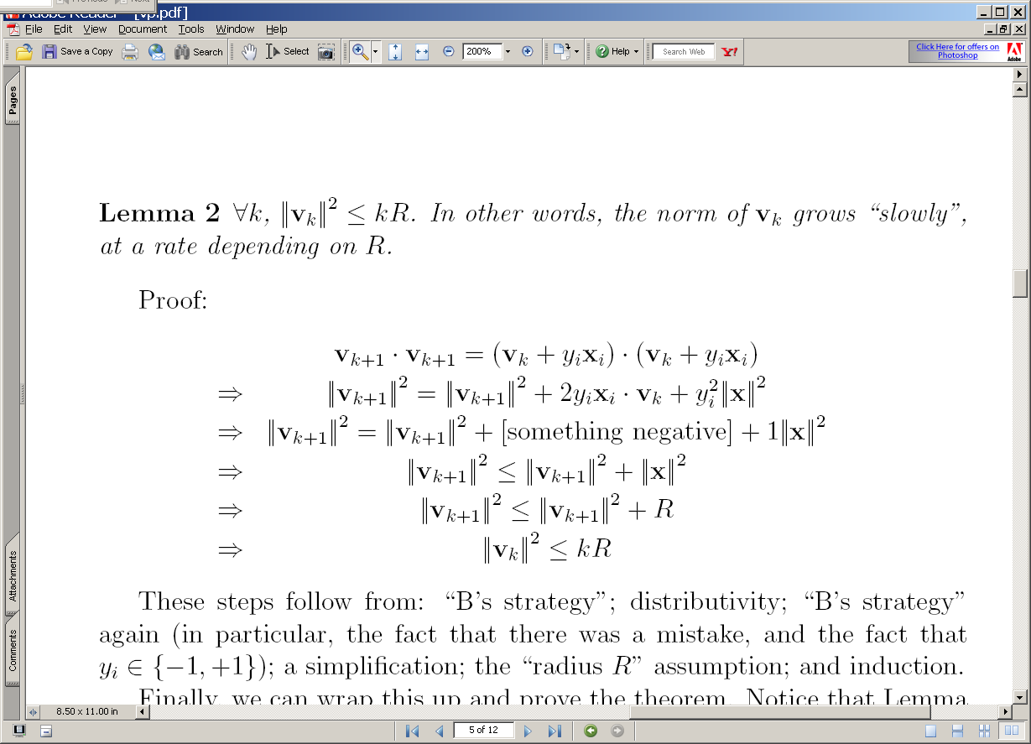
(3a) The guess v₂ after the two positive examples: v₂=v₁+x₂
(3b) The guess v₂ after the one positive and one negative example: v₂=v₁-x₂
u
u
+x₂
v₂
v₂
v₁
v₁
+x₁
-x₂
-u
-u
2γ
2γ

Slide 10
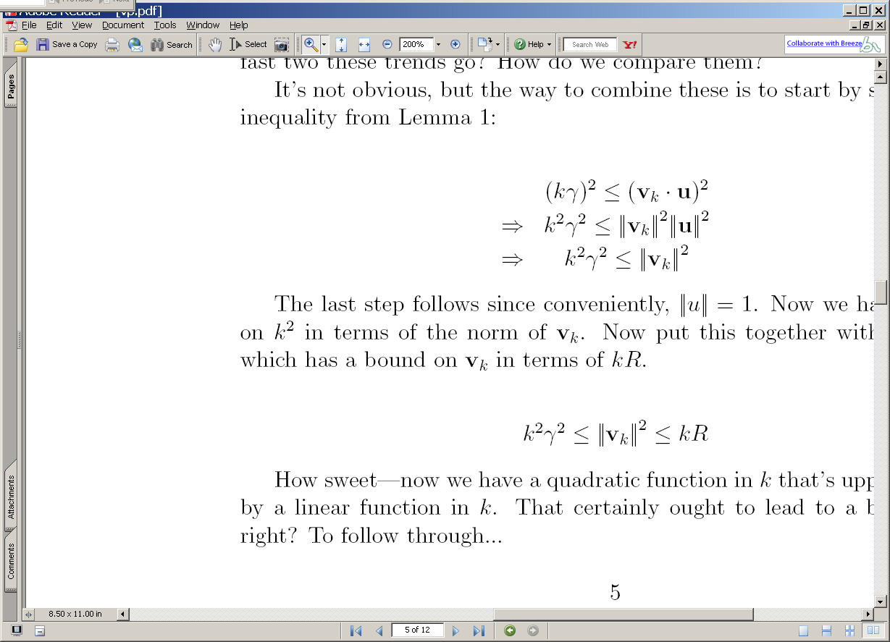
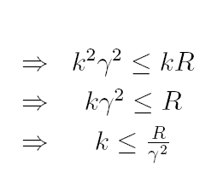
2
2
2
2
2

Slide 11
Summary
We have shown that
If : exists a u with unit norm that has margin γ on examples in the seq (x₁,y₁),(x₂,y₂),….
Then : the perceptron algorithm makes < R²/ γ² mistakes on the sequence (where R >= ||x_{i}||)
Independent of dimension of the data or classifier (!)
This doesn’t follow from M(C)<=VCDim(C)
We don’t know if this algorithm could be better
There are many variants that rely on similar analysis (ROMMA, Passive-Aggressive, MIRA, …)
We don’t know what happens if the data’s not separable
Unless I explain the “Δ trick” to you
We don’t know what classifier to use “after” training

Slide 12
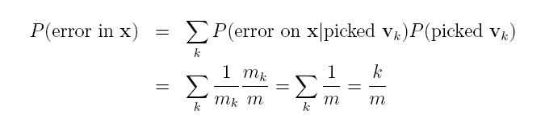
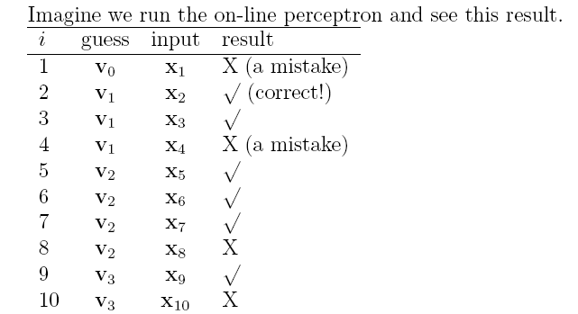
On-line to batch learning
Pick a v_{k} at random according to m_{k}/m, the fraction of examples it was used for.
Predict using the v_{k} you just picked.
(Actually, use some sort of deterministic approximation to this).

Slide 13
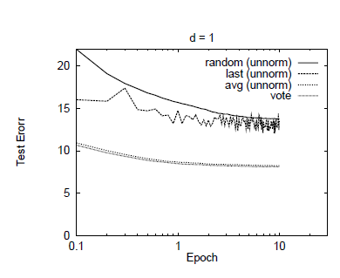

Slide 14
Complexity of perceptron learning
Algorithm:
v=0
for each example x,y:
if sign(v.x) != y
v = v + yx
O(n)
init hashtable
for x_{i}!=0, v_{i} += yx_{i}
O(|x|)=O(|d|)

Slide 15
Complexity of averaged perceptron
Algorithm:
vk=0
va = 0
for each example x,y:
if sign(vk.x) != y
va = va + vk
vk = vk + yx
mk = 1
else
nk++
O(n) O(n|V|)
init hashtables
for vk_{i}!=0, va_{i} += vk_{i}
for x_{i}!=0, v_{i} += yx_{i}
O(|V|)
O(|x|)=O(|d|)

Slide 16
Parallelizing perceptrons
Instances/labels
Split into example subsets
Instances/labels – 1
Instances/labels – 2
Instances/labels – 3
Compute vk’s on subsets
vk/va -1
vk/va- 2
vk/va-3
Combine somehow?
vk
Notes:
Rennie, Shih, Teevan, and Karger (2003) Tackling the Poor Assumptions of Naive Bayes Text Classifiers.
lingpipe-blog.com/.../rennie-shih-teevan-and-karger-2003-tackling-p...
Feb 16, 2009 – Rennie, Shih, Teevan, Karger (2003) Tackling the Poor Assumptions of Naive Bayes Text Classifiers. In ICML. Rennie et al. introduce four ...
Tackling the - AAAI

Slide 17
Parallelizing perceptrons
Instances/labels
Split into example subsets
Instances/labels – 1
Instances/labels – 2
Instances/labels – 3
Compute vk’s on subsets
vk/va -1
vk/va- 2
vk/va-3
Combine somehow
vk/va
Notes:
Rennie, Shih, Teevan, and Karger (2003) Tackling the Poor Assumptions of Naive Bayes Text Classifiers.
lingpipe-blog.com/.../rennie-shih-teevan-and-karger-2003-tackling-p...
Feb 16, 2009 – Rennie, Shih, Teevan, Karger (2003) Tackling the Poor Assumptions of Naive Bayes Text Classifiers. In ICML. Rennie et al. introduce four ...
Tackling the - AAAI

Slide 18
Parallelizing perceptrons
vk/va
Instances/labels
Split into example subsets
Instances/labels – 1
Instances/labels – 2
Instances/labels – 3
Compute vk’s on subsets
vk/va -1
vk/va- 2
vk/va-3
Synchronize with messages
vk/va
Notes:
Rennie, Shih, Teevan, and Karger (2003) Tackling the Poor Assumptions of Naive Bayes Text Classifiers.
lingpipe-blog.com/.../rennie-shih-teevan-and-karger-2003-tackling-p...
Feb 16, 2009 – Rennie, Shih, Teevan, Karger (2003) Tackling the Poor Assumptions of Naive Bayes Text Classifiers. In ICML. Rennie et al. introduce four ...
Tackling the - AAAI

Slide 19
Review/outline
How to implement Naïve Bayes
Time is linear in size of data (one scan!)
We need to count C( X=word ^ Y=label)
Can you parallelize Naïve Bayes?
Trivial solution 1
Split the data up into multiple subsets
Count and total each subset independently
Add up the counts
Result should be the same
This is unusual for streaming learning algorithms
Why? no interaction between feature weight updates
For perceptron that’s not the case

Slide 20
A hidden agenda
Part of machine learning is good grasp of theory
Part of ML is a good grasp of what hacks tend to work
These are not always the same
Especially in big-data situations
Catalog of useful tricks so far
Brute-force estimation of a joint distribution
Naive Bayes
Stream-and-sort, request-and-answer patterns
BLRT and KL-divergence (and when to use them)
TF-IDF weighting – especially IDF
it’s often useful even when we don’t understand why
Perceptron/mistake bound model
often leads to fast, competitive, easy-to-implement methods
parallel versions are non-trivial to implement/understand

