Slide 1
Perceptrons – the story continues

Slide 2
On-line learning/regret analysis
Optimization
  is a great model of what you want to do
  a less good model of what you have time to do
Example:
  How much to we lose when we replace gradient descent with SGD?
  what if we can only approximate the local gradient?
  what if the distribution changes over time?
  …
One powerful analytic approach: online-learning aka regret analysis (~aka on-line optimization)

Slide 3
Theory: the prediction game
Player A:
  picks a “target concept” c
    for now - from a finite set of possibilities C (e.g., all decision trees of size m)
  for t=1,….,
    Player A picks x=(x₁,…,x_{n}) and sends it to B
      For now, from a finite set of possibilities (e.g., all binary vectors of length n)
    B predicts a label, ŷ, and sends it to A
    A sends B the true label y=c(x)
    we record if B made a mistake or not
  We care about the worst case number of mistakes B will make over all possible concept & training sequences of any length
    The “Mistake bound” for B, M_{B}(C), is this bound

Slide 4
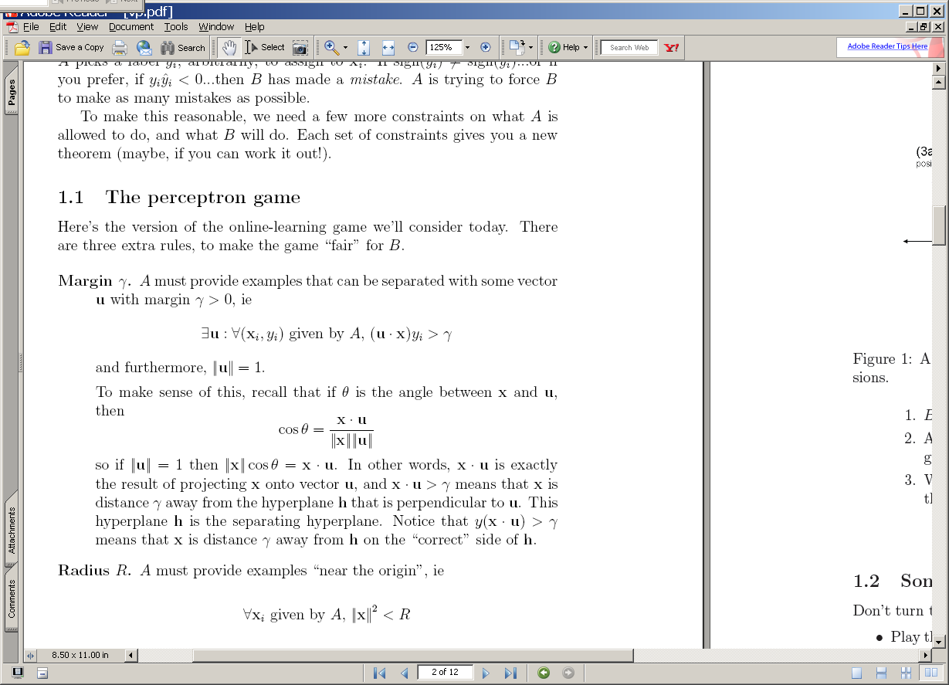
The voted perceptron: a simple algorithm with an easy mistake bound
^
instance x_{i}
B
Compute: y_{i} = sign(v_{k} . x_{i} )
A
^
If mistake: v_{k+1} = v_{k} + y_{i} x_{i}
y_{i}
y_{i}
2

Slide 5
The perceptron game
x is a vector
y is -1 or +1
^
instance x_{i}
B
Compute: y_{i} = sign(v_{k} . x_{i} )
A
^
If mistake: v_{k+1} = v_{k} + y_{i} x_{i}
y_{i}
y_{i}
u
+x₂
Depends on how easy the learning problem is, not dimension of vectors x
Fairly intuitive:
“Similarity” of v to u looks like (v.u)/|v.v|
(v.u) grows by >= γafter mistake
(v.v) grows by <= R²
v₂
>γ
v₁
-u
2γ

Slide 6
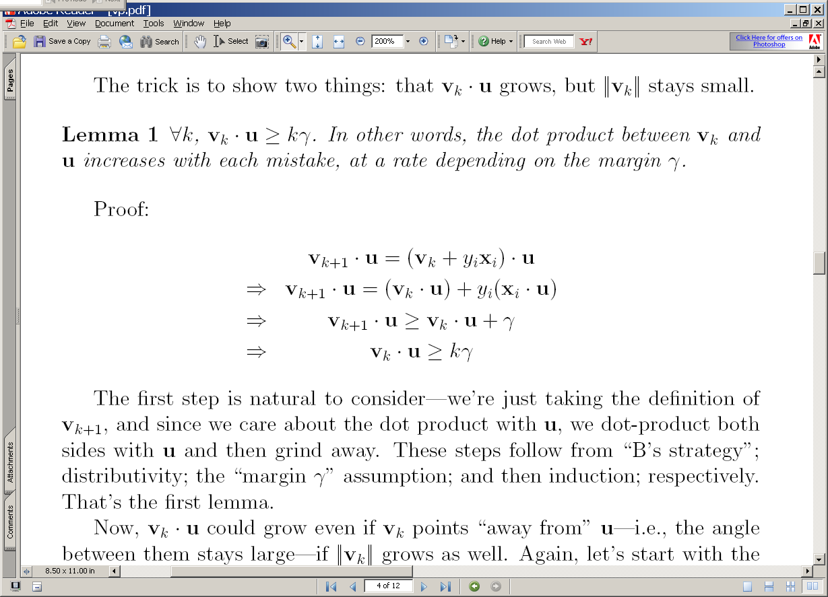
(3a) The guess v₂ after the two positive examples: v₂=v₁+x₂
(3b) The guess v₂ after the one positive and one negative example: v₂=v₁-x₂
u
u
+x₂
v₂
v₂
>γ
v₁
v₁
+x₁
-x₂
-u
-u
2γ
2γ

Slide 7
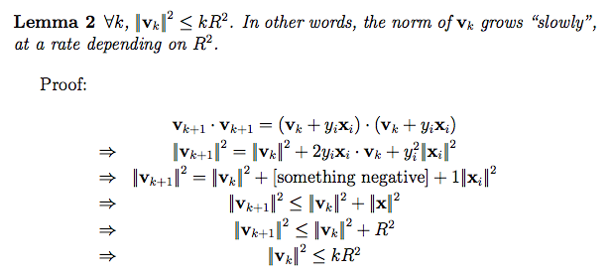
(3a) The guess v₂ after the two positive examples: v₂=v₁+x₂
(3b) The guess v₂ after the one positive and one negative example: v₂=v₁-x₂
u
u
+x₂
v₂
v₂
v₁
v₁
+x₁
-x₂
-u
-u
2γ
2γ

Slide 8
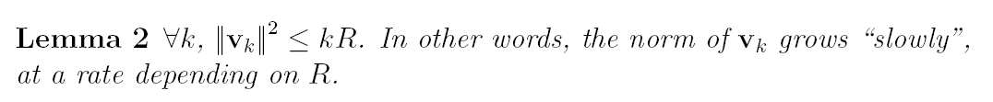
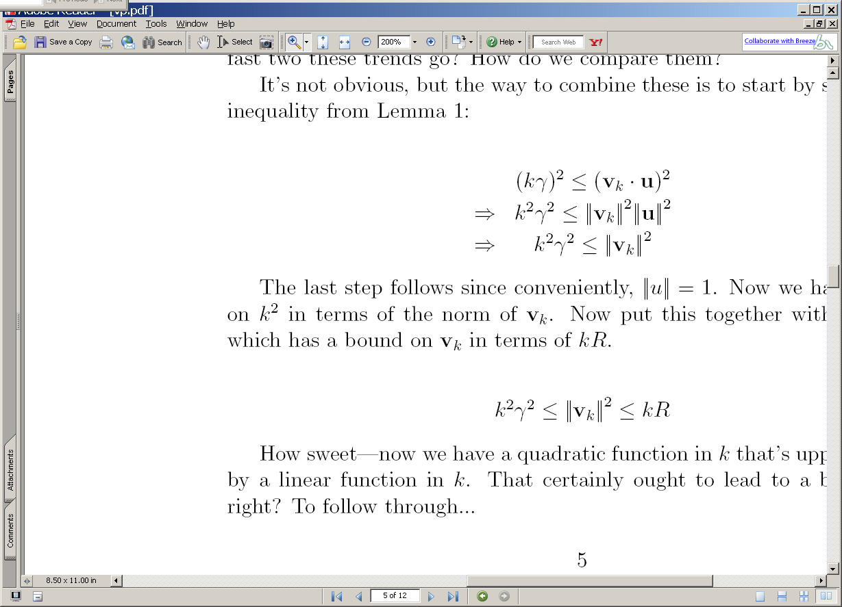
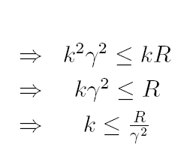
2
2
2
2
2

Slide 9
Summary
We have shown that
  If : exists a u with unit norm that has margin γ on examples in the seq (x₁,y₁),(x₂,y₂),…. (the data is easily separable)
  Then : the perceptron algorithm makes < R²/ γ² mistakes on the sequence (where R >=max_{i} ||x_{i}||)
  Independent of dimension of the data or classifier (!)
We can improve this (it’s not optimal, just bounded)
  There are many variants that rely on similar analysis (ROMMA, Passive-Aggressive, MIRA, …)
We can extend the analysis to deal with noise
We can extend the method to deal with other losses
We can make the method more robust with averaging or voting

Slide 10
Theory: regret analysis
In general: We care about the worst case “regret” of B
  its loss on the on-line sequence
  compared to the best-case predictions it could make if it had seem the entire sequence before making any predictions
Mistakes for realizable case:
  loss is 0/1 (mistake or not)
  best case: 0 mistakes

Slide 11
Averaging and voting
Theory says we get low error on the training set with a randomized algorithm:
  pick a timepoint t
  pick the perceptron v_{k} active at t
  predict on x with v_{k}
We can approximate this by
  voting the predictions of all the classifiers, weighted by their probability of being picked
  averaging the classifiers themselves, with the same weights

Slide 12
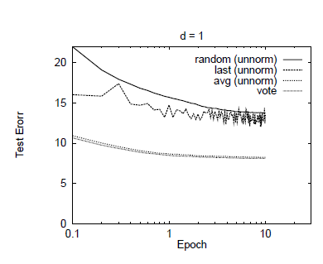
perceptrons on the NIST digits data

Slide 13
Summary
We have shown that
  If : exists a u with unit norm that has margin γ on examples in the seq (x₁,y₁),(x₂,y₂),…. (the data is easily separable)
  Then : the perceptron algorithm makes < R²/ γ² mistakes on the sequence (where R >=max_{i} ||x_{i}||)
  Independent of dimension of the data or classifier (!)
Very similar to SVMs:
  in an SVM you search for a u that will maximize margin γ subject to a bound on ||u||
  or else, minimize ||u|| subject to constraint on the margin
  like SVMs you can kernelize perceptrons….

Slide 14
sparsifying the Averaged Perceptron Update

Slide 15
Complexity of perceptron learning
Algorithm:
v=0
for each example x,y:
  if sign(v.x) != y
    v = v + yx
O(n)
init hashtable
    for x_{i}!=0, v_{i} += yx_{i}
O(|x|)=O(|d|)

Slide 16
Complexity of perceptron learning
Algorithm:
v=0
for each example x,y:
  if sign(v.x) != y
    v = v + yx
O(n)
init hashtable
    for x_{i}!=0, v_{i} += yx_{i}
O(|x|)=O(|d|)

Slide 17
Complexity of averaged perceptron
Algorithm:
vk=0
va = 0
for each example x,y:
  if sign(vk.x) != y
    va = va + vk * mk
    vk = vk + yx
    mk = 1
  else
    mk++
O(n) O(n|V|)
init hashtables
    for vk_{i}!=0, va_{i} += vk_{i}
    for x_{i}!=0, v_{i} += yx_{i}
O(|V|)
O(|x|)=O(|d|)

Slide 18
Complexity of averaged perceptron
Algorithm:
vk=0
va = 0
for each example x,y:
  if sign(vk.x) != y
    va = va + vk * mk
    vk = vk + yx
    mk = 1
  else
    mk++
return va/k where k=#mistakes
O(n) O(n|V|)
init hashtables
    for vk_{i}!=0, va_{i} += vk_{i}
    for x_{i}!=0, v_{i} += yx_{i}
O(|V|)
O(|x|)=O(|d|)

Slide 19
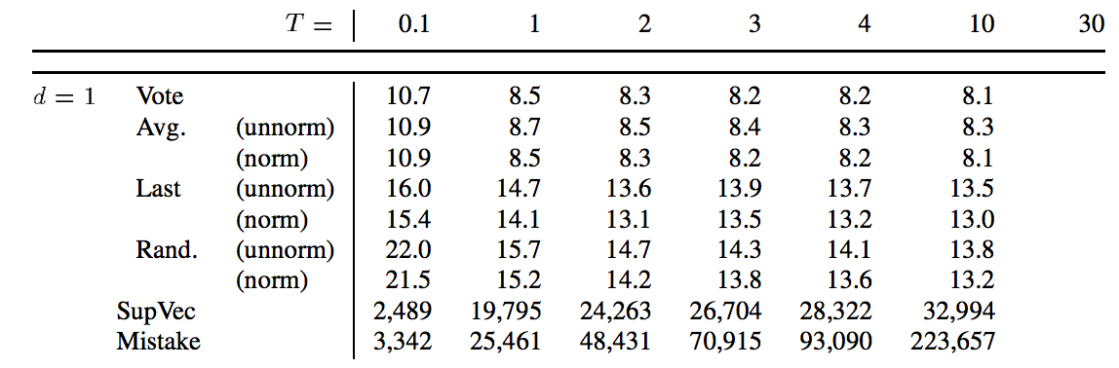
There are lots of mistakes….

Slide 20
Alternative averaged perceptron
Algorithm:
vk = 0
va = 0
for each example x,y:
  va = va + vk
  t = t+1
  if sign(vk.x) != y
    vk = vk + y*x
Return va/t
Observe:
S_{k} is the set of examples including the first k mistakes

Slide 21
Alternative averaged perceptron
Algorithm:
vk = 0
va = 0
for each example x,y:
  va = va + vk
  t = t+1
  if sign(vk.x) != y
    vk = vk + y*x
Return va/t
So when there’s a mistake at time t on x,y:
y*x is added to va on every subsequent iteration
Suppose you know T, the total number of examples in the stream…

Slide 22
Alternative averaged perceptron
Algorithm:
vk = 0
va = 0
for each example x,y:
  va = va + vk
  t = t+1
  if sign(vk.x) != y
    vk = vk + y*x
    va = va + (T-t)*y*x
Return va/T
T = the total number of examples in the stream…
All subsequent additions of x to va
Unpublished? I figured this out recently, Leon Bottou knows it too

Slide 23
Perceptrons in Parallel

Slide 24
Parallelizing perceptrons
Instances/labels
Split into example subsets
Instances/labels – 1
Instances/labels – 2
Instances/labels – 3
Compute vk’s on subsets
vk/va -1
vk/va- 2
vk/va-3
Combine somehow?
vk
Notes:
Rennie, Shih, Teevan, and Karger (2003) Tackling the Poor Assumptions of Naive Bayes Text Classifiers.
lingpipe-blog.com/.../rennie-shih-teevan-and-karger-2003-tackling-p...
Feb 16, 2009 – Rennie, Shih, Teevan, Karger (2003) Tackling the Poor Assumptions of Naive Bayes Text Classifiers. In ICML. Rennie et al. introduce four ...
Tackling the - AAAI

Slide 25
Parallelizing perceptrons
Instances/labels
Split into example subsets
Instances/labels – 1
Instances/labels – 2
Instances/labels – 3
Compute vk’s on subsets
vk/va -1
vk/va- 2
vk/va-3
Combine somehow
vk/va
Synchonization cost
vs Inference (classification)
cost
Notes:
Rennie, Shih, Teevan, and Karger (2003) Tackling the Poor Assumptions of Naive Bayes Text Classifiers.
lingpipe-blog.com/.../rennie-shih-teevan-and-karger-2003-tackling-p...
Feb 16, 2009 – Rennie, Shih, Teevan, Karger (2003) Tackling the Poor Assumptions of Naive Bayes Text Classifiers. In ICML. Rennie et al. introduce four ...
Tackling the - AAAI

Slide 26
A hidden agenda
Part of machine learning is good grasp of theory
Part of ML is a good grasp of what hacks tend to work
These are not always the same
  Especially in big-data situations
Catalog of useful tricks so far
  Brute-force estimation of a joint distribution
  Naive Bayes
  Stream-and-sort, request-and-answer patterns
  BLRT and KL-divergence (and when to use them)
  TF-IDF weighting – especially IDF
    it’s often useful even when we don’t understand why
  Perceptron/mistake bound model
    often leads to fast, competitive, easy-to-implement methods
    parallel versions are non-trivial to implement/understand

Slide 27
The Voted Perceptron for Ranking and Structured Classification

Slide 28
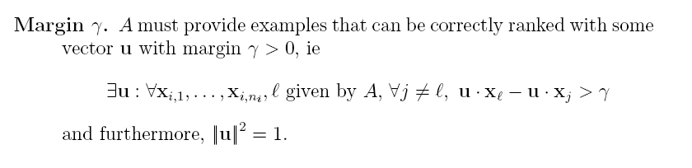
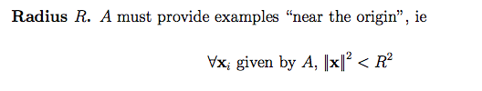
The voted perceptron for ranking
instances x₁ x₂ x₃ x₄…
^
A
B
Compute: y_{i} = v_{k} . x_{i}
Return: the index b* of the “best” x_{i}
b*
If mistake: v_{k+1} = v_{k} + x_{b} - x_{b*}
b

Slide 29
u
Ranking some x’s with the target vector u
x
γ
x
x
x
x
-u

Slide 30
u
Ranking some x’s with some guess vector v – part 1
x
γ
v
x
x
x
x
-u

Slide 31
u
Ranking some x’s with some guess vector v – part 2.
The purple-circled x is x_{b*} - the one the learner has chosen to rank highest. The green circled x is x_{b}, the right answer.
x
v
x
x
x
x
-u

Slide 32
u
Correcting v by adding x_{b} – x_{b*}
x
v
x
x
x
x
-u

Slide 33
Correcting v by adding x_{b} – x_{b*}
(part 2)
V_{k+1}
x
v_{k}
x
x
x
x

Slide 34
(3a) The guess v₂ after the two positive examples: v₂=v₁+x₂
u
+x₂
v₂
>γ
v₁
-u
2γ

Slide 35
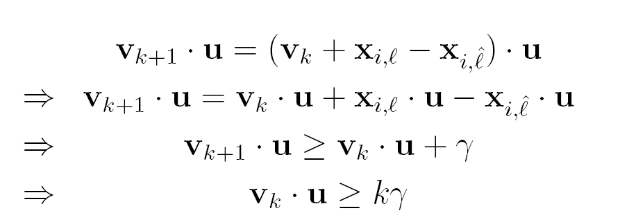
(3a) The guess v₂ after the two positive examples: v₂=v₁+x₂
u
+x₂
v₂
>γ
v₁
-u
2γ
3

Slide 36
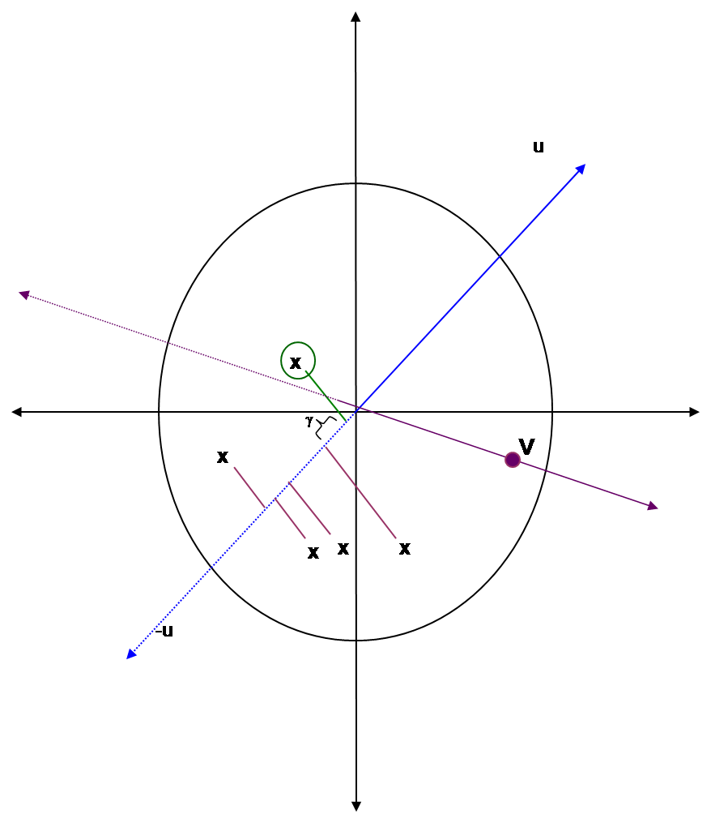
(3a) The guess v₂ after the two positive examples: v₂=v₁+x₂
u
+x₂
v₂
>γ
v₁
-u
2γ
3

Slide 37
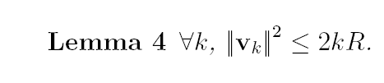
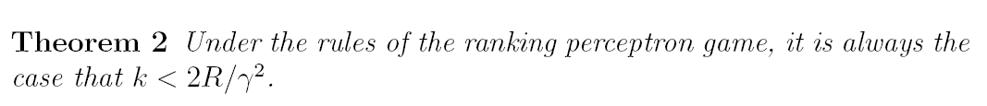
Notice this doesn’t depend at all on the number of x’s being ranked
(3a) The guess v₂ after the two positive examples: v₂=v₁+x₂
u
+x₂
v₂
>γ
v₁
-u
2γ
2
2
Neither proof depends on the dimension of the x’s.

Slide 38
Ranking perceptrons ➔ structured perceptrons
The API:
  A sends B a (maybe huge) set of items to rank
  B finds the single best one according to the current weight vector
  A tells B which one was actually best
Structured classification on a sequence
  Input: list of words: x=(w₁,…,w_{n})
  Output: list of labels: y=(y_{1,}…,y_{n})
  If there are K classes, there are K^{n} labels possible for x

Slide 39
Ranking perceptrons ➔ structured perceptrons
Suppose we can
  1. Given x and y, form a feature vector F(x,y)
  Then we can score x,y using a weight vector: w.F(x,y)
  2. Given x, find the top-scoring y, with respect to w.F(x,y)
  Then we can learn….
Structured classification on a sequence
  Input: list of words: x=(w₁,…,w_{n})
  Output: list of labels: y=(y_{1,}…,y_{n})
  If there are K classes, there are K^{n} labels possible for x

Slide 40
Example Structure classification problem: segmentation or NER
  Example: Addresses, bib records
  Problem: some DBs may split records up differently (eg no “mail stop” field, combine address and apt #, …) or not at all
  Solution: Learn to segment textual form of records
Author
Year
Title
Journal
Page
Volume
P.P.Wangikar, T.P. Graycar, D.A. Estell, D.S. Clark, J.S. Dordick (1993) Protein and Solvent Engineering of Subtilising BPN' in Nearly Anhydrous Organic Media J.Amer. Chem. Soc. 115, 12231-12237.
When will prof Cohen post the notes …

Slide 41
Converting segmentation to a feature set (Begin,In,Out)
When will prof Cohen post the notes …
Idea 1: features are properties of two adjacent tokens, and the pair of labels assigned to them.
(y(i)==B or y(i)==I) and (token(i) is capitalized)
(y(i)==I and y(i-1)==B) and (token(i) is hyphenated)
(y(i)==B and y(i-1)==B)
  eg “tell Rahul William is on the way”
Idea 2: construct a graph where each path is a possible sequence labeling.

Slide 42
Find the top-scoring y
When will prof Cohen post the notes …
B
B
B
B
B
B
B
I
I
I
I
I
I
I
O
O
O
O
O
O
O
Inference: find the highest-weight path
This can be done efficiently using dynamic programming (Viterbi)

Slide 43
Ranking perceptrons ➔ structured perceptrons
New API:
  A sends B the word sequence x
  B finds the single best y according to the current weight vector using Viterbi
  A tells B which y was actually best
  This is equivalent to ranking pairs g=(x,y’) based on w.F(x,y)
Structured classification on a sequence
  Input: list of words: x=(w₁,…,w_{n})
  Output: list of labels: y=(y_{1,}…,y_{n})
  If there are K classes, there are K^{n} labels possible for x

Slide 44
The voted perceptron for NER
instances g₁ g₂ g₃ g₄…
^
A
B
Compute: y_{i} = v_{k} . g_{i}
Return: the index b* of the “best” g_{i}
If mistake: v_{k+1} = v_{k} + g_{b} - g_{b*}
b*
b
A sends B feature functions, and instructions for creating the instances g:
  A sends a word vector x_{i}. Then B could create the instances g₁ =F(x_{i},y₁), g₂= F(x_{i},y₂), …
  but instead B just returns the y* that gives the best score for the dot product v_{k} . F(x_{i},y*) by using Viterbi.
A sends B the correct label sequence y_{i.}
On errors, B sets v_{k+1} = v_{k} + g_{b} - g_{b*} = v_{k} + F(x_{i},y) - F(x_{i},y*)

Slide 45
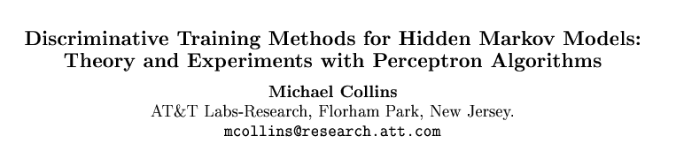

EMNLP 2002

Slide 46
Some background…
Collins’ parser: generative model…
…New Ranking Algorithms for Parsing and Tagging: Kernels over Discrete Structures, and the Voted Perceptron, Collins and Duffy, ACL 2002.
…Ranking Algorithms for Named-Entity Extraction: Boosting and the Voted Perceptron, Collins, ACL 2002.
  Propose entities using a MaxEnt tagger (as in MXPOST)
  Use beam search to get multiple taggings for each document (20)
  Learn to rerank the candidates to push correct ones to the top, using some new candidate-specific features:
    Value of the “whole entity” (e.g., “Professor_Cohen”)
    Capitalization features for the whole entity (e.g., “Xx+_Xx+”)
    Last word in entity, and capitalization features of last word
    Bigrams/Trigrams of words and capitalization features before and after the entity

Slide 47
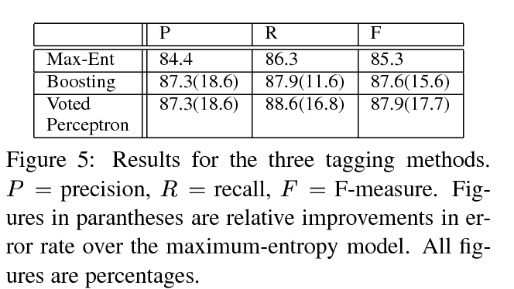
Some background…

Slide 48
Collins’ Experiments
POS tagging
NP Chunking (words and POS tags from Brill’s tagger as features) and BIO output tags
Compared Maxent Tagging/MEMM’s (with iterative scaling) and “Voted Perceptron trained HMM’s”
  With and w/o averaging
  With and w/o feature selection (count>5)

Slide 49
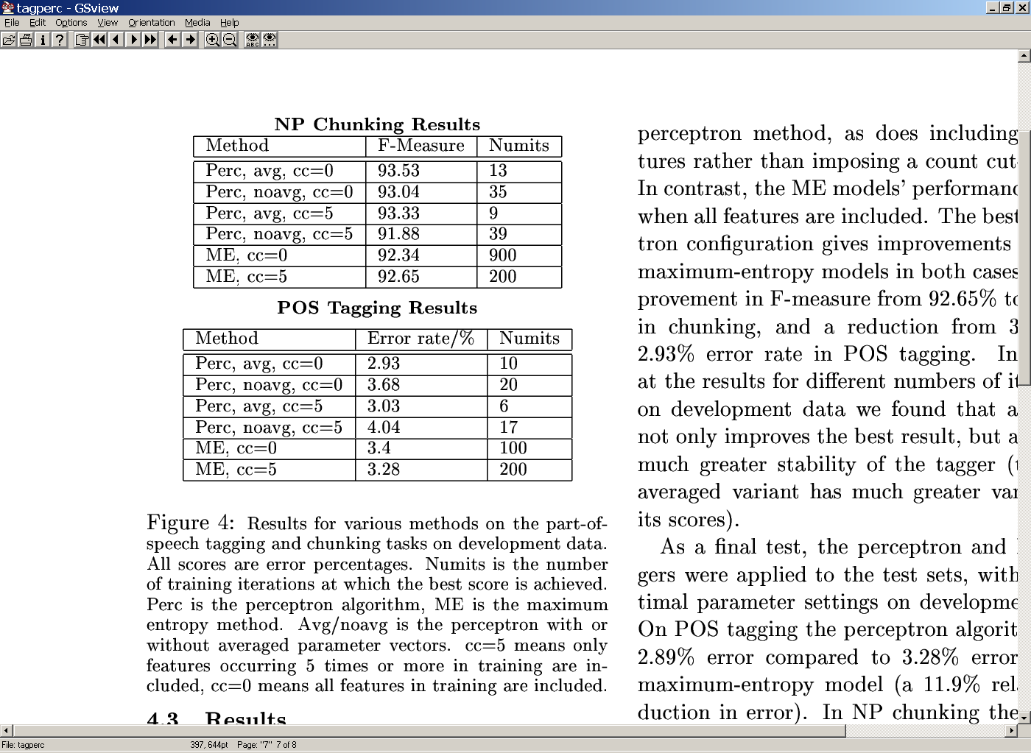
Collins’ results

