Slide 1
Graph-Based Parallel Computing
William Cohen

Slide 2
Computing paradigms
Stream-and-sort
Iterative streaming ML (eg SGD)
Map-reduce (stream-and-sort + parallelism)
  plus dataflow-language abstractions
Iterative parameter mixing (~= 2 + 3)
Spark and Flink (~= 2 + iteration + caching)
….?

Slide 3
Many ML algorithms tend to have
Sparse data dependencies
Local computations
Iterative updates
Typical example: PageRank
  repeat:
    for each node, collect/combine incoming PRs
    for each node, send outgoing PR

Slide 4
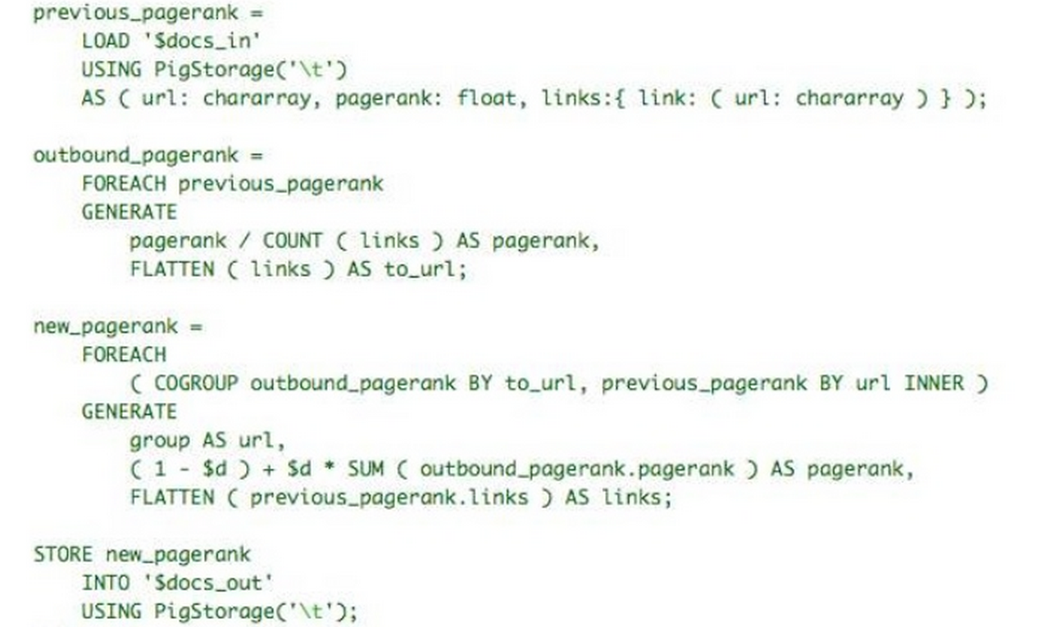
lots of i/o happening here…

Slide 5
Many ML algorithms tend to have
Sparse data dependencies
Local computations
Iterative updates
Typical example: PageRank
  repeat:
    for each node, collect/combine incoming PRs
    for each node, send outgoing PR

Slide 6
Many Graph-Parallel Algorithms
Collaborative Filtering
  Alternating Least Squares
  Stochastic Gradient Descent
  Tensor Factorization
Structured Prediction
  Loopy Belief Propagation
  Max-Product Linear Programs
  Gibbs Sampling
Semi-supervised ML
  Graph SSL
  CoEM
Community Detection
  Triangle-Counting
  K-core Decomposition
  K-Truss
Graph Analytics
  PageRank
  Personalized PageRank
  Shortest Path
  Graph Coloring
Classification
  Neural Networks

Slide 7
Suggested architecture
A large mutable graph stored in distributed memory
  Repeat some node-centric computation until convergence
  Node values change and edges (mostly) don’t
  Node updates depend (mostly) on their neighbors in the graph
  Node updates are done in parallel

Slide 8
Sample system: Pregel

Slide 9
Pregel (Google, Sigmod 2010)
Primary data structure is a graph
Computations are sequence of supersteps, in each of which
  user-defined function (UDF) is invoked (in parallel) at each vertex v, can get/set value
  UDF can also issue requests to get/set edges
  UDF can read messages sent to v in the last superstep and schedule messages to send to in the next superstep
  Halt when every vertex votes to halt
Output is directed graph
Also: aggregators (like ALLREDUCE)
Bulk synchronous processing (BSP) model: all vertex operations happen simultaneously
vertex value changes
communication

Slide 10
Pregel (Google, Sigmod 2010)
One master: partitions the graph among workers
Workers keep graph “shard” in memory
Messages to other partitions are buffered
Communication across partitions is expensive, within partitions is cheap
  quality of partition makes a difference!

Slide 11
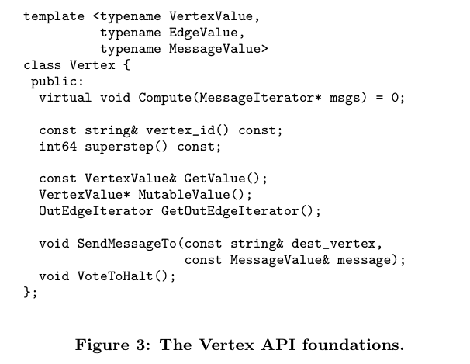
everyone computes in parallel
simplest rule: stop when everyone votes to halt

Slide 12
Streaming PageRank: with some long rows
recap
Repeat until converged:
  Let v^{t+1} = cu + (1-c)Wv^{t}
Store A as a list of edges: each line is: “i d(i) j”
Store v’ and v in memory: v’ starts out as cu
For each line “i d j“
    v’[j] += (1-c)v[i]/d
note we need to scan through the graph each time
We need to get the degree of i and store it locally

Slide 13
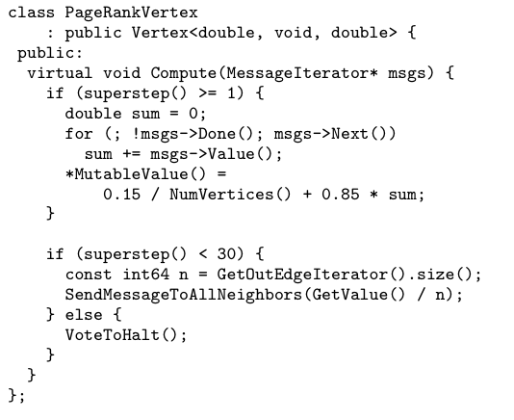

Slide 14
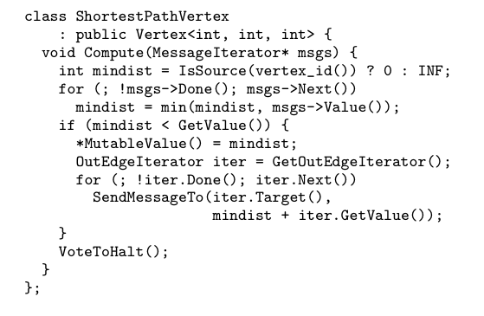
Another task: single source shortest path
edge weight

Slide 15
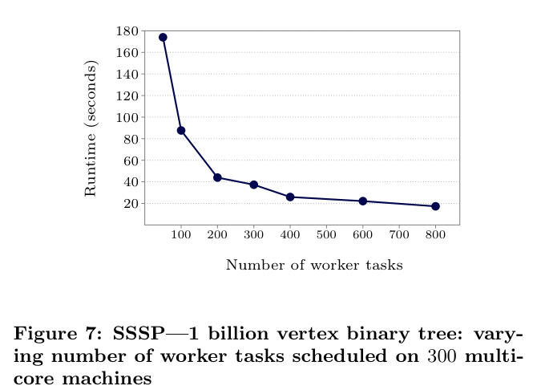
a little bit of a cheat

Slide 16
Sample system: Signal-Collect

Slide 17
Signal/collect model vs Pregel
Integrated with RDF/SPARQL
Vertices can be non-uniform types
Vertex:
  id, mutable state, outgoing edges, most recent received signals (map: neighbor id→signal), uncollected signals
  user-defined collect function
Edge: id, source, dest
  user-defined signal function
Allows asynchronous computations….via v.scoreSignal, v.scoreCollect
For “data-flow” operations
On multicore architecture: shared memory for workers

Slide 18
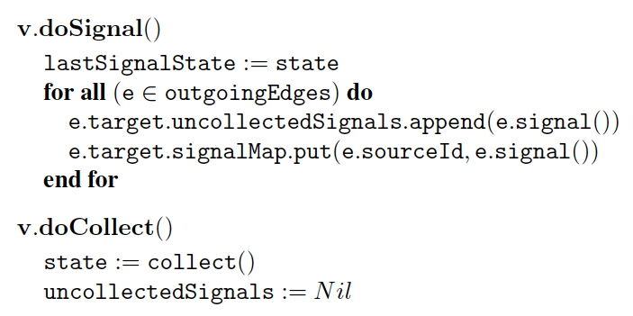
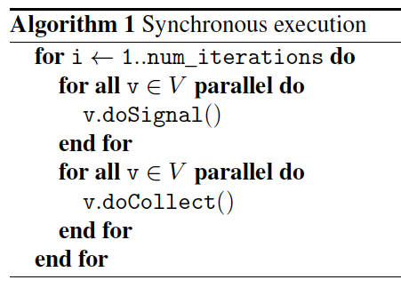
Signal/collect model
signals are made available in a list and a map
relax “num_iterations” soon
next state for a vertex is output of the collect() operation

Slide 19
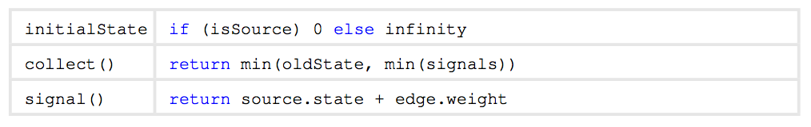
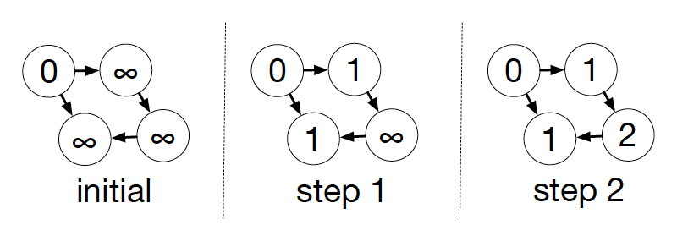
Signal/collect examples
Single-source shortest path

Slide 20
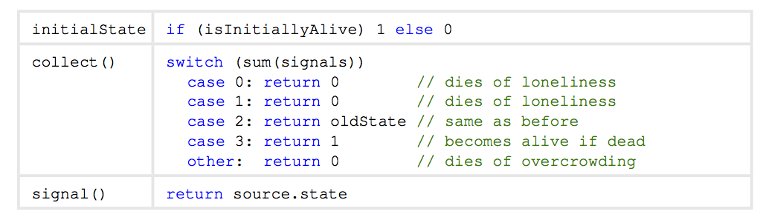
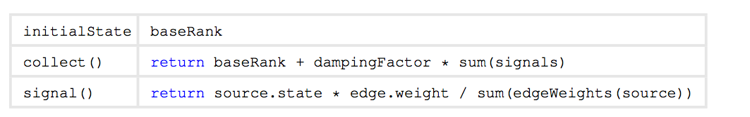
Signal/collect examples
Life
PageRank

Slide 21
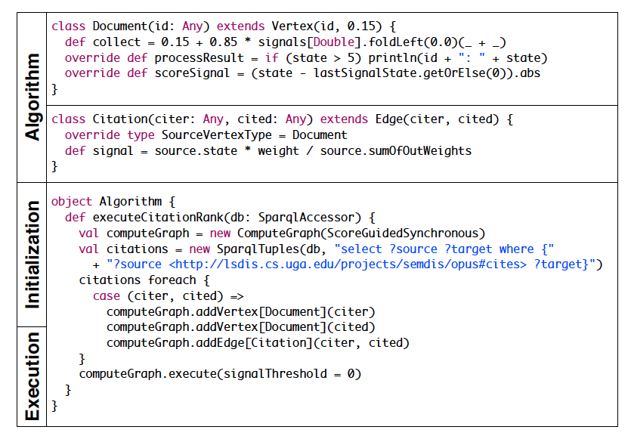
PageRank + Preprocessing and Graph Building

Slide 22
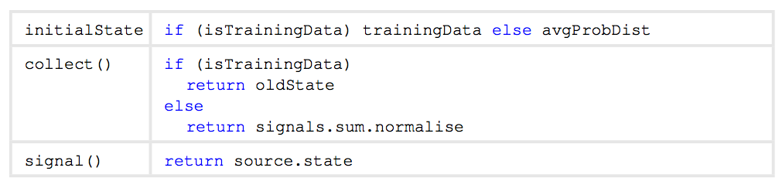
Signal/collect examples
Co-EM/wvRN/Harmonic fields

Slide 23
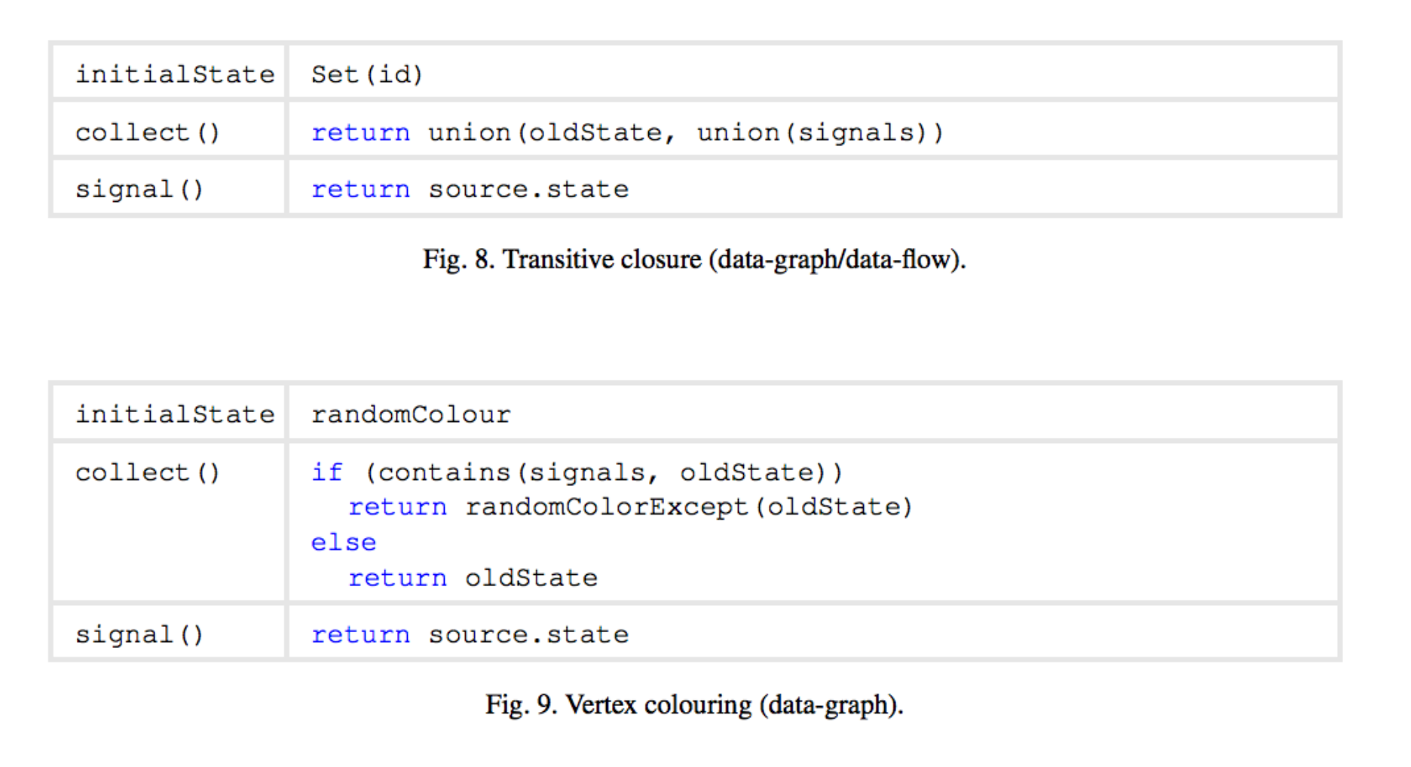

Slide 24
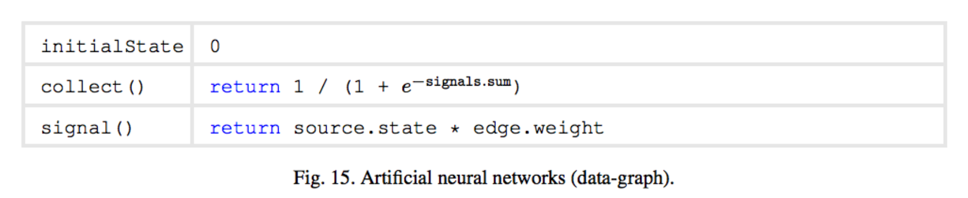

Slide 25
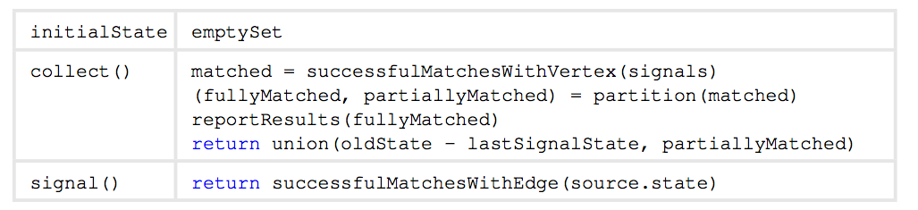
Signal/collect examples
Matching path queries:
dept(X) -[member]→ postdoc(Y) -[recieved]→ grant(Z)
dept(X) -[member]→ postdoc(Y) -[recieved]→ grant(Z)
LTI
wcohen
NSF378
MLD
partha
InMind7

Slide 26
Signal/collect examples: data flow
Matching path queries:
dept(X) -[member]→ postdoc(Y) -[recieved]→ grant(Z)
dept(X=MLD) -[member]→ postdoc(Y) -[recieved]→ grant(Z)
note: can be multiple input signals
LTI
wcohen
NSF378
MLD
partha
InMind7
dept(X=LTI) -[member]→ postdoc(Y) -[recieved]→ grant(Z)

Slide 27
Signal/collect examples
Matching path queries:
dept(X) -[member]→ postdoc(Y) -[recieved]→ grant(Z)
dept(X=MLD) -[member]→ postdoc(Y=partha) -[recieved]→ grant(Z)
LTI
wcohen
NSF378
MLD
partha
InMind7

Slide 28
Signal/collect model vs Pregel
Integrated with RDF/SPARQL
Vertices can be non-uniform types
Vertex:
  id, mutable state, outgoing edges, most recent received signals (map: neighbor id→signal), uncollected signals
  user-defined collect function
Edge: id, source, dest
  user-defined signal function
Allows asynchronous computations….via v.scoreSignal, v.scoreCollect
For “data-flow” operations

Slide 29
Asynchronous Parallel Computation
Bulk-Synchronous: All vertices update in parallel
  need to keep copy of “old” and “new” vertex values
Asynchronous:
  Reason 1: if two vertices are not connected, can update them in any order
    more flexibility, less storage
  Reason 2: not all updates are equally important
    parts of the graph converge quickly, parts slowly

Slide 30
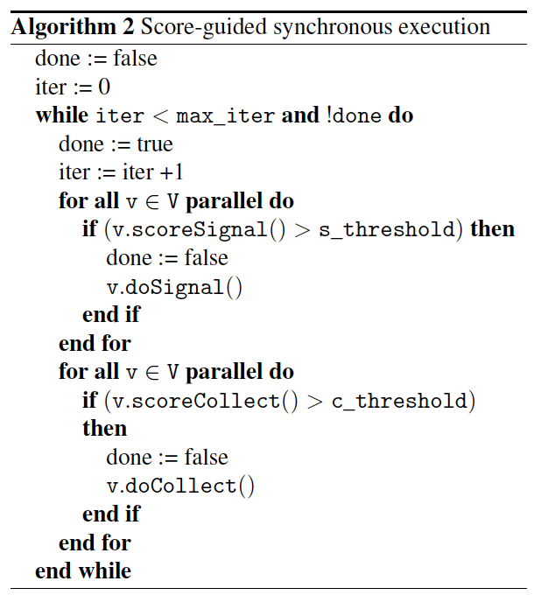
using:
v.scoreSignal
v.scoreCollect

Slide 31
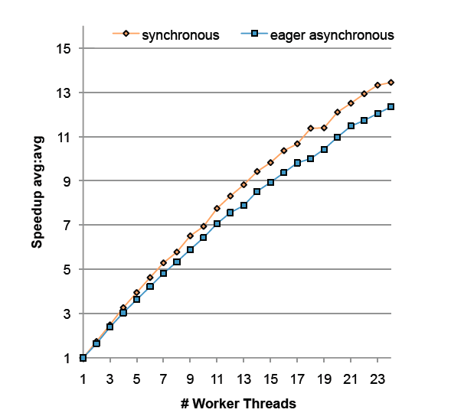
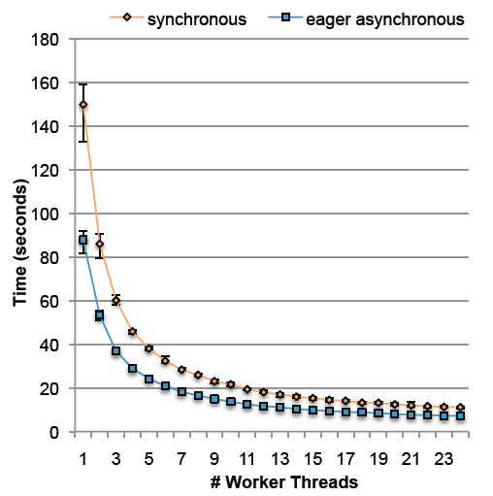

Slide 32
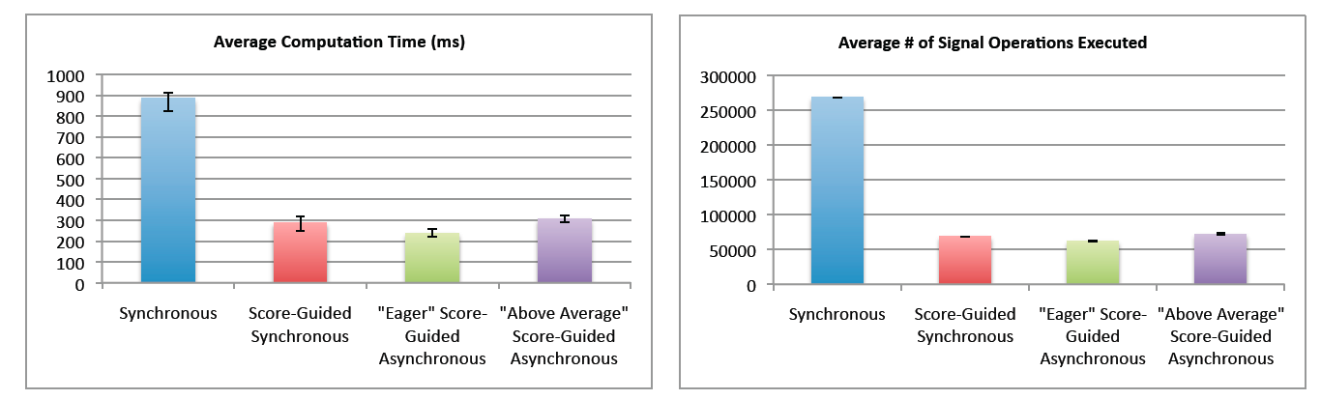
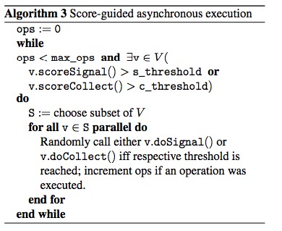
SSSP
PageRank

Slide 33
Sample system: GraphLab

Slide 34
GraphLab
Data in graph, UDF vertex function
Differences:
  some control over scheduling
    vertex function can insert new tasks in a queue
  messages must follow graph edges: can access adjacent vertices only
  “shared data table” for global data
  library algorithms for matrix factorization, coEM, SVM, Gibbs, …
  GraphLab → Now Dato

Slide 35
GraphLab’s descendents
PowerGraph
GraphChi
GraphX

Slide 36
GraphLab con’t
PowerGraph
GraphChi
  Goal: use graph abstraction on-disk, not in-memory, on a conventional workstation
Graph
Analytics
Graphical
Models
Computer
Vision
Clustering
Topic
Modeling
Collaborative
Filtering
General-purpose API
MPI/TCP-IP
PThreads
Hadoop/HDFS
Linux Cluster Services (Amazon AWS)

Slide 37
GraphLab con’t
GraphChi
  Key insight:
    some algorithms on graph are streamable (i.e., PageRank-Nibble)
    in general we can’t easily stream the graph because neighbors will be scattered
    but maybe we can limit the degree to which they’re scattered … enough to make streaming possible?
      “almost-streaming”: keep P cursors in a file instead of one

Slide 38
PSW: Shards and Intervals
1. Load
2. Compute
3. Write
Vertices are numbered from 1 to n
  P intervals, each associated with a shard on disk.
  sub-graph = interval of vertices
1
v₁
v₂
n
interval(1)
interval(2)
interval(P)
shard(1)
shard(2)
shard(P)
Notes:
How are the sub-graphs defined?

Slide 39
PSW: Layout
1. Load
2. Compute
3. Write
Shard: in-edges for interval of vertices; sorted by source-id
Vertices
1..100
Vertices
101..700
Vertices
701..1000
Vertices
1001..10000
Shard 1
Shard 2
Shard 3
Shard 4
Shard 1
in-edges for vertices 1..100
sorted by source_id
Shards small enough to fit in memory; balance size of shards
Notes:
Let us show an example

Slide 40
PSW: Loading Sub-graph
1. Load
2. Compute
3. Write
Load subgraph for vertices 1..100
Vertices
1..100
Vertices
101..700
Vertices
701..1000
Vertices
1001..10000
Shard 1
Shard 2
Shard 3
Shard 4
in-edges for vertices 1..100
sorted by source_id
Load all in-edges
in memory
What about out-edges?
Arranged in sequence in other shards

Slide 41
PSW: Loading Sub-graph
1. Load
2. Compute
3. Write
Load subgraph for vertices 101..700
Vertices
1..100
Vertices
101..700
Vertices
701..1000
Vertices
1001..10000
Shard 1
Shard 2
Shard 3
Shard 4
in-edges for vertices 1..100
sorted by source_id
Load all in-edges
in memory
Out-edge blocks
in memory

Slide 42
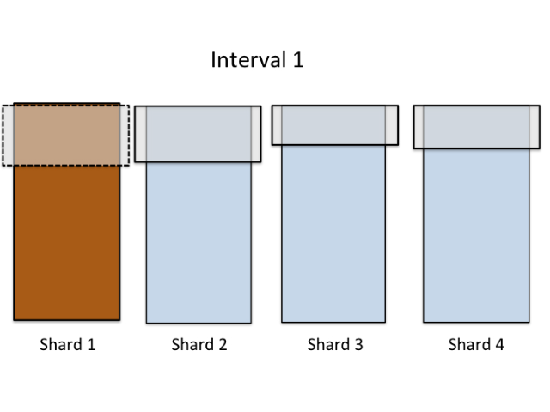
PSW Load-Phase
1. Load
2. Compute
3. Write
Only P large reads for each interval.
P² reads on one full pass.

Slide 43

PSW: Execute updates
1. Load
2. Compute
3. Write
Update-function is executed on interval’s vertices
Edges have pointers to the loaded data blocks
  Changes take effect immediately → asynchronous.
Block X
&Data
&Data
&Data
&Data
&Data
&Data
Block Y
&Data
&Data
&Data
&Data
Notes:
Now, when we have the sub-graph in memory, i.e for all vertices in the sub-graph we have all their in- and out-edges, we can execute the update-functions. Now comes important thing to understand: as we loaded the edges from disk, these large blocks are stored in memory. When we then create the graph objects – vertices and edges – the edge object will have a pointer to the data block. I have changed the figure to show that actually all data blocks are represented by pointers, pointing in to the blocks loaded from disk. Now: if two vertices share an edge, they will immediatelly observe change made by the other one since their edge pointers point to the same address.

Slide 44
PSW: Commit to Disk
1. Load
2. Compute
3. Write
In write phase, the blocks are written back to disk
  Next load-phase sees the preceding writes → asynchronous.
In total:
P² reads and writes / full pass on the graph.
→ Performs well on both SSD and hard drive.
Block X
&Data
&Data
To make this work: the size of a vertex state can’t change when it’s updated (at last, as stored on disk).
&Data
&Data
&Data
&Data
Block Y
&Data
&Data
&Data
&Data

Slide 45
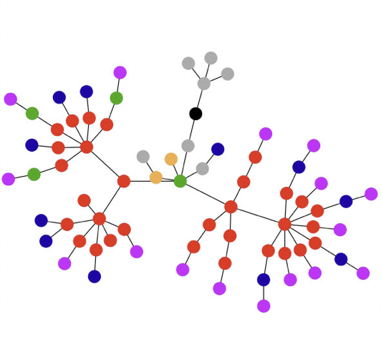
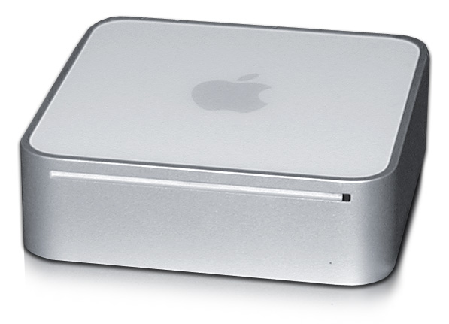
Experiment Setting
Mac Mini (Apple Inc.)
  8 GB RAM
  256 GB SSD, 1TB hard drive
  Intel Core i5, 2.5 GHz
Experiment graphs:
Graph | Vertices | Edges | P (shards) | Preprocessing
live-journal | 4.8M | 69M | 3 | 0.5 min
netflix | 0.5M | 99M | 20 | 1 min
twitter-2010 | 42M | 1.5B | 20 | 2 min
uk-2007-05 | 106M | 3.7B | 40 | 31 min
uk-union | 133M | 5.4B | 50 | 33 min
yahoo-web | 1.4B | 6.6B | 50 | 37 min
Notes:
The same graphs are typically used for benchmarking distributed graph processing systems.

Slide 46
Comparison to Existing Systems
See the paper for more comparisons.
PageRank
WebGraph Belief Propagation (U Kang et al.)
Matrix Factorization (Alt. Least Sqr.)
Triangle Counting
Notes: comparison results do not include time to transfer the data to cluster, preprocessing, or the time to load the graph from disk. GraphChi computes asynchronously, while all but GraphLab synchronously.
Notes:
Unfortunately the literature is abundant with Pagerank experiments, but not much more. Pagerank is really not that interesting, and quite simple solutions work. Nevertheless, we get some idea. Pegasus is a hadoop-based graph mining system, and it has been used to implement a wide range of different algorithms. The best comparable result we got was for a machine learning algo “belief propagation”. Mac Mini can roughly match a 100node cluster of Pegasus. This also highlights the inefficiency of MapReduce. That said, the Hadoop ecosystem is pretty solid, and people choose it for the simplicity. Matrix factorization has been one of the core Graphlab applications, and here we show that our performance is pretty good compared to GraphLab running on a slightly older 8-core server. Last, triangle counting, which is a heavy-duty social network analysis algorithm. A paper in VLDB couple of years ago introduced a Hadoop algorithm for counting triangles. This comparison is a bit stunning. But, I remind that these are prior to PowerGraph: in OSDI, the map changed totally!
However, we are confident in saying, that GraphChi is fast enough fo rmany purposes. And indeed, it can solve as big problems as the other systems have been shown to execute. It is limited by the disk space.

Slide 47
GraphLab’s descendents
PowerGraph
GraphChi
GraphX
On multicore architecture: shared memory for workers
On cluster architecture (like Pregel): different memory spaces
What are the challenges moving away from shared-memory?

Slide 48
Natural Graphs → Power Law
Top 1% of vertices is adjacent to
53% of the edges!
“Power Law”
-Slope = α ≈ 2
Altavista Web Graph: 1.4B Vertices, 6.7B Edges
GraphLab group/Aapo
Notes:
slide from Joey Gonzalez.
LOG-LOG

Slide 49
Problem:
High Degree Vertices Limit Parallelism
Edge information
too large for single
machine
Touches a large
fraction of graph
(GraphLab 1)
Produces many
messages
(Pregel, Signal/Collect)
Asynchronous consistency
requires heavy locking (GraphLab 1)
Synchronous consistency is prone to
stragglers (Pregel)
GraphLab group/Aapo

Slide 50
PowerGraph
Problem: GraphLab’s localities can be large
  “all neighbors of a node” can be large for hubs, high indegree nodes
Approach:
  new graph partitioning algorithm
    can replicate data
  gather-apply-scatter API: finer-grained parallelism
    gather ~ combiner
    apply ~ vertex UDF (for all replicates)
    scatter ~ messages from vertex to edges

Slide 51
Factorized Vertex Updates
GraphLab group/Aapo
Split update into 3 phases
Gather
Apply
Scatter
Scope
Y
Y
Y
Parallel
Sum
+ + … + → Δ
Locally apply the
accumulated Δ to vertex
Update neighbors
Y
Y
Y
Data-parallel over edges
Apply( , Δ) →
Y
Data-parallel over edges
Y

Slide 52
Signal/collect examples
Single-source shortest path

Slide 53
Signal/collect examples
Life
PageRank

Slide 54
PageRank + Preprocessing and Graph Building

Slide 55
Signal/collect examples
Co-EM/wvRN/Harmonic fields

Slide 56
PageRank in PowerGraph
GraphLab group/Aapo
gather/sum like a group by … reduce or collect
PageRankProgram(i)
Gather( j → i ) : return w_{ji} * R[j]
sum(a, b) : return a + b;
Apply(i, Σ) : R[i] = β + (1 – β) * Σ
Scatter( i → j ) :
if (R[i] changes) then activate(j)
j edge
i vertex
scatter is like a signal
Notes:
How ever, in some cases, this can seem rather inefficient.

Slide 57
Distributed Execution of a PowerGraph Vertex-Program
GraphLab group/Aapo
Machine 1
Machine 2
Gather
Y’
Y’
Y’
Y’
Σ₁
Σ
Σ₂
+ + +
Apply
Y
Y
Y
Y
Machine 3
Machine 4
Scatter
Σ₃
Σ₄

Slide 58
Minimizing Communication in PowerGraph
GraphLab group/Aapo
Communication is linear in
the number of machines
each vertex spans
Y
Y
Y
A vertex-cut minimizes
machines each vertex spans
  Percolation theory suggests that power law graphs have good vertex cuts. [Albert et al. 2000]

Slide 59
Partitioning Performance
GraphLab group/Aapo
Twitter Graph: 41M vertices, 1.4B edges
Cost
Construction Time
Random
Oblivious
Better
Oblivious
Coordinated
Coordinated
Random
Oblivious balances partition quality and partitioning time.
Notes:
Put Random, coordinated, then oblivious as compromise

Slide 60
Partitioning matters…
GraphLab group/Aapo

Slide 61
GraphLab’s descendents
PowerGraph
GraphChi
GraphX
  implementation of GraphLabs API on top of Spark
  Motivations:
    avoid transfers between subsystems
    leverage larger community for common infrastructure
  What’s different:
    Graphs are now immutable and operations transform one graph into another (RDD ➔ RDG, resiliant distributed graph)

Slide 62
Idea 1: Graph as Tables
Vertex Property Table
Property Graph
Id
Rxin
Jegonzal
Franklin
Istoica
Property (V)
(Stu., Berk.)
(PstDoc, Berk.)
(Prof., Berk)
(Prof., Berk)
Under the hood things can be split even more finely: eg a vertex map table + vertex data table. Operators maximize structure sharing and minimize communication.
R
F
Edge Property Table
SrcId | DstId
rxin | jegonzal
franklin | rxin
istoica | franklin
franklin | jegonzal
Property (E)
Friend
Advisor
Coworker
PI
J
I

Slide 63
Operators
Table (RDD) operators are inherited from Spark:
map
filter
groupBy
sort
union
join
leftOuterJoin
rightOuterJoin
reduce
count
fold
reduceByKey
groupByKey
cogroup
cross
zip
sample
take
first
partitionBy
mapWith
pipe
save
...

Slide 64
Graph Operators
class Graph [ V, E ] {
def Graph(vertices: Table[ (Id, V) ],
edges: Table[ (Id, Id, E) ])
// Table Views -----------------
def vertices: Table[ (Id, V) ]
def edges: Table[ (Id, Id, E) ]
def triplets: Table [ ((Id, V), (Id, V), E) ]
// Transformations ------------------------------
def reverse: Graph[V, E]
def subgraph(pV: (Id, V) => Boolean,
pE: Edge[V,E] => Boolean): Graph[V,E]
def mapV(m: (Id, V) => T ): Graph[T,E]
def mapE(m: Edge[V,E] => T ): Graph[V,T]
// Joins ----------------------------------------
def joinV(tbl: Table [(Id, T)]): Graph[(V, T), E ]
def joinE(tbl: Table [(Id, Id, T)]): Graph[V, (E, T)]
// Computation ----------------------------------
def mrTriplets(mapF: (Edge[V,E]) => List[(Id, T)],
reduceF: (T, T) => T): Graph[T, E]
}
Idea 2: mrTriplets: low-level routine similar to scatter-gather-apply.
Evolved to aggregateNeighbors,
aggregateMessages
Notes:
Make mrTriplets more visible.

Slide 65
The GraphX Stack
(Lines of Code)
PageRank (5)
Connected Comp. (10)
Shortest Path (10)
SVD
(40)
ALS
(40)
K-core
(51)
Triangle
Count
(45)
LDA
(120)
Pregel (28) + GraphLab (50)
GraphX (3575)
Spark

Slide 66
Performance Comparisons
Live-Journal: 69 Million Edges
GraphX is roughly 3x slower than GraphLab

Slide 67
Wrapup

Slide 68
Summary
Large immutable data structures on (distributed) disk, processing by sweeping through then and creating new data structures:
  stream-and-sort, Hadoop, PIG, Hive, …
Large immutable data structures in distributed memory:
  Spark – distributed tables
Large mutable data structures in distributed memory:
  parameter server: structure is a hashtable
  Pregel, GraphLab, GraphChi, GraphX: structure is a graph

Slide 69
Summary
APIs for the various systems vary in detail but have a similar flavor
  Typical algorithms iteratively update vertex state
  Changes in state are communicated with messages which need to be aggregated from neighbors
Biggest wins are
  on problems where graph is fixed in each iteration, but vertex data changes
  on graphs small enough to fit in (distributed) memory

Slide 70
Some things to take away
Platforms for iterative operations on graphs
  GraphX: if you want to integrate with Spark
  GraphChi: if you don’t have a cluster
  GraphLab/Dato: if you don’t need free software and performance is crucial
  Pregel: if you work at Google
  Giraph, Signal/collect, … ??
Important differences
  Intended architecture: shared-memory and threads, distributed cluster memory, graph on disk
  How graphs are partitioned for clusters
  If processing is synchronous or asynchronous

