Slide 1
Lecture Nov 1
> halfway to midterm project reports

Slide 3
Deep Learning (continued)

Slide 4
Recap of ANNs: so far
History/overview of ANNs
ANN utility, scalability, and trainability
ANNs are expressive (especially if you can vary the architecture ands sets of computational units you can use)
ANNs are fast for large datasets (especially if you can use GPUs and parallel processing for matrix operations)
Modern ANNs
…

Slide 5
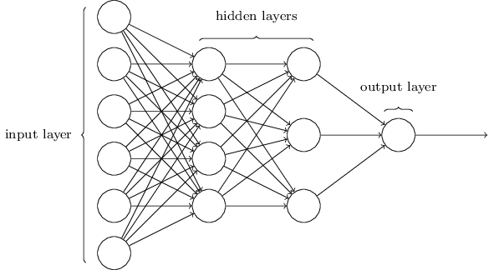
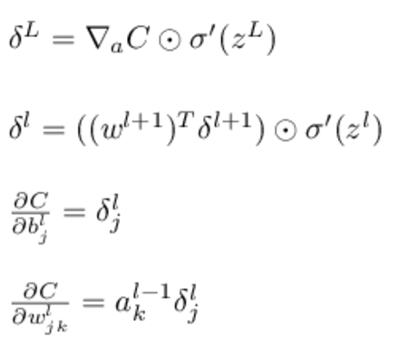
BackProp: summary
Level l for l=1,…,L
Matrix: w^{l}
Vectors:
bias b^{l}
activation a^{l}
pre-sigmoid activ: z^{l}
target output y
“local error”δ^{l}

Slide 6
Computation propagates errors backward
for l=1, 2, … L:
for l=L,L-1,…1:

Slide 7
Modern ANNs
Use of softmax and entropic loss instead of quadratic loss.
Use of alternate non-linearities
reLU and hyperbolic tangent
Better understanding of weight initialization
Ability to explore architectures rapidly

Slide 8
Deep Neural Network Toolkits: What’s Under the Hood?
How can we generalize BackProp to other ANNs?

Slide 9
Recap: weight updates for multilayer ANN
How can we generalize BackProp to other ANNs?
For nodes k in output layer:
“Propagate errors backward”
BACKPROP
For nodes j in hidden layer:
Can carry this recursion out further if you have multiple hidden layers
For all weights:

Slide 10
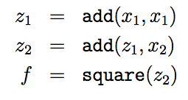
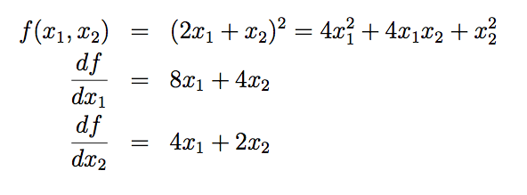

Slide 11
…

Slide 13
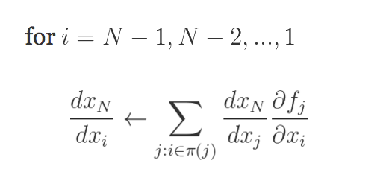
Generalizing backprop
https://justindomke.wordpress.com/
e.g.
Starting point: a function of n variables
Step 1: code your function as a series of assignments
Step 2: back propagate by going thru the list in reverse order, starting with…
…and using the chain rule
Step 1: forward
Wengert list
inputs:
return
Step 1: backprop
A function
Computed in previous step

Slide 14
Recap: logistic regression with SGD
Let X be a matrix with k examples
Let w_{i} be the input weights for the i-th hidden unit
Then Z = X W is output (pre-sigmoid) for all m units
for all k examples
w₁ | w₂ | w₃ | … | w_{m}
0.1 | -0.3 | …
-1.7 | …
0.3 | …
1.2
x₁ | 1 | 0 | 1 | 1
x₂ | …
…
x_{k}
There’s a lot of chances to do this in parallel…. with parallel matrix multiplication
x₁.w₁ | x₁.w₂ | … | x₁.w_{m}
x_{k}.w₁ | … | … | x_{k}.w_{m}
XW =

Slide 15
Example: 2-layer neural network
Step 1: forward
Step 1: backprop
inputs:
return
X is N*D, W1 is D*H, B1 is 1*H, W2 is H*K, …
Inputs: X,W1,B1,W2,B2
Z1a = mul(X,W1) // matrix mult
Z1b = add*(Z1a,B1) // add bias vec
A1 = tanh(Z1b) //element-wise
Z2a = mul(A1,W2)
Z2b = add*(Z2a,B2)
A2 = tanh(Z2b) // element-wise
P = softMax(A2) // vec to vec
C = crossEnt_{Y}(P) // cost function
Z1a is N*H
Z1b is N*H
A1 is N*H
Z2a is N*K
Z2b is N*K
A2 is N*K
P is N*K
C is a scalar
Target Y; N examples; K outs; D feats, H hidden

Slide 16
Example: 2-layer neural network
Step 1: forward
Step 1: backprop
inputs:
return
dC/dC = 1
dC/dP = dC/dC * dCrossEnt_{Y}/dP
dC/dA2 = dC/dP * dsoftmax/dA2
dC/Z2b = dC/dA2 * dtanh/dZ2b
dC/dZ2a = dC/dZ2b * dadd*/dZ2a
dC/dB2 = dC/dZ2b * dadd*/dB2
dC/dA1 = …
Inputs: X,W1,B1,W2,B2
Z1a = mul(X,W1) // matrix mult
Z1b = add*(Z1a,B1) // add bias vec
A1 = tanh(Z1b) //element-wise
Z2a = mul(A1,W2)
Z2b = add*(Z2a,B2)
A2 = tanh(Z2b) // element-wise
P = softMax(A2) // vec to vec
C = crossEnt_{Y}(P) // cost function
N*K
(N*K) * (K*K)
(N*K)
N*H
Target Y; N rows; K outs; D feats, H hidden

Slide 17
Example: 2-layer neural network
X
W1
mul
dC/dC = 1
dC/dP = dC/dC * dCrossEnt_{Y}/dP
dC/dA2 = dC/dP * dsoftmax/dA2
dC/dZ2b = dC/dA2 * dtanh/dZ2b
dC/dZ2a = dC/dZ2b * dadd*/dZ2a
dC/dB2 = dC/dZ2b * dadd*/dB2
dC/dA1 = dC/dZ2a *dmul/dA1
dC/dW2 = dC/dZ2a *dmul/dW2
dC/dZ1b = dC/dA1 * dtanh/dZ1b
dC/dZ1a = dC/dZ1b * dadd*/dZ1a
dC/dB1 = dC/dZ1b * dadd*/dB1
dC/dX = dC/dZ1a * dmul*/dZ1a
dC/dW1 = dC/dZ1a * dmul*/dW1
Z1a
B1
add
Z1b
tanh
W2
A1
mul
Z2a
B2
add
Z2b
tanh
A2
softmax
P
crossent_{Y}
C

Slide 18
Example: 2-layer neural network
Step 1: forward
Step 1: backprop
inputs:
return
dC/dC = 1
dC/dP = dC/dC * dCrossEnt_{Y}/dP
dC/dA2 = dC/dP * dsoftmax/dA2
dC/Z2b = dC/dA2 * dtanh/dZ2b
dC/dZ2a = dC/dZ2b * dadd*/dZ2a
dC/dB2 = dC/dZ2b * dadd*/dB2
dC/dA1 = …
N*K
Inputs: X,W1,B1,W2,B2
Z1a = mul(X,W1) // matrix mult
Z1b = add(Z11,B1) // add bias vec
A1 = tanh(Z1b) //element-wise
Z2a = mul(A1,W2)
Z2b = add(Z2a,B2)
A2 = tanh(Z2b) // element-wise
P = softMax(A2) // vec to vec
C = crossEnt_{Y}(P) // cost function
N*H
Need a backward form for each matrix operation used in forward
Target Y; N rows; K outs; D feats, H hidden

Slide 19
Example: 2-layer neural network
Step 1: forward
Step 1: backprop
inputs:
return
dC/dC = 1
dC/dP = dC/dC * dCrossEnt_{Y}/dP
dC/dA2 = dC/dP * dsoftmax/dA2
dC/Z2b = dC/dA2 * dtanh/dZ2b
dC/dZ2a = dC/dZ2b * dadd*/dZ2a
dC/dB2 = dC/dZ2b * dadd*/dB2
dC/dA1 = …
N*K
Inputs: X,W1,B1,W2,B2
Z1a = mul(X,W1) // matrix mult
Z1b = add(Z11,B1) // add bias vec
A1 = tanh(Z1b) //element-wise
Z2a = mul(A1,W2)
Z2b = add(Z2a,B2)
A2 = tanh(Z2b) // element-wise
P = softMax(A2) // vec to vec
C = crossEnt_{Y}(P) // cost function
N*H
Need a backward form for each matrix operation used in forward, with respect to each argument
Target Y; N rows; K outs; D feats, H hidden

Slide 20
Example: 2-layer neural network
Step 1: forward
inputs:
An autodiff package usually includes
A collection of matrix-oriented operations (mul, add*, …)
For each operation
A forward implementation
A backward implementation for each argument
It’s still a little awkward to program with a list of assignments so….
return
Inputs: X,W1,B1,W2,B2
Z1a = mul(X,W1) // matrix mult
Z1b = add(Z11,B1) // add bias vec
A1 = tanh(Z1b) //element-wise
Z2a = mul(A1,W2)
Z2b = add(Z2a,B2)
A2 = tanh(Z2b) // element-wise
P = softMax(A2) // vec to vec
C = crossEnt_{Y}(P) // cost function
N*H
Need a backward form for each matrix operation used in forward, with respect to each argument
Target Y; N rows; K outs; D feats, H hidden

Slide 21
Generalizing backprop
https://justindomke.wordpress.com/
Step 1: forward
Starting point: a function of n variables
Step 1: code your function as a series of assignments
inputs:
Wengert list
return
Better plan: overload your matrix operators so that when you use them in-line they build an expression graph
Convert the expression graph to a Wengert list when necessary

Slide 22
Some autodiff systems

Slide 23
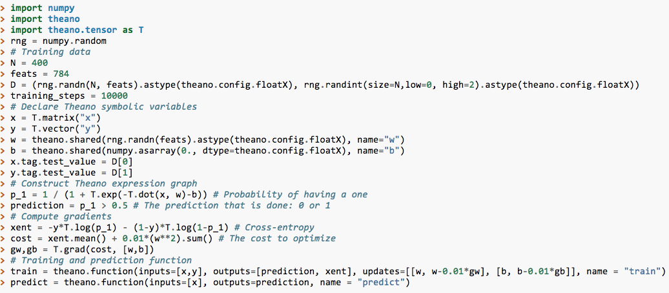
Example: Theano
… # generate some training data

Slide 24
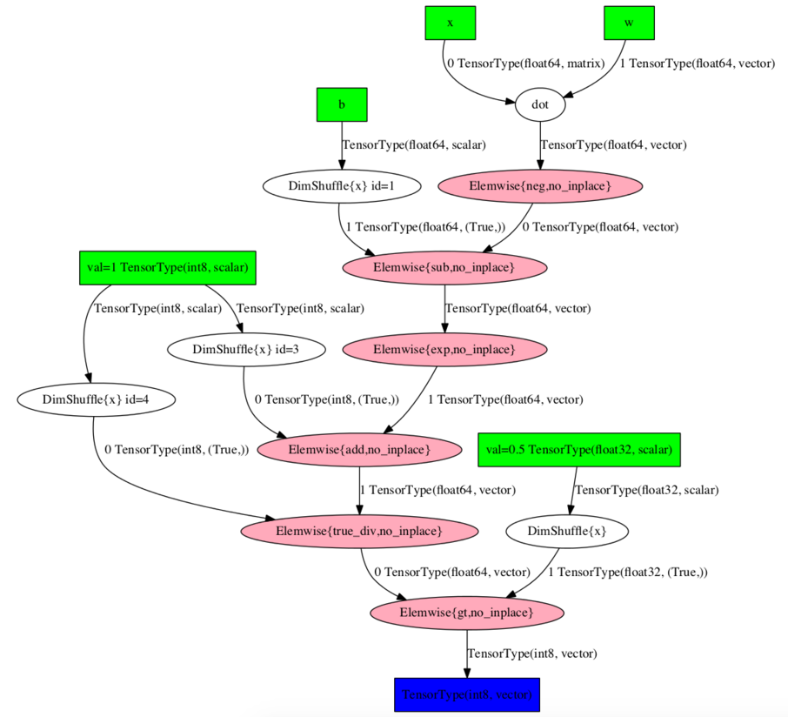
Example: Theano

Slide 25
p_1

Slide 26
Example: 2-layer neural network
Step 1: forward
inputs:
An autodiff package usually includes
A collection of matrix-oriented operations (mul, add*, …)
For each operation
A forward implementation
A backward implementation for each argument
A way of composing operations into expressions (often using operator overloading) which evaluate to expression trees
Expression simplification/compilation
return
Inputs: X,W1,B1,W2,B2
Z1a = mul(X,W1) // matrix mult
Z1b = add(Z11,B1) // add bias vec
A1 = tanh(Z1b) //element-wise
Z2a = mul(A1,W2)
Z2b = add(Z2a,B2)
A2 = tanh(Z2b) // element-wise
P = softMax(A2) // vec to vec
C = crossEnt_{Y}(P) // cost function
N*H

Slide 27
Some tools that use autodiff
Theano:
Univ Montreal system, Python-based, first version 2007 now v0.8, integrated with GPUs
Many libraries build over Theano (Lasagne, Keras, Blocks..)
Torch:
Collobert et al, used heavily at Facebook, based on Lua. Similar performance-wise to Theano
TensorFlow:
Google system
Also supported by Keras
Autograd
New system which is very Pythonic, doesn’t support GPUs (yet)
…

Slide 28
Breaking down autodiff

Slide 29
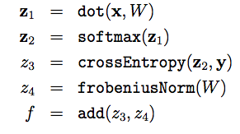
Walkthru of an Autodiff Program
Matrix and vector operations are very useful

Slide 30
Walkthru of an Autodiff Program
Matrix and vector operations are very useful

Slide 31
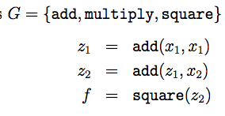
Walkthru of an Autodiff Program
Matrix and vector operations are very useful…but lets start with some simple scalar operations.
Python encoding

Slide 32
The Interesting Part: Evaluation and Differentiation of a Wengert list
To compute f(3,7):

Slide 33
The Interesting Part: Evaluation and Differentiation of a Wengert list
To compute f(3,7):
Populated with call to “eval”

Slide 34
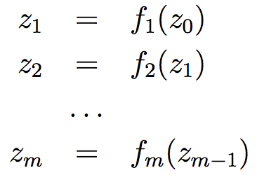
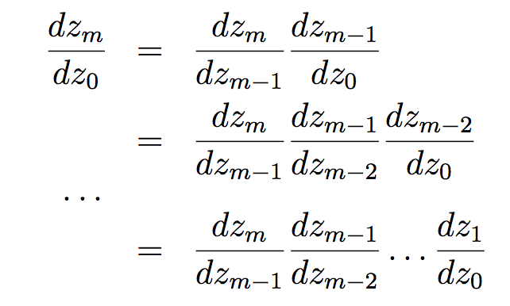
Differentiating a Wengert list: a simple case
Notation:
→

Slide 35
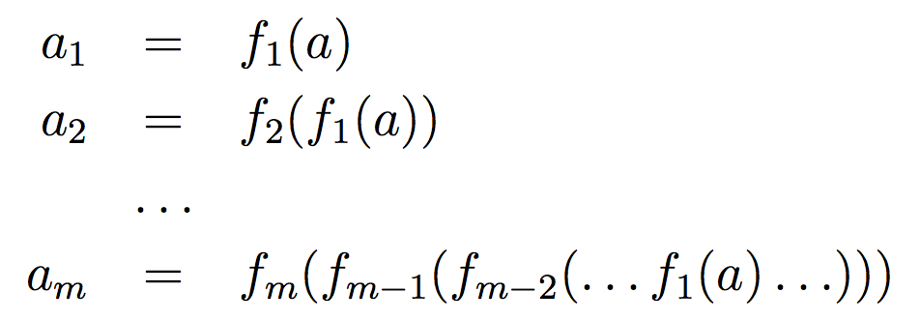
Differentiating a Wengert list: a simple case
a_{i} is the i-th ouput
on input a
Notation:
→

Slide 36
Differentiating a Wengert list: a simple case
for all a
m-1,0
Notation:
→

Slide 37
Differentiating a Wengert list: a simple case
for all a
Notation:
→

Slide 38
Differentiating a Wengert list: a simple case
for all a
backprop routine compute order

Slide 39
Differentiating a Wengert list

Slide 40
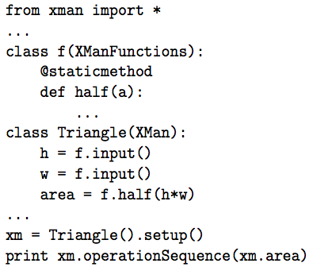
The Tricky Part: Constructing a List
Goal: write code like this:
Add your problem-specific functions: but just the syntax, not the G and DG definitions
Define the function to optimize with gradient descent
Use your function

Slide 41
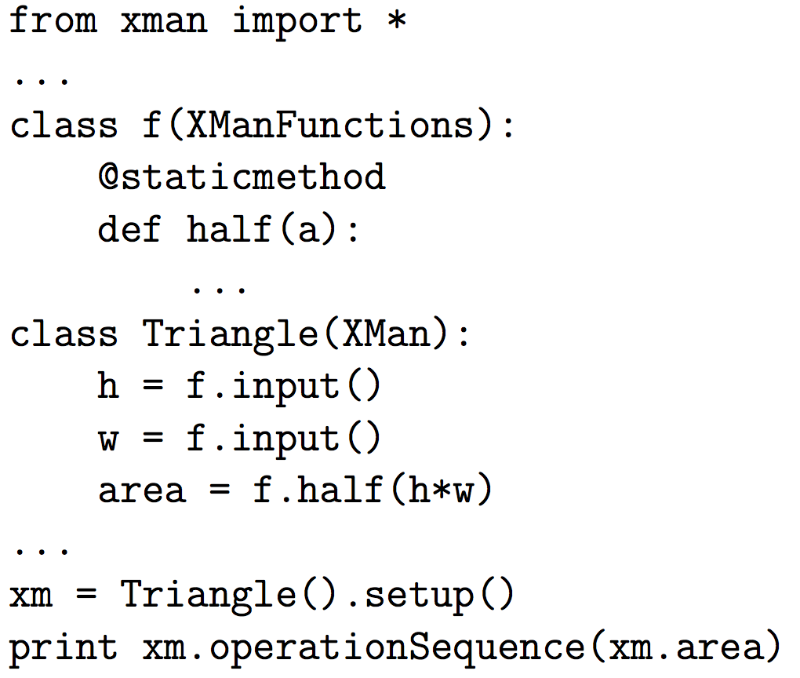
Python code to create a Wengert list
h, w, area are registers
also an automatically-named register z1 to hold h*w

Slide 42
Python code to create a Wengert list
name | “h”
role | “input”
some Python hacking can use the class variable name ‘area’ and insert it into the ‘name’ field of a register
name | “w”
role | “input”
z1
name
role | “opOut”
defAs | O1
name | “area”
role | “opOut”
defAs | O2
and invert names for the others at setup() time

Slide 43
Python code to create a Wengert list
“half” is an operator
so is “mul” --- h*w ➔ mul(h,w)
each instance of an operator points to registers that are arguments and outputs

Slide 44
Python code to create a Wengert list
name | “h”
role | “input”
h, w are registers;
mul() generates an operator
name | “w”
role | “input”
name | z1
role | “opOut”
defAs | O1
args | [A1,A2]
fun | “mul”
output | R3
name | “area”
role | “opOut”
defAs | O2
args | [A1]
fun | “half”
output | R4

Slide 45
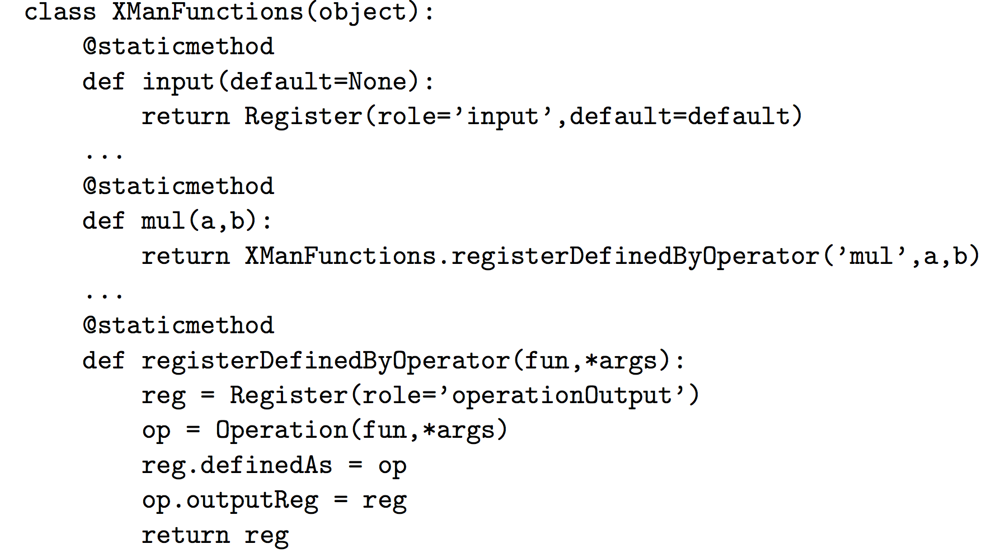
Python code to create a Wengert list
name | “area”
role | “opOut”
defAs | O2
args | [A1]
fun | “half”
output | R4

Slide 46
Even more detail….

Slide 47
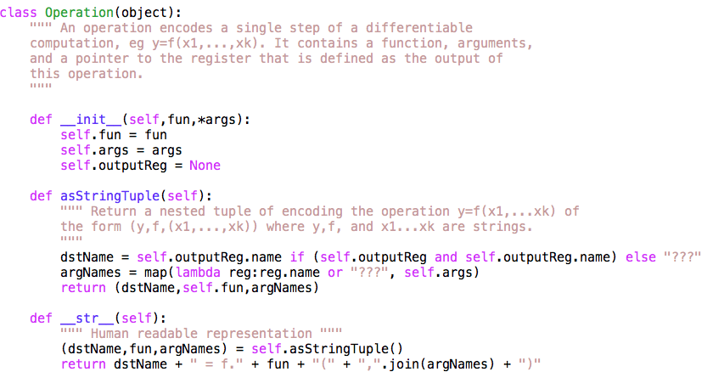
More detail: xman.py

Slide 48
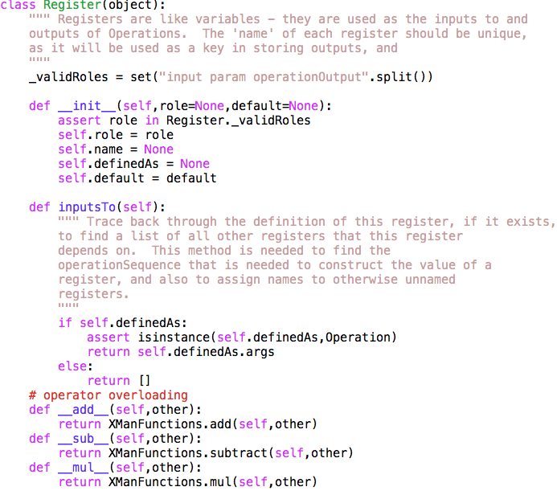
More detail

Slide 49
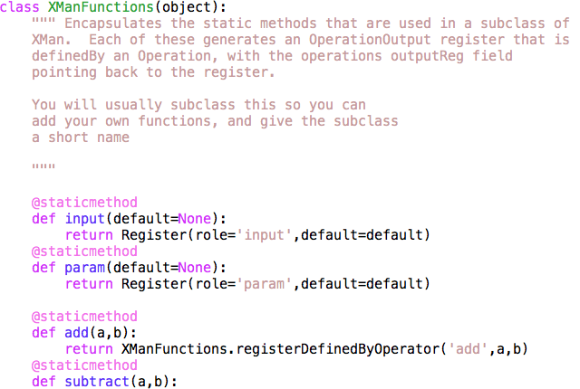
…
…
name | “area”
role | “opOut”
defAs | O2
args | [A1]
fun | “half”
output | R4

Slide 50
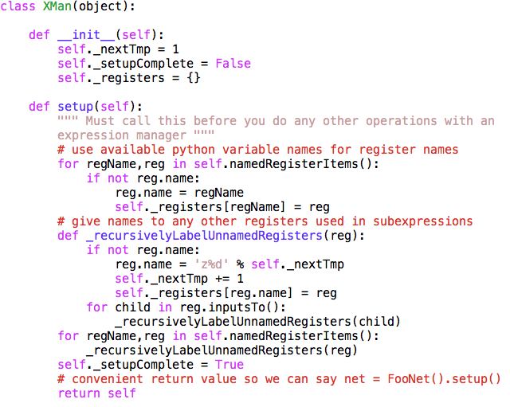
…

Slide 51
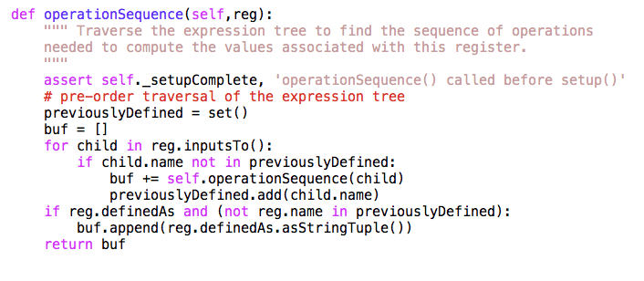
…

Slide 52
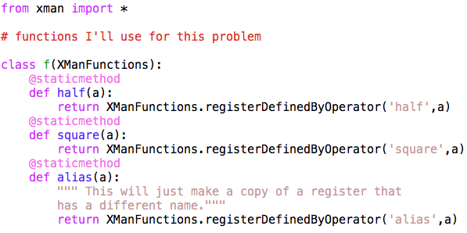
Using xman.py

Slide 53
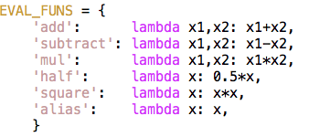
Using xman.py

Slide 54
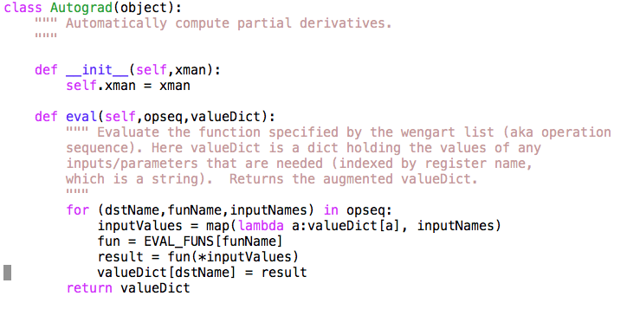
Using xman.py

Slide 55
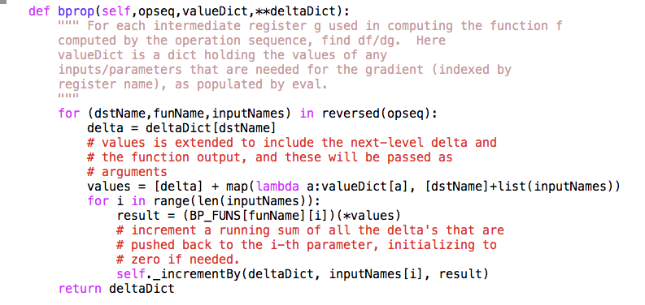
Using xman.py
…

Slide 56
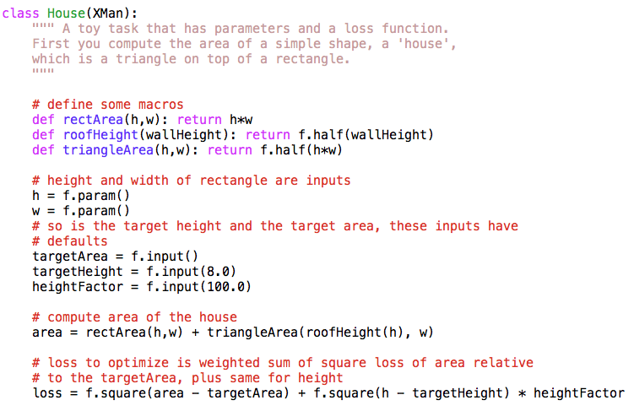
Using xman.py – like Guinea Pig

Slide 57
Using xman.py

Slide 58
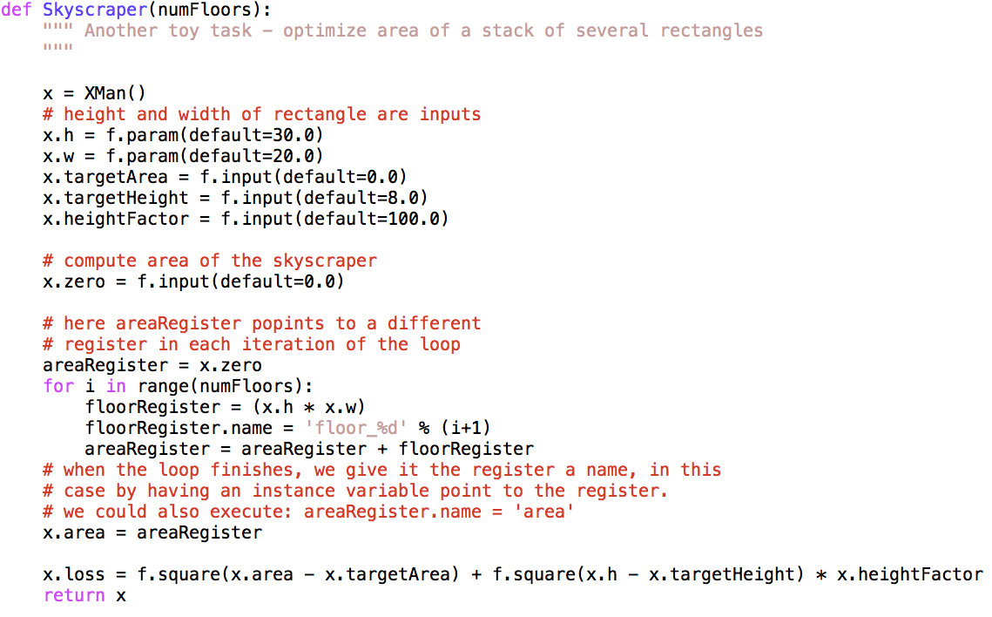
An Xman instance and a loop

Slide 59
Modern ANNs
Use of softmax and entropic loss instead of quadratic loss.
Use of alternate non-linearities
reLU and hyperbolic tangent
Better understanding of weight initialization
Ability to explore architectures rapidly

Slide 60
Recurrent Neural Networks

Slide 61
Motivation: what about sequence prediction?
What can I do when input size and output size vary?

Slide 62
Motivation: what about sequence prediction?
h
A
x

Slide 63
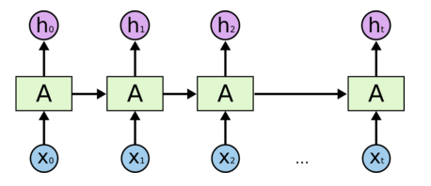
Architecture for an RNN
Some information is passed from one subunit to the next
Sequence of outputs
Sequence of inputs
Start of sequence marker
End of sequence marker
http://colah.github.io/posts/2015-08-Understanding-LSTMs/

Slide 64
Architecture for an 1980’s RNN
…
Problem with this: it’s extremely deep and very hard to train

Slide 65
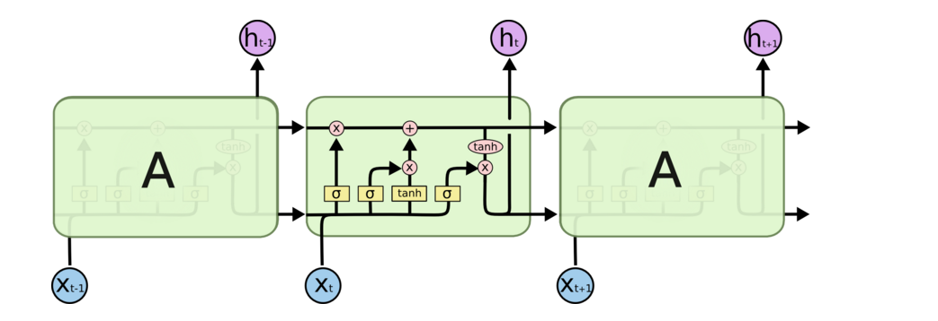
Architecture for an LSTM
“Bits of memory”
Decide what to forget
Decide what to insert
Longterm-short term model
Combine with transformed x_{t}
σ: output in [0,1]
tanh: output in [-1,+1]
http://colah.github.io/posts/2015-08-Understanding-LSTMs/
Notes:
Info is transferred down the chain, not just propagated
Decide when to insert imformation from input into the “backbone”

Slide 66
Walkthrough
What part of memory to “forget” – zero means forget this bit

Slide 67
Walkthrough
What bits to insert into the next states
What content to store into the next state
http://colah.github.io/posts/2015-08-Understanding-LSTMs/

Slide 68
Walkthrough
Next memory cell content – mixture of not-forgotten part of previous cell and insertion
http://colah.github.io/posts/2015-08-Understanding-LSTMs/

Slide 69
Walkthrough
What part of cell to output
tanh maps bits to [-1,+1] range
http://colah.github.io/posts/2015-08-Understanding-LSTMs/

Slide 70
Architecture for an LSTM
(1)
(2)
C_{t-1}
(3)
i_{t}
o_{t}
f_{t}
http://colah.github.io/posts/2015-08-Understanding-LSTMs/
Notes:
Info is transferred down the chain, not just propagated
Decide when to insert imformation from input into the “backbone”

Slide 71
Implementing an LSTM
For t = 1,…,T:
(1)
(2)
(3)
http://colah.github.io/posts/2015-08-Understanding-LSTMs/
Notes:
Info is transferred down the chain, not just propagated
Decide when to insert imformation from input into the “backbone”

Slide 72
Some Fun LSTM Examples
http://karpathy.github.io/2015/05/21/rnn-effectiveness/

Slide 73
LSTMs can be used for other sequence tasks
image captioning
sequence classification
named entity recognition
translation
http://karpathy.github.io/2015/05/21/rnn-effectiveness/

Slide 74
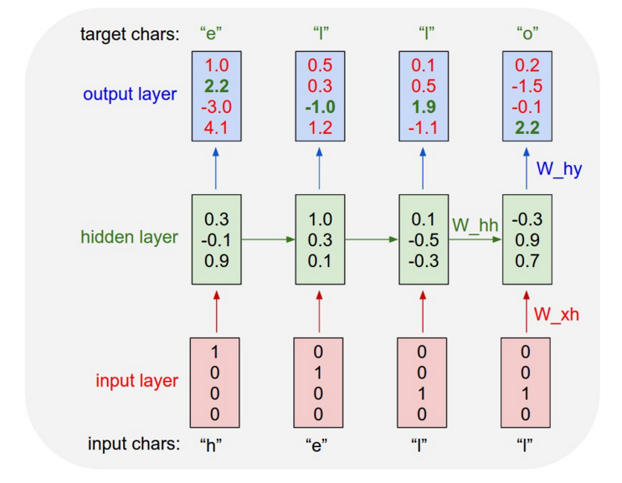
Character-level language model
Test time:
pick a seed character sequence
generate the next character
then the next
then the next …
http://karpathy.github.io/2015/05/21/rnn-effectiveness/

Slide 75
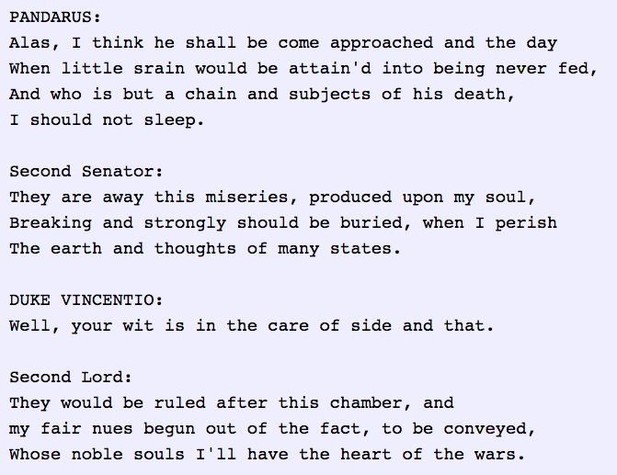
Character-level language model
http://karpathy.github.io/2015/05/21/rnn-effectiveness/

Slide 76
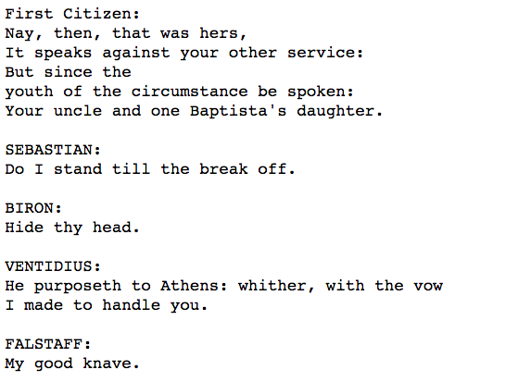
Character-level language model
Yoav Goldberg:
order-10 unsmoothed character n-grams
http://karpathy.github.io/2015/05/21/rnn-effectiveness/

Slide 77
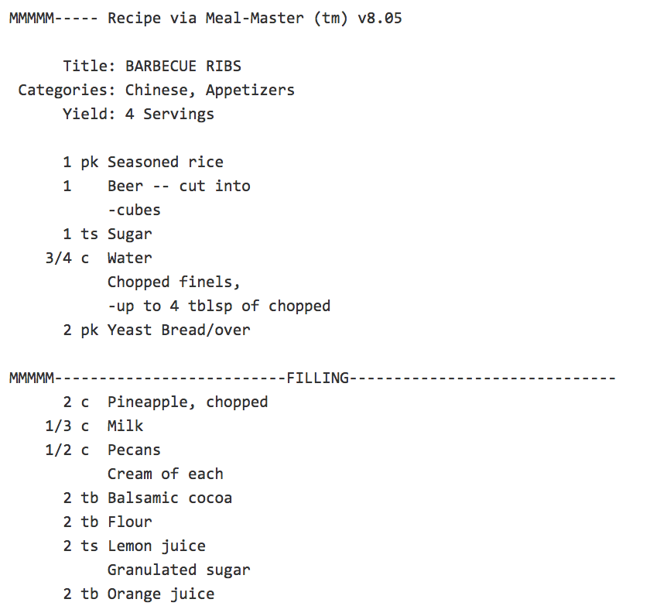
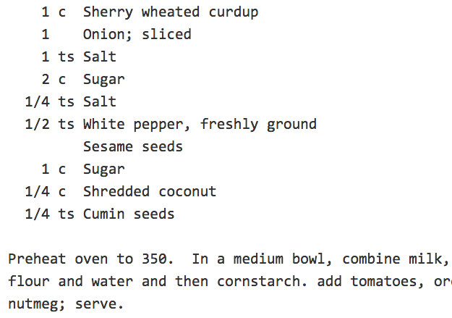
Character-level language model
http://karpathy.github.io/2015/05/21/rnn-effectiveness/

Slide 78
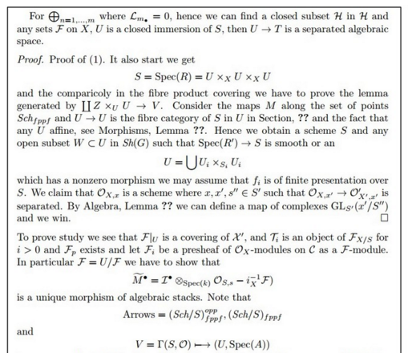
Character-level language model
LaTeX “almost compiles”
http://karpathy.github.io/2015/05/21/rnn-effectiveness/

Slide 79
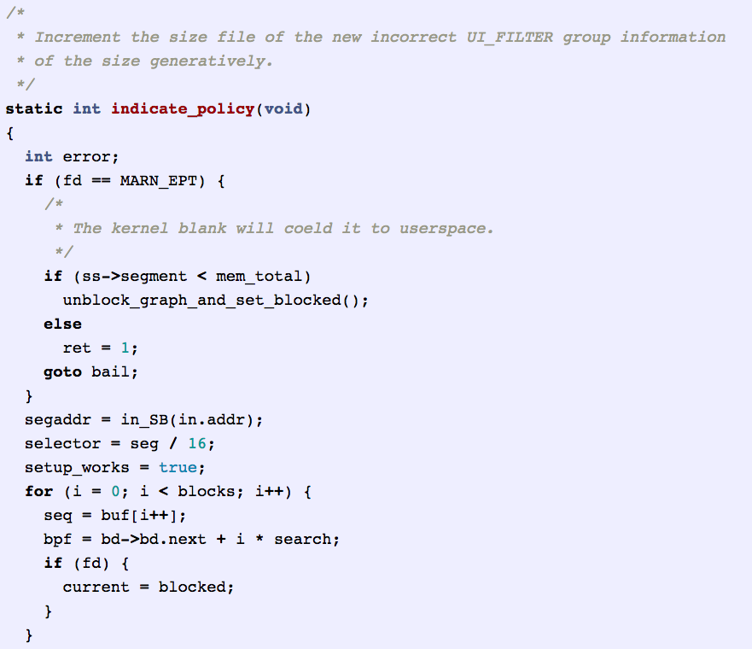
Character-level language model
http://karpathy.github.io/2015/05/21/rnn-effectiveness/

Slide 80
Convolutional Neural Networks

Slide 81
Model of vision in animals

Slide 82
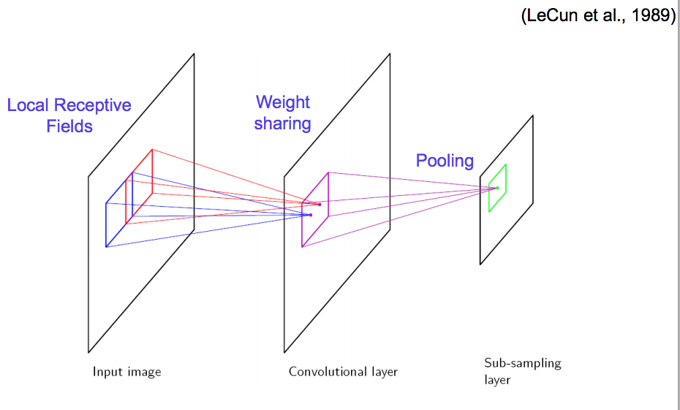
Vision with ANNs

Slide 83
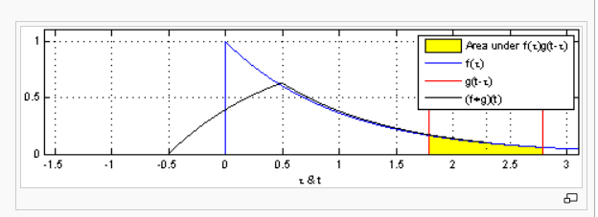
What’s a convolution?
https://en.wikipedia.org/wiki/Convolution
1-D

Slide 84
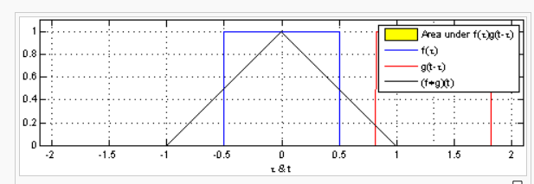
What’s a convolution?
https://en.wikipedia.org/wiki/Convolution
1-D

Slide 85
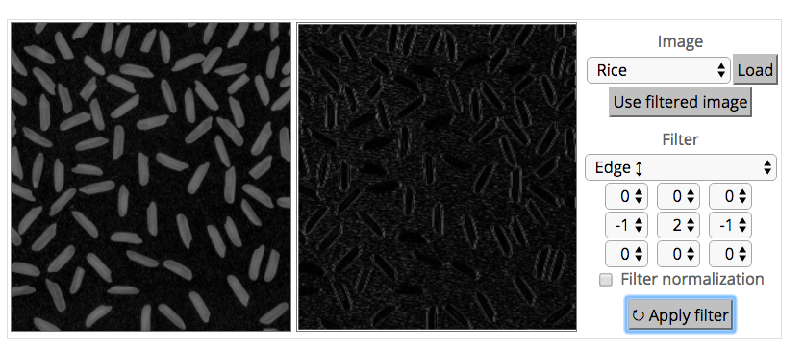
What’s a convolution?
http://matlabtricks.com/post-5/3x3-convolution-kernels-with-online-demo

Slide 86
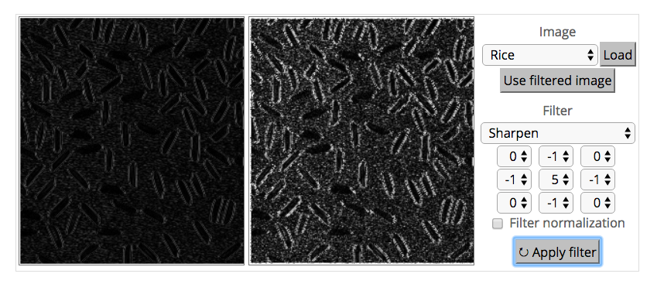
What’s a convolution?
http://matlabtricks.com/post-5/3x3-convolution-kernels-with-online-demo

Slide 87
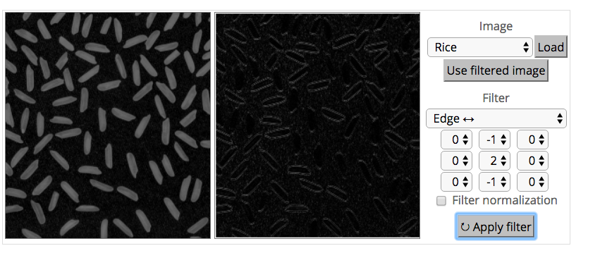
What’s a convolution?
http://matlabtricks.com/post-5/3x3-convolution-kernels-with-online-demo

Slide 88
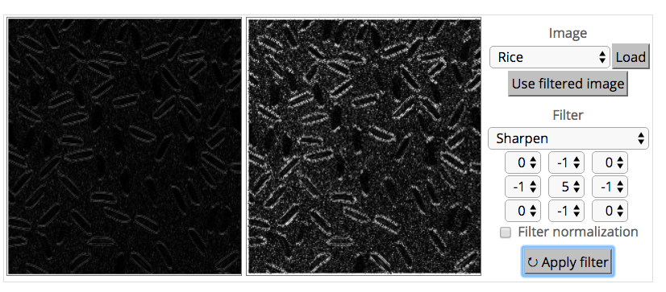
What’s a convolution?
http://matlabtricks.com/post-5/3x3-convolution-kernels-with-online-demo

Slide 89
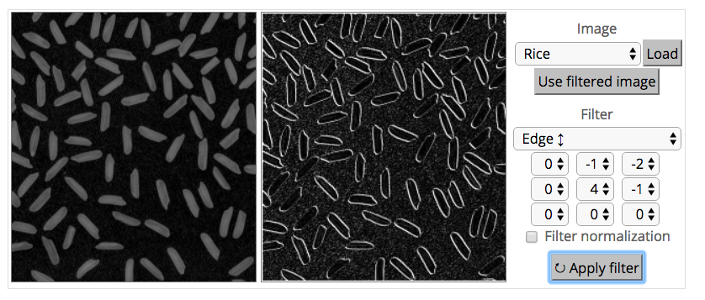
What’s a convolution?
http://matlabtricks.com/post-5/3x3-convolution-kernels-with-online-demo

Slide 90
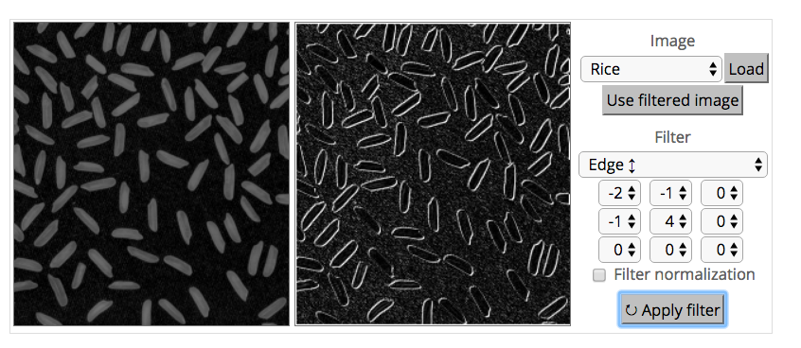
What’s a convolution?
http://matlabtricks.com/post-5/3x3-convolution-kernels-with-online-demo

Slide 91
What’s a convolution?
Basic idea:
Pick a 3-3 matrix F of weights
Slide this over an image and compute the “inner product” (similarity) of F and the corresponding field of the image, and replace the pixel in the center of the field with the output of the inner product operation
Key point:
Different convolutions extract different types of low-level “features” from an image
All that we need to vary to generate these different features is the weights of F

Slide 92
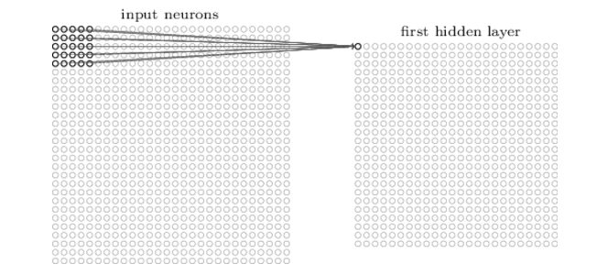
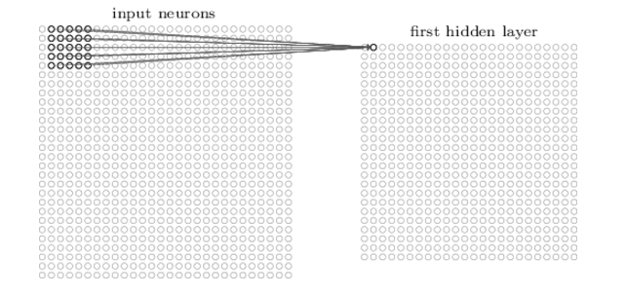
How do we convolve an image with an ANN?
Note that the parameters in the matrix defining the convolution are tied across all places that it is used

Slide 93
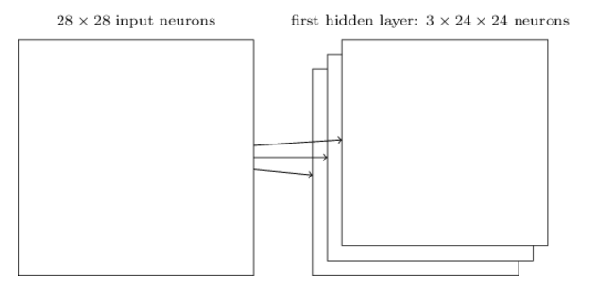
How do we do many convolutions of an image with an ANN?

Slide 94
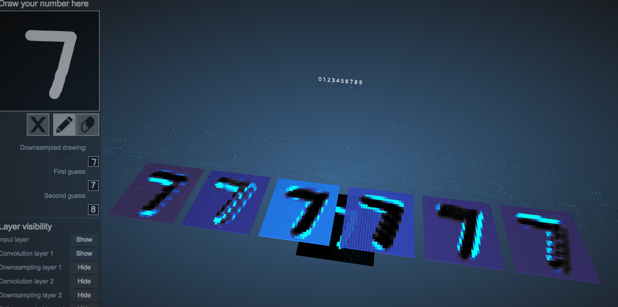
Example: 6 convolutions of a digit
http://scs.ryerson.ca/~aharley/vis/conv/

Slide 95
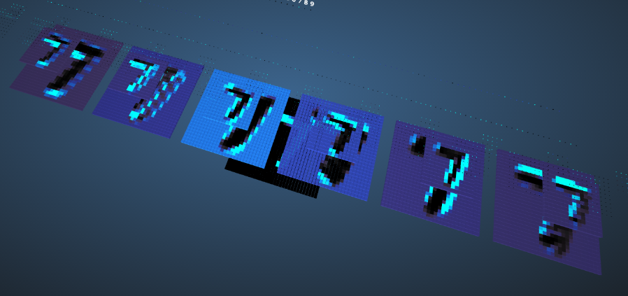
CNNs typically alternate convolutions, non-linearity, and then downsampling
Downsampling is usually averaging or (more common in recent CNNs) max-pooling

Slide 96
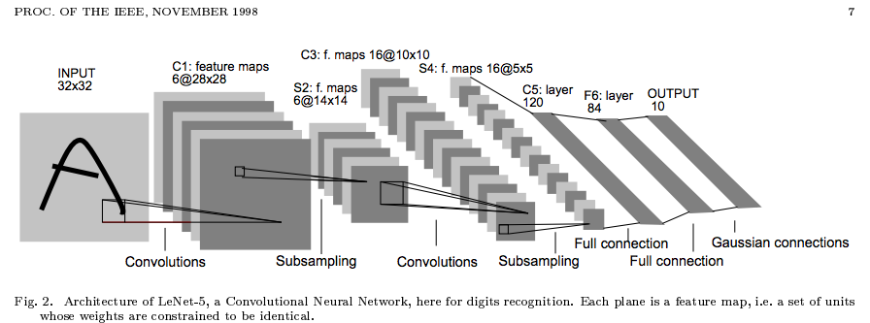
Why do max-pooling?
Saves space
Reduces overfitting?
Because I’m going to add more convolutions after it!
Allows the short-range convolutions to extend over larger subfields of the images
So we can spot larger objects
Eg, a long horizontal line, or a corner, or …

Slide 97
Another CNN visualization
https://cs.stanford.edu/people/karpathy/convnetjs/demo/mnist.html

Slide 100
Why do max-pooling?
Saves space
Reduces overfitting?
Because I’m going to add more convolutions after it!
Allows the short-range convolutions to extend over larger subfields of the images
So we can spot larger objects
Eg, a long horizontal line, or a corner, or …
At some point the feature maps start to get very sparse and blobby – they are indicators of some semantic property, not a recognizable transformation of the image
Then just use them as features in a “normal” ANN

Slide 101
Why do max-pooling?
Saves space
Reduces overfitting?
Because I’m going to add more convolutions after it!
Allows the short-range convolutions to extend over larger subfields of the images
So we can spot larger objects
Eg, a long horizontal line, or a corner, or …

Slide 102
Alternating convolution and downsampling
5 layers up
The subfield in a large dataset that gives the strongest output for a neuron

