Slide 1
A Quick Overview of Probability
William W. Cohen
Machine Learning 10-605

Slide 2
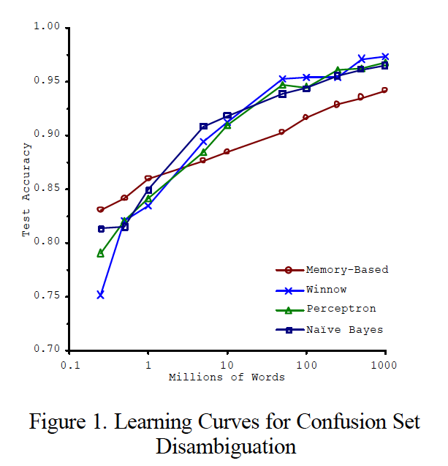
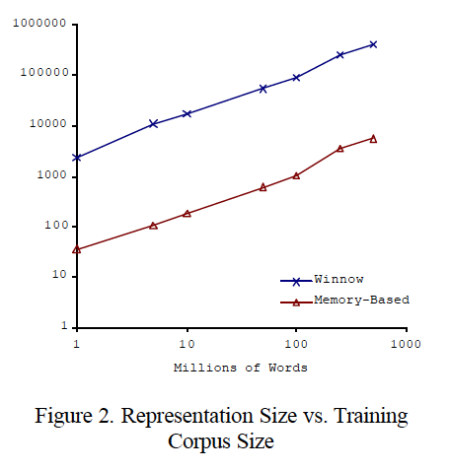
Big ML c. 2001 (Banko & Brill, “Scaling to Very Very Large…”, ACL 2001)
Task: distinguish pairs of easily-confused words (“affect” vs “effect”) in context

Slide 3
Twelve years later….
Starting point: Google books 5-gram data
  All 5-grams that appear >= 40 times in a corpus of 1M English books
    approx 80B words
    5-grams: 30Gb compressed, 250-300Gb uncompressed
    Each 5-gram contains frequency distribution over years
  Wrote code to compute
    Pr(A,B,C,D,E|C=affect or C=effect)
    Pr(any subset of A,…,E|any other fixed values of A,…,E with C=affect V effect)

Slide 5
Tuesday’s Lecture - Review
Intro
  Who, Where, When - administrivia
  Why – motivations
  What/How – assignments, grading, …
  Review - How to count and what to count
  Big-O and Omega notation, example, …
  Costs of i/o vs computation
What sort of computations do we want to do in (large-scale) machine learning programs?
  Probability

Slide 6
Probability - what you need to really, really know
Probabilities are cool
Random variables and events
The Axioms of Probability
Independence, binomials, multinomials
Conditional probabilities
Bayes Rule
MLE’s, smoothing, and MAPs
The joint distribution

Slide 7
The Joint Distribution
Example: Boolean variables A, B, C
Recipe for making a joint distribution of M variables:
Make a truth table listing all combinations of values of your variables (if there are M Boolean variables then the table will have 2^{M} rows).
A | B | C
0 | 0 | 0
0 | 0 | 1
0 | 1 | 0
0 | 1 | 1
1 | 0 | 0
1 | 0 | 1
1 | 1 | 0
1 | 1 | 1

Slide 8
The Joint Distribution
Example: Boolean variables A, B, C
Recipe for making a joint distribution of M variables:
Make a truth table listing all combinations of values of your variables (if there are M Boolean variables then the table will have 2^{M} rows).
For each combination of values, say how probable it is.
A | B | C | Prob
0 | 0 | 0 | 0.30
0 | 0 | 1 | 0.05
0 | 1 | 0 | 0.10
0 | 1 | 1 | 0.05
1 | 0 | 0 | 0.05
1 | 0 | 1 | 0.10
1 | 1 | 0 | 0.25
1 | 1 | 1 | 0.10

Slide 9
The Joint Distribution
Example: Boolean variables A, B, C
Recipe for making a joint distribution of M variables:
Make a truth table listing all combinations of values of your variables (if there are M Boolean variables then the table will have 2^{M} rows).
For each combination of values, say how probable it is.
If you subscribe to the axioms of probability, those numbers must sum to 1.
A | B | C | Prob
0 | 0 | 0 | 0.30
0 | 0 | 1 | 0.05
0 | 1 | 0 | 0.10
0 | 1 | 1 | 0.05
1 | 0 | 0 | 0.05
1 | 0 | 1 | 0.10
1 | 1 | 0 | 0.25
1 | 1 | 1 | 0.10
A
0.05
0.10
0.05
0.10
0.25
0.05
C
B
0.10
0.30

Slide 10
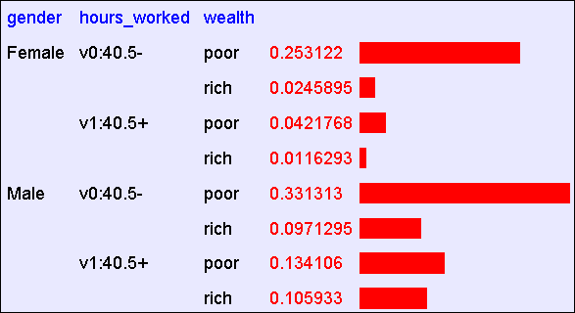
Using the Joint
One you have the JD you can ask for the probability of any logical expression involving your attribute
Abstract: Predict whether income exceeds $50K/yr based on census data. Also known as "Census Income" dataset. [Kohavi, 1996]
Number of Instances: 48,842
Number of Attributes: 14 (in UCI’s copy of dataset); 3 (here)

Slide 11
Using the Joint
P(Poor Male) = 0.4654

Slide 12
Using the Joint
P(Poor) = 0.7604

Slide 13
Probability - what you need to really, really know
Probabilities are cool
Random variables and events
The Axioms of Probability
Independence, binomials, multinomials
Conditional probabilities
Bayes Rule
MLE’s, smoothing, and MAPs
The joint distribution
Inference

Slide 14
Inference with the Joint

Slide 15
Inference with the Joint
P(Male | Poor) = 0.4654 / 0.7604 = 0.612

Slide 16
Estimating the joint distribution
Collect some data points
Estimate the probability P(E1=e1 ^ … ^ En=en) as #(that row appears)/#(any row appears)
….
Gender | Hours | Wealth
g1 | h1 | w1
g2 | h2 | w2
.. | … | …
gN | hN | wN

Slide 17
Estimating the joint distribution
For each combination of values r:
  Total = C[r] = 0
For each data row r_{i}
  C[r_{i}] ++
  Total ++
Complexity?
O(2^{d})
d = #attributes (all binary)
Complexity?
O(n)
n = total size of input data
Gender | Hours | Wealth
g1 | h1 | w1
g2 | h2 | w2
.. | … | …
gN | hN | wN
= C[r_{i}]/Total
r_{i} is “female,40.5+, poor”

Slide 18
Estimating the joint distribution
For each combination of values r:
  Total = C[r] = 0
For each data row r_{i}
  C[r_{i}] ++
  Total ++
Complexity?
k_{i} = arity of attribute i
Complexity?
O(n)
n = total size of input data
Gender | Hours | Wealth
g1 | h1 | w1
g2 | h2 | w2
.. | … | …
gN | hN | wN

Slide 19
Estimating the joint distribution
For each combination of values r:
  Total = C[r] = 0
For each data row r_{i}
  C[r_{i}] ++
  Total ++
Complexity?
k_{i} = arity of attribute i
Complexity?
O(n)
n = total size of input data
Gender | Hours | Wealth
g1 | h1 | w1
g2 | h2 | w2
.. | … | …
gN | hN | wN

Slide 20
Estimating the joint distribution
For each data row r_{i}
  If r_{i} not in hash tables C,Total:
    Insert C[r_{i}] = 0
  C[r_{i}] ++
  Total ++
Complexity?
O(m)
m = size of the model
Complexity?
O(n)
n = total size of input data
Gender | Hours | Wealth
g1 | h1 | w1
g2 | h2 | w2
.. | … | …
gN | hN | wN

Slide 21
Another example….

Slide 22
Big ML c. 2001 (Banko & Brill, “Scaling to Very Very Large…”, ACL 2001)
Task: distinguish pairs of easily-confused words (“affect” vs “effect”) in context

Slide 23
An experiment
Starting point: Google books 5-gram data
  All 5-grams that appear >= 40 times in a corpus of 1M English books
    approx 80B words
    5-grams: 30Gb compressed, 250-300Gb uncompressed
    Each 5-gram contains frequency distribution over years
  Extract all 5-grams from books published before 2000 that contain ‘effect’ or ‘affect’ in middle position
    about 20 “disk hours”
    approx 100M occurrences
    approx 50k distinct n-grams --- not big
  Wrote code to compute
    Pr(A,B,C,D,E|C=affect or C=effect)
    Pr(any subset of A,…,E|any other subset,C=affect V effect)

Slide 24
Some of the Joint Distribution
A | B | C | D | E | p
is | the | effect | of | the | 0.00036
is | the | effect | of | a | 0.00034
. | The | effect | of | this | 0.00034
to | this | effect | : | “ | 0.00034
be | the | effect | of | the | …
 | … | … | … | … | …
not | the | effect | of | any | 0.00024
 | … | … | … | … | …
does | not | affect | the | general | 0.00020
does | not | affect | the | question | 0.00020
any | manner | affect | the | principle | 0.00018

Slide 25
Another experiment
Extracted all affect/effect 5-grams from the old (small) Reuters corpus
  about 20k documents
  about 723 n-grams, 661 distinct
  Financial news, not novels or textbooks
Tried to predict center word with:
  Pr(C|A=a,B=b,D=d,E=e)
  then P(C|A,B,D,C=effect V affect)
  then P(C|B,D, C=effect V affect)
  then P(C|B, C=effect V affect)
  then P(C, C=effect V affect)

Slide 26
EXAMPLES
“The cumulative _ of the” → effect (1.0)
“Go into _ on January” → effect (1.0)
“From cumulative _ of accounting” not present
  Nor is ““From cumulative _ of _”
  But “_ cumulative _ of _” → effect (1.0)
“Would not _ Finance Minister” not present
  But “_ not _ _ _” → affect (0.9625)

Slide 27
Performance summary
Pattern | Used | Errors
P(C|A,B,D,E) | 101 | 1
P(C|A,B,D) | 157 | 6
P(C|B,D) | 163 | 13
P(C|B) | 244 | 78
P(C) | 58 | 31

Slide 28
Probability - what you need to really, really know
Probabilities are cool
Random variables and events
The Axioms of Probability
Independence, binomials, multinomials
Conditional probabilities
Bayes Rule
MLE’s, smoothing, and MAPs
The joint distribution
Inference
Density estimation and classification

Slide 29
Density Estimation
Our Joint Distribution learner is our first example of something called Density Estimation
A Density Estimator learns a mapping from a set of attributes values to a Probability
Input
Attributes
Density
Estimator
Probability

Slide 30
Density Estimation
Compare it against the two other major kinds of models:
Input
Attributes
Classifier
Prediction of
categorical output or class
One of a few discrete values
Input
Attributes
Density
Estimator
Probability
Input
Attributes
Regressor
Prediction of
real-valued output

Slide 31
Density Estimation ➔ Classification
Input
Attributes
x
Classifier
Prediction of
categorical output
One of y1, …., yk
Input
Attributes
Density
Estimator
^
P(x,y)
Class
To classify x
Use your estimator to compute P(x,y1), …., P(x,yk)
Return the class y* with the highest predicted probability
^
^
Binary case: predict POS if P(x)>0.5
^
^
^
^
^
Ideally is correct with P(x,y*) = P(x,y*)/(P(x,y1) + …. + P(x,yk))

Slide 32
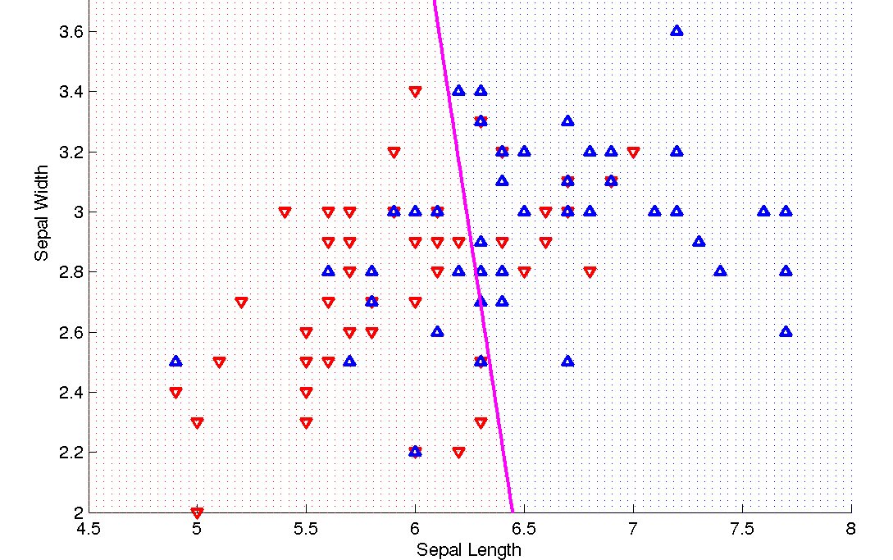
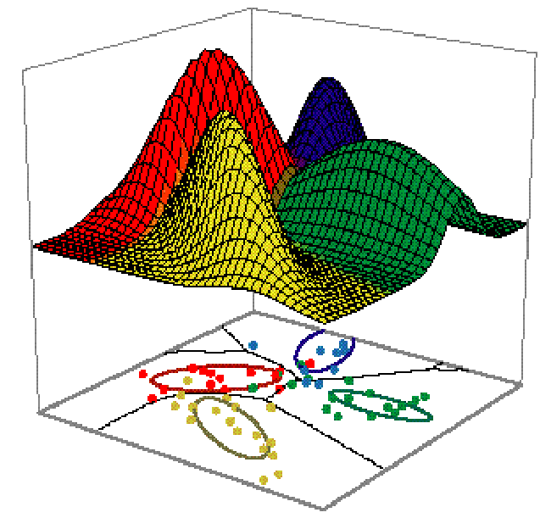
Classification vs Density Estimation
Classification
Density Estimation

Slide 33

Classification vs density estimation

