Slide 1


Slide 2
Announcements
My office hours: Tues 4pm
Wed: guest lecture, Matt Hurst, Bing Local Search

Slide 3
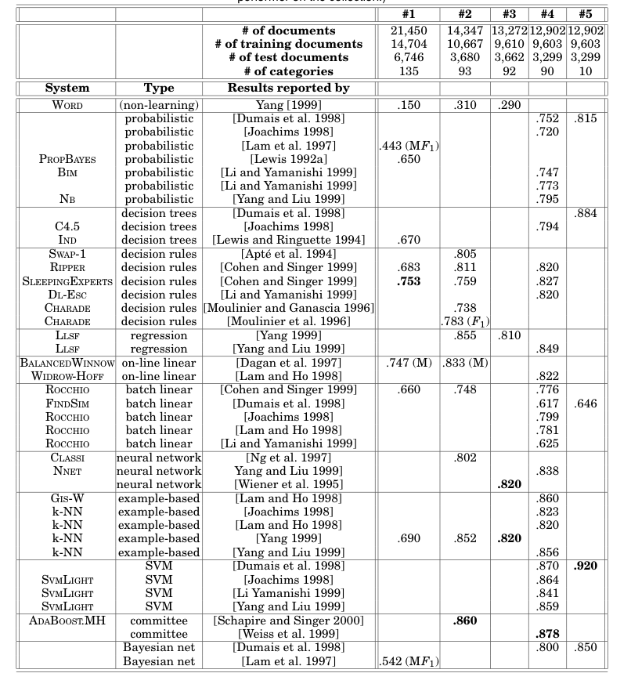
Notes:
Sebastiani’s survey

Slide 4
Parallel Rocchio - pass 1
“extra” work in parallel version
Documents/labels
Split into documents subsets
Documents/labels – 1
Documents/labels – 2
Documents/labels – 3
Compute DFs
DFs -1
DFs - 2
DFs -3
Sort and add counts
DFs
Notes:
Rennie, Shih, Teevan, and Karger (2003) Tackling the Poor Assumptions of Naive Bayes Text Classifiers.
lingpipe-blog.com/.../rennie-shih-teevan-and-karger-2003-tackling-p...
Feb 16, 2009 – Rennie, Shih, Teevan, Karger (2003) Tackling the Poor Assumptions of Naive Bayes Text Classifiers. In ICML. Rennie et al. introduce four ...
Tackling the - AAAI

Slide 5
Parallel Rocchio - pass 2
extra work in parallel version
DFs
Documents/labels
Split into documents subsets
Documents/labels – 1
Documents/labels – 2
Documents/labels – 3
Compute partial v(y)’s
v-1
v-2
v-3
Sort and add vectors
v(y)’s
Notes:
Rennie, Shih, Teevan, and Karger (2003) Tackling the Poor Assumptions of Naive Bayes Text Classifiers.
lingpipe-blog.com/.../rennie-shih-teevan-and-karger-2003-tackling-p...
Feb 16, 2009 – Rennie, Shih, Teevan, Karger (2003) Tackling the Poor Assumptions of Naive Bayes Text Classifiers. In ICML. Rennie et al. introduce four ...
Tackling the - AAAI

Slide 6
Limitations of Naïve Bayes/Rocchio
This isn’t silly – often there are features that are “noisy” duplicates, or important phrases of different length
Naïve Bayes: one pass
Rocchio: two passes
  if vocabulary fits in memory
Both method are algorithmically similar
  count and combine
Thought thought thought thought thought thought thought thought thought thought experiment: what if we duplicated some features in our dataset many times times times times times times times times times times?
  e.g., Repeat all words that start with “t” “t” “t” “t” “t” “t” “t” “t” “t” “t” ten ten ten ten ten ten ten ten ten ten times times times times times times times times times times.
  Result: those features will be over-weighted in classifier by a factor of 10

Slide 7
One simple way to look for interactions
Naïve Bayes
sparse vector of TF values for each word in the document…plus a “bias” term for f(y)
dense vector of g(x,y) scores for each word in the vocabulary .. plus f(y) to match bias term

Slide 8
One simple way to look for interactions
Scan thru data:
whenever we see x with y we increase g(x,y)-g(x,~y)
whenever we see x with ~y we decrease g(x,y)-g(x,~y)
Naïve Bayes – two class version
To detect interactions:
increase/decrease g(x,y)-g(x,~y) only if we need to (for that example)
otherwise, leave it unchanged
dense vector of g(x,y) scores for each word in the vocabulary

Slide 9
A “Conservative” Streaming Algorithm is Sensitive to Duplicated Features
Train Data
^
instance x_{i}
B
Compute: y_{i} = v_{k} . x_{i}
If mistake: v_{k+1} = v_{k} + correction
+1,-1: label y_{i}
To detect interactions:
increase/decrease v_{k} only if we need to (for that example)
otherwise, leave it unchanged (“conservative”)
We can be sensitive to duplication by coupling updates to feature weights with classifier performance (and hence with other updates)

Slide 10
Parallel Rocchio
DFs
Documents/labels
Split into documents subsets
Documents/labels – 1
Documents/labels – 2
Documents/labels – 3
Compute partial v(y)’s
v-1
v-2
v-3
Sort and add vectors
v(y)’s
Notes:
Rennie, Shih, Teevan, and Karger (2003) Tackling the Poor Assumptions of Naive Bayes Text Classifiers.
lingpipe-blog.com/.../rennie-shih-teevan-and-karger-2003-tackling-p...
Feb 16, 2009 – Rennie, Shih, Teevan, Karger (2003) Tackling the Poor Assumptions of Naive Bayes Text Classifiers. In ICML. Rennie et al. introduce four ...
Tackling the - AAAI

Slide 11
Parallel Conservative Learning
Like DFs or event counts, size is O(|V|)
Classifier
Documents/labels
Split into documents subsets
Documents/labels – 1
Documents/labels – 2
Documents/labels – 3
Compute partial v(y)’s
v-1
v-2
v-3
v(y)’s
Key Point: We need shared write access to the classifier – not just read access. So we only need to not copy the information but synchronize it. Question: How much extra communication is there?
Notes:
Rennie, Shih, Teevan, and Karger (2003) Tackling the Poor Assumptions of Naive Bayes Text Classifiers.
lingpipe-blog.com/.../rennie-shih-teevan-and-karger-2003-tackling-p...
Feb 16, 2009 – Rennie, Shih, Teevan, Karger (2003) Tackling the Poor Assumptions of Naive Bayes Text Classifiers. In ICML. Rennie et al. introduce four ...
Tackling the - AAAI

Slide 12
Parallel Conservative Learning
Like DFs or event counts, size is O(|V|)
Classifier
Documents/labels
Split into documents subsets
Documents/labels – 1
Documents/labels – 2
Documents/labels – 3
Compute partial v(y)’s
v-1
v-2
v-3
Key Point: We need shared write access to the classifier – not just read access. So we only need to not copy the information but synchronize it. Question: How much extra communication is there?
Answer: Depends on how the learner behaves…
…how many weights get updated with each example … (in Naïve Bayes and Rocchio, only weights for features with non-zero weight in x are updated when scanning x)
…how often it needs to update weight … (how many mistakes it makes)
v(y)’s
Notes:
Rennie, Shih, Teevan, and Karger (2003) Tackling the Poor Assumptions of Naive Bayes Text Classifiers.
lingpipe-blog.com/.../rennie-shih-teevan-and-karger-2003-tackling-p...
Feb 16, 2009 – Rennie, Shih, Teevan, Karger (2003) Tackling the Poor Assumptions of Naive Bayes Text Classifiers. In ICML. Rennie et al. introduce four ...
Tackling the - AAAI

Slide 13
Review/outline
Streaming learning algorithms … and beyond
  Naïve Bayes
  Rocchio’s algorithm
Similarities & differences
  Probabilistic vs vector space models
  Computationally similar
  Parallelizing Naïve Bayes and Rocchio
    easier than parallelizing a conservative algorithm?
Alternative:
  Adding up contributions for every example vs conservatively updating a linear classifier
  On-line learning model: mistake-bounds
    some theory
    a mistake bound for perceptron
  Parallelizing the perceptron

Slide 14
A “Conservative” Streaming Algorithm
Train Data
^
instance x_{i}
B
Compute: y_{i} = v_{k} . x_{i}
If mistake: v_{k+1} = v_{k} + correction
+1,-1: label y_{i}

Slide 15
Theory: the prediction game
Player A:
  picks a “target concept” c
    for now - from a finite set of possibilities C (e.g., all decision trees of size m)
  for t=1,….,
    Player A picks x=(x₁,…,x_{n}) and sends it to B
      For now, from a finite set of possibilities (e.g., all binary vectors of length n)
    B predicts a label, ŷ, and sends it to A
    A sends B the true label y=c(x)
    we record if B made a mistake or not
  We care about the worst case number of mistakes B will make over all possible concept & training sequences of any length
    The “Mistake bound” for B, M_{B}(C), is this bound

Slide 16
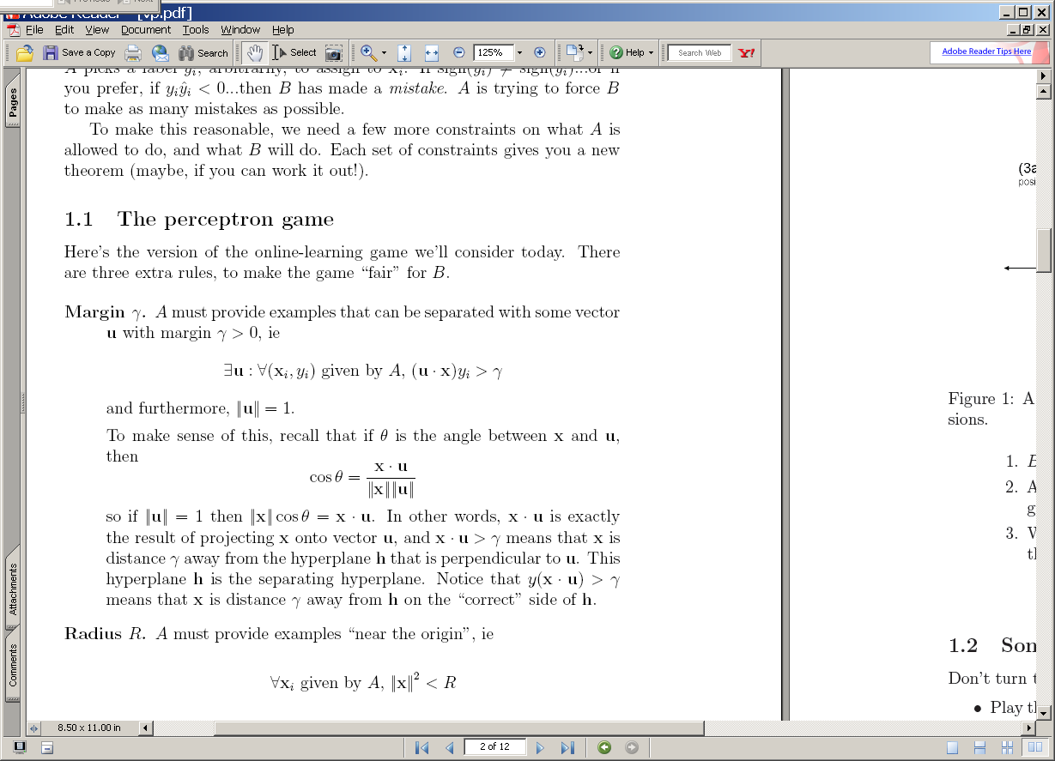
The perceptron game
x is a vector
y is -1 or +1
^
instance x_{i}
B
Compute: y_{i} = sign(v_{k} . x_{i} )
A
^
If mistake: v_{k+1} = v_{k} + y_{i} x_{i}
y_{i}
y_{i}

Slide 17
(1) A target u
(2) The guess v₁ after one positive example.
u
u
v₁
+x₁
-u
-u
2γ
2γ
(3a) The guess v₂ after the two positive examples: v₂=v₁+x₂
(3b) The guess v₂ after the one positive and one negative example: v₂=v₁-x₂
u
u
+x₂
v₂
v₂
v₁
v₁
+x₁
-x₂
-u
-u
2γ
2γ
If mistake: v_{k+1} = v_{k} + y_{i} x_{i}

Slide 18
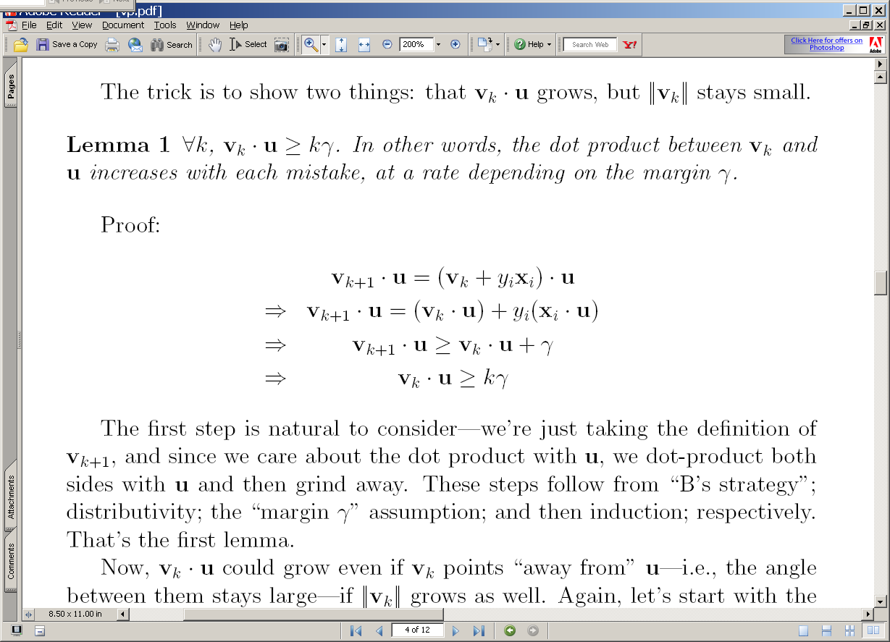
(3a) The guess v₂ after the two positive examples: v₂=v₁+x₂
(3b) The guess v₂ after the one positive and one negative example: v₂=v₁-x₂
u
u
+x₂
v₂
v₂
>γ
v₁
v₁
+x₁
-x₂
-u
-u
2γ
2γ
If mistake: v_{k+1} = v_{k} + y_{i} x_{i}

Slide 19
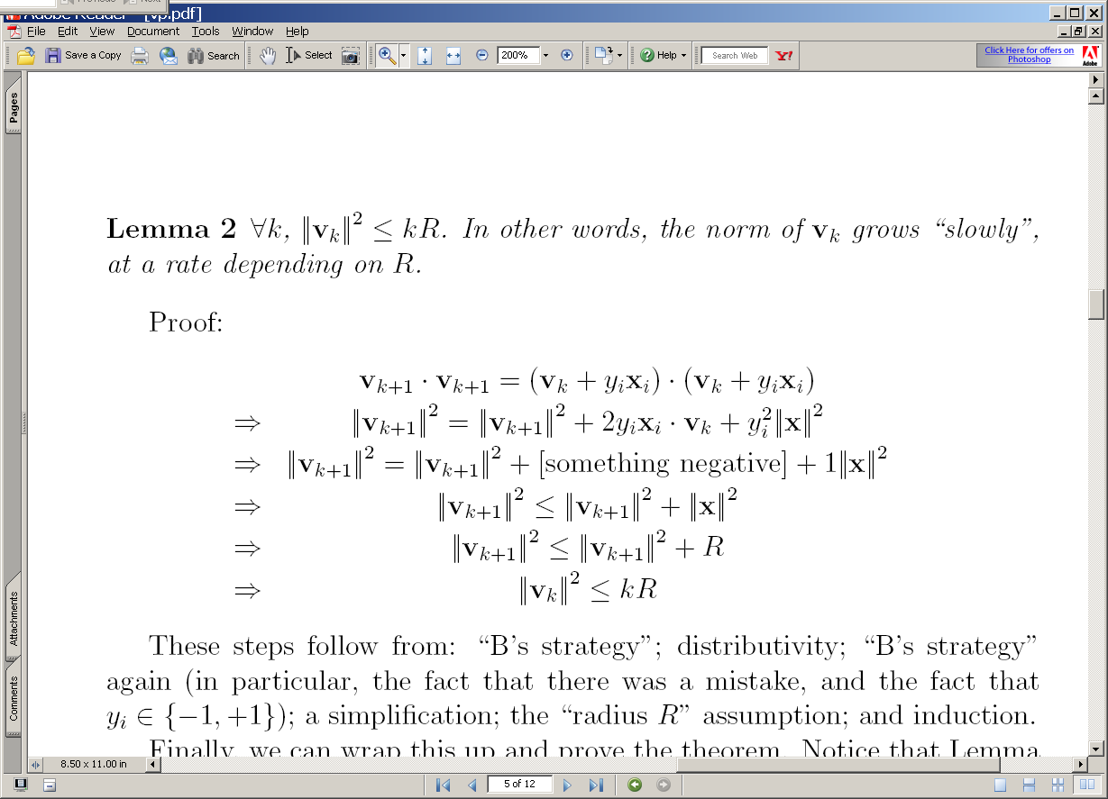
(3a) The guess v₂ after the two positive examples: v₂=v₁+x₂
(3b) The guess v₂ after the one positive and one negative example: v₂=v₁-x₂
u
u
+x₂
v₂
v₂
v₁
v₁
+x₁
-x₂
-u
-u
2γ
2γ
If mistake: y_{i} x_{i} v_{k} < 0

Slide 20
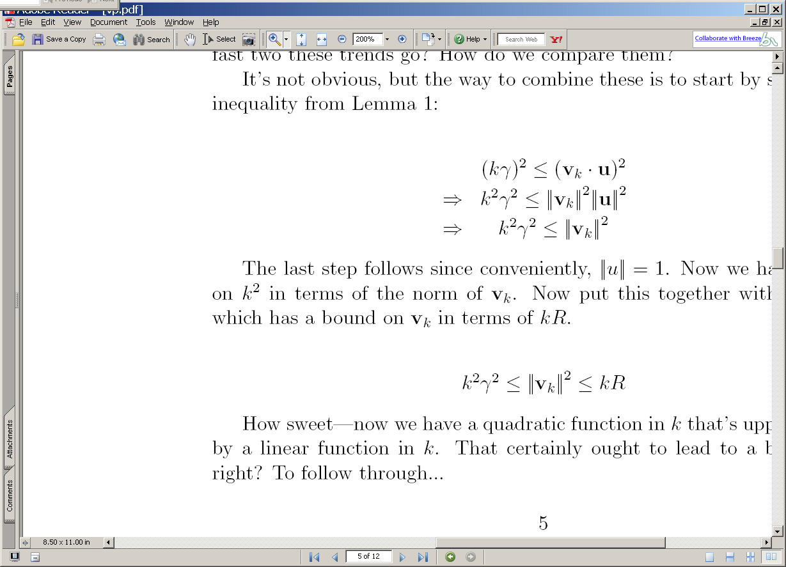
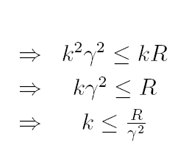

Slide 21
2
2
2
2
2
Notation fix to be consistent with next paper

Slide 22
Summary
We have shown that
  If : exists a u with unit norm that has margin γ on examples in the seq (x₁,y₁),(x₂,y₂),….
  Then : the perceptron algorithm makes < R²/ γ² mistakes on the sequence (where R >= ||x_{i}||)
  Independent of dimension of the data or classifier (!)
  This doesn’t follow from M(C)<=VCDim(C)
We don’t know if this algorithm could be better
  There are many variants that rely on similar analysis (ROMMA, Passive-Aggressive, MIRA, …)
We don’t know what happens if the data’s not separable
  Unless I explain the “Δ trick” to you
We don’t know what classifier to use “after” training

Slide 23
The Δ Trick
Replace x_{i} with x’_{i} so X becomes [X | I Δ]
Replace R² in our bounds with R² + Δ²
Let d_{i} = max(0, γ - y_{i} x_{i} u)
Let u’ = (u₁,…,u_{n}, y₁d₁/Δ, … y_{m}d_{m}/Δ) * 1/Z
  So Z=sqrt(1 + D²/ Δ²), for D=sqrt(d₁²+…+d_{m}²)
Mistake bound is (R² + Δ²)Z² / γ²
Let Δ = sqrt(RD) ➔ k <= ((R + D)/ γ)²

Slide 24
Summary
We have shown that
  If : exists a u with unit norm that has margin γ on examples in the seq (x₁,y₁),(x₂,y₂),….
  Then : the perceptron algorithm makes < R²/ γ² mistakes on the sequence (where R >= ||x_{i}||)
  Independent of dimension of the data or classifier (!)
We don’t know what happens if the data’s not separable
  Unless I explain the “Δ trick” to you
We don’t know what classifier to use “after” training

Slide 25
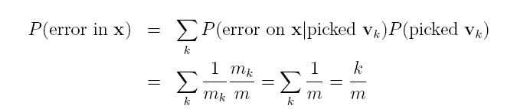
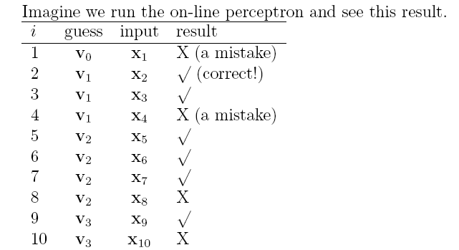
On-line to batch learning
Pick a v_{k} at random according to m_{k}/m, the fraction of examples it was used for.
Predict using the v_{k} you just picked.
(Actually, use some sort of deterministic approximation to this).

Slide 26
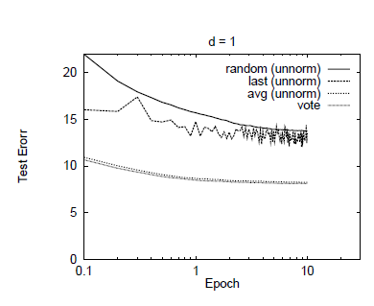

Slide 27
Complexity of perceptron learning
Algorithm:
v=0
for each example x,y:
  if sign(v.x) != y
    v = v + yx
O(n)
init hashtable
    for x_{i}!=0, v_{i} += yx_{i}
O(|x|)=O(|d|)

Slide 28
Complexity of averaged perceptron
Algorithm:
vk=0
va = 0
for each example x,y:
  if sign(vk.x) != y
    va = va + nk vk
    vk = vk + yx
    nk = 1
  else
    nk++
O(n) O(n|V|)
init hashtables
    for vk_{i}!=0, va_{i} += vk_{i}
    for x_{i}!=0, v_{i} += yx_{i}
O(|V|)
O(|x|)=O(|d|)
So: averaged perceptron is better from point of view of accuracy (stability, …) but much more expensive computationally.

Slide 29
Complexity of averaged perceptron
Algorithm:
vk=0
va = 0
for each example x,y:
  if sign(vk.x) != y
    va = va + nk vk
    vk = vk + yx
    nk = 1
  else
    nk++
O(n) O(n|V|)
init hashtables
    for vk_{i}!=0, va_{i} += vk_{i}
    for x_{i}!=0, v_{i} += yx_{i}
O(|V|)
O(|x|)=O(|d|)
The non-averaged perceptron is also hard to parallelize…

Slide 30
A hidden agenda
Part of machine learning is good grasp of theory
Part of ML is a good grasp of what hacks tend to work
These are not always the same
  Especially in big-data situations
Catalog of useful tricks so far
  Brute-force estimation of a joint distribution
  Naive Bayes
  Stream-and-sort, request-and-answer patterns
  BLRT and KL-divergence (and when to use them)
  TF-IDF weighting – especially IDF
    it’s often useful even when we don’t understand why
  Perceptron
    often leads to fast, competitive, easy-to-implement methods
    averaging helps
    what about parallel perceptrons?

Slide 31
Parallel Conservative Learning
vk/va
Classifier
Documents/labels
Split into documents subsets
Documents/labels – 1
Documents/labels – 2
Documents/labels – 3
Compute partial v(y)’s
v-1
v-2
v-3
v(y)’s
Notes:
Rennie, Shih, Teevan, and Karger (2003) Tackling the Poor Assumptions of Naive Bayes Text Classifiers.
lingpipe-blog.com/.../rennie-shih-teevan-and-karger-2003-tackling-p...
Feb 16, 2009 – Rennie, Shih, Teevan, Karger (2003) Tackling the Poor Assumptions of Naive Bayes Text Classifiers. In ICML. Rennie et al. introduce four ...
Tackling the - AAAI

Slide 32
Parallelizing perceptrons
Instances/labels
Split into example subsets
Instances/labels – 1
Instances/labels – 2
Instances/labels – 3
Compute vk’s on subsets
vk/va -1
vk/va- 2
vk/va-3
Combine somehow?
vk
Notes:
Rennie, Shih, Teevan, and Karger (2003) Tackling the Poor Assumptions of Naive Bayes Text Classifiers.
lingpipe-blog.com/.../rennie-shih-teevan-and-karger-2003-tackling-p...
Feb 16, 2009 – Rennie, Shih, Teevan, Karger (2003) Tackling the Poor Assumptions of Naive Bayes Text Classifiers. In ICML. Rennie et al. introduce four ...
Tackling the - AAAI

Slide 33
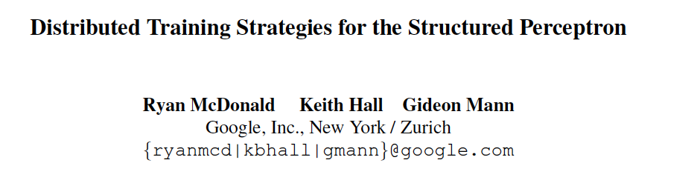
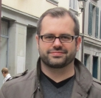
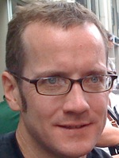
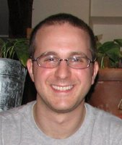
NAACL 2010

Slide 34
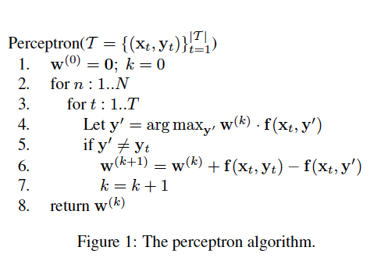
Aside: this paper is on structured perceptrons
…but everything they say formally applies to the standard perceptron as well
Briefly: a structured perceptron uses a weight vector to rank possible structured predictions y’ using features f(x,y’)
Instead of incrementing weight vector by y x, the weight vector is incremented by f(x,y)-f(x,y’)

Slide 35
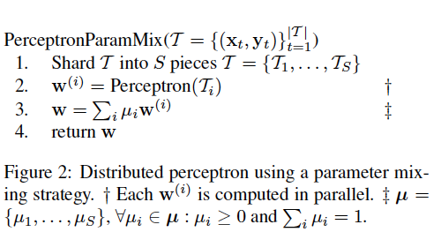
Parallel Perceptrons
Simplest idea:
  Split data into S “shards”
  Train a perceptron on each shard independently
    weight vectors are w⁽¹⁾ , w⁽²⁾ , …
  Produce some weighted average of the w^{(i)}‘s as the final result

Slide 36
Parallelizing perceptrons
Instances/labels
Split into example subsets
Instances/labels – 1
Instances/labels – 2
Instances/labels – 3
Compute vk’s on subsets
vk -1
vk- 2
vk-3
Combine by some sort of weighted averaging
vk
Notes:
Rennie, Shih, Teevan, and Karger (2003) Tackling the Poor Assumptions of Naive Bayes Text Classifiers.
lingpipe-blog.com/.../rennie-shih-teevan-and-karger-2003-tackling-p...
Feb 16, 2009 – Rennie, Shih, Teevan, Karger (2003) Tackling the Poor Assumptions of Naive Bayes Text Classifiers. In ICML. Rennie et al. introduce four ...
Tackling the - AAAI

Slide 37
Parallel Perceptrons
Simplest idea:
  Split data into S “shards”
  Train a perceptron on each shard independently
    weight vectors are w⁽¹⁾ , w⁽²⁾ , …
  Produce some weighted average of the w^{(i)}‘s as the final result
Theorem: this doesn’t always work.
Proof: by constructing an example where you can converge on every shard, and still have the averaged vector not separate the full training set – no matter how you average the components.

Slide 38
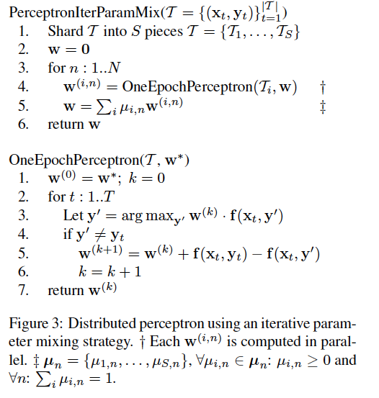
Parallel Perceptrons – take 2
Idea: do the simplest possible thing iteratively.
Split the data into shards
Let w = 0
For n=1,…
  Train a perceptron on each shard with one pass starting with w
  Average the weight vectors (somehow) and let w be that average
Extra communication cost:
redistributing the weight vectors
done less frequently than if fully synchronized, more frequently than if fully parallelized

Slide 39
Parallelizing perceptrons – take 2
w (previous)
Instances/labels
Split into example subsets
Instances/labels – 1
Instances/labels – 2
Instances/labels – 3
Compute local vk’s
w -1
w- 2
w-3
Combine by some sort of weighted averaging
w
Notes:
Rennie, Shih, Teevan, and Karger (2003) Tackling the Poor Assumptions of Naive Bayes Text Classifiers.
lingpipe-blog.com/.../rennie-shih-teevan-and-karger-2003-tackling-p...
Feb 16, 2009 – Rennie, Shih, Teevan, Karger (2003) Tackling the Poor Assumptions of Naive Bayes Text Classifiers. In ICML. Rennie et al. introduce four ...
Tackling the - AAAI

Slide 40
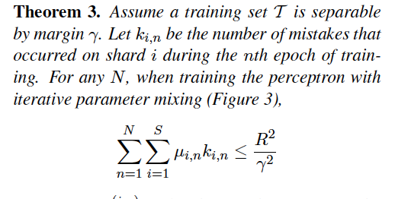
A theorem
Corollary: if we weight the vectors uniformly, then the number of mistakes is still bounded.
I.e., this is “enough communication” to guarantee convergence.

Slide 41
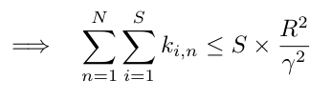
What we know and don’t know
uniform mixing…μ=1/S
could we lose our speedup-from-parallelizing to slower convergence?

Slide 42
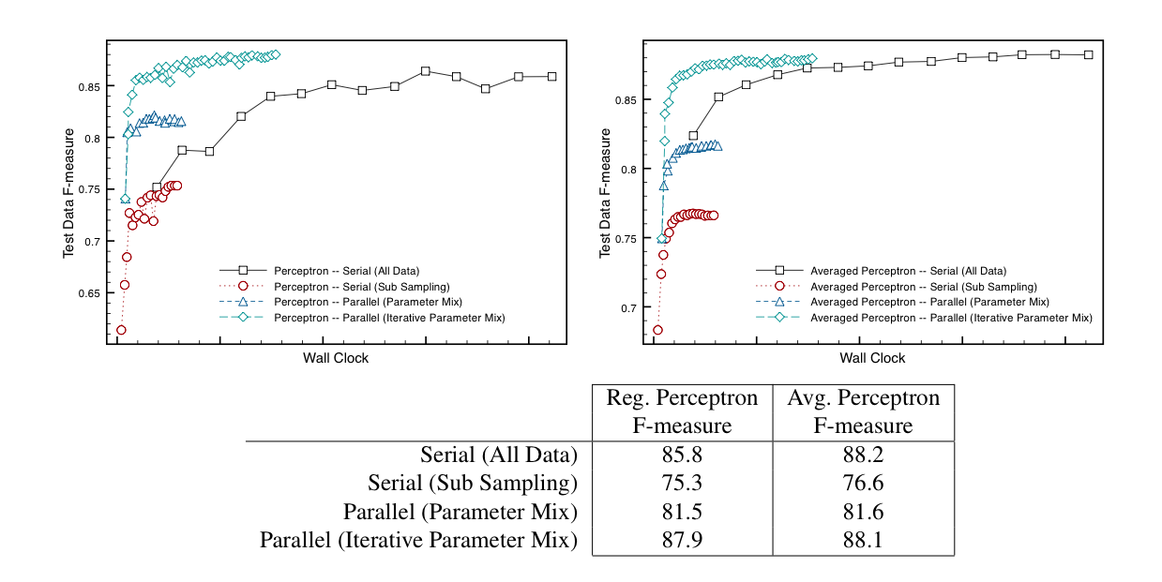
Results on NER

Slide 43
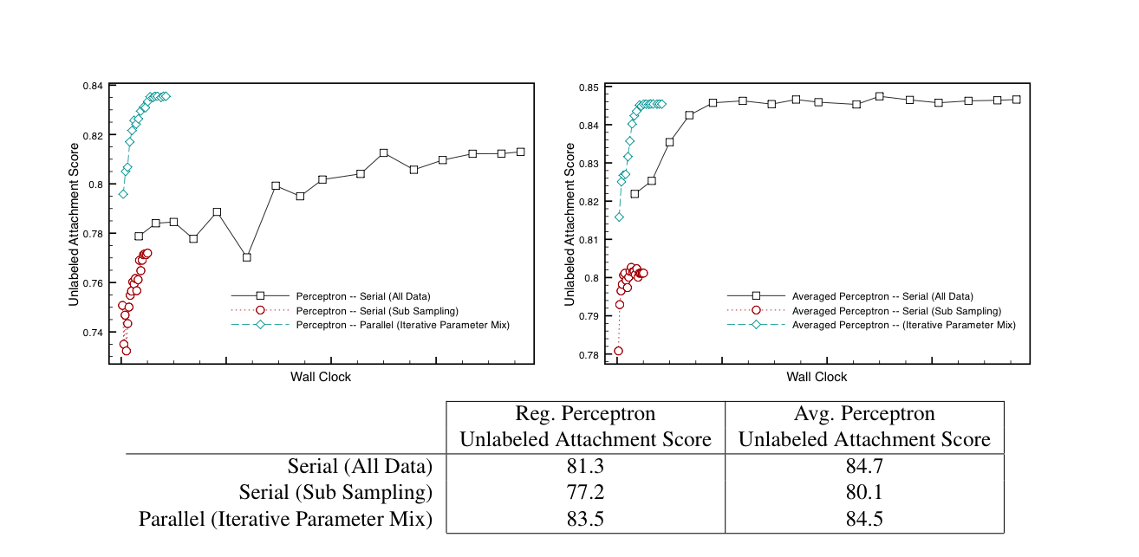
Results on parsing

Slide 44

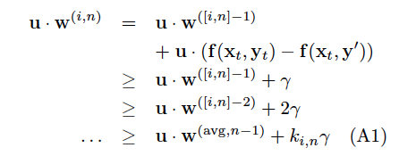
The theorem…

Slide 45
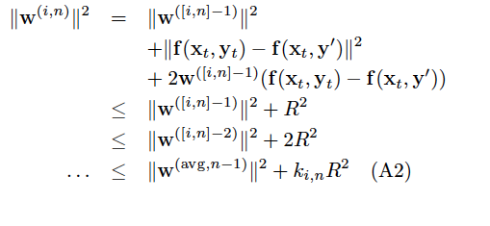
The theorem…

Slide 46
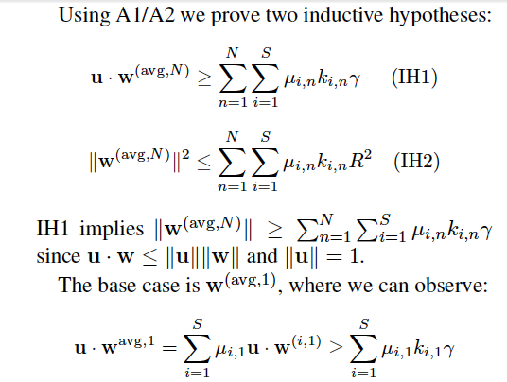

Slide 47
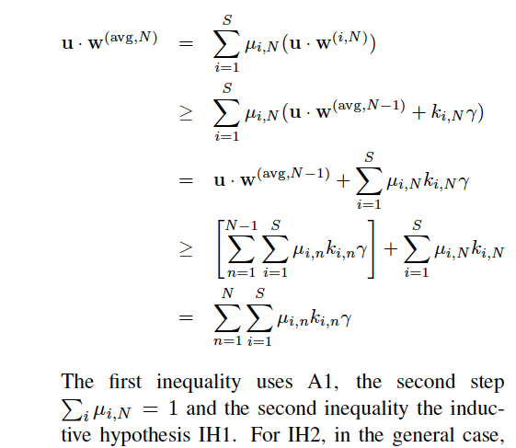
IH1 inductive case:
γ

Slide 48
Review/outline
Streaming learning algorithms … and beyond
  Naïve Bayes
  Rocchio’s algorithm
Similarities & differences
  Probabilistic vs vector space models
  Computationally similar
  Parallelizing Naïve Bayes and Rocchio
Alternative:
  Adding up contributions for every example vs conservatively updating a linear classifier
  On-line learning model: mistake-bounds
    some theory
    a mistake bound for perceptron
  Parallelizing the perceptron

Slide 49
What we know and don’t know
uniform mixing…
could we lose our speedup-from-parallelizing to slower convergence?

Slide 50
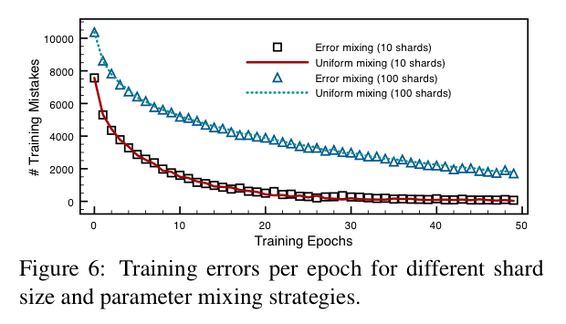
What we know and don’t know

Slide 51
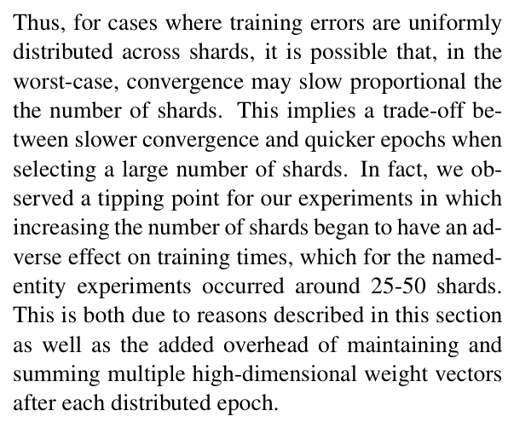
What we know and don’t know

Slide 52
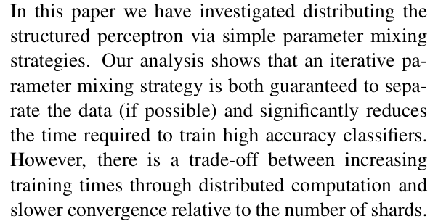
What we know and don’t know

Slide 53
Review/outline
Streaming learning algorithms … and beyond
  Naïve Bayes
  Rocchio’s algorithm
Similarities & differences
  Probabilistic vs vector space models
  Computationally similar
  Parallelizing Naïve Bayes and Rocchio
Alternative:
  Adding up contributions for every example vs conservatively updating a linear classifier
  On-line learning model: mistake-bounds
    some theory
    a mistake bound for perceptron
  Parallelizing the perceptron

Slide 54
Where we are…
Summary of course so far:
  Math tools: complexity, probability, on-line learning
  Algorithms: Naïve Bayes, Rocchio, Perceptron, Phrase-finding as BLRT/pointwise KL comparisons, …
  Design patterns: stream and sort, messages
    How to write scanning algorithms that scale linearly on large data (memory does not depend on input size)
  Beyond scanning: parallel algorithms for ML
  Formal issues involved in parallelizing
    Naïve Bayes, Rocchio, … easy?
    Conservative on-line methods (e.g., perceptron) … hard?
Next: practical issues in parallelizing
  details on Hadoop

