Slide 1
Blocking

Slide 2
Blocking
Basic idea:
heuristically find candidate pairs that are likely to be similar
only compare candidates, not all pairs
Variant 1:
pick some features such that
pairs of similar names are likely to contain at least one such feature (recall)
the features don’t occur too often (precision)
example: not-too-frequent character n-grams
build inverted index on features and use that to generate candidate pairs

Slide 3
Blocking in MapReduce
For each string s
For each char 4-gram g in s
Output pair (g,s)
Sort and reduce the output:
For each g
For each value s associated with g
Load first K value into memory buffer
If buffer was big enough:
output (s,s’) for each distinct pair of s’s.
Else
skip this g

Slide 4
Blocking
Basic idea:
heuristically find candidate pairs that are likely to be similar
only compare candidates, not all pairs
Variant 2:
pick some numeric feature f such that similar pairs will have similar values of f
example: length of string s
sort all strings s by f(s)
Go through sorted list, and output all pairs with similar values
use a fixed-size sliding window over the sorted list

Slide 5
What’s next?
Combine blocking, indexing and matching
Exploit A*-like bounds
Match in a streaming process….

Slide 6
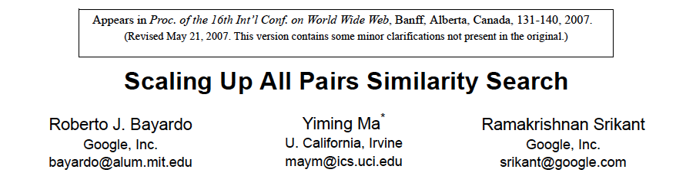
Key idea:
try and find all pairs x,y with similarity over a fixed threshold
use inverted indices and exploit fact that similarity function is a dot product

Slide 7
A* (best-first) search for good paths
Find all paths shorter than t between start n₀ and goal n_{g}:goal(n_{g})
Define f(n) = g(n) + h(n)
g(n) = MinPathLength(n₀ ,n)|
h(n) = lower-bound of path length from n to n_{g}
Algorithm:
OPEN= {n₀ }
While OPEN is not empty:
remove “best” (minimal f) node n from OPEN
if goal(n), output path n₀→n
and stop if you’ve output K answers
otherwise, add CHILDREN(n) to OPEN
unless there’s no way its score will be low enough
h is “admissible” and A* will always return the K lowest-cost paths

Slide 8
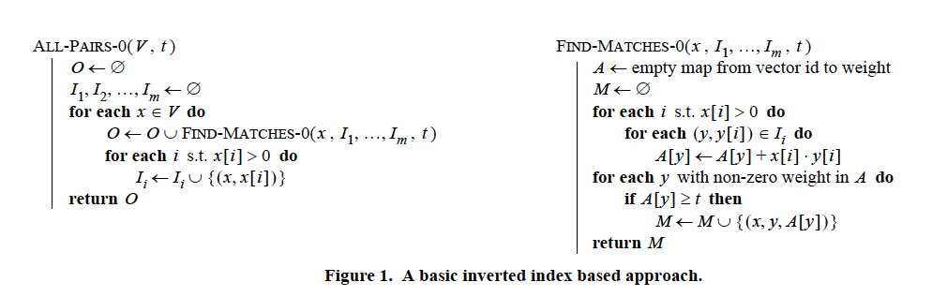
x15={william:1, w:1, cohen:1}
i=william
I_{william} = (x2:1),(x7:1),…
Build index on-the-fly
When finding matches for x consider y before x in ordering
Keep x[i] in inverted index for i
so you can find dot product dot(x,y) without using y

Slide 9
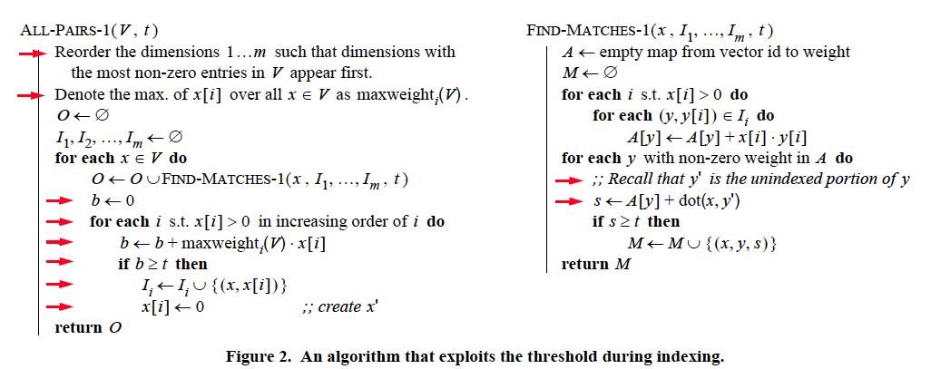
maxweight_{i}(V) * x[i] >= best score for matching on i
x[i] should be x’ here – x’ is the unindexed part of x
Build index on-the-fly
only index enough of x so that you can be sure to find it
score of things only reachable by non-indexed fields < t
total mass of what you index needs to be large enough
correction:
indexes no longer have enough info to compute dot(x,y)
ordering common→rare features is heuristic (any order is ok)

Slide 10
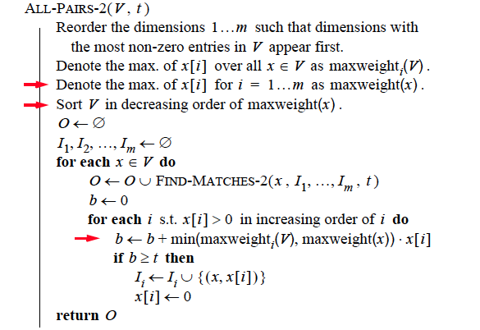
Order all the vectors x by maxweight(x) – now matches y to indexed parts of x will have lower “best scores for i”

Slide 11
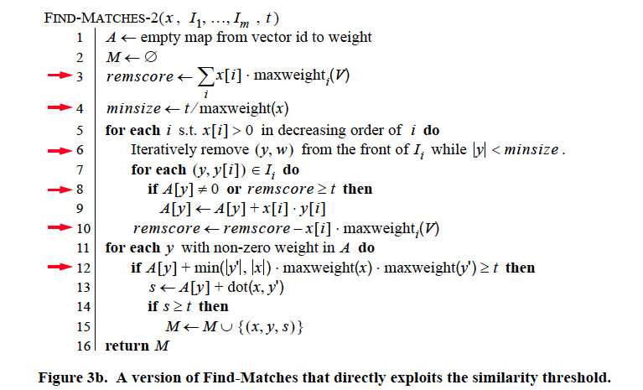
best score for matching the unindexed part of x
update to reflect the all-ready examined part of x
Trick 1: bound y’s possible score to the unindexed part of x, plus the already-examined part of x, and skip y’s if this is too low

Slide 12
upper bound on dot(x,y’)
Trick 2: use cheap upper-bound to see if y is worthy of having dot(x,y) computed.

Slide 13
y is too small to match x well
really we will update a start counter for I
Trick 3: exploit this fact: if dot(x,y)>t, then |y|>t/maxweight(x)

Slide 14
Large data version
Start at position 0 in the database
Build inverted indexes till memory is full
Say at position m<<n
Then switch to match-only mode
Match rest of data only to items up to position m
Then restart the process at position m instead of position 0 and repeat…..

Slide 15
Experiments
QSC (Query snippet containment)
term a in vector for b if a appears >=k times in a snippet using search b
5M queries, top 20 results, about 2Gb
Orkut
vector is user, terms are friends
20M nodes, 2B non-zero weights
need 8 passes over data to completely match
DBLP
800k papers, authors + title words

Slide 16
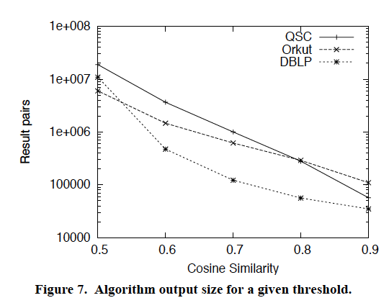
Results

Slide 17
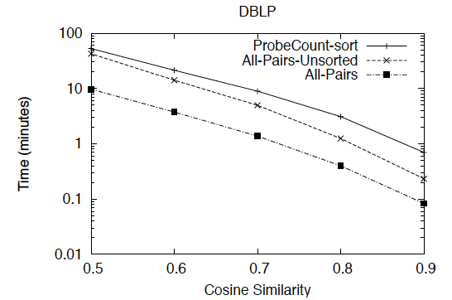
Results

Slide 18
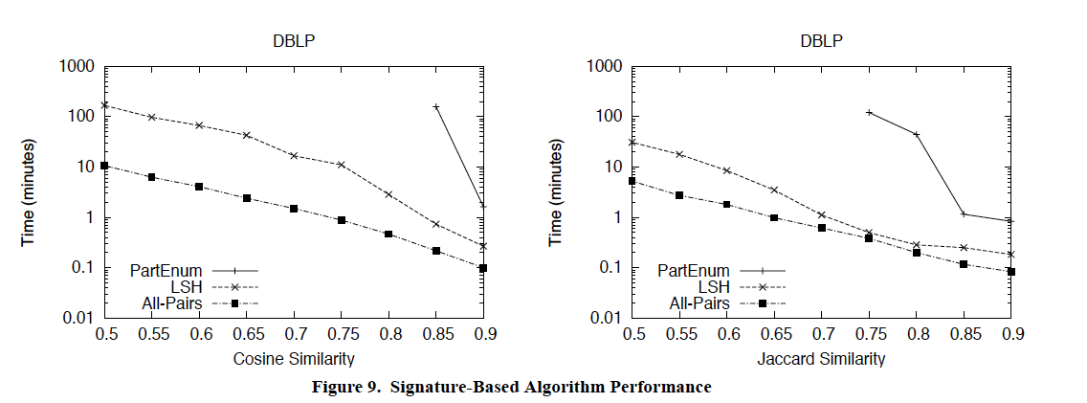
Results
LSH tuned for 95% recall rate

Slide 19
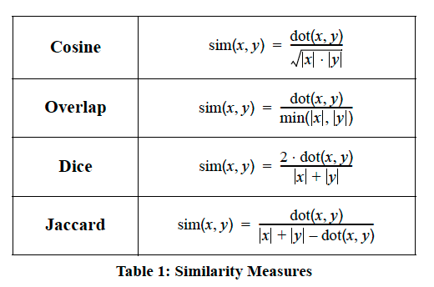
Extension (requires some work on upper bounds)

Slide 20
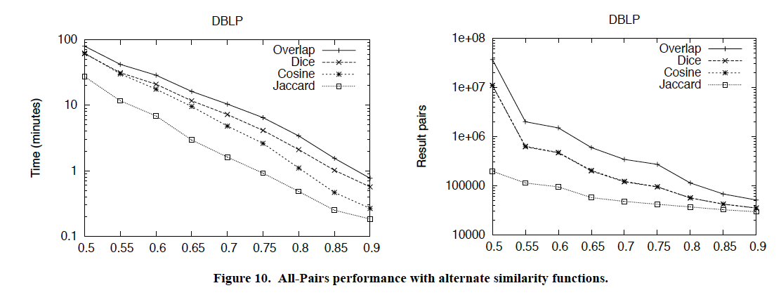
Results

Slide 21
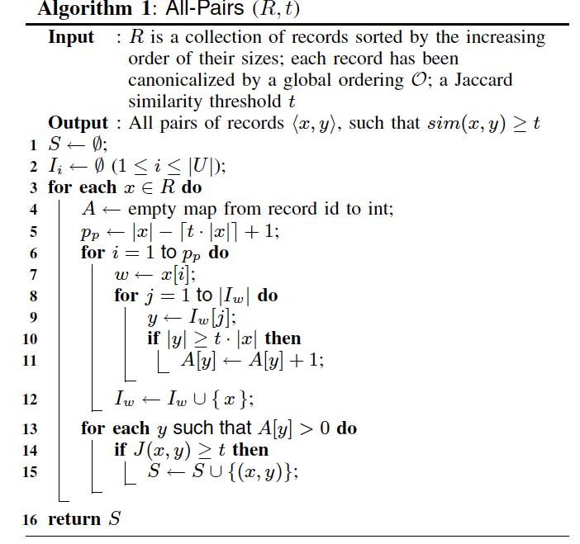
Simplification – for Jaccard similarity only

Slide 22
Beyond one machine…..

Slide 23
Parallelizing Similarity Joins
Blocking and comparing
Map:
For each record with id i, and blocking attribute values a_{i},b_{i},c_{i},d_{i}
Output
a_{i},i
b_{i},i
…
Reduce:
For each line
a_{m}: i₁,…,i_{k}
Output all id pairs i_{j}<i_{k}
Map/reduce to remove duplicates
Now given pairs i_{j}<i_{k} we want to compute similarities
Send messages to data tables to collect the actual contents of the records
Compute similarities

Slide 24
Parallel Similarity Joins
Generally we can decompose most algorithms to index-building, candidate-finding, and matching
These can usually be parallelized

Slide 25
MAP
Output i, (id(x), x[i])
Output id(x), x’
Minus calls to find-matches, this is just building a (reduced) index…and a reduced representation x’ of unindexed stuff

Slide 26
MAP through reduced inverted indices to find x, y candidates, maybe with an upper bound on score….

Slide 27

SIGMOD 2010

Slide 28
Beyond token-based distance metrics

Slide 29
Robust distance metrics for strings
Kinds of distances between s and t:
Edit-distance based (Levenshtein, Smith-Waterman, …): distance is cost of cheapest sequence of edits that transform s to t.
Term-based (TFIDF, Jaccard, DICE, …): distance based on set of words in s and t, usually weighting “important” words
Which methods work best when?

Slide 30
Edit distances
Common problem: classify a pair of strings (s,t) as “these denote the same entity [or similar entities]”
Examples:
(“Carnegie-Mellon University”, “Carnegie Mellon Univ.”)
(“Noah Smith, CMU”, “Noah A. Smith, Carnegie Mellon”)
Applications:
Co-reference in NLP
Linking entities in two databases
Removing duplicates in a database
Finding related genes
“Distant learning”: training NER from dictionaries

Slide 31
Edit distances: Levenshtein
Edit-distance metrics
Distance is shortest sequence of edit commands that transform s to t.
Simplest set of operations:
Copy character from s over to t
Delete a character in s (cost 1)
Insert a character in t (cost 1)
Substitute one character for another (cost 1)
This is “Levenshtein distance”

Slide 32
Levenshtein distance - example
distance(“William Cohen”, “Willliam Cohon”)
s
W | I | L | L | I | A | M | _ | C | O | H | E |  | N
W | I | L | L | L | I | A | M | _ | C | O | H | O | N
C | C | C | C | I | C | C | C | C | C | C | C | S | C
0 | 0 | 0 | 0 | 1 | 1 | 1 | 1 | 1 | 1 | 1 | 1 | 2 | 2
alignment
t
op
cost

Slide 33
Levenshtein distance - example
distance(“William Cohen”, “Willliam Cohon”)
s
W | I | L | L |  | I | A | M | _ | C | O | H | E | N
W | I | L | L | L | I | A | M | _ | C | O | H | O | N
C | C | C | C | I | C | C | C | C | C | C | C | S | C
0 | 0 | 0 | 0 | 1 | 1 | 1 | 1 | 1 | 1 | 1 | 1 | 2 | 2
gap
alignment
t
op
cost

Slide 34
Computing Levenshtein distance - 1
D(i,j) = score of best alignment from s1..si to t1..tj
D(i-1,j-1), if si=tj //copy
D(i-1,j-1)+1, if si!=tj //substitute
D(i-1,j)+1 //insert
D(i,j-1)+1 //delete
= min

Slide 35
Computing Levenshtein distance - 2
D(i,j) = score of best alignment from s1..si to t1..tj
D(i-1,j-1) + d(si,tj) //subst/copy
D(i-1,j)+1 //insert
D(i,j-1)+1 //delete
= min
(simplify by letting d(c,d)=0 if c=d, 1 else)
also let D(i,0)=i (for i inserts) and D(0,j)=j

Slide 36
Computing Levenshtein distance - 3
D(i-1,j-1) + d(si,tj) //subst/copy
D(i-1,j)+1 //insert
D(i,j-1)+1 //delete
D(i,j)= min
 |  | C | O |  | H | E | N
M |  | 1 | 2 |  | 3 | 4 | 5
C |  | 1 | 2 |  | 3 | 4 | 5
C |  | 2 | 2 |  | 3 | 4 | 5
O |  | 3 | 2 |  | 3 | 4 | 5
H |  | 4 | 3 |  | 2 | 3 | 4
N |  | 5 | 4 |  | 3 | 3 | 3
= D(s,t)

Slide 37
Jaro-Winkler metric
Very ad hoc
Very fast
Very good on person names
Algorithm sketch
characters in s,t “match” if they are identical and appear at similar positions
characters are “transposed” if they match but aren’t in the same relative order
score is based on numbers of matching and transposed characters
there’s a special correction for matching the first few characters

Slide 38
Set-based distances
TFIDF/Cosine distance
after weighting and normalizing vectors, a dot product
Jaccard distance
Dice
…

Slide 39
Robust distance metrics for strings
SecondString (Cohen, Ravikumar, Fienberg, IIWeb 2003):
Java toolkit of string-matching methods from AI, Statistics, IR and DB communities
Tools for evaluating performance on test data
Used to experimentally compare a number of metrics

Slide 40
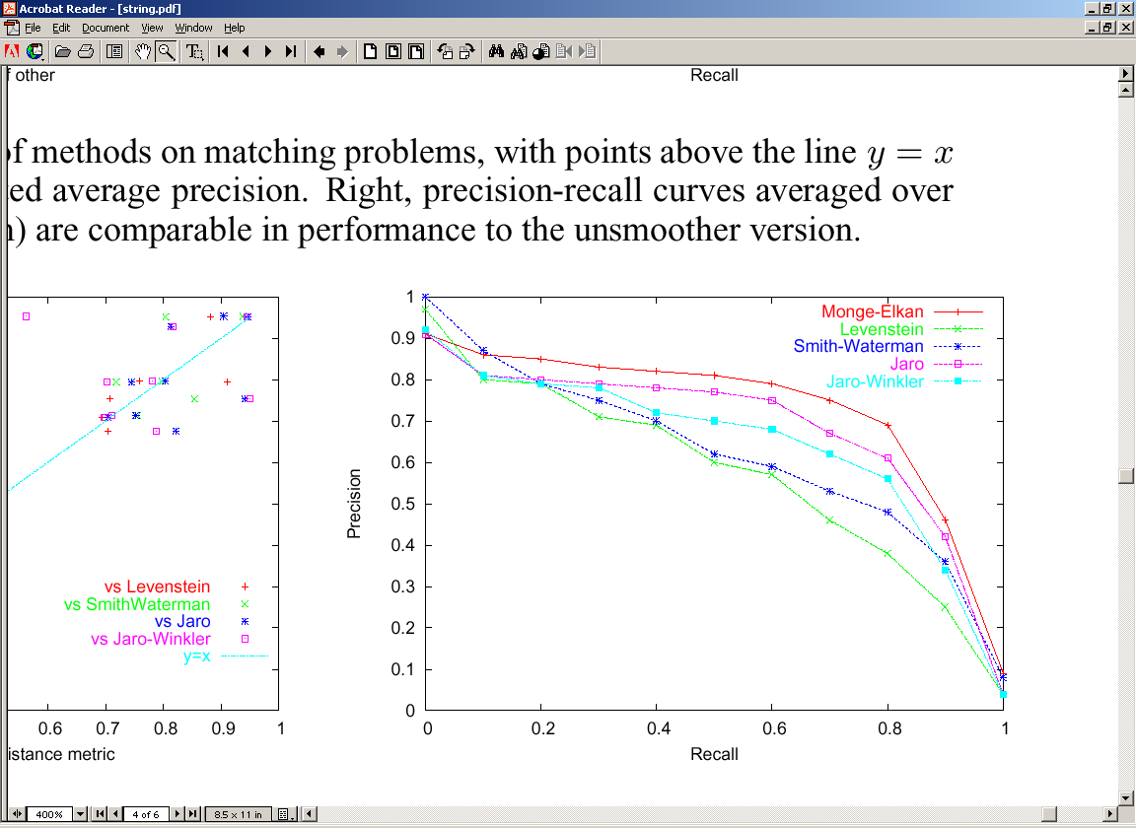
Results: Edit-distance variants
Monge-Elkan (a carefully-tuned Smith-Waterman variant) is the best on average across the benchmark datasets…
11-pt interpolated recall/precision curves averaged across 11 benchmark problems

Slide 41
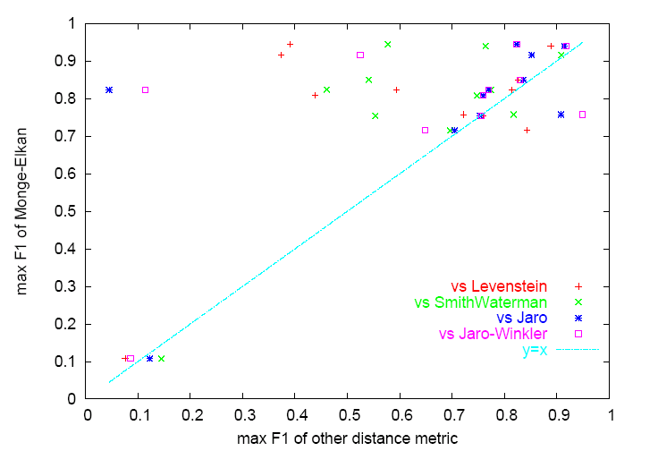
Results: Edit-distance variants
But Monge-Elkan is sometimes outperformed on specific datasets
Precision-recall for Monge-Elkan and one other method (Levenshtein) on a specific benchmark

Slide 42
SoftTFDF: A robust distance metric
We also compared edit-distance based and term-based methods, and evaluated a new “hybrid” method:
SoftTFIDF, for token sets S and T:
Extends TFIDF by including pairs of words in S and T that “almost” match—i.e., that are highly similar according to a second distance metric (the Jaro-Winkler metric, an edit-distance like metric).

Slide 43
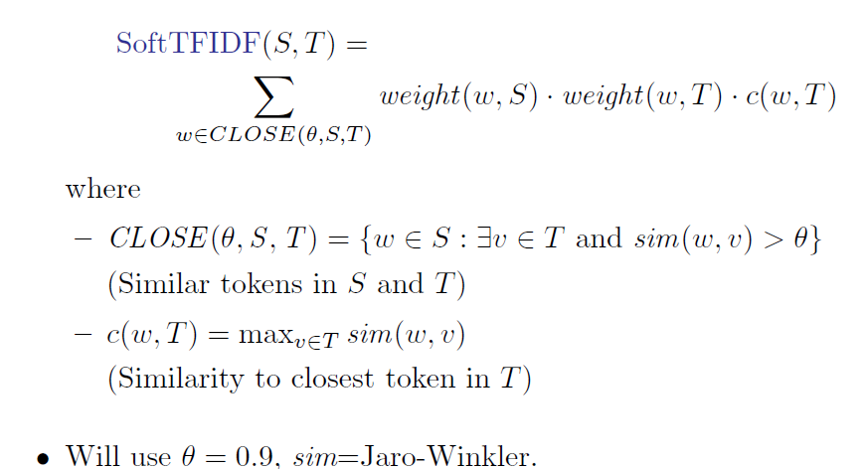

Slide 44
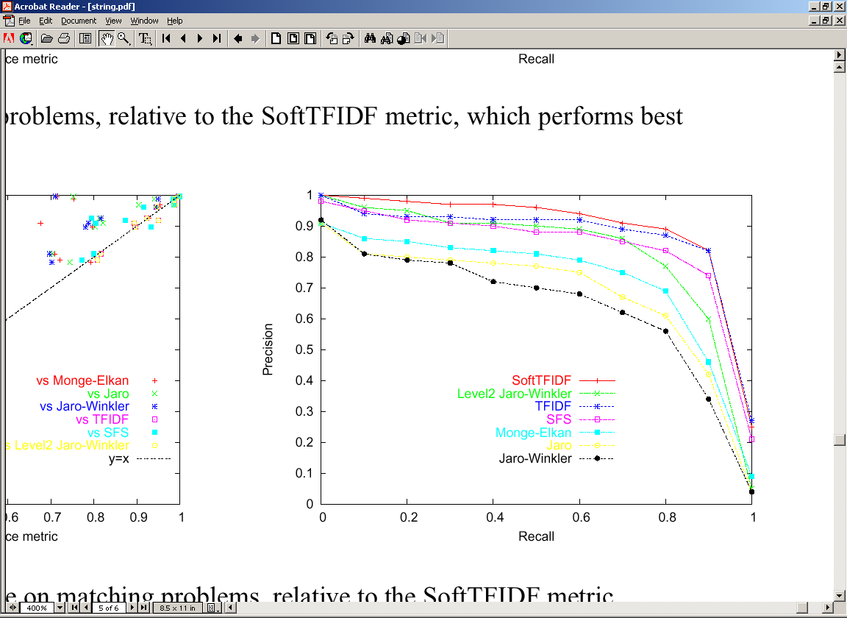
Comparing token-based, edit-distance, and hybrid distance metrics
SFS is a vanilla IDF weight on each token (circa 1959!)

Slide 45
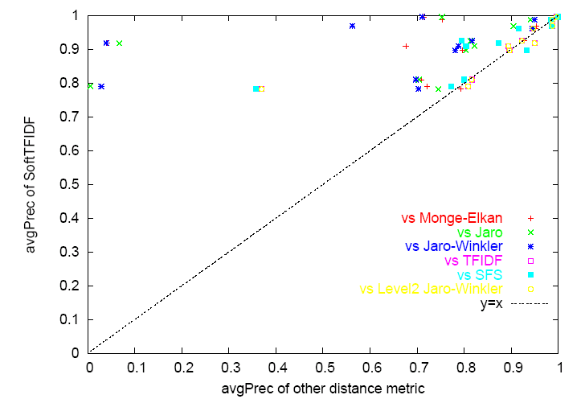
SoftTFIDF is a Robust Distance Metric

