Slide 1
Semi-Supervised Learning With Graphs
William Cohen

Slide 2
Administrivia
Final proposal:
  Due Wed 1:30
  We’ve given everyone comments
Final project:
  We’re asking everyone to keep in touch
    We’ve assigned each project a mentor (soon)
    Feel free to discuss issues in office hours
    April 15: short (1-2page) progress report
    Like proposal, required but not graded

Slide 3
From SemiSupervised to Unsupervised Learning
Continued from last week…..

Slide 4
Spectral Clustering: Graph = Matrix
 | A | B | C | D | E | F | G | H | I | J
A |  | 1 |  | 1 |  | 1
B | 1 |  | 1
C |  | 1
D | 1 |  |  |  |  | 1
E |  |  |  |  |  | 1
F | 1 |  |  | 1 | 1
G |  |  |  |  |  |  |  |  | 1
H |  |  |  |  |  |  | 1 |  | 1 | 1
I |  |  |  |  |  |  | 1 | 1 |  | 1
J |  |  |  |  |  |  |  | 1 | 1
C
A
B
G
I
H
J
F
D
E

Slide 5
Spectral Clustering: Graph = Matrix
Transitively Closed Components = “Blocks”
 | A | B | C | D | E | F | G | H | I | J
A | _ | 1 | 1 |  |  | 1
B | 1 | _ | 1
C | 1 | 1 | _
D |  |  |  | _ | 1 | 1
E |  |  |  | 1 | _ | 1
F | 1 |  |  | 1 | 1 | _
G |  |  |  |  |  |  | _ |  | 1 | 1
H |  |  |  |  |  |  |  | _ | 1 | 1
I |  |  |  |  |  |  | 1 | 1 | _ | 1
J |  |  |  |  |  |  | 1 | 1 | 1 | _
C
A
B
G
I
H
J
F
D
E
Of course we can’t see the “blocks” unless the nodes
are sorted by cluster…

Slide 6
Spectral Clustering: Graph = Matrix
Vector = Node → Weight
M
v
 | A | B | C | D | E | F | G | H | I | J
A | _ | 1 | 1 |  |  | 1
B | 1 | _ | 1
C | 1 | 1 | _
D |  |  |  | _ | 1 | 1
E |  |  |  | 1 | _ | 1
F | 1 |  |  | 1 | 1 | _
G |  |  |  |  |  |  | _ |  | 1 | 1
H |  |  |  |  |  |  |  | _ | 1 | 1
I |  |  |  |  |  |  | 1 | 1 | _ | 1
J |  |  |  |  |  |  | 1 | 1 | 1 | _
 | A
A | 3
B | 2
C | 3
D
E
F
G
H
I
J
C
A
B
G
I
H
J
F
D
E
M

Slide 7
Spectral Clustering: Graph = Matrix
M*v₁ = v₂ “propogates weights from neighbors”
M
*
v₁
=
v₂
 | A | B | C | D | E | F | G | H | I | J
A | _ | 1 | 1 |  |  | 1
B | 1 | _ | 1
C | 1 | 1 | _
D |  |  |  | _ | 1 | 1
E |  |  |  | 1 | _ | 1
F |  |  |  | 1 | 1 | _
G |  |  |  |  |  |  | _ |  | 1 | 1
H |  |  |  |  |  |  |  | _ | 1 | 1
I |  |  |  |  |  |  | 1 | 1 | _ | 1
J |  |  |  |  |  |  | 1 | 1 | 1 | _
A | 3
B | 2
C | 3
D
E
F
G
H
I
J
A | 2*1+3*1+0*1
B | 3*1+3*1
C | 3*1+2*1
D
E
F
G
H
I
J
C
A
B
G
I
H
J
F
D
E
M

Slide 8
Spectral Clustering: Graph = Matrix
W*v₁ = v₂ “propogates weights from neighbors”
W
*
v₁
=
v₂
W: normalized so columns sum to 1
 | A | B | C | D | E | F | G | H | I | J
A | _ | .5 | .5 |  |  | .3
B | .3 | _ | .5
C | .3 | .5 | _
D |  |  |  | _ | .5 | .3
E |  |  |  | .5 | _ | .3
F | .3 |  |  | .5 | .5 | _
G |  |  |  |  |  |  | _ |  | .3 | .3
H |  |  |  |  |  |  |  | _ | .3 | .3
I |  |  |  |  |  |  | .5 | .5 | _ | .3
J |  |  |  |  |  |  | .5 | .5 | .3 | _
A | 3
B | 2
C | 3
D
E
F
G
H
I
J
A | 2*.5+3*.5+0*.3
B | 3*.3+3*.5
C | 3*.33+2*.5
D
E
F
G
H
I
J
C
A
B
G
I
H
J
F
D
E

Slide 9
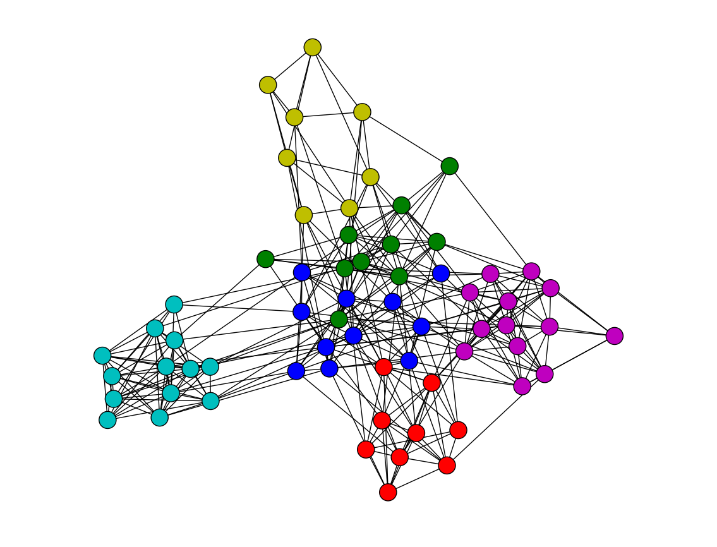
Spectral Clustering: Graph = Matrix
W*v₁ = v₂ “propogates weights from neighbors”
Q: How do I pick v to be an eigenvector for a block-stochastic matrix?

Slide 10
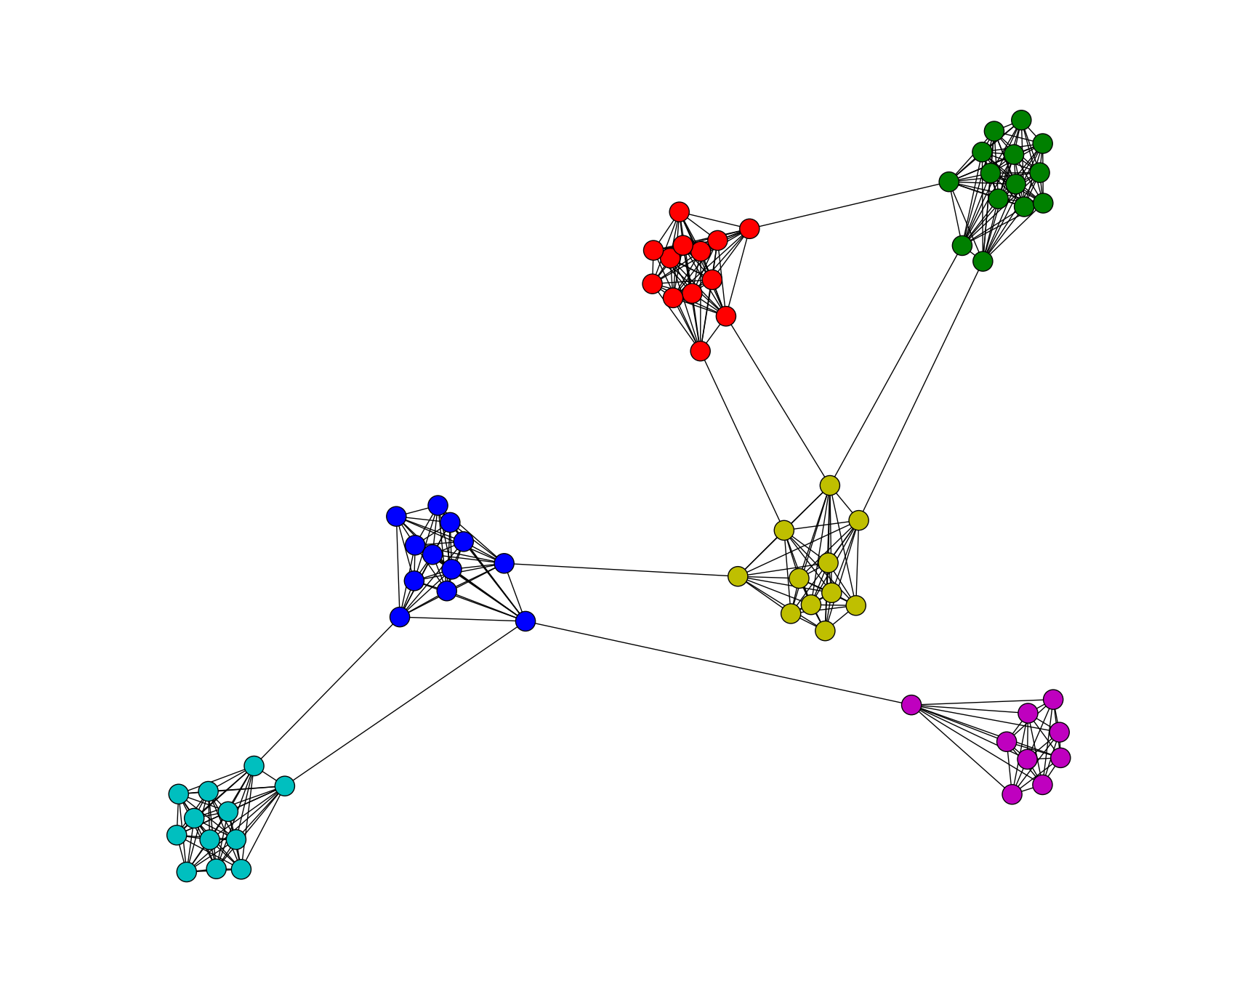
Spectral Clustering: Graph = Matrix
W*v₁ = v₂ “propogates weights from neighbors”
How do I pick v to be an eigenvector for a block-stochastic matrix?

Slide 11
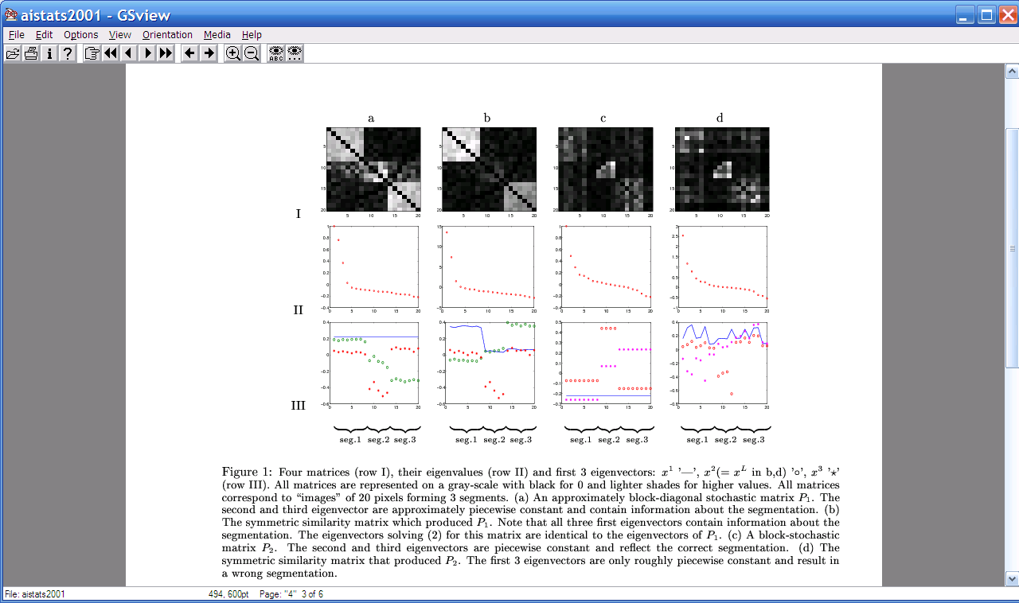
Spectral Clustering: Graph = Matrix
W*v₁ = v₂ “propogates weights from neighbors”
λ₁
e₁
λ₂
“eigengap”
e₃
λ₃
λ₄
e₂
λ₅,_{6,7,….}
[Shi & Meila, 2002]

Slide 12
Spectral Clustering: Graph = Matrix
W*v₁ = v₂ “propogates weights from neighbors”
e₂
0.4
0.2
x
x
x
x
x
x
x
x
x
0.0
x
x
x
-0.2
y
z
y
y
z
-0.4
y
z
z
e₃
z
z
z
z
z
z
y
z
e₁
-0.4
-0.2
0
0.2
e₂
[Shi & Meila, 2002]

Slide 13
Spectral Clustering: Graph = Matrix
W*v₁ = v₂ “propogates weights from neighbors”
If W is connected but roughly block diagonal with k blocks then
the top eigenvector is a constant vector
the next k eigenvectors are roughly piecewise constant with “pieces” corresponding to blocks
M

Slide 14
Spectral Clustering: Graph = Matrix
W*v₁ = v₂ “propogates weights from neighbors”
If W is connected but roughly block diagonal with k blocks then
the “top” eigenvector is a constant vector
the next k eigenvectors are roughly piecewise constant with “pieces” corresponding to blocks
Spectral clustering:
Find the top k+1 eigenvectors v₁,…,v_{k+1}
Discard the “top” one
Replace every node a with k-dimensional vector x_{a} = <v₂(a),…,v_{k+1} (a) >
Cluster with k-means
M

Slide 15
Spectral Clustering: Pros and Cons
Elegant, and well-founded mathematically
Tends to avoid local minima
  Optimal solution to relaxed version of mincut problem (Normalized cut, aka NCut)
Works quite well when relations are approximately transitive (like similarity, social connections)
Expensive for very large datasets
  Computing eigenvectors is the bottleneck
  Approximate eigenvector computation not always useful
Noisy datasets sometimes cause problems
  Picking number of eigenvectors and k is tricky
  “Informative” eigenvectors need not be in top few
  Performance can drop suddenly from good to terrible

Slide 16
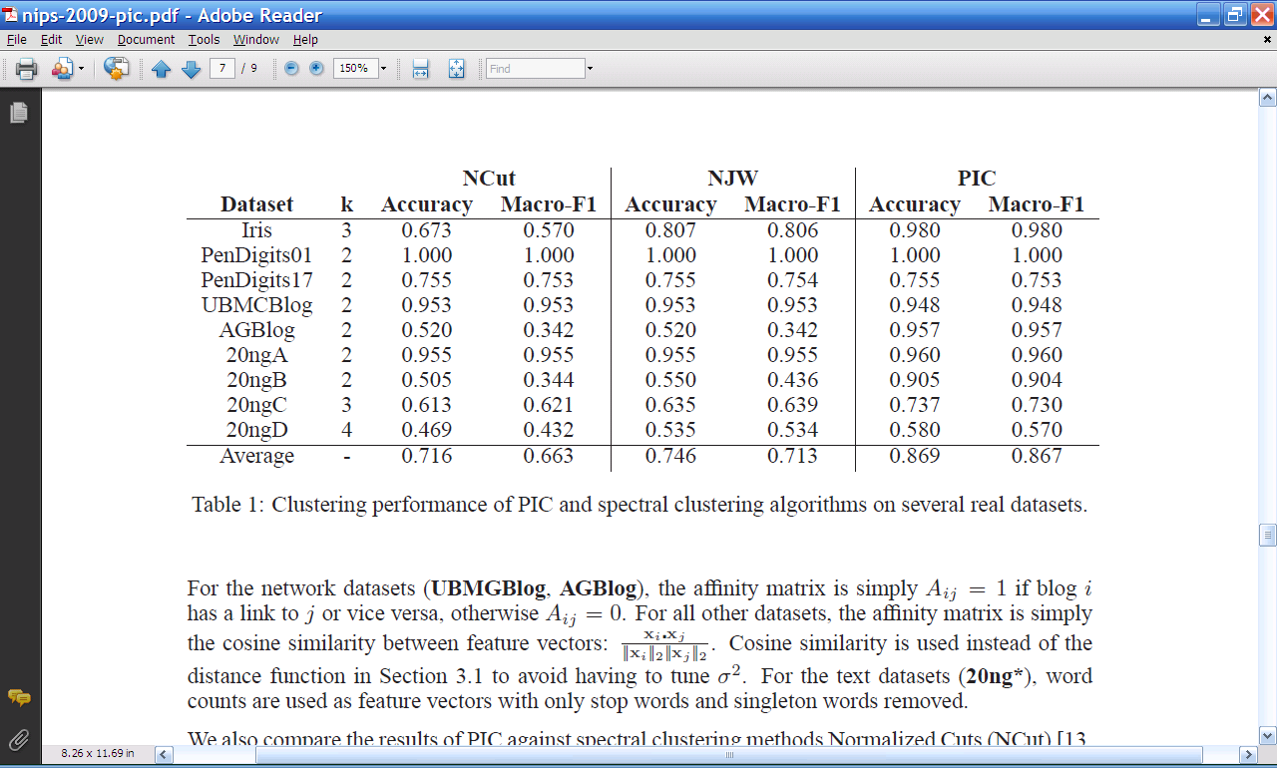
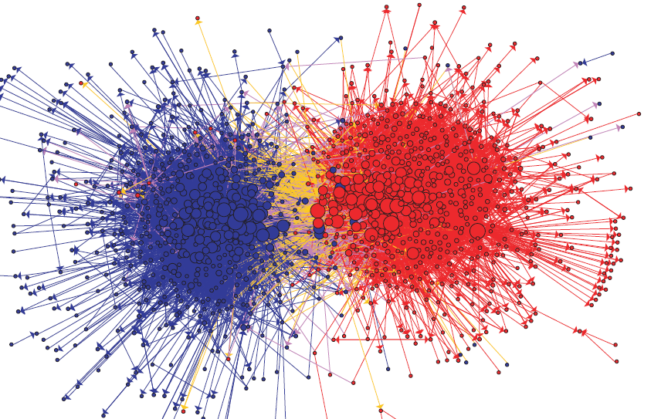
Experimental results: best-case assignment of class labels to clusters

Slide 17
Another way to think about spectral clustering….

Slide 18
Spectral Clustering: Graph = Matrix
W*v₁ = v₂ “propogates weights from neighbors”
smallest eigenvecs of D-A are largest eigenvecs of A
smallest eigenvecs of I-W are largest eigenvecs of W
Suppose each y(i)=+1 or -1:
Then y is a cluster indicator that splits the nodes into two
what is y^{T}(D-A)y ?

Slide 19
= size of CUT(y)
NCUT: roughly minimize ratio of transitions between classes vs transitions within classes

Slide 20
Spectral Clustering: Graph = Matrix
W*v₁ = v₂ “propogates weights from neighbors”
smallest eigenvecs of D-A are largest eigenvecs of A
smallest eigenvecs of I-W are largest eigenvecs of W
Suppose each y(i)=+1 or -1:
Then y is a cluster indicator that cuts the nodes into two
what is y^{T}(D-A)y ? The cost of the graph cut defined by y
what is y^{T}(I-W)y ? Also a cost of a graph cut defined by y
How to minimize it?
  Turns out: to minimize y^{T} X y / (y^{T}y) find smallest eigenvector of X
  But: this will not be +1/-1, so it’s a “relaxed” solution

Slide 21
Another way to think about spectral clustering….
Most normal people think about spectral clustering like that - as relaxed optimization
…me, not so much
I like the connection to “averaging”…because….

Slide 22
Spectral Clustering: Graph = Matrix
W*v₁ = v₂ “propogates weights from neighbors”
W
*
v₁
=
v₂
W: normalized so columns sum to 1
 | A | B | C | D | E | F | G | H | I | J
A | _ | .5 | .5 |  |  | .3
B | .3 | _ | .5
C | .3 | .5 | _
D |  |  |  | _ | .5 | .3
E |  |  |  | .5 | _ | .3
F | .3 |  |  | .5 | .5 | _
G |  |  |  |  |  |  | _ |  | .3 | .3
H |  |  |  |  |  |  |  | _ | .3 | .3
I |  |  |  |  |  |  | .5 | .5 | _ | .3
J |  |  |  |  |  |  | .5 | .5 | .3 | _
A | 3
B | 2
C | 3
D
E
F
G
H
I
J
A | 2*.5+3*.5+0*.3
B | 3*.3+3*.5
C | 3*.33+2*.5
D
E
F
G
H
I
J
C
A
B
G
I
H
J
F
D
E

Slide 23
Repeated averaging with neighbors as a clustering method
Pick a vector v⁰ (maybe at random)
Compute v¹ = Wv⁰
  i.e., replace v⁰[x] with weighted average of v⁰[y] for the neighbors y of x
Plot v¹[x] for each x
Repeat for v², v³, …
Variants widely used for semi-supervised learning
  ZGL - average + clamping of labels for nodes with known labels
Without clamping, will converge to constant v^{t}
What are the dynamics of this process?

Slide 24
Spectral Clustering: Graph = Matrix
W*v₁ = v₂ “propogates weights from neighbors”
λ₁
e₁
λ₂
“eigengap”
e₃
λ₃
λ₄
e₂
λ₅,_{6,7,….}
[Shi & Meila, 2002]

Slide 25
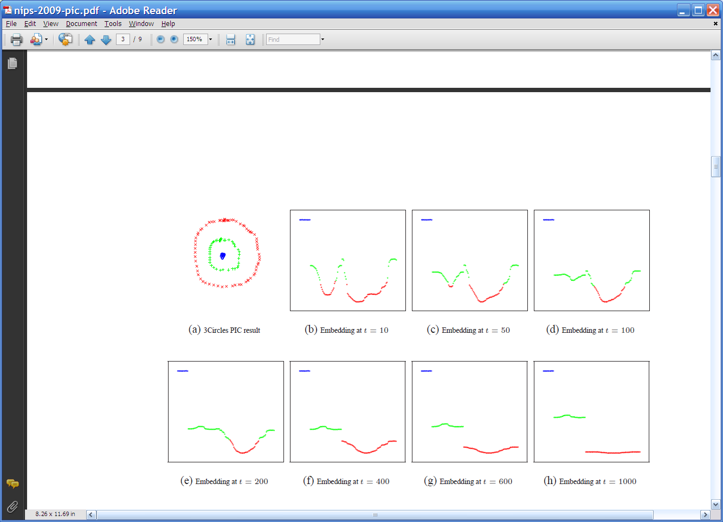
Repeated averaging with neighbors on a sample problem…
blue
green
___red___
Create a graph, connecting all points in the 2-D initial space to all other points
  Weighted by distance
Run power iteration (averaging) for 10 steps
Plot node id x vs v¹⁰(x)
  nodes are ordered and colored by actual cluster number
g
g
g
g
g
g
g
g
g
r
r
r
r
…
b
b
r
r
r
b
b
b

Slide 26
Repeated averaging with neighbors on a sample problem…
blue
green
___red___
blue
green
___red___
blue
green
___red___
larger
smaller

Slide 27
Repeated averaging with neighbors on a sample problem…
blue
green
___red___
blue
green
___red___
blue
green
___red___
blue
green
___red___
blue
green
___red___

Slide 28
Repeated averaging with neighbors on a sample problem…
very small

Slide 29
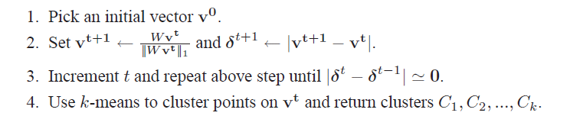
PIC: Power Iteration Clustering run power iteration (repeated averaging w/ neighbors) with early stopping
  V⁰: random start, or “degree matrix” D, or …
  Easy to implement and efficient
  Very easily parallelized
  Experimentally, often better than traditional spectral methods
  Surprising since the embedded space is 1-dimensional!

Slide 30
Experiments
“Network” problems: natural graph structure
  PolBooks: 105 political books, 3 classes, linked by copurchaser
  UMBCBlog: 404 political blogs, 2 classes, blogroll links
  AGBlog: 1222 political blogs, 2 classes, blogroll links
“Manifold” problems: cosine distance between classification instances
  Iris: 150 flowers, 3 classes
  PenDigits01,17: 200 handwritten digits, 2 classes (0-1 or 1-7)
  20ngA: 200 docs, misc.forsale vs soc.religion.christian
  20ngB: 400 docs, misc.forsale vs soc.religion.christian
  20ngC: 20ngB + 200 docs from talk.politics.guns
  20ngD: 20ngC + 200 docs from rec.sport.baseball

Slide 31

Experimental results: best-case assignment of class labels to clusters

Slide 32
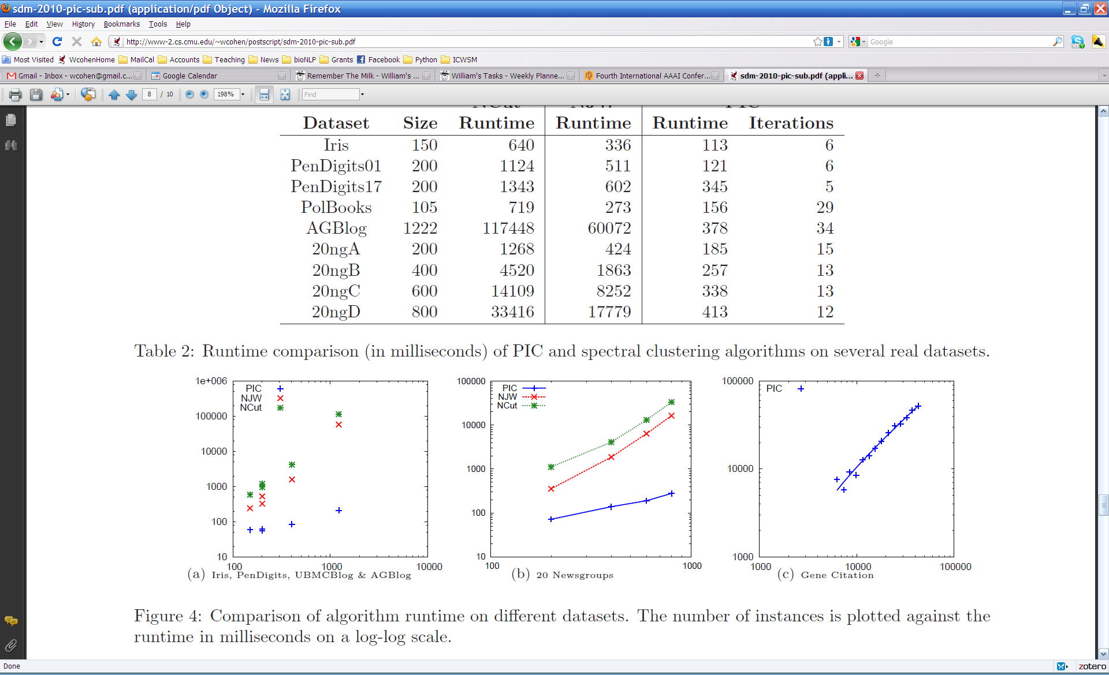

Slide 33
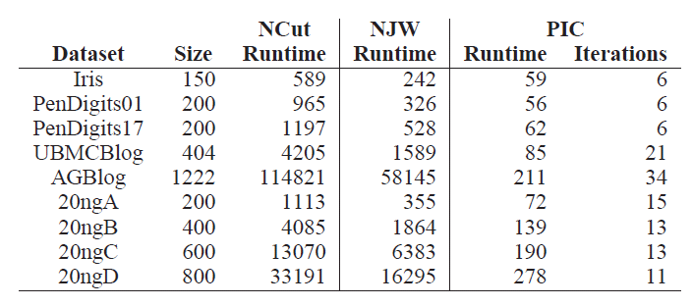
Experiments: run time and scalability
Time in millisec

Slide 34
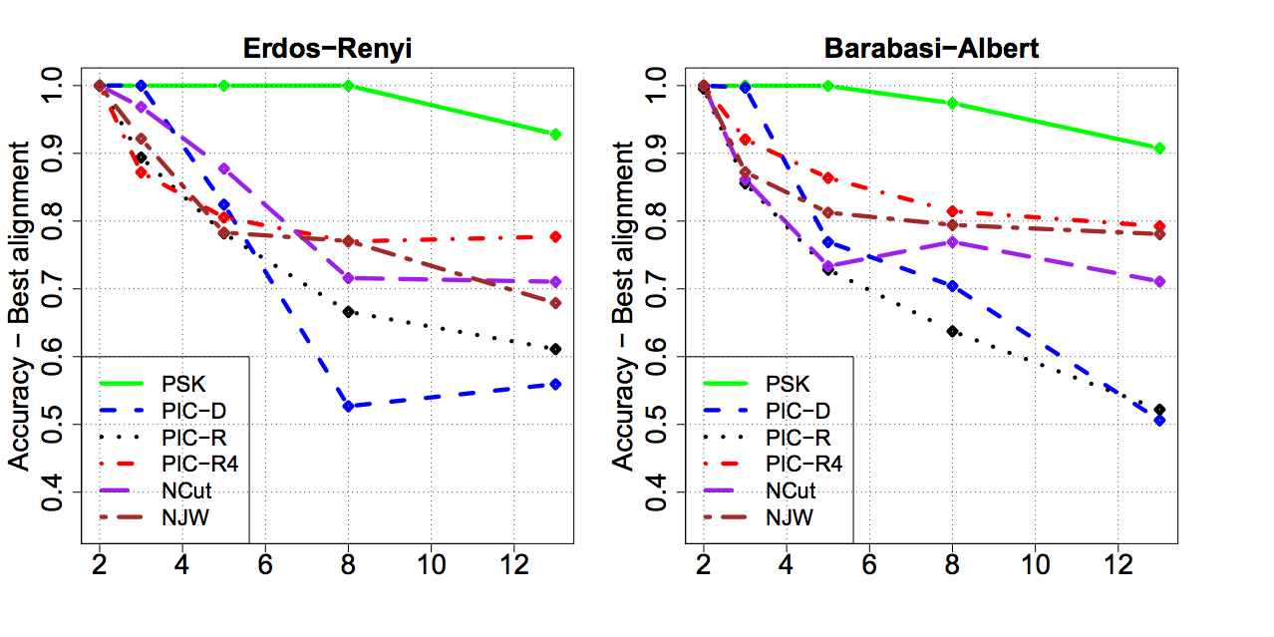
More experiments
Varying the number of clusters for PIC and PIC4 (starts with random 4-d point rather than a random 1-d point).

Slide 35
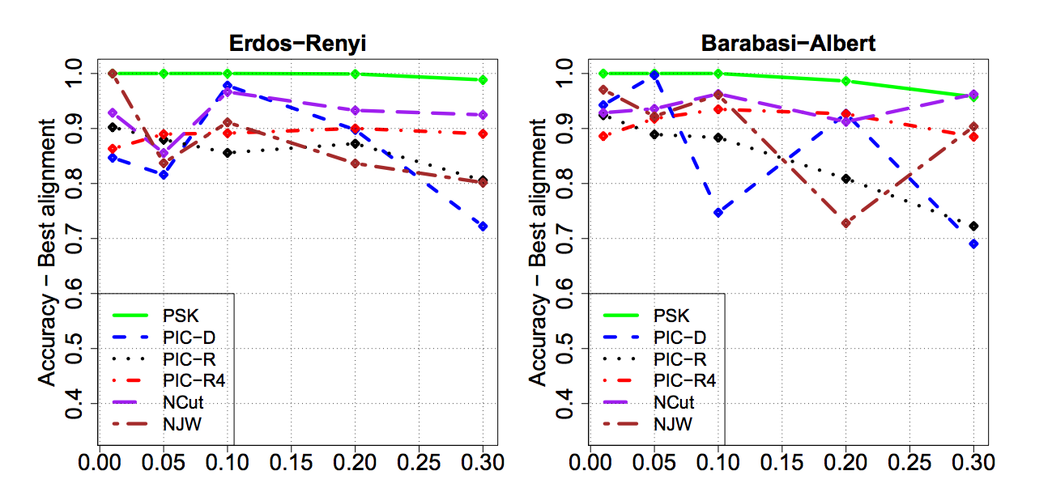
More experiments
Varying the amount of noise for PIC and PIC4 (starts with random 4-d point rather than a random 1-d point).

Slide 36
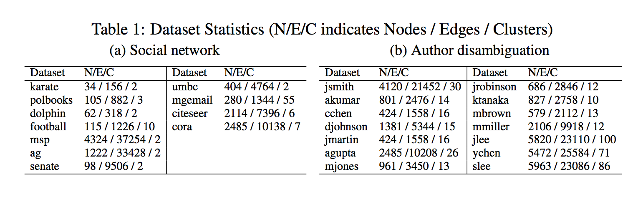
More experiments
More “real” network datasets from various domains

Slide 37
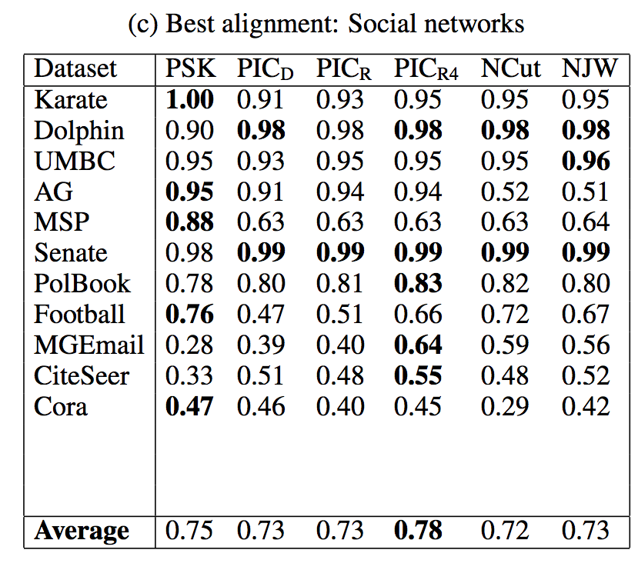
More experiments

Slide 38
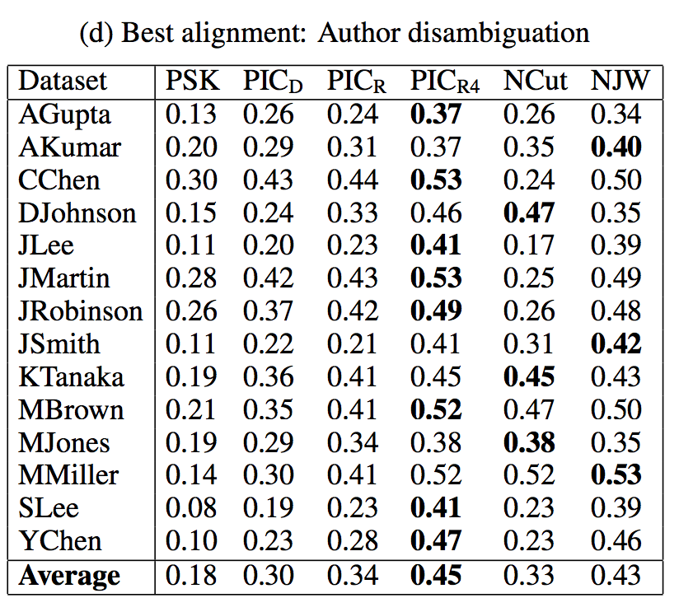

Slide 39
From SemiSupervised to Unsupervised Learning
and now a new topic….

Slide 40
Why I’m talking about graphs
Lots of large data is graphs
  Facebook, Twitter, citation data, and other social networks
  The web, the blogosphere, the semantic web, Freebase, Wikipedia, Twitter, and other information networks
  Text corpora (like RCV1), large datasets with discrete feature values, and other bipartite networks
    nodes = documents or words
    links connect document → word or word → document
  Computer networks, biological networks (proteins, ecosystems, brains, …), …
  Heterogeneous networks with multiple types of nodes
    people, groups, documents

Slide 41

Simplest Case: Bi-partite Graphs
CALO
William
graph
proposal
CMU
Notes:
Usually, information retrieval systems, for both the web and email, index data a bipartite graph, which includes words, or terms, on one hand – and files, on the other hand.
Given a query, which is a set of words, the retrieval engine ranks documents by their relevance, or similarity, to the query.
However, email can be represented by a richer graph. With nodes representing persons, dates, meetings and email-addresses.
In this graph, persons are inter-connected via messages that they send or receive, and via the meetings they attend. Files are inter-connected through the social network of the recipients, similar content and so on.
So, we have a typed graph – where every node has a type. And, in addition, the edges in the graph are directed and have types as well.
For example, “sent to” from email to recipient. Or “has subject term” going from an email message and a term appearing in its subject line.
Given a schema of relations, a whole corpus of email can be represented as one joint graph. For email, you can easily extract this information by parsing the email header.

Slide 42
Outline
Background on spectral clustering
“Power Iteration Clustering”
  Motivation
  Experimental results
Analysis: PIC vs spectral methods
PIC for sparse bipartite graphs
  “Lazy” Distance Computation
  “Lazy” Normalization
  Experimental Results

Slide 43
Motivation: Experimental Datasets are…
“Network” problems: natural graph structure
  PolBooks: 105 political books, 3 classes, linked by copurchaser
  UMBCBlog: 404 political blogs, 2 classes, blogroll links
  AGBlog: 1222 political blogs, 2 classes, blogroll links
  Also: Zachary’s karate club, citation networks, ...
“Manifold” problems: cosine distance between all pairs of classification instances
  Iris: 150 flowers, 3 classes
  PenDigits01,17: 200 handwritten digits, 2 classes (0-1 or 1-7)
  20ngA: 200 docs, misc.forsale vs soc.religion.christian
  20ngB: 400 docs, misc.forsale vs soc.religion.christian
  …
Gets expensive fast

Slide 44
Spectral Clustering: Graph = Matrix
A*v₁ = v₂ “propogates weights from neighbors”
A
*
v₁
=
v₂
 | A | B | C | D | E | F | G | H | I | J
A | _ | 1 | 1 |  |  | 1
B | 1 | _ | 1
C | 1 | 1 | _
D |  |  |  | _ | 1 | 1
E |  |  |  | 1 | _ | 1
F |  |  |  | 1 | 1 | _
G |  |  |  |  |  |  | _ |  | 1 | 1
H |  |  |  |  |  |  |  | _ | 1 | 1
I |  |  |  |  |  |  | 1 | 1 | _ | 1
J |  |  |  |  |  |  | 1 | 1 | 1 | _
A | 3
B | 2
C | 3
D
E
F
G
H
I
J
A | 2*1+3*1+0*1
B | 3*1+3*1
C | 3*1+2*1
D
E
F
G
H
I
J
C
A
B
G
I
H
J
F
D
E
M

Slide 45
Spectral Clustering: Graph = Matrix
W*v₁ = v₂ “propogates weights from neighbors”
W
*
v₁
=
v₂
W: normalized so columns sum to 1
 | A | B | C | D | E | F | G | H | I | J
A | _ | .5 | .5 |  |  | .3
B | .3 | _ | .5
C | .3 | .5 | _
D |  |  |  | _ | .5 | .3
E |  |  |  | .5 | _ | .3
F | .3 |  |  | .5 | .5 | _
G |  |  |  |  |  |  | _ |  | .3 | .3
H |  |  |  |  |  |  |  | _ | .3 | .3
I |  |  |  |  |  |  | .5 | .5 | _ | .3
J |  |  |  |  |  |  | .5 | .5 | .3 | _
A | 3
B | 2
C | 3
D
E
F
G
H
I
J
A | 2*.5+3*.5+0*.3
B | 3*.3+3*.5
C | 3*.33+2*.5
D
E
F
G
H
I
J
C
A
B
G
I
H
J
F
D
E
W = D⁻¹*A
D[i,i]=1/degree(i)

Slide 46
Lazy computation of distances and normalizers
Recall PIC’s update is
  v^{t} = W * v^{t-1 =} = D⁻¹A * v^{t-1}
  …where D is the [diagonal] degree matrix: D=A*1
My favorite distance metric for text is length-normalized TFIDF:
  Def’n: A(i,j)=<v_{i},v_{j}>/||v_{i}||*||v_{j}||
  Let N(i,i)=||v_{i}|| … and N(i,j)=0 for i!=j
  Let F(i,k)=TFIDF weight of word w_{k} in document v_{i}
  Then: A = N⁻¹F^{T}FN⁻¹
1 is a column vector of 1’s
<u,v>=inner product
||u|| is L2-norm

Slide 47
Lazy computation of distances and normalizers
Equivalent to using TFIDF/cosine on all pairs of examples but requires only sparse matrices
Recall PIC’s update is
  v^{t} = W * v^{t-1 =} = D⁻¹A * v^{t-1}
  …where D is the [diagonal] degree matrix: D=A*1
  Let F(i,k)=TFIDF weight of word w_{k} in document v_{i}
  Compute N(i,i)=||v_{i}|| … and N(i,j)=0 for i!=j
  Don’t compute A = N⁻¹F^{T}FN⁻¹
  Let D(i,i)= N⁻¹F^{T}FN⁻¹*1 where 1 is an all-1’s vector
    Computed as D=N⁻¹⁽F^{T(}F(N⁻¹*1))) for efficiency
  New update:
    v^{t} = D⁻¹A * v^{t-1} = D⁻¹ N⁻¹F^{T}FN⁻¹ *v^{t-1}

Slide 48
Experimental results
RCV1 text classification dataset
  800k + newswire stories
  Category labels from industry vocabulary
  Took single-label documents and categories with at least 500 instances
  Result: 193,844 documents, 103 categories
Generated 100 random category pairs
  Each is all documents from two categories
  Range in size and difficulty
  Pick category 1, with m₁ examples
  Pick category 2 such that 0.5m₁<m₂<2m₁

Slide 49
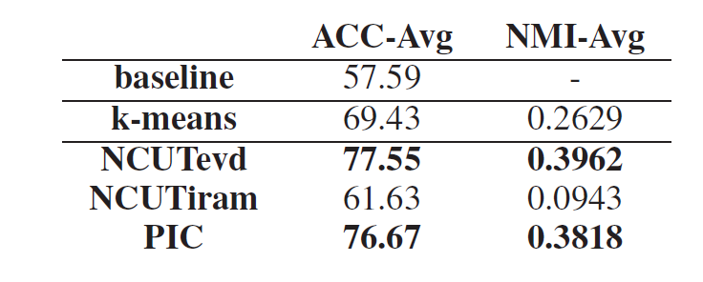
Results
NCUTevd: Ncut with exact eigenvectors
NCUTiram: Implicit restarted Arnoldi method
No stat. signif. diffs between NCUTevd and PIC

Slide 50
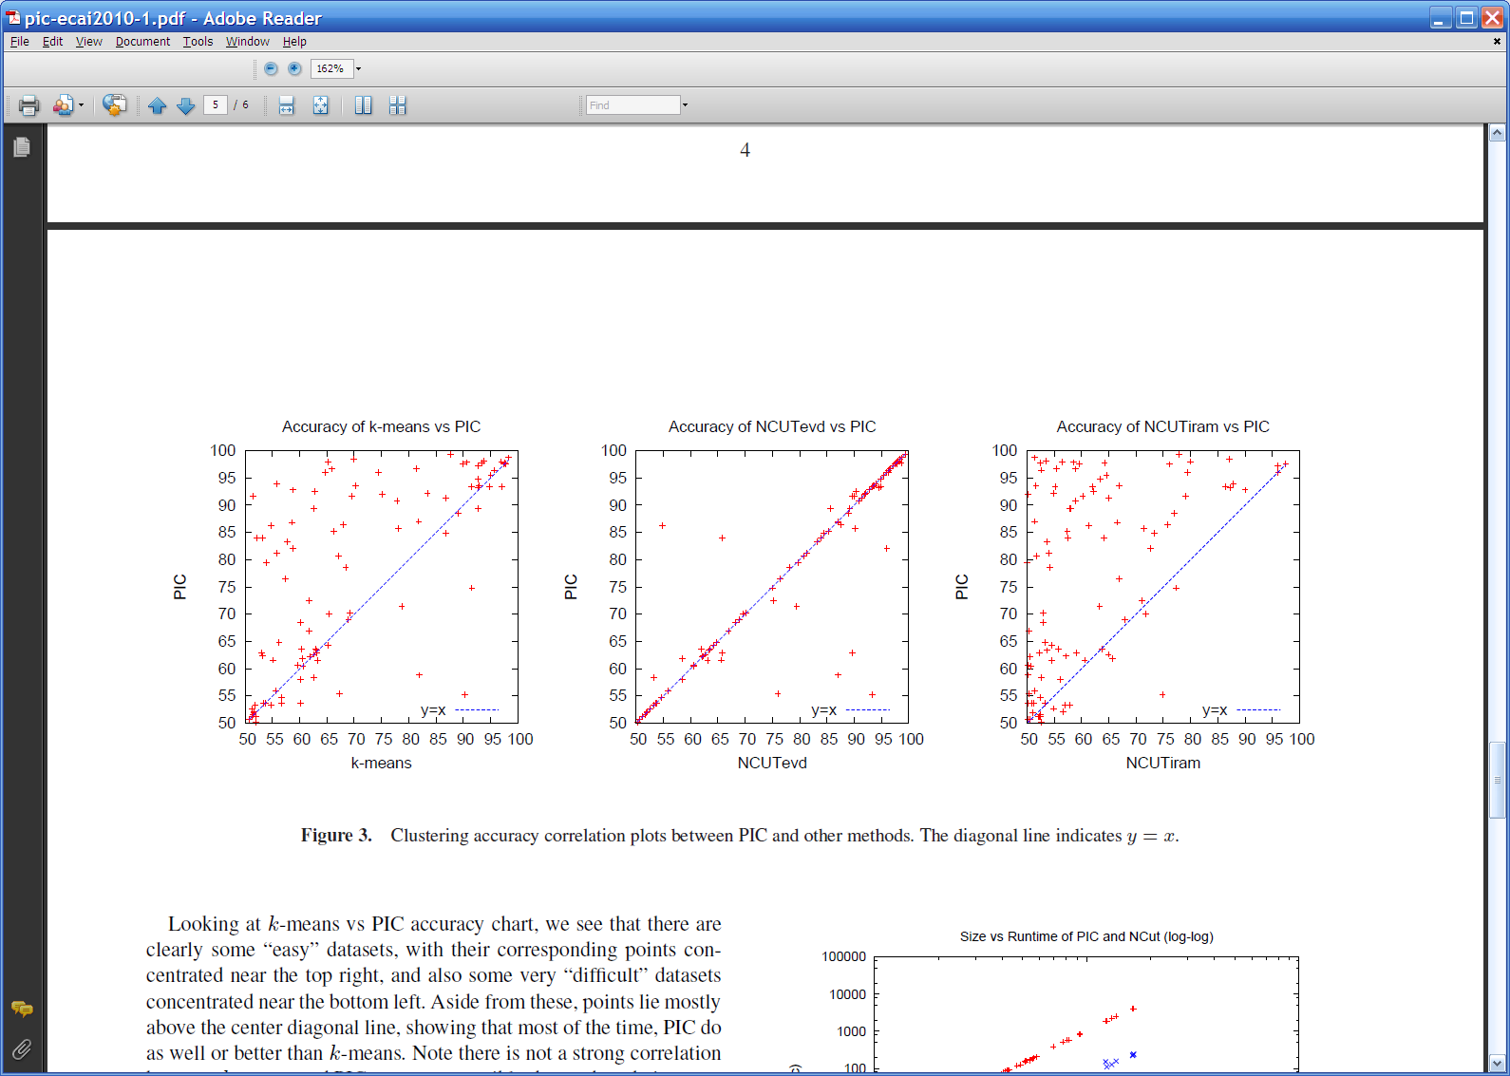
Results

Slide 51
Results

Slide 52
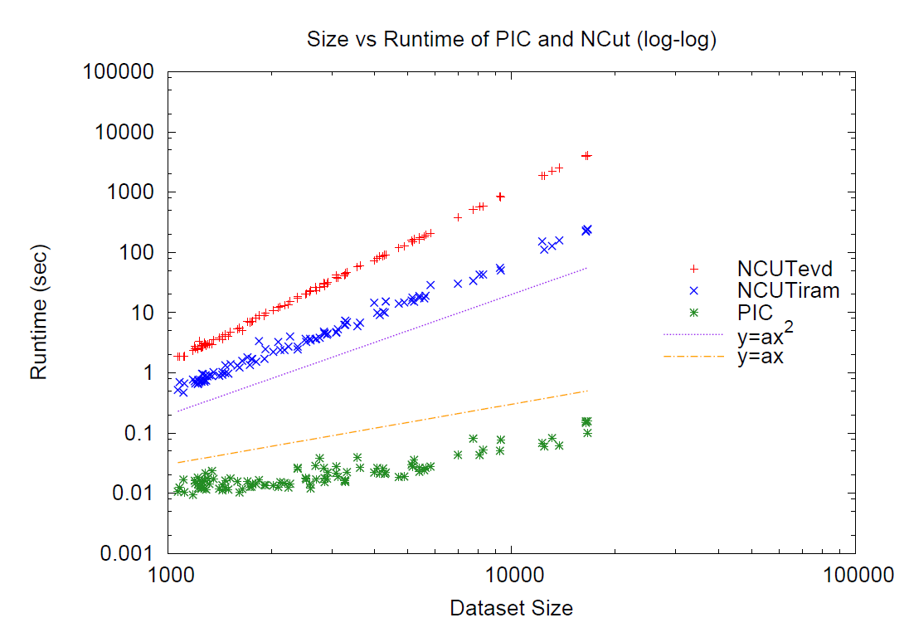
Results

Slide 53
Results
Linear run-time implies constant number of iterations
Number of iterations to “acceleration-convergence” is hard to analyze:
  Faster than a single complete run of power iteration to convergence
  On our datasets
    10-20 iterations is typical
    30-35 is exceptional

Slide 54
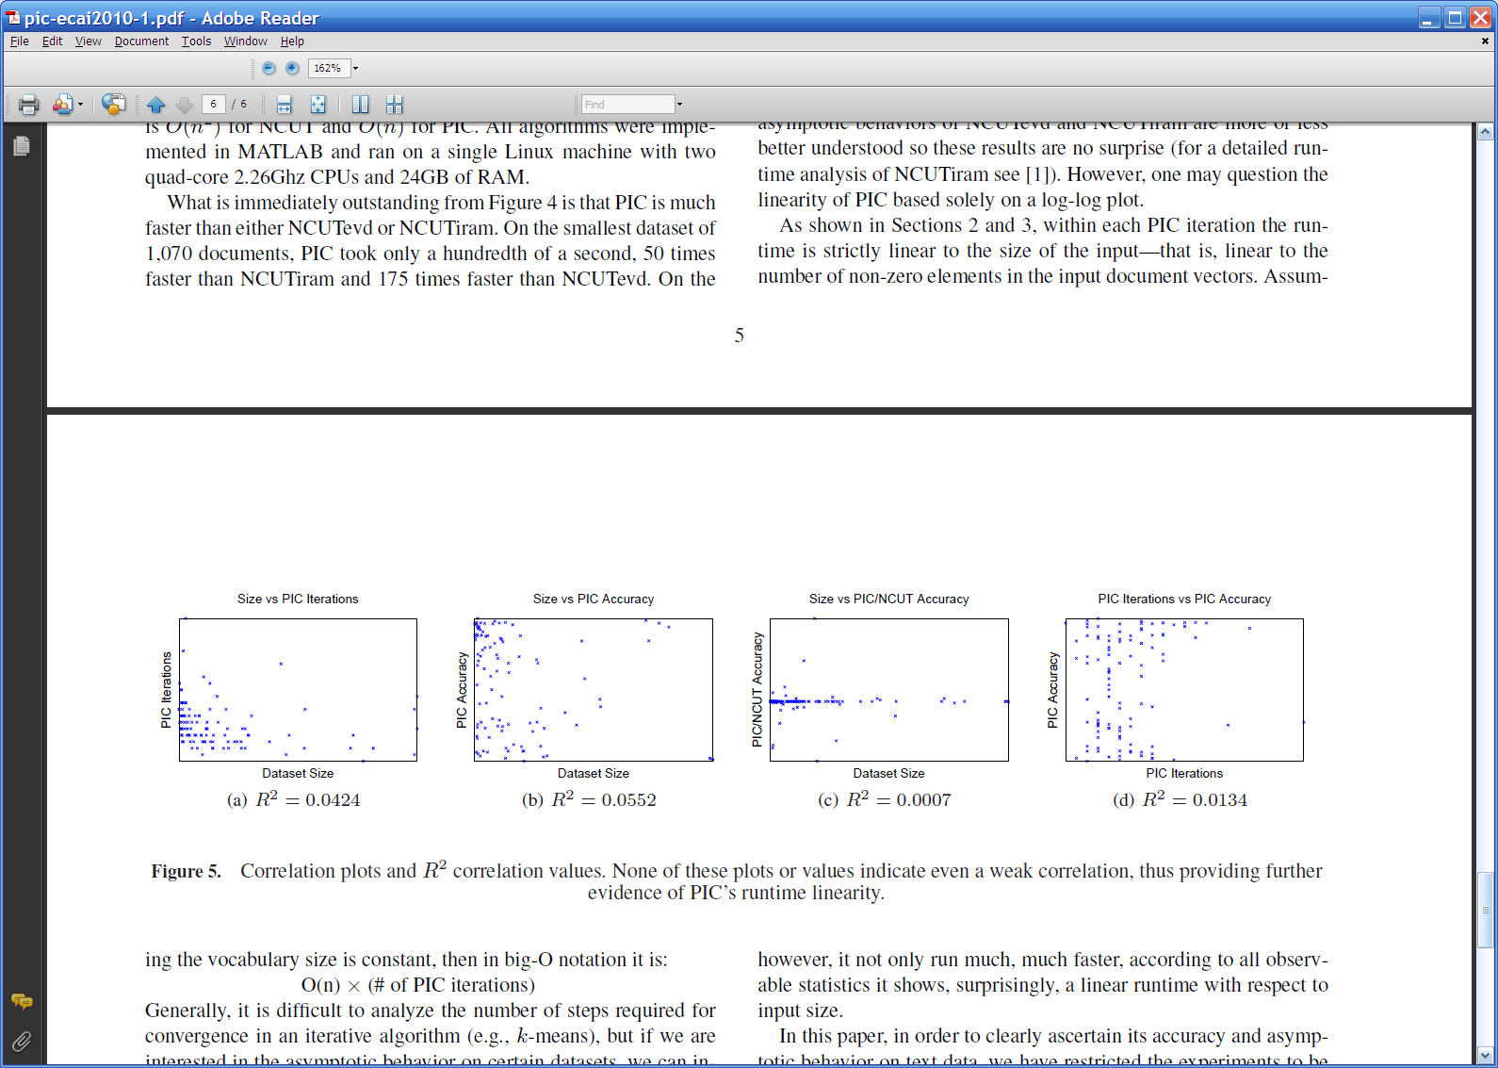

Slide 55
From SemiSupervised to Unsupervised Learning … and back again
Implicit manifolds work for unsupervised learning (PIC)
But PIC is so close to SSL methods

Slide 56
PIC: Power Iteration Clustering run power iteration (repeated averaging w/ neighbors) with early stopping

Slide 57
Harmonic Functions/CoEM/wvRN
then replace v^{t+1}(i) with seed values +1/-1 for labeled data
for 5-10 iterations
Classify data using final values from v

Slide 58
Implicit Manifolds on the NELL datasets
mayor of arg1
arg1 is home of
San Francisco
Austin
Paris
Pittsburgh
anxiety
traits such as arg1
live in arg1
traits such as arg1
arrogance
denial
selfishness
denial
selfishness
Seattle
Nodes “near” seeds
Nodes “far from” seeds

Slide 59
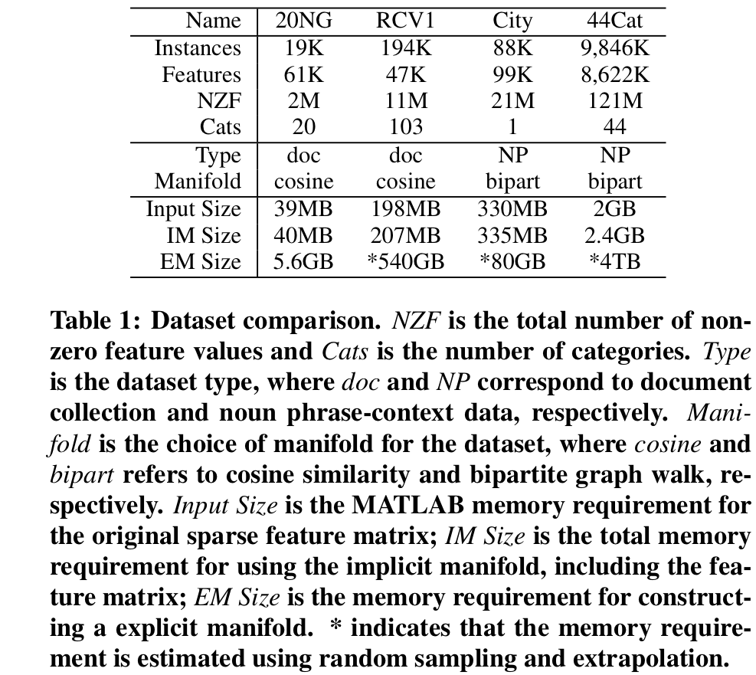
Using the Manifold Trick for SSL

Slide 60
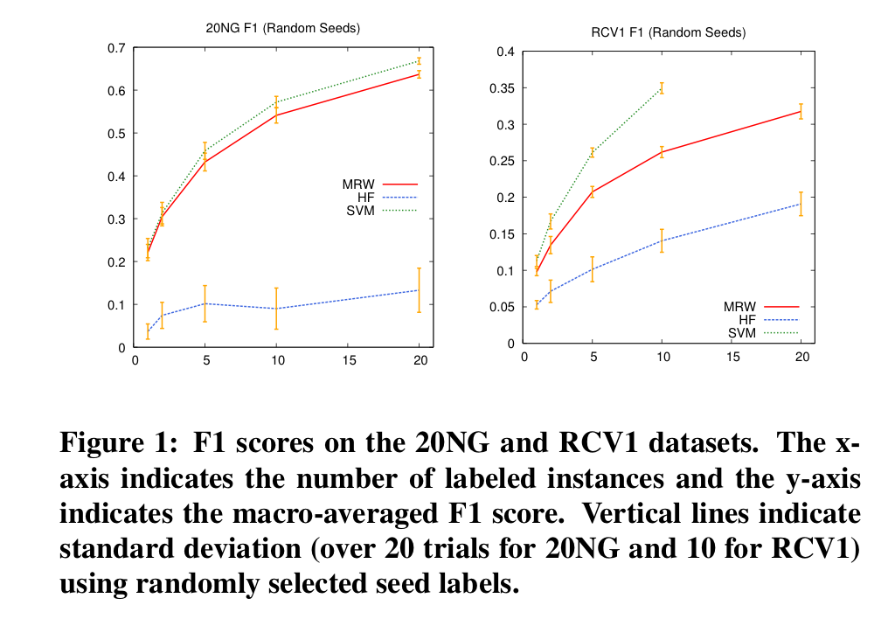
Using the Manifold Trick for SSL

Slide 61
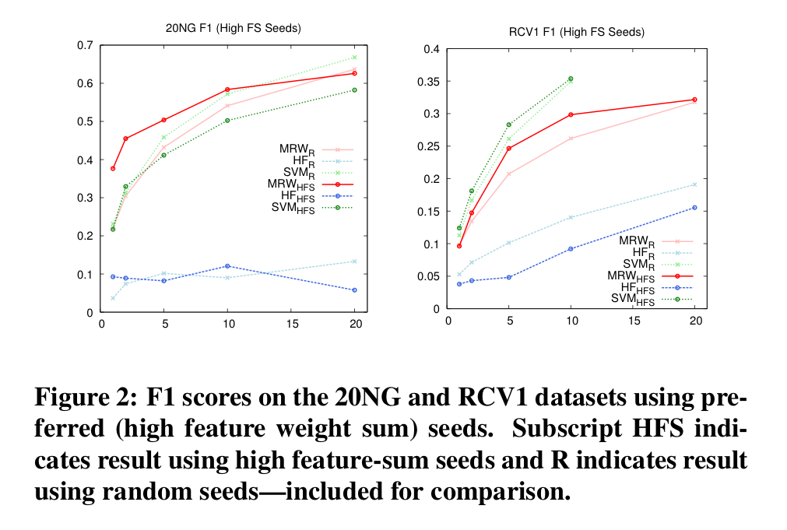
Using the Manifold Trick for SSL

Slide 62
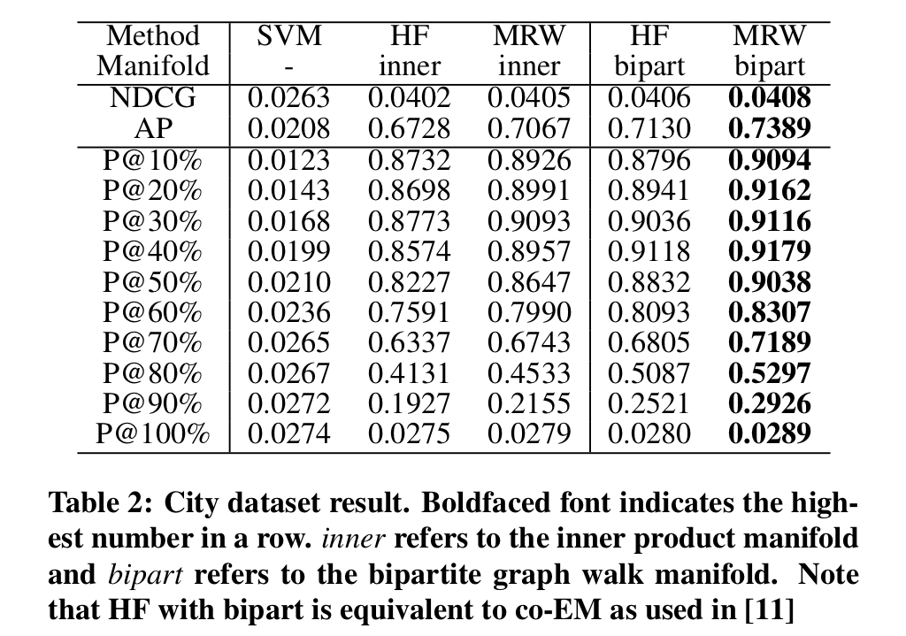
Using the Manifold Trick for SSL

Slide 63
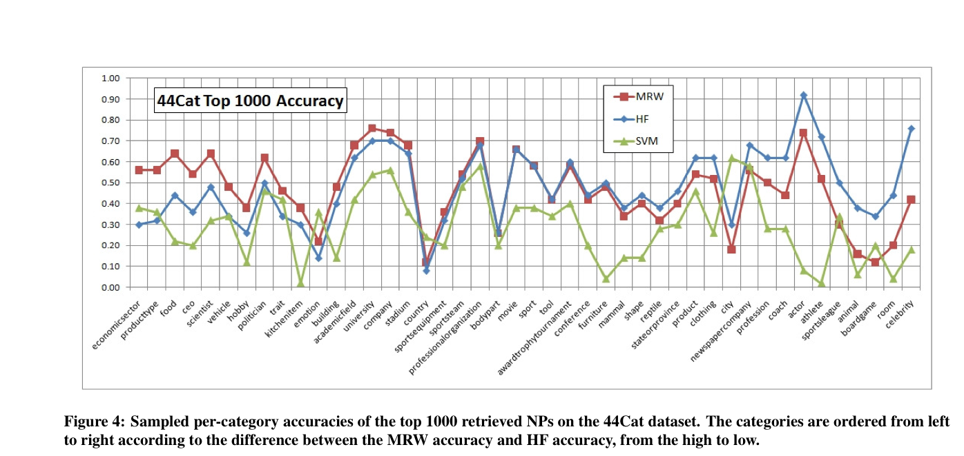
Using the Manifold Trick for SSL

Slide 64
Using the Manifold Trick for SSL
A smoothing trick:

Slide 65
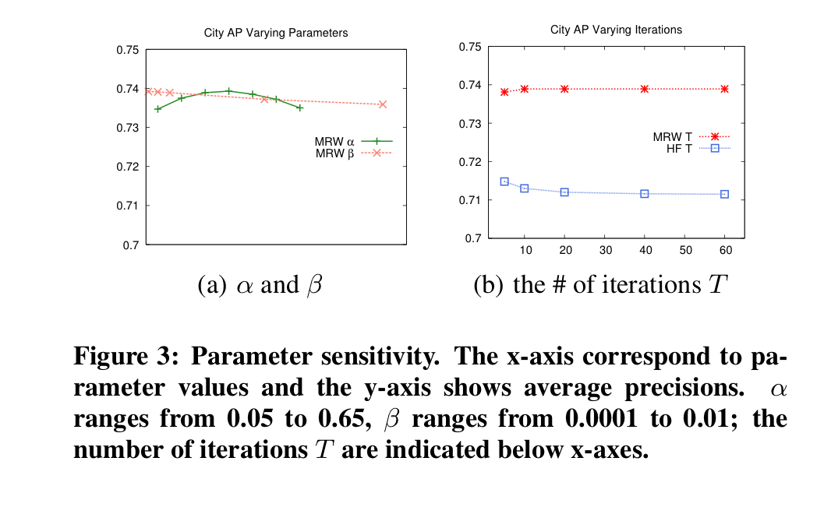
Using the Manifold Trick for SSL

