Slide 1
Scaling up Decision Trees

Slide 2
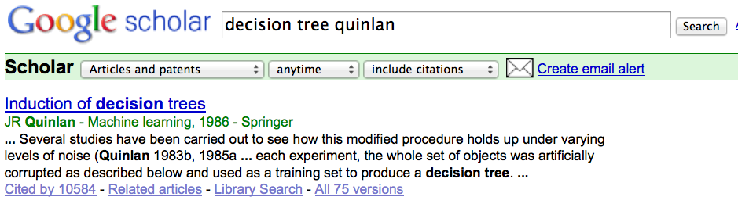

Decision tree learning

Slide 3
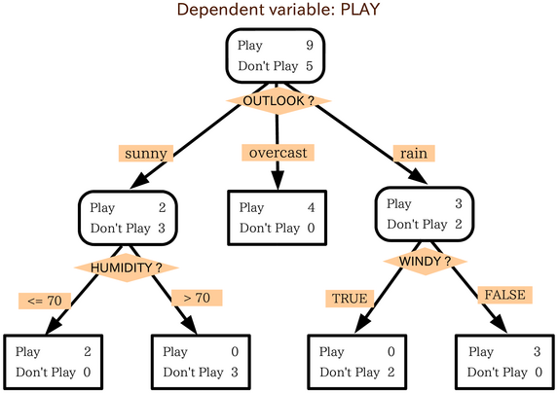
A decision tree

Slide 4
A regression tree
Play ~= 33
Play ~= 24
Play ~= 48
Play ~= 18
Play = 45m,45,60,40
Play ~= 37
Play ~= 5
Play ~= 0
Play ~= 32
Play = 30m, 45min
Play = 0m, 0m, 15m
Play = 0m, 0m
Play = 20m, 30m, 45m,

Slide 5
Most decision tree learning algorithms
Given dataset D:
return leaf(y) if all examples are in the same class y … or if blahblah...
pick the best split, on the best attribute a
a<θ or a ≥ θ
a or not(a)
a=c₁ or a=c₂ or …
a in {c₁,…,c_{k}} or not
split the data into D₁ ,D₂ , … D_{k} and recursively build trees for each subset
“Prune” the tree

Slide 6
Most decision tree learning algorithms
Given dataset D:
return leaf(y) if all examples are in the same class y … or if blahblah...
pick the best split, on the best attribute a
a<θ or a ≥ θ
a or not(a)
a=c₁ or a=c₂ or …
a in {c₁,…,c_{k}} or not
split the data into D₁ ,D₂ , … D_{k} and recursively build trees for each subset
“Prune” the tree
Popular splitting criterion: try to lower entropy of the y labels on the resulting partition
i.e., prefer splits that contain fewer labels, or that have very skewed distributions of labels

Slide 7
Most decision tree learning algorithms
“Pruning” a tree
avoid overfitting by removing subtrees somehow
trade variance for bias
15
13

Slide 8
Most decision tree learning algorithms
Given dataset D:
return leaf(y) if all examples are in the same class y … or if blahblah...
pick the best split, on the best attribute a
a<θ or a ≥ θ
a or not(a)
a=c₁ or a=c₂ or …
a in {c₁,…,c_{k}} or not
split the data into D₁ ,D₂ , … D_{k} and recursively build trees for each subset
“Prune” the tree
Same idea

Slide 9
Decision trees: plus and minus
Simple and fast to learn
Arguably easy to understand (if compact)
Very fast to use:
often you don’t even need to compute all attribute values
Can find interactions between variables (play if it’s cool and sunny or ….) and hence non-linear decision boundaries
Don’t need to worry about how numeric values are scaled

Slide 10
Decision trees: plus and minus
Hard to prove things about
Not well-suited to probabilistic extensions
Don’t (typically) improve over linear classifiers when you have lots of features
Sometimes fail badly on problems that linear classifiers perform well on

Slide 11




Slide 12
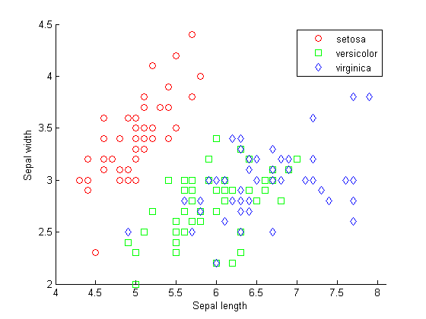
Another view of a decision tree

Slide 13
Another view of a decision tree
Sepal_length<5.7
Sepal_width>2.8

Slide 14
Another view of a decision tree

Slide 15
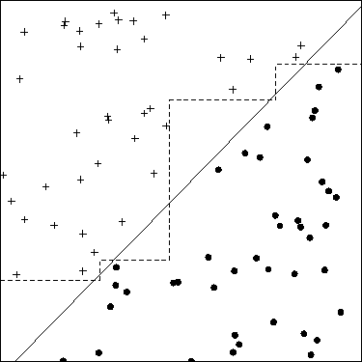
Another picture…

Slide 16
Fixing decision trees….
Hard to prove things about
Don’t (typically) improve over linear classifiers when you have lots of features
Sometimes fail badly on problems that linear classifiers perform well on
Solution is two build ensembles of decision trees

Slide 17
Most decision tree learning algorithms
“Pruning” a tree
avoid overfitting by removing subtrees somehow
trade variance for bias
15
13
Alternative - build a big ensemble to reduce the variance of the algorithms - via boosting, bagging, or random forests

Slide 18
Example: random forests
Repeat T times:
Draw a bootstrap sample S (n examples taken with replacement) from the dataset D.
Select a subset of features to use for S
Usually half to 1/3 of the full feature set
Build a tree considering only the features in the selected subset
Don’t prune
Vote the classifications of all the trees at the end
Ok - how well does this work?

Slide 19
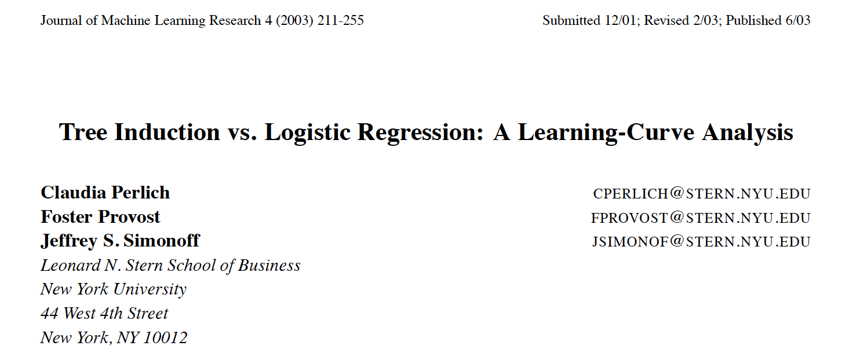

Slide 20
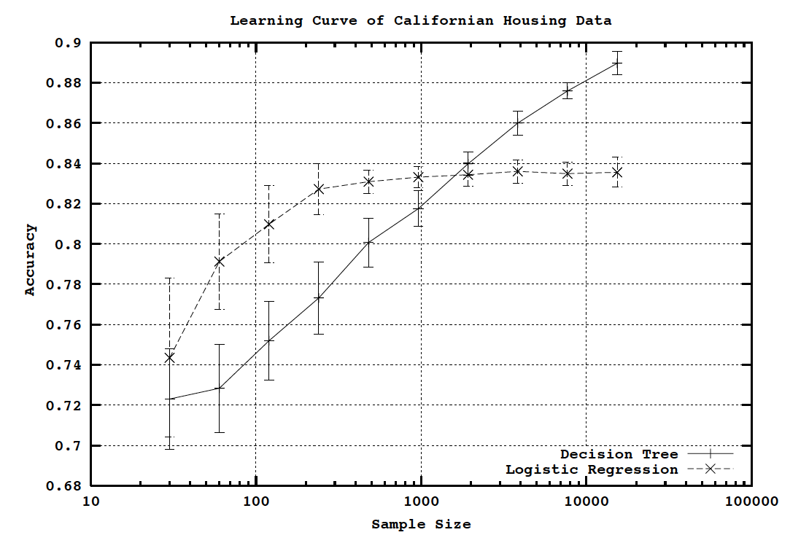

Slide 21
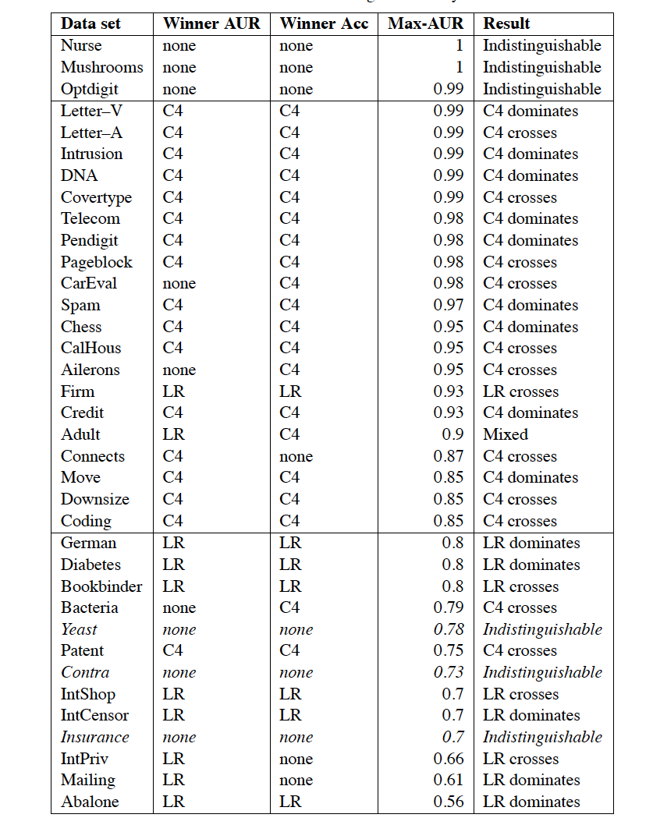
Generally, bagged decision trees outperform the linear classifier eventually if the data is large enough and clean enough.

Slide 22
Scaling up decision tree algorithms
Given dataset D:
return leaf(y) if all examples are in the same class y
pick the best split, on the best attribute a
a<θ or a ≥ θ
a or not(a)
a=c₁ or a=c₂ or …
a in {c₁,…,c_{k}} or not
split the data into D₁ ,D₂ , … D_{k} and recursively build trees for each subset
“Prune” the tree

Slide 23
Scaling up decision tree algorithms
Given dataset D:
return leaf(y) if all examples are in the same class y
pick the best split, on the best attribute a
a<θ or a ≥ θ
a or not(a)
a=c₁ or a=c₂ or …
a in {c₁,…,c_{k}} or not
split the data into D₁ ,D₂ , … D_{k} and recursively build trees for each subset
“Prune” the tree
easy cases!

Slide 24
Scaling up decision tree algorithms
Given dataset D:
return leaf(y) if all examples are in the same class y
pick the best split, on the best attribute a
a<θ or a ≥ θ
a or not(a)
a=c₁ or a=c₂ or …
a in {c₁,…,c_{k}} or not
split the data into D₁ ,D₂ , … D_{k} and recursively build trees for each subset
“Prune” the tree
Numeric attribute:
sort examples by a
retain label y
scan thru once and update the histogram of y|a<θ and y|a>θ at each point θ
pick the threshold θ with the best entropy score
O(nlogn) due to the sort
but repeated for each attribute

Slide 25
Scaling up decision tree algorithms
Given dataset D:
return leaf(y) if all examples are in the same class y
pick the best split, on the best attribute a
a<θ or a ≥ θ
a or not(a)
a=c₁ or a=c₂ or …
a in {c₁,…,c_{k}} or not
split the data into D₁ ,D₂ , … D_{k} and recursively build trees for each subset
“Prune” the tree
Numeric attribute:
or, fix a set of possible split-points θ in advance
scan through once and compute the histogram of y’s
O(n) per attribute

Slide 26
Scaling up decision tree algorithms
Given dataset D:
return leaf(y) if all examples are in the same class y
pick the best split, on the best attribute a
a<θ or a ≥ θ
a or not(a)
a=c₁ or a=c₂ or …
a in {c₁,…,c_{k}} or not
split the data into D₁ ,D₂ , … D_{k} and recursively build trees for each subset
“Prune” the tree
Subset splits:
expensive but useful
there is a similar sorting trick that works for the regression case

Slide 27
Scaling up decision tree algorithms
Given dataset D:
return leaf(y) if all examples are in the same class y
pick the best split, on the best attribute a
a<θ or a ≥ θ
a or not(a)
a=c₁ or a=c₂ or …
a in {c₁,…,c_{k}} or not
split the data into D₁ ,D₂ , … D_{k} and recursively build trees for each subset
“Prune” the tree
Points to ponder:
different subtrees are distinct tasks
once the data is in memory, this algorithm is fast.
each example appears only once in each level of the tree
depth of the tree is usually O(log n)
as you move down the tree, the datasets get smaller

Slide 29
Scaling up decision tree algorithms
Given dataset D:
return leaf(y) if all examples are in the same class y
pick the best split, on the best attribute a
a<θ or a ≥ θ
a or not(a)
a=c₁ or a=c₂ or …
a in {c₁,…,c_{k}} or not
split the data into D₁ ,D₂ , … D_{k} and recursively build trees for each subset
“Prune” the tree
The classifier is sequential and so is the learning algorithm
it’s really hard to see how you can learn the lower levels without learning the upper ones first!

Slide 30
Scaling up decision tree algorithms
Given dataset D:
return leaf(y) if all examples are in the same class y
pick the best split, on the best attribute a
a<θ or a ≥ θ
a or not(a)
a=c₁ or a=c₂ or …
a in {c₁,…,c_{k}} or not
split the data into D₁ ,D₂ , … D_{k} and recursively build trees for each subset
“Prune” the tree
Bottleneck points:
what’s expensive is picking the attributes
especially at the top levels
also, moving the data around
in a distributed setting

Slide 31
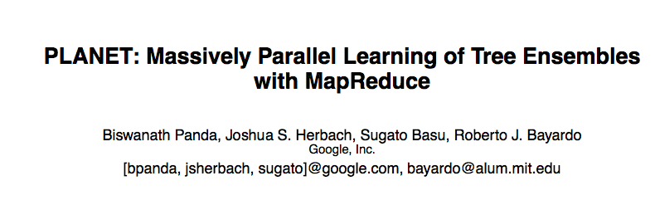

Slide 32
Key ideas
A controller to generate Map-Reduce jobs
distribute the task of building subtrees of the main decision trees
handle “small” and “large” tasks differently
small:
build tree in-memory
large:
build the tree (mostly) depth-first
send the whole dataset to all mappers and let them classify instances to nodes on-the-fly

Slide 33
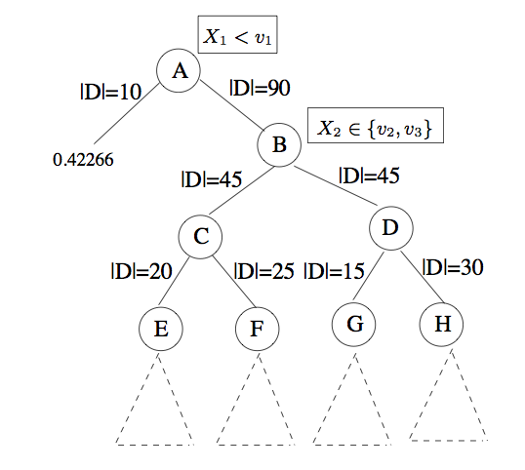
Walk through
DeQueue “large” job for root, A.
Submit job to compute split quality for each attribute:
reduction in var
size of left/right branches
branch predictions (Left/Right)
After completion:
Pick best split and add it to the “model”
Key point: we need the split criterion (var) to be something that can be computed in a map-reduce framework.
If we just need to aggregate histograms, we’re ok.

Slide 34
Walk through
DeQueue “large” job for root, A.
Submit job to compute split quality for each attribute:
reduction in var
size of left/right branches
branch predictions (Left/Right)
After completion:
Pick best split and add it to the “model”
Key point: model file is shared with the mappers.
The model file also contains information on job completion status (for error recovery)

Slide 35
Walk through
DeQueue job for left branch:
it’s small enough to stop, so we do
DeQueue job for B:
submit mapreduce job
scan thru the whole dataset and identifies records send in B
computes possible splits for these records
on completion pick best split and enQueue…

Slide 36
Walk through
DeQueue job for left branch:
it’s small enough to stop, so we do
DeQueue job for B:
submit mapreduce job
scan thru the whole dataset and identifies records send in B
computes possible splits for these records
on completion pick best split

Slide 37
Walk through
DeQueue jobs for C and D
submits a single map-reduce job for {C,D}
scan thru data
pick nodes sent to C or D.
computes split quality
sends to controller

Slide 38
Walk through
DeQueued jobs for E, F, G are small enough for memory
put them on a separate “inMemQueue”
DeQueue job H is send to map-reduce ….
…

Slide 39
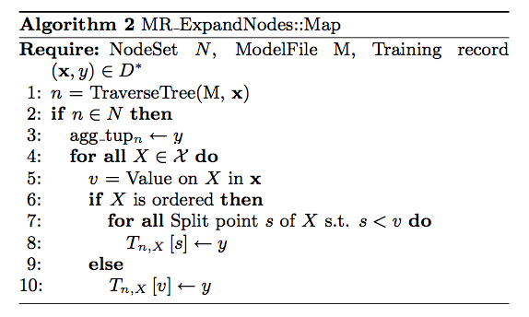
MR routines for expanding nodes
Update all histograms incrementally - use
fixed number of split points to save memory

Slide 40
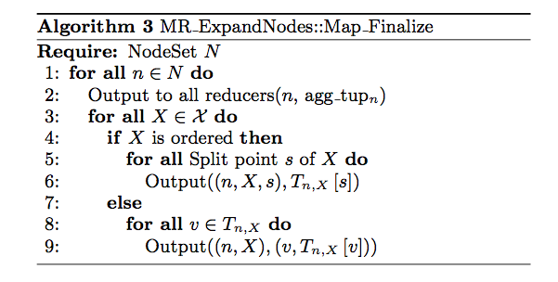
MR routines for expanding nodes

Slide 41
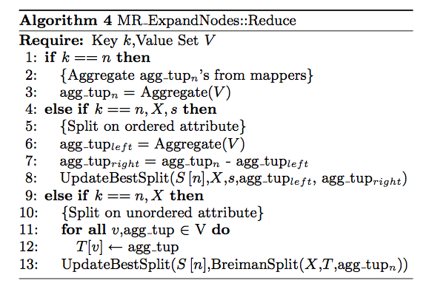
MR routines for expanding node

Slide 42
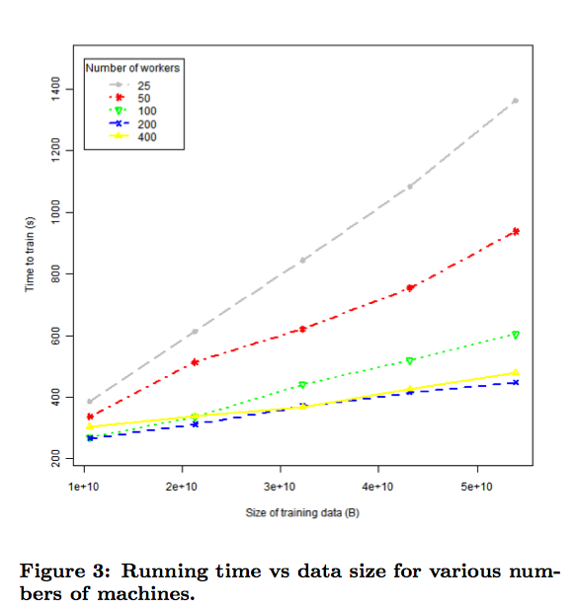

Slide 43
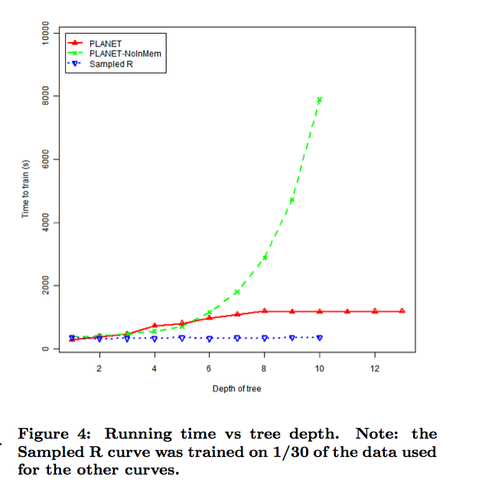

Slide 44
