Slide 1

In the once upon a time days of the First Age of Magic, the prudent sorcerer regarded his own true name as his most valued possession but also the greatest threat to his continued good health, for--the stories go--once an enemy, even a weak unskilled enemy, learned the sorcerer's true name, then routine and widely known spells could destroy or enslave even the most powerful. As times passed, and we graduated to the Age of Reason and thence to the first and second industrial revolutions, such notions were discredited. Now it seems that the Wheel has turned full circle (even if there never really was a First Age) and we are back to worrying about true names again:
The first hint Mr. Slippery had that his own True Name might be known--and, for that matter, known to the Great Enemy--came with the appearance of two black Lincolns humming up the long dirt driveway ... Roger Pollack was in his garden weeding, had been there nearly the whole morning.... Four heavy-set men and a hard-looking female piled out, started purposefully across his well-tended cabbage patch.…
This had been, of course, Roger Pollack's great fear. They had discovered Mr. Slippery's True Name and it was Roger Andrew Pollack TIN/SSAN 0959-34-2861.
Notes:
To do

Slide 2
Similarity Joins for Strings and Sets
William Cohen

Slide 3
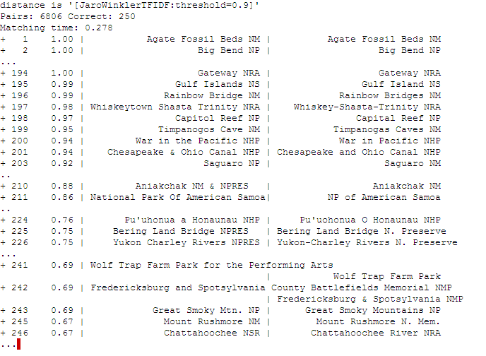
Semantic Joining with Multiscale Statistics
William Cohen
Katie Rivard, Dana Attias-Moshevitz
CMU

Slide 4
WHIRL queries
“Find reviews of sci-fi comedies [movie domain]
  FROM review SELECT * WHERE r.text~’sci fi comedy’
  (like standard ranked retrieval of “sci-fi comedy”)
“ “Where is [that sci-fi comedy] playing?”
  FROM review as r, LISTING as s, SELECT *
  WHERE r.title~s.title and r.text~’sci fi comedy’
  (best answers: titles are similar to each other – e.g., “Hitchhiker’s Guide to the Galaxy” and “The Hitchhiker’s Guide to the Galaxy, 2005” and the review text is similar to “sci-fi comedy”)

Slide 5
Aside: Why WHIRL’s query language was cool
Combination of cascading queries and getting top-k answers is very useful
  Highly selective queries:
    system can apply lots of constraints
    user can pick from a small set of well-constrained potential answers
  Very broad queries:
    system can cherry-pick and get the easiest/most obvious answers
    most of what the user sees is correct
Similar to joint inference schemes
Can handle lots of problems
  classification,

Slide 6
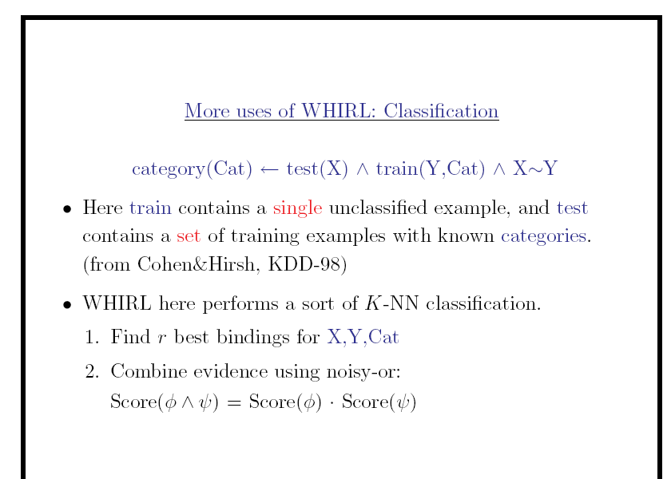

Slide 7
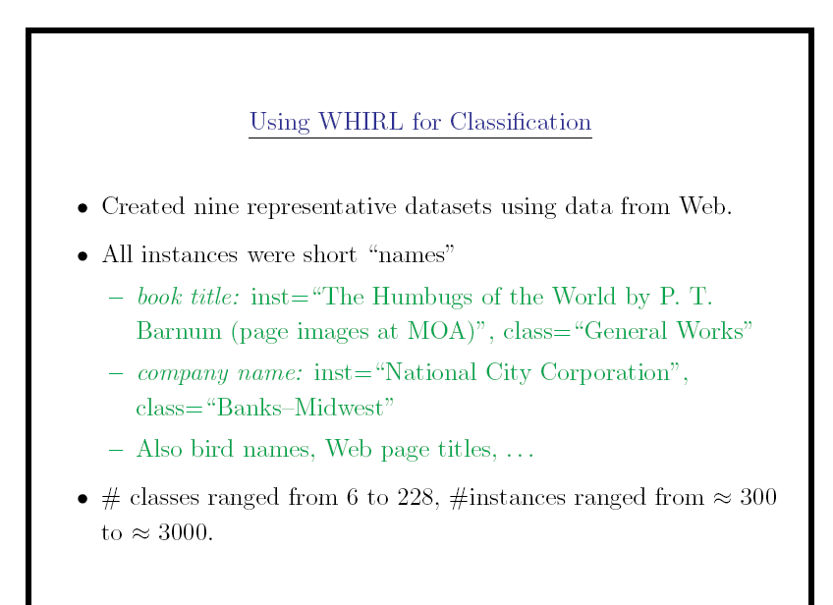

Slide 8
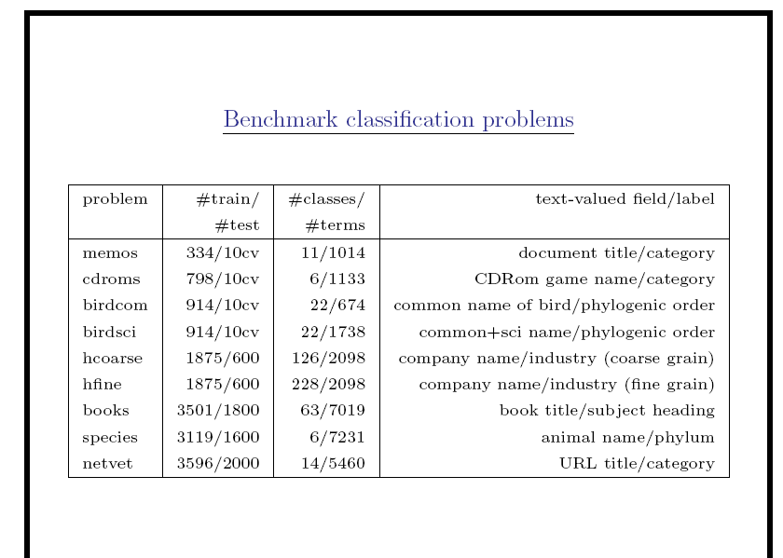

Slide 9
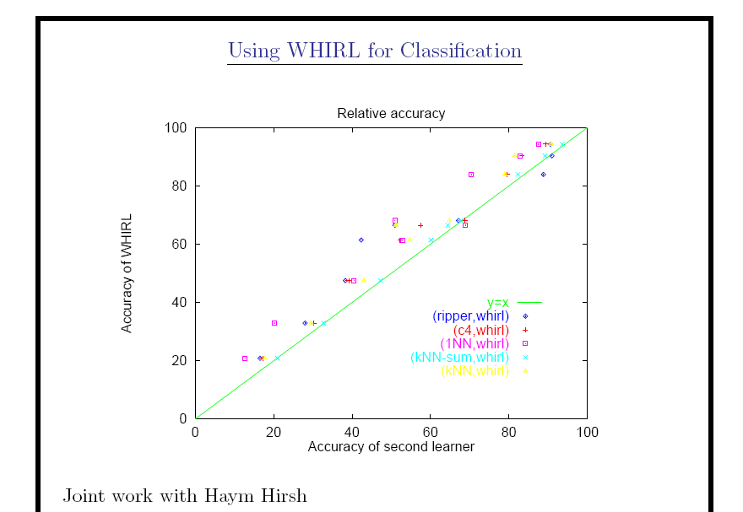

Slide 10


Slide 11
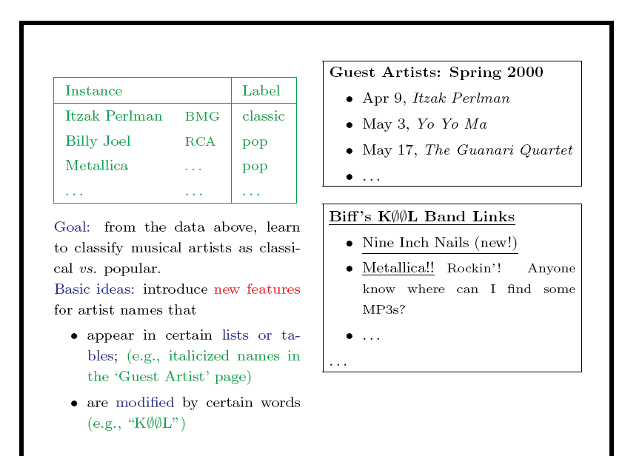

Slide 12
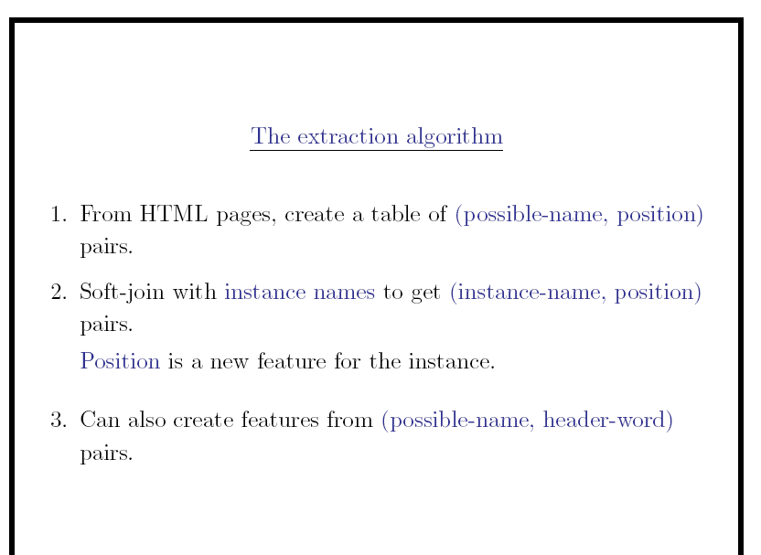

Slide 13
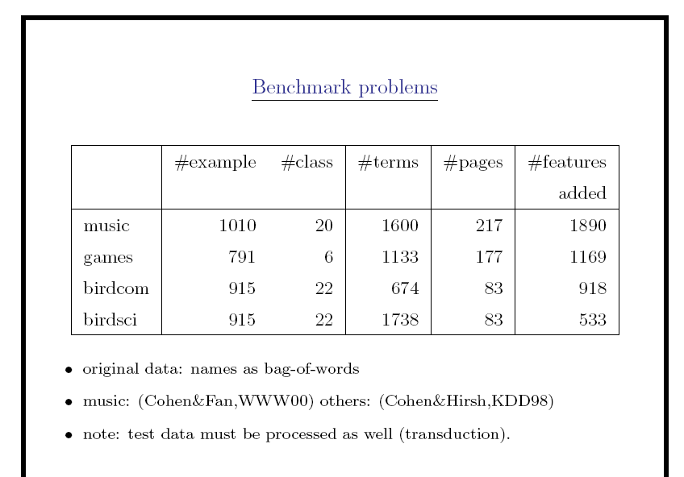

Slide 14
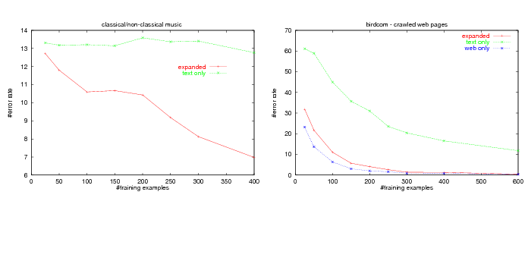

Slide 15
Epilogue
A few followup query systems to WHIRL
  ELIXIR, iSPARQL, …
“Joint inference” trick mostly ignored
  and/or rediscovered over and over
Lots and lots of work on similarity/distance metrics and efficient similarity joins
  much of which rediscovers A*-like tricks

Slide 16
Outline
Why joins are important
Why similarity joins are important
Useful similarity metrics for sets and strings
Fast methods for K-NN and similarity joins
  Blocking
  Indexing
  Short-cut algorithms
  Parallel implementation

Slide 17
Robust distance metrics for strings
Kinds of distances between s and t:
  Edit-distance based (Levenshtein, Smith-Waterman, …): distance is cost of cheapest sequence of edits that transform s to t.
  Term-based (TFIDF, Jaccard, DICE, …): distance based on set of words in s and t, usually weighting “important” words
  Which methods work best when?

Slide 18
Edit distances
Common problem: classify a pair of strings (s,t) as “these denote the same entity [or similar entities]”
  Examples:
    (“Carnegie-Mellon University”, “Carnegie Mellon Univ.”)
    (“Noah Smith, CMU”, “Noah A. Smith, Carnegie Mellon”)
Applications:
  Co-reference in NLP
  Linking entities in two databases
  Removing duplicates in a database
  Finding related genes
  “Distant learning”: training NER from dictionaries

Slide 19
Edit distances: Levenshtein
Edit-distance metrics
  Distance is shortest sequence of edit commands that transform s to t.
  Simplest set of operations:
    Copy character from s over to t
    Delete a character in s (cost 1)
    Insert a character in t (cost 1)
    Substitute one character for another (cost 1)
  This is “Levenshtein distance”

Slide 20
Levenshtein distance - example
distance(“William Cohen”, “Willliam Cohon”)
s
W | I | L | L | I | A | M | _ | C | O | H | E |  | N
W | I | L | L | L | I | A | M | _ | C | O | H | O | N
C | C | C | C | I | C | C | C | C | C | C | C | S | C
0 | 0 | 0 | 0 | 1 | 1 | 1 | 1 | 1 | 1 | 1 | 1 | 2 | 2
alignment
t
op
cost

Slide 21
Levenshtein distance - example
distance(“William Cohen”, “Willliam Cohon”)
s
W | I | L | L |  | I | A | M | _ | C | O | H | E | N
W | I | L | L | L | I | A | M | _ | C | O | H | O | N
C | C | C | C | I | C | C | C | C | C | C | C | S | C
0 | 0 | 0 | 0 | 1 | 1 | 1 | 1 | 1 | 1 | 1 | 1 | 2 | 2
gap
alignment
t
op
cost

Slide 22
Computing Levenshtein distance - 1
D(i,j) = score of best alignment from s1..si to t1..tj
D(i-1,j-1), if si=tj //copy
D(i-1,j-1)+1, if si!=tj //substitute
D(i-1,j)+1 //insert
D(i,j-1)+1 //delete
= min

Slide 23
Computing Levenshtein distance - 2
D(i,j) = score of best alignment from s1..si to t1..tj
D(i-1,j-1) + d(si,tj) //subst/copy
D(i-1,j)+1 //insert
D(i,j-1)+1 //delete
= min
(simplify by letting d(c,d)=0 if c=d, 1 else)
also let D(i,0)=i (for i inserts) and D(0,j)=j

Slide 24
Computing Levenshtein distance - 3
D(i-1,j-1) + d(si,tj) //subst/copy
D(i-1,j)+1 //insert
D(i,j-1)+1 //delete
D(i,j)= min
 |  | C | O |  | H | E | N
M |  | 1 | 2 |  | 3 | 4 | 5
C |  | 1 | 2 |  | 3 | 4 | 5
C |  | 2 | 2 |  | 3 | 4 | 5
O |  | 3 | 2 |  | 3 | 4 | 5
H |  | 4 | 3 |  | 2 | 3 | 4
N |  | 5 | 4 |  | 3 | 3 | 3
= D(s,t)

Slide 25
Jaro-Winkler metric
Very ad hoc
Very fast
Very good on person names
Algorithm sketch
  characters in s,t “match” if they are identical and appear at similar positions
  characters are “transposed” if they match but aren’t in the same relative order
  score is based on numbers of matching and transposed characters
  there’s a special correction for matching the first few characters

Slide 26
Set-based distances
TFIDF/Cosine distance
  after weighting and normalizing vectors, a dot product
Jaccard distance
Dice
…

Slide 27
Robust distance metrics for strings
SecondString (Cohen, Ravikumar, Fienberg, IIWeb 2003):
Java toolkit of string-matching methods from AI, Statistics, IR and DB communities
Tools for evaluating performance on test data
Used to experimentally compare a number of metrics

Slide 28
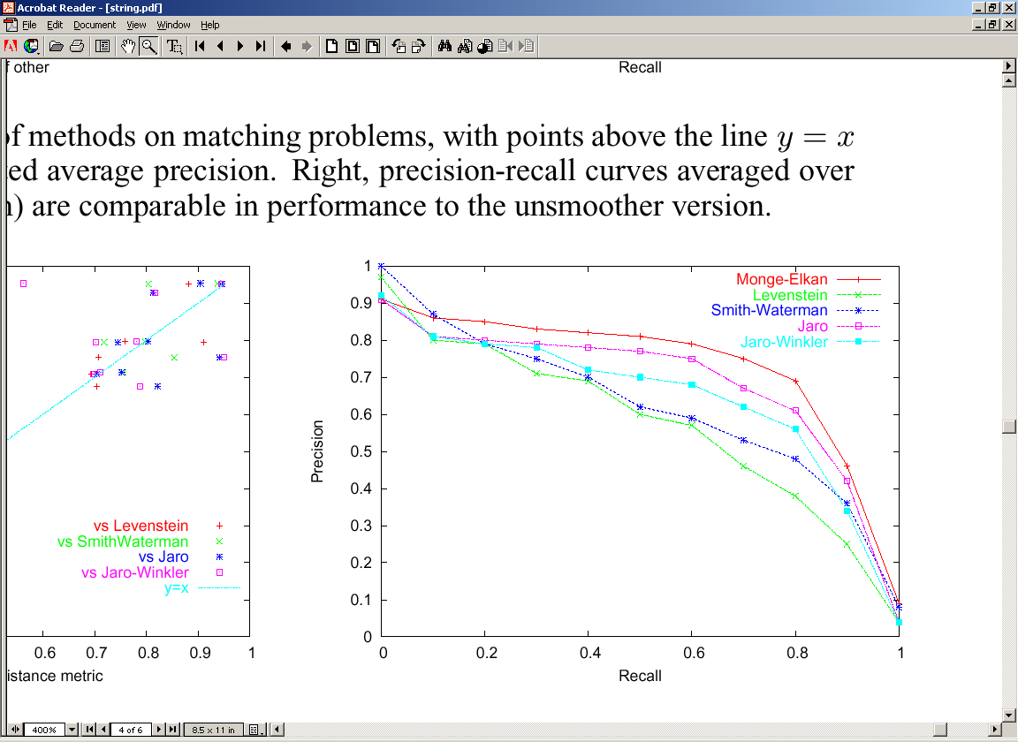
Results: Edit-distance variants
Monge-Elkan (a carefully-tuned Smith-Waterman variant) is the best on average across the benchmark datasets…
11-pt interpolated recall/precision curves averaged across 11 benchmark problems

Slide 29
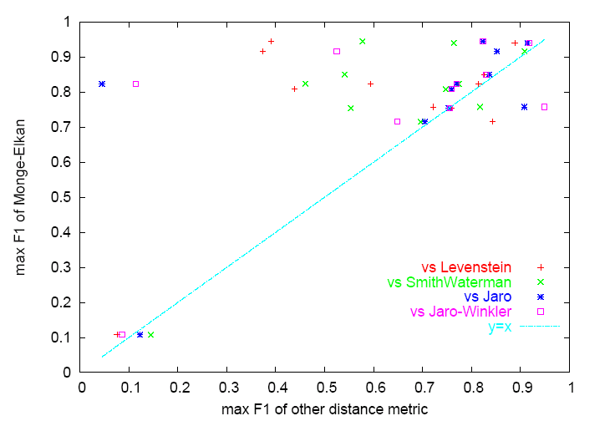
Results: Edit-distance variants
But Monge-Elkan is sometimes outperformed on specific datasets
Precision-recall for Monge-Elkan and one other method (Levenshtein) on a specific benchmark

Slide 30
SoftTFDF: A robust distance metric
We also compared edit-distance based and term-based methods, and evaluated a new “hybrid” method:
SoftTFIDF, for token sets S and T:
Extends TFIDF by including pairs of words in S and T that “almost” match—i.e., that are highly similar according to a second distance metric (the Jaro-Winkler metric, an edit-distance like metric).

Slide 31
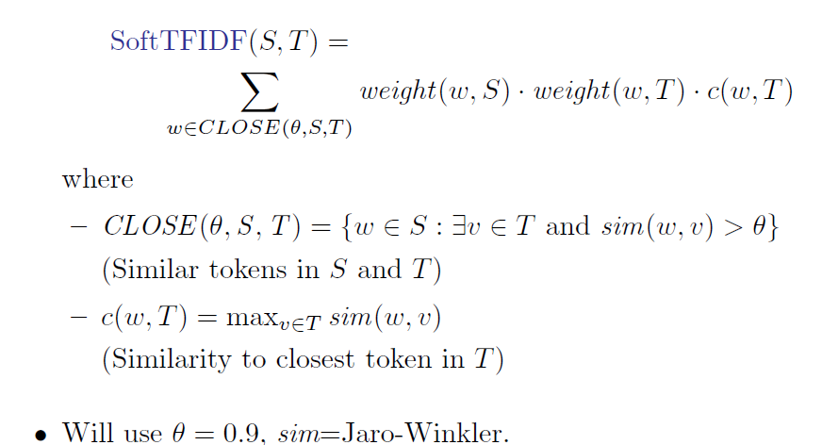

Slide 32
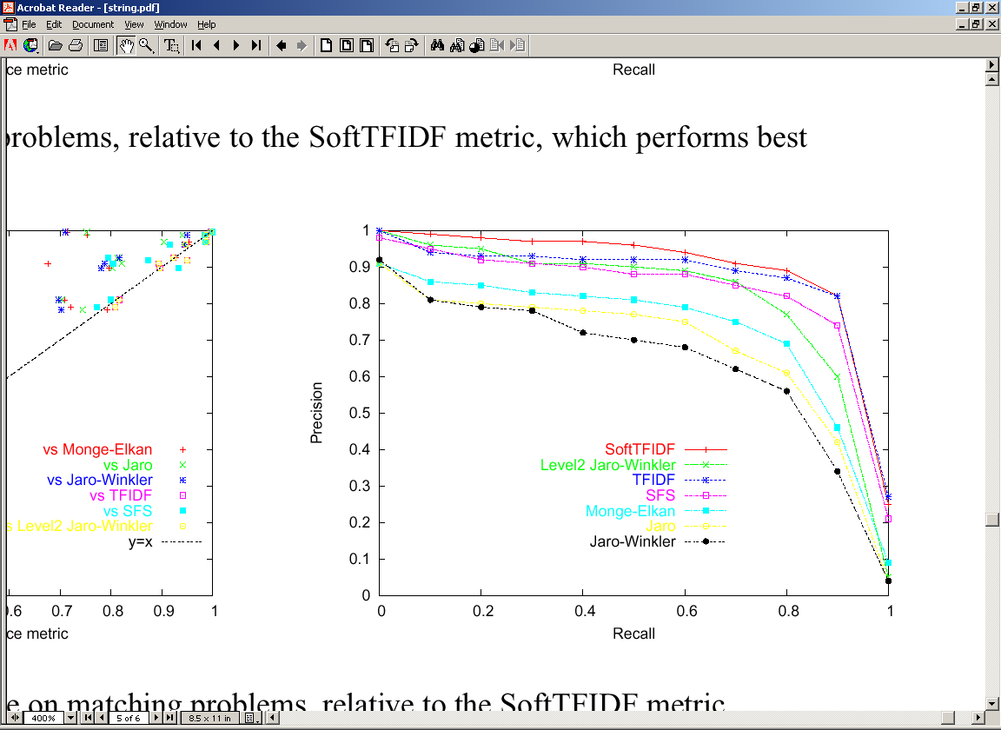
Comparing token-based, edit-distance, and hybrid distance metrics
SFS is a vanilla IDF weight on each token (circa 1959!)

Slide 33
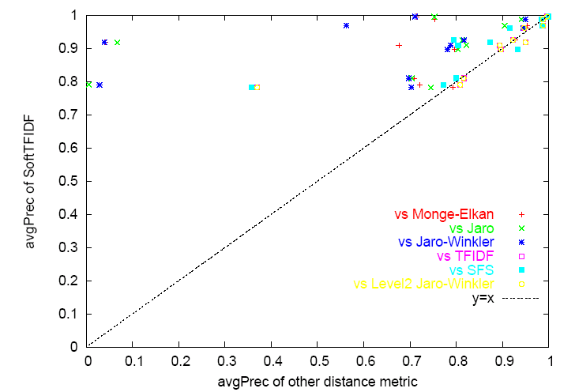
SoftTFIDF is a Robust Distance Metric

Slide 34
Outline
Why joins are important
Why similarity joins are important
Useful similarity metrics for sets and strings
Fast methods for K-NN and similarity joins
  Blocking
  Indexing
  Short-cut algorithms
  Parallel implementation

Slide 35
Blocking
Basic idea:
  heuristically find candidate pairs that are likely to be similar
  only compare candidates, not all pairs
Variant 1:
  pick some features such that
    pairs of similar names are likely to contain at least one such feature (recall)
    the features don’t occur too often (precision)
    example: not-too-frequent character n-grams
  build inverted index on features and use that to generate candidate pairs

Slide 36
Blocking in MapReduce
For each string s
  For each char 4-gram g in s
      Output pair (g,s)
Sort and reduce the output:
  For each g
    For each value s associated with g
      Load first K value into memory buffer
    If buffer was big enough:
      output (s,s’) for each distinct pair of s’s.
    Else
      skip this g

Slide 37
Blocking
Basic idea:
  heuristically find candidate pairs that are likely to be similar
  only compare candidates, not all pairs
Variant 2:
  pick some numeric feature f such that similar pairs will have similar values of f
  example: length of string s
  sort all strings s by f(s)
  Go through sorted list, and output all pairs with similar values
    use a fixed-size sliding window over the sorted list

Slide 38
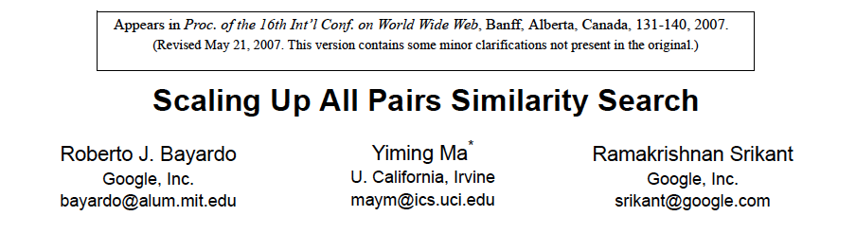
Key idea:
  try and find all pairs x,y with similarity over a fixed threshold
  use inverted indices and exploit fact that similarity function is a dot product

Slide 39
A* (best-first) search for best K paths
Find shortest path between start n₀ and goal n_{g}:goal(n_{g})
  Define f(n) = g(n) + h(n)
    g(n) = MinPathLength(n₀ ,n)|
    h(n) = lower-bound of path length from n to n_{g}
  Algorithm:
    OPEN= {n₀ }
    While OPEN is not empty:
      remove “best” (minimal f) node n from OPEN
      if goal(n), output path n₀→n
        and stop if you’ve output K answers
      otherwise, add CHILDREN(n) to OPEN
        and record their MinPathLength parents
        …note this is easy for a tree
h is “admissible” and A* will always return the K lowest-cost paths

Slide 40
A* (best-first) search for good paths
Find all paths shorter than t between start n₀ and goal n_{g}:goal(n_{g})
  Define f(n) = g(n) + h(n)
    g(n) = MinPathLength(n₀ ,n)|
    h(n) = lower-bound of path length from n to n_{g}
  Algorithm:
    OPEN= {n₀ }
    While OPEN is not empty:
      remove “best” (minimal f) node n from OPEN
      if goal(n), output path n₀→n
        and stop if you’ve output K answers
      otherwise, add CHILDREN(n) to OPEN
        unless there’s no way its score will be low enough
h is “admissible” and A* will always return the K lowest-cost paths

Slide 41
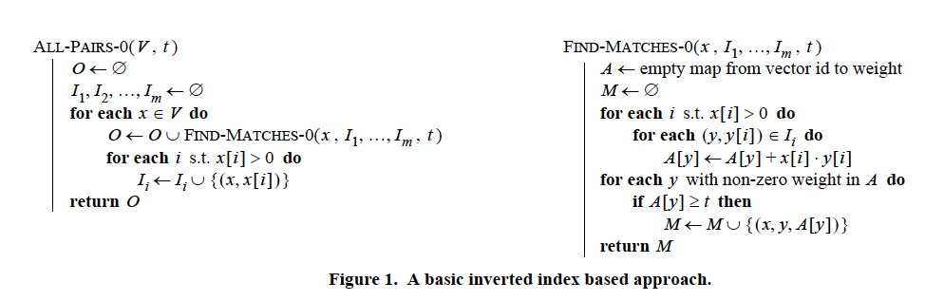
Build index on-the-fly
  When finding matches for x consider y before x in ordering
Keep x[i] in inverted index for i
  so you can find dot product dot(x,y) without using y

Slide 42
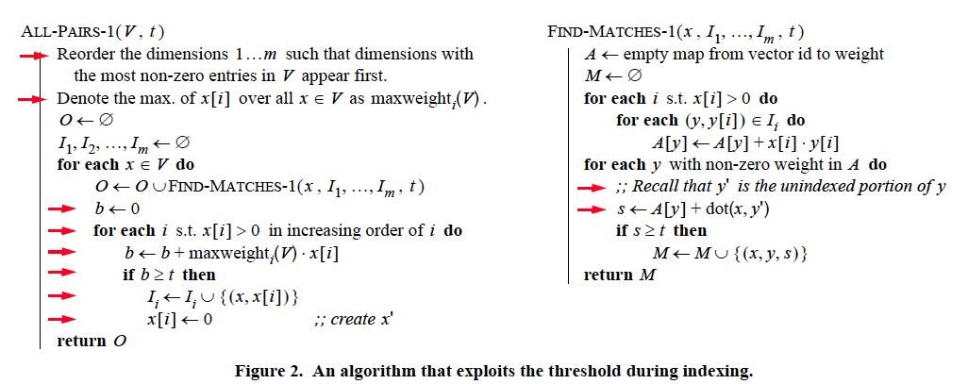
maxweight_{i}(V) * x[i] >= best score for matching on i
x[i] should be x’ here – x’ is the unindexed part of x
Build index on-the-fly
  only index enough of x so that you can be sure to find it
    score of things only reachable by non-indexed fields < t
  total mass of what you index needs to be large enough
  correction:
    indexes no longer have enough info to compute dot(x,y)
  ordering common→rare features is heuristic (any order is ok)

Slide 43
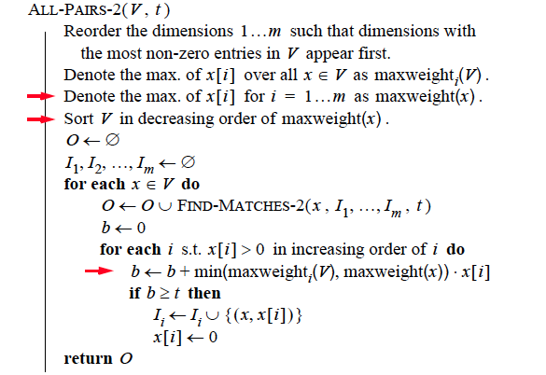
Order all the vectors x by maxweight(x) – now matches y to indexed parts of x will have lower “best scores for i”

Slide 44
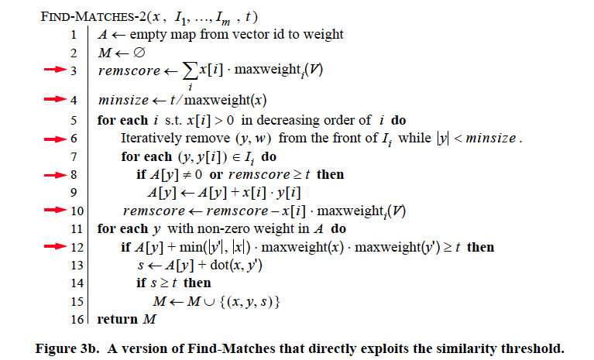
best score for matching the unindexed part of x
update to reflect the all-ready examined part of x
Trick 1: bound y’s possible score to the unindexed part of x, plus the already-examined part of x, and skip y’s if this is too low

Slide 45
upper bound on dot(x,y’)
Trick 2: use cheap upper-bound to see if y is worthy of having dot(x,y) computed.

Slide 46
y is too small to match x well
really we will update a start counter for I
Trick 3: exploit this fact: if dot(x,y)>t, then |y|>t/maxweight(x)

Slide 47
Large data version
Start at position 0 in the database
Build inverted indexes till memory is full
  Say at position m<<n
Then switch to match-only mode
  Match rest of data only to items up to position m
Then restart the process at position m instead of position 0 and repeat…..

Slide 48
Experiments
QSC (Query snippet containment)
  term a in vector for b if a appears >=k times in a snippet using search b
  5M queries, top 20 results, about 2Gb
Orkut
  vector is user, terms are friends
  20M nodes, 2B non-zero weights
  need 8 passes over data to completely match
DBLP
  800k papers, authors + title words

Slide 49
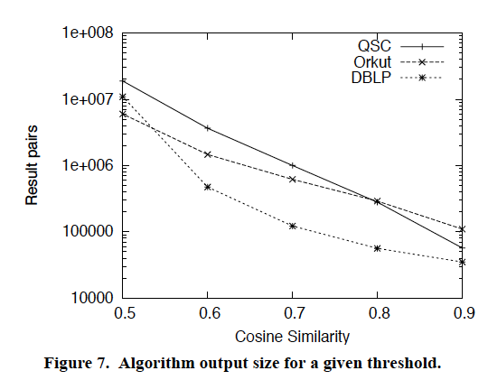
Results

Slide 50
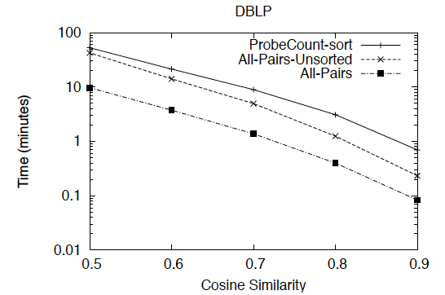
Results

Slide 51
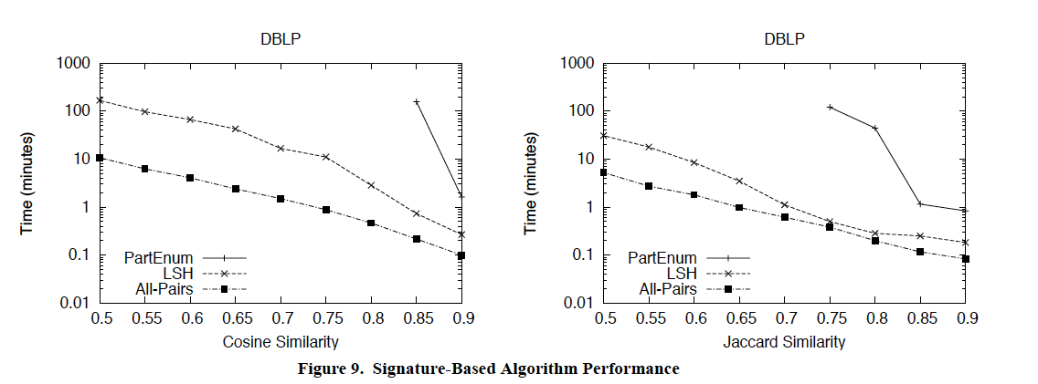
Results
LSH tuned for 95% recall rate

Slide 52
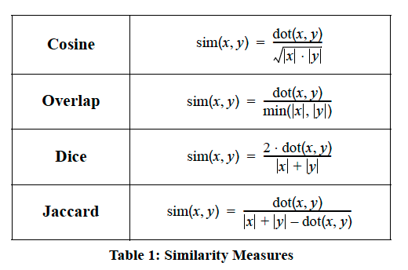
Extension
(requires some work on upper bounds)

Slide 53
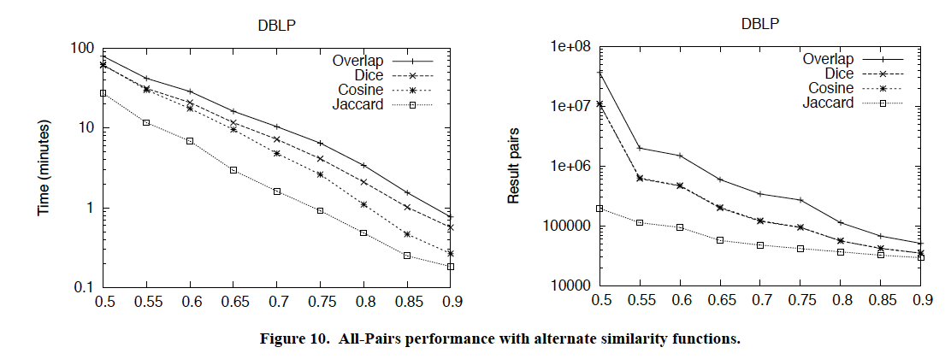
Results

Slide 54
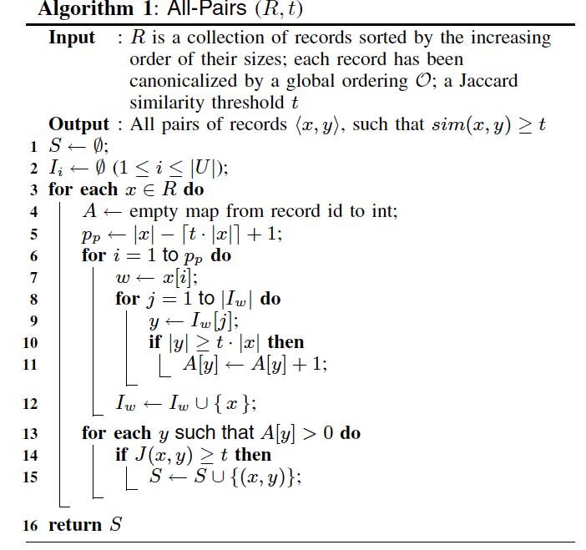
Simplification – for Jaccard similarity only

Slide 55
Parallelizing Similarity Joins
Blocking and comparing
  Map:
    For each record with id i, and blocking attribute values a_{i},b_{i},c_{i},d_{i}
      Output
        a_{i},i
        b_{i},i
      …
  Reduce:
    For each line
      a_{m}: i₁,…,i_{k}
    Output all id pairs i_{j}<i_{k}
  Map/reduce to remove duplicates
Now given pairs i_{j}<i_{k} we want to compute similarities
Send messages to data tables to collect the actual contents of the records
Compute similarities

Slide 56
Parallel Similarity Joins
Generally we can decompose most algorithms to index-building, candidate-finding, and matching
These can usually be parallelized

Slide 57
MAP
Output i, (id(x), x[i])
Output id(x), x’
Minus calls to find-matches, this is just building a (reduced) index…and a reduced representation x’ of unindexed stuff

Slide 58
MAP through reduced inverted indices to find x, y candidates, maybe with an upper bound on score….

Slide 59

SIGMOD 2010

