Slide 1

In the once upon a time days of the First Age of Magic, the prudent sorcerer regarded his own true name as his most valued possession but also the greatest threat to his continued good health, for--the stories go--once an enemy, even a weak unskilled enemy, learned the sorcerer's true name, then routine and widely known spells could destroy or enslave even the most powerful. As times passed, and we graduated to the Age of Reason and thence to the first and second industrial revolutions, such notions were discredited. Now it seems that the Wheel has turned full circle (even if there never really was a First Age) and we are back to worrying about true names again:
The first hint Mr. Slippery had that his own True Name might be known--and, for that matter, known to the Great Enemy--came with the appearance of two black Lincolns humming up the long dirt driveway ... Roger Pollack was in his garden weeding, had been there nearly the whole morning.... Four heavy-set men and a hard-looking female piled out, started purposefully across his well-tended cabbage patch.…
This had been, of course, Roger Pollack's great fear. They had discovered Mr. Slippery's True Name and it was Roger Andrew Pollack TIN/SSAN 0959-34-2861.
Notes:
To do

Slide 2
Similarity Joins for Strings and Sets
William Cohen

Slide 3
Outline
Why joins are important
Why similarity joins are important
Useful similarity metrics for sets and strings
Fast methods for K-NN and similarity joins
  Blocking
  Indexing
  Short-cut algorithms
  Parallel implementation

Slide 4
Why Joins Are So Cool

Slide 5
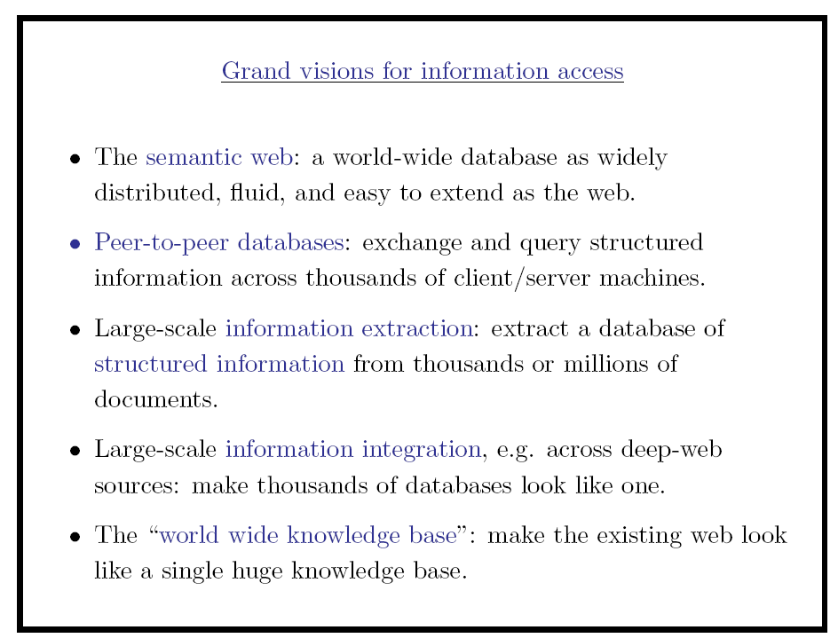

Slide 6
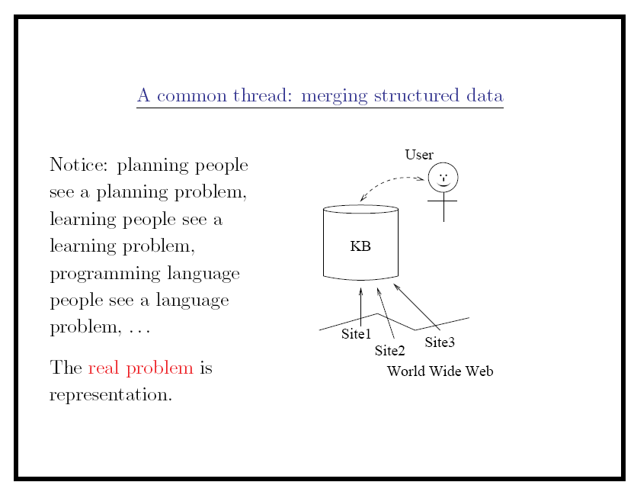

Slide 7
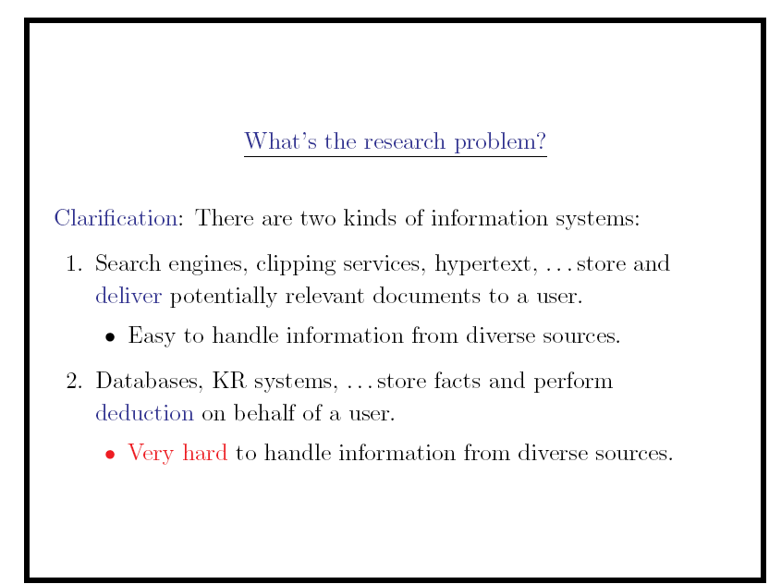

Slide 8
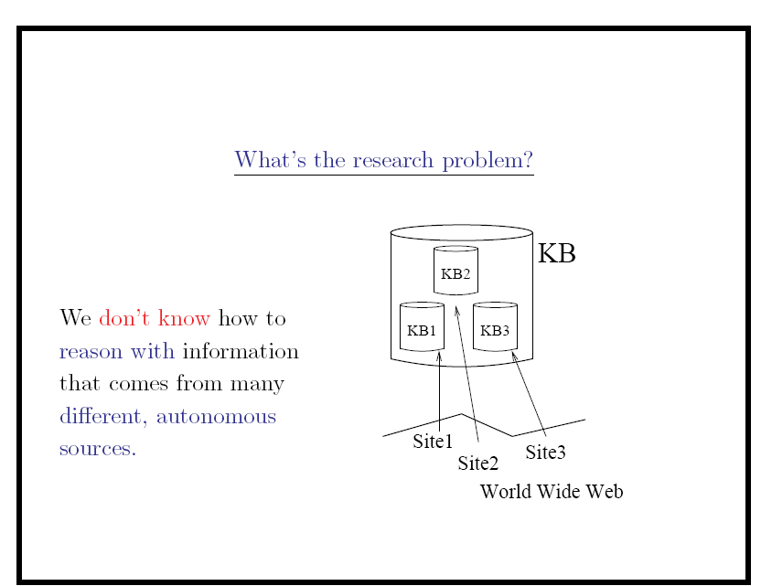

Slide 9
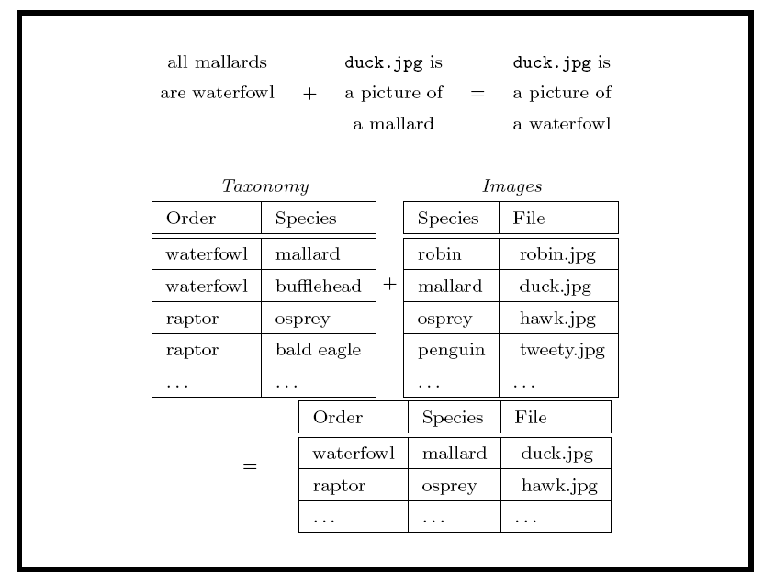

Slide 10
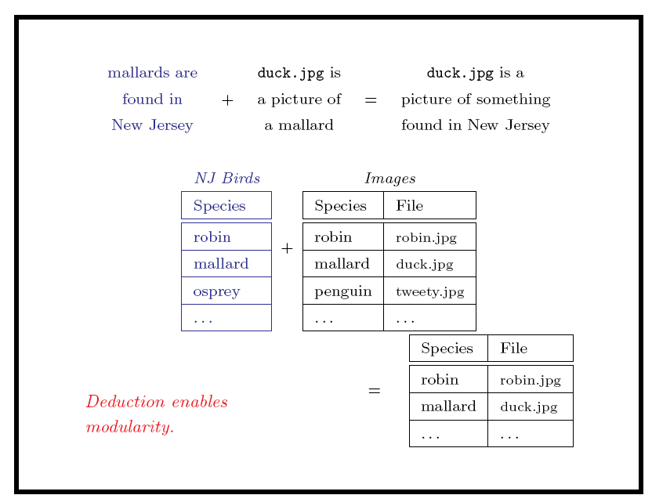

Slide 11
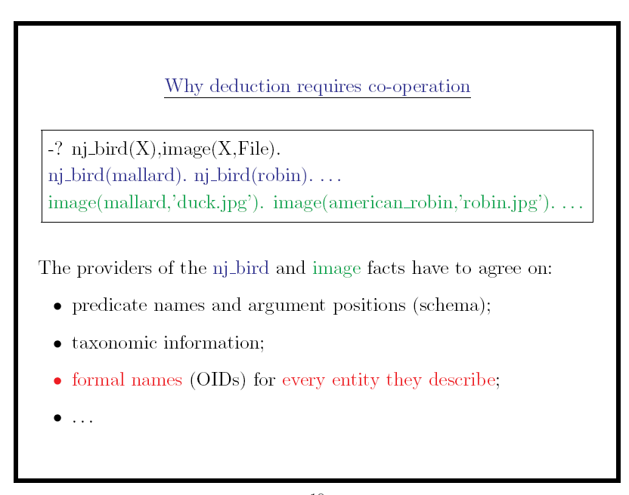

Slide 12
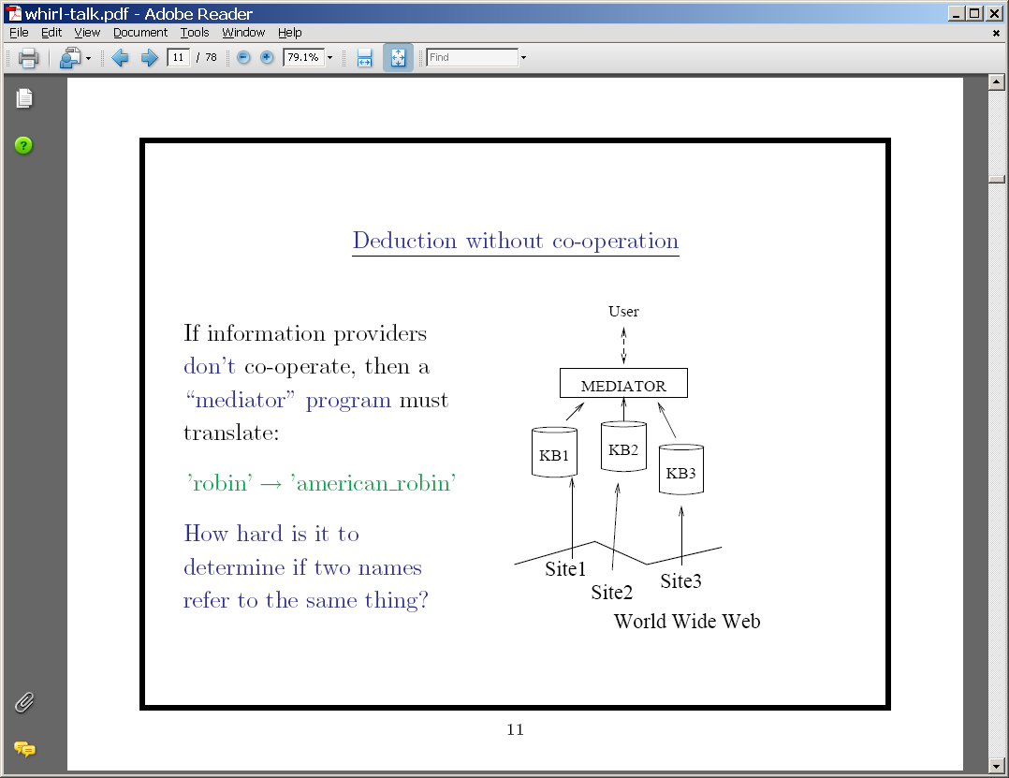

Slide 13
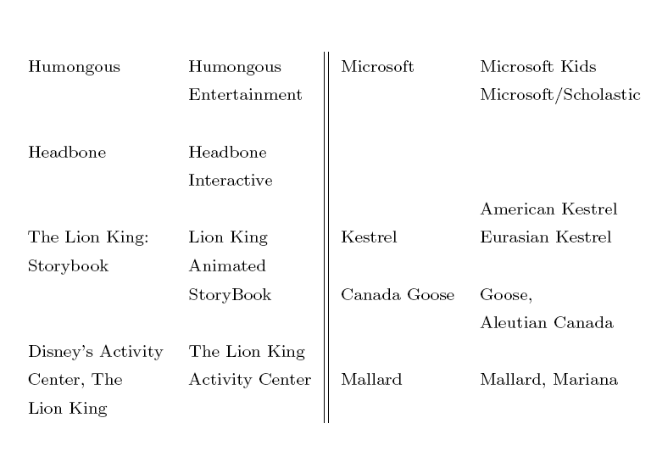

Slide 14


When are two entities the same?
Bell Labs
Bell Telephone Labs
AT&T Bell Labs
A&T Labs
AT&T Labs—Research
AT&T Labs Research, Shannon Laboratory
Shannon Labs
Bell Labs Innovations
Lucent Technologies/Bell Labs Innovations
[1925]
History of Innovation: From 1925 to today, AT&T has attracted some of the world's greatest scientists, engineers and developers…. [www.research.att.com]
Bell Labs Facts: Bell Laboratories, the research and development arm of Lucent Technologies, has been operating continuously since 1925… [bell-labs.com]

Slide 15
Outline
Why joins are important (and non-trivial)
Why similarity joins are important
Useful similarity metrics for sets and strings
Fast methods for K-NN and similarity joins
  Blocking
  Indexing
  Short-cut algorithms
  Parallel implementation

Slide 16
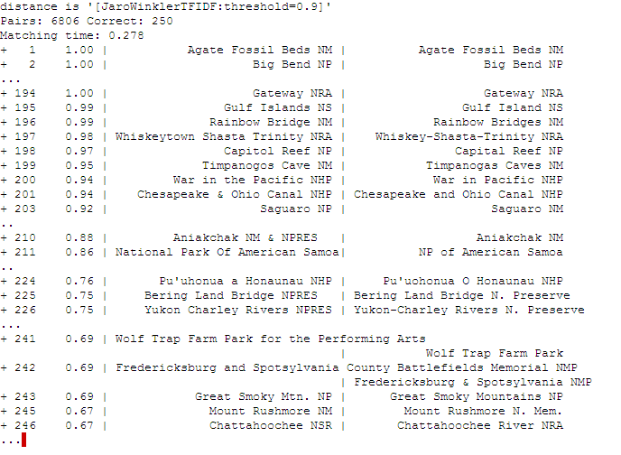
Semantic Joining with Multiscale Statistics
William Cohen
Katie Rivard, Dana Attias-Moshevitz
CMU

Slide 17
Deduction via co-operation
User
Economic issues:
Who pays for integration? Who tracks errors & inconsistencies? Who fixes bugs? Who pushes for clarity in underlying concepts and object identifiers?
Standards approach → publishers are responsible → publishers pay
Mediator approach: 3rd party does the work, agnostic as to cost
Integrated KB
Site1
Site3
Site2
KB1
KB3
KB2
Standard Terminology

Slide 18

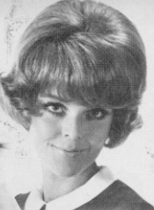
Traditional approach:
normalize and join
Linkage
Queries
Uncertainty about what to link
must be decided by the integration
system, not the end user

Slide 19
WHIRL approach:
SELECT R.a,S.a,S.b,T.b FROM R,S,T
WHERE R.a=S.a and S.b=T.b
Link items as
needed by Q
Query Q
R.a | S.a | S.b | T.b
Anhai | Anhai | Doan | Doan
Dan | Dan | Weld | Weld
Strongest links: those agreeable to most users
Weaker links: those agreeable to some users
William | Will | Cohen | Cohn
Steve | Steven | Minton | Mitton
even weaker links…
William | David | Cohen | Cohn

Slide 20
WHIRL approach:
SELECT R.a,S.a,S.b,T.b FROM R,S,T
WHERE R.a~S.a and S.b~T.b (~ TFIDF-similar)
Link items as
needed by Q
Query Q
R.a | S.a | S.b | T.b
Anhai | Anhai | Doan | Doan
Dan | Dan | Weld | Weld
Incrementally produce a ranked list of possible links, with “best matches” first. User (or downstream process) decides how much of the list to generate and examine.
William | Will | Cohen | Cohn
Steve | Steven | Minton | Mitton
William | David | Cohen | Cohn

Slide 21
WHIRL queries
Assume two relations:
  review(movieTitle,reviewText): archive of reviews
  listing(theatre, movieTitle, showTimes, …): now showing
The Hitchhiker’s Guide to the Galaxy, 2005 | This is a faithful re-creation of the original radio series – not surprisingly, as Adams wrote the screenplay ….
Men in Black, 1997 | Will Smith does an excellent job in this …
Space Balls, 1987 | Only a die-hard Mel Brooks fan could claim to enjoy …
… | …
Star Wars Episode III | The Senator Theater | 1:00, 4:15, & 7:30pm.
Cinderella Man | The Rotunda Cinema | 1:00, 4:30, & 7:30pm.
… | … | …

Slide 22
WHIRL queries
“Find reviews of sci-fi comedies [movie domain]
  FROM review SELECT * WHERE r.text~’sci fi comedy’
  (like standard ranked retrieval of “sci-fi comedy”)
“ “Where is [that sci-fi comedy] playing?”
  FROM review as r, LISTING as s, SELECT *
  WHERE r.title~s.title and r.text~’sci fi comedy’
  (best answers: titles are similar to each other – e.g., “Hitchhiker’s Guide to the Galaxy” and “The Hitchhiker’s Guide to the Galaxy, 2005” and the review text is similar to “sci-fi comedy”)

Slide 23
WHIRL queries
Similarity is based on TFIDF➔ rare words are most important.
Search for high-ranking answers uses inverted indices….
- It is easy to find the (few) items that match on “important” terms
- Search for strong matches can prune “unimportant terms”
Star Wars Episode III
Hitchhiker’s Guide to the Galaxy
Cinderella Man
…
The Hitchhiker’s Guide to the Galaxy, 2005
Men in Black, 1997
Space Balls, 1987
…
hitchhiker | movie00137
the | movie001,movie003,movie007,movie008, movie013,movie018,movie023,movie0031, …..
Years are common in the review archive, so have low weight

Slide 24
A* (best-first) search
Find shortest path between start n₀ and goal n_{g}:goal(n_{g})
  Define f(n) = g(n) + h(n)
    g(n) = MinPathLength(n₀ ,n)|
    h(n) = estimate of path length from n to n_{g}
  Algorithm:
    OPEN= {n₀ }
    While OPEN is not empty:
      remove “best” (minimal f) node n from OPEN
      if goal(n), output path n₀→n and stop
      otherwise, add CHILDREN(n) to OPEN
        and record their MinPathLength parents

Slide 25

empty circles = open set, filled = closed set; color = distance from the start (the greener, the further)

Slide 26
A* (best-first) search
Find shortest path between start n₀ and goal n_{g}:goal(n_{g})
  Define f(n) = g(n) + h(n)
    g(n) = MinPathLength(n₀ ,n)|
    h(n) = lower-bound of path length from n to n_{g}
  Algorithm:
    OPEN= {n₀ }
    While OPEN is not empty:
      remove “best” (minimal f) node n from OPEN
      if goal(n), output path n₀→n and stop
      otherwise, add CHILDREN(n) to OPEN
        and record their MinPathLength parents
        …note this is easy for a tree
h is “admissible” and A* will always return the lowest-cost path

Slide 27
A* (best-first) search for best K paths
Find shortest path between start n₀ and goal n_{g}:goal(n_{g})
  Define f(n) = g(n) + h(n)
    g(n) = MinPathLength(n₀ ,n)|
    h(n) = lower-bound of path length from n to n_{g}
  Algorithm:
    OPEN= {n₀ }
    While OPEN is not empty:
      remove “best” (minimal f) node n from OPEN
      if goal(n), output path n₀→n
        and stop if you’ve output K answers
      otherwise, add CHILDREN(n) to OPEN
        and record their MinPathLength parents
        …note this is easy for a tree
h is “admissible” and A* will always return the K lowest-cost paths

Slide 28
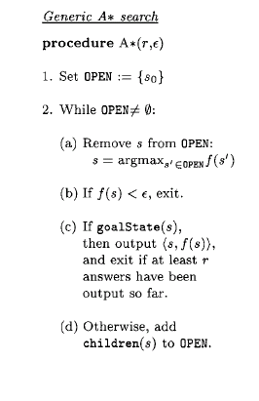
Inference in WHIRL
“Best-first” search: pick state s that is “best” according to f(s)
Suppose graph is a tree, and for all s, s’, if s’ is reachable from s then f(s)>=f(s’). Then A* outputs the globally best goal state s* first, and then next best, ...

Slide 29
Using A* For WHIRL Queries
Assume two relations:
  review(movieTitle,reviewText): archive of reviews
  listing(theatre, movieTitle, showTimes, …): now showing
The Hitchhiker’s Guide to the Galaxy, 2005 | This is a faithful re-creation of the original radio series – not surprisingly, as Adams wrote the screenplay ….
Men in Black, 1997 | Will Smith does an excellent job in this …
Space Balls, 1987 | Only a die-hard Mel Brooks fan could claim to enjoy …
… | …
Star Wars Episode III | The Senator Theater | 1:00, 4:15, & 7:30pm.
Cinderella Man | The Rotunda Cinema | 1:00, 4:30, & 7:30pm.
… | … | …

Slide 30
A* search to solve WHIRL queries
review(Title,Text),
Text ~ “sci fi comedy”
“Find reviews of sci-fi comedies [movie domain]
  FROM review SELECT * WHERE r.text~’sci fi comedy’
“ “Where is [that sci-fi comedy] playing?”
  FROM review as r, LISTING as s, SELECT *
  WHERE r.title~s.title and r.text~’sci fi comedy’
  (best answers: titles are similar to each other – e.g., “Hitchhiker’s Guide to the Galaxy” and “The Hitchhiker’s Guide to the Galaxy, 2005” and the review text is similar to “sci-fi comedy”)
Answer to Q is an assignment Θ to all the variables in Q
review(TitleA,Text),
listing( TitleB,Where,When),
Text ~ “sci fi comedy”,
TitleA ~ TitleB

Slide 31
Using A* For WHIRL Queries
review(TitleA,Text), listing(Where, TitleB,When),
Text ~ “sci fi comedy”, TitleA ~ TitleB
Menace II Society, 1993 | In this urban crime drama, directed by twin brothers Allen and Albert Hughes, a young street hustler …
Men in Black, 1997 | Will Smith does an excellent job in this campy sci-fi. With Jones playing straight man this comedy succeeds in …
Men in Tights, 1988 | Only a die-hard Mel Brooks fan could claim to enjoy …
… | …
The Kings Speech Impediment | The Senator Theater | 1:00, 4:15, & 7:30pm.
Hunger Games | The Rotunda Cinema | 1:00, 4:30, & 7:30pm.
Men In Black 3 | Leows Water Front | 7:00 pm

Slide 32
Using A* For WHIRL Queries
review(TitleA,Text), listing(TitleB,Where,When),
Text ~ “sci fi comedy”, TitleA ~ TitleB
Menace II Society, 1993 | In this urban crime drama, directed by twin brothers Allen and Albert Hughes, a young street hustler …
Men in Black, 1997 | Will Smith does an excellent job in this campy sci-fi. With Jones playing straight man this comedy succeeds in …
Men in Tights, 1988 | Only a die-hard Mel Brooks fan could claim to enjoy …
… | …
The Black Stallion - Director’s Cut | The Senator | 1:00, 4:15, & 7:30pm.
Hunger Games | The Rotunda Cinema | 1:00, 4:30, & 7:30pm.
Men In Black 3 | Leows Water Front | 7:00 pm

Slide 33
Using A* For WHIRL Queries
review(TitleA,Text), listing(TitleB,Where,When),
Text ~ “sci fi comedy”, TitleA ~ TitleB
Menace II Society, 1993 | In this urban crime drama, directed by twin brothers Allen and Albert Hughes, a young street hustler …
Men in Black, 1997 | Will Smith does an excellent job in this campy sci-fi. With Jones playing straight man this comedy succeeds in …
Men in Tights, 1988 | Only a die-hard Mel Brooks fan could claim to enjoy …
… | …
The Black Stallion - Director’s Cut | The Senator | 1:00, 4:15, & 7:30pm.
Hunger Games | The Rotunda Cinema | 1:00, 4:30, & 7:30pm.
Men In Black 3 | Leows Water Front | 7:00 pm

Slide 34
Using A* For WHIRL Queries
review(TitleA,Text), listing(TitleB,Where,When),
Text ~ “sci fi comedy”, TitleA ~ TitleB
Menace II Society, 1993 | In this urban crime drama, directed by twin brothers Allen and Albert Hughes, a young street hustler …
Men in Black, 1997 | Will Smith does an excellent job in this campy sci-fi. With Jones playing straight man this comedy succeeds in …
Men in Tights, 1988 | Only a die-hard Mel Brooks fan could claim to enjoy …
… | …
The Black Stallion - Director’s Cut | The Senator | 1:00, 4:15, & 7:30pm.
Hunger Games | The Rotunda Cinema | 1:00, 4:30, & 7:30pm.
Men In Black 3 | Leows Water Front | 7:00 pm

Slide 35
A* (best-first) search for best K paths
Find shortest path between start n₀ and goal n_{g}:goal(n_{g})
  Define f(n) = g(n) + h(n)
    g(n) = MinPathLength(n₀ ,n)|
    h(n) = lower-bound of path length from n to n_{g}
  Algorithm:
    OPEN= {n₀ }, where n₀ is an empty assignment to variables
    While OPEN is not empty:
      remove “best” (minimal f) node n from OPEN
      if goal(n), output path n₀→n
        and stop if you’ve output K answers
      otherwise, add CHILDREN(n) to OPEN
        where CHILDREN(n) binds a few more variables

Slide 36
A* (best-first) search for best K paths
Find shortest path between start n₀ and goal n_{g}:allVarsBound(n_{g})
  Define f(n) = g(n) + h(n)
    g(n) = MinPathLength(n₀ ,n)|
    h(n) = lower-bound of path length from n to n_{g}
  Algorithm:
    OPEN= {n₀ }, where n₀ is an empty assignment to variables
    While OPEN is not empty:
      remove “best” (minimal f) node n from OPEN
      if allVarsBound(n), output path n₀→n
        and stop if you’ve output K answers
      otherwise, add CHILDREN(n) to OPEN
        where CHILDREN(n) binds a few more variables

Slide 37
A* (best-first) search for best K paths
Find shortest path between start n₀ and goal n_{g}:allVarsBound(n_{g})
  Define f(n) = g(n) + h(n)
    g(n) = MinPathLength(n₀ ,n)|
    h(n) = lower-bound of path length from n to n_{g}
  Algorithm:
    OPEN= {n₀ }, where n₀ is an empty assignment θ and an empty “exclusion list” E
    While OPEN is not empty:
      remove “best” (minimal f) node n from OPEN
      if allVarsBound(n), output path n₀→n
        and stop if you’ve output K answers
      otherwise, add CHILDREN(n) to OPEN
        where CHILDREN(n) binds a few more variables

Slide 38
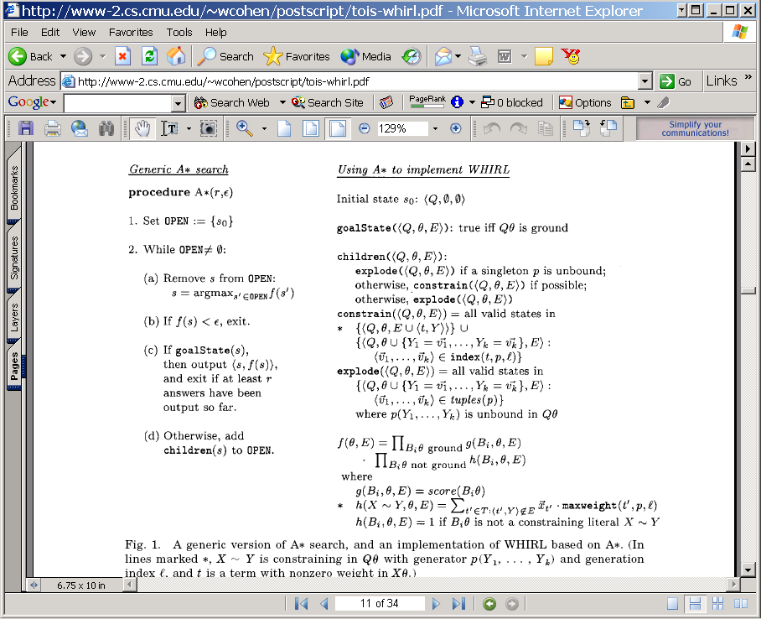
Inference in WHIRL
Explode p(X1,X2,X3): find all DB tuples <p,a1,a2,a3> for p and bind Xi to ai.
Constrain X~Y: if X is bound to a and Y is unbound,
  find DB column C to which Y should be bound
  pick a term t in X, find proper inverted index for t in C, and bind Y to something in that index
Keep track of t’s used previously, and don’t allow Y to contain one.

Slide 39
Inference in WHIRL
Adding to exclusions E means that upper bound h decreases
Looking at maxweight means that partial assignments that can’t match well are penalized

Slide 40
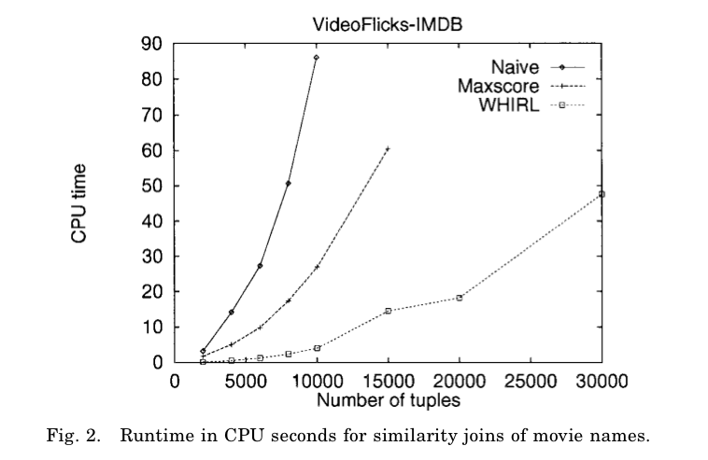
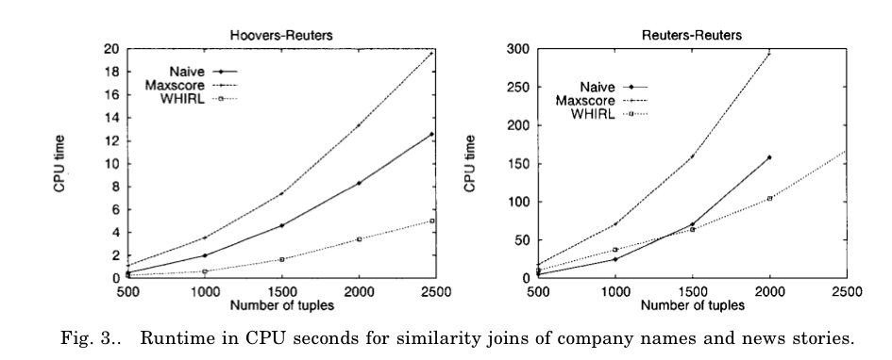

Slide 41
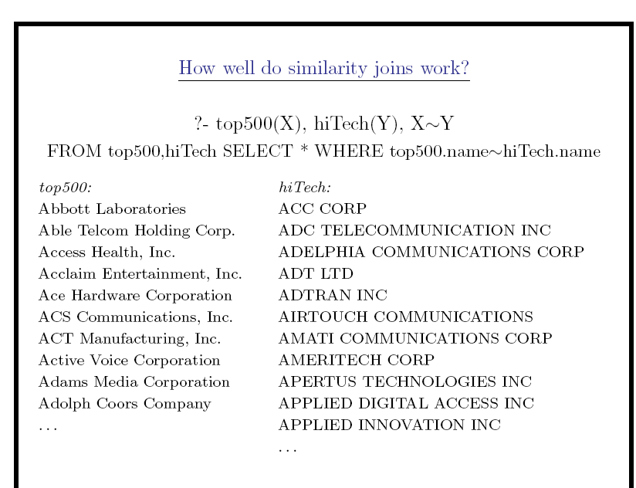

Slide 42
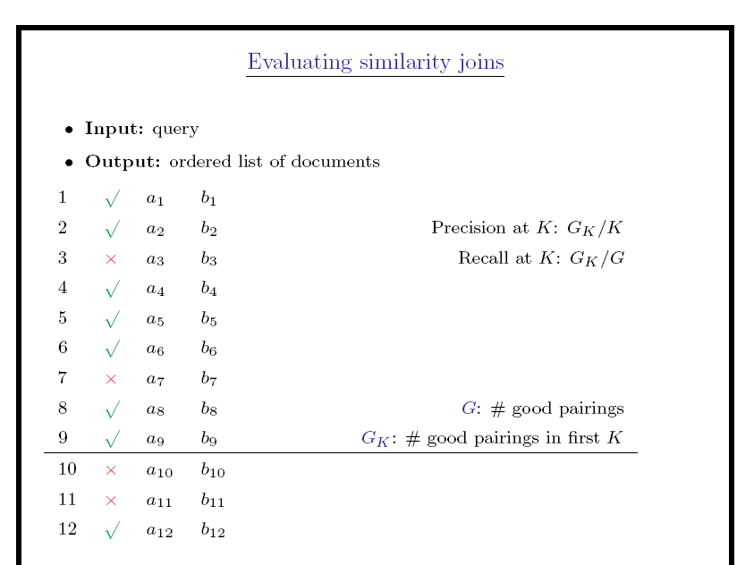

Slide 43
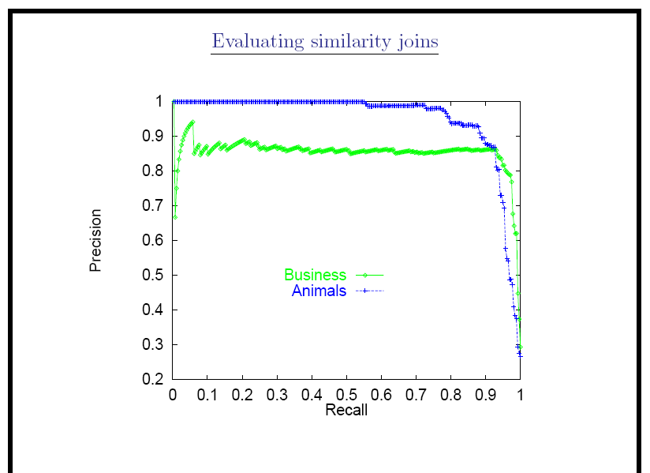
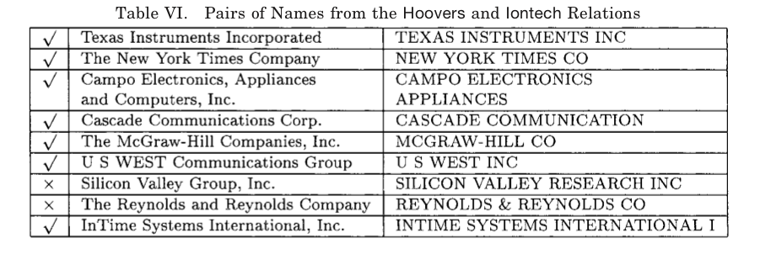

Slide 44
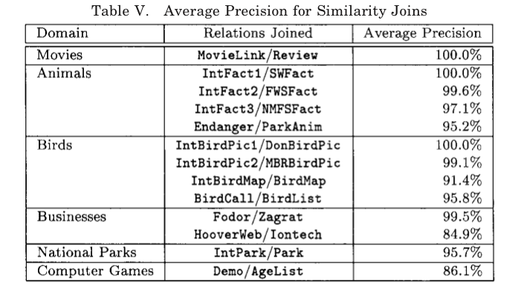

Slide 45
Aside: Why WHIRL’s query language was cool
Combination of cascading queries and getting top-k answers is very useful
  Highly selective queries:
    system can apply lots of constraints
    user can pick from a small set of well-constrained potential answers
  Very broad queries:
    system can cherry-pick and get the easiest/most obvious answers
    most of what the user sees is correct
Similar to joint inference schemes
Can handle lots of problems
  classification,

Slide 46
stopped

Slide 47
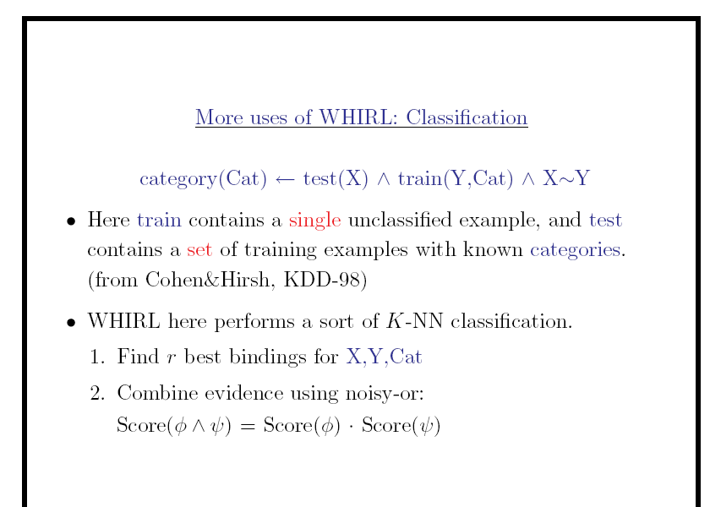

Slide 48
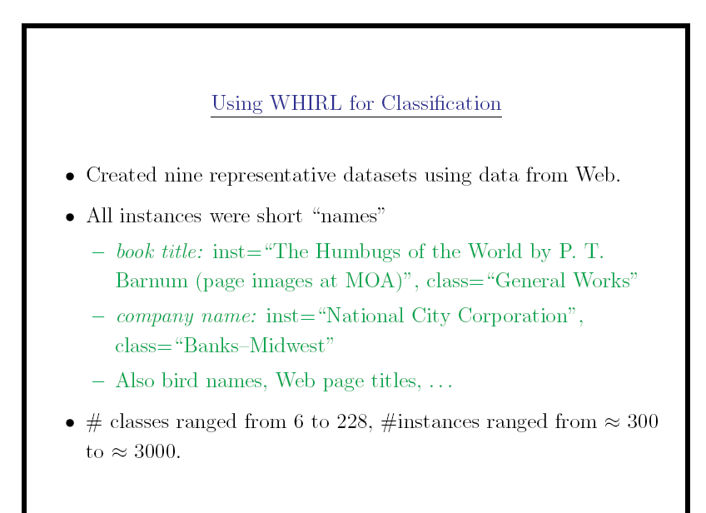

Slide 49
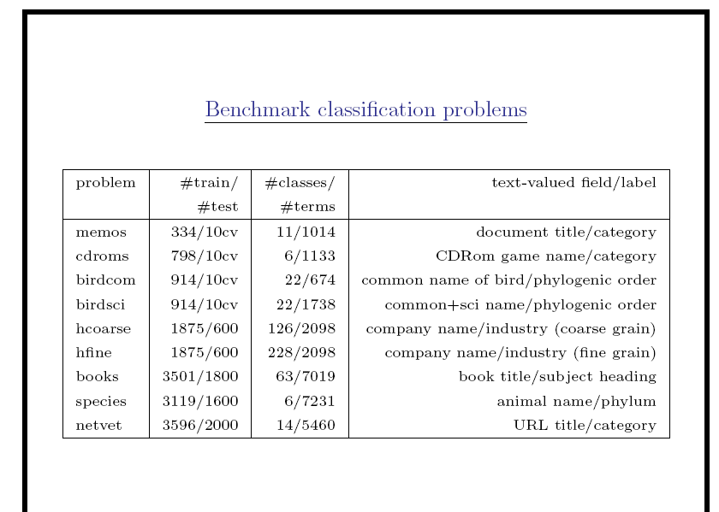

Slide 50
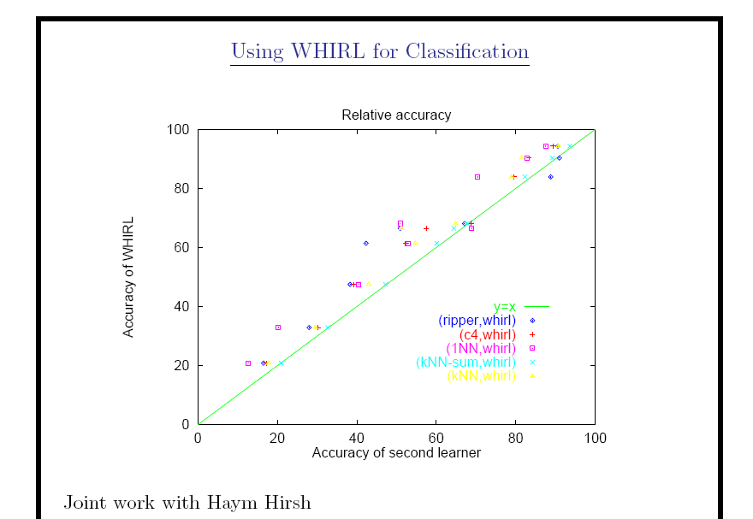

Slide 51
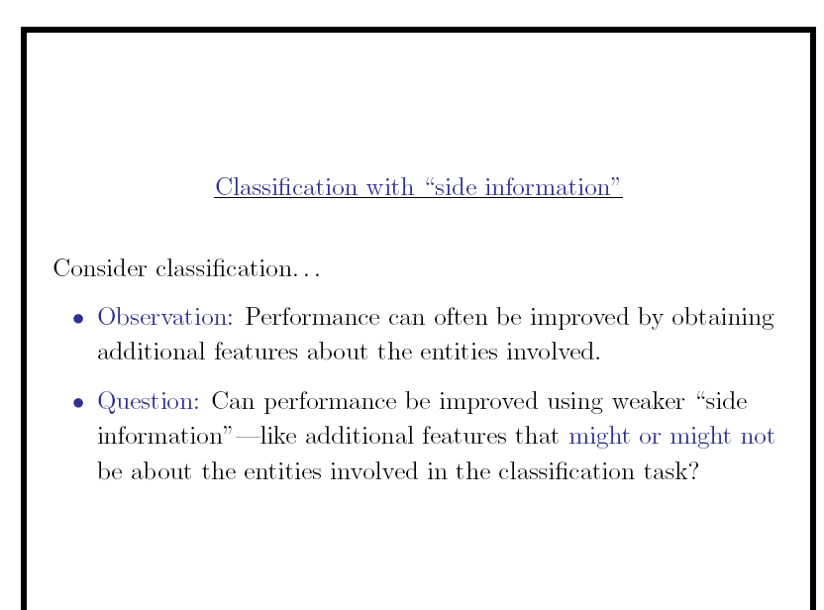

Slide 52
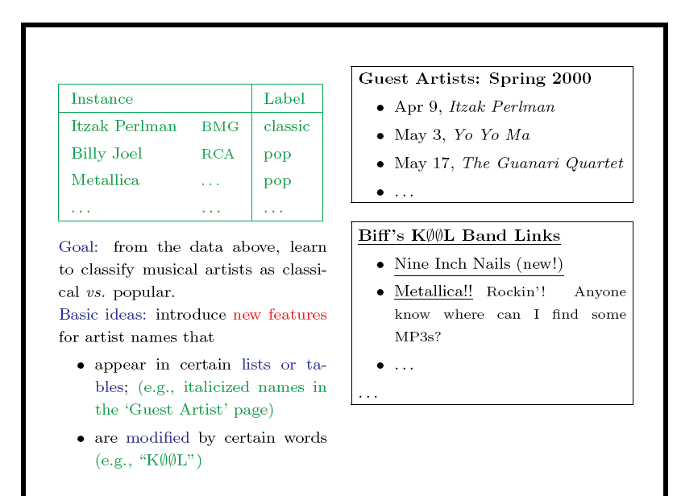

Slide 53
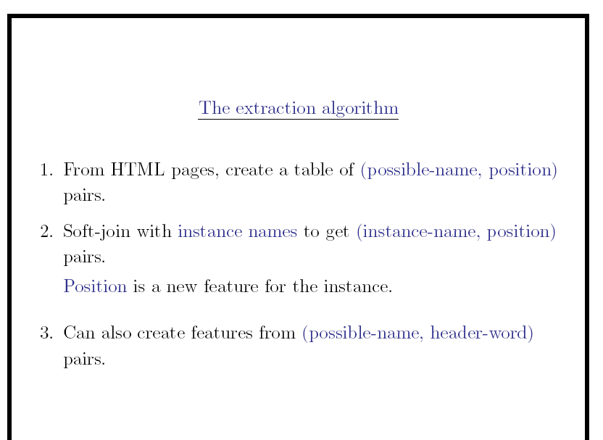

Slide 54
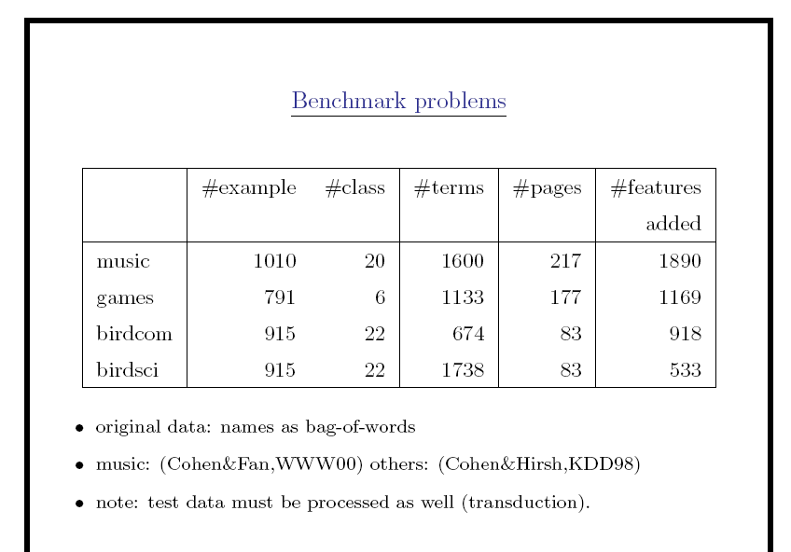

Slide 55
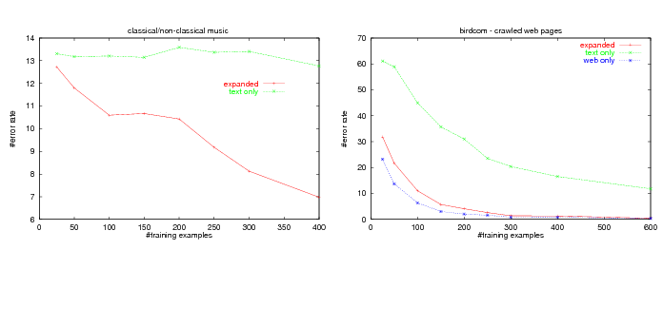

Slide 56
Epilogue
A few followup query systems to WHIRL
  ELIXIR, iSPARQL, …
“Joint inference” trick mostly ignored
  and/or rediscovered over and over
Lots and lots of work on similarity/distance metrics and efficient similarity joins
  much of which rediscovers A*-like tricks

Slide 57
Outline
Why joins are important
Why similarity joins are important
Useful similarity metrics for sets and strings
Fast methods for K-NN and similarity joins
  Blocking
  Indexing
  Short-cut algorithms
  Parallel implementation

